Slide 1
From Disks to Distributed
Our Journey of Database Evolution in the Cloud

Slide 2
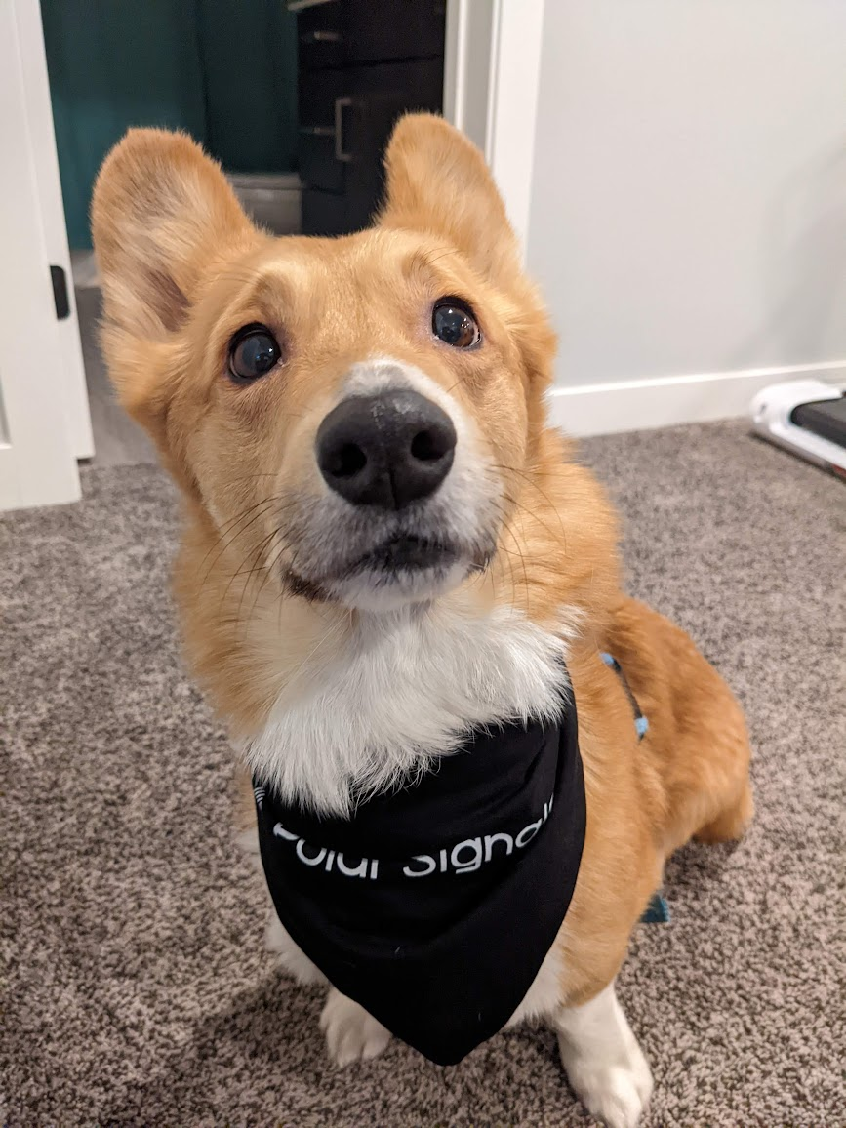
Dog Tax

Slide 3
Overview
What we’re building a database for
What wasn’t working with our database
How we rearchitechted
The open source projects that we built upon

Slide 4
Why we’re building a database

Slide 5
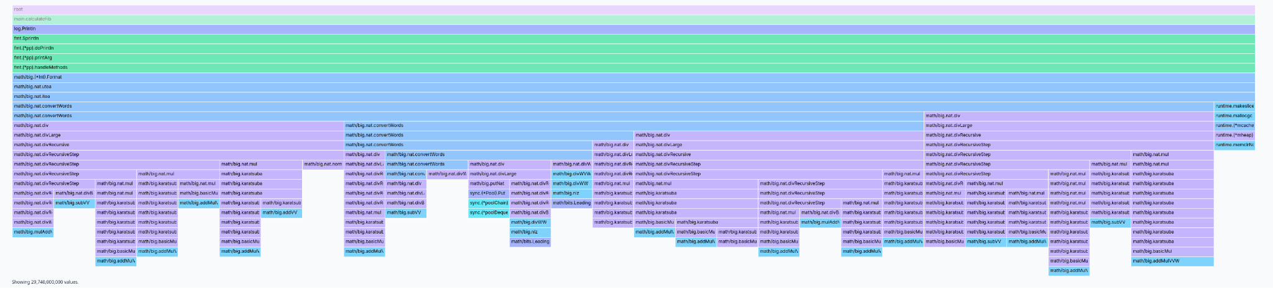
Continuous Profiling!

Slide 6
Goals
Easy to operate
Cost effective at scale
Storage and compute decoupled

Slide 7
Our Profiling Database

Slide 8
A database for stacks
func main() {
func1()
}
func func1() {
if reason {
return func2()
}
return func3()
}
Timestamp | Stacktrace | Value
1768334015 | main;func1;func2 | 2s
1768334020 | main;func1;func3 | 8s
1768334040 | … | …
Notes:
I promise this is not a talk about our product, but I’m going to give a quick overview of what we are building

Slide 9
Data shape of stacktraces
Repeated
Deeply nested
Immutable
Temporal
Non-relational
Dynamic Columns (labels describing where the data came from)
Write dominated

Slide 10
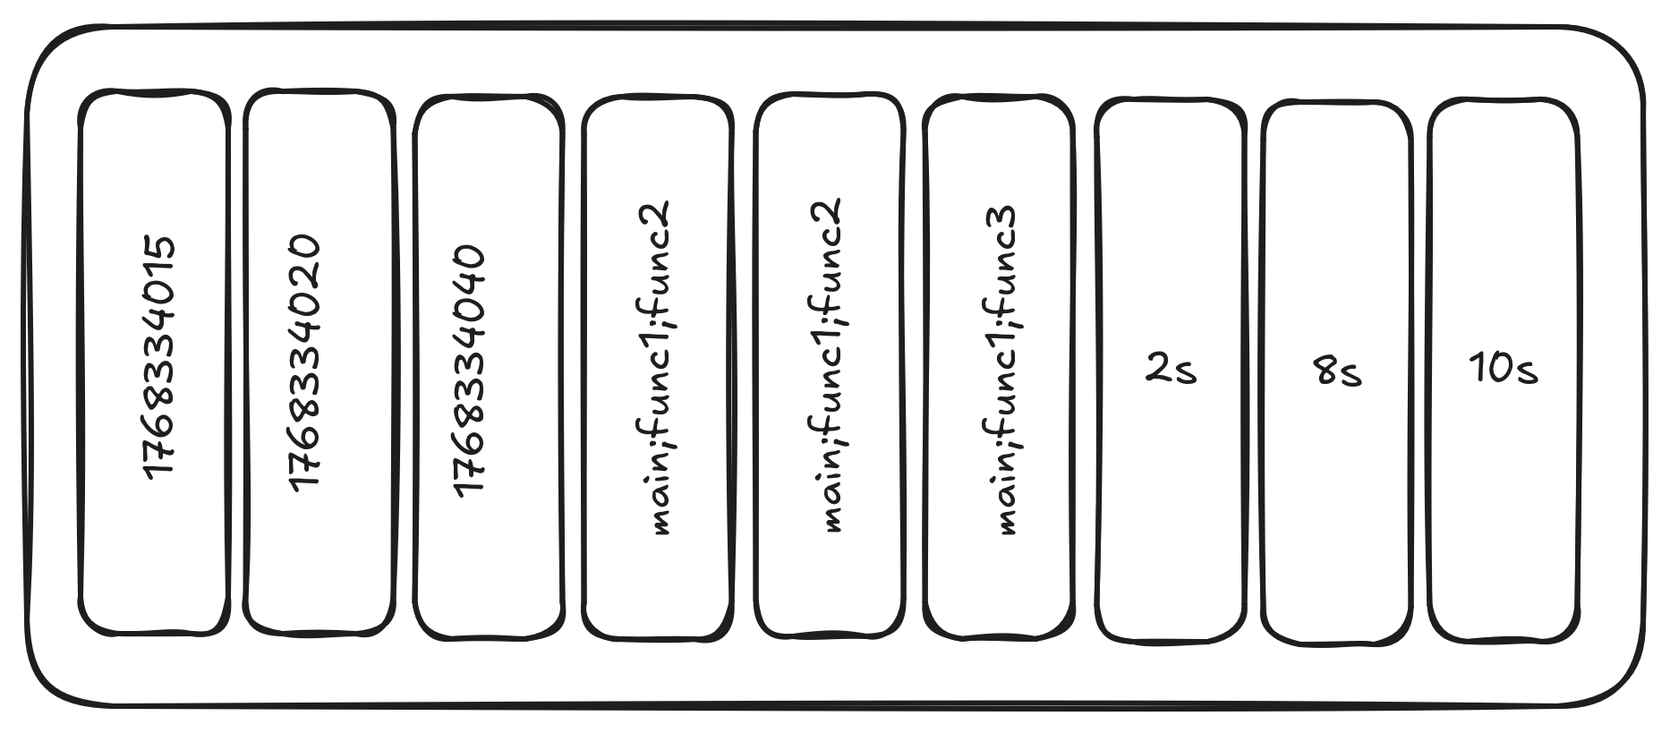


Columnar!
Timestamp | Stacktrace | Value
1768334015 | main;func1;func2 | 2s
1768334020 | main;func1;func3 | 8s
1768334040 | … | …

Slide 11
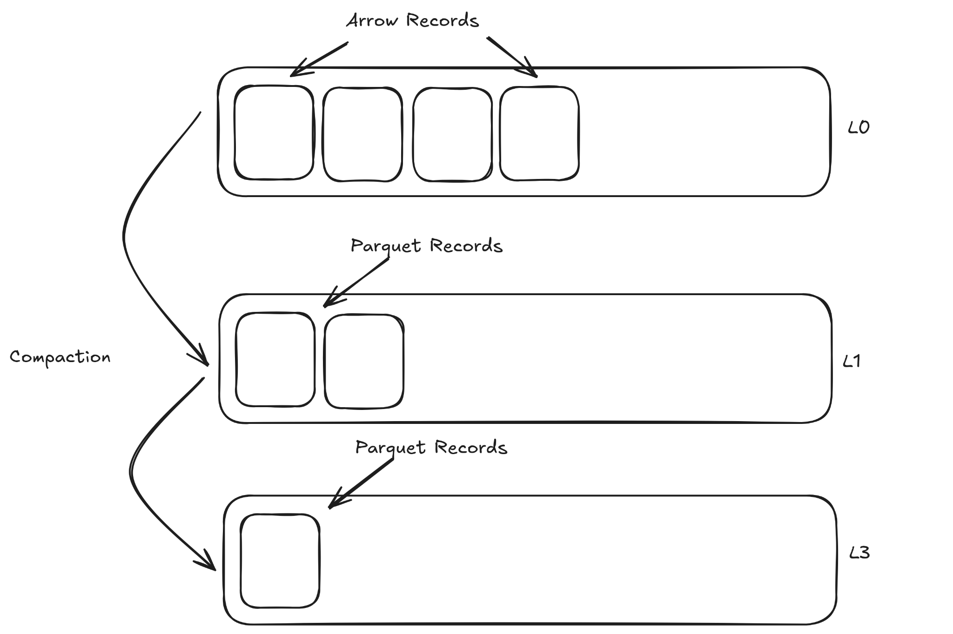

FrostDB github.com/polarsignals/frostdb

Slide 12
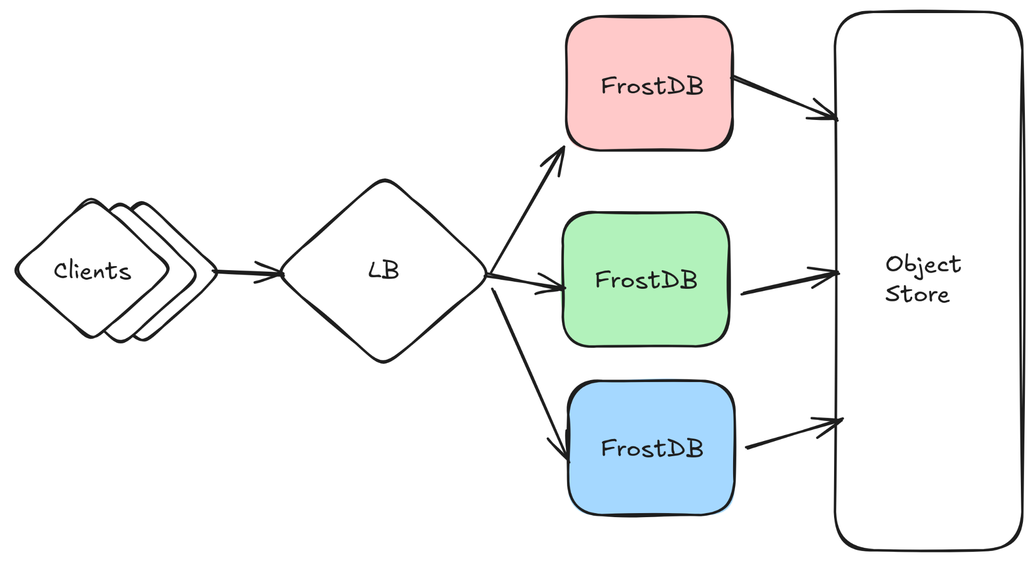
Sharded writes
Fan-in reads
Preemptible instances
Unable to write out memory in time for preemption

Slide 13
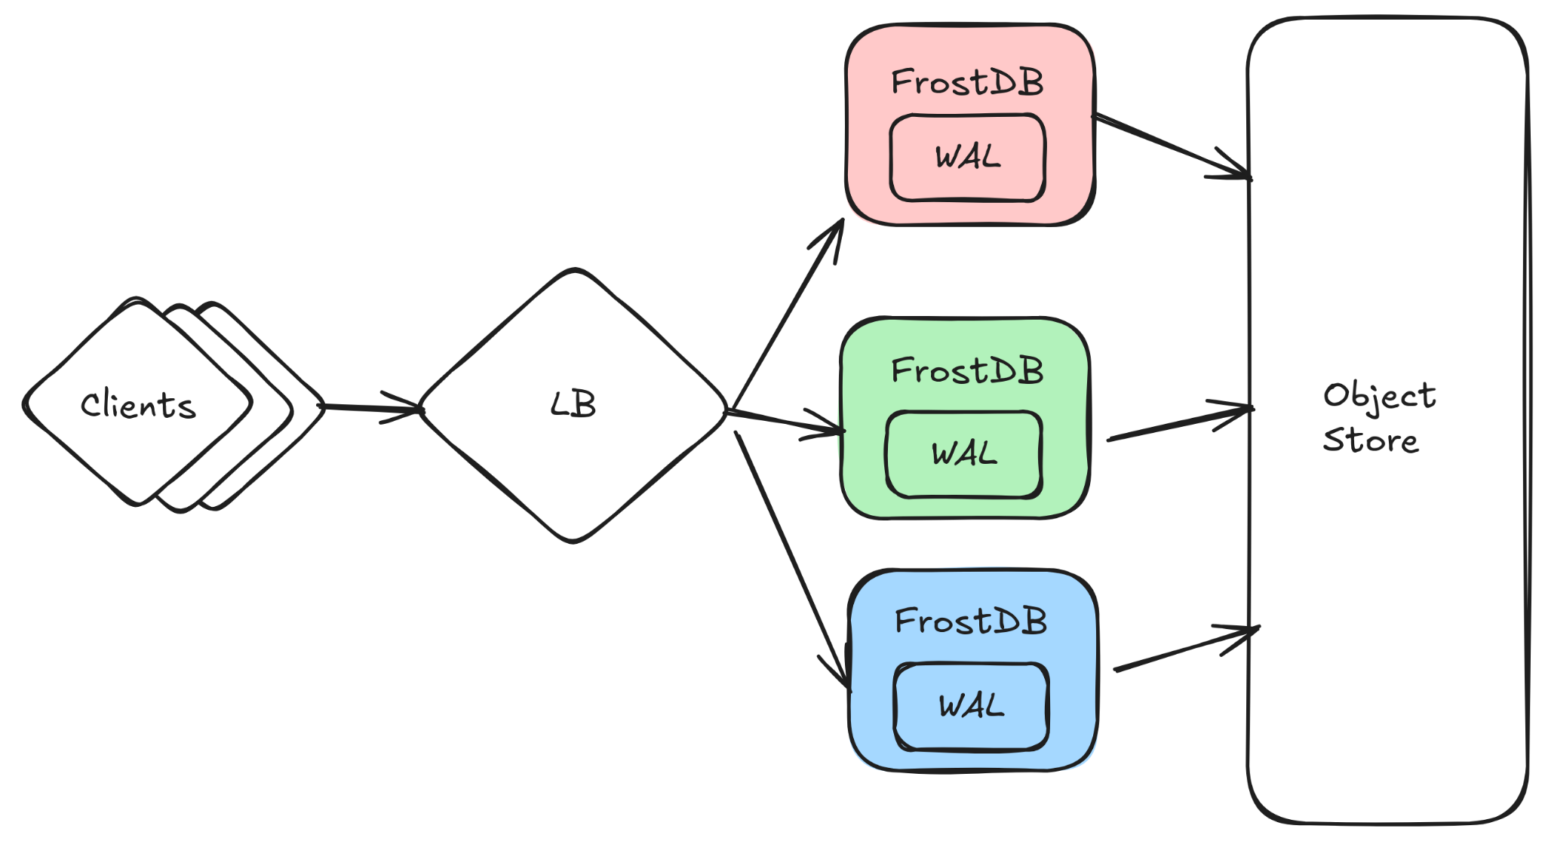
Write ahead log for durability
Data is unavailable during replay

Slide 14
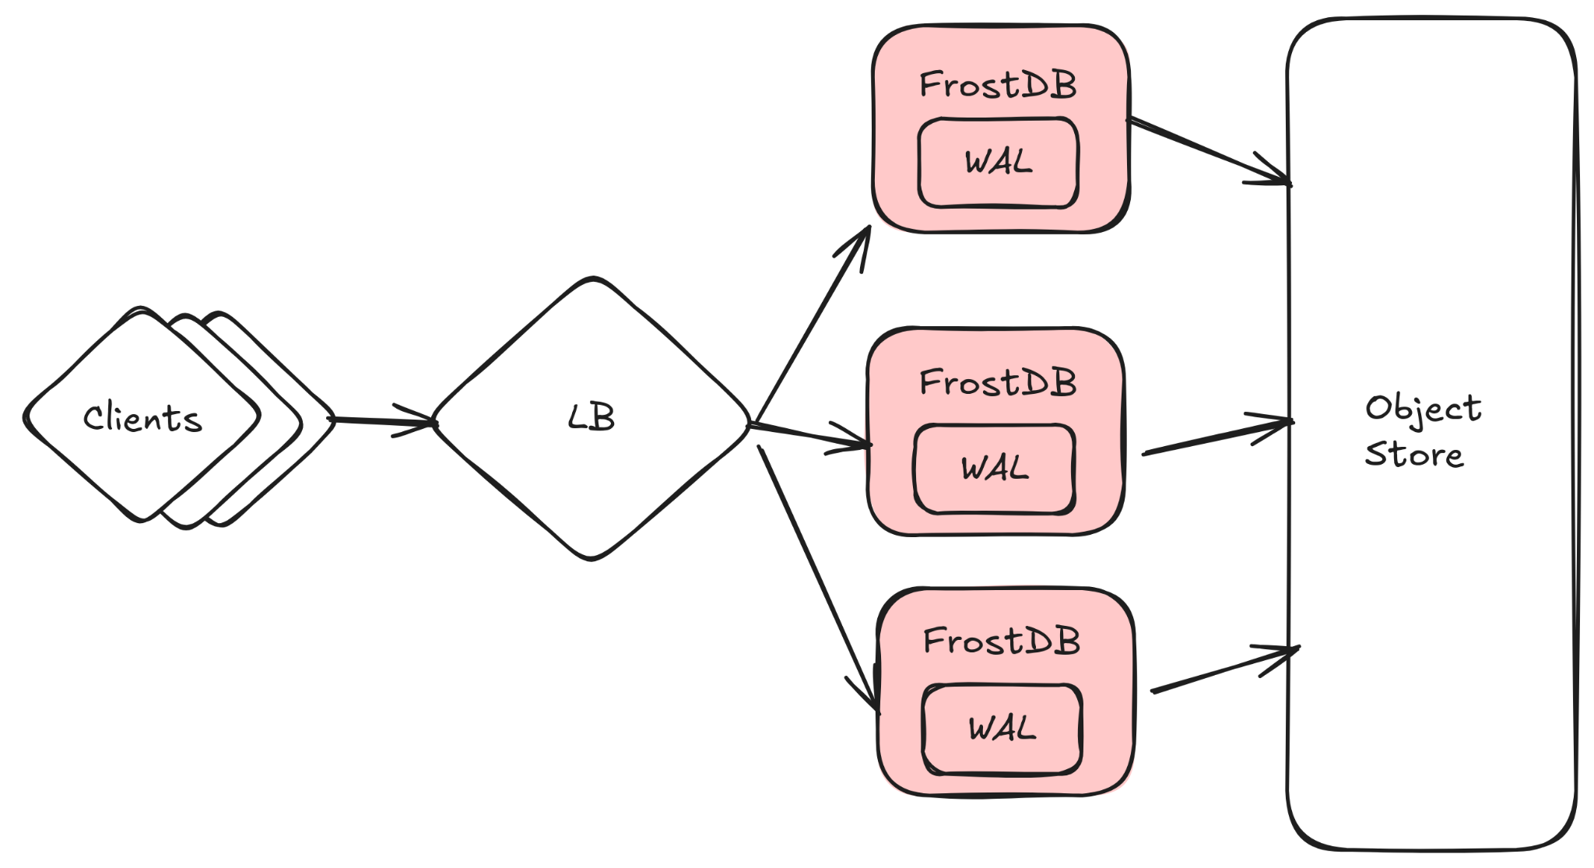
Replicated writes
Long replays caused nodes to become out of date

Slide 15
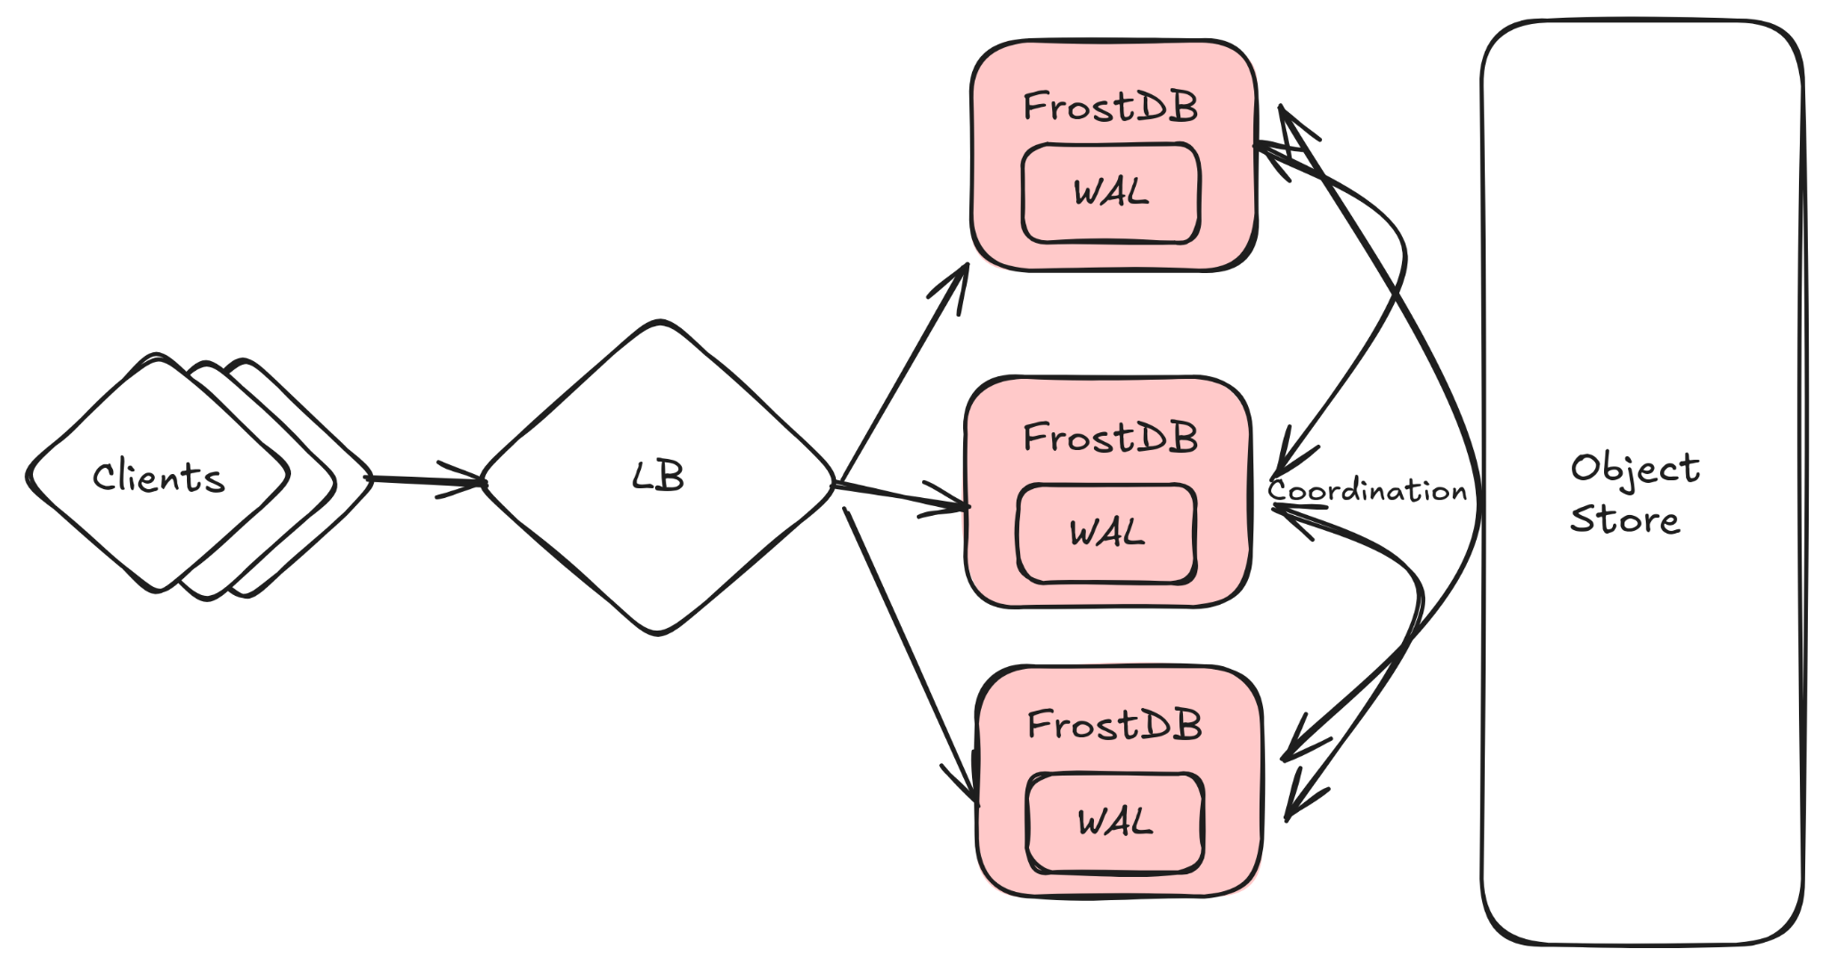
Replay coordination
Complex failure scenarios and cascading failures

Slide 16
“Every system is perfectly designed to get the result that it does.”
- W. Edwards Deming

Slide 17
Goals Results
Easy to operate Challenging to operate
Cost effective at scale Expensive at any scale
Storage and compute decoupled Hard dependencies

Slide 18
New Architecture

Slide 19

Fast
Written in Rust
Columnar
Extensible
Works with many table formats out of the box

Slide 20
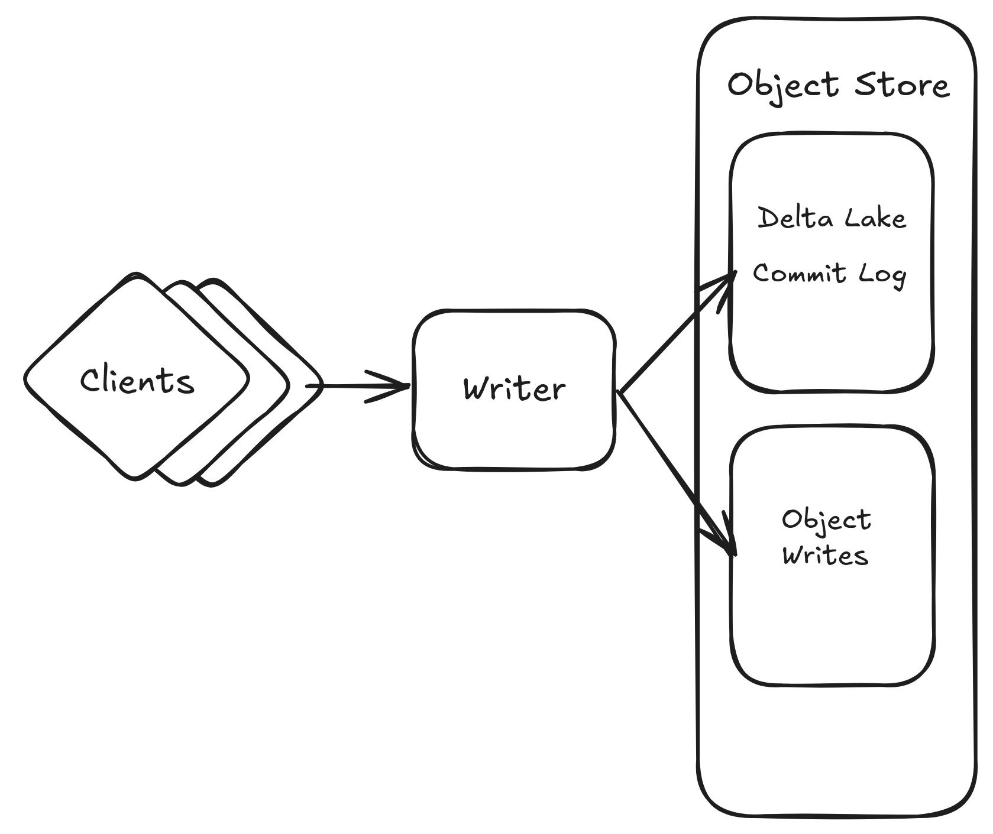

ACID Transactions
Fast writes
Quick Reads through pruning
Schema Evolution

Slide 21
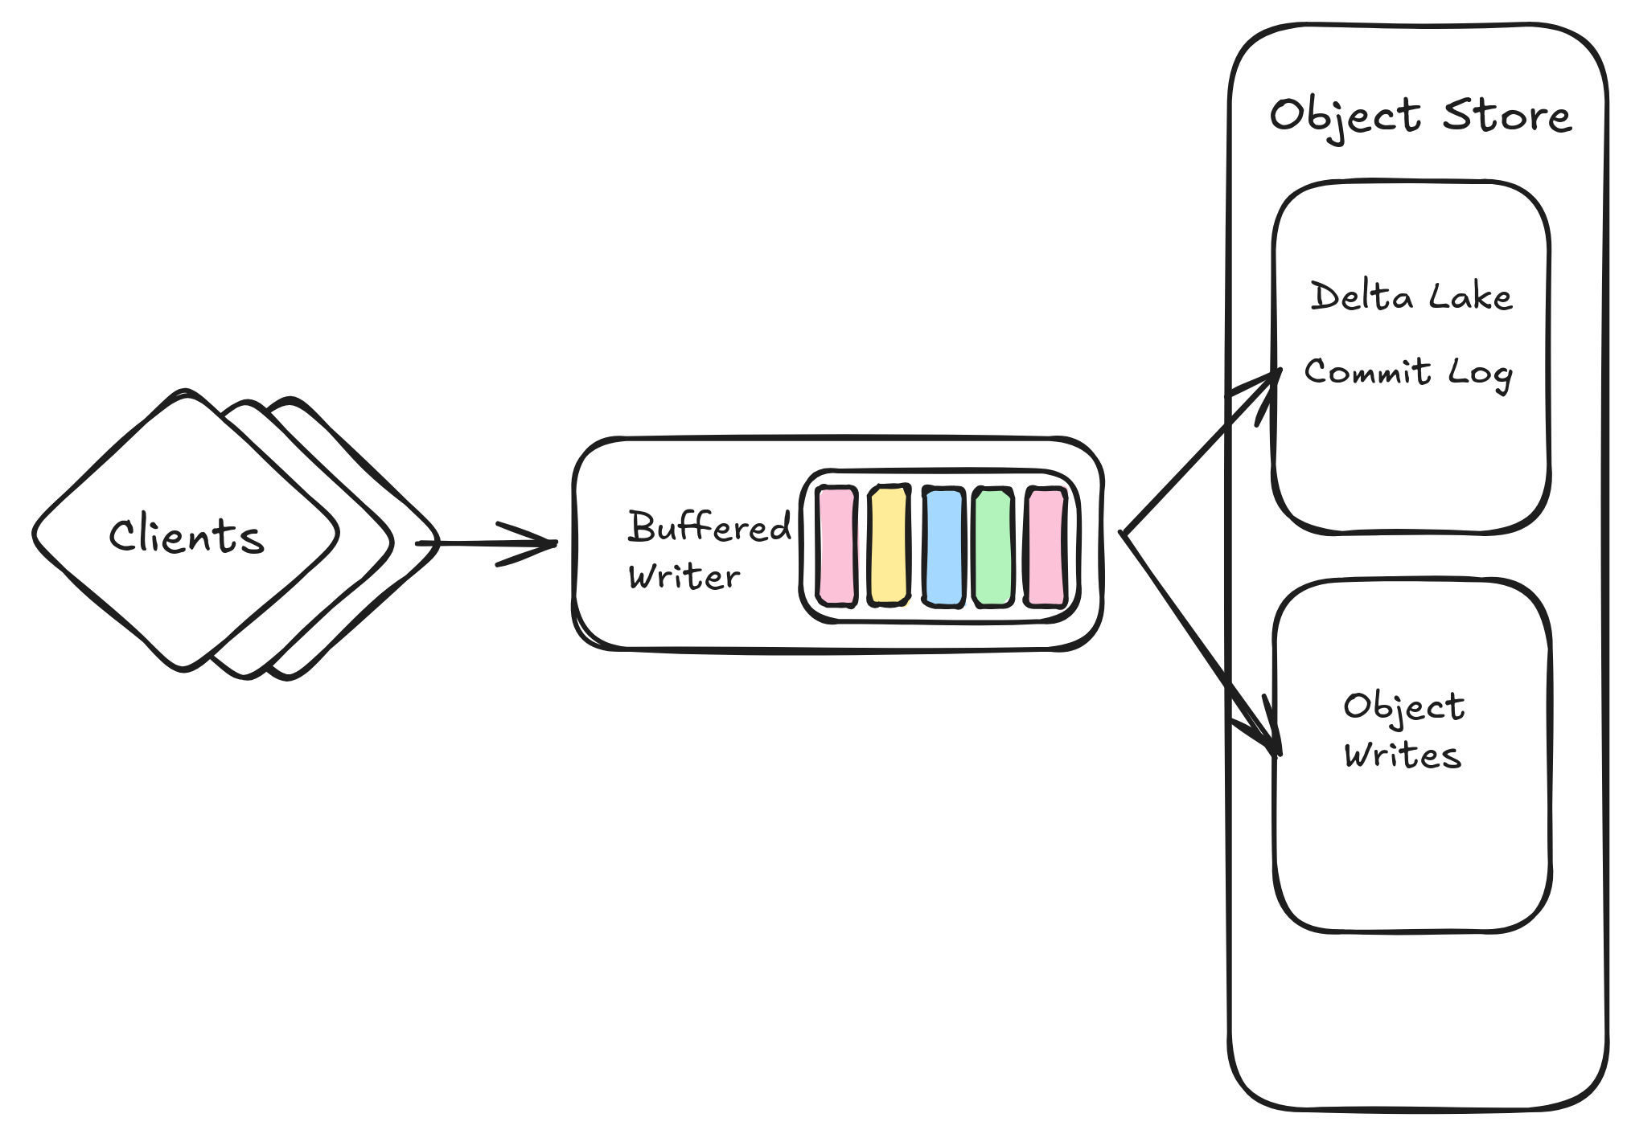

Slide 22
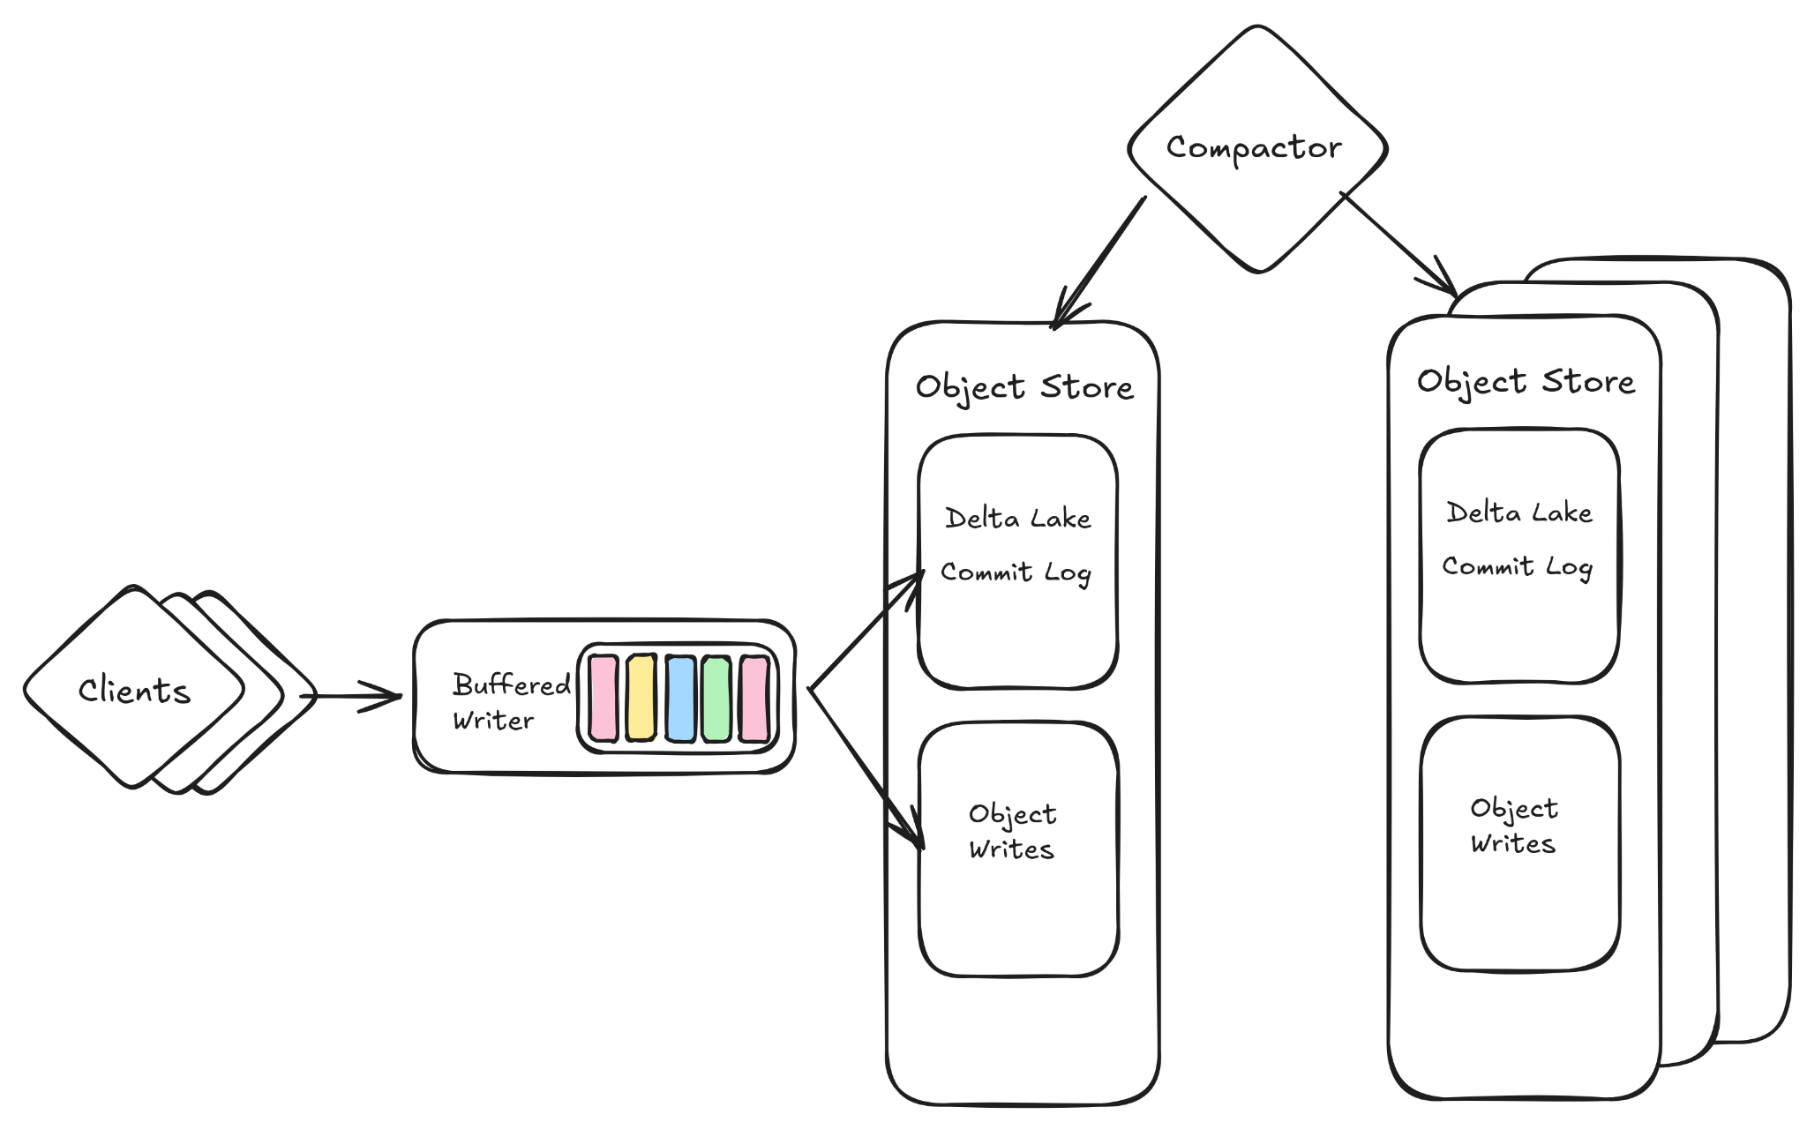
Notes:
TODO: We can start with what we originally had and I can walk through each thing we added as we encountered problems (wal, replication, replays etc.)

Slide 23

Faster queries
Zero copy reads
Lower memory overhead
Extensible
Notes:
TODO: We can start with what we originally had and I can walk through each thing we added as we encountered problems (wal, replication, replays etc.)

Slide 24
Goals Results Achievements
Easy to operate Challenging to operate
Cost effective at scale Expensive at any scale
Storage and compute decoupled Hard dependencies
50% reduction in cost
200% query latency reduction
No data unavailability

Slide 25

The projects that made it possible

Slide 26
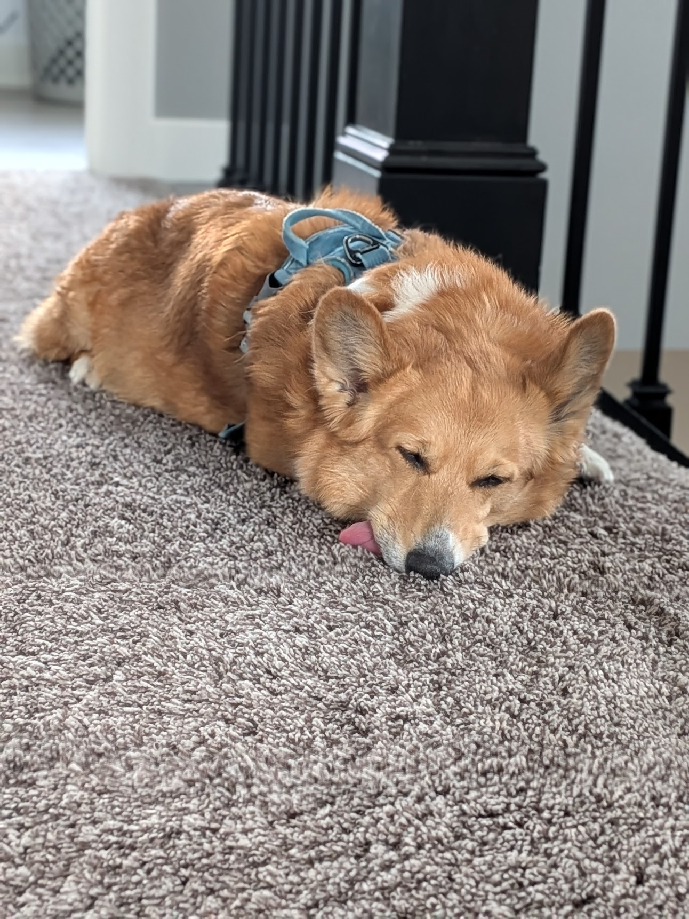
Questions?
Final Dog Tax

