Slide 1

Non-Blocking Continuous Code Reviews
2021 Ghent lightening festival
Kunsthal Gent
Lange Steenstraat
shy speaker
Trunk-Based Thierry (they/them)
Notes:
Don’t forget the timer!
I want to make a case for Non-Blocking Code Reviews as opposed to the classic, pervasive Pull Request.
Just to clarify, I do not question the Pull Request model in the OSS world. They have there use. I do question it for the corporate world. Where they do not have any value.
It is something we practiced back in 2012 with a rather novice team.
I haven’t really talked a lot about this. Except for the occasional mention on Twitter when people asked how do we do code reviews with trunk-based development. Which is one option.
I did not realise that this was thing … in all honesty, I was fairly embarrassed about our way of working, because it was nowhere near what the rest of the industry did using branches and Pull Requests.
Until I discovered, that someone else wrote about this in 2020. Martin Mortensen from Denmark.
And then one Sunday morning Dave Farley contacted me asking if I could point him to any article. So, somewhere in 2023 I wrote this down. And here I am.

Slide 2
A Team’s Tale
Notes:
Somewhere around 2012, I had the opportunity to tech coach a somewhat novice team inside a somehow conservative bigger player in the finance industry. The purpose of the coaching was to upscale the team’s software engineering skills.
Back then we used SubVersion, because I thought Git was just a bridge too far for a novice team.
Because branching was difficult in SubVersion, we also decided to use no branches at all. The whole team committed directly into mainline. That worked pretty well because we introduced right from the start the practice of Continuous Integration and team commitment that any change had to be covered by an automated test, preferably unit tests.
Because the team was novice, we wanted to have some mentoring in place. Pair programming was difficult. The team wasn’t particularly open to the idea. Though there was some pair programming as learning opportunities where my fellow coach and I sat next to team members showing them how a practice worked. But there wasn’t continuous pair programming. Not an instituted practice part of the team’s culture.
So the next best thing was code reviews.
Back then I was a fervent believer of code reviews. Mostly influenced by books like Code Complete and Facts and Fallacies of Software Engineering and from the blog posts from Joel Spolsky.
Given the team was novice, we decided that every single commit had to be reviewed.
Because there was no branching in place, we ended up running non-blocking code reviews. It was the result of applying lean principles and keeping things simple. Not realising this was a performant way to run code reviews.
That was quite beneficial for us and our customers as it allowed us to have a fairly good and constant delivery cadence.

Slide 3
Two key ideas …
Establish a continuous review process.
Notes:
The review process was based on the combination of two key ideas:
The first key idea was
Establish a continuous review process that consists of a set of regular reviews as part of the development flow

Slide 4
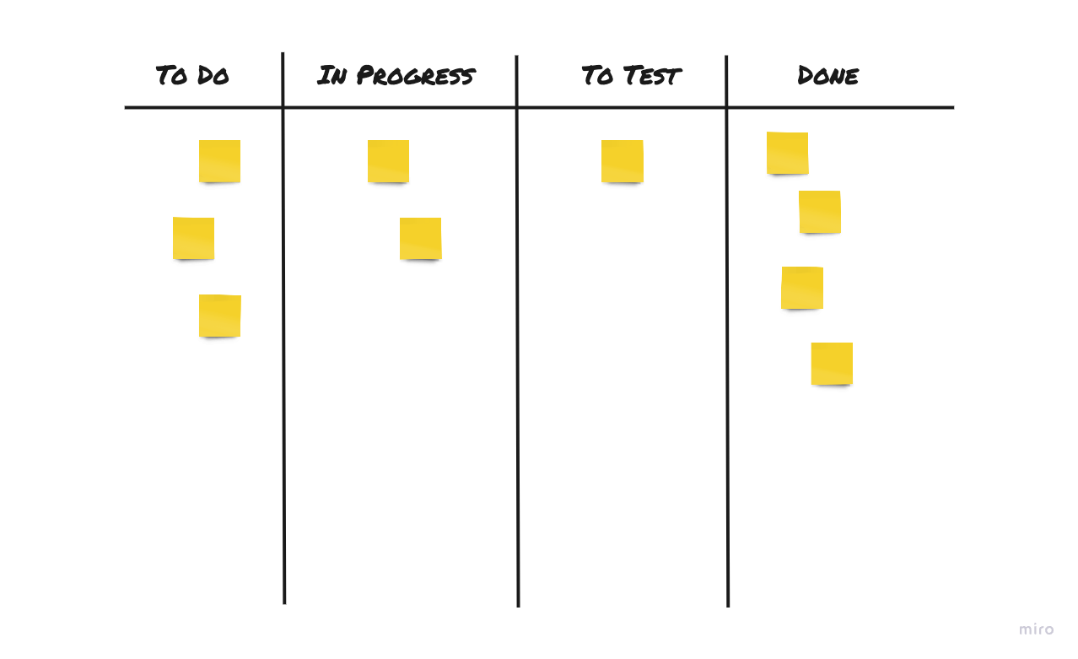
Notes:
The team used a Kanban board to track work.
Every ticket was a feature, not a task, but a whole feature. It has the benefit to set a constraint on the size of the features and to keep them small. So they can move fast from left to right.
The feature was the unit of work on our Kanban board.
Yet, the feature was not the unit of integration, as it happens with feature branching and pull requests. The unit of integration was the commit.
The unit of release could be a commit or a set of commits. Because there was still a manual decision to release. We practiced Continuous Delivery not Continuous Deployment.
To ensure code reviews happened, we added a To Review column to track the reviews.

Slide 5
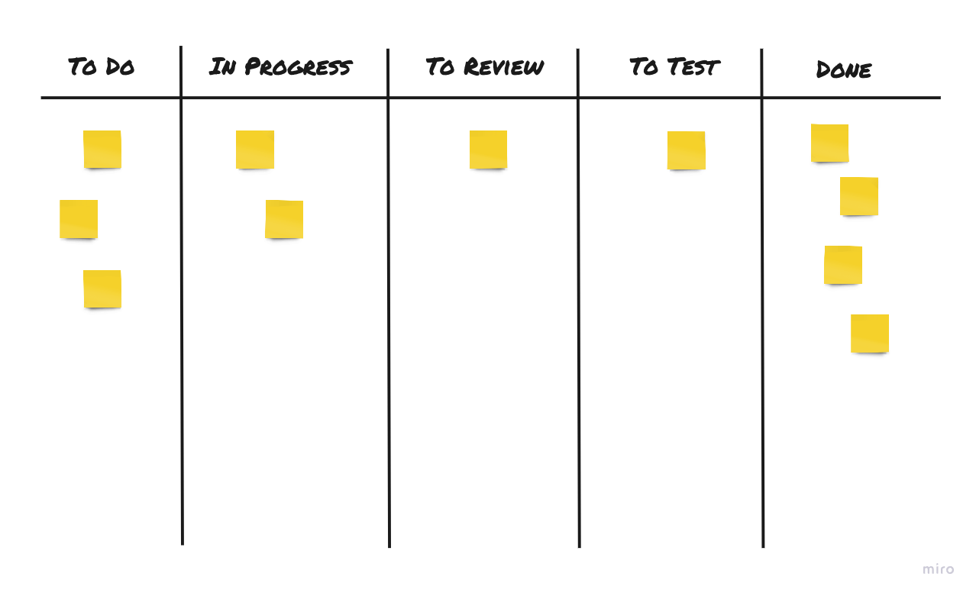
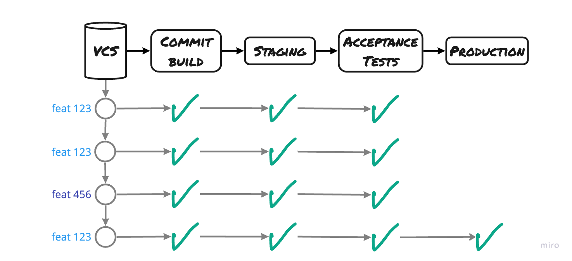
Notes:
The To Review column indicates this feature is ready for review.
Dave Farley reports he has seen this before. And it never really worked. Usually, it is seen as some sort of gate in the process. The research is clear about this: the idea of slowing down for safety is a mistake. It introduces all sorts of problems and dysfunctions, additionally it drives down quality.
But here it was different. The review was not a gate.
The feature growed commit by commit on mainline.
But reviews occured on a per-feature level on mainline.
When a feature was finished and ready for review it was added to the To Review column.
To avoid context-switching, we decided that whenever someone finished a piece of work, before starting new work or at the start of the day, they would first check the To Review column to spot whether nothing is waiting to be reviewed. If there was something to review, they reviewed it.
This ensured the rolling review happened. And so we had continuous review in place.
We had one single rule in place: nobody should review code that they were involved in writing.
There weren't any rules about the seniority of who reviewed who's code. There was no hierarchy. We had true peer-reviews in place.
Seniors reviewed juniors and seniors. Juniors reviewed code from seniors and juniors. I wasn't expecting many comments from juniors, but at least I hoped they would learn something from reading the code from a more experienced engineer.
However, I have experienced quite interesting reviews from juniors. They ask different questions. More outsider questions, the why questions which are good triggers for the necessary improvement.

Slide 6
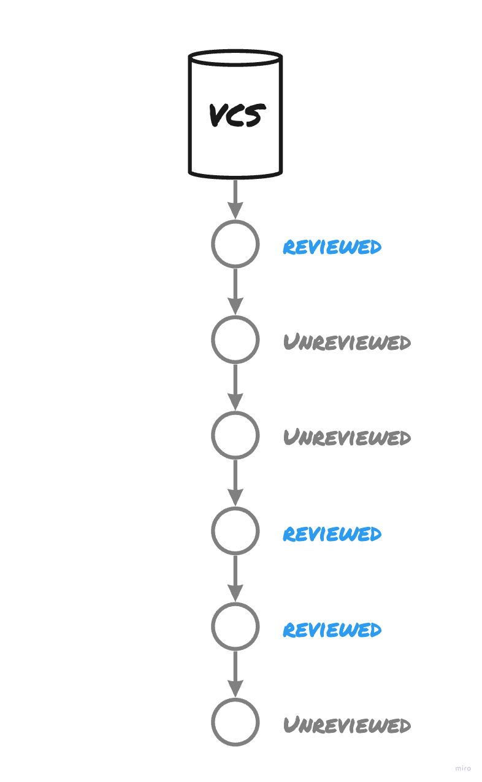
If we commit changes
directly to the remote mainline,
we have unreviewed code
alongside reviewed code.
Notes:
If we do not do Pull Requests or Pair Programming we now have unreviewed code going straight into the remote mainline.
Now we have reviewed and unreviewed code alongside each other on mainline.
And so we have, this code is releasable and this code is not-releasable at the same time.
How do we keep this code apart?
What does releasable mean, in that case?

Slide 7
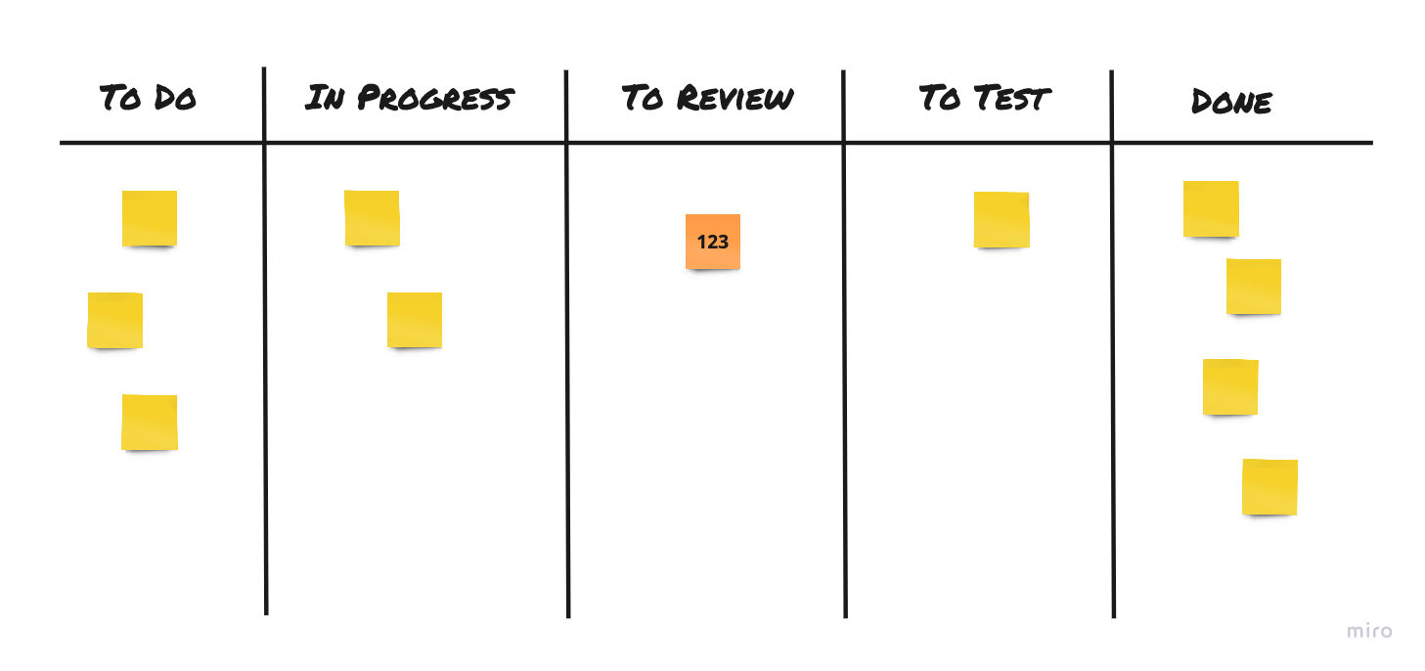
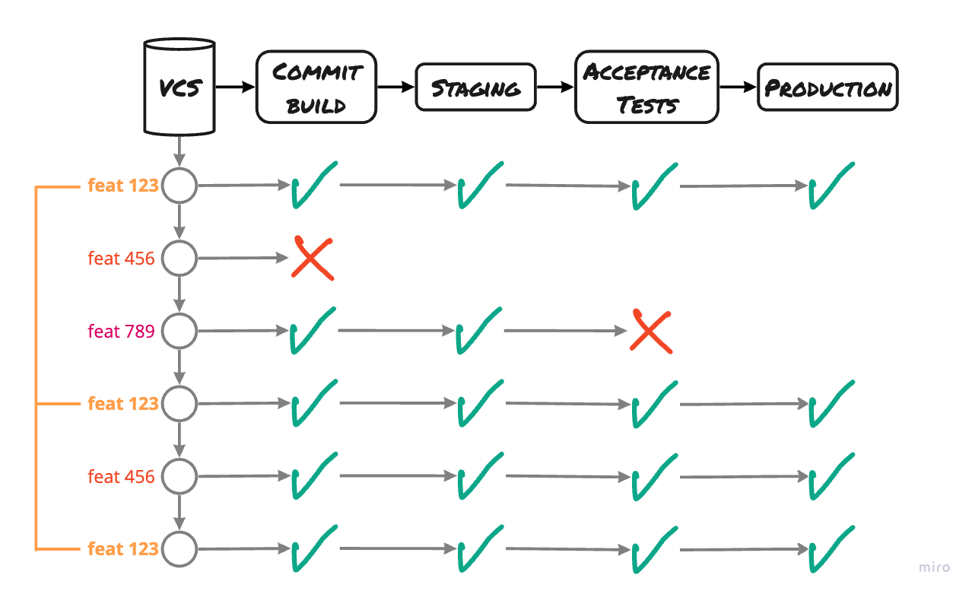
Second key idea …
Stop the code review
being definitive for release.
Notes:
This brings us to the second key idea …
Stop the review being definitive for release.
Stop the code review to be a deciding factor to determine the releasability of the code. The code review is not a process gate, it is not a Go/No-Go decision anymore. It does not block the release anymore.
The team practiced true Continuous Integration with trunk-based development that later evolved towards Continuous Delivery with a deployment pipeline.
Every commit that went successfully through all stages of the deployment pipeline and that have been thoroughly tested could land in production.
The kanban board and the reviews were working at the level of whole features.
But the software growed small commit by small commit, and every commit had the potential to land on production

Slide 8
Unreviewed code could end up in production
whether the feature was finished or not
whether the feature was reviewed or not
Notes:
This means that unreviewed code could end up in production, whether the feature was finished or not, and whether the feature was reviewed or not
We can argue we run the risk of having bad-quality code in production. Yes, that is right. That is possible and that happened. But I do not see a problem over here.

Slide 9
Unreviewed code ≠ a bug !!
automated and exploratory tests
catch bugs not reviews
Notes:
First, bad quality does not mean a bug. Code reviews are not there to catch bugs. For this, we have our automated tests and exploratory testing in place.
We had team commitment that any change had to be covered by an automated test, preferably a unit test. On top of that we had automated acceptance tests in place. We also ran manual exploratory testing by a peer, different from the engineer that implemented the functionality. Lastly, we had a fair amount of static code analysis that would break the build on rule violations.
The risk of working this way is not that the code will be buggier, but rather that we may end up releasing code of lower quality in production
But code quality has not much impact on the product delivery and even less on functionality.
However, it has impact on the speed of change. And this is the exact reason why we want to have better code quality. To be able to add new functionality faster, more easily, with a shorter delay and the shorter time to market.

Slide 10
The unreviewed code is code that works.
It passed all tests!
Notes:
In the end, this is code that works because the automated tests say so, but that could be better. At some level that is always true. Code review may only reduce the chances of releasing lower-quality code, but that depends on the quality of the review. It doesn’t eliminate bad quality altogether.
This worked, because as a team we agreed that every single commit would be reviewed at some point. Any issue raised during a code review had to be handled with the highest priority to ensure the poor quality was removed from production as soon as possible during the next release.

Slide 11
Benefits

Slide 12
Transaction Cost
the cost of sending a batch
to the next stage
Notes:
To understand the benefits, we need to understand the concept of transaction cost from Lean Manufacturing.
transaction cost = the cost of sending a batch to the next stage.
This is important because the higher the transaction cost, the more inventory will be created in front of the next stage to compensate that cost.
If the transaction cost for buying goods is 3 EUR. Let’s say delivery costs 3 EUR. In that case, we won't order a good of 1 EUR. We will order a multiple of goods of 1 EUR to compensate that transaction costs. We are going to batch up work.

Slide 13
92%
wait time 😳
If it takes 10 min to make a change, the change is blocked until it is reviewed and it takes 2 hours to get a review …
High cost of code review!
=> ask less often for a review 🤷
Notes:
if it takes 10 minutes to make a change, the change is blocked until it is reviewed and it takes 2 hours to get a review, that change is waiting 92.3% of its total lead time!
This is a fairly expensive process. It signals us code reviews are pretty costly.
In that case, to compensate this transaction cost, we are incentivised to ask less often for code reviews.
So, what happens, when we ask less often for code reviews?

Slide 14
Expensive process
works against making small changes
-> less refactoring
-> less incremental development
Notes:
We will make more changes before asking for a review
In that case, the process discourages working in small incremental steps and refactoring
If we do not refactor enough, we do not pay back technical debt. This will have an impact on the speed of change. Adding new functionalities will take more time, thus increasing the time to market.

Slide 15
the wait time incentivises Work in Progress
Notes:
Because we are waiting, we are also incentivised to create more WIP.
People want to feel productive. They do not feel comfortable just waiting and do nothing until someone is available to review the code. So what happens? Right, they start new work.
And here’s the start of lots of context switching. And we know where this goes and it is not pretty.

Slide 16
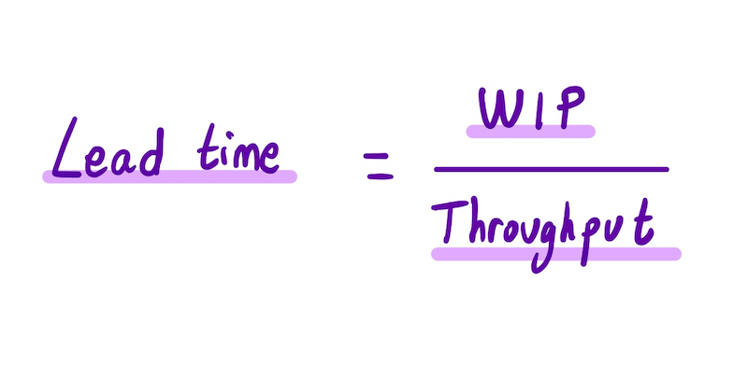
Little’s Law
the higher the WIP
the more delay
Notes:
Because of Little's Law, more WIP means bigger Lead Times and more delays.
We end up with delayed delivery, delayed feedback. Learning will decelerate, we become risk averse, innovation falls flat and we will go back to conservative solutions.
This is what happens with organisations that practice the Pull Requests. They go back to conservative ways of working.

Slide 17
To get something out sooner …
need to reduce the transaction cost!
Minimise the cost of code review.
Notes:
So, to get things out sooner, we need to reduce the transaction cost.
We need to minimise the cost of the code review.

Slide 18
Benefits (bis)

Slide 19
Transaction Cost is nearly zero.
=> work in small increments
Notes:
Because the transaction cost is nearly zero, the code review has zero impact on the total lead time. The commits already went through the deployment pipeline and might already be in production before the code review even started.
There is no reason to make more changes in bigger batches before asking for a review.
We are incentivised to work in small increments.
Refactoring happens, naturally, leading to way better quality and improved speed of change. It optimises engineering time for adding new functionality. It takes way less time to introduce new changes. Which reduces time to market and cost of delay.

Slide 20
With Non-Blocking Reviews
we have early, fast feedback.
Notes:
The fact that unreviewed code could be tested or deployed in production before a review happened was surprisingly a significant benefit.
Because it allowed us to already obtain valuable feedback from testing, and from production, from users using the feature. Even before a review happened.

Slide 21
With Non-Blocking Code Reviews
no new work is started before finishing.
=> less Work in Progress
=> because Little’s Law: less delays
Notes:
Because we never have to wait for someone to be available, we can now work on functionality from start to finish.
Therefore, no new work is started before finishing any on-going work to feel more productive.
In the end, people can focus on one thing at a time. No more context-switching. No more multi-tasking, no more productivity killer.
Because we do not have to start new work, we have far less work in progress.
Because of Little’s Law we now have a reduced lead time.

Slide 22
With Non-Blocking Code Reviews
no pressure to improve code quality.
Nobody is waiting.
Notes:
Sometimes, it happened we noticed during a review the software design was off. That were moments when I wished we practised pair programming to catch these situations earlier.
But then again, this was not a real problem. Testing found the feature good enough. It was already delivered in production and delivering value for our users.
We had all the time to redo the design without any pressure. Our users already had the benefits of the feature. We could even incorporate the feedback from the user into the new design.
Something that is not possible with Pull Requests. With PR, we have two options when noticing a bad design:
Either we impose to fix it, but the feature is blocked all the time we fix it, users do not benefit from the feature and we still do not have any feedback. We might still be wrong during all that time.
Or because there is pressure to deliver, we cut corners or we even decide to not fix the design, and here starts the technical debt and this impacts the speed of change
So, no pressure, no stress, no fatigue, no burnout.

Slide 23
With Non-Blocking Code Reviews
there is high trust.
Notes:
Because unreviewed commits go straight into production after successfully going through all stages of the deployment pipeline, we put a lot of trust on the team.
We expected they are going to do the right thing. Instead of assuming they are stupid and we need a process to fix for that.
We expect the team to add enough tests and the right tests.
This is applying management theory Y over theory X
And even if something goes wrong in production, that's not the end of the world. The process allows us to fix that quickly.
Continuous Delivery allowed us to deploy within hours.

Slide 24
Gotcha with
Non-Blocking Code Reviews
Notes:
To be honest, there is one gotcha with Non-Blocking Code Reviews

Slide 25
It might not work for regulated industries.
=> Pair Programming or Team Programing
are the better solution
Notes:
But … this will be difficult for regulated industries especially in healthcare.
Many regulated industries demand that changes be reviewed.
If the release in production is gated by the need for a review then this non-blocking approach may not work
But then again I can think of some options to even implement this in healthcare, but unfortunately I have never worked for healthcare and so have never been able to test this.
But for regulated industries:
=> For that pair or team programming is the better solution
When pairing, a pair can sign off the review at the point when we commit the change and tag the change with the ids of each engineer in the pair

Slide 26
Conclusion
Notes:
To conclude

Slide 27
Pair Programming or Team Programming
are still a superior delivery option.
But can be a cultural stretch.
Notes:
IMHO, Pair or Team Programming are still a superior delivery option, but well, in certain organisations this is a cultural stretch for many valid reasons.

Slide 28
Non-Blocking Review strategies are significantly better than any of the alternatives.
No gating
Deliver faster without delays
Less WIP
No context switching
No urgency to fix quality issues
Features grow incrementally, commit by commit
Encourages refactoring
Notes:
In that case, Non-Blocking Review Strategies are significantly better than any of the alternatives
We do not have any gating.
Therefore, we can deliver faster without any delays. This allows us to maintain the fast flow of work through our value stream. Which is a critical practice to adopt to achieve higher quality.
Because there is no waiting times, people do not need to start new work to feel productive. So, we have less WIP. Because of Little’s Law this reduces lead time, and time to market, accelerates feedback and consequently leads to better quality.
Because we can finish work from start to finish in one go, we do not have any context switching. So no multitasking. No productivity killer.
There is no urgency to fix code quality issues. We can take all the time, and do a thorough fix. The feature works. All automated tests pass. It is delivered, in the hands of the users. Users benefit from it. No stress, no fatigue, no burnout.
And lastly, features grow incrementally, small commit by small commit
encouraging refactoring. Which again leads to higher quality and improves the speed of change.

Slide 29



2024 Ghent lightening festival
Portus Ganda
picture by Camille de Pauw, daughter of
Hello, I am Thierry de Pauw
Acknowledgments:
Stefan De Moerloose (https://linkedin.com/in/stefandemoerloose/) for having been that incredible team manager open to try out all of our crazy ideas.
Dave Farley (@davefarley77.bsky.social) for nudging me to write this down and then turning it into that lovely video.
Giovanni Asproni (@gasproni@mastodon.social) for poking me to turn this into a positive story.
Lanette Creamer, Wouter Lagerwije, Diane Gombart, Falk Kühnel and Steve Berczuk for reviewing the slide deck.
The Article:
https://thinkinglabs.io/articles/2023/05/02/non-blocking-continuous-code-reviews-a-case-study.html

Slide 30
Resources
Optimizing the Software development process for continuous integration and flow of work, Martin Mortensen
The Article: Non-Blocking Continuous Code Reviews, a Case Study, Thierry de Pauw
I’ve found something better than PRs, the video from Dave Farley on the topic
Code Complete, Steve McConnell
Facts and Fallacies of Software Engineering, Robert Glass
Joel on Software, Joel Spolsky
What is the purpose of Code Reviews, Thierry de Pauw, a discussion on LinkedIn
From Async Code Reviews to Co-Creation Patterns, Dragan Stepanović
I Hate Pull Requests, Pia Fåk Sunnanbo
Problems with Pull Requests and How to Fix Them, Gregory Szorc
On the Evilness of Feature Branching - But Compliance, Thierry de Pauw
How to make sure tests are of quality, Thierry de Pauw, a discussion on LinkedIn

