Slide 1
Modern Concurrency Made Easy(ier)
Hernan Ponce de Leon
Dresden Research Center

Slide 2



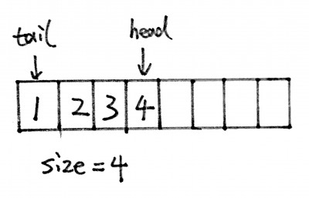




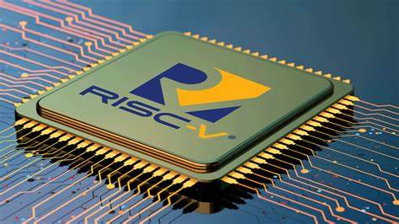
Modern Concurrency
Applications
This is hard!
Target audience today
Data Structures
Sync Primitives
Atomic API
Ping me if you are interested about this part
Multicore CPU

Slide 3
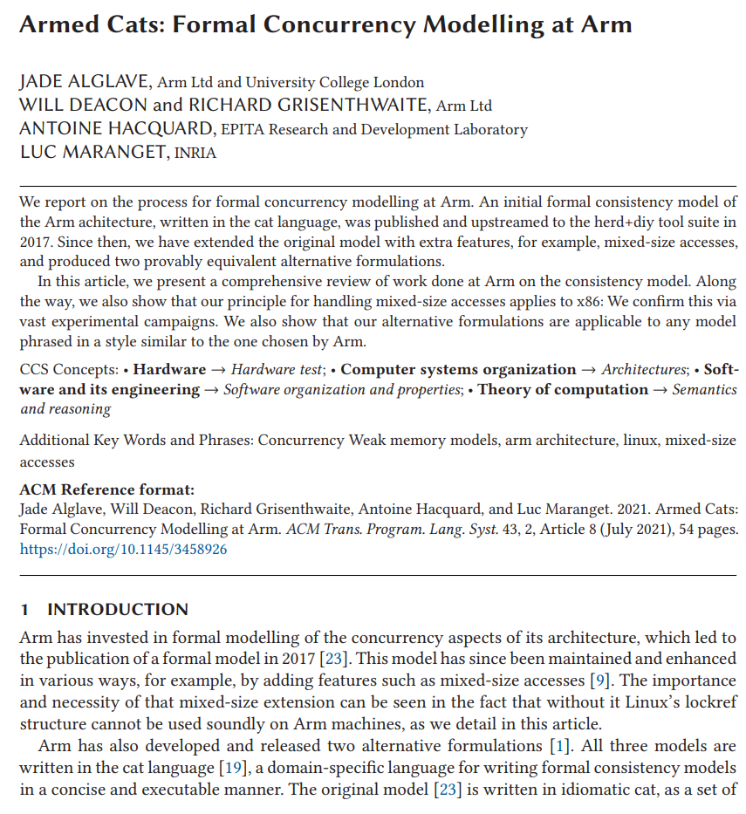
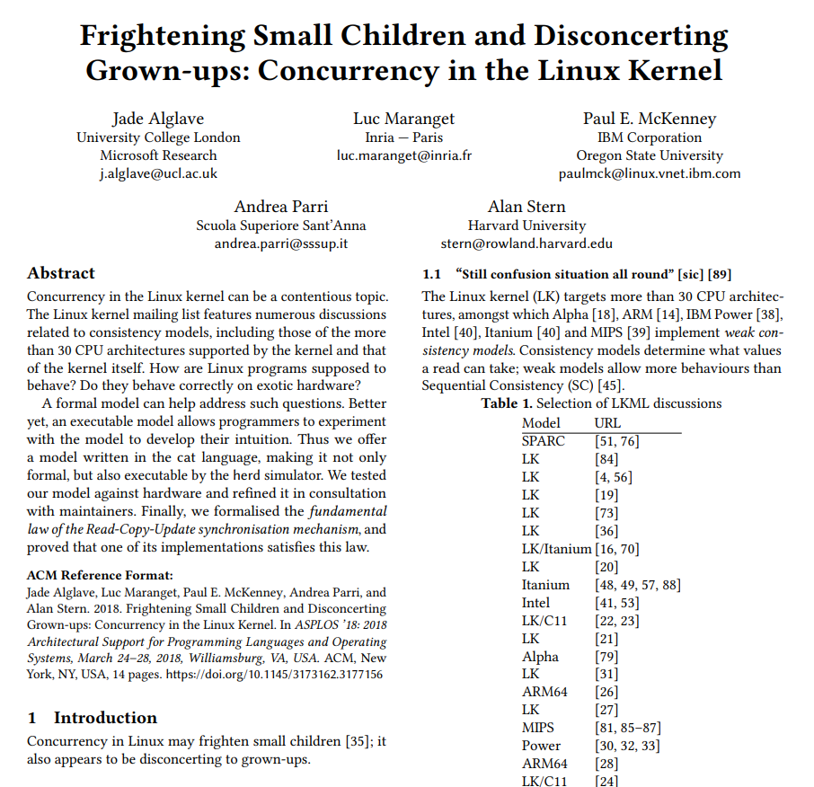
Guarantees by the Modern Software Stack

Slide 4
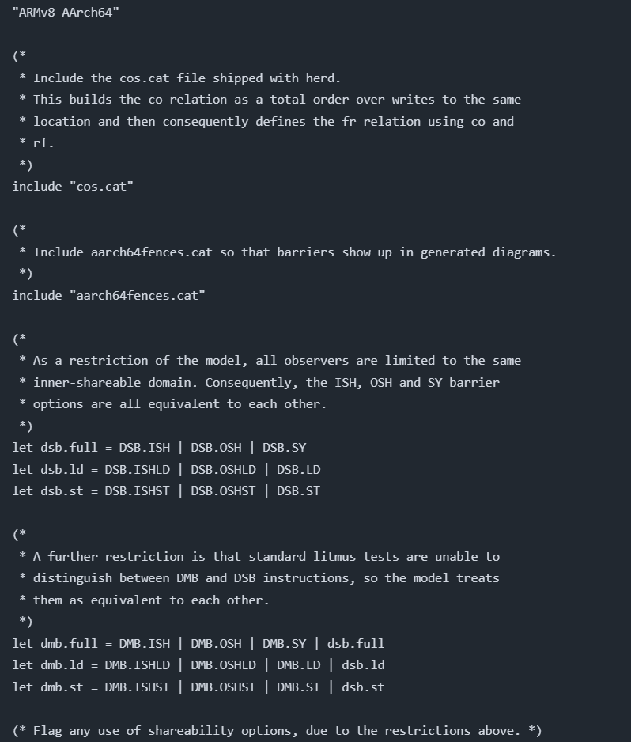
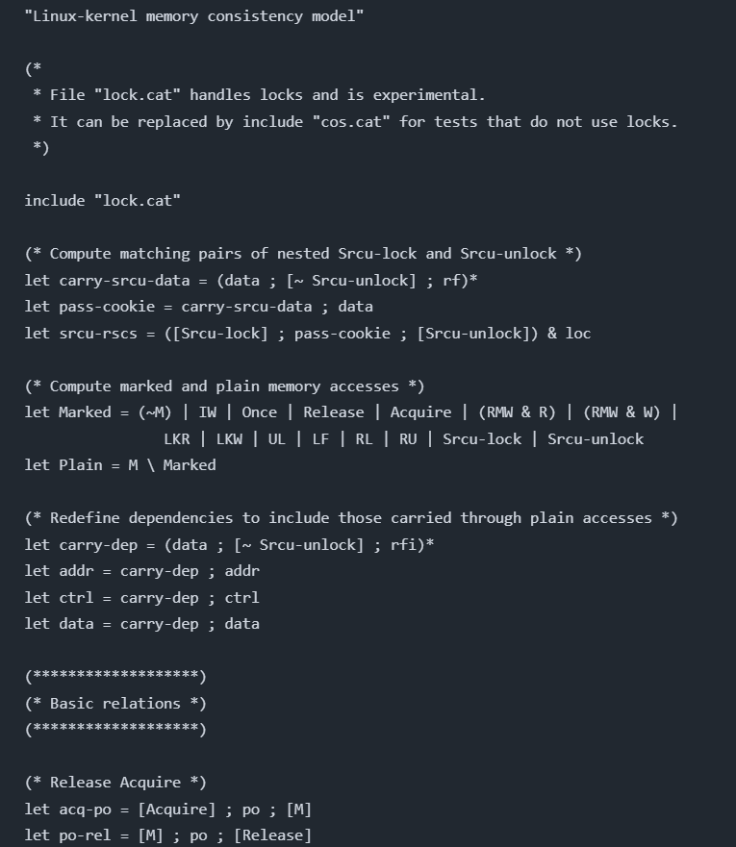
Guarantees by the Modern Software Stack

Slide 5
Dartagnan
DEMO

Slide 6
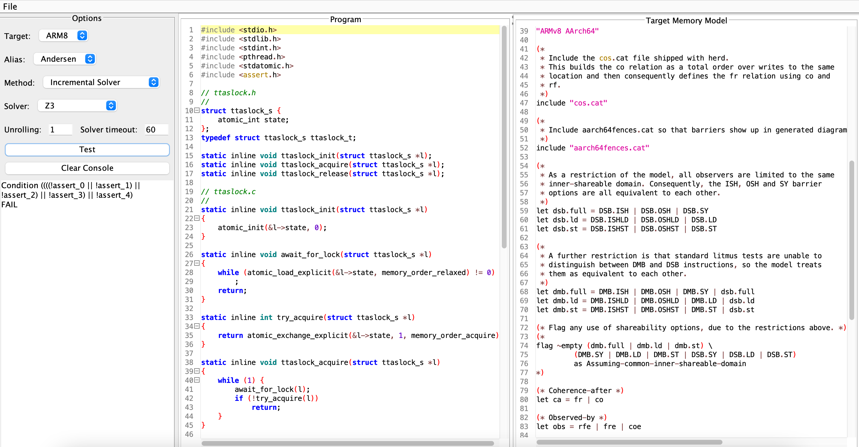
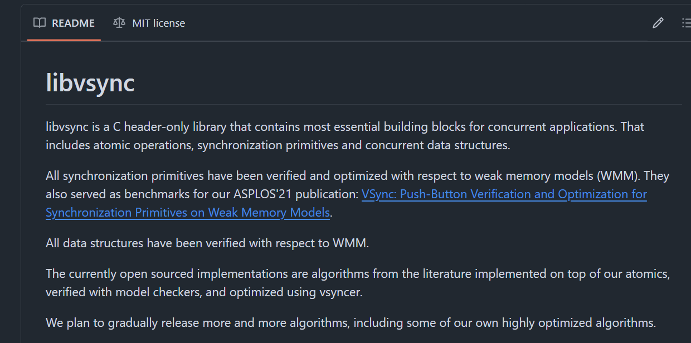
Take-aways
Are you designing a new concurrent algorithm?
Are you building a concurrent component?
hernanponcedeleon/Dat3M: A verification tool for many memory models
open-s4c/libvsync: A verified library of synchronization primitives and concurrent data structures

