Slide 1
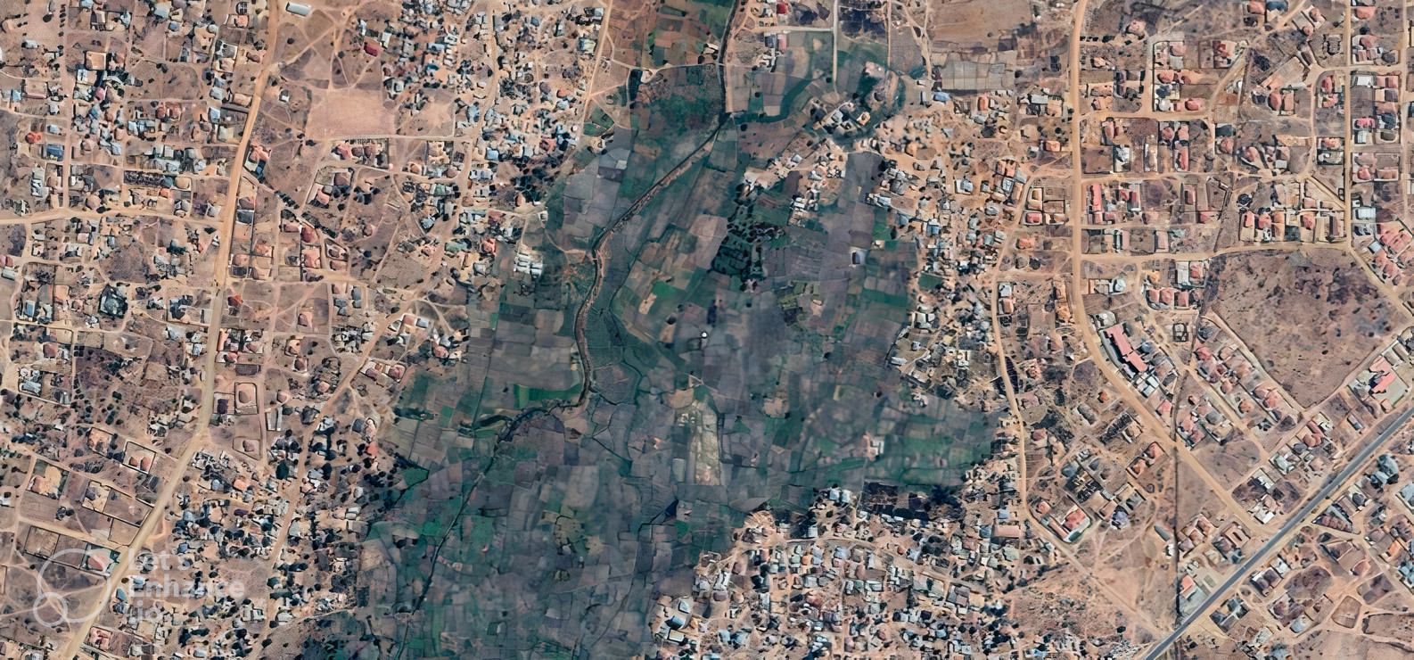


Energy Access Explorer
A Digital Public Good to Deliver Energy Transitions for Everyone
Akansha Saklani
Energy Access Explorer

Slide 2
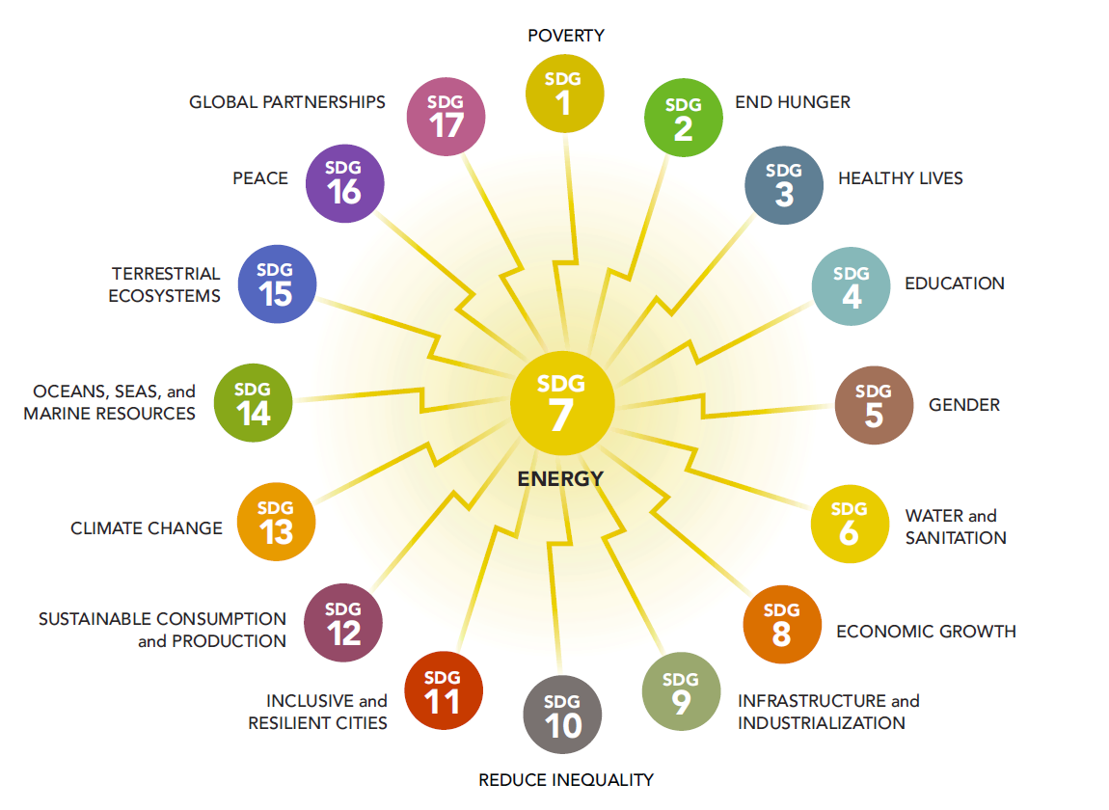




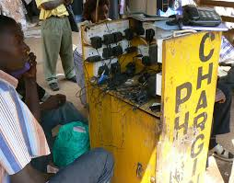
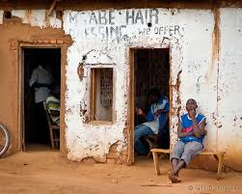
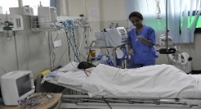
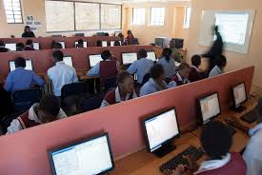

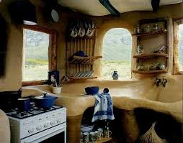
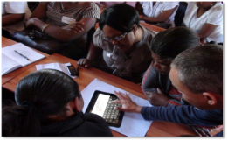

Importance of energy for socio-economic development
675 million people no access to electricity / 2 billion people cook with polluting fuels
Without access to electricity
With access to electricity
Energy is interconnected with 125 (74%) out of 169 SDG targets
Source: NASA Earth Observatory

Slide 3
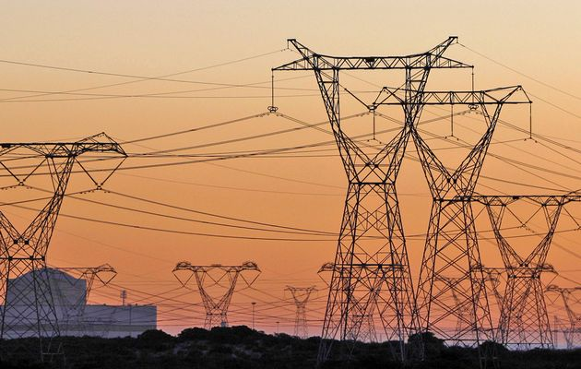
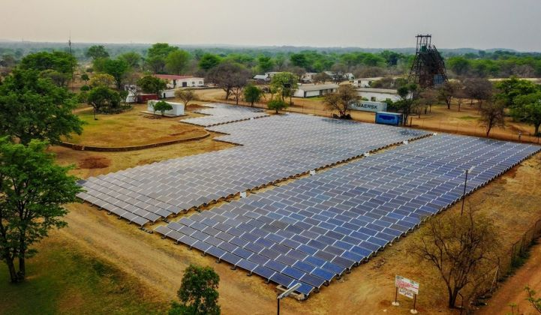

Importance of integrated energy planning
Integrated Planning is essential for:
matching supply with the growing demand;
incorporating decentralized and cost-effective renewable energy production into a region’s energy mix.

Slide 4

Importance of inclusive energy planning
Inclusive Planning is essential for:
Accounting for varying, cross-sectoral stakeholder perspectives
Assessing energy needs from the bottom up
Linking energy systems at different geographic levels

Slide 5
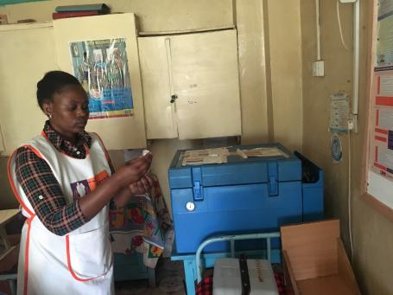
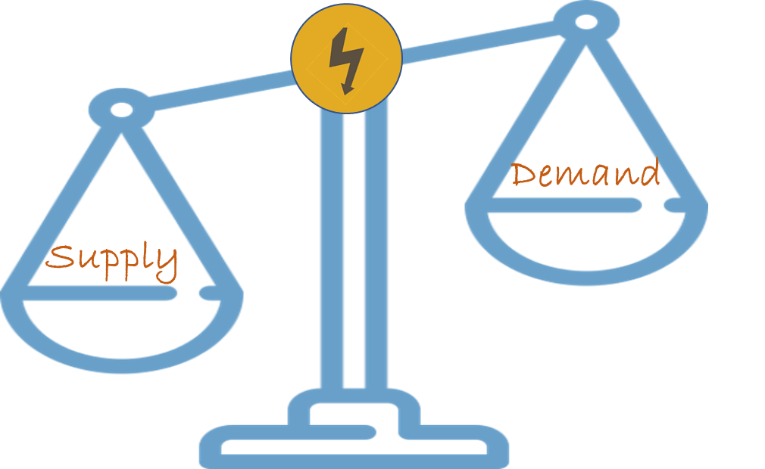
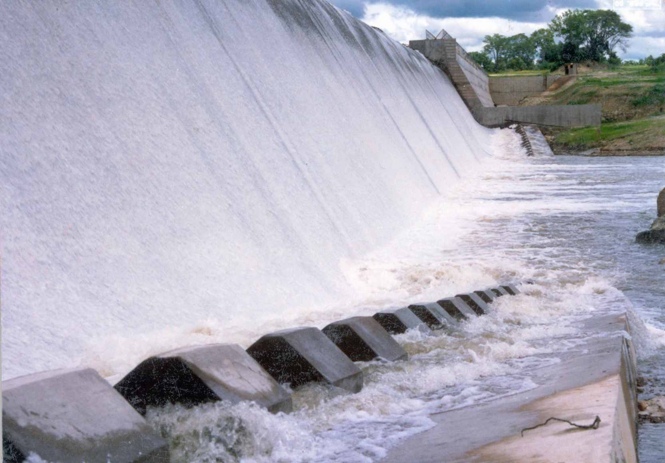
Need for a multi-dimensional energy access platform
Treat demand and supply as equal
Notes:
The gaps we identified in the existing ecosystem of geospatial analytical tools and platforms, and multi year stakeholder engagement exercise helped us better understand the requirements for the mapping platform we started conceptualizing and developing three years ago. The Energy Access Explorer.
So there are three main reasons/opportunities that guided us in the development of EAE.
First of all, there is a need to treat demand and supply as equal. If we don’t understand demand
from the bottom up, supply strategies will not viable neither for utilities nor for consumers, whether households or institutions.
So we need a platform that synthesizes granular data on both demand and supply while taking
into account other criteria and constraints which are geospatial in nature, such as location of health facilities, topography, environment etc,

Slide 6

Reduce reliance on GIS and programming expertise for data users
Notes:
Furthermore, it is essential to reduce reliance on GIS capacity and programming expertise: Planning agencies, clean energy enterprises, development finance institutions, health care departments with limited or no GIS capacity should be able to develop custom, high resolution geospatial analysis on the fly.

Slide 7

Deploy an open-source dynamic information system For data providers
Notes:
And the third reason: Data providers and stakeholders (energy ministries, REAs, line ministries) need access to an open source information system to reduce resource intensive software engineering costs.
Note that open source refers to no licensing costs, no subscription fees when it comes to the infrastructure. Data, however, can be either open access or password protected.

Slide 8
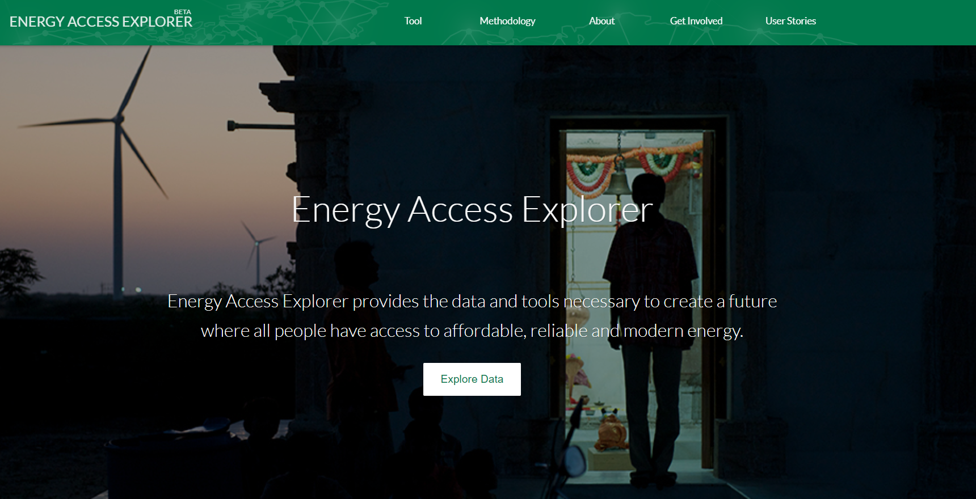


Notes:
EAE is developed by WRI and its partners to support inclusive and integrated energy planning. The Energy Access Explorer is the world’s first digital public good designed to advance climate-friendly energy access and support sustainable energy transitions. It is an interactive online platform that compiles and analyses several spatial datasets across development and electricity sectors EAE is publicly available in Jharkhand, Assam, Nagaland and Mizoram.

Slide 9
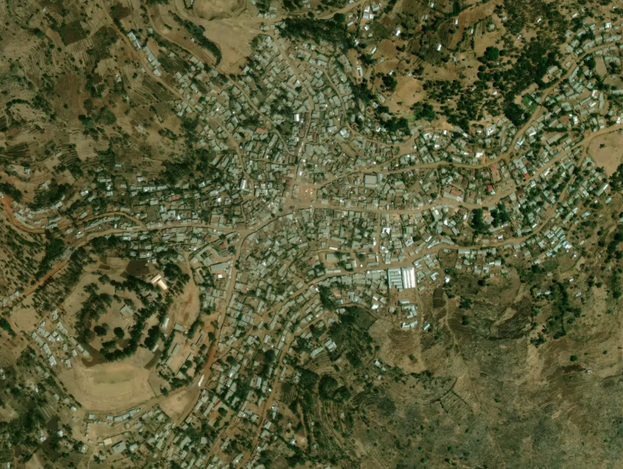
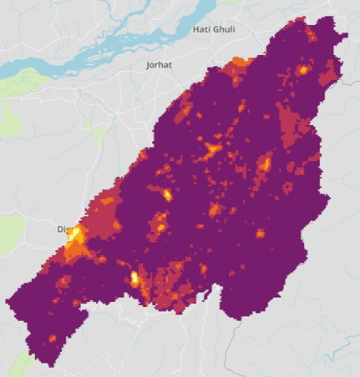
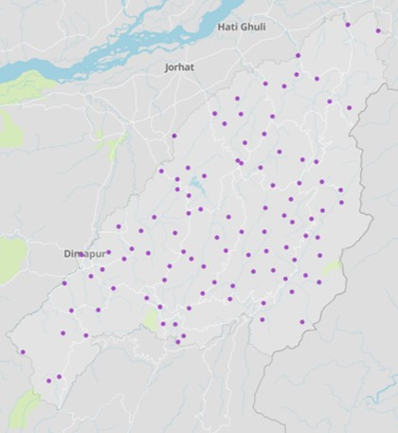
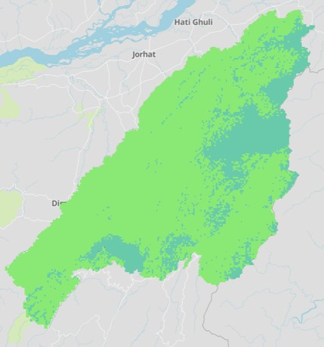
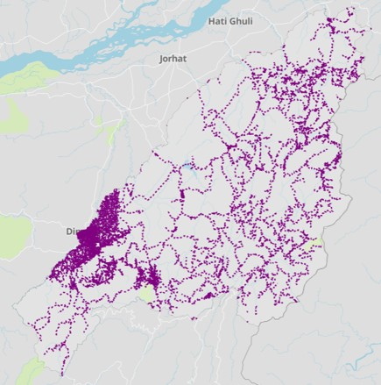
Energy Access Explorer
Data-informed Integrated Equity-driven Inclusive
Functionality
High resolution Priority Areas for Energy Access Interventions
Dynamic Information System for Data Providers
Track Change over time
Data in different scales and formats:
Open Census
Satellite
Global
National
Sub-national
Primary
DEMAND
Social & Productive Uses
Demographics
SUPPLY
Energy Resources
Infrastructure
Notes:
EAE provides use :
Identification of priority areas for intervention – for example EAE can be used to identify which healthcare facilities should be electrified/solarized first
It also acts as a dynamic information system. For example: In Nagaland, we are working with their state GIS department for using EAE’s analysis and use it as dynamic data repository
Track change over time (monitoring)
The data is from Nagaland

Slide 10
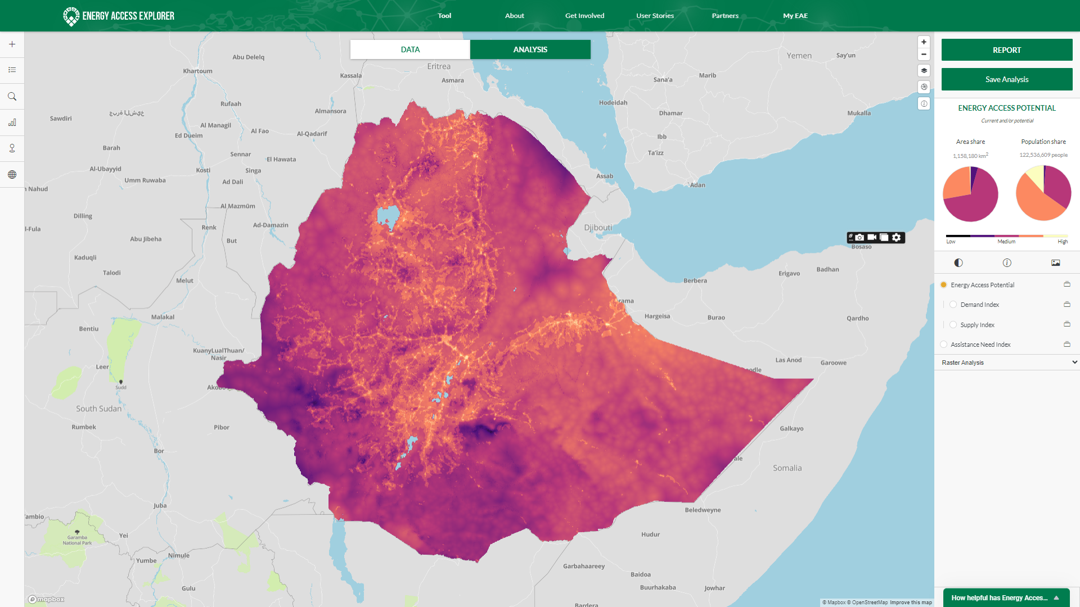
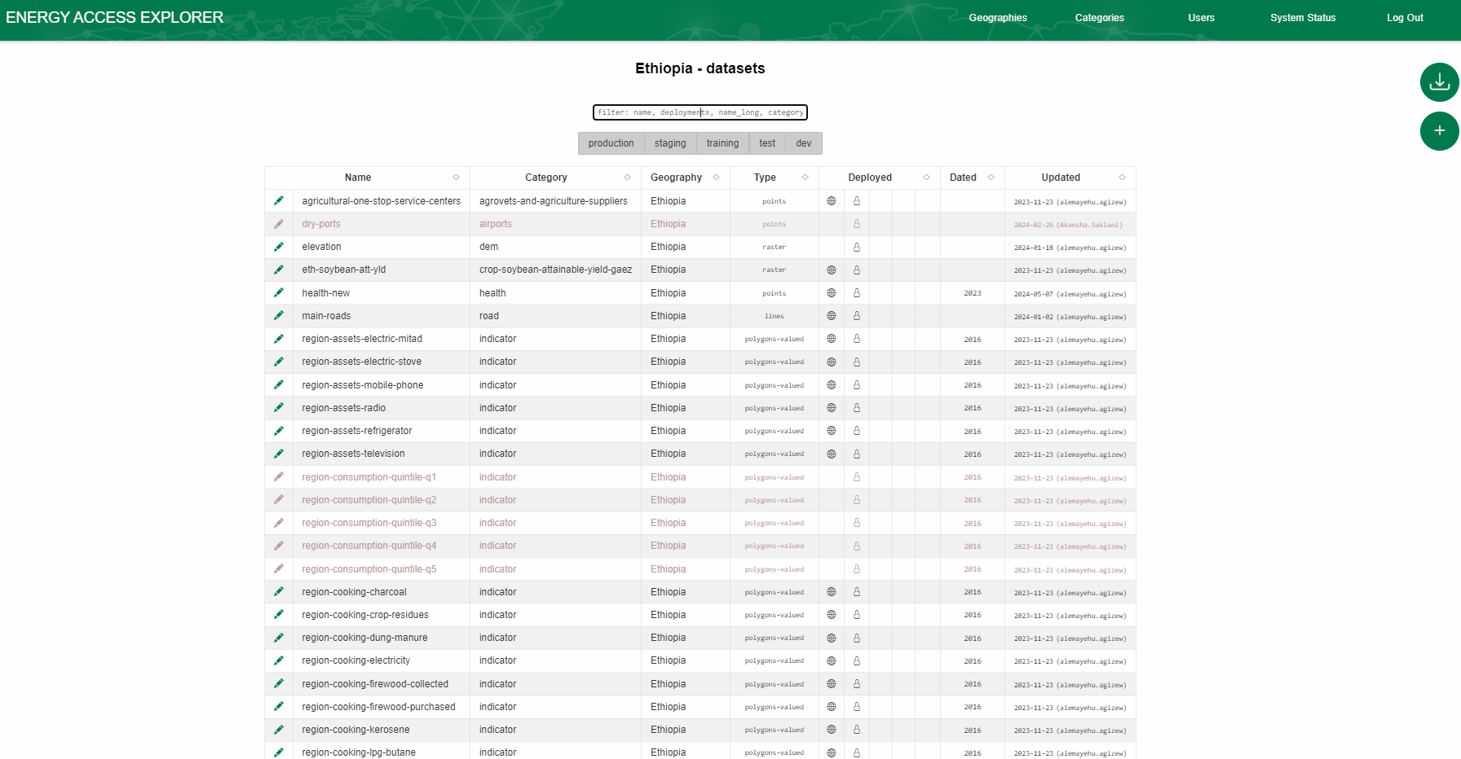
TECHNICAL EXPERTISE
Frontend - Data & Analysis users
No programming
No GIS
Backend - Data administrators
No programming
Basic GIS

Slide 11
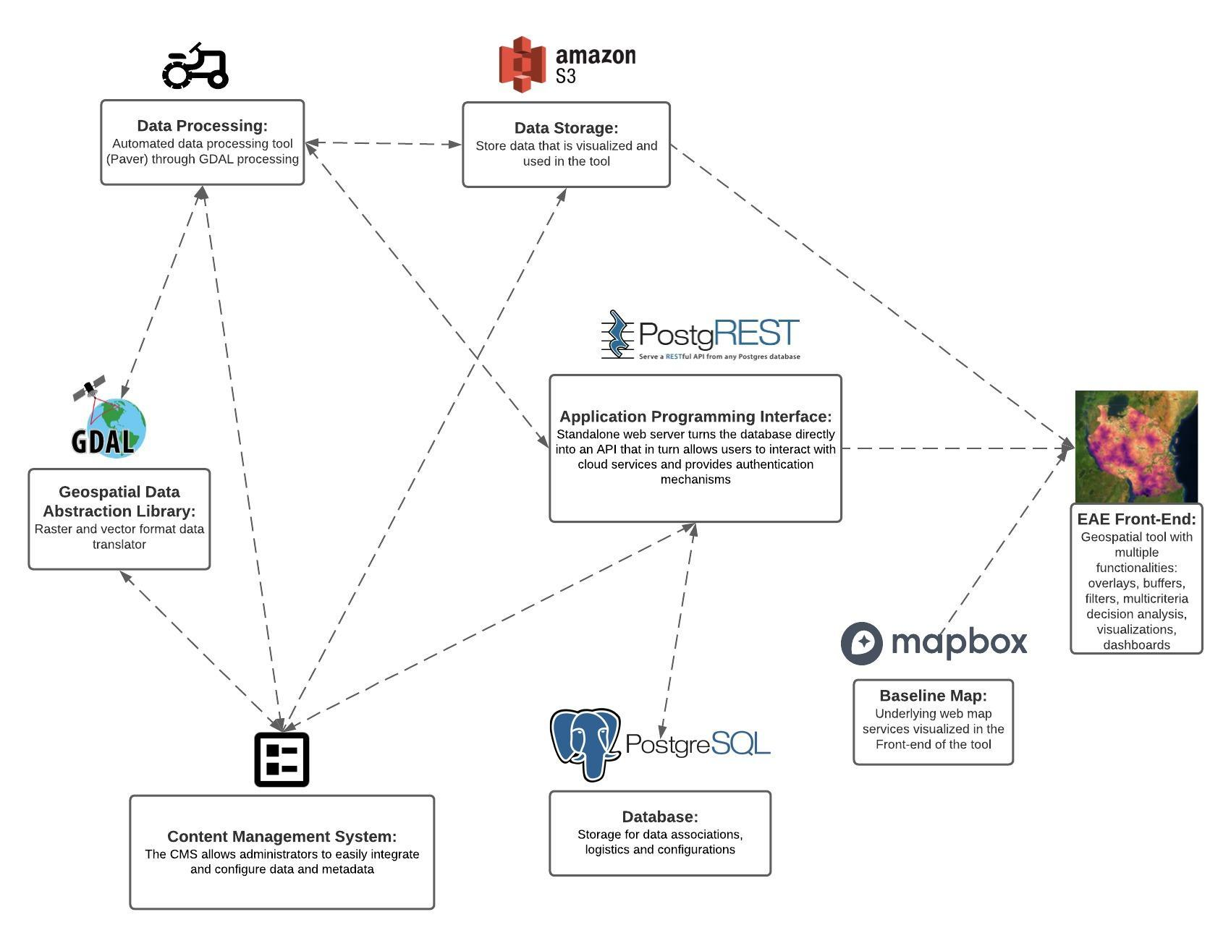
Energy Access Explorer – Dynamic Geographic Information System
Open Source -Adaptable - Web Architecture
EAE’s Backend provides:
Automated Data Processing
Dynamic database
Efficient data storage
Customized Content Management System
Variety of Baseline Maps
A modular API
Notes:
Beyond its visualization and analytical capabilities, EAE’s provides a unique infrastructure for administrators. This comes with:
Automated Data Processing to minimize resource requirements when it comes to harmonizing, integrating new data or updating the existing ones.
Dynamic database and Efficient data storage
Customized Content Management System which allows administrators with limited or no GIS and programming expertise to add data and metadata in a simple manner. Furthermore, administrators can customize visualizations, decide how data are grouped and presented in the front end, have the possibility to add new multi criteria analysis.
Variety of Baseline Maps including names of places, satellite imagery and other.
A modular API that connects the Backend of the application with the Front-end and enables users to generate rapid, high resolution visualizations and prioritization analysis on the fly
So EAE constitutes a Dynamic Geographic Information System, with an open source,
adaptable web-architecture

Slide 12
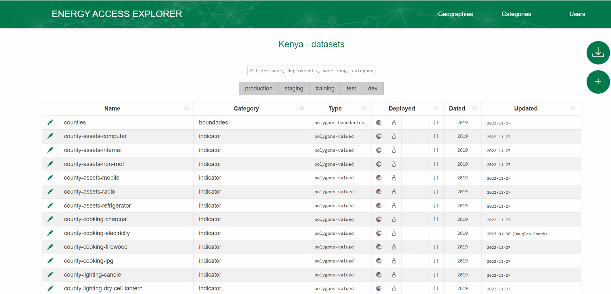
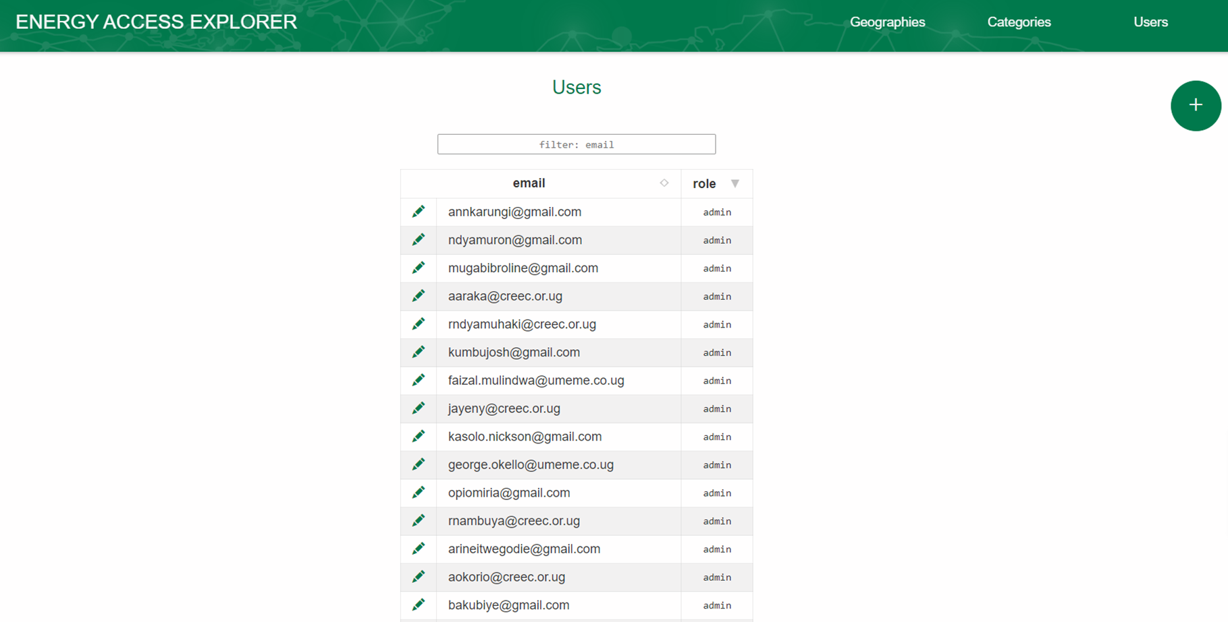
Effective data management and governance system
Data Management System
Data, Metadata, System Customization in one place
Data Governance System
Roles and Responsibilities of partnering institutions/data providers
Notes:
Data providers without any programming expertise are now able to access a user friendly web infrastructure that facilitates data management and improves data governance.
12

Slide 13
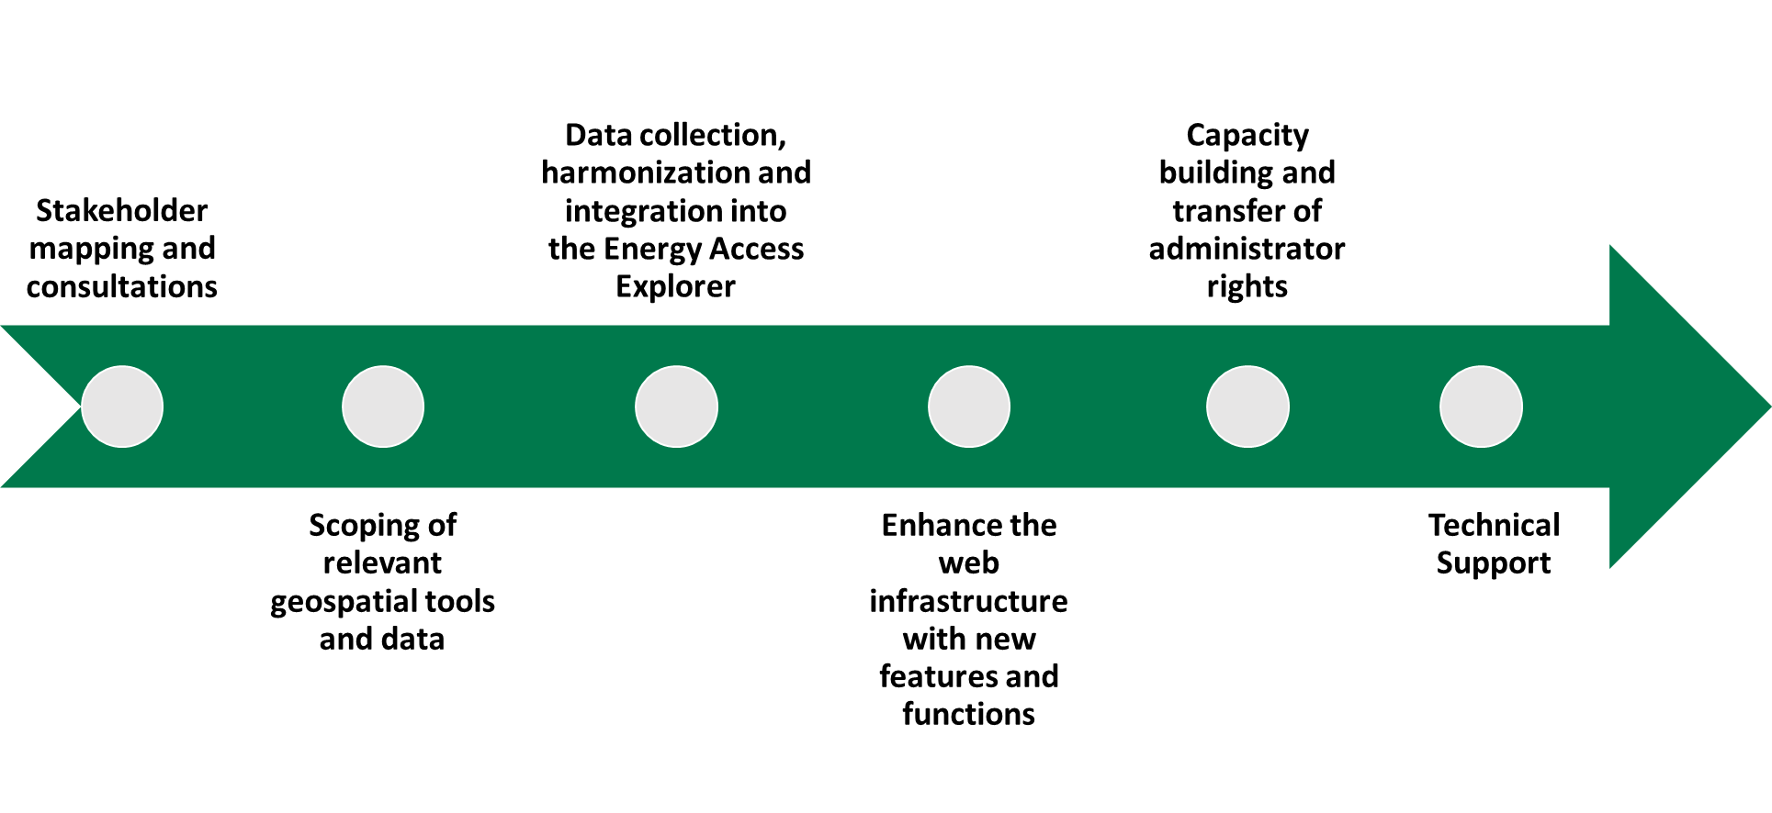
Six steps to customize
EAE
EAE Zambia

Slide 14

A data driven, integrated and inclusive approach to planning for achieving universal access to energy for equitable development
Covers countries with 32% of the total unserved population globally
Originally prototyped for 3 countries and is now being developed for 23 geographies, at both national and subnational levels
Close partnership with > 200 stakeholders and users.
> 25,000 returning users

Slide 15
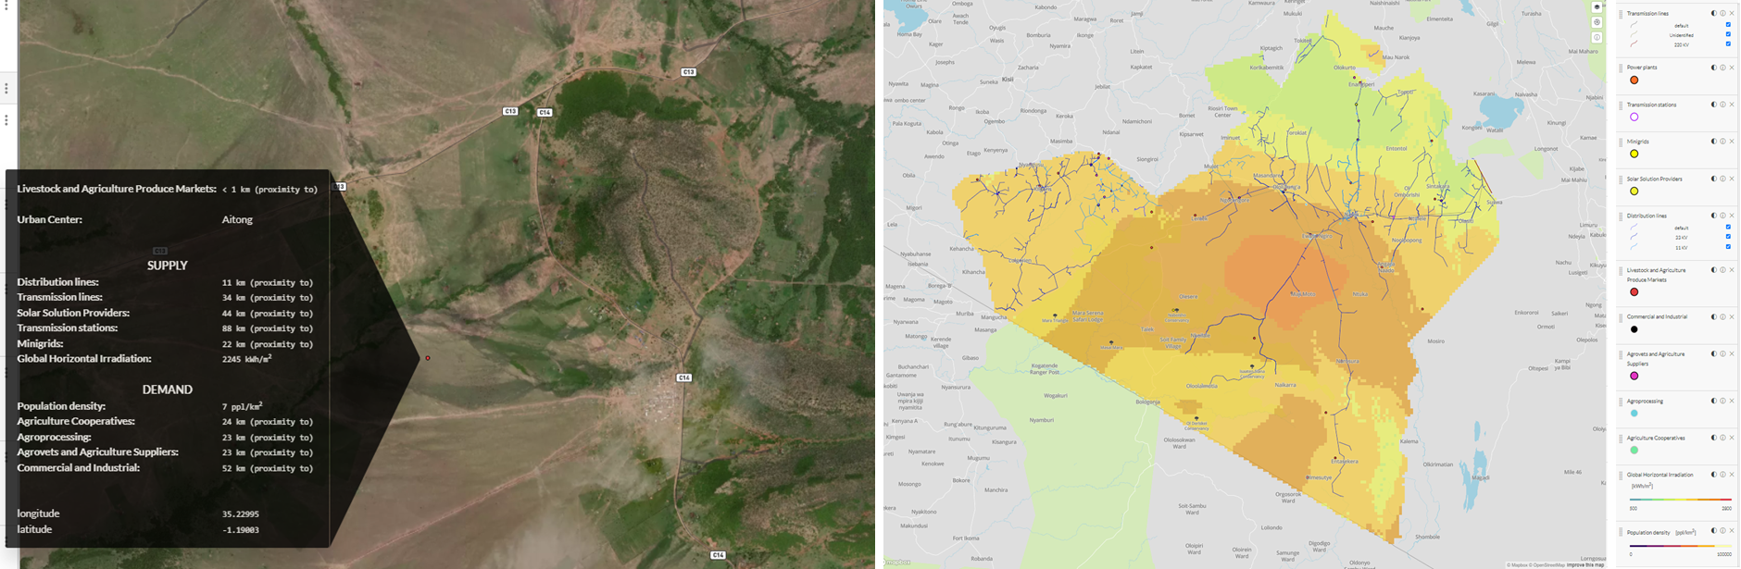





PRODUCTIVE USES OF ENERGY— CRITICAL FOR SOCIO-ECONOMIC GROWTH
Notes:
PUE are critical for socio economic growth considering Africa’s reliance on agricultural activities (17% of the GDP). More than 4 times higher the global average. As such, EAE is being used to assess opportunities for expanding PUE. We started in three counties in Kenya (Narok, Bungoma, Makueni) and we will be scaling this effort across the country and other countries too.

Slide 16
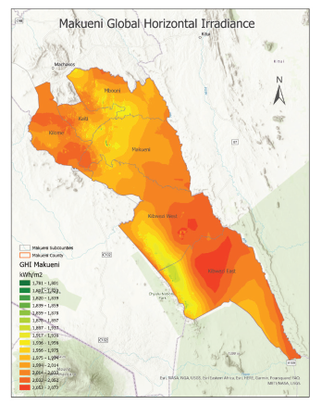




Integrated and Inclusive Energy Planning IN KENYA
Strengthening county-level capacity
Collecting and analyzing data
Integrating data on EAE
Modelling Least-Cost electrification & Cooking scenarios
CEP Writing, Validation & Launch
Notes:
In collaboration with local and national government agencies, EAE is being used to support the development of inclusive County Energy Plans which are supposed to feed into the Integrated National Energy Plan. Here we see a sample from Narok county’s least cost electrification assessment using OnSSET.
OnSSET is a bottom-up GIS-based cost optimization toolkit that runs on python-based code for identifying least cost technological options for electrification of un-served areas. (Mentis, D. et al, 2020). It calculates scenarios for expanding access through an analysis of electrification options: grid-connected, mini grids and standalone systems (e.g.: Solar home systems or SHSs the associated investment and capacity needs. An electrification algorithm identifies and selects the technology configuration with the lowest Levelized Cost of Electricity (LCOE) for a given settlement

Slide 17
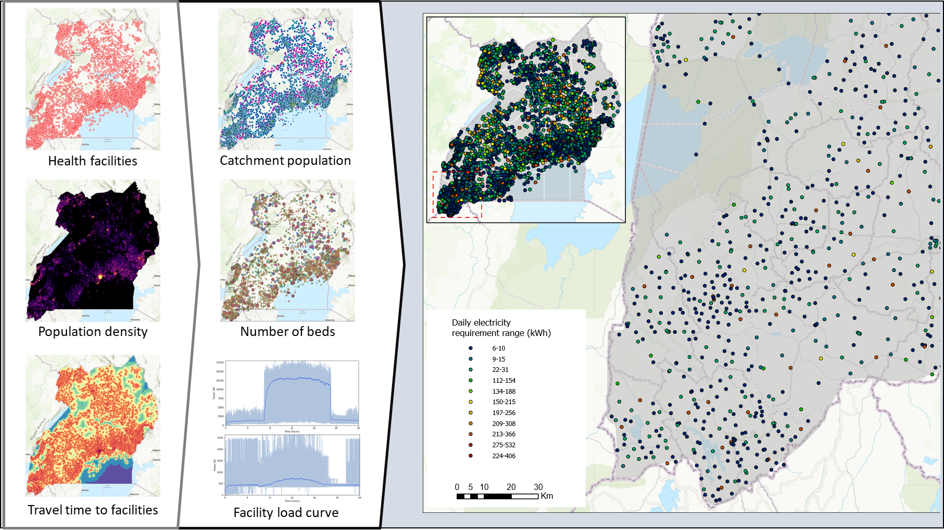





Powering Healthcare — Quintessential for Equitable Development
Notes:
In Uganda, EAE is being used by the Ministry of Health and MEMD and partners to develop a powering healthcare roadmap. More specifically, together with POLIMI and IIASA we assessed the electricity requirements of unserved and underserved facilities, information which is essential for designing viable supply systems. Over 3 million people in the country are served by facilities without off-grid or on-grid electricity. All these facilities are in areas that have a significant solar energy potential.

Slide 18
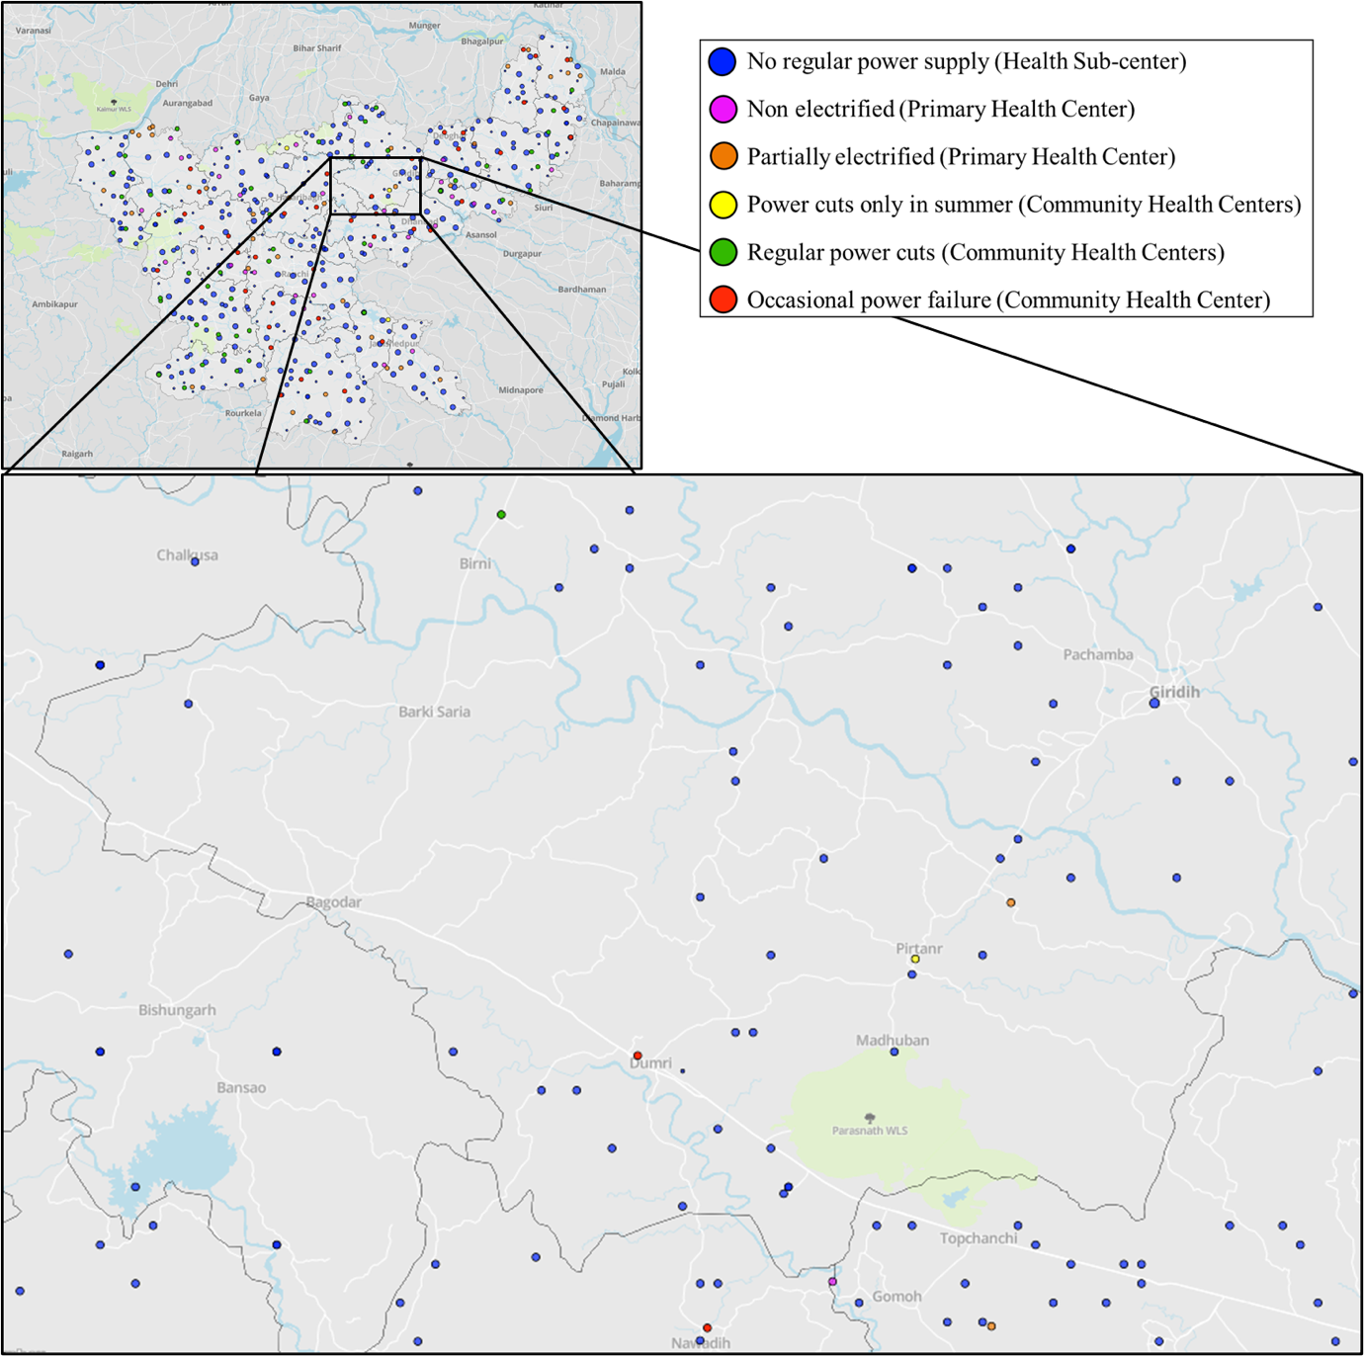
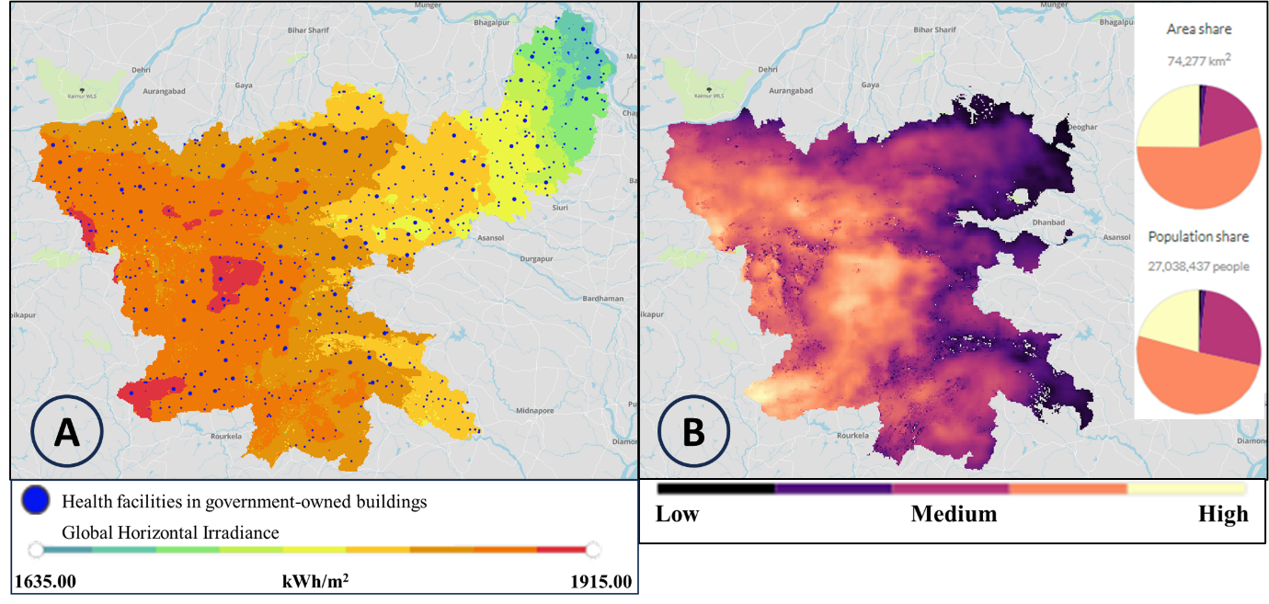


Powering Healthcare – Quintessential for Equitable development
Notes:
There are some practical ways in which EAE offers a pathway toward the expansion of modern energy services for achieving critical development outcomes in a climate sensitive manner.
First of all, Powering healthcare . In Jharkhand, EAE has been used to identify and prioritize 300 healthcare facilities for solarization.
The Jharkhand Renewable Energy Development Agency (JREDA) has been solarizing health facilities and other government departments in different phases of the Grid Connected Rooftop (GCRT) solarization project. To electrify Health Care Facilities (HCFs) in a phased manner, JREDA used the Energy Access Explorer (EAE) for identifying and prioritizing healthcare facilities as part of the GCRT Project.

Slide 19
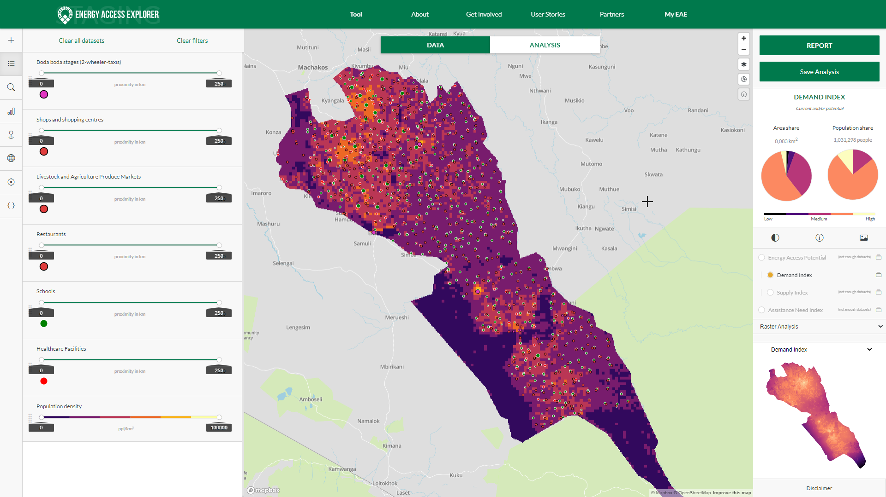
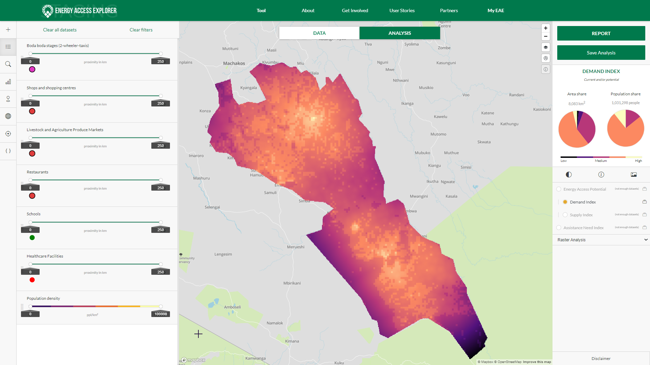

Decarbonizing Transportation : Optimal Location for installing EV Charging Infrastructure

Slide 20
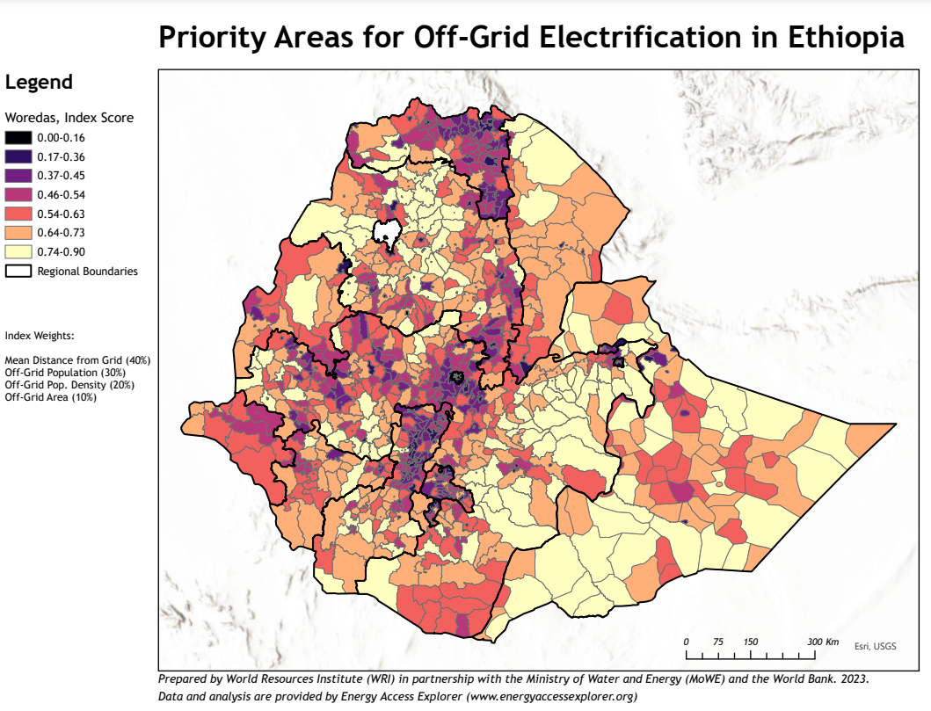






Investing for Impact
Results based financing – off grid electrification in Ethiopia
Notes:
There are 6 practical ways in which EAE offers a pathway toward the expansion of modern energy services for achieving critical development outcomes in a climate sensitive manner.
First of all, impact investment. In Ethiopia, MoWE, Utilities and the World Bank use EAE to inform the design of the Results Based Financing for off grid electrification. More than 19 million people living in 145 woredas have been prioritized for off-grid electrification.

Slide 21
Equity driven
Equitable Access to Energy: EAE integrates data on poverty and affordability, unserved households, health and education facilities and enables stakeholders to identify possible supply options based on current and planned infrastructure and the location specific energy resource availability.
Equitable Access to Software: Stakeholders that were previously left outside energy planning conversations, are now able to utilize granular data and analytics and gain actionable insights with regards to the expansion of energy services where it’s needed the most.
Cross-sectoral EAE working groups in the various countries to enable the integrated and inclusive approach to planning and ensure local ownership (key for the sustainability of this initiative)

Slide 22
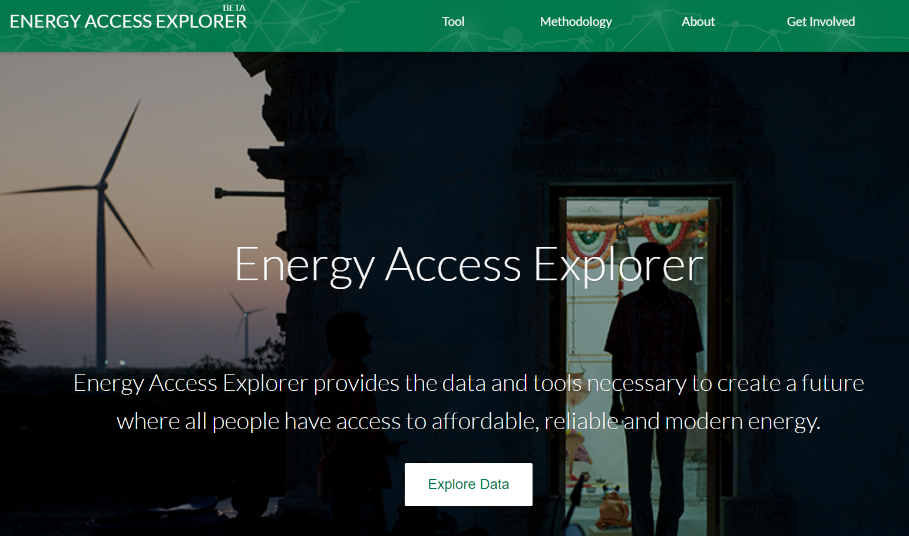
Interested in learning more or contributing to the development of EAE?
Akansha.Saklani@wri.org
Website: energyaccessexplorer.org
Code: GitHub.com/energyaccessexplorer
Online Training: https://www.open.edu/openlearncreate/course/view.php?id=11552
Source: NASA Earth Observatory

