Slide 1
Rethinking the Web CMS and Finding the Excitement
Michael Diedrick
Jozi Schneider
Slides URL: byte.dev/fosdem

Slide 2
Character Exposition
Finding the Mission
An Enemy Emerges
But the Enemy is Us
A Reckoning
How Can We Turn This Around?
Reasons For Hope

Slide 3
Character Exposition
Finding the Mission
An Enemy Emerges
But the Enemy is Us
A Reckoning
How Can We Turn This Around?
Reasons For Hope

Slide 4

Character Exposition
Developer for 25 years
Switched to working for public good 15 years ago
I wanted to focus my energy on one area
I believe in the power of education and knowledge
The public library is amazing
I may get obsessed with things

Slide 5
Character Exposition
Finding the Mission
An Enemy Emerges
But the Enemy is Us
A Reckoning
How Can We Turn This Around?
Reasons For Hope

Slide 6

Finding the Mission
The public library is…
Dedicated to knowledge & learning
A beacon of culture in every city or county
The only place you can go that nobody is selling
anything
Trusted by people
1000x more trustworthy than the internet

Slide 7
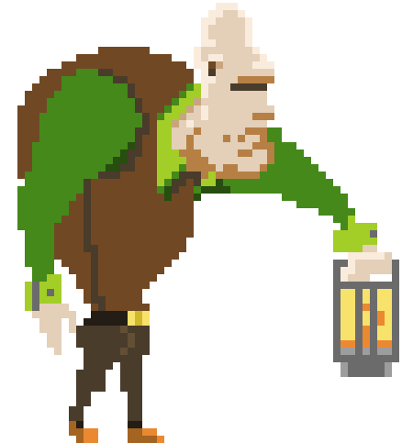
Finding the Mission
I see most public library websites are “anti-mission”:
The design says they’re out of touch
People don’t see the plethora of events and programs
Sites have endless accessibility and usability issues
Many sites send most/all site searches to the online catalog, saying their only value is books
Art by Moperius on DeviantArt

Slide 8
Finding the Mission
Beyond the design, public library sites fall into a content doom spiral:
They’re hard to update, so they don’t get updated
Since they’re never updated, people don’t visit them
Citizens who pay for libraries see little value in them

Slide 9
Character Exposition
Finding the Mission
An Enemy Emerges
But the Enemy is Us
A Reckoning
How Can We Turn This Around?
Reasons For Hope

Slide 10

An Enemy Emerges
From a library’s point of view:
Choosing a CMS is hard
Using a CMS is hard and requires a lot of training
CMSes are not focused on library types of content
CMSes require discovery and installation of plugins
CMSes are limited, so can’t ask for much
The CMS or plugins may break at any time
CMS search is not useful, controllable
Art by Dal-Bo on DeviantArt

Slide 11
Character Exposition
Finding the Mission
An Enemy Emerges
But the Enemy is Us
A Reckoning
How Can We Turn This Around?
Reasons For Hope

Slide 12
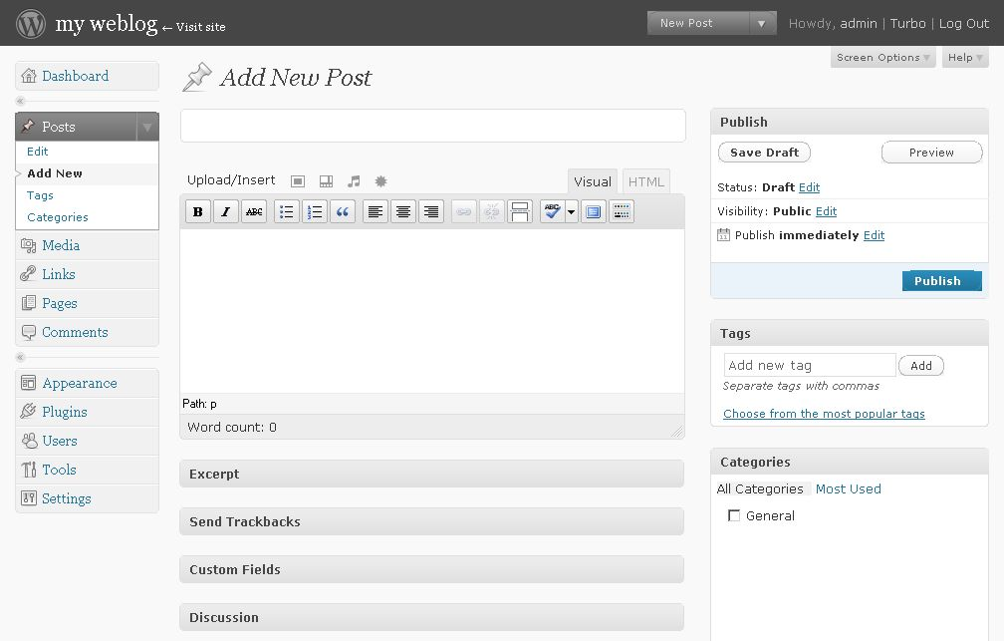
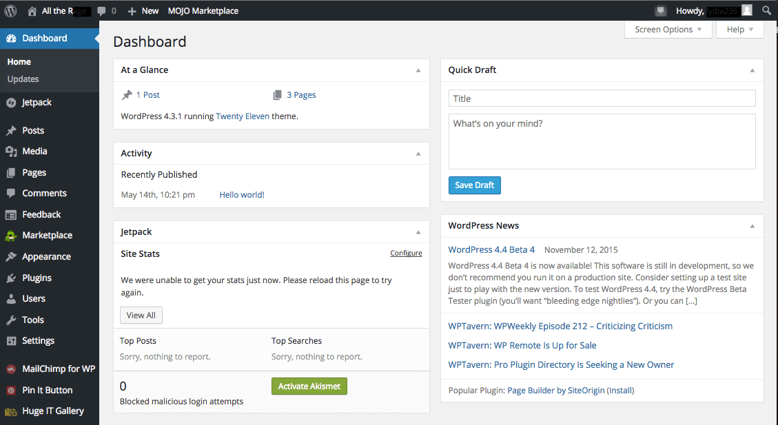
But the Enemy is Us
From my point of view, CMSes haven’t changed much.
2008
2024

Slide 13
But the Enemy is Us
What are the great CMS innovations of the last 10 years?

Slide 14
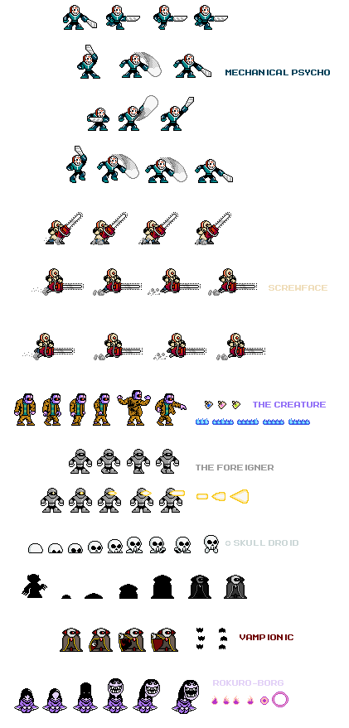
But the Enemy is Us
What are the great CMS innovations of the last 10 years?
Multi-channel
Experience management
CRMs
SEO
(hint: great for business)
Art by boberatu on DeviantArt

Slide 15
But the Enemy is Us
What are the great CMS innovations of the last 10 years?
Single Site Generation
Full site building tools like Webflow
Templating like Twig
Alternative data like Github for hosting
(hint: great for technologists)

Slide 16
But the Enemy is Us
What are the great CMS innovations of the last 10 years?
Block editor
(Actually good for librarians.)

Slide 17
But the Enemy is Us
Where did the innovation go?

Slide 18
Character Exposition
Finding the Mission
An Enemy Emerges
But the Enemy is Us
A Reckoning
How Can We Turn This Around?
Reasons For Hope

Slide 19
A Reckoning
In 2020, I started working on a CMS specifically for public libraries. I heard countless times:
“Why on earth?”
“Have you heard of …[insert popular CMS here]?”
“It’s impossible to do well.”
“It’s going to be a complete waste of time.”

Slide 20
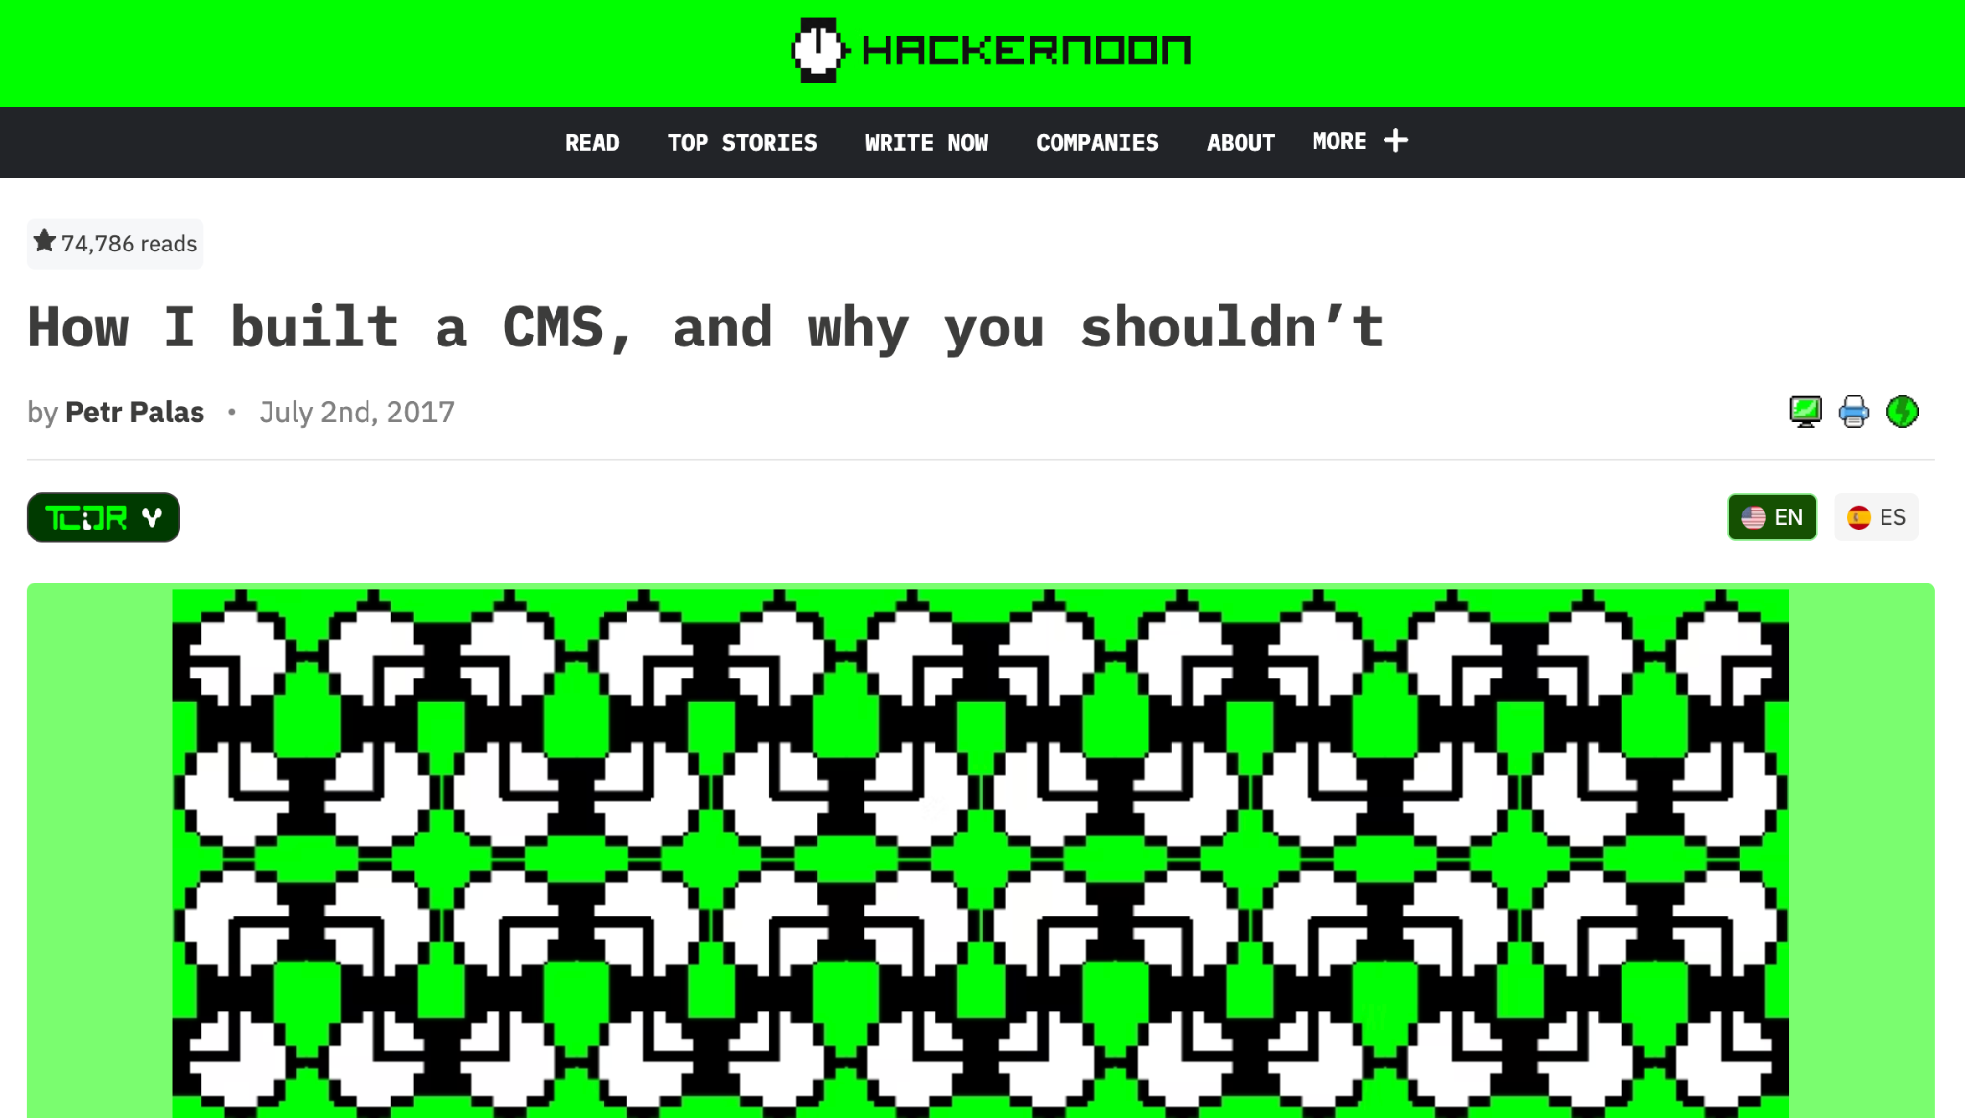
A Reckoning

Slide 21
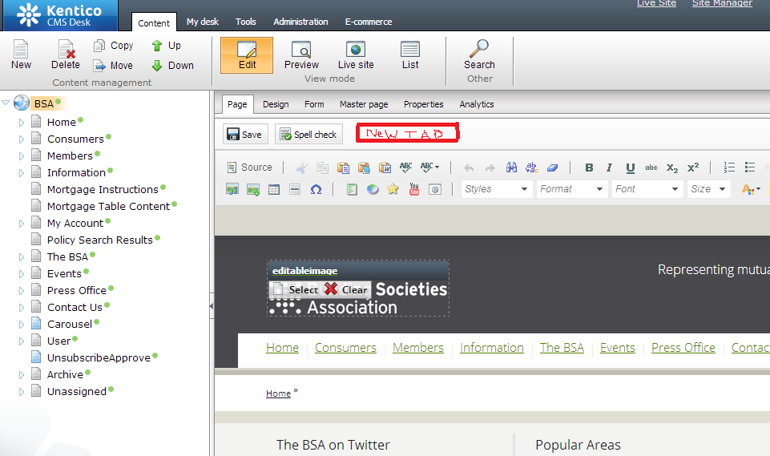
A Reckoning

Slide 22


Slide 23
A Reckoning
Some other possible causes:
CMSes are overgeneralized

Slide 24
A Reckoning
Some other possible causes:
CMSes are overgeneralized
CMSes are siloed

Slide 25
A Reckoning
Some other possible causes:
CMSes are overgeneralized
CMSes are siloed
CMS data isn’t easily exportable / importable

Slide 26
A Reckoning
Some other possible causes:
CMSes are overgeneralized
CMSes are siloed
CMS data isn’t easily exportable / importable
CMSes don’t make data management a priority

Slide 27
A Reckoning
Some other possible causes:
CMSes are overgeneralized
CMSes are siloed
CMS data isn’t easily exportable / importable
CMSes don’t make data management a priority
CMSes don’t make content creation a priority

Slide 28
A Reckoning
Some other possible causes:
CMSes are overgeneralized
CMSes are siloed
CMS data isn’t easily exportable / importable
CMSes don’t make data management a priority
CMSes don’t make content creation a priority
CMSes don’t help people learn how to do better

Slide 29
A Reckoning
Some other possible causes:
CMSes are overgeneralized
CMSes are siloed
CMS data isn’t easily exportable / importable
CMSes don’t make data management a priority
CMSes don’t make content creation a priority
CMSes don’t help people learn how to do better
The plugin-first environment works against users

Slide 30
A Reckoning
Some other possible causes:
CMSes are overgeneralized
CMSes are siloed
CMS data isn’t easily exportable / importable
CMSes don’t make data management a priority
CMSes don’t make content creation a priority
CMSes don’t help people learn how to do better
The plugin-first environment works against users
Experimentation isn’t part of the CMS ethos

Slide 31
Character Exposition
Finding the Mission
An Enemy Emerges
But the Enemy is Us
A Reckoning
How Can We Turn This Around?
Reasons For Hope

Slide 32

How Can We Turn This Around?
Make the CMS specifically for a target user / market

Slide 33
How Can We Turn This Around?
Make the CMS specifically for a target user / market
Make the CMS objectively easy

Slide 34
How Can We Turn This Around?
Make the CMS specifically for a target user / market
Make the CMS objectively easy
Make an export system that preserves relationships

Slide 35
How Can We Turn This Around?
Make the CMS specifically for a target user / market
Make the CMS objectively easy
Make an export system that preserves relationships
Make rich data management a native feature

Slide 36
How Can We Turn This Around?
Make the CMS specifically for a target user / market
Make the CMS objectively easy
Make an export system that preserves relationships
Make rich data management a native feature
Make the CMS a writing / production studio

Slide 37
How Can We Turn This Around?
Make the CMS specifically for a target user / market
Make the CMS objectively easy
Make an export system that preserves relationships
Make rich data management a native feature
Make the CMS a writing / production studio
Make a didactic interface, contextual help

Slide 38

How Can We Turn This Around?
Make the CMS specifically for a target user / market
Make the CMS objectively easy
Make an export system that preserves relationships
Make rich data management a native feature
Make the CMS a writing / production studio
Make a didactic interface, contextual help

Slide 39
How Can We Turn This Around?
Make the CMS specifically for a target user / market
Make the CMS objectively easy
Make an export system that preserves relationships
Make rich data management a native feature
Make the CMS a writing / production studio
Make a didactic interface, contextual help
Make the experience full featured first, plugins 2nd, or plugin groups

Slide 40
How Can We Turn This Around?
Make the CMS specifically for a target user / market
Make the CMS objectively easy
Make an export system that preserves relationships
Make rich data management a native feature
Make the CMS a writing / production studio
Make a didactic interface, contextual help
Make the experience full featured first, plugins 2nd, or plugin groups
Make experimentation easy

Slide 41
Character Exposition
Finding the Mission
An Enemy Emerges
But the Enemy is Us
A Reckoning
How Can We Turn This Around?
Reasons For Hope

Slide 42

Reasons For Hope
CMSes that excite me
Medium – editor experience
CraftCMS – developer exp.
StoryBlok – image service, dev exp.
Webflow – designer exp. (alternative: webstudio)

Slide 43
Reasons For Hope
CMSes that excite me
Medium – editor experience
CraftCMS – developer exp.
StoryBlok –
Webflow – designer exp. (alternative: webstudio)
Most importantly: You. Thanks for being here.

