Slide 1
Opening the Unlocked
Manuscript Chest
A Compact Edition Template for Visualizing Archival HTR Material
FOSDEM 2025 – Open Research Devroom
February 2025
Nooshin Shahidzadeh Asadi

Slide 2
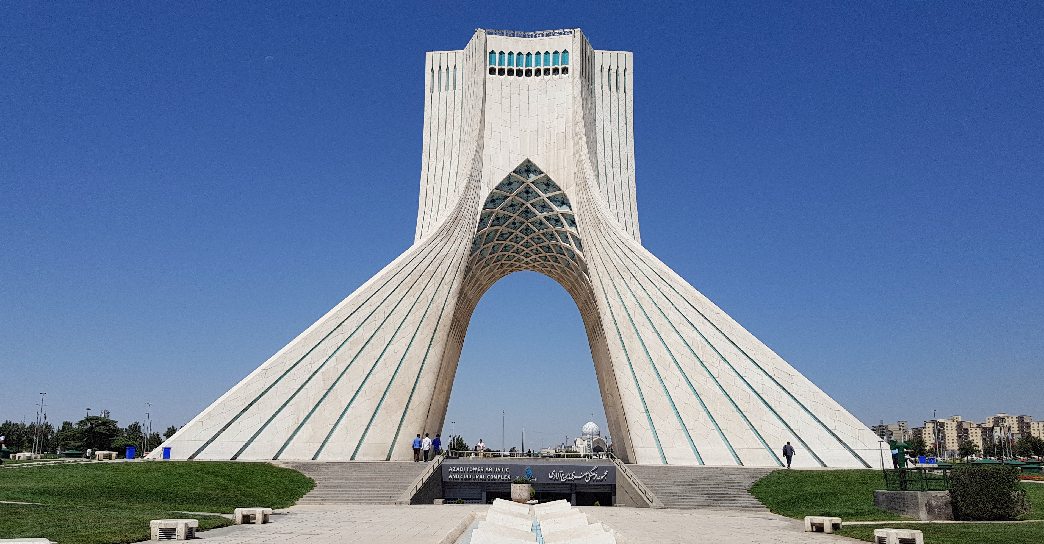
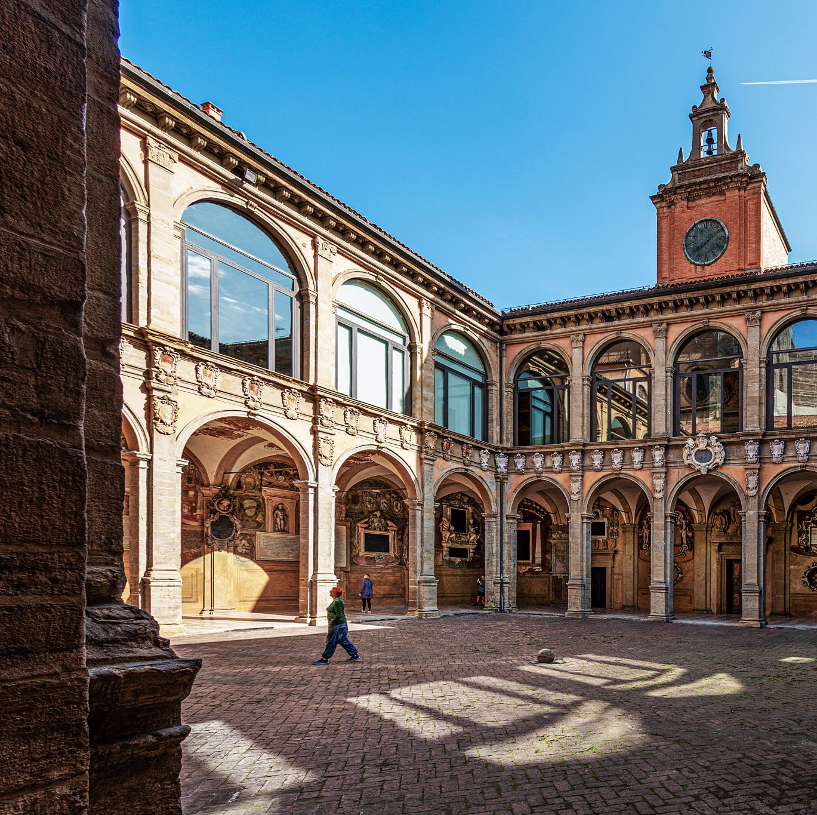
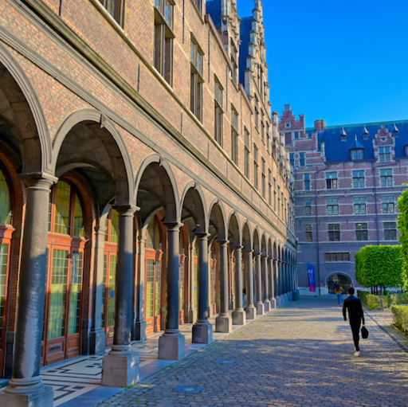
Who am I?
Nooshin S. Asadi
BSc in Software Engineering from University of Tehran
MA in Digital Humanities and Digital Knowledge from University of Bologna
PhD student in Digital Humanities at University of Antwerp (Antwerp Center for Digital Humanities and Literary Criticism)

Slide 3
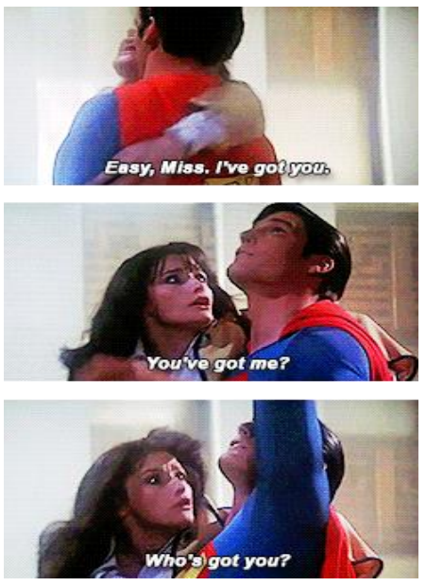
What are some challenges I’ve been facing in DH?
Sometimes getting expert advice proves difficult, we’re a society of amateurs
Tool prototypes are not the ideal thing to publish/present in the age of AI and Machine Learning
DH is still young, lags a bit behind the fast evolving bleeding edge of science
Sometimes people can be reluctant towards changing ‘what has been working so far’
Team structures in DH have not fully matured yet

Slide 4
What do we do in my research group?
Make digital scholarly editions of manuscripts
  Medieval Middle Dutch manuscripts
  Modernist manuscripts (e.g. Beckett and Joyce)
  Born-digital manuscripts
Use Handwritten Text Recognition to facilitate the transcription of documents
Publish our results

Slide 5
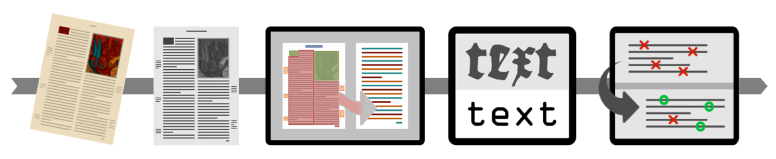
What is Handwritten Text Recognition (HTR)?
Technology used for transcribing handwriting
Utilizes supervised machine learning
Successor of Optical Character Recognition (OCR) and Automatic Speech Detection
Illustration credit: Wouter Haverals

Slide 6


How does one do HTR?
Two main platforms directed towards humanities research (for now):
  Transkribus
    More popular
    Proprietary (Freemium → Subscription)
    Centralized server
  eScriptorium
    Free and open-source
    Users should set up their own servers
    Ground truth data could be shared

Slide 7
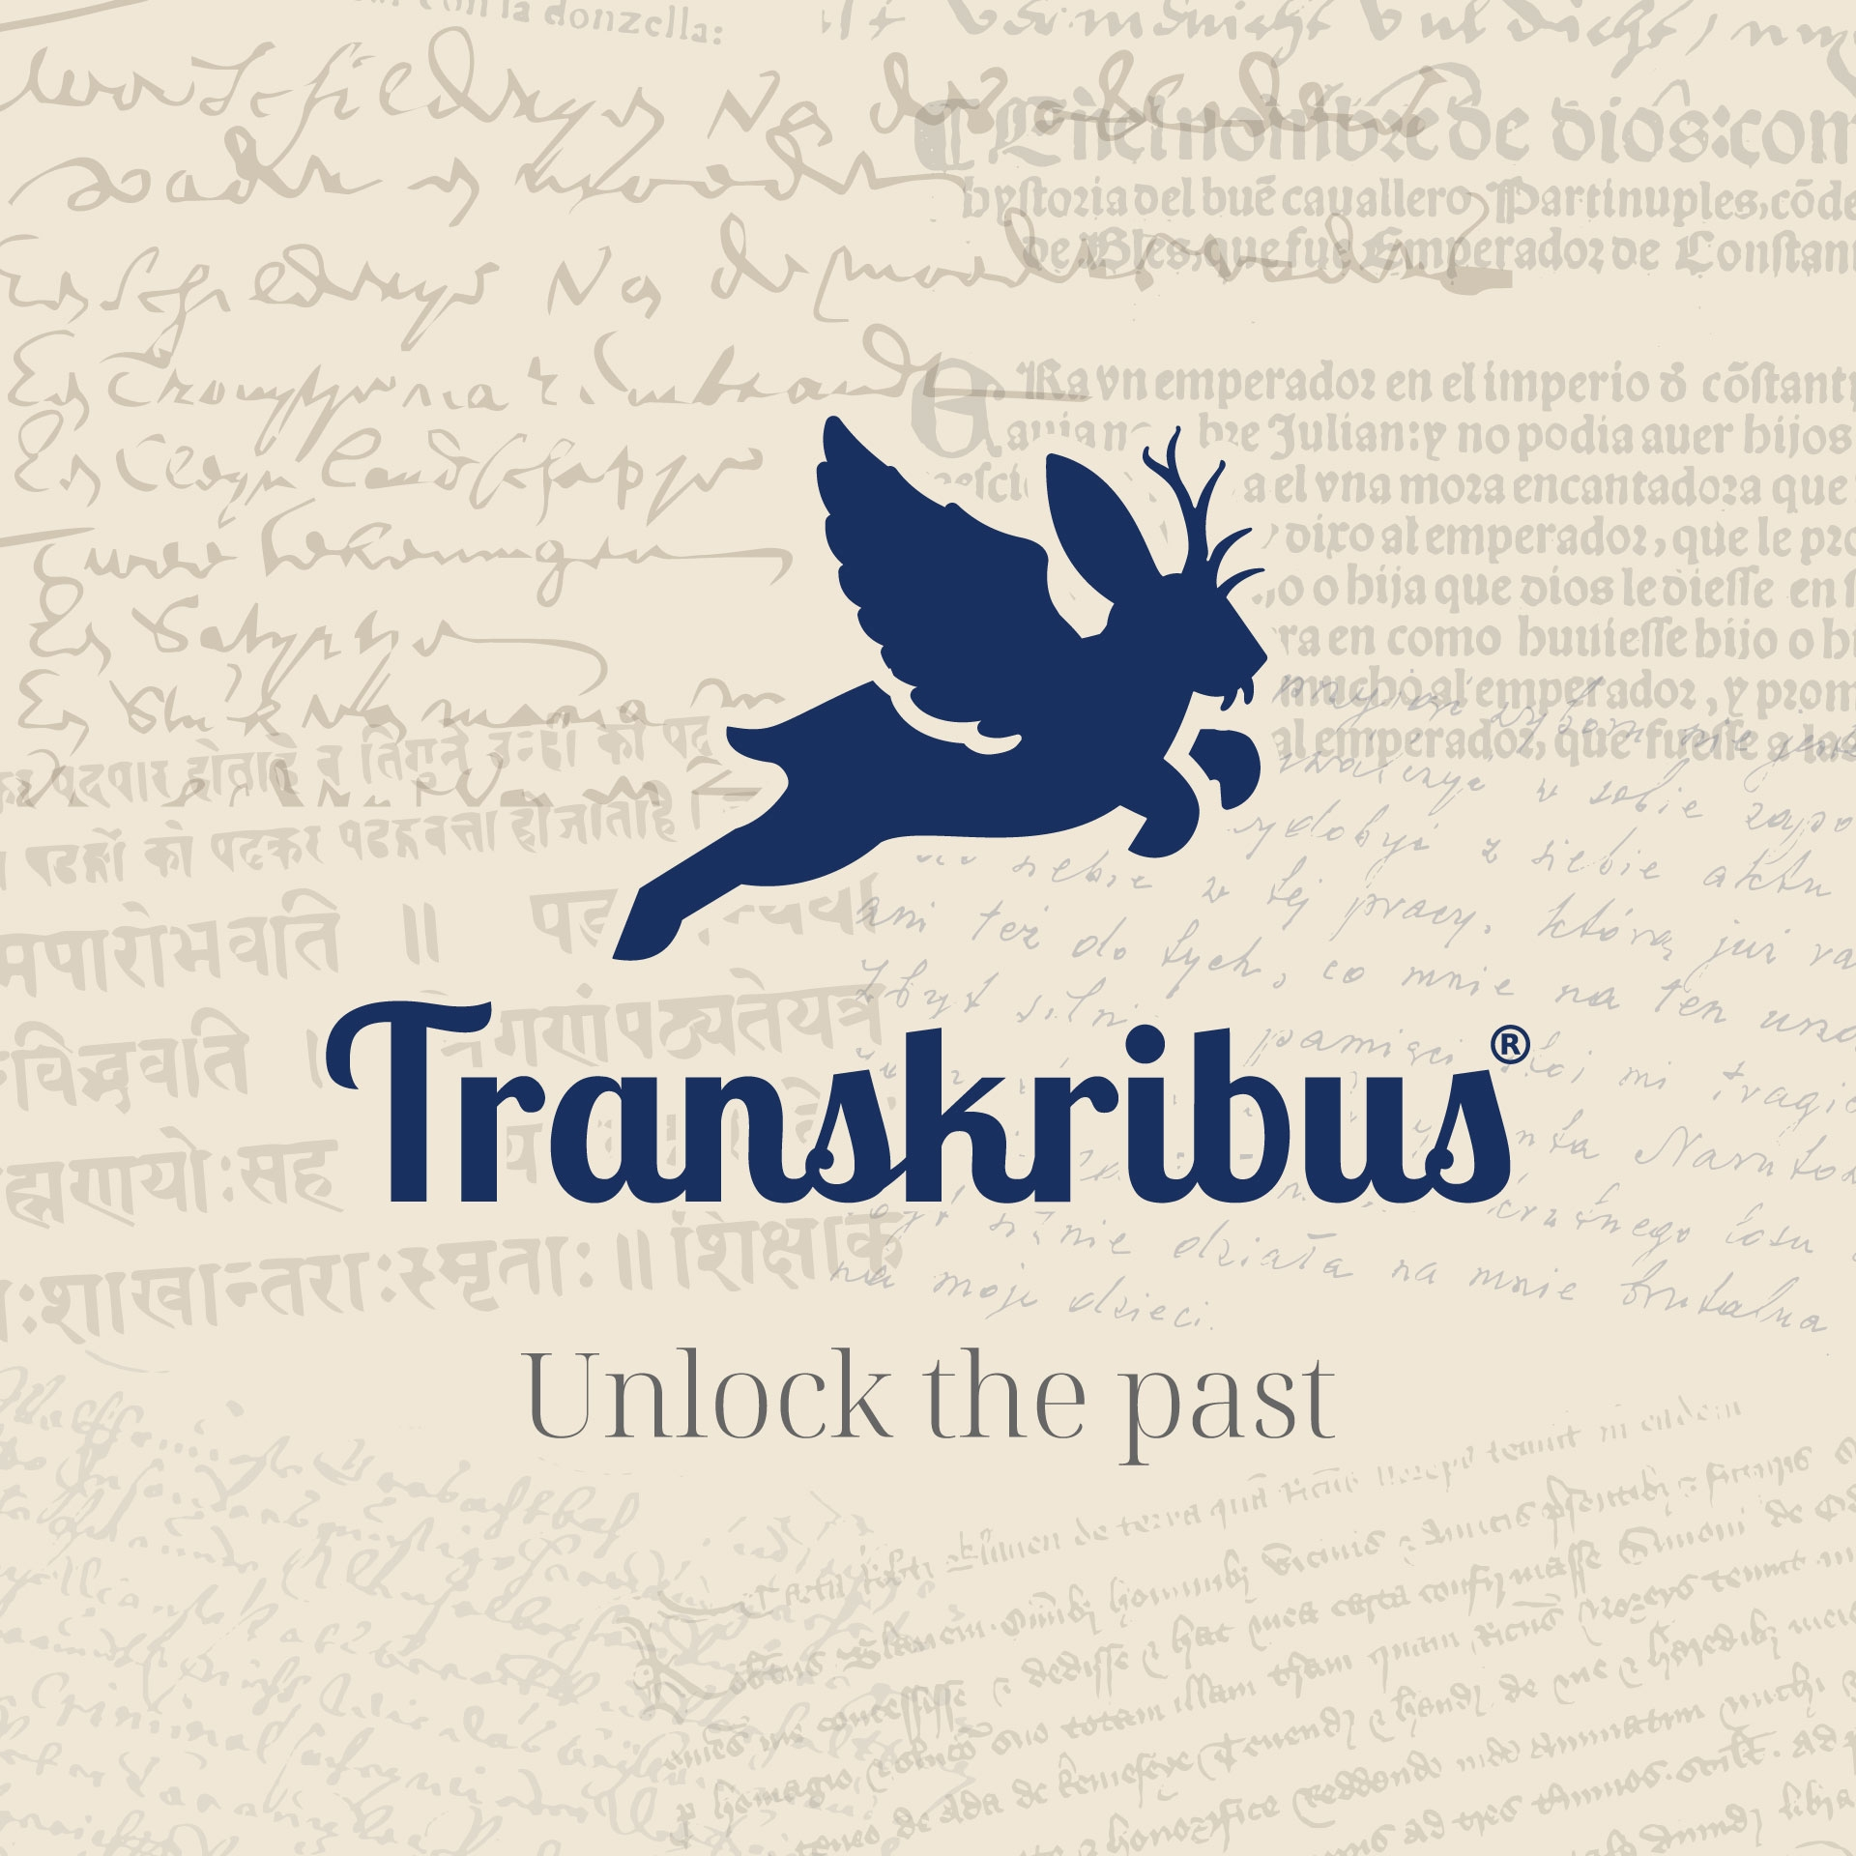
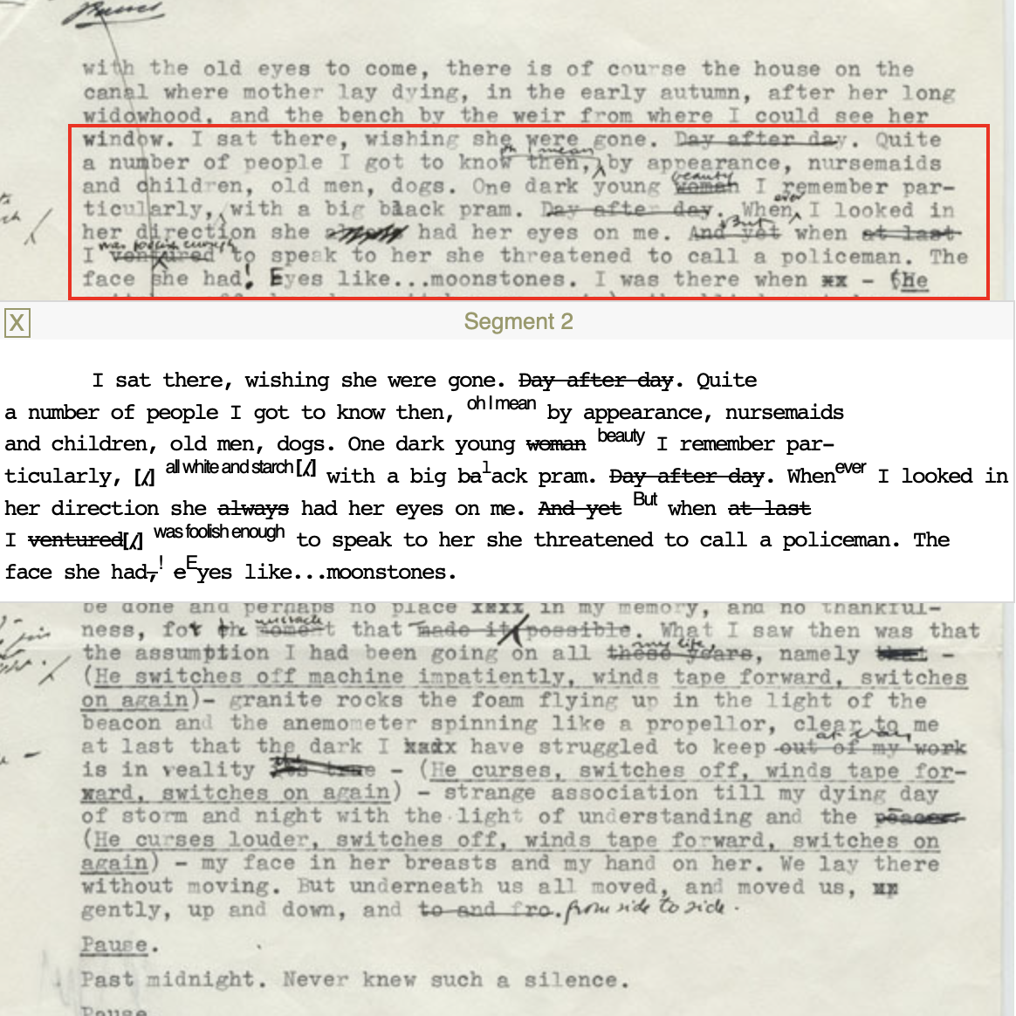
🤔
Hooray!
But wait…
However…
Transkribus is “unlocking the past”
This rich collection of “unlocked” material ends up extracted as plain text and/or used for distant reading
Digital scholarly editions emphasize the connection between image and text

Slide 8
Current solutions for visualization
Bespoke digital editions, from scratch
  Require large amounts of time, effort, money
Transkribus Sites
  Starts at over €47/month
  Not free/open-source
  Not for users of eScriptorium
TEI Publisher
  Loses the text/image connection
  Very steep learning curve
  Dependent on eXist-db ecosystem

Slide 9
Proposed solution
Necturus, a lightweight and modularized TEI viewer and publisher
Processed data can be directly exported to and rendered in the viewer
The interlinked zones from will still be present to aid the user
HTR
Platforms
XML-TEI Editor
Annotation Viewer/
Editor
Rendered XML Output + Annotations
API
API
Axolotl
Necturus

Slide 10
Features of Necturus
Pagination
Collection support
Raw XML view available
Flexible page layout
Collection search
Authentication
API-driven architecture
Of course, free and open-source!

Slide 11
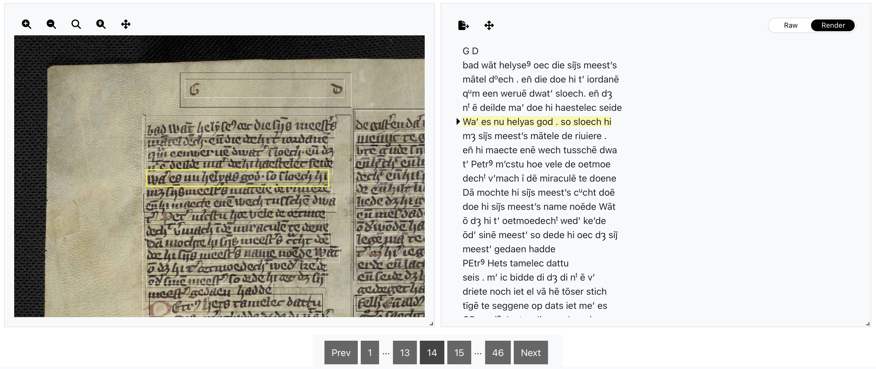
What does the viewer look like?

Slide 12
But this is difficult for humanities scholars to set up…
That’s why Necturus compact viewer was developed!
A GitHub Pages template for a static version of the app
The only required skill is minimal familiarity with git
Works very well for smaller projects
Can act as a first step for bigger projects, which can then choose to set up their own server

Slide 13
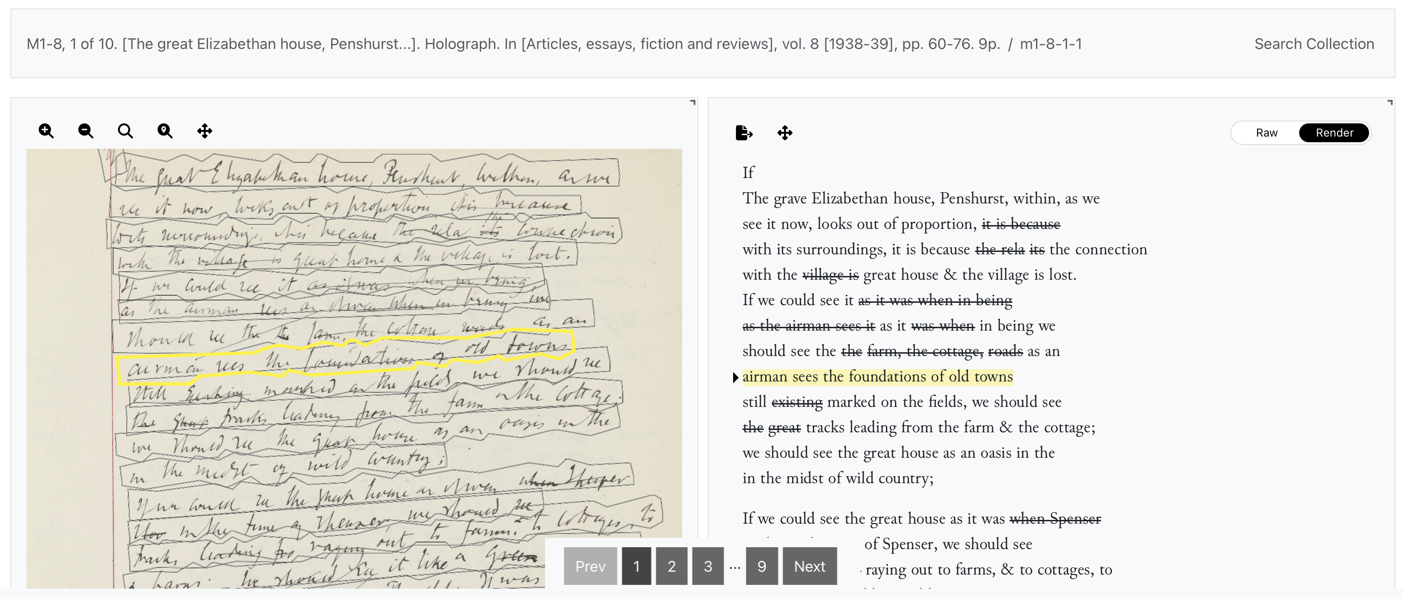
Sample use case
The Woolf Anon Project, currently with 275 pages over 45 documents

Slide 14
Thank you!
Feel free to send any questions/suggestions to
nooshin.shahidzadehasadi@uantwerpen.be

