Slide 1
Building flashless servers with Open Source Firmware for security and better flexibility
Jean-Marie Verdun, Sr Distinguished Technologist
February 2025

Slide 2

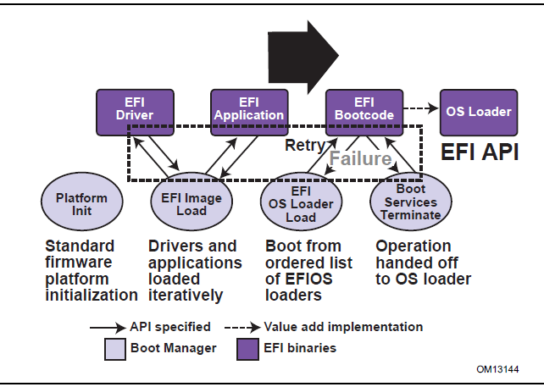
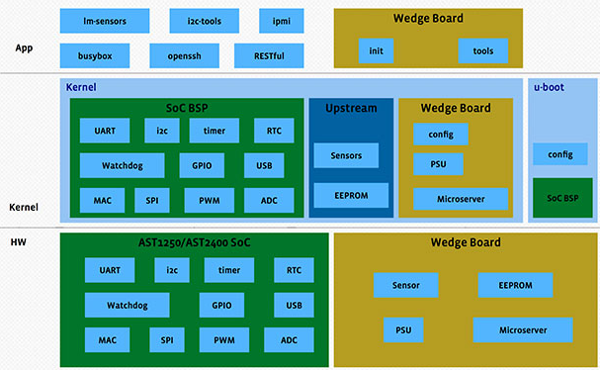
World is evolving but Firmware is still static with aging concepts
From https://engineering.fb.com/2015/03/10/open-source/introducing-openbmc-an-open-software-framework-for-next-generation-system-management
From https://uefi.org/specs/UEFI/2.10/02_Overview.html

Slide 3


Hardware evolution: DC-MHS
Data Center Modular Hardware System
New standardized approach to compute architecture
Better alignment between hardware demands and software stacks
Deliver an integrated, familiar, secure experience
Monolithic servers
Modular servers
Power Supplies
Power Supplies
PCIe Slots
BMC
PCIe Slots
CPUs & Memory
BMC
CPUs & Memory
Media Bays
Disk Cages
Fan Kits
Media Bays
Disk Cages
Fan Kits
Notes:
Monolithic Servers
All components statically defined on the motherboard
Inability to evolve technologies without whole redesign
Server generation tied to specific processor family
Platform management and locked and proprietary
Modular servers
Motherboard is deconstructed into individual modules
Individual technologies can evolve independently
Server lifecycle not restricted to any module
Platform management is versatile and standardized

Slide 4
Firmware distribution and volatile concept
Static
Monolithic
Per device with different update approaches
Central point
Volatile
Adaptive

Slide 5
Proposal: Break down firmware in 2 steps
Low level hardware init and network boot capability
High level system configuration

Slide 6

Example with BMC bootflow
Bootblock
U-boot / bootloader
Linux Kernel
RO User space
Hardware discovery / Kernel config overlay
User Space Discovery
Package Manager
Zero touch provisioning
Common image
Fast Deployment and discovery
Continuous updates

Slide 7
Example with PCIe device bootflow
Bootblock
U-boot / bootloader netboot
Map in device memory
Device start
BMC as central firmware database

Slide 8
Demo

Slide 9
Key repositories
https://github.com/opencomputeproject/OCP-OPF-Backend
https://github.com/opencomputeproject/OCP-OPF-Testing-and-Validation
https://github.com/vejmarie/coredhcp/tree/discover

Slide 10
Thank you
Verdun@hpe.com

