Slide 1
Extracting reliable data for short-lived processes using eBPF for Linux Security Threat Analysis
Ankit Garg Lakshmy A V Avtansh Gupta
Meghna Vasudeva Ayush Garg

Slide 2
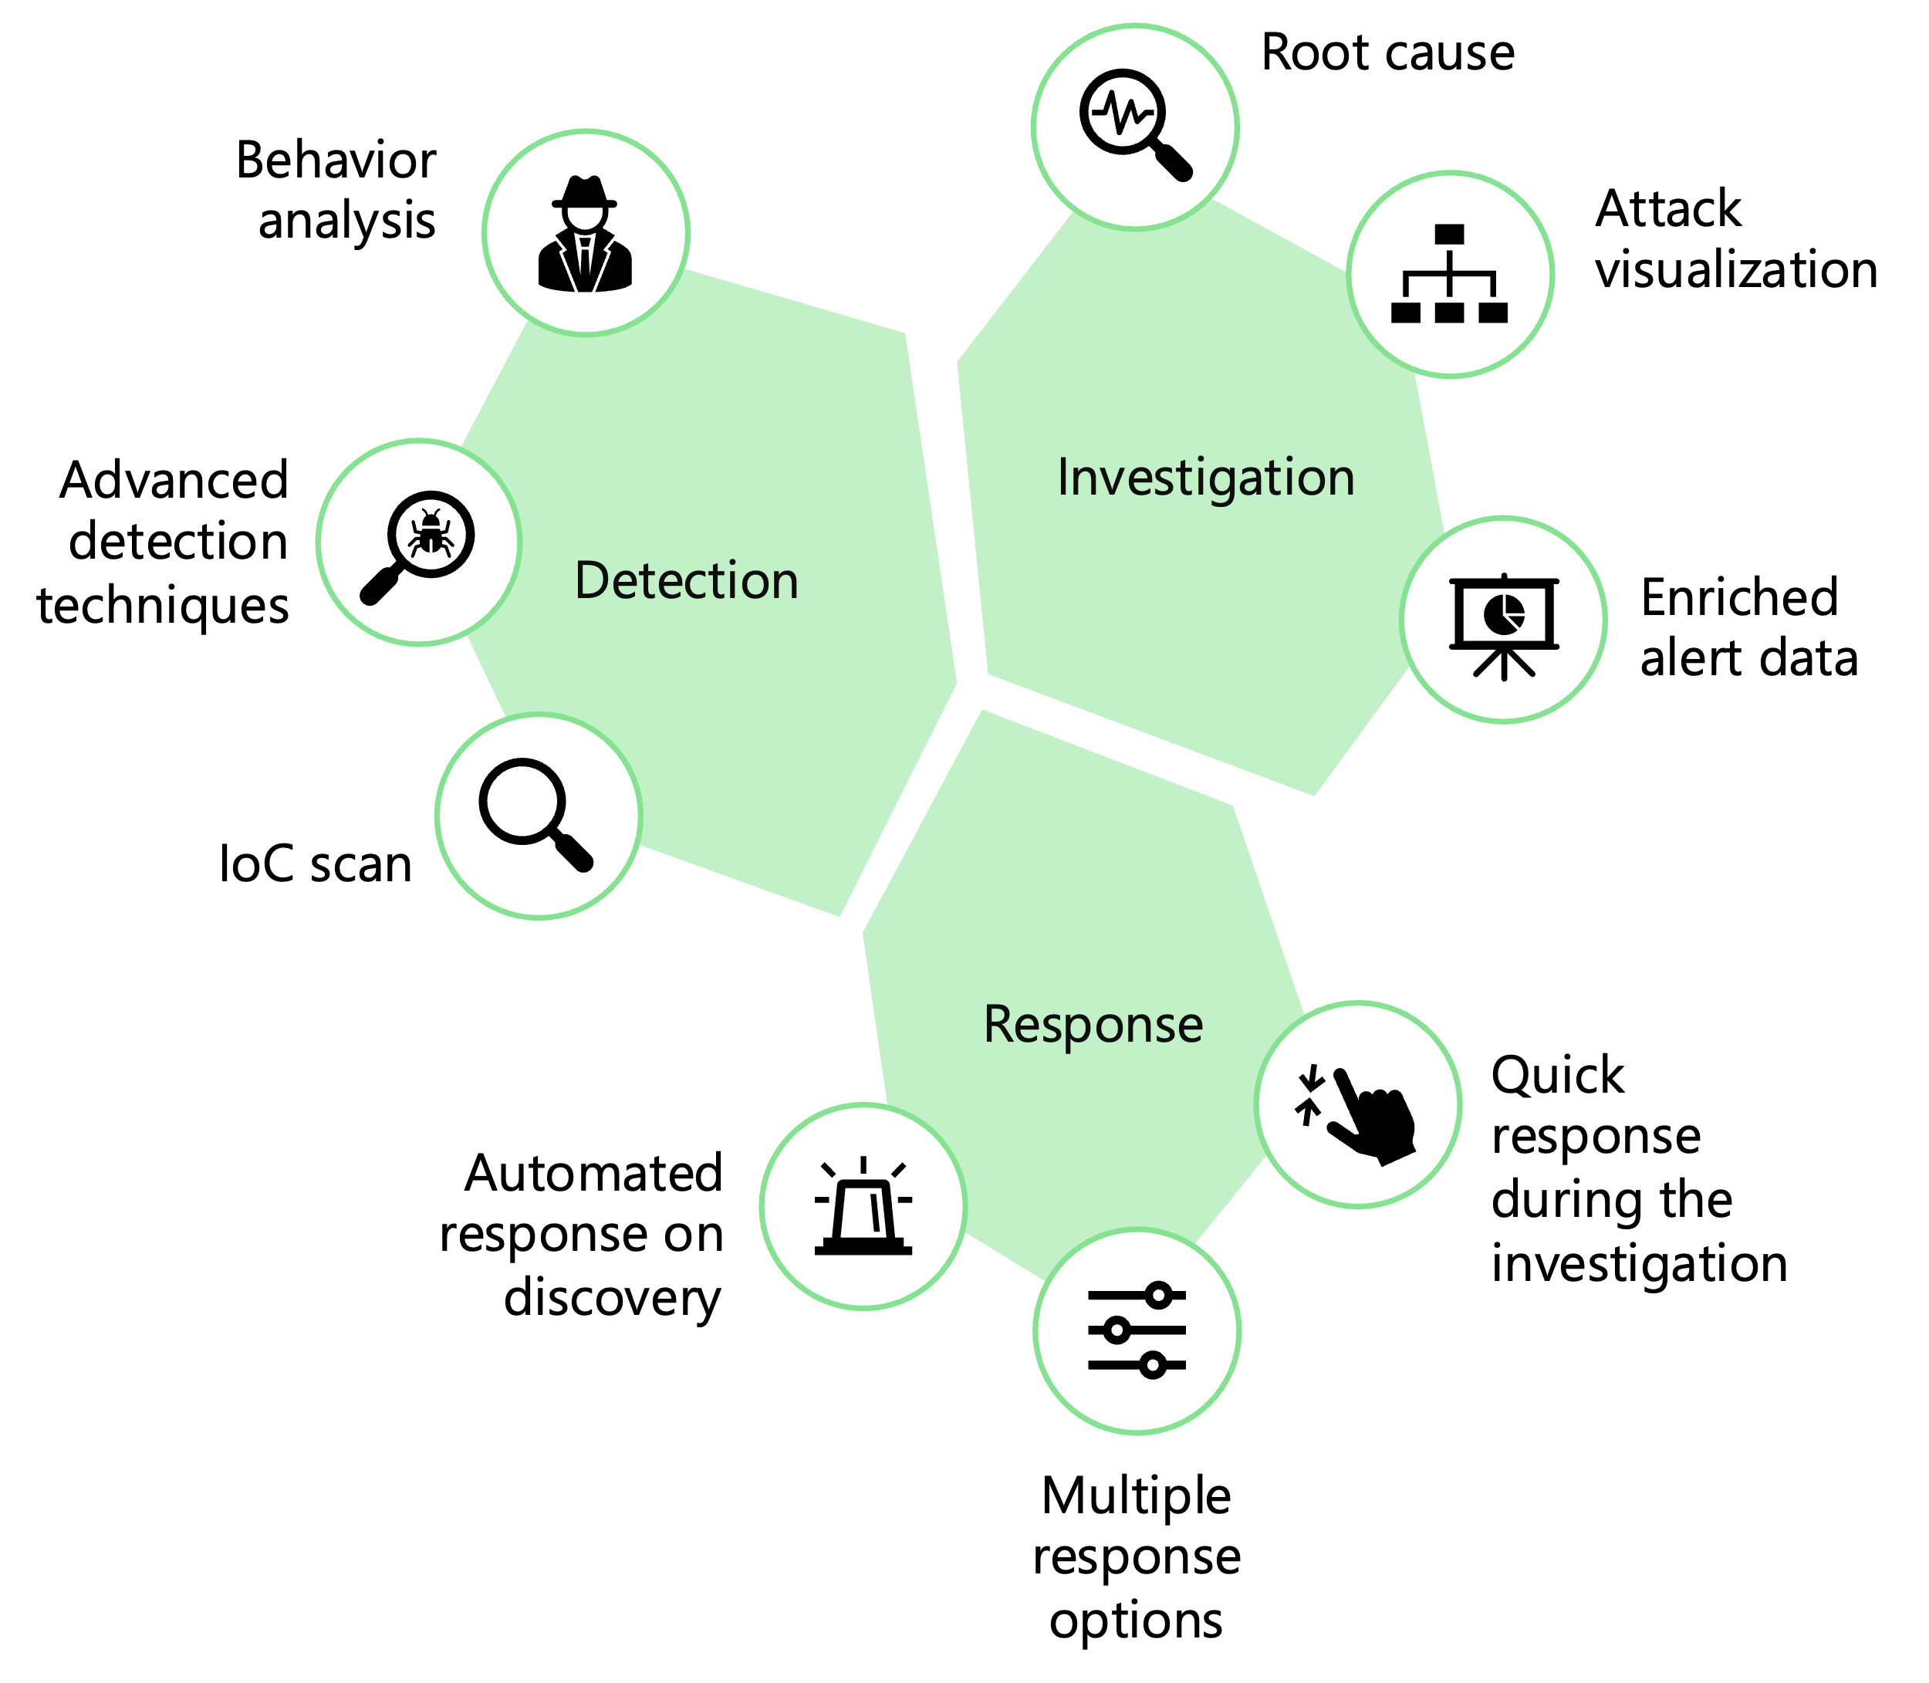
Motivation
EDR: Endpoint Detection and Response
An EDR solution continuously monitors endpoints.
  Event logs, authentication attempts, tracks process timelines
Process timelines are crucial for EDR features helps in full history, scope of a security breach
Created using PID, creation time, name, path, command line arguments etc.
Gaps in timelines hampers detection logic/ investigation, prevents mapping to corresponding threats
Notes:
Endpoint Detection and Response (EDR) solutions are cybersecurity tools designed to monitor, detect, investigate, and respond to threats on endpoints such as desktops, laptops, servers. These solutions provide comprehensive visibility into endpoint activity
There are 3 major buckets in EDR features: Detection, Investigation and Response
On Detection side: Behaviour analysis, advanced detection techniques which allows you track the sequence of events leading to malicious behaviour
On Investigation side root cause analysis, attack surface visualization, alerts
Based on real time alerts allows security teams to respond to the detected threats.
Process timelines has a critical role on each of the feature provided by EDR solution. It provide the chronological record of the lifecycle of the process
Contributes to each of the above features in edr for e.g behavior analysis
Timelines are created using PID, creation time, path, cwd, path etc.
Any gaps hampers detection logic, investigation prevents mapping to corresponding threats.

Slide 3
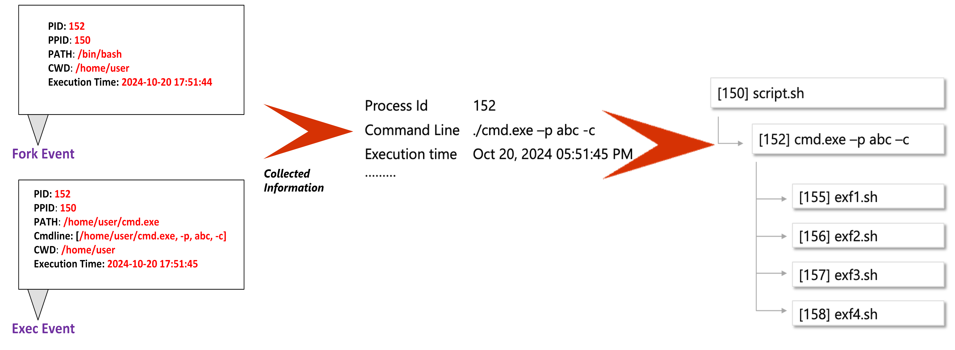
Process Timeline for Threat Analysis

Slide 4
Existing ways to extract process data
Procfs
AuditD
Netlink (Proc Connector)
Vfs provides detailed information about each process
Data is erased as soon as the corresponding process exits
Unreliable for short-lived processes
Captures detailed information about security-relevant events, logging them for later analysis
Noisy logs
Performance issues impacts both CPU and Memory
Standardized interface for sending and receiving messages related to process events
Allows user-space applications to efficiently track and respond
Provides numerical data like PID, PPID, without additional info like executable path
Notes:
Procfs:
Details
Entry , Exit of the process
Collect the details in the user space , waste a lot of time
Becomes highly unreliable for short lived process
Auditd :
Server can’t afford this much perf overhead
Lead to kernel panics as well
Conficting rules
Netlink:
Completeness of data
So this cause issues in the reliability/completenss

Slide 5
Proposed Solution
Leverage eBPF to extract process data information
Pass on this information to user space for consumption
Information is reliable, completely being in kernel space
Extract information within eBPF program running in kernel space
Utilize BTF which provides access to kernel data structures like task structure
Very effective, particularly for short-lived processes, efficient
Notes:
Read from the user space , delays the data a lot and increases the chance of missing it
We need to move to move to as close to source to get the data
The operating system has always been an ideal place to implement observability, security, and networking functionality due to the
kernel’s privileged ability to oversee and control the entire system
Keep this in mind :
We propose to extract the information for all process from kernel using ebpf . Along ebpf we will be using btf to get access to kernel data structures for completeness of data.
Info collected towards user space and make sure consistentency of the data

Slide 6
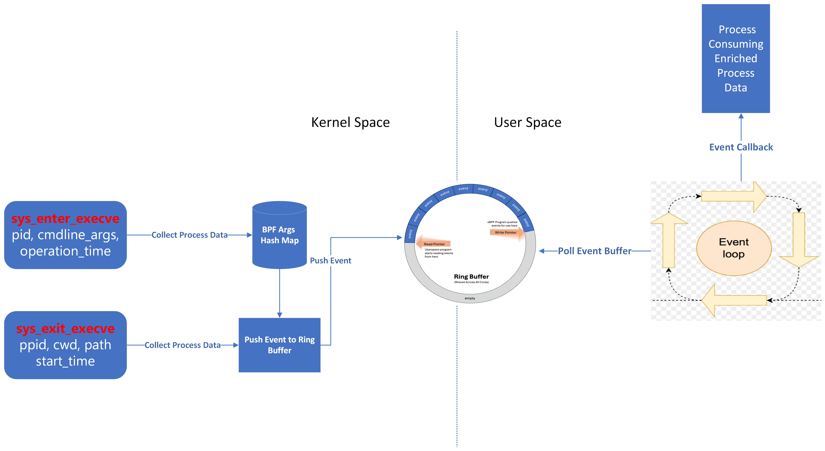
Detailed Flow from eBPF to User Space

Slide 7
Implementation summary
Process Data | Source in Kernel
pid | bpf_get_current_pid_tgid (Upper 32 bits)
ppid | task_struct → real_parent
cwd | task_struct → fs → pwd → dentry
path | task_struct → mm.exe_file → f_path → dentry
cmdline_args | ctx->args[1] (syscall arguments)
operation_time | bpf_ktime_get_ns
Event | Process Data(start_time)
Fork | bpf_ktime_get_ns
Exec | task_struct → start_boottime
Kernel Hooks | Event | Process Data
tracepoint/task_newtask | Fork | pid, ppid, cwd, path, start_time
tracepoint/syscalls/sys_enter_execve | Exec | pid, operation_time, cmdline_args
tracepoint/syscalls/sys_exit_execve | Exec | ppid, cwd, path, start_time
Notes:
So here we summarize the implementations and the different structures we used to enrich the different data points for a process event.
For the fork event as mentioned earlier a single hook is used, which is the new task hook. The parent process, the current working directory and the process paths are enriched using the task structure. The task structure gives us the dentry points for the paths and the dentry enrichment algo is used to get the complete path. To capture the process id we capture the id of the process which called the kernel hook, while the start time is the current kernel time captured using a BPF API.

Slide 8
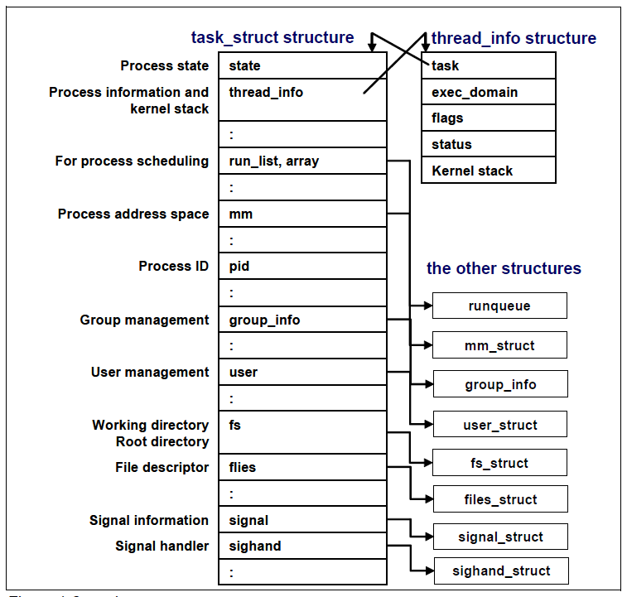
eBPF Building Blocks – Task Structure
Contains all information the kernel needs to manage and schedule processes:
    process state
    memory management
    file descriptors, and more.
bpf_get_current_task
Used to extract
  ppid
  process paths dentry
  cwd dentry
  mount point paths dentry
Notes:
The next building block used in this PoC is kernel task structures. The task structure is a fundamental structure in Linux kernel. This structure represents every process and thread created in the linux subsystem. This task structure is designed in such a way that it stores all the information the kernel needs to mange these processes. In our PoC we try to enrich some of this data the Kernel has stored, for our consumption. The data enriched using the task structure include parent process information, process paths, current working directories and paths to various mount points.
https://compas.cs.stonybrook.edu/~nhonarmand/courses/fa17/cse306/slides/16-fs_basics.pdf
https://mohammednv.wordpress.com/tag/process-descriptor/

Slide 9
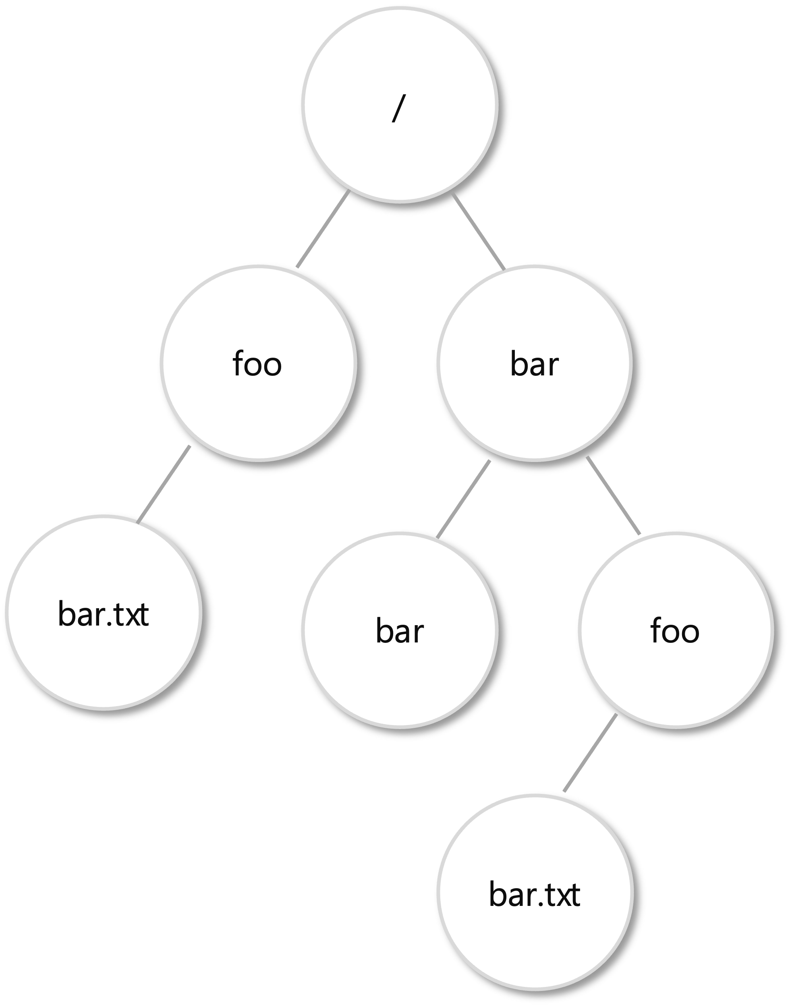
eBPF Building Blocks – Dentry Structure
dentry (directory entry) structure: fundamental part of the Virtual Filesystem (VFS) layer in Linux kernel
Organizes files and directories into tree like structure in file system
Internal nodes of tree -> directories Leaves -> Ordinary files.
Tree Traversal from leaf to root gives the path
Deep paths can make the event data very heavy: Need to keep static size of total nodes
Notes:
Moving on to the next building block, we have the dentry structure. The dentry structure is another fundamental structure in the Linux kernel. Dentry stands for directory entry. This structure represents the paths in Linux Kernel. The dentry structure stores the paths in a treelike or hierarchical format as shown in the diagram. The task structure stores the address of the leaf corresponding to the process or file of this tree. When we need to enrich the path, we traverse upward from the node to the root. The Linux Kernel uses this bottom-up traversal approach to build full paths and reduce the filesystem hierarchy complexities.
https://compas.cs.stonybrook.edu/~nhonarmand/courses/fa17/cse306/slides/16-fs_basics.pdf

Slide 10
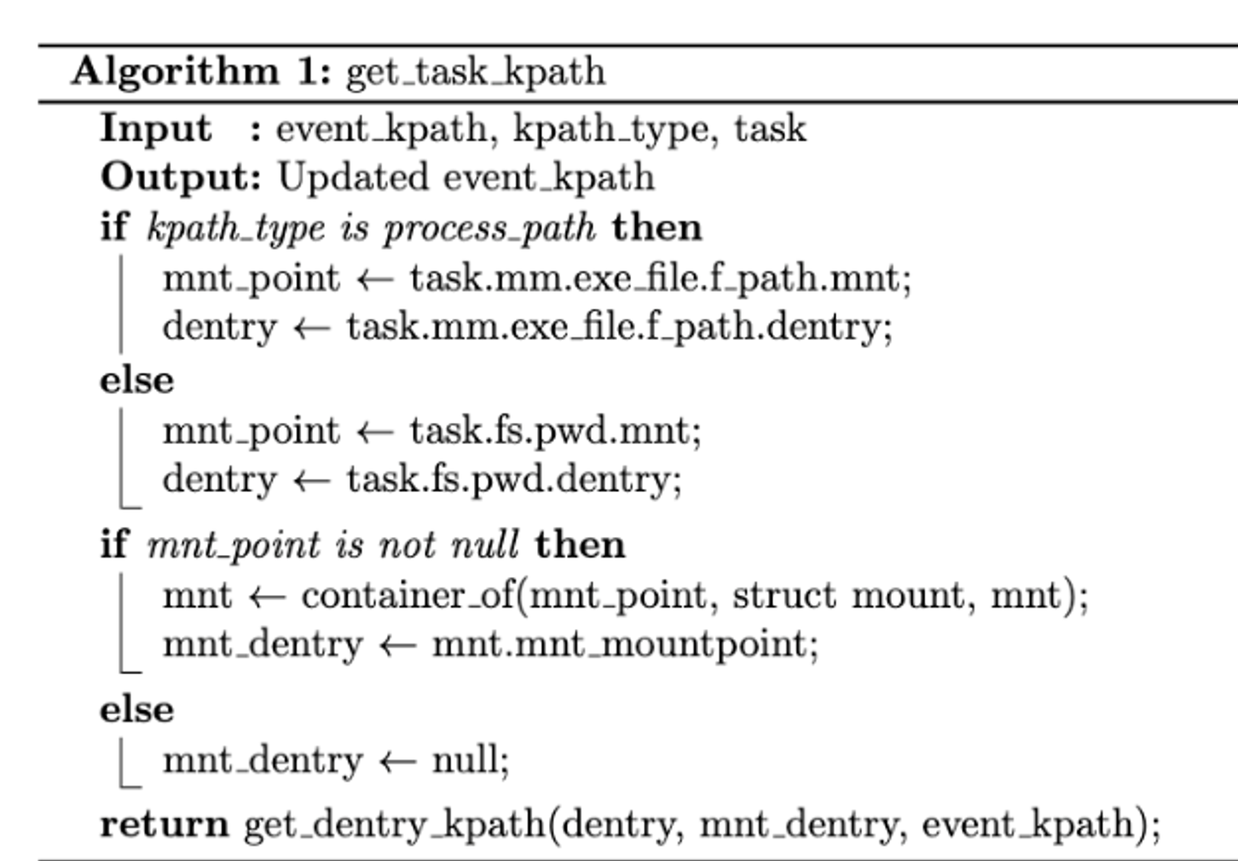
Implementation – Extracting Dentry
Cwd and process path
Process Path Dentry
Cwd Dentry
Notes:
Here we have the algorithm to extract the path from the dentry structure. To extract the path from the dentry we need use two different dentry entries and then combine the two. In Linux the dentry structure for any path is stored relative to the root of the mount point on which the path exists. To get the absolute path we need to extract the mount point path and then merge it with the process or cwd path to get the complete path.
As seen here, we first start with the dentry variable, this depicts the path for the process or current working directory. Here we traverse from the leaf to the parent till we either reach a null node or the parent represents the node itself. We store the dentry name at each level in an array and also the depth of the path for easy traversing in the future.
We then follow the same logic to extract the path of the mount point. We append the mount point node values to the same array to make a complete path. Once both these enrichments are done we will have a complete path in the array along with the depth of the path.

Slide 11
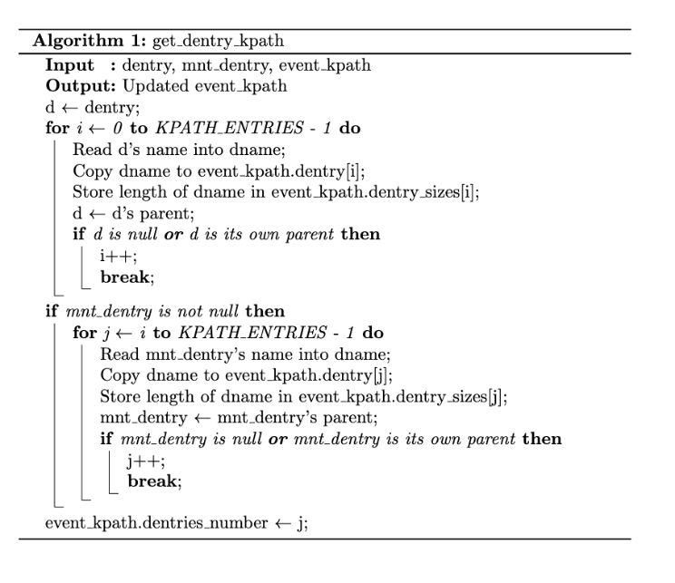
Implementation – Extracting Path from Dentry
Fixed Number of Entries
d_name field in dentry struct
Process Path from dentry
Notes:
Here we have the algorithm to extract the path from the dentry structure. To extract the path from the dentry we need use two different dentry entries and then combine the two. In Linux the dentry structure for any path is stored relative to the root of the mount point on which the path exists. To get the absolute path we need to extract the mount point path and then merge it with the process or cwd path to get the complete path.
As seen here, we first start with the dentry variable, this depicts the path for the process or current working directory. Here we traverse from the leaf to the parent till we either reach a null node or the parent represents the node itself. We store the dentry name at each level in an array and also the depth of the path for easy traversing in the future.
We then follow the same logic to extract the path of the mount point. We append the mount point node values to the same array to make a complete path. Once both these enrichments are done we will have a complete path in the array along with the depth of the path.

Slide 12


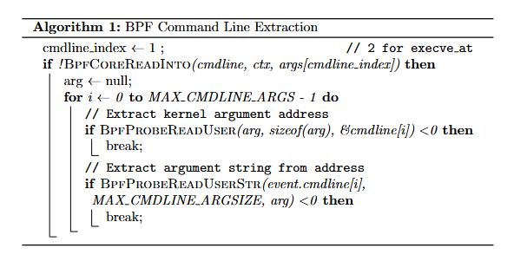

Implementation: Extracting Cmdline Args from hook

Slide 13
Validation Experiments
Approach A:
Procfs Enrichment
Approach B:
eBPF Enrichment
Command executed | Expected Process path | Expected Cmd args
ls -lrth | /usr/bin/ls | -lrth
uname -ar | /usr/bin/uname | -ar
cat /etc/hostname | /usr/bin/cat | /etc/hostname
chmod +x test.sh | /usr/bin/chmod | +x test.sh
./test.sh | /usr/bin/bash | ./test.sh
Idle workload
PostgreSQL workload
OpenSSL compilation
Note: All the experiments were done on an Ubuntu 22 machine with 32GB RAM and 8 cores.
Notes:
On summarizing all the testing scenarios we see that for the new proposed approach, under all the scenarios the data points obtained were complete with almost no missing data. On the other hand it was observed that for the traditional approach we see missing data under all the scenarios. The missing data increases when the system is under stress.
This summary shows that the new proposed solution with the enrichment of data at the eBPF source is more efficient and reliable than the traditional approach of data enrichment using proc FS.

Slide 14
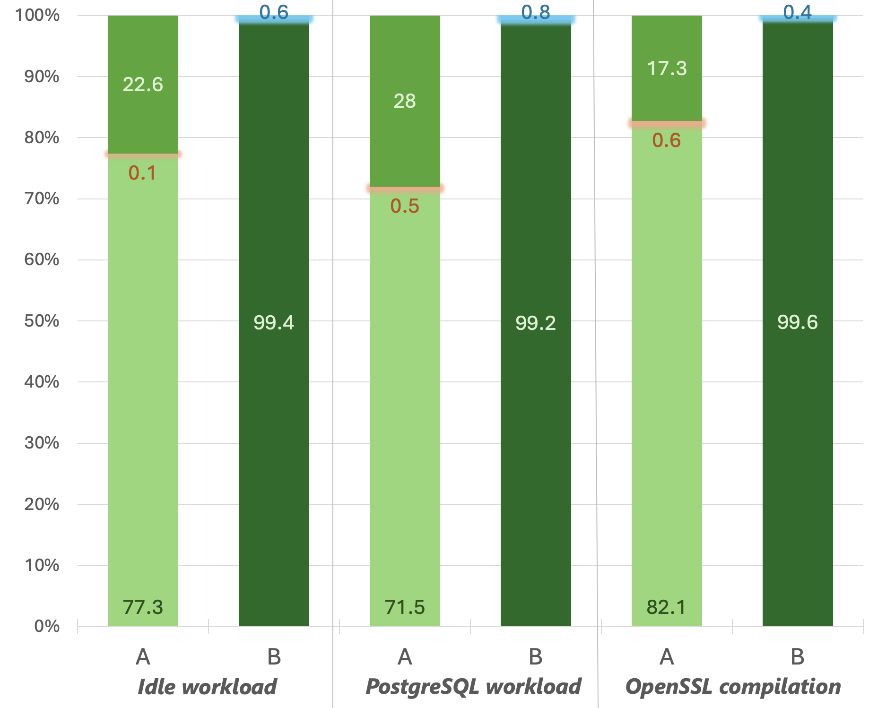
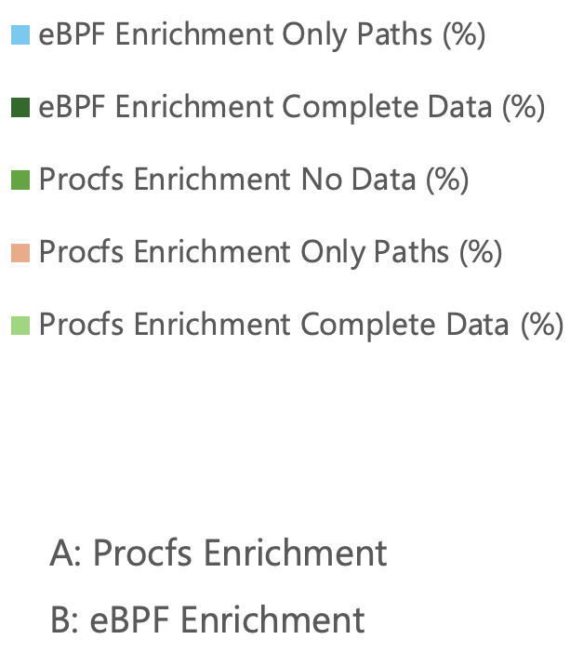
Results Summary
Notes:
On summarizing all the testing scenarios we see that for the new proposed approach, under all the scenarios the data points obtained were complete with almost no missing data. On the other hand it was observed that for the traditional approach we see missing data under all the scenarios. The missing data increases when the system is under stress.
This summary shows that the new proposed solution with the enrichment of data at the eBPF source is more efficient and reliable than the traditional approach of data enrichment using proc FS.

Slide 15
Limitations
Complexity involved in eBPF programs
Requires a deep understanding of the kernel internals and eBPF
BTF is not supported in kernel versions < 4.18
eBPF programs may result in performance overhead
The right balance needs to be found out, on what data we enrich in kernel space and in user space.
eBPF programs must be thoroughly vetted by verifier to ensure there are no security vulnerabilities / crashes
This reduces the amount of data being transferred from kernel space to user space
Notes:
Discussing about the limitations of this approach, the first limitation is with eBPF programs itself. The eBPF programs are complex and require deep understanding of the Linux internals. Along with it all the eBPF programs must be in accordance with the eBPF verifier making the code even mode complex.
The second limitation is with the support for this approach. This approach depends on the BTF support in Linux kernel. The minimum kernel support for BTF is 4.18 thus reducing the scope of this approach.
The final limitation we have is that with the increase in the amount of data being transferred between the kernel space and userspace and increase is observed in the CPU utilization and the memory consumption.
These limitations need to be worked upon.

Slide 16

Scan me for the code repo link
Q & A
Thank you!

Slide 17
Experiment
Generate large number of short-lived processes in the system.
Aim was to quantify and compare the data completeness per-process information.
Following commands were executed in random order for large iterations:
  ls –lrth
  uname –ar
  cat /etc/hostname
  chmod +x test.sh
  ./test.sh (test.sh is a script present in the file system and it aims to print date and locate some file)
Notes:
To validate our solutions, we ran a set of experiments. All these experiments involved generating a large number of short-lived processes in the system. Our aim here was to run quantitative analysis on our approach as well as the previous approach and then compare the completeness of data in both the scenarios.
As a part of this experiment, we selected the commands listed here. We have observed that these commands generate short-lived process events. These commands are some of the most commonly used commands on Linux systems.

Slide 18
Analysis
Expected results
The output and accuracy of the experiments were determined by comparing following data received from the program.
Process path
Command line args (args/ cmd args) of the events received.
Each command mentioned here was run 10000 times using two different approaches/programs under four different scenarios.
Command | Process path | Cmd args
ls -lrth | /usr/bin/ls | -lrth
uname -ar | /usr/bin/uname | -ar
cat /etc/hostname | /usr/bin/cat | /etc/hostname
chmod +x test.sh | /usr/bin/chmod | +x test.sh
./test.sh | /usr/bin/bash | ./test.sh
Notes:
To compare the accuracy and completeness of the solutions we analysed two data points that we captured, one was the process path and the other was the command line argument. The table here shows what is the expected process path and CLI arg for each of the event that we generate.
For our experiment we run each command 10000 times and then capture the data points using both the approaches under different scenarios and stress situations. This helps us see how many times we were able to get the desired data that we want.

Slide 19
Setup – Approaches/Programs
Approach 1 – Our PoC
Source Enrichment of Data
Approach 2
Traditional Approach
Hooks are attached to the previously mentioned trace points.
We enrich the data of the event at source, i.e., in the kernel space itself.
Hooks are attached in the kernel to extract only the pids of the process.
Once the event has reached the user space, we enrich the data by reading from the proc filesystem.
Note: All the experiments were done on an Ubuntu 22 machine with 32GB RAM and 8 cores.
Notes:
As mentioned, we will run the commands through two data enrichment approaches. The first approach is the implementation of our PoC. Here we are extracting the data using the building blocks that was mentioned during our implementation discussion.
The second approach is the traditional approach. In this approach only the PID is enriched using the kernel hooks while the remaining data is then enriched in the user space using the proc filesystem.
To maintain consistency across experiments the machines with the same configurations were selected to run these approaches.

