Slide 1
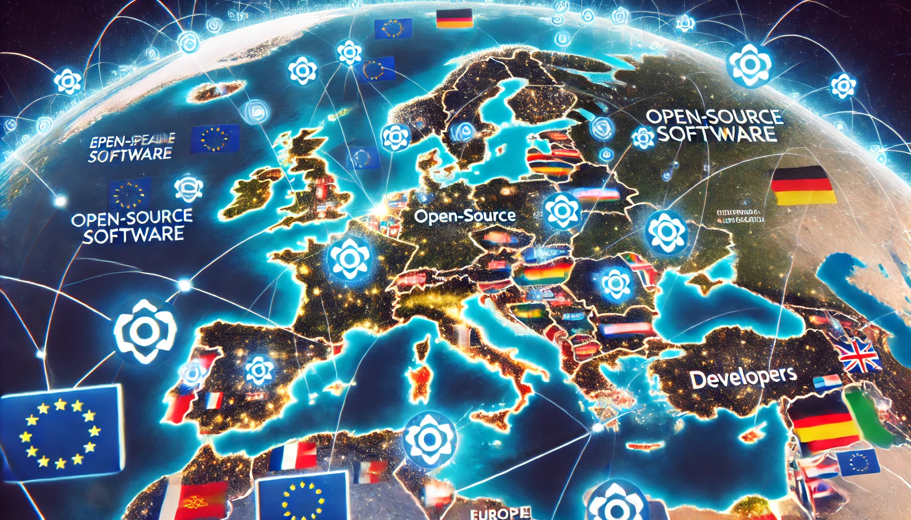
_How do we get the_ _European Union to invest_ _in FOSS maintenance and_ _security?_
_Nicholas (‘Nick’) Gates (OpenForum Europe)_
_Felix Reda (GitHub)_

Slide 2


Notes:
Picture credit: Authors

Slide 3
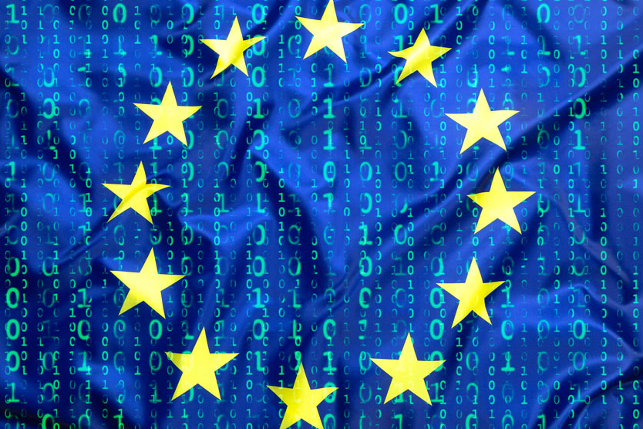
_Why should Europe care_ _about FOSS maintenance_ _and security?_
Notes:
Picture credit: https://www.techrepublic.com/article/top-open-source-security-risks/

Slide 4





Slide 5
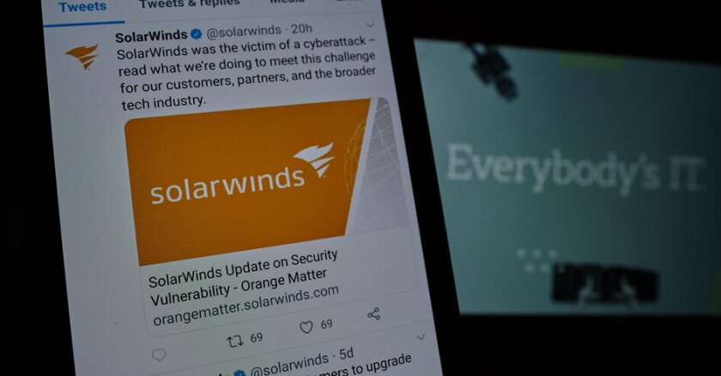
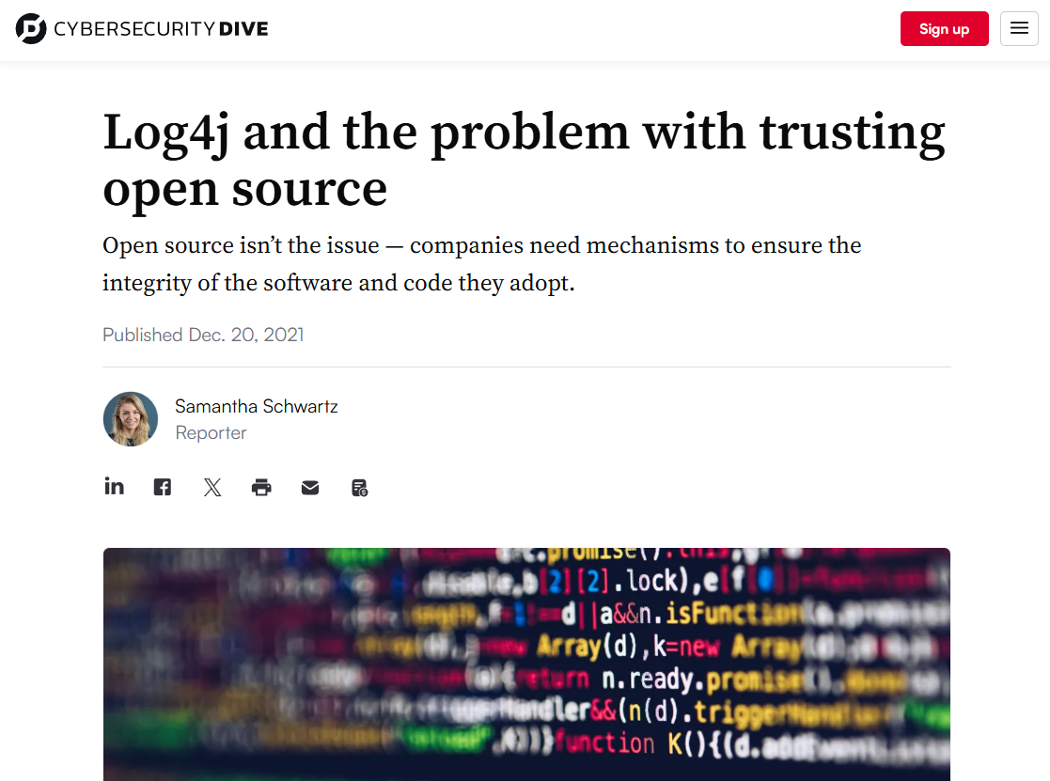
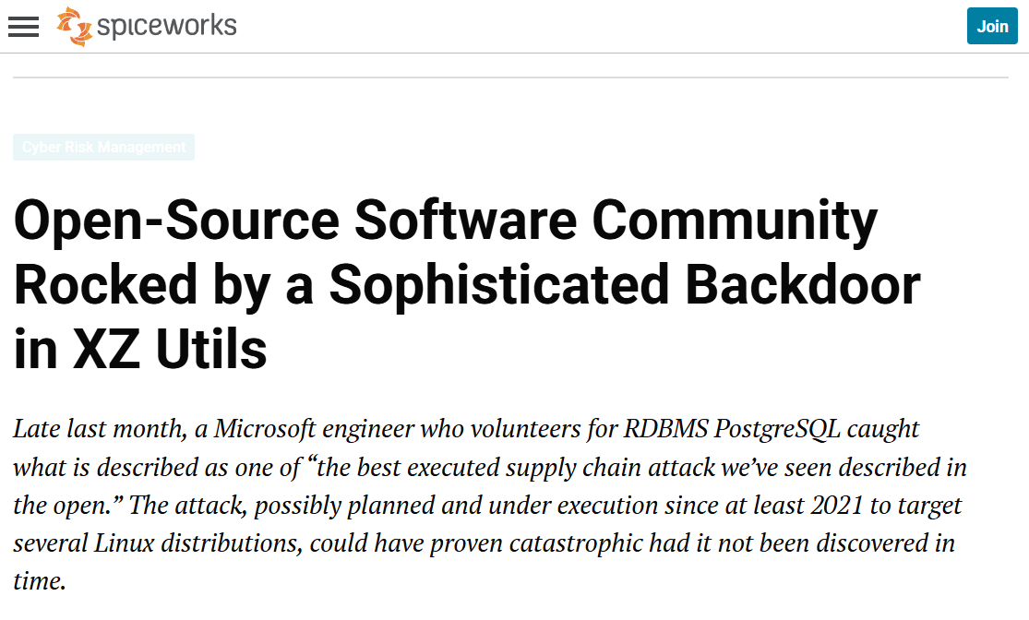
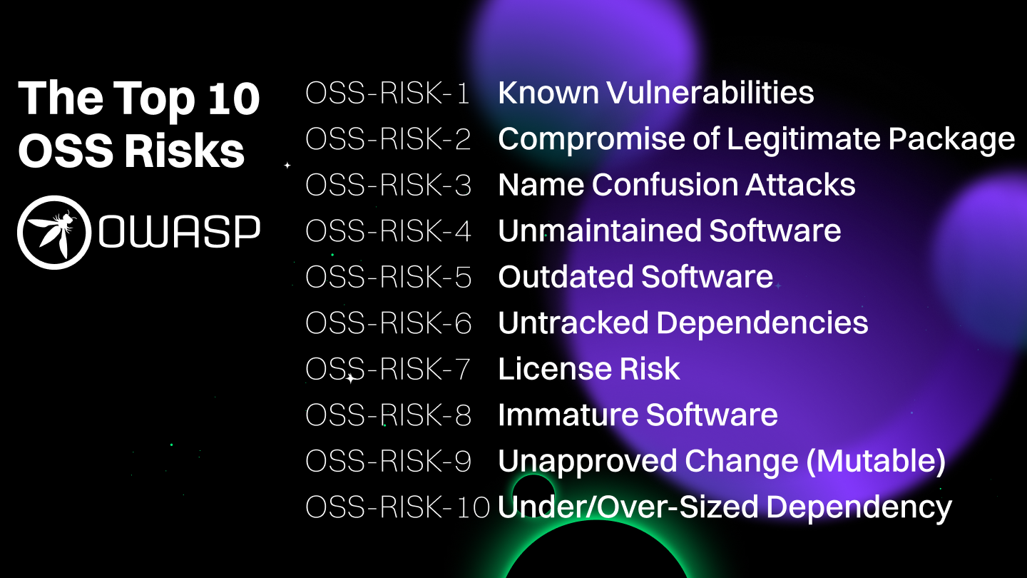
Notes:
Picture credit: https://www.govtech.com/security/solarwinds-hack-recovery-may-cost-upward-of-100b.html
Picture credit: https://www.cybersecuritydive.com/news/log4j-open-source-vulnerability/611784/
Picture credit: https://www.spiceworks.com/it-security/cyber-risk-management/news/xz-utils-backdoor-open-source-software-attack/
Picture credit: https://owasp.org/www-project-open-source-software-top-10/

Slide 6
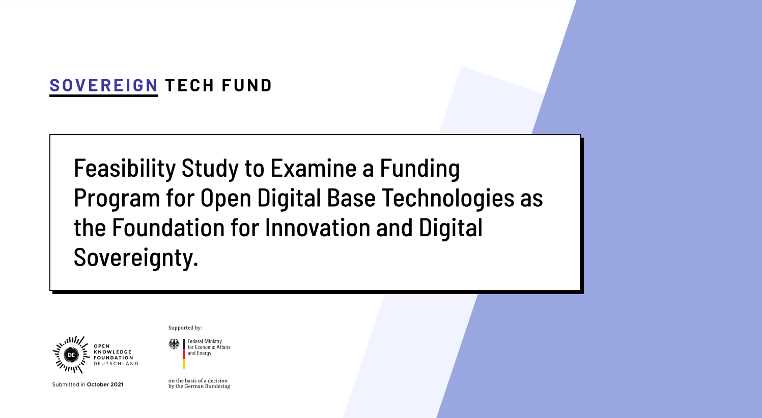
→ Link to the feasibility study
Notes:
Picture credit: https://www.sovereign.tech/public/files/SovereignTechFund_FeasibilityStudy.pdf

Slide 7
… but how do we scale the EU Sovereign Tech Agency to the EU-level?

Slide 8
Some challenges to consider:

Slide 9
The Economic Challenge
€ 65-95B minimum contribution to EU economy
$ 8.8T global estimated demand-side value
Notes:
Without OSS and networks of OSS developers, firms would pay an estimated 3.5 times more to build the software and platforms that run their businesses, or roughly $8.8 trillion (Nagle et. al, 2024)
70-90% of any given software codebase is made up of open source components (Linux Foundation, 2022
Based on the value of OSS and the scale/reach of OSS, the potential economic impacts of open source vulnerabilities is huge.
Therefore, we need an economic argument that carefully considers the value and scale/reach of OSS, building on the work of the STA, to make an argument for commensurate investment and support from across the EU.

Slide 10
The Legal Challenge
2-3 different institutional setups that should be analysed:
Scaling a well-resourced, EU-wide version of the STA
A federated set-up with a funded coordinating body
Free-for-all for all Member States to set up their own funding instruments
Notes:
It is potentially difficult to understand where the agency would sit in European governance/funding instruments and the modalities by which it should receive/disburse funding
Scaling a well-resourced, EU-wide version of the STA, modelled after the German STA (though potentially with different features
A federated set-up with a funded coordinating body, which allows for each Member State to set up their own versions of the STA
Free-for-all for all Member States to set up their own funding instruments, with a common policy framework in place and more limited support investment from EC

Slide 11
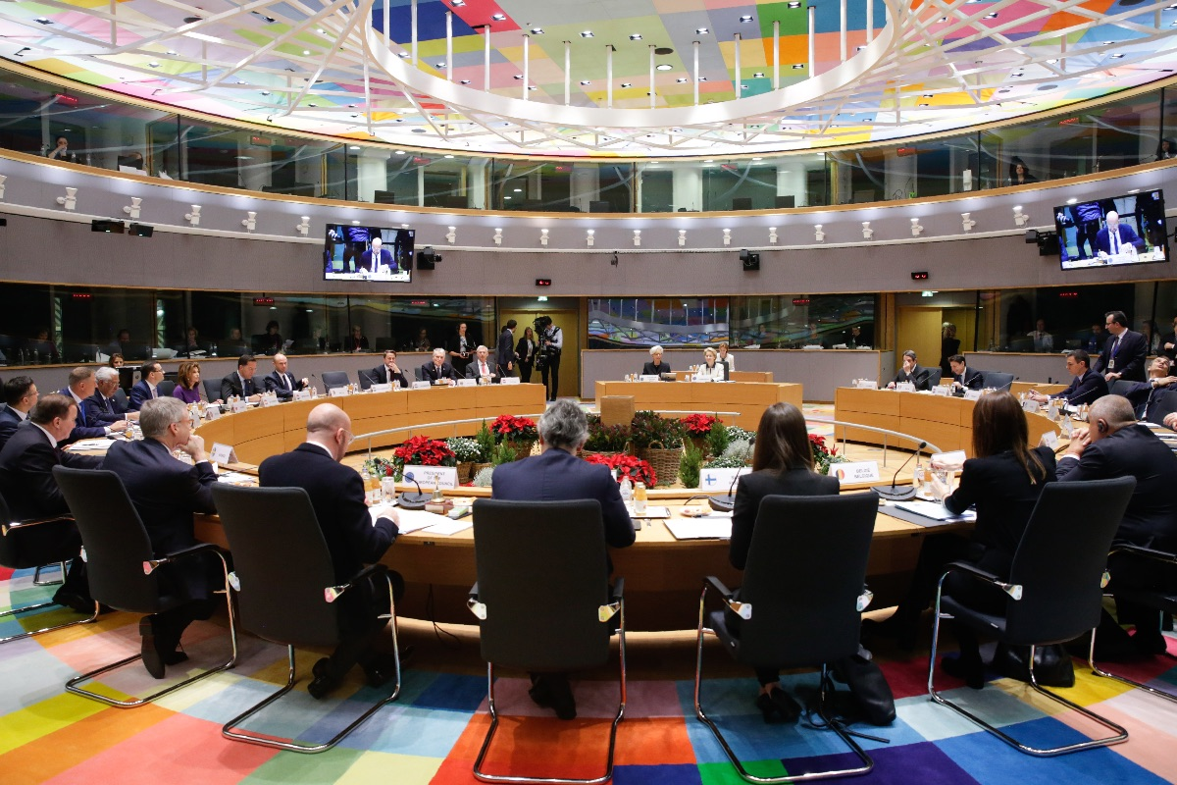
_The Role of the Multiannual _Financial Framework (MFF)_ _Negotiations_
Notes:
Picture credit: https://www.epc.eu/en/publications/The-MFF-non-decision-More-at-stake-than-delays~2daf50

Slide 12
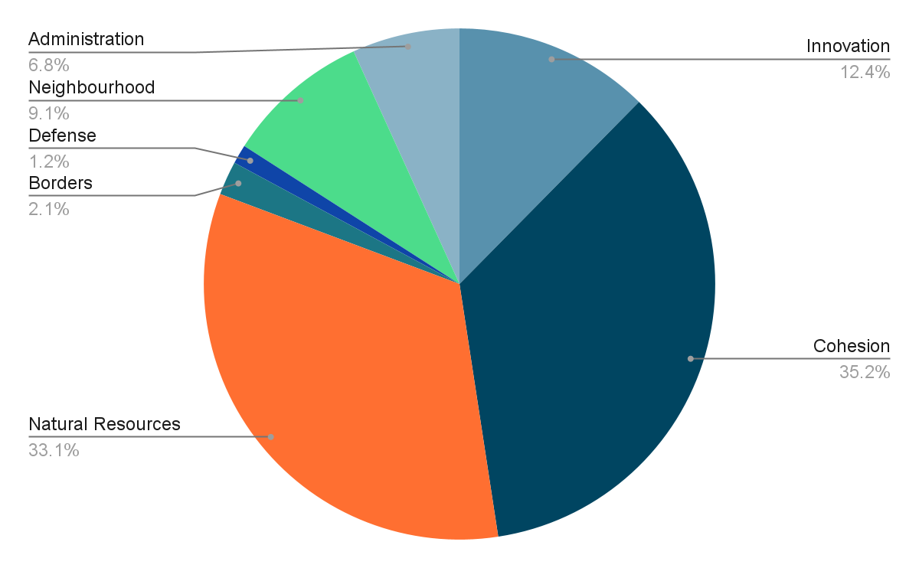
Where does EU funding go? (21-27)
Notes:
Last MFF: 1.06 trillion € over seven years
Natural resources = mostly Agriculture,
Cohesion = decreasing differences between Member States
Innovation = mostly research and industrial policy

Slide 13
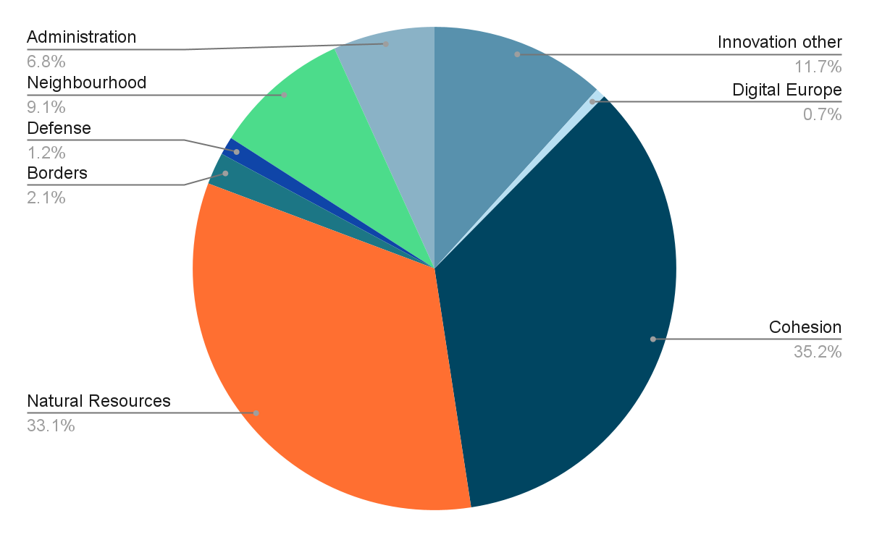
Where does EU funding go? (21-27)
Notes:
Specific digital policy is a tiny part of Innovation bucket.
The EU’s research funding programme, Horizon Europe, includes Next Generation Internet, which has also been funding some open source projects.

Slide 14
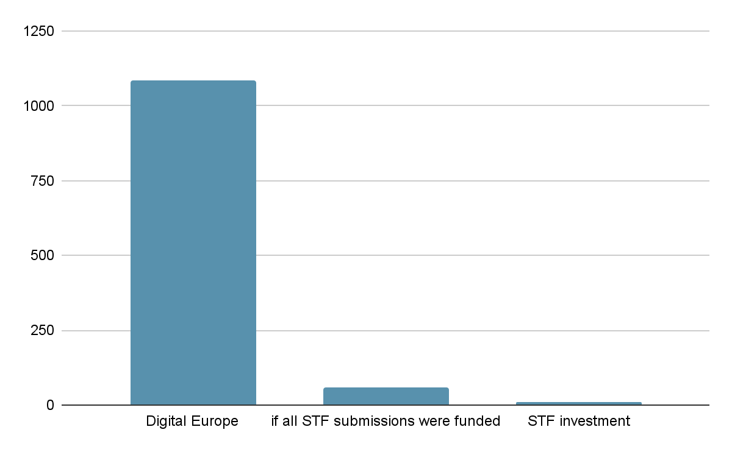
Average annual budget in M€
Notes:
Digital Europe: 7.59 billion € over seven years = 1.1 billion / year
Sovereign Tech Fund: 23 million over two years = 11.5 million / year
All submissions to STF: € 114 million over two years = 57 million / year

Slide 15
MFF Negotiations Timeline
Spring 2025
July 2025
Fall 2025
2026/27
early 2028
MFF Consultation
MFF Special procedure
Proposals for Sectoral Programmes
MFF negotiations
Adoption of Sectoral Programmes
Run by EU Commission, anyone can participate
Commission & Council agree on size of main pie slices
What ends up in the pie? Ordinary Legislative Procedure
Must be concluded before start of MFF in 2028
Commission approves annual work programmes by implementing act
Notes:
Current MFF Regulation, Art. 21: “Before 1 July 2025, the Commission shall present a proposal for a new multiannual financial framework.”

Slide 16
Digital Europe Regulation
Objectives:
High Performance Computing
Artificial Intelligence
Cybersecurity and Trust
Digital Skills
Deployment & Interoperability
OS Funding Barriers?
No open source focus
Designed to directly fund EU companies
Natural persons cannot receive funding

Slide 17

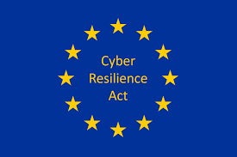
The Cyber Resilience Act (CRA)
Art. 13 (25) CRA
“In order to assess the dependence of Member States and of the Union as a whole on software components and in particular on components qualifying as free and open-source software, ADCO may decide to conduct a Union wide dependency assessment for specific categories of products with digital elements. For that purpose, market surveillance authorities may request manufacturers of such categories of products with digital elements to provide the relevant software bills of materials as referred to in Part II, point (1), of Annex I. On the basis of such information, the market surveillance authorities may provide ADCO with anonymised and aggregated information about software dependencies. ADCO shall submit a report on the results of the dependency assessment to the Cooperation Group established pursuant to Article 14 of Directive (EU) 2022/2555.”
Notes:
Picture credit: https://iotac.eu/top-8-things-you-should-know-about-the-eu-cyber-resilience-act-cra/

Slide 18
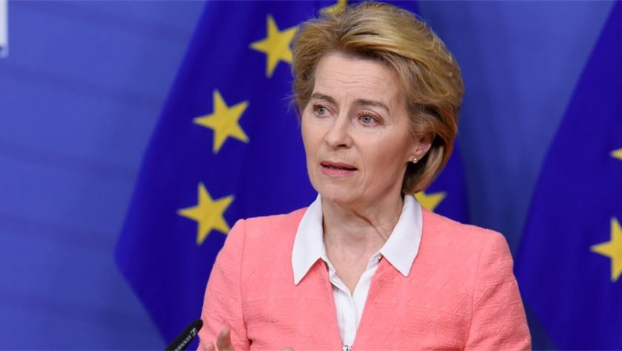
“I want a policy-based budget, not a programme-based budget”
Notes:
Consequence: Digital Europe Programme may not continue in the current form.
Announcement of a new European Competitiveness Fund: Every expense will likely be seen through the lense of competitiveness
Picture credit: https://www.theparliamentmagazine.eu/news/article/von-der-leyen-apologises-for-eus-initial-lack-of-coronavirus-preparedness

Slide 19
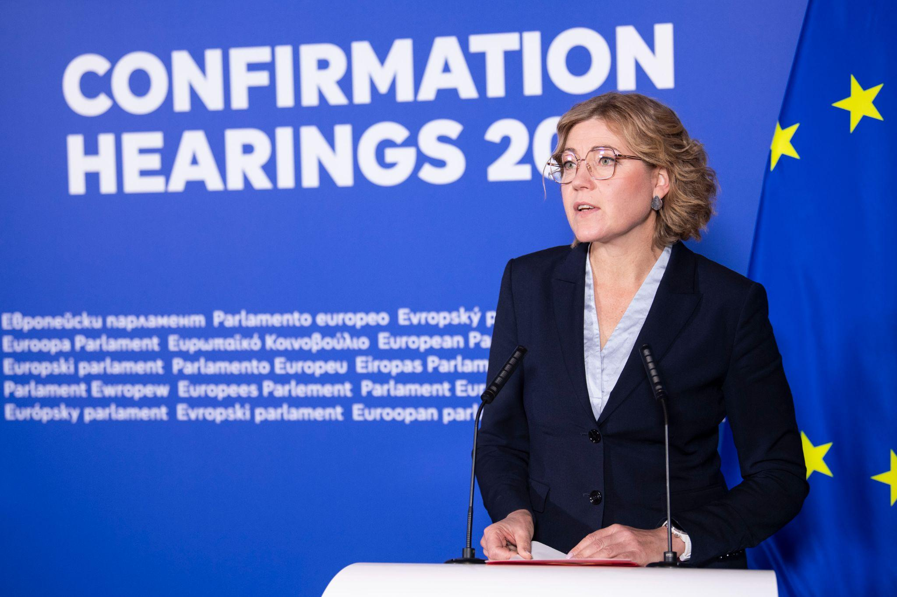
“... open source and open standards […] has really been a European success story, and they have been in the heart of our policies of connectivity, eID data and AI also. So we will continue this approach. […] In data spaces and also in the cloud services, this is an important basis […] Now we can see that the market is taking up here because of the open source projects, where European Start-Ups are doing, for example, now projects on generative AI and in microelectronics”
Notes:
Support for open source is positive, but quote also shows it is seen through a lense of how open source helps specific sectors of the economy.
The challenge: Viewing open source as infrastructure that underlies all sectors, funding basic technologies like the STA does.
Picture credit: https://multimedia.europarl.europa.eu/en/topic/confirmation-hearings_28401

Slide 20
So, what policy ideas should be linked to the idea of FOSS funding at the EU level?

Slide 21
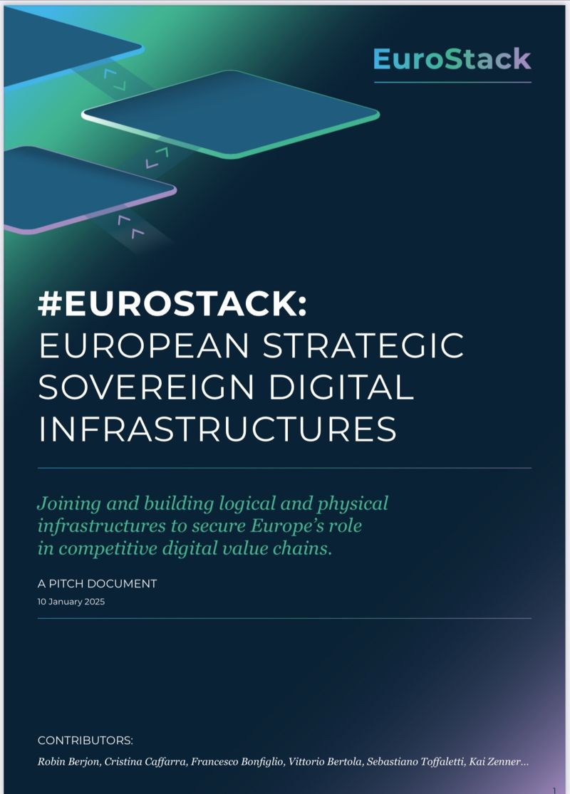
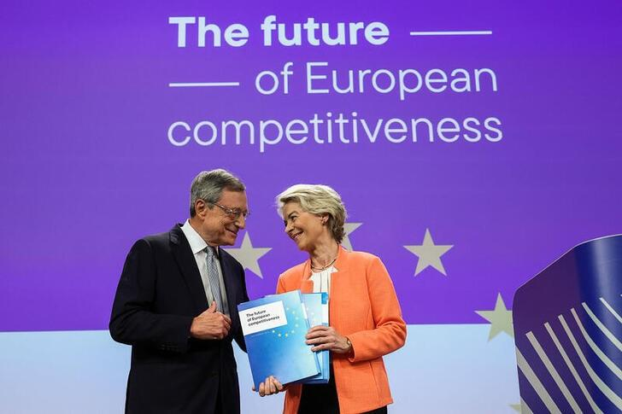
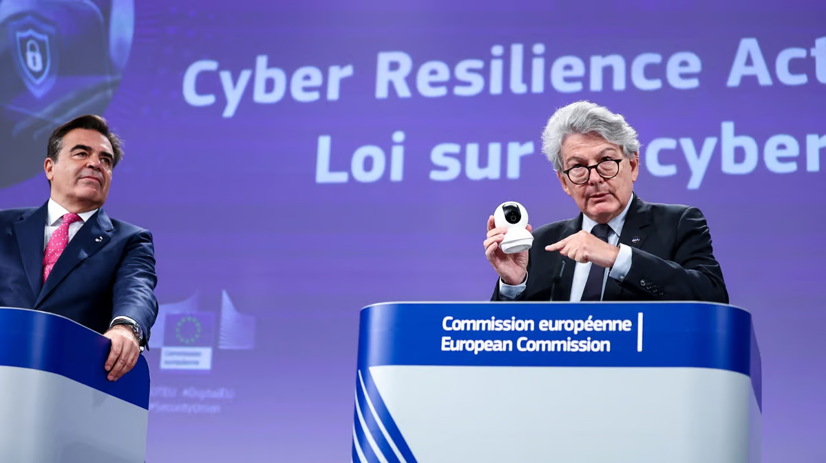
Policy Basis for an EU-Wide STF
Competitiveness: The so-called ‘Draghi report’ proposes an annual investment of €800 billion to enhance digital infrastructure
Cybersecurity: Europe recognised the increasing importance of cybersecurity with the passage of the Cyber Resilience Act (CRA), which went into effect in December 2025
Digital Sovereignty: The EuroStack Initiative, backed by Members of the European Parliament, calls for hundreds of million dollars in sovereign digital technologies
Notes:
Picture credit: https://www.atlanticcouncil.org/blogs/new-atlanticist/draghis-new-report-on-european-competitiveness/
Picture credit: https://www.politico.eu/article/new-cyber-act-to-raise-safety-standards-across-the-bloc/
Picture credit: https://euro-stack.eu/a-pitch-paper/

Slide 22

Draghi & European Competitiveness
Proposes to double Horizon Europe funding to €200B, focusing on semiconductors, AI, and computing
Potential for more resources for OS projects through increased funding BUT focus on scaling large companies may favor proprietary solutions
Report emphasizes industry consolidation, while overlooking community-driven OS contributions
Notes:
Why is OS important to implementing the Draghi manifesto?
When interpreted right, it is clearly complementary and allocation of targeted funding for open source projects would be strategic
Competitiveness as a policy tool could promote collaboration between enterprises and open-source communities
Ensure regulations support both proprietary and open-source innovation models
Picture credit: https://www.chemsafe-consulting.com/2024/10/08/how-mario-draghis-vision-for-european-competitiveness-could-transform-the-pharma-industry/

Slide 23
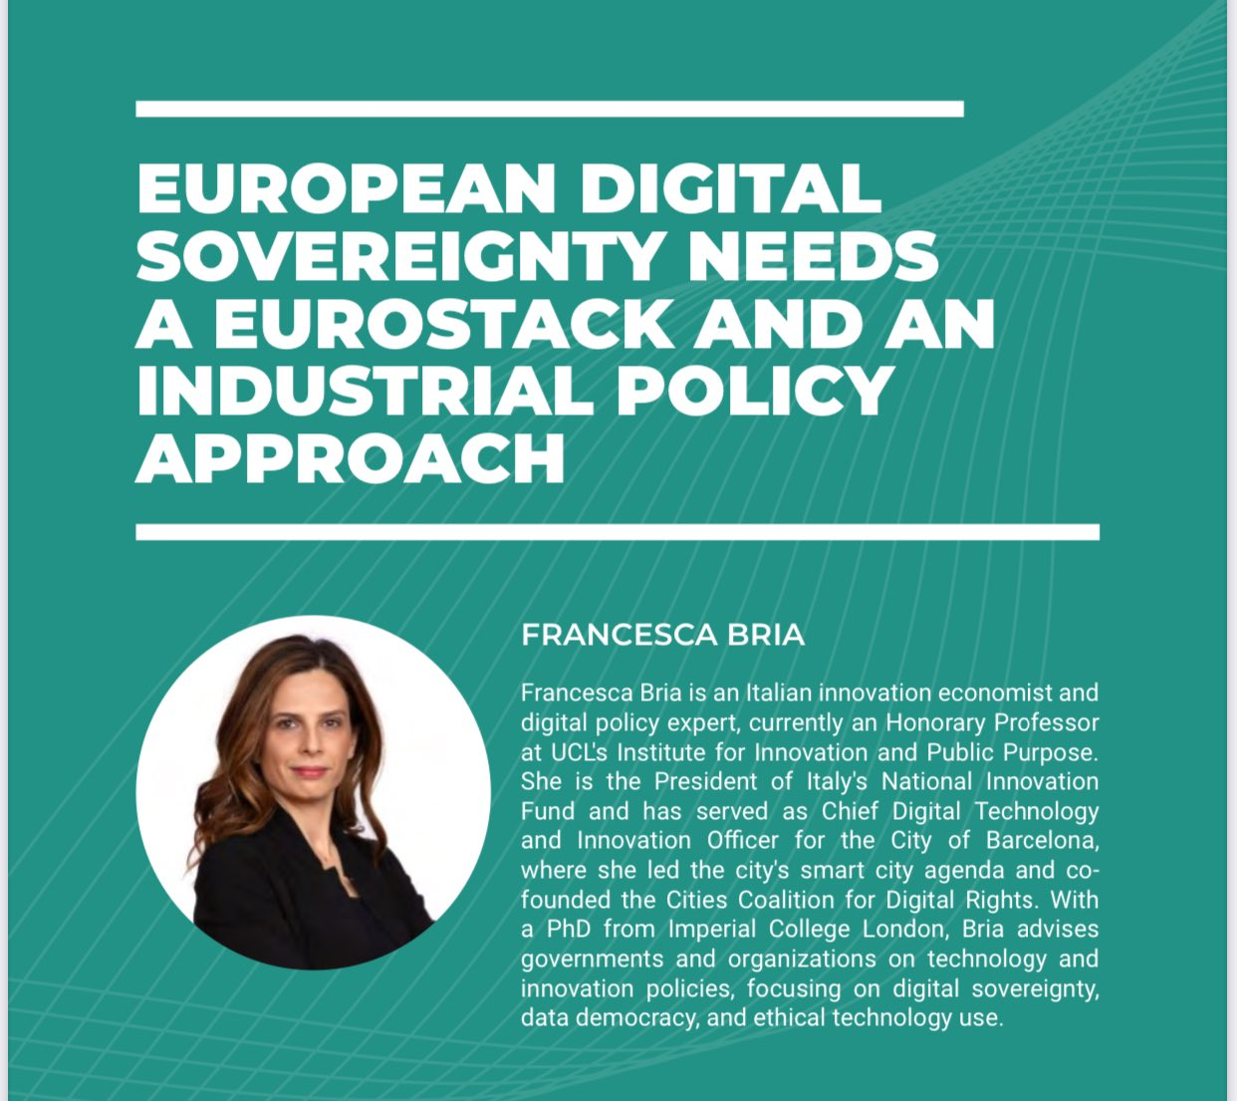
Digital Sovereignty for Europe
Sovereignty is part of the intellectual basis for Europe’s focus on investment in open source alternatives and Digital Commons
Digital sovereignty, or sovereign digital technologies, are a key focus of the nascent EuroStack initiative, which seeks to link open technologies and digital infrastructure with industrial policy
Notes:
Picture credit: https://x.com/francesca_bria/status/1866402060855644242

Slide 24

_What is the focus_ _of our proposed_ _study?3
Notes:
Picture credit: https://www.torontoauditor.ca/report/cybersecurity-review-open-source-internet-data-intelligence-review/

Slide 25
This study will assess the opportunity and feasibility for a fund at the EU level.
GUIDING QUESTION: What is the opportunity and feasibility of building and implementing an EU-wide funding instrument, modelled after the Sovereign Tech Agency, which is focused on sustainability, maintenance, and security of critical open source software?

Slide 26





Research Partners and Supporters
Notes:
Picture credit: Original organisations

Slide 27
High-Level Objectives of the Study
Gather the actors working in this space in a coalition and communicate a coherent message to European policymakers
Bring together stakeholders from various sectors to advocate for European digital sovereignty, cyber resilience, and competitiveness
Deliver a clear and consistent message highlighting the fund's importance across discreet policy objectives
Foster synergies among stakeholders to avoid duplicating efforts and ensure a unified approach
Notes:
Picture credit: https://www.epc.eu/en/publications/The-MFF-non-decision-More-at-stake-than-delays~2daf50

Slide 28

Goals for the Final Whitepaper
Define the scope of the sustainability and security challenge
Distinguish the maintenance investments
Establish the case for appropriate funding levels
Assess the economic and legal feasibility
Offer financing and governance options
Make policy recommendations
Notes:
Picture credit: https://commission.europa.eu/strategy-and-policy/priorities-2019-2024/europe-fit-digital-age_en

Slide 29
Uptake is important though!
What can happen to make sure the EU listens to whatever recommendations we make?

Slide 30
In time for June, we need…
A detailed economic and legal analysis, grounded in interview and economic analysis
A detailed white paper with policy recommendations, delivered in time for the upcoming MFF negotiations (more on this soon)
An advocacy plan to ensure uptake by the European Commission and engagement from the European Parliament

Slide 31
_Wrapping up__
Notes:
Picture credit: https://www.techrepublic.com/article/top-open-source-security-risks/

Slide 32

Participate in the consultation
Notes:
Picture credit: https://epthinktank.eu/2018/07/30/eu-law-for-an-open-independent-and-efficient-european-administration-summary-report-of-the-public-consultation/

Slide 33

Get involved in our research
Notes:
Picture credit: https://publicspaces.net/2024/05/31/the-future-of-media-is-open-source-display-europe-shows-how/

Slide 34
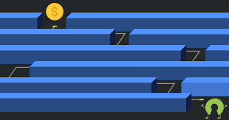
Funders! Write about your successes
Notes:
Picture credit: https://stackoverflow.blog/2021/01/07/open-source-has-a-funding-problem/

Slide 35
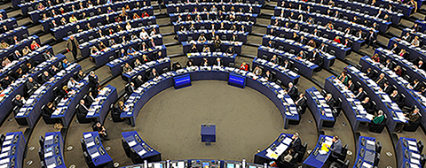
Find MEP champions for open source
Notes:
Picture credit: https://www.europarl.europa.eu/meps/en/about/meps

Slide 36

Talk to government representatives
Notes:
Picture credit: https://opensource.com/government/12/6/what-open-source-can-teach-government-officials

