Slide 1
NGI Commons
PRESENTATION: DIGITAL COMMONS AS PILLARS OF DIGITAL SOVEREIGNTY IN EUROPE

Slide 2
What is the Next Generation Internet (NGI)? And what is NGI Commons?
Let’s talk about the NGI and what it is attempting to achieve

Slide 3
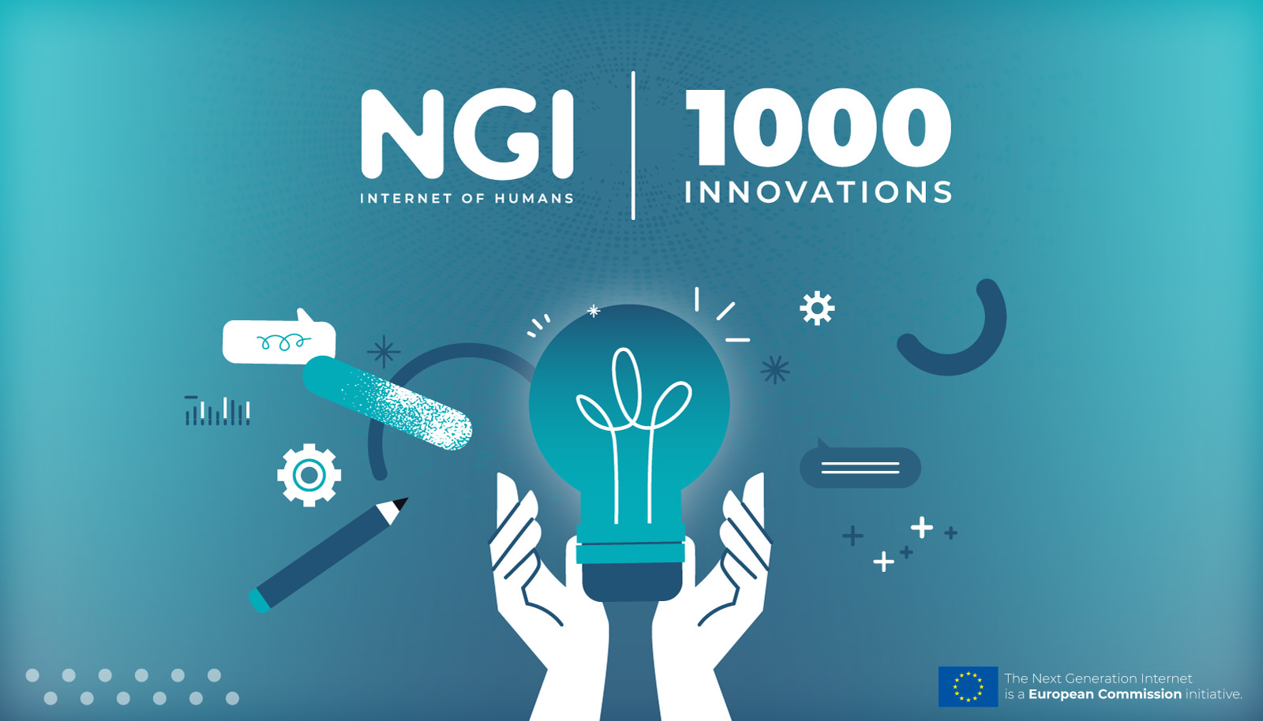
NGI.EU/DISCOVER-NGI-SOLUTIONS

Slide 4



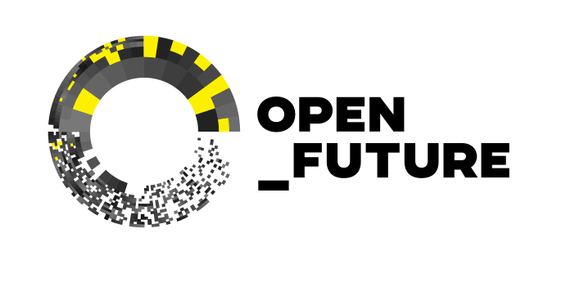

Partners

Slide 5
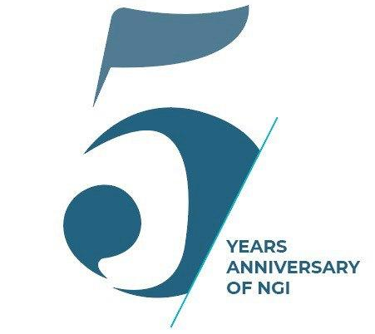

The NGI Portfolio at a Glance
The Next Generation Internet (NGI) is a European Commission initiative that aims to shape the development and evolution of the Internet into an Internet of Trust. An Internet that responds to people’s fundamental needs, including trust, security, and inclusion, while reflecting the values and the norms all citizens enjoy in Europe.
Restoring trust
CHALLENGES
⇢ Protect personal data
⇢ Ensure privacy and security
⇢ Combat disinformation online
⇢ Guarantee access and freedom of choice
⇢ Respect fundamentals rights
⇢ Enforce ethics and sustainability by design

Slide 6
Supporting (Open) Internet Innovation through an Ecosystem Approach
The NGI is providing funding to support innovators including individual researchers, developers, start-ups and SMEs and an ecosystem for efforts to flourish and grow contributing to Europe technological sovereignty
NGI Research and Innovation Actions are acting as intermediaries: 20% of their budget is dedicated to select, monitor, mentor, train and build the community; 80% to fund individual projects among 3rd party individuals and/or organisations
NGI Coordination and Support Actions are at work to ensure synergies across all stakeholders, with a focus on:
⇢ Outreach, community building, business acceleration
⇢ Policy and strategic programming
⇢ EU-US/CANADA collaboration

Slide 7
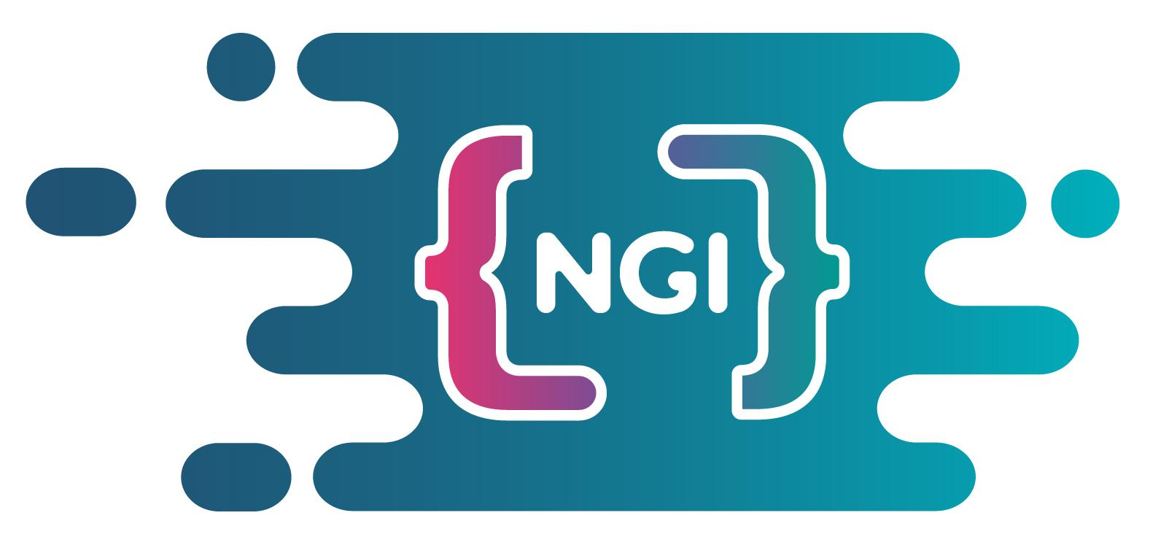
The NGI Commons Ambition
A 36 months CSA started in January 2024
Digital Commons (DC) have become increasingly relevant and diverse, and have crossed paths with core digital governance issues such as digital sovereignty and self-determination over personal data.
NGI Commons aims to to ensure strategic alignment and integration of the NGI efforts within the broader European DC context, elaborating on a long-term strategy for DC, helping overcome fragmentation and close the gap between grass-root commoners initiatives and top-down sovereignty policies

Slide 8
What are Digital Commons?

Slide 9
What are Digital Commons?
A digital resource
from data to software
A governance system
a governance system with established rules for access and sharing to ensure the long term maintenance of the resource (Ostrom)
A community
coordinated not through pricing or subordination but through voluntary peer production (Benkler)
‹#›
2024-2026 | https://commons.ngi.eu/

Slide 10
What are digital commons?
From communities to global infrastructures
Digital commons like Wikipedia and Apache have evolved into essential global infrastructures with millions of daily users.
96% of commercial code incorporates OSS, and 76% of all code is open source (OSSRA). OSS forms the backbone of digital systems.
The economic value of digital commons
OSS contributes €65–€95 billion annually to the EU’s GDP (DG Connect)
Globally, OSS’s market value is estimated at $8.8 trillion (Nagle)
Beyond software, Wikimedia Commons’ images alone are valued at $28.9 billion (Erickson et al.).
The Stack: An Accidental Megastructure (Bratton)
Digital commons have formed a complex, intertwined stack of technologies—a shared foundation for tech companies, governments, industries, and societies (Berlinguer).
‹#›
2024-2026 | https://commons.ngi.eu/

Slide 11
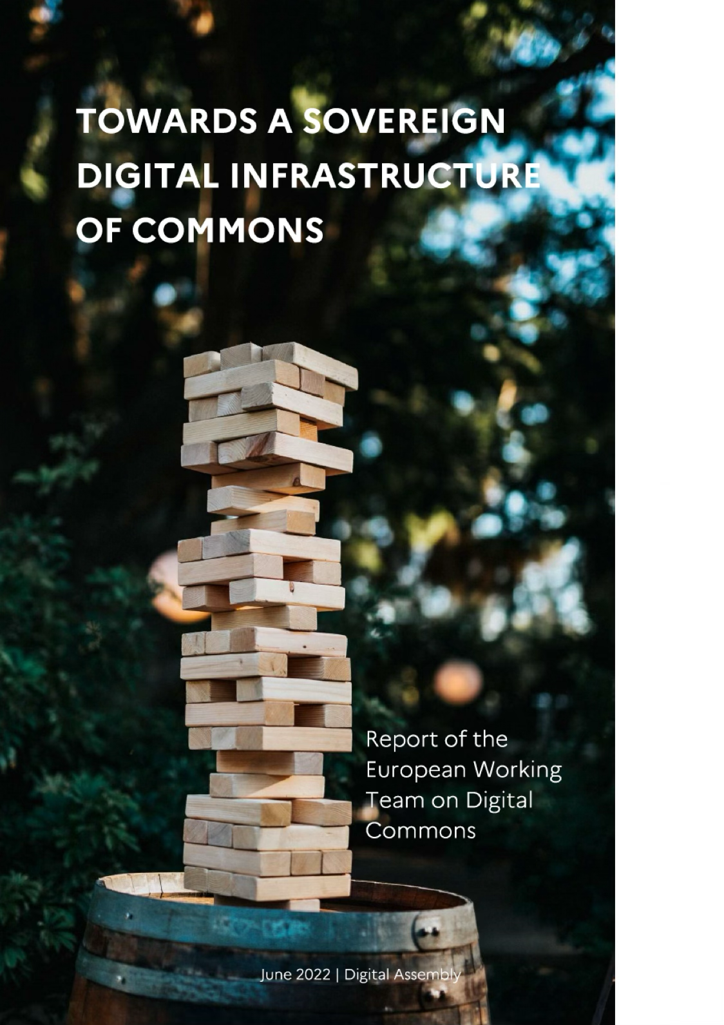
What are digital commons?
Digital commons are increasingly perceived as potential providers of public digital infrastructure to enhance sovereignty, competition and accessibility of services.
EU Member States are currently designing a “Digital Commons European Digital Infrastructure Consortium”. A novel approach, based on the strategic mobilization of communities for example for the:
Provision of e-government foundations, public goods and services.
Provision of key components of the internet Stack with critical dependencies for states, economies and societies.
‹#›
2024-2026 | https://commons.ngi.eu/

Slide 12
Digital Commons Have Real World Use Cases for Promoting European Digital Sovereignty
Let’s look at some examples

Slide 13
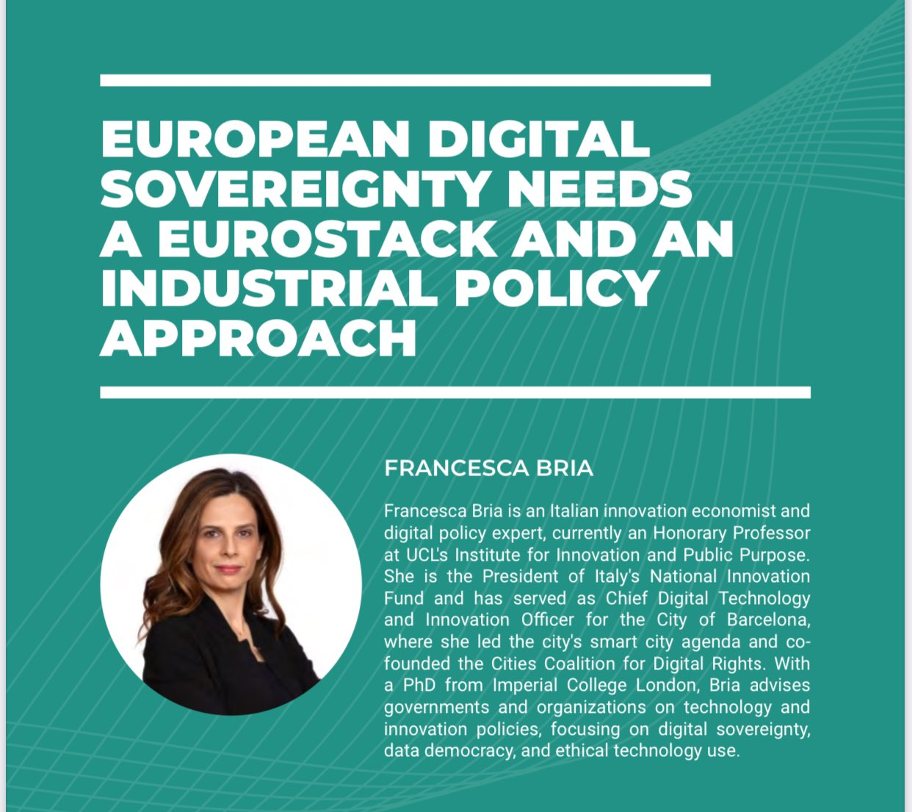
Understanding Digital Sovereignty in a European Context
Digital sovereignty is part of an emerging narrative around the importance of digital infrastructure for European industrial policy, competitiveness, resilience, etc
Sovereignty is part of the intellectual basis for Europe’s focus on investment in open source alternatives and Digital Commons
Digital sovereignty, or sovereign digital technologies, are a key focus of the nascent EuroStack initiative, which seeks to link open technologies and digital infrastructure with industrial policy
‹#›
2024-2026 | https://commons.ngi.eu/

Slide 14
Digital Commons as policy tools
Individual projects are Digital Commons, but the value of Digital Commons for European digital sovereignty – and related areas like industrial policy, cybersecurity, and competitiveness – comes from the linking of commons to policy objectives and policy implementation
Digital Commons which are grounded in real world policy and implementation are those which bundle together individual commons to provide real-world value as part of a larger commons with a community of practice (e.g. OpenDesk, Gaia-X, etc)
Digital Commons are part of a number of emerging initiatives in Europe, such as the independent EuroStack Initiative, the Digital Commons EDIC, and the Commission’s proposed plan for an Open Internet Stack
‹#›
2024-2026 | https://commons.ngi.eu/

Slide 15
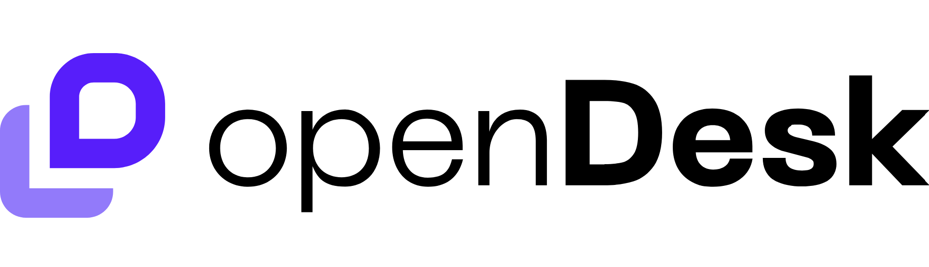
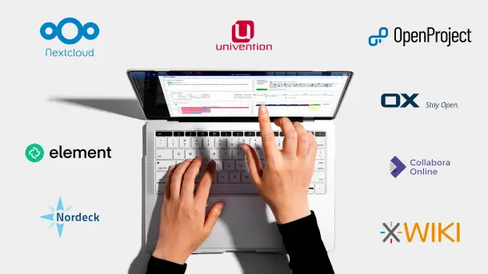
OpenDesk: Building sovereign alternatives to Microsoft for workspace collaboration
Sovereign workplace technology to provide alternatives to Microsoft
Pioneered by Germany’s ZenDis, but being expanded on in collaboration with DINUM in France, which is developing their own version
Bundling different open source tools together, many of which are commons in their own right
‹#›
2024-2026 | https://commons.ngi.eu/
Notes:
Picture credit: https://www.google.com/url?sa=i&url=https%3A%2F%2Finteroperable-europe.ec.europa.eu%2Fcollection%2Fopen-source-observatory-osor%2Fnews%2Fopendesk-10-lessons-learned&psig=AOvVaw2wjU5E9MaS6ZS2wE3TU-5G&ust=1738081662009000&source=images&cd=vfe&opi=89978449&ved=0CBcQjhxqFwoTCODT_vOolosDFQAAAAAdAAAAABAE
Picture credit: https://www.google.com/url?sa=i&url=https%3A%2F%2Fwww.heise.de%2Fen%2Fnews%2FMicrosoft-365-alternative-openDesk-version-1-0-announced-for-October-9955715.html&psig=AOvVaw2wjU5E9MaS6ZS2wE3TU-5G&ust=1738081662009000&source=images&cd=vfe&opi=89978449&ved=0CBcQjhxqFwoTCODT_vOolosDFQAAAAAdAAAAABAJ

Slide 16
What are other examples of Digital Commons which might be linked to Digital Sovereignty objectives?
Let’s look at some examples

Slide 17

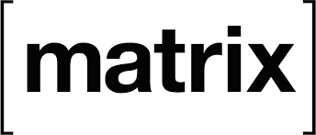
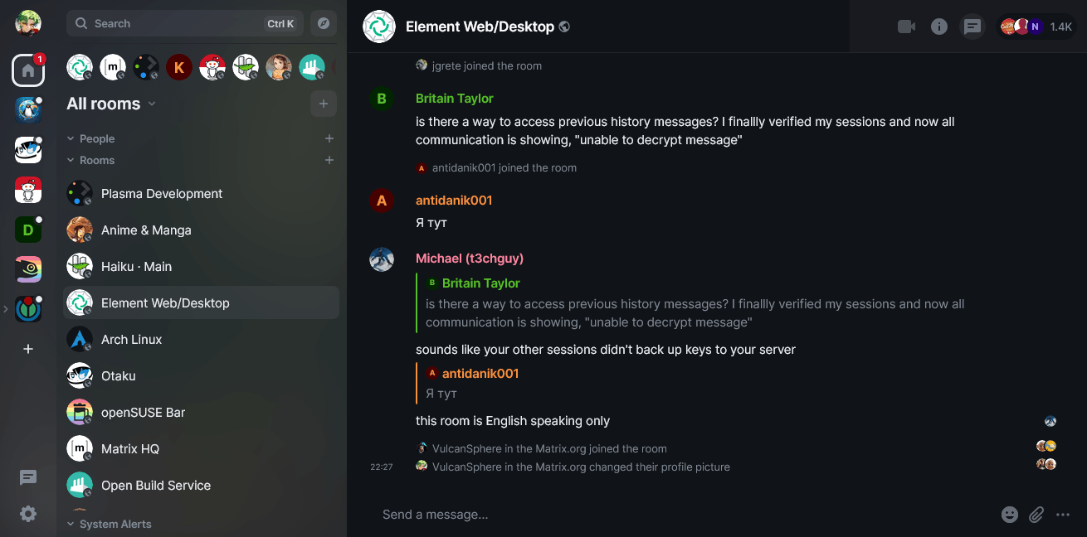
Matrix/Element: Creating secure communication tools in an era of change and uncertainty
Matrix is a secure messaging protocol, and Element is a FOSS instant messaging client implementing Matrix
Both developed and maintained by the Matrix.org Foundation with community contribution and supported
Being used by governments, companies, and many others – including NGI Commons!
‹#›
2024-2026 | https://commons.ngi.eu/
Notes:
Picture credit: https://en.wikipedia.org/wiki/Matrix_(protocol)
Picture credit: https://www.google.com/url?sa=i&url=https%3A%2F%2Fproducts.containerize.com%2Fvideo-conferencing%2Felement%2F&psig=AOvVaw2GcUBIVV9P-RiWoenKdF_4&ust=1738082573281000&source=images&cd=vfe&opi=89978449&ved=0CBcQjhxqFwoTCIiurLuslosDFQAAAAAdAAAAABAJ
Picture credit: https://www.google.com/url?sa=i&url=https%3A%2F%2Fen.wikipedia.org%2Fwiki%2FElement_%2528software%2529&psig=AOvVaw2GcUBIVV9P-RiWoenKdF_4&ust=1738082573281000&source=images&cd=vfe&opi=89978449&ved=0CBcQjhxqFwoTCIiurLuslosDFQAAAAAdAAAAABAR

Slide 18

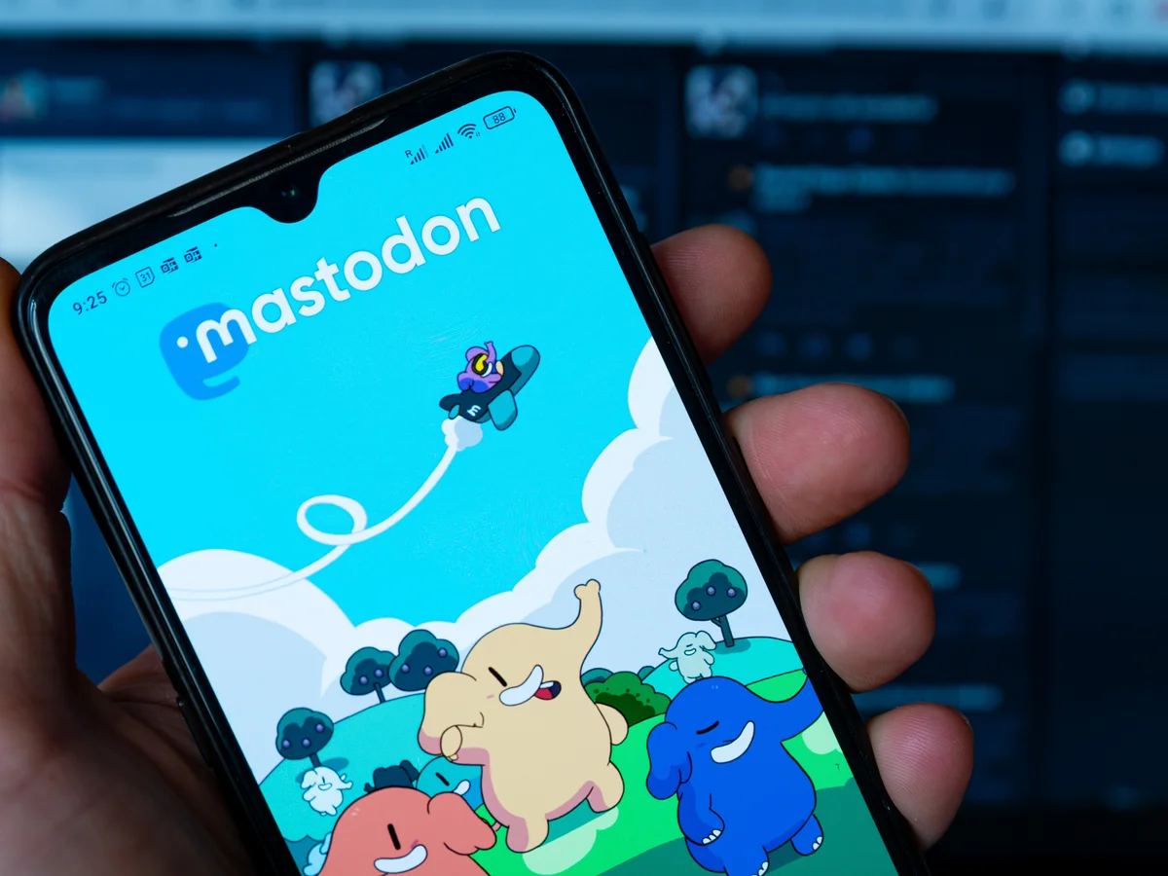
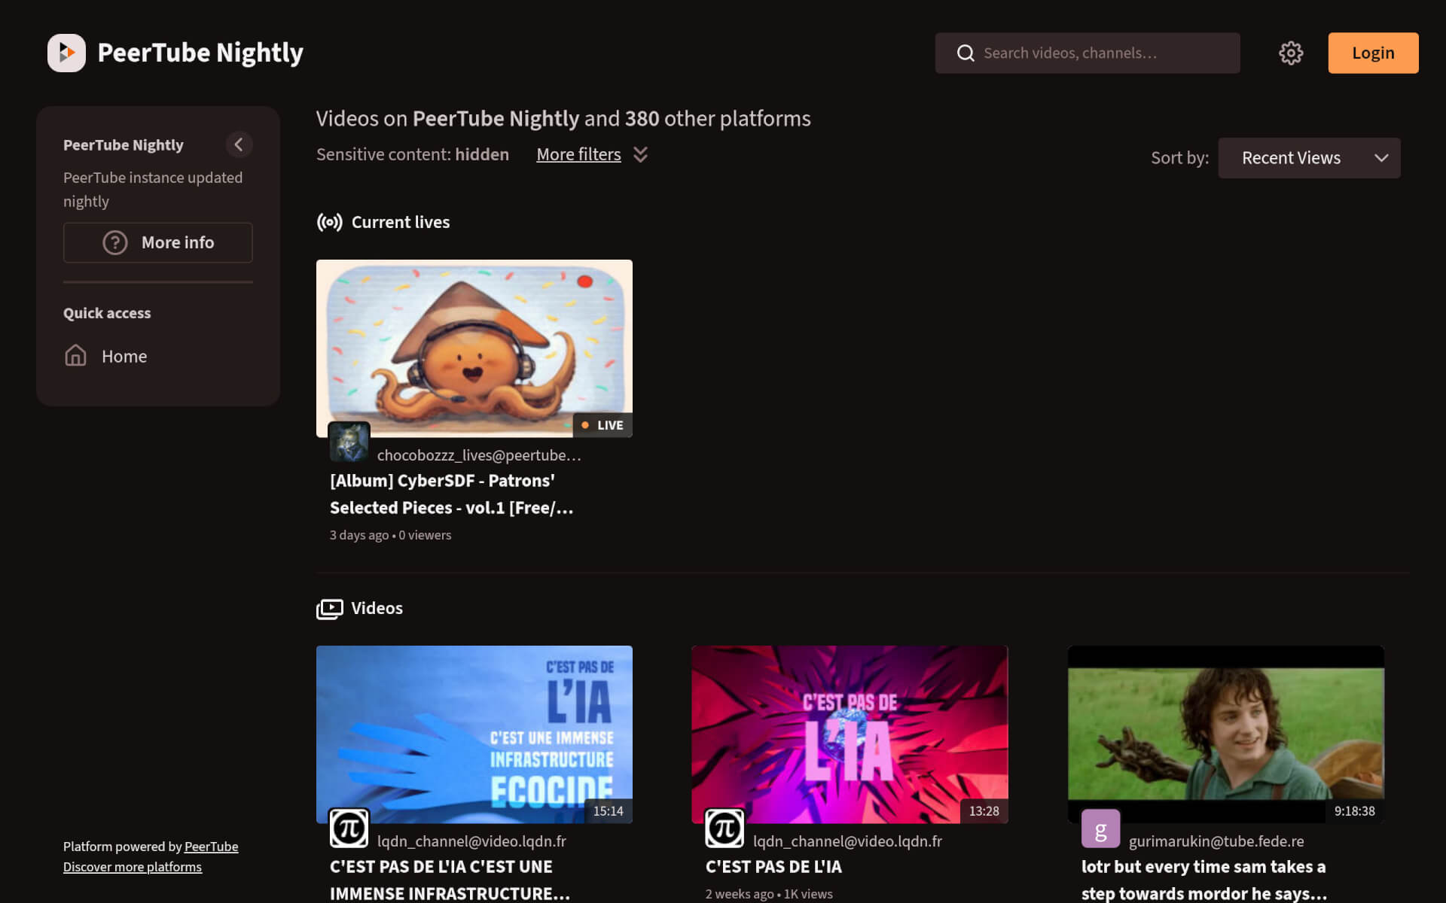
Mastodon and Peertube: Investing in alternative modes of social media organisation
Mastodon and PeerTube both seen as part of a movement to ‘switch’ or move away from traditional, commercial-driven models of social media
Both projects being actively invested in and support as Digital Commons, with different governance models
‹#›
2024-2026 | https://commons.ngi.eu/
Notes:
Picture credit: https://plume.artsrn.ualberta.ca/~/AsmFediverse/Mastodon%20x%20PeerTube/
Picture credit: https://www.google.com/url?sa=i&url=https%3A%2F%2Fwww.theguardian.com%2Ftechnology%2F2022%2Fnov%2F08%2Fmastodon-what-is-it-how-do-i-join-use-find-best-server-list-change-elon-musk-twitter-leaving-social-network-alternative&psig=AOvVaw0kzC0SRot-t-wGp7ky0xbB&ust=1738082064251000&source=images&cd=vfe&opi=89978449&ved=0CBcQjhxqFwoTCMCn6bCqlosDFQAAAAAdAAAAABAE
Picture credit: https://www.google.com/url?sa=i&url=https%3A%2F%2Fjoinpeertube.org%2Fnews%2Frelease-7.0&psig=AOvVaw0YoSpLl_C1aEwbR0LEKlL_&ust=1738082138689000&source=images&cd=vfe&opi=89978449&ved=0CBcQjhxqFwoTCJDsj9aqlosDFQAAAAAdAAAAABAE

Slide 19
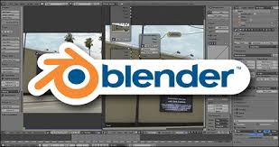
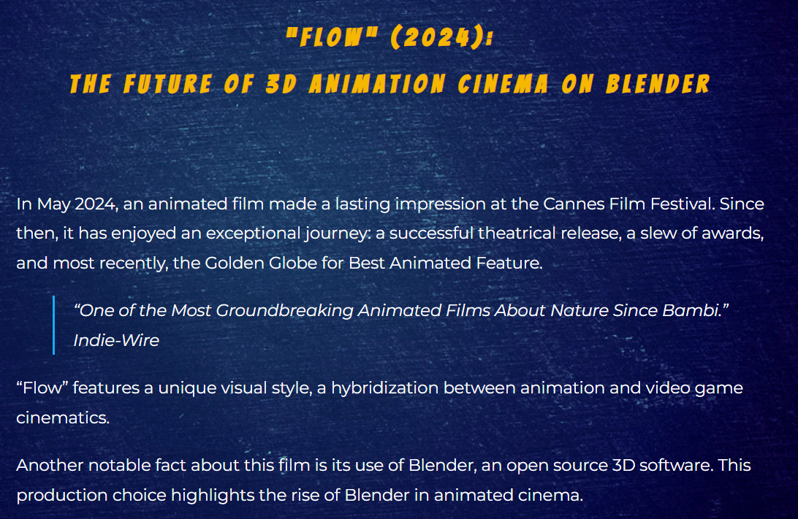
Blender: Giving choice back to European creatives in an era of brain drain
Free and open source 3D computer graphics software tool → Used in a Best Animated Feature nominee!
Heavily invested in education and community building as part of its engagement
Being managed as a Digital Commons by the Blender Foundation
‹#›
2024-2026 | https://commons.ngi.eu/
Notes:
Picture credit: https://www.google.com/url?sa=i&url=https%3A%2F%2Fshoutingthomas.typepad.com%2Fharleys_cars_girls_guitar%2F2015%2F10%2Fblender-open-source-3d-animation-software.html&psig=AOvVaw2QEhvoIatYb8cIqET8lGGf&ust=1738082286957000&source=images&cd=vfe&opi=89978449&ved=0CBcQjhxqFwoTCJCNjKerlosDFQAAAAAdAAAAABAE
Picture credit:

Slide 20
Reviewing past policies to support Digital Commons

Slide 21
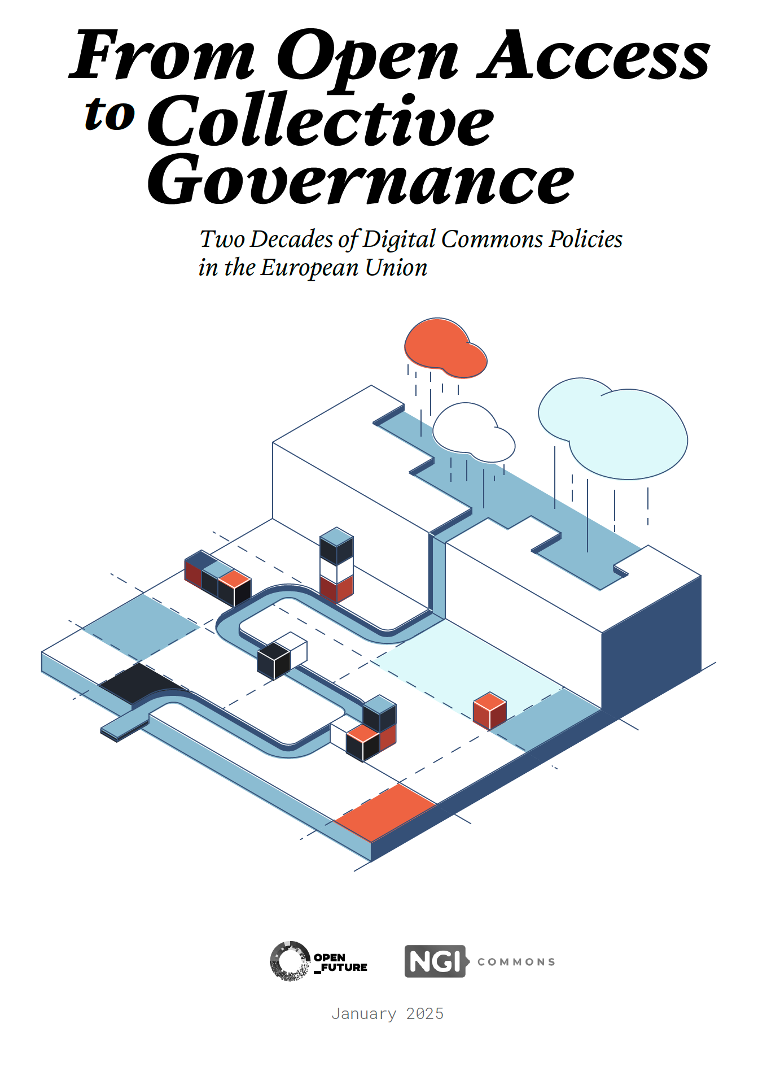
From Open Access to Collective Governance:
Two Decades of Digital Commons Policies in the European Union
Unlike previous studies that have examined subsets of Digital Commons, such as open source software (OSS) or Open Data, this report offers a holistic perspective.
It integrates various resources and initiatives under the broader framework of Digital Commons, presenting a comprehensive view of how these policies have evolved.
Policies Promoting the Adoption of Open Source Software (OSS)
Policies Promoting Open Access to Knowledge
Policies Promoting Open Data
Policies Promoting Open Source Hardware

Slide 22
From Open Access to Collective Governance:
Two Decades of Digital Commons Policies in the European Union
Initially, efforts centered on open access, emphasizing transparency and the free circulation of knowledge, data, and software to drive economic and societal benefits. Public administrations adopted OSS to modernize operations, reduce costs, and enhance transparency.
In the past decade, policy priorities have evolved to address the governance and collective management of digital infrastructures, driven by concerns over digital sovereignty and the growing dominance of a few global platforms.
Policies Promoting Interoperability and Open Standards
Policies Mobilizing Digital Commons for Industrial Strategies and Economic Development
Policies Supporting the Distributed Ownership of Critical Digital Resources

Slide 23
What’s next? How can you join us?

Slide 24
Digital Commons Taskforce (DCTF)
Theory of Change: Connect + Learn + Share knowledge and issues + Mobilize stakeholders
20+ experts regularly engaged, based on specific interest topics, which we are blogging and writing articles about
Other experts will be invited to join all along the duration of the project - up to ~ 70
We seek to share events, projects, publications for promotion and amplification
Dedicated mailing list available at dctf@ngicommons.eu
Bi-monthly online meetings to review and contribute to the work of the project consortium
Community platform on Matrix/Element for sharing ideas and facilitating discussions
Contact us at info@ngicommons.eu to become a candidate to the DCTF

Slide 25
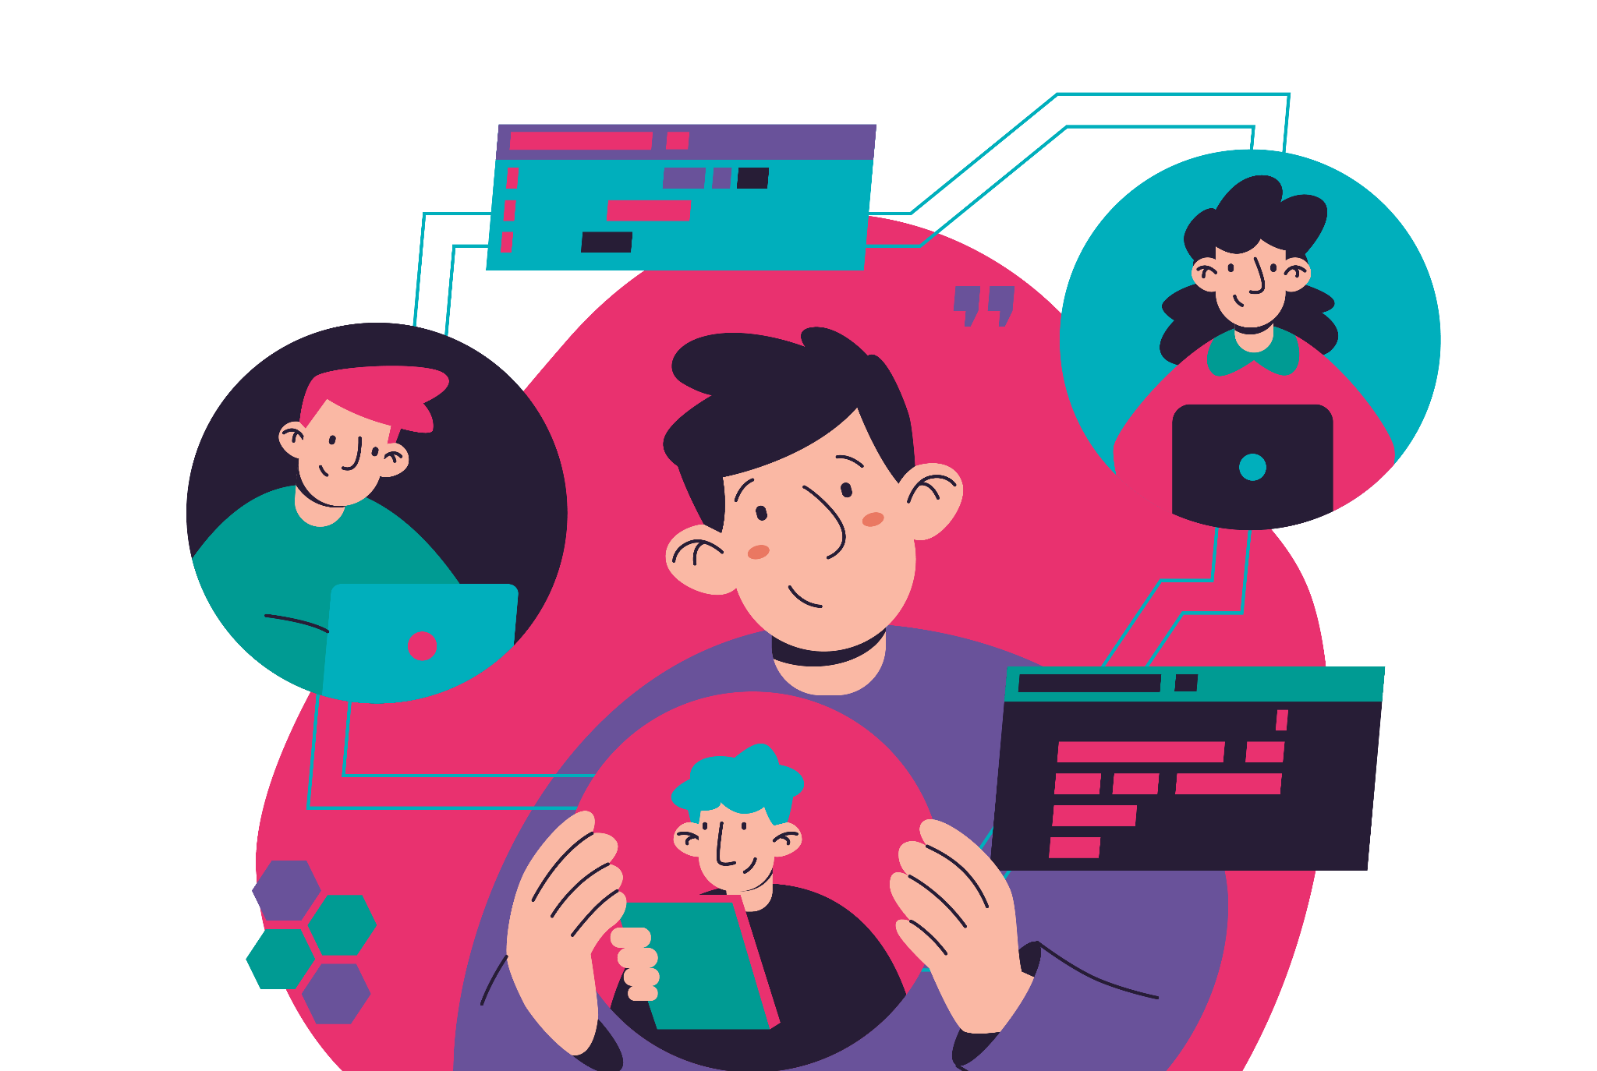
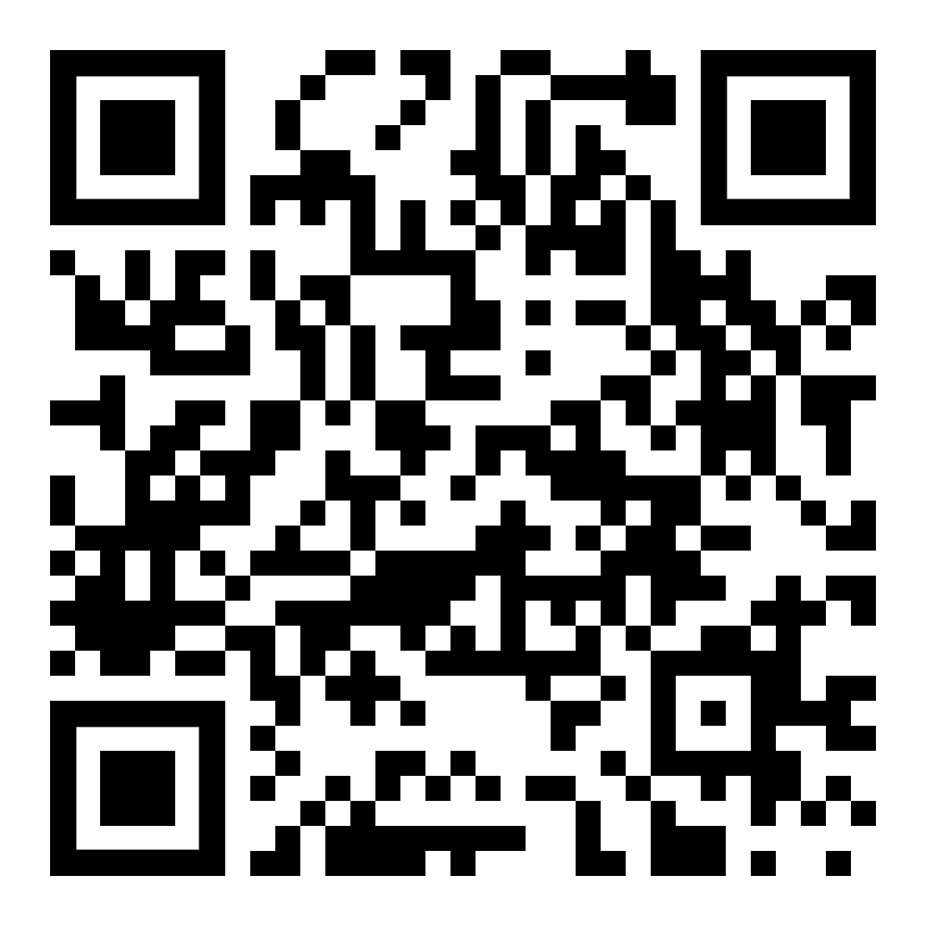

Join the Digital Commons Community Platform (DCCP) over on Matrix!

Slide 26


Register to our newsletter
commons.ngi.eu/newsletter

Slide 27



Follow us on social media and get involved with the project!
  FOLLOW US!
@NGICommons@eupolicy.social
  NGICommons
@ngi-commons
@ngicommons.bsky.social

Slide 28
Thank you!

