Slide 1


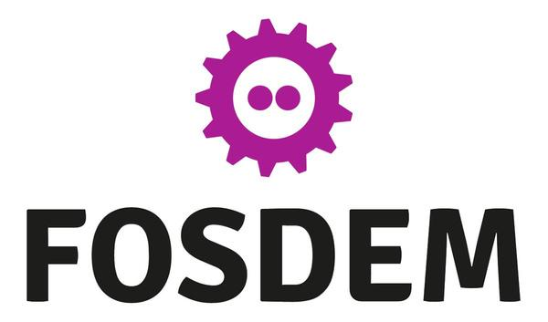

PICO Scholar: Advancing Open Research with an Open-Source AI Platform
Speakers: Cristina DeLisle, Matias Vizcaino

Slide 2
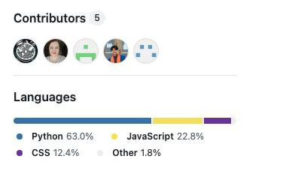
PICO Scholar: Accelerating Systematic Reviews with AI
  Open-source PoC: domain-adaptive AI, real-time collaboration
  Towards a community of developers & researchers.
  MSc in CS @ Georgia Tech students:
    Team of 4 software engineers @ TiDB Future App Hackathon 2024: Matias, Cristina, Will, Benjamin.
    Team of 5 software engineers @ Red Hat and Intel AI Hackathon: Matias, Cristina, Isaac, Arpit, Peter.
  Collaboration with Robert Gordon University researchers: Regina & Carlos.

Slide 3
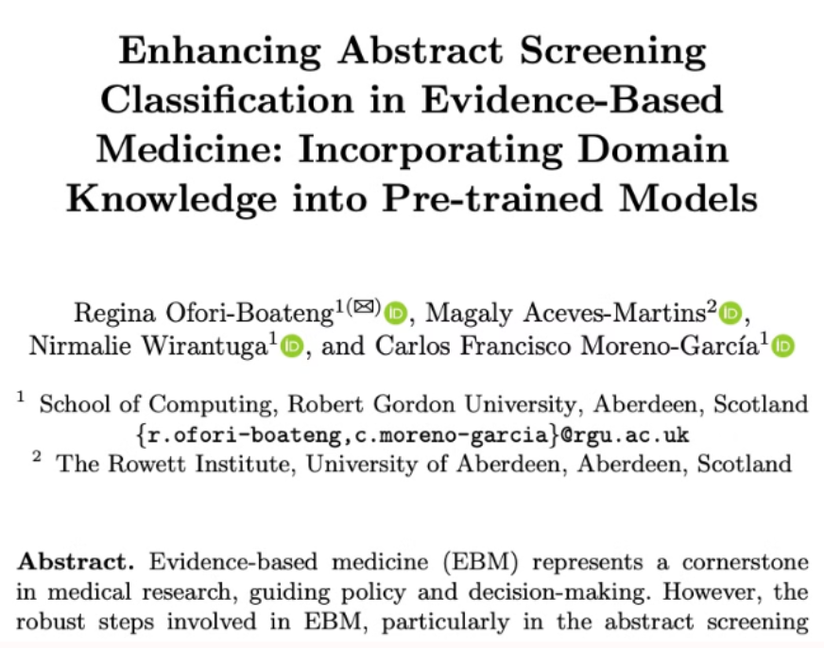

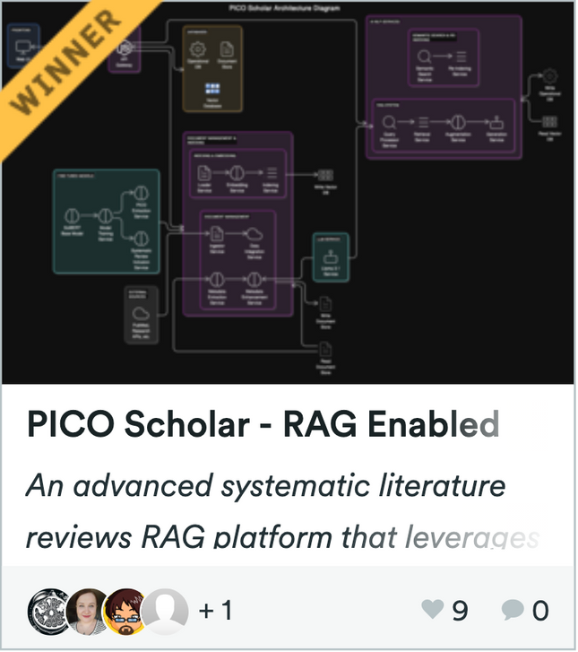

PICO Scholar Journey

Slide 4
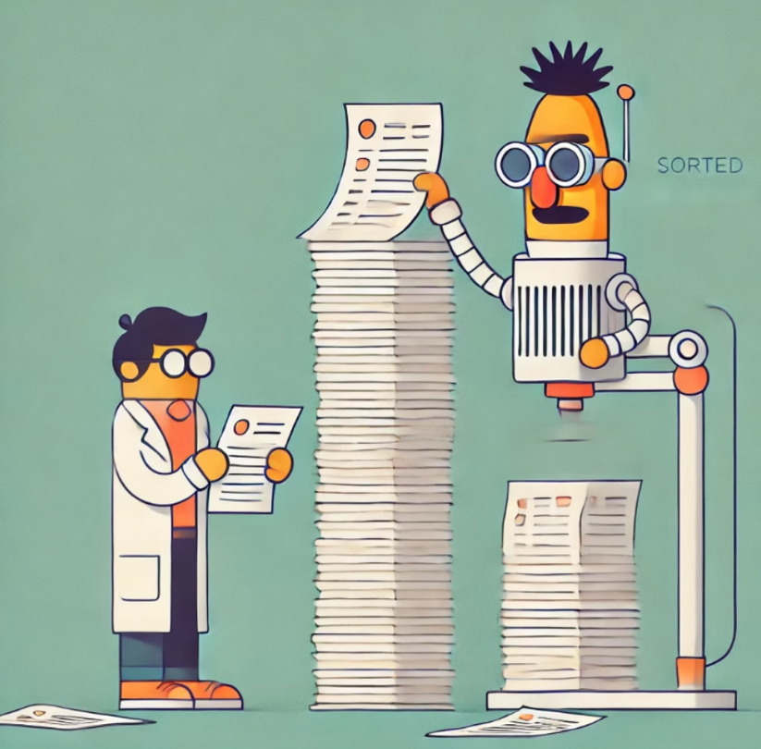
The Literature Review Bottleneck
The Challenge
Existing tools struggle with:
  Increasing volume and complexity of technical literature
  Specialized terminology
  Transparent selection workflows
  Limited ability to integrate new publications into ongoing or past literature reviews

Slide 5



Pain Points Addressed
Information Overload
Manual Review Processes
Lack of Guidance and Resources
Academic researchers:
  challenges navigating vast amounts of literature.
  new knowledge is hard to integrate in published literature reviews.
Conference organizers:
  struggles with manually reviewing submissions, which leads to time-consuming and potentially biased selection processes.
Students and Educators:
  lack of access to comprehensive resources and structured guidance for conducting effective literature reviews.

Slide 6

PICO Scholar PoC
Scalable Architecture
AI-Powered Search & Ranking
Microservices for flexibility: plug-and-play models.
Enhances literature relevance.
Systematic Review Flow
Design of Collaboration Tools
Including metadata extraction and selection criteria - inspired from biomedicine methodologies (Population, Intervention, Comparison, Outcome).
Design for shared workspaces,
role-based access.

Slide 7
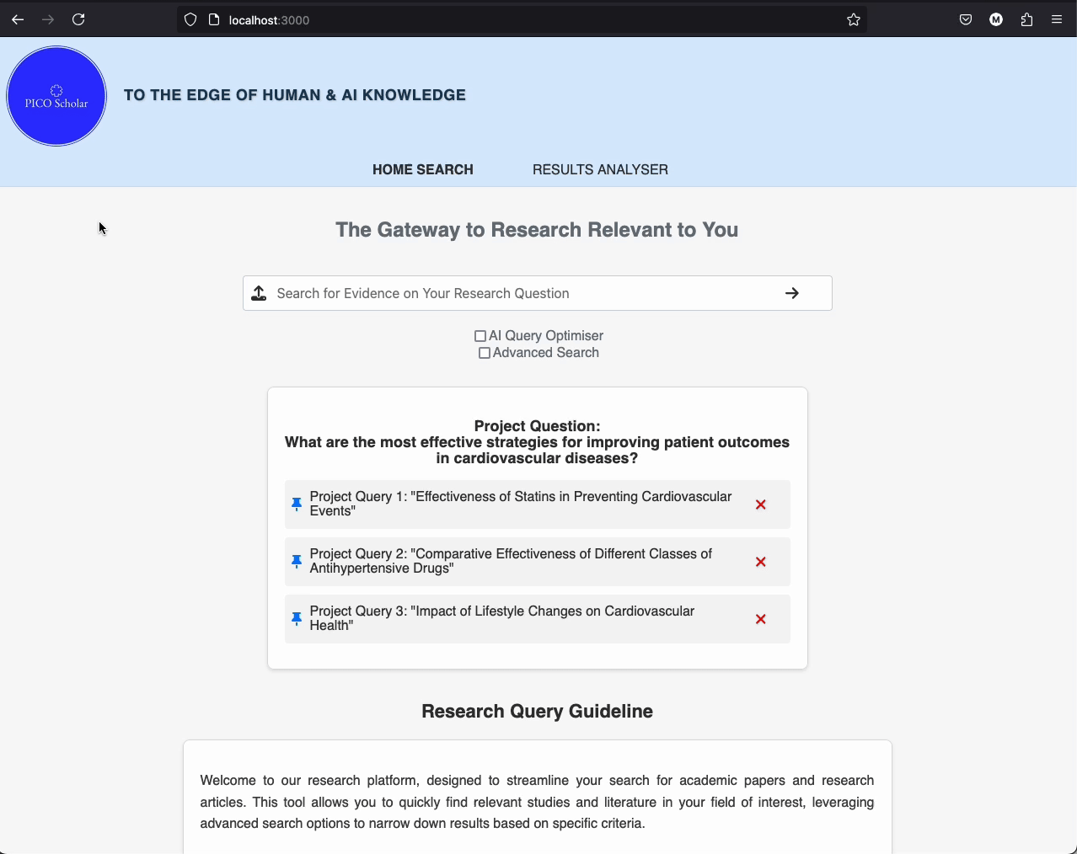
PICO Scholar Search

Slide 8
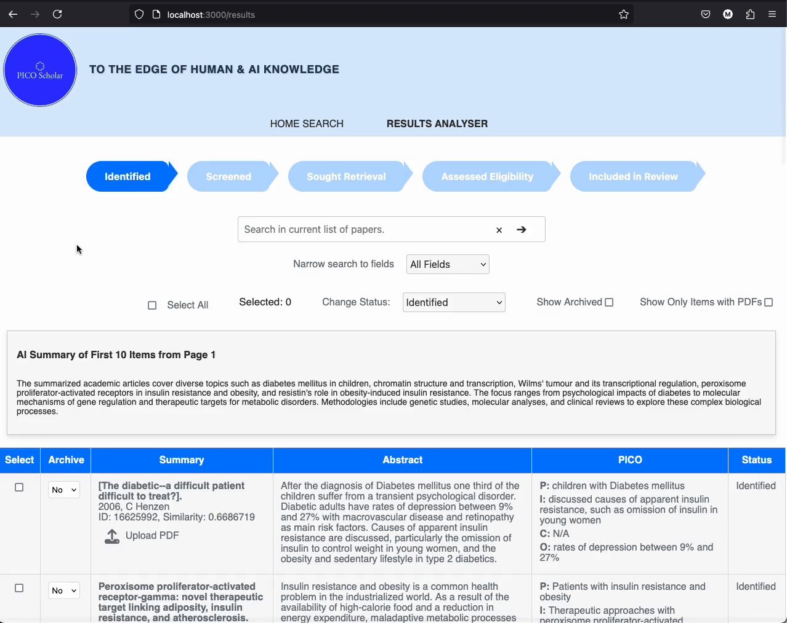
PICO Scholar Funnel View

Slide 9
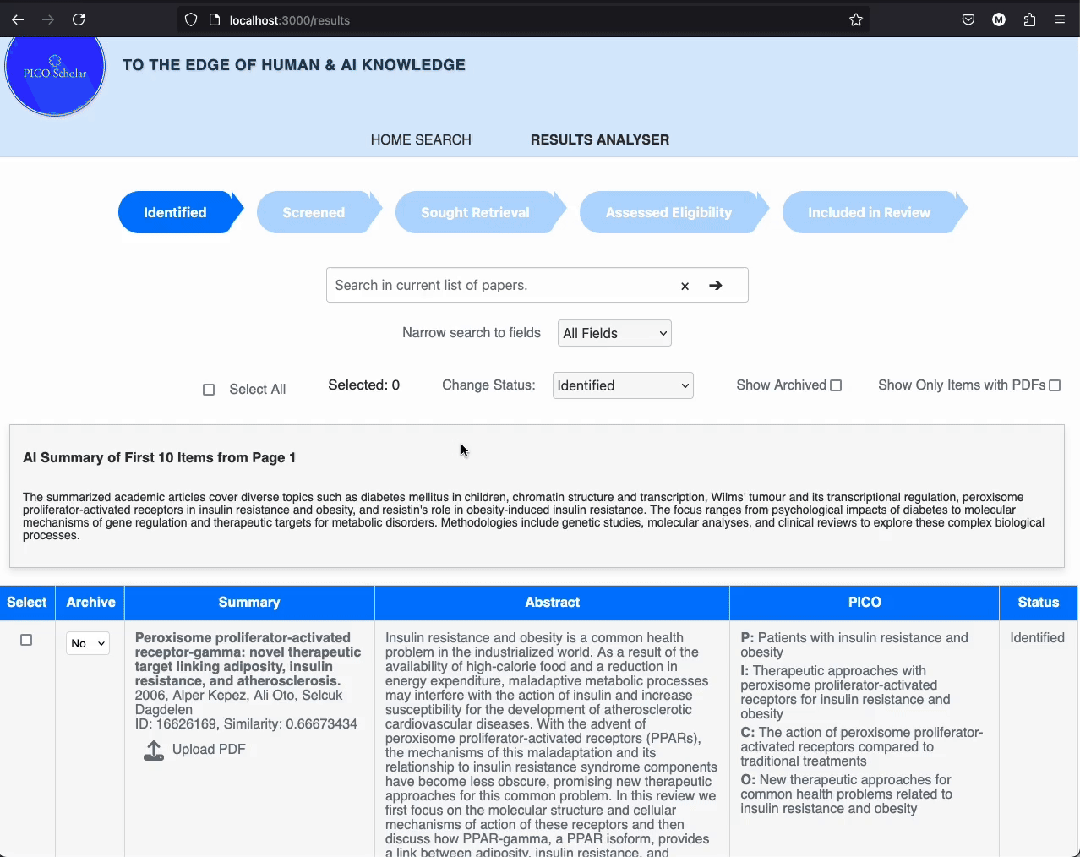
PICO Scholar AI Assistant Chat

Slide 10
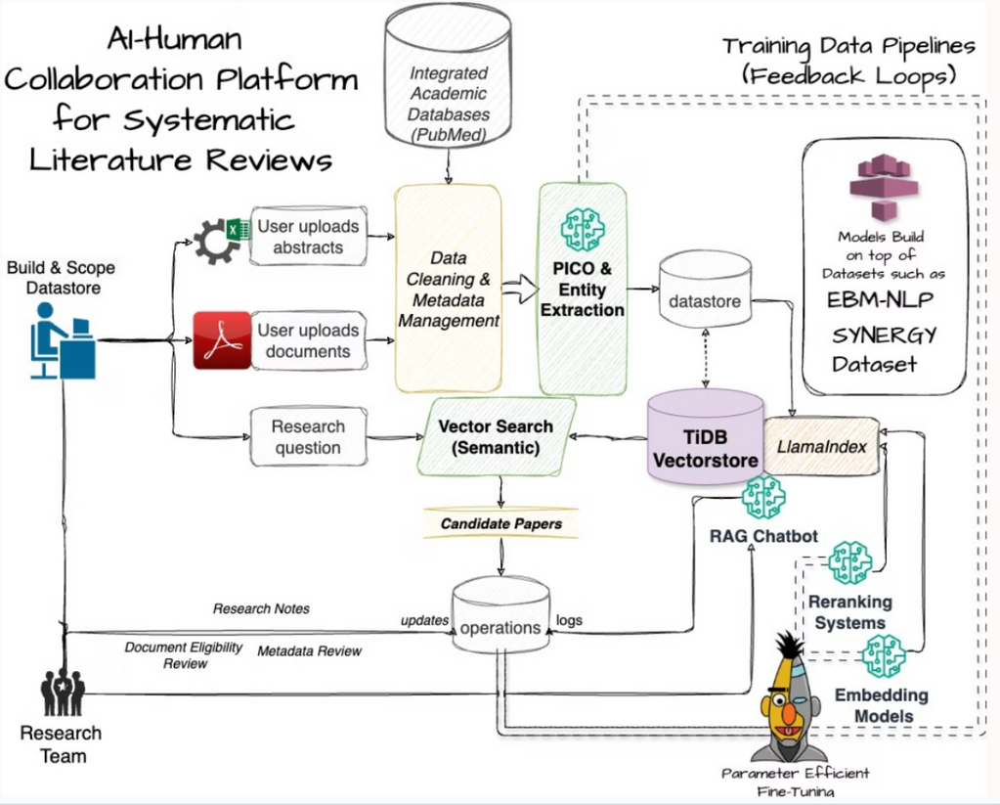
Solution Design Diagram
Core capabilities:
  Data ingestion
  PICO extraction
  Vector search
  Feedback loops for model refinement

Slide 11


Current Tech Stack
Backend
Python (FastAPI), LlamaIndex, SciBERT
Frontend
React.js
Red Hat OpenShift AI, leveraging Intel OpenVINO optimizations
Infra
TiDB for scalable vector search (free-tier offers 5GB)
Database
Microservices
Scalable and modular design for efficient processing.
AI Adapters
Fine-tuned AI models for metadata extraction.

Slide 12

PICO Scholar Potential
Collaboration & Transparency
Intuitive User Experience
Shared workspaces, role-based access, auditable team workflows.
Easy onboarding for beginners, advanced tools for experts.
Human-AI Collaboration
Continuous Learning
Domain-specific AI fine-tunes search results for higher relevance.
Community-driven training data improves results across domains.
Workflow Integration
Data-Driven Insights
Connect to citation managers, academic databases, and more.
Interactive dashboards and study refresh features provide real-time, actionable research insights.

Slide 13

PICO Scholar Development Vision
PoC to MVP
Transitioning through agile, iterative development approach.
Self-Hosted Solution
Focus on conference organizers for efficient submission management.
Expansion
Support additional user personas and integrate public datastores

Slide 14

Use Case: Conference Organizer
Phase 1: Backend & Core Features
Develop self-hosted tool with AI-driven search and basic screening tools.
Phase 2: Collaboration & PM
Enable real-time collaboration and enhance AI models.
Phase 3: Analytics & Reporting
Implement customizable reporting tools and analytics dashboards.

Slide 15
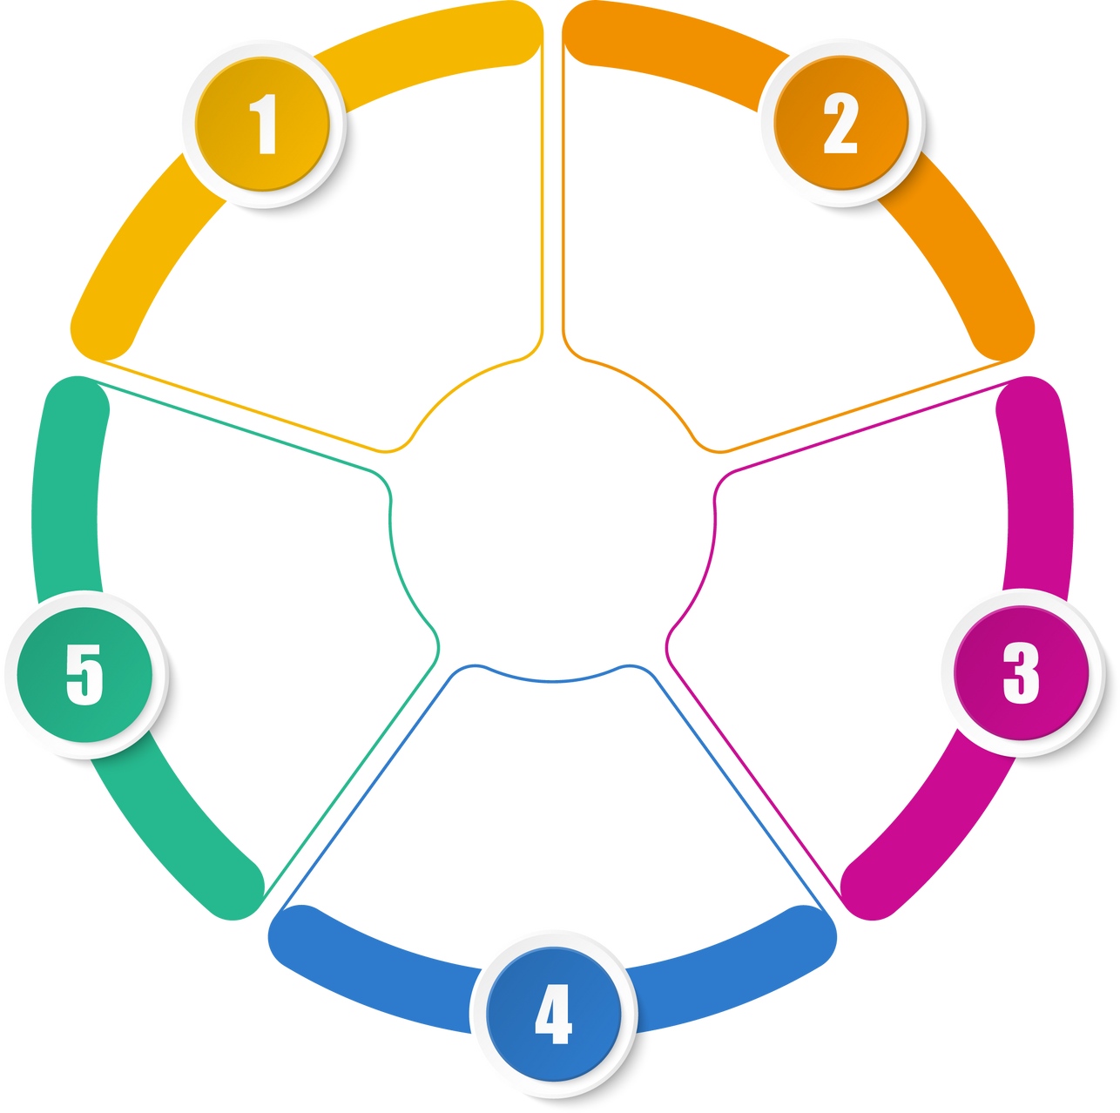
Next Steps for PICO Scholar
Automation
Better RAG
Community
Datastores
Domain templates

Slide 16

How to Contribute
Backend Developers (Go)
AI Researchers
Drive backend improvements for real-time web experience.
Improve model accuracy and efficiency.
Frontend (React,
UX / UI)
PhD Students
Offer domain expertise to enhance PICO extraction models.
Enhance the user interface experience.

Slide 17



Join the PICO Scholar Community
GitHub Repository
Online Engagement
Access our project code and contribute directly.
https://github.com/datagero/pico-scholar
Join our community forums and share your ideas.
Virtual Meetings
Participate in regular online discussions and collaborations.

