Slide 1
OpenLayers
the reference web-mapping library

Slide 2



Olivia Guyot
Developer at Camptocamp
@jahow
@oliviaguyot.bsky.social
olivia.guyot@camptocamp.com

Slide 3
What is OpenLayers?

Slide 4
JavaScript library to show interactive maps
Has been around for a long time
Constantly evolving and improving
OpenLayers - FOSDEM '25

Slide 5
npm install ol
OpenLayers - FOSDEM '25

Slide 6
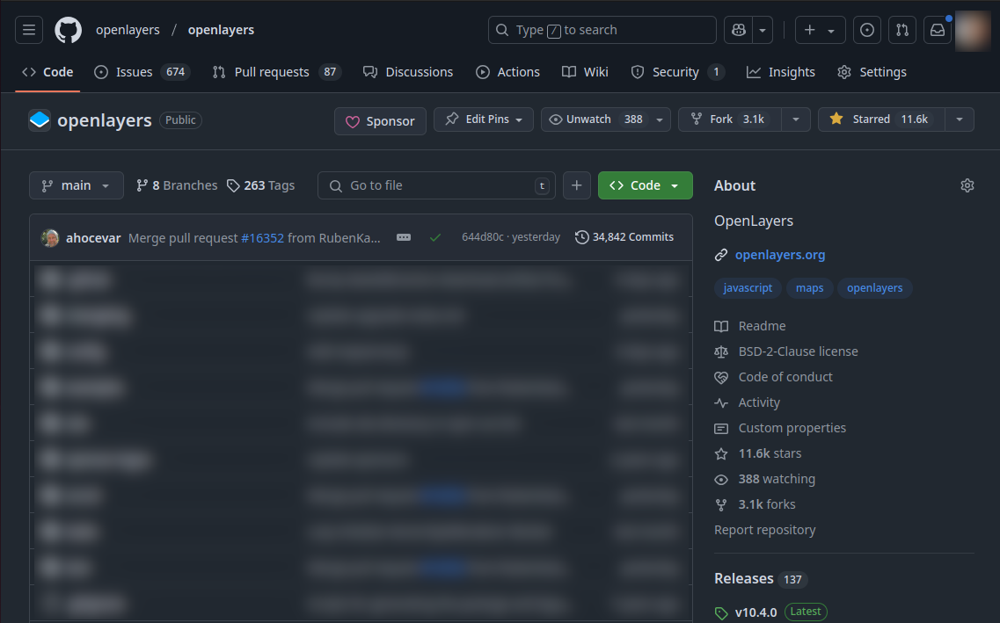
https://github.com/openlayers/openlayers
OpenLayers - FOSDEM '25

Slide 7
Features are split in modules that can be imported separately
Does not rely exclusively on plugins
OpenLayers - FOSDEM '25

Slide 8
Beautiful maps ✨

Slide 9
Vector styles
OpenLayers - FOSDEM '25

Slide 10
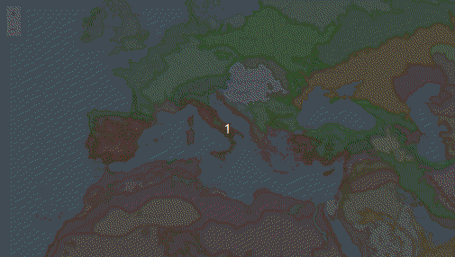
OpenLayers - FOSDEM '25

Slide 11
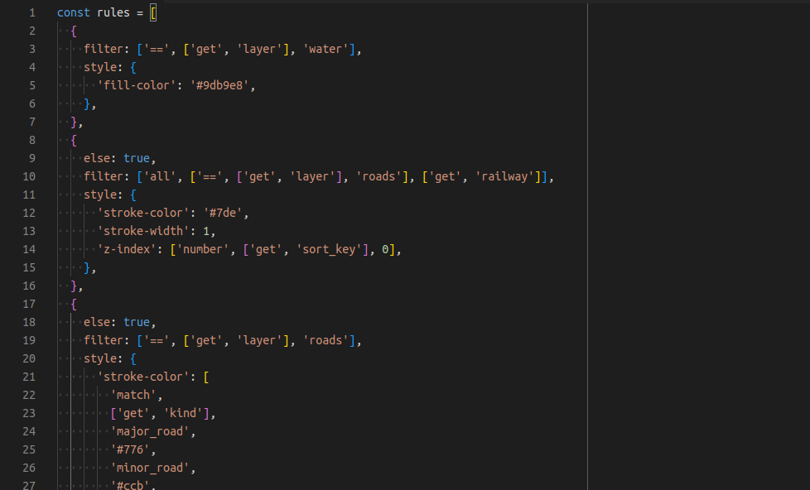
Rule-based styling
OpenLayers - FOSDEM '25

Slide 12
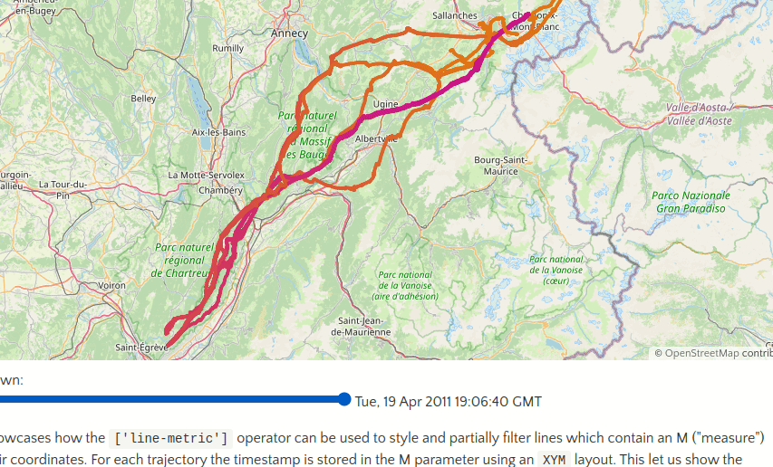
Varying colors along a line
OpenLayers - FOSDEM '25

Slide 13
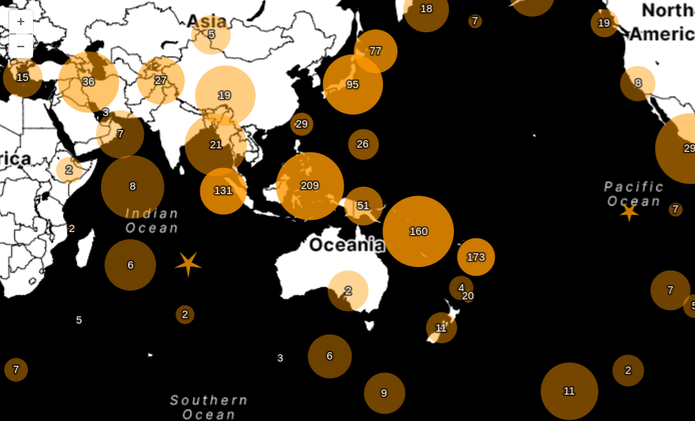
Point clusters
OpenLayers - FOSDEM '25

Slide 14
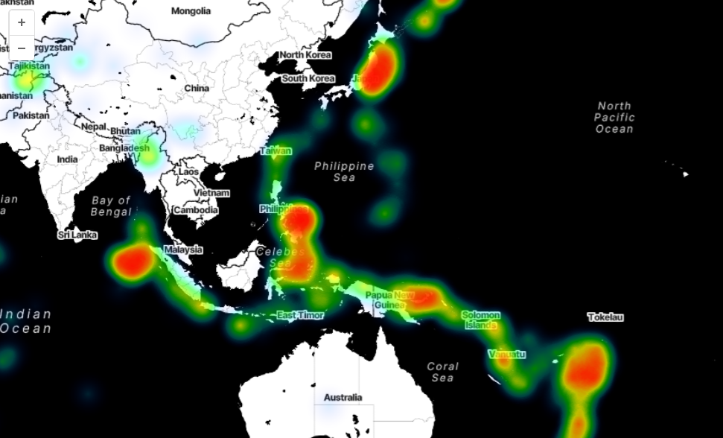
Heatmap
OpenLayers - FOSDEM '25

Slide 15
Tiled data
OpenLayers - FOSDEM '25

Slide 16
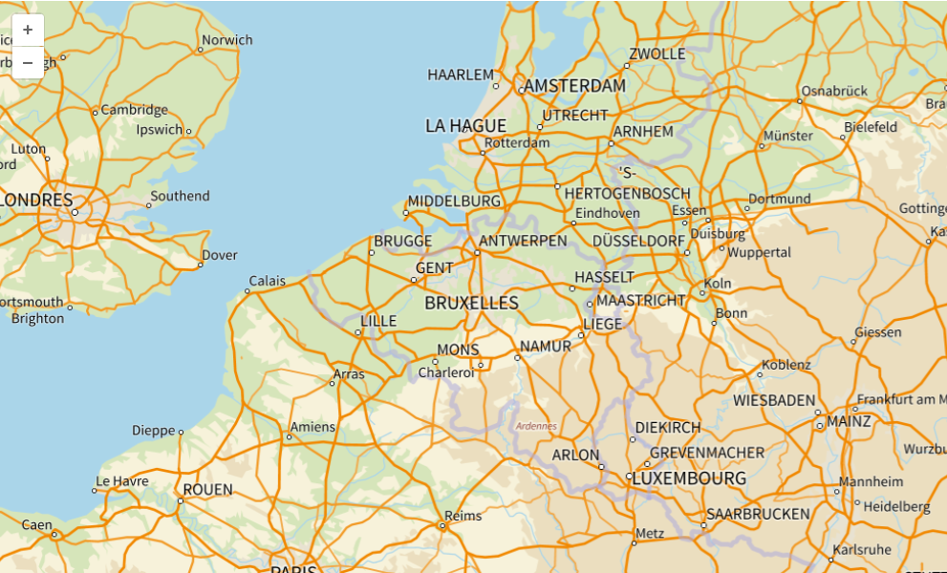
Image tiles
OpenLayers - FOSDEM '25

Slide 17
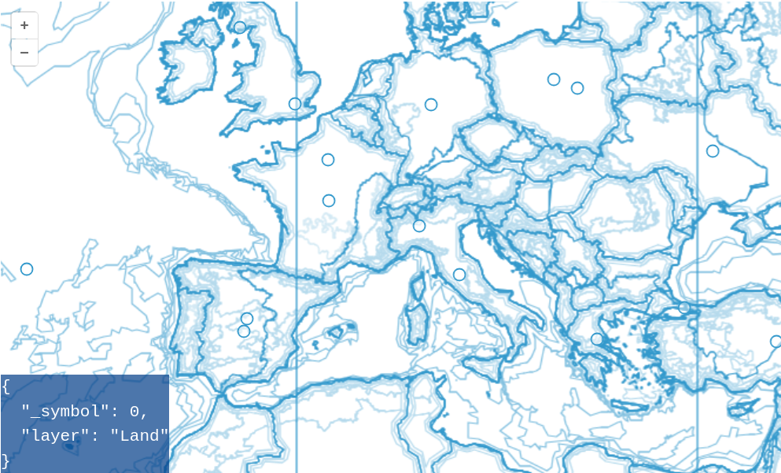
Tiled data
Vector tiles (unstyled)
OpenLayers - FOSDEM '25

Slide 18
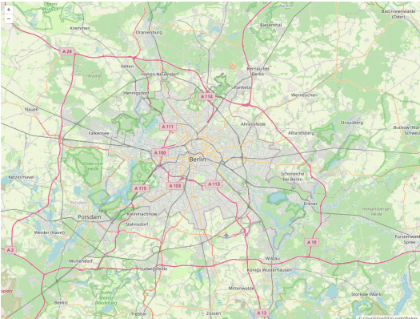
Tile loading across a view animation
OpenLayers - FOSDEM '25

Slide 19
Optimized tile loading: the right tiles at the right time
Tile grid can be anything
(not just web mercator)
Support high DPI
Decluttering on vector tiles
OpenLayers - FOSDEM '25

Slide 20
Raster data
OpenLayers - FOSDEM '25

Slide 21
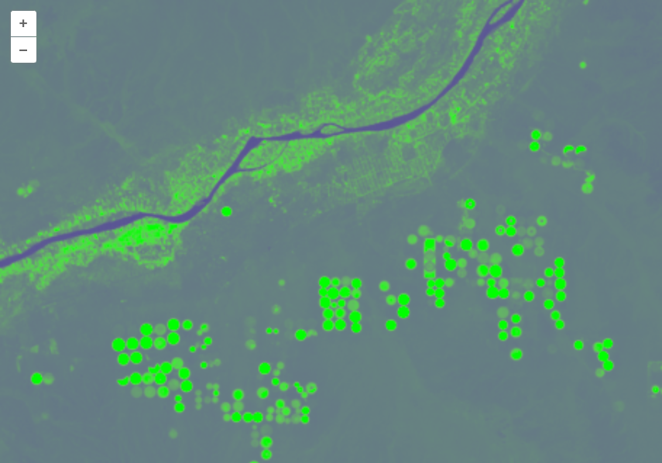
NDVI computed from a GeoTIFF file
OpenLayers - FOSDEM '25

Slide 22
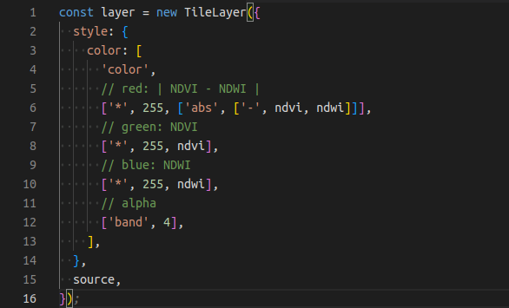
Dynamic styling of image tiles
OpenLayers - FOSDEM '25

Slide 23
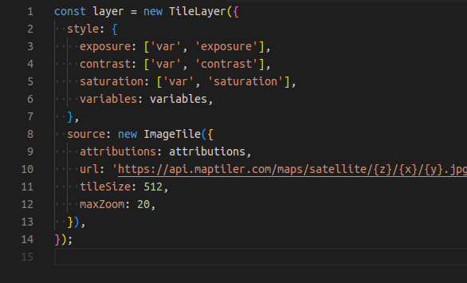
Dynamic styling of image tiles
OpenLayers - FOSDEM '25

Slide 24
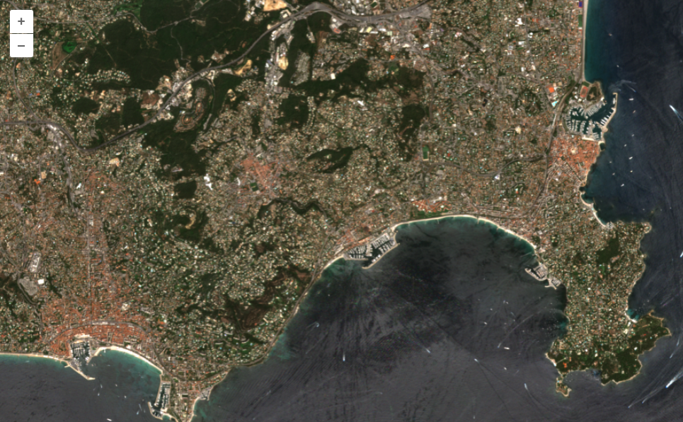
Flow layer
Visible colors & near infrared from Sentinel 2
OpenLayers - FOSDEM '25

Slide 25
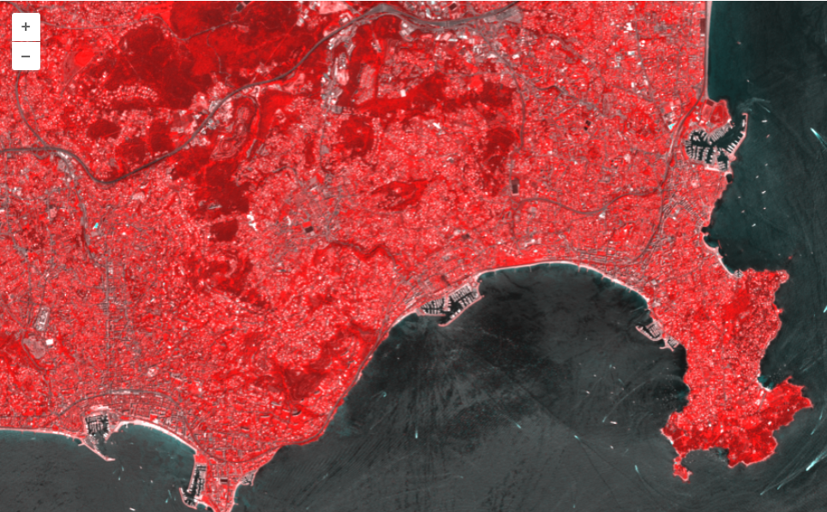
Flow layer
Visible colors & near infrared from Sentinel 2
OpenLayers - FOSDEM '25

Slide 26
Projections!
OpenLayers - FOSDEM '25

Slide 27
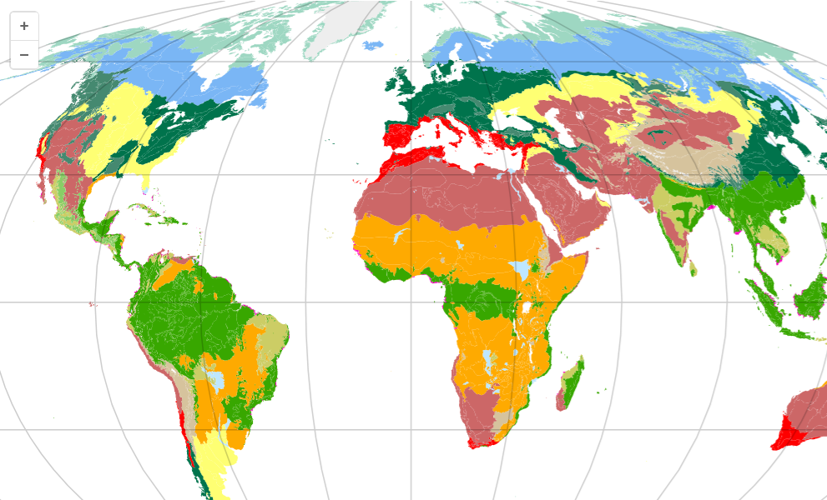
Mollweide projection (better area proportions)
OpenLayers - FOSDEM '25

Slide 28
Flow layer
OpenLayers - FOSDEM '25

Slide 29
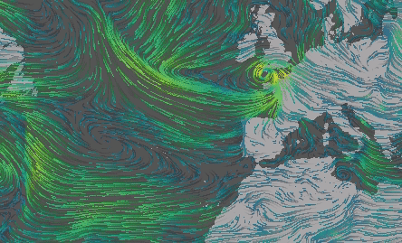
OpenLayers - FOSDEM '25

Slide 30
Formats
OpenLayers - FOSDEM '25

Slide 31
GeoJSON
WKT, WKB
GML
GPX
KML
MVT
OSMXML
TopoJSON
…
OpenLayers - FOSDEM '25

Slide 32
Sources
OpenLayers - FOSDEM '25

Slide 33
OGC API Tiles
WMS, WFS, WMTS
SentinelHub
PMTiles
Google Maps
Stadia Maps
COG
IIIF, Zoomify, ...
OpenLayers - FOSDEM '25

Slide 34
How-to 🔧

Slide 35
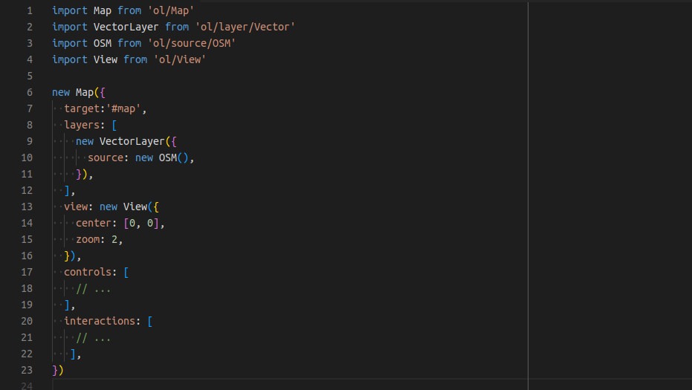
OpenLayers - FOSDEM '25

Slide 36
NPM package
OpenLayers - FOSDEM '25

Slide 37
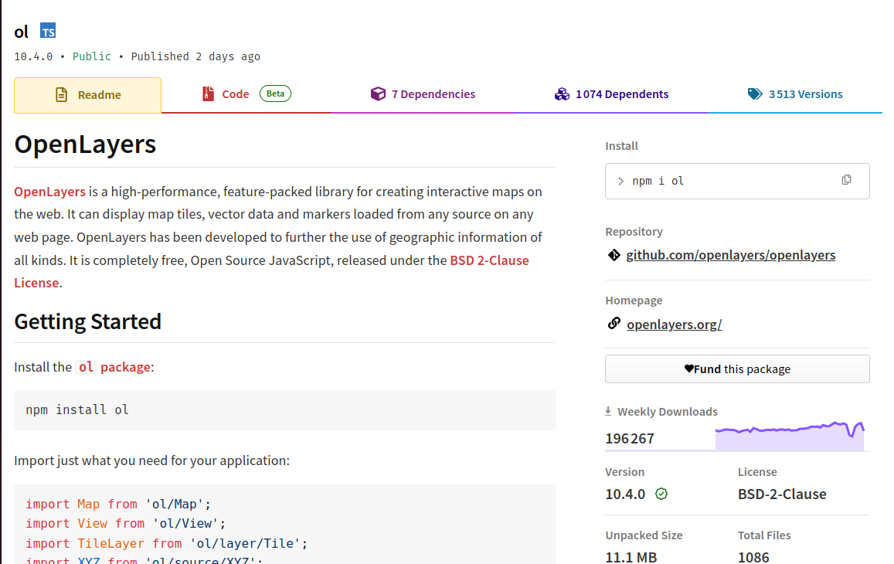
https://www.npmjs.com/package/ol
OpenLayers - FOSDEM '25

Slide 38
npm install ol
Latest stable
npm install ol@dev
Version on main branch
OpenLayers - FOSDEM '25

Slide 39
Examples & API doc
OpenLayers - FOSDEM '25

Slide 40
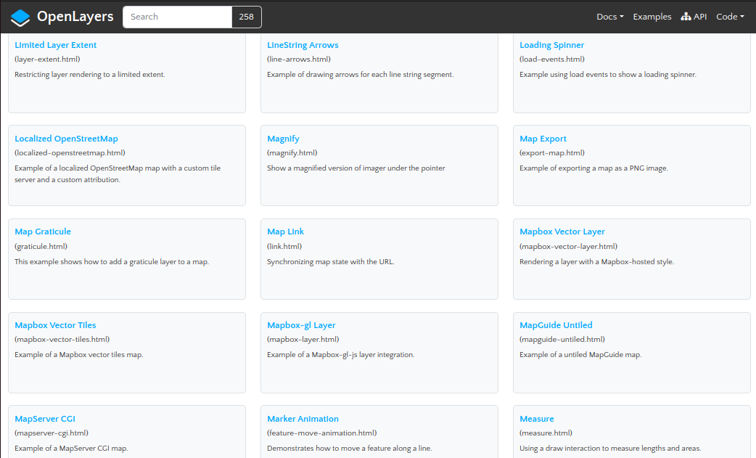
https://openlayers.org/en/latest/examples
OpenLayers - FOSDEM '25

Slide 41
Benchmarks!
OpenLayers - FOSDEM '25

Slide 42
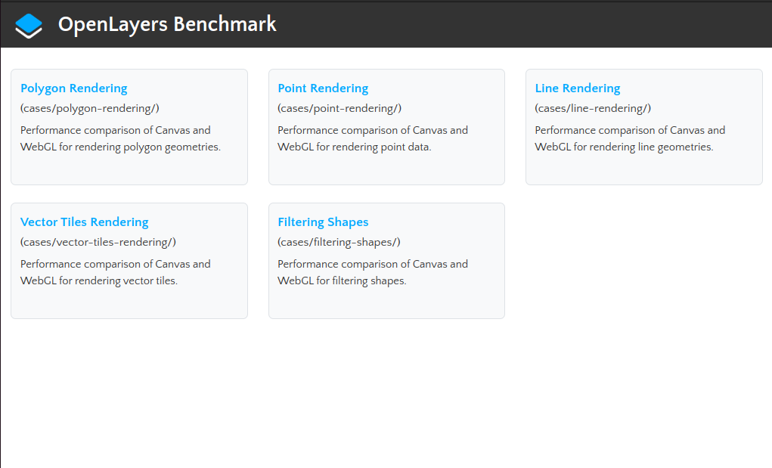
https://openlayers.org/bench
OpenLayers - FOSDEM '25

Slide 43
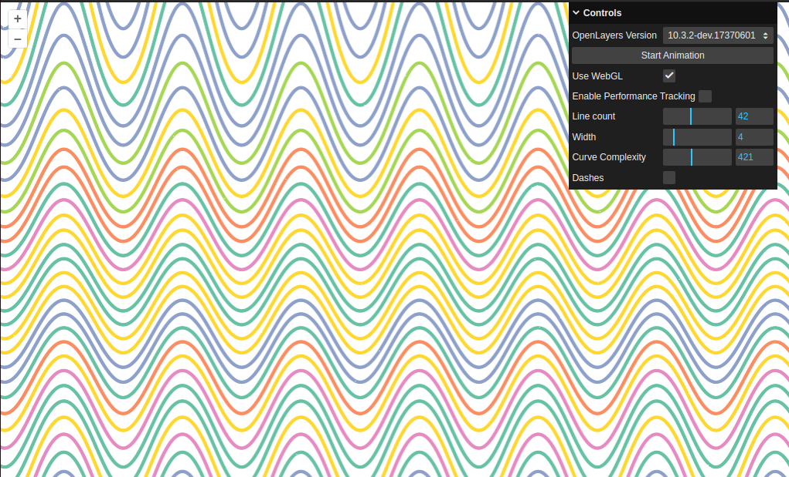
https://openlayers.org/bench/cases/line-rendering
OpenLayers - FOSDEM '25

Slide 44
Vector data is the main area for performance improvement
Used to measure progress on WebGL renderers
OpenLayers - FOSDEM '25

Slide 45
Why it matters

Slide 46
Accessibility to good maps is essential
Vendor lock-in is a reality
OpenLayers is not owned by a company
OpenLayers - FOSDEM '25

Slide 47
Diversity of data formats ensures ease of use
No "western" assumption
OpenLayers - FOSDEM '25

Slide 48
Help is always welcome! 💪
OpenLayers - FOSDEM '25

Slide 49
Q & A

Slide 50
Thank you!! 🫶
Feel free to reach out if you want to know more

