Slide 1
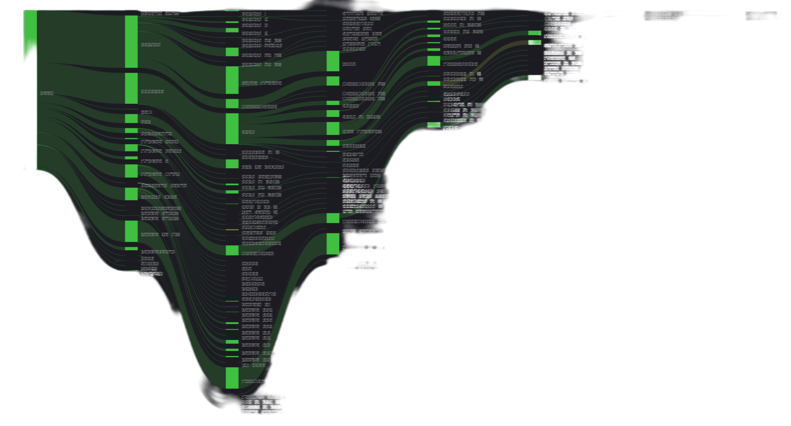
Every ISP Needs To Use A QoE Middle-Box On Their Network
FOSDEM 2025
Frantisek (Frank) Borsik
Gopher, LibreQoS
frantisek.borsik@gmail.com

Slide 2
About Bufferbloat & LibreQoS
Bufferbloat is most evident when a connection is heavily loaded with downloads or uploads. It causes increased latency (ping), resulting in poor performance for real-time tasks like VoIP, video chat, and lag in online gaming, and generally makes the internet less responsive.
To date, the advice you will get on the Net is “Install OpenWrt”, and “configure CAKE SQM”. 99% of users don´t know they have bufferbloat and even fewer know how to fix it.
The goal of the bufferbloat project has always been to get the ISPs to “do it right” in the first place. Much progress has been made in the cable industry where DOCSIS-PIE and L4S are emerging… but little elsewhere.
Everybody should have CAKE.

Slide 3
SQM´s Problems for ISPs
Shaping inbound on the home router is the wrong place
It is also CPU intensive there
Requiring router upgrades is expensive
Doing it right for thousands of customers has multiple bottlenecks.

Slide 4
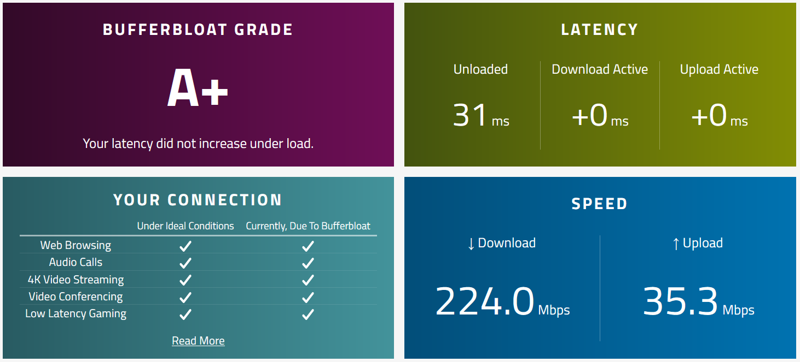
Typical Customer Response w/LibreQoS
Running CAKE to shape inbound on the CPE has more jitter than this.

Slide 5
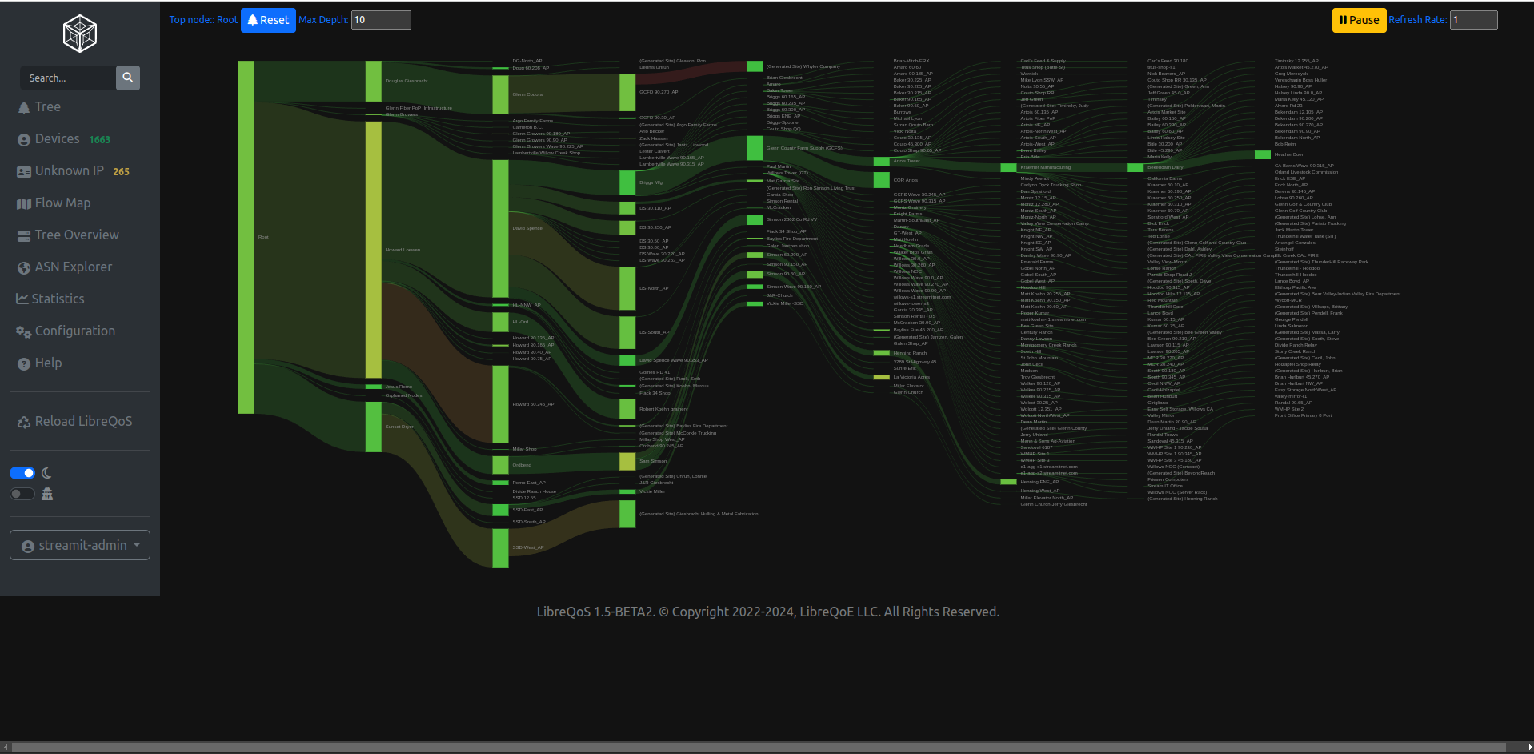
LibreQoS Sankey Total Network Overview
LibreQos can model and manage a network 8 hops deep. It has all kinds of cool stats like this sankey, which in this case shows latency issues across dozens of towers.
We have NOCs dedicating whole displays to this!

Slide 6
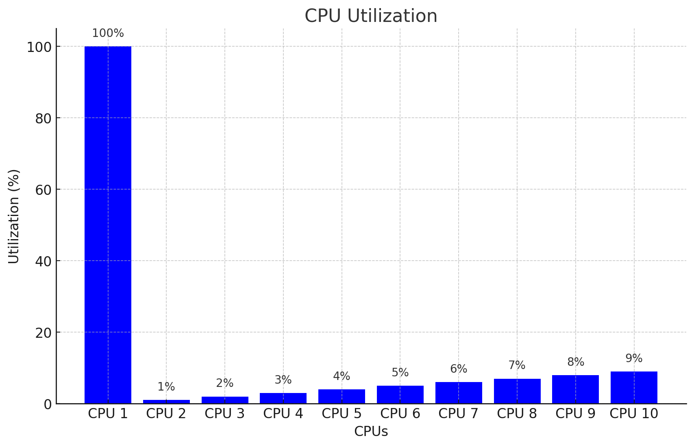
Linux Traffic Control is Single Threaded
TC is great, but it was designed with a single CPU core in mind.
CAKE+HTB is heavy - throughput is limited by CPU, even if you have lots of them!

Slide 7
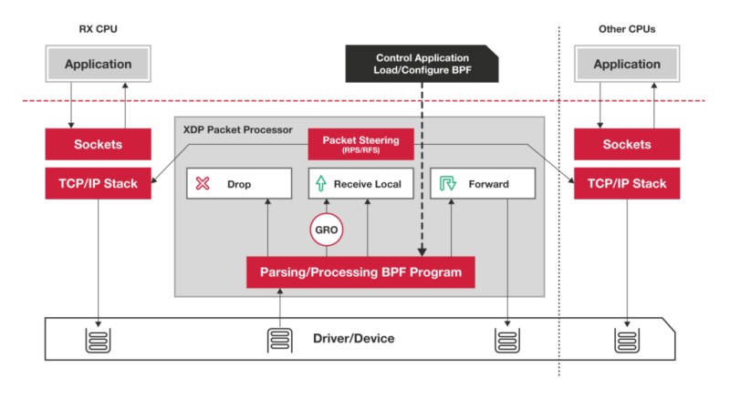
XDP cpumap
XDP cpumap is part of the XDP project, running eBPF programs per-packet as they pass through the kernel.
XDP cpumap provided us a way to scale traffic across CPU cores.

Slide 8
Operational Success: Understand Your Customers
Before version 1.4, we could:
Use CAKE to fight bufferbloat and improve latency.
Use HTB to model the networks.
Use XDP-CPUMap to scale to large networks.
Drop in a “bump in the wire” transparent bridge to do this without visiting customers.
Integrate with various Customer Relationship Management solutions to gather traffic plans and apply them in real-time.
Receive 80% fewer support calls
Now we can - with a tactical view:
See “hotspots” and pain points in real time.
Drill down and identify trouble occurring right now.
Receive a call, jump to a customer’s circuit and watch their experience right now - and provide personalized troubleshooting.
Capture data for further analysis.
Expand the science - collect useful, actionable data for the Bufferbloat team to make this even better.

Slide 9
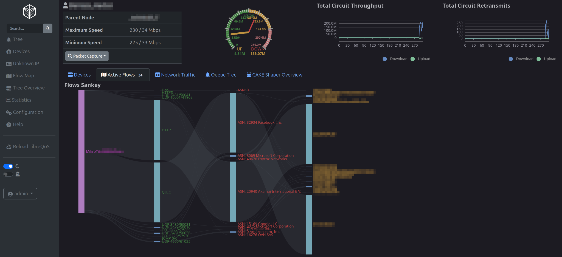
Real Time Flow Analysis (In LibreQoS v1.5)

Slide 10
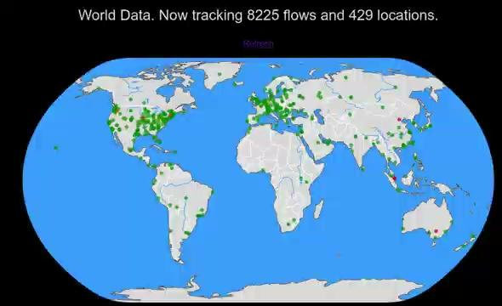
Measuring live latency worldwide

Slide 11

NOTE: Flow Queueing is almost enough today!!
98% of flows don´t need AQM, but the 2% need it desperately and the 98% need the 2% well taken care of.
Otherwise the principal driver of subscriber bandwidth need is video streaming.
To get 4K video, provision about 35Mbits to the user (DASH 4/10 rule)
Per customer average usage at peak time is no more than 6-10Mbits.
Gaming, DNS, keystrokes, VOIP and videoconferencing always just work
Once uploads are CAKEd…
nobody cares about lag anymore.
(except on WiFi)

Slide 12

An answer
LibreQoS´s FQ, packet shaping and AQM algorithms completely remove excess latency from an ISP network.
Really. If you don´t believe us, schedule or download a demo.
That said, once your network is LibreQoS optimized, our extensive passive statistics can track new problems and old in and outside your network.

Slide 13
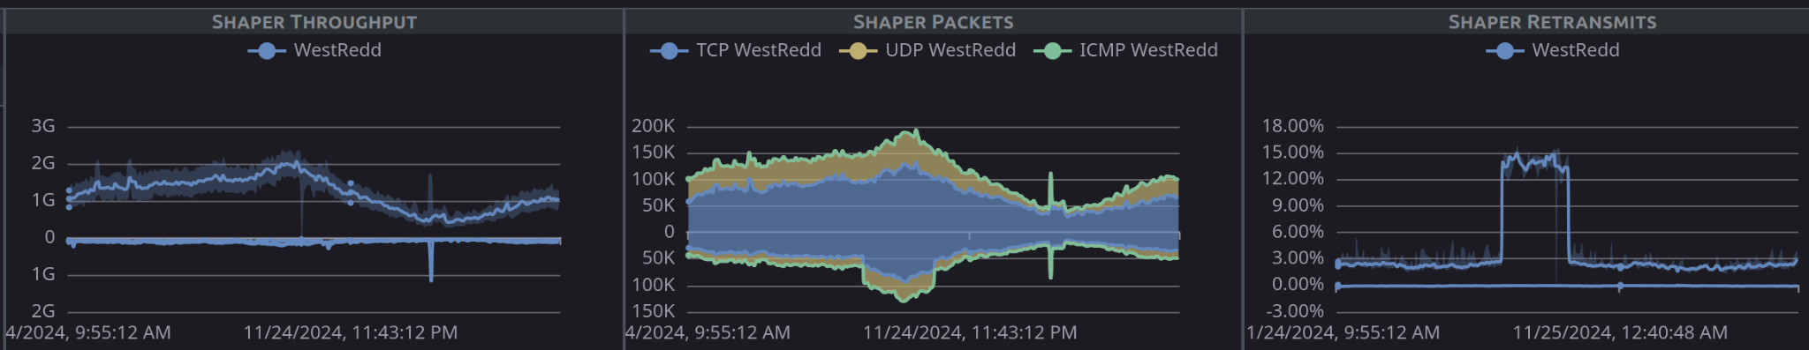
Tracking TCP retransmits
(this was a case where a packet sniffer on a given network segment caused excess packet loss)

Slide 14
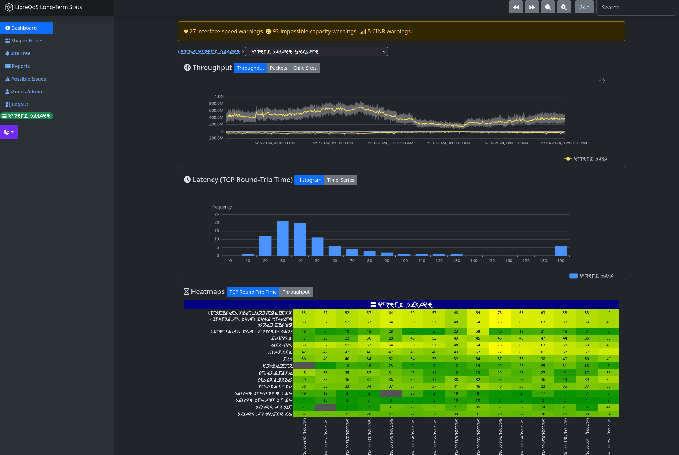
Sector Latency Heatmaps

Slide 15
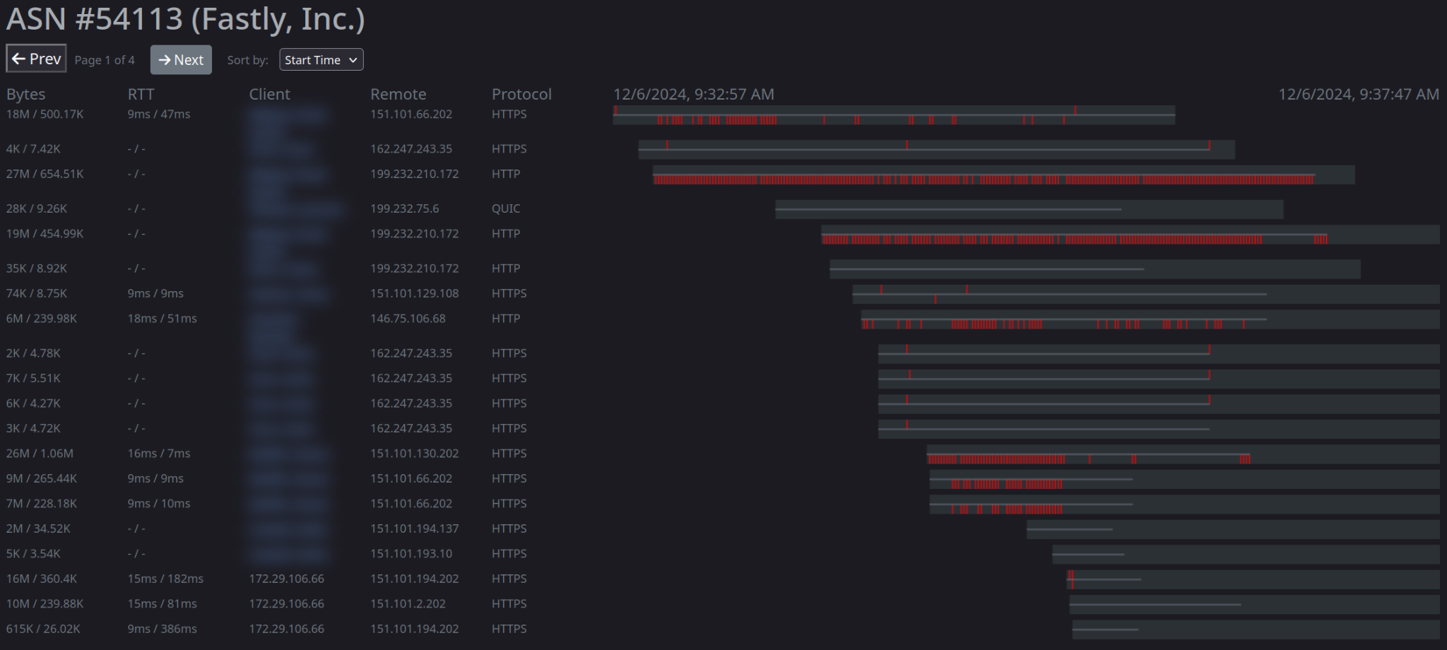
Per-ASN Performance

Slide 16




LibreQoS - On A Mission to Save The Net
Robert Chacón (CEO): “I must fix this!”
Built LibreQoS to apply FQ-CoDel and Cake to customer connections. Founded the LibreQoS project, created a really solid starting point.
Dave Täht (Chief Science Officer): “14 years of 100x better internet latency feasible… why hasn’t it deployed fully?”
- Runs the bufferbloat project.
Herbert Wolverson (Chief Product Officer): “My ISP Needs This - I’ll Rewrite it in Rust” - Herbert’s ISP in Central Missouri was suffering, LibreQoS made it work again. Along the way, Herbert rewrote a chunk in Rust, and started adding features…
Frantisek Borsik (Gopher): “The Internet Needs This”
Frank runs an awesome community, keeps us on track, and has a knack for connecting with ISPs.

Slide 17
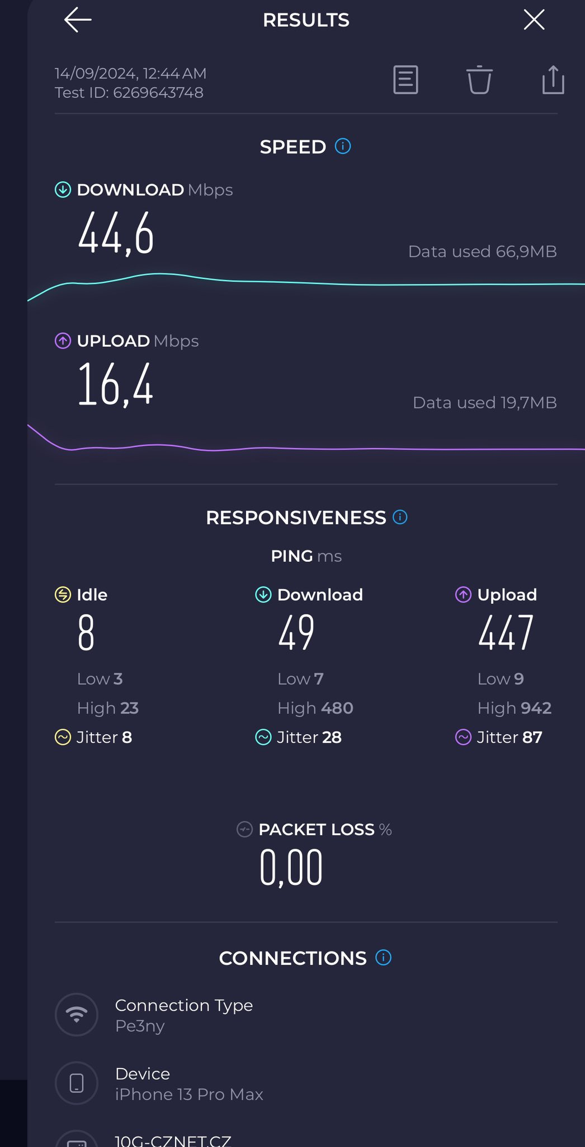
Test Tools of the trade
“It is wrong to suppose that if you can’t measure it, you can’t manage it – a costly myth.” - E.W. Deming
Flent v2.2 - the rrul and rtt_fair tests
Iperf2 - many new features!
Crusader - Rust rrul on everything
Xtcp2 - Monitor TCP_DIAG in docker
networkQuality - from Apple
All the speedtests have bufferbloat
Metrics now!
https://flent.org
https://sourceforge.net/projects/iperf2/
https://github.com/Zoxc/crusader
https://github.com/randomizedcoder/xtcp2
https://github.com/network-quality
https://www.waveform.com/tools/bufferbloat

Slide 18
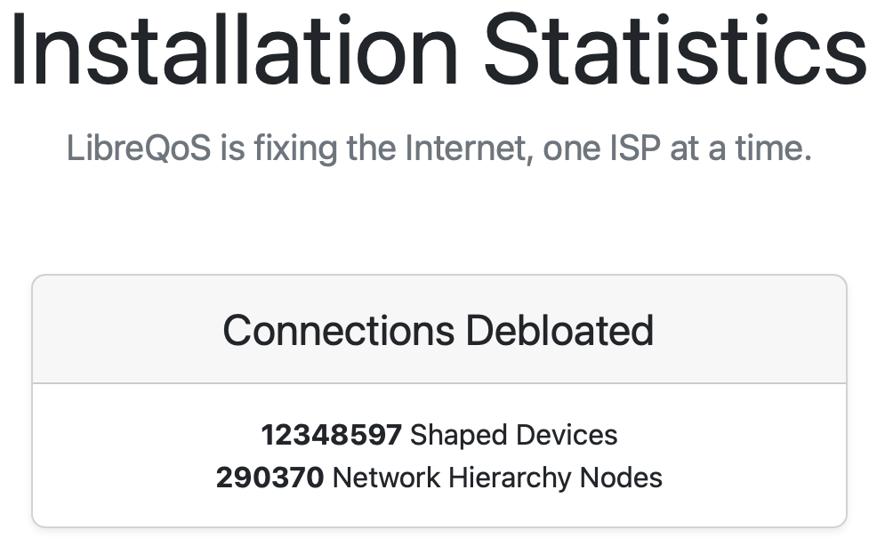
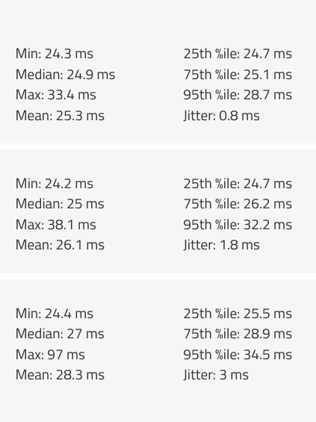
LibreQoS 1.5-Beta New Features
NetFlow
IS-IS support
Close integration with ISP CRMs: Splynx, UISP, Sonar, and Powercode
WIP: Gaiia, WISP gate, VISP
Flow Tracking - RTT, directionally, by ASN, etc.
New Web UI and Long-Term Stats backends
Vastly reduced memory usage

Slide 19
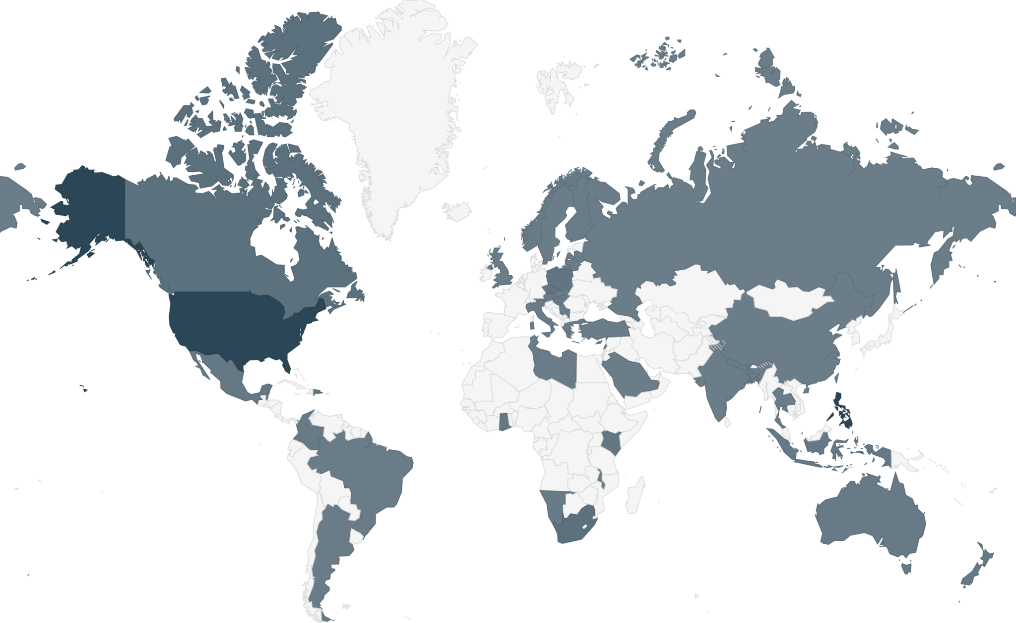
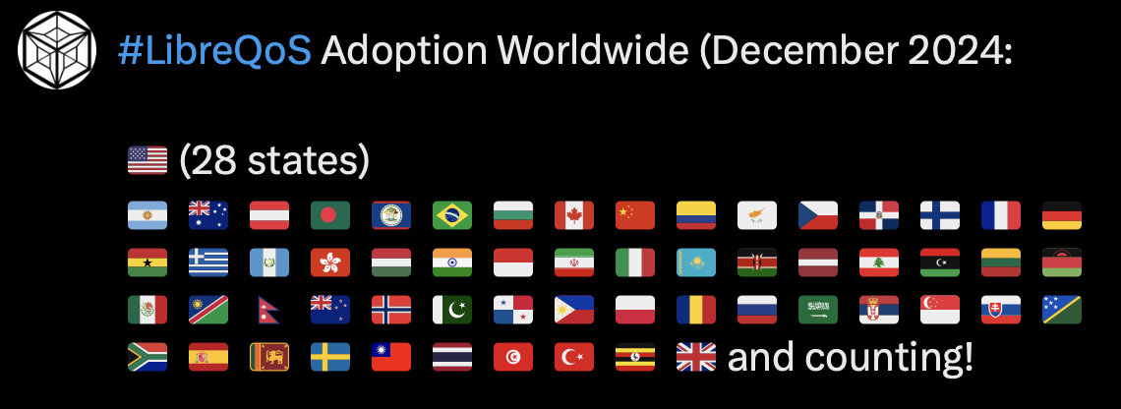
About LibreQoS
World beating ISP bufferbloat solution - leveraging Rust, C, python, eBPF, CAKE
Core product is Open Source. Over 400 ISPs using it today! 30k subscribers/box.
Core Supported by NLnet’s NGI0 Fund

Slide 20
LibreQoS is Free, Open Source Software
We love giving it away.
We’ve helped so many small ISPs in the regions that need the most help.
Making the Internet better for everyone just feels right.
We’ve helped many of the parts of the world that need it the most.
Unfortunately, we still have to eat.

Slide 21

THANK YOU!
NLNet have funded development of many features - THANK YOU.
Some of our enthusiastic users make donations - THANK YOU.
Stop by the NLNet booth. We have stickers!
It’s amazing and awesome…

Slide 22



BUT
We still have to eat!
Like so many other OSS projects, we’ve made the decision to monetize some of the non-essential features.
We’ve made 100% sure that you can use LibreQoS and reap the benefits for free - but some of the deeper analytics are now monetized (a self-host version is coming).
We’ll let you know how it goes!

Slide 23

Thanks!
Contact us:
sales@libreqos.io
www.libreqos.io
https://github.com/LibreQoE/LibreQoS
Please join the chat!

Slide 24

Postcript
What Can I Do About Bufferbloat?
https://www.bufferbloat.net/projects/bloat/wiki/What_can_I_do_about_Bufferbloat/
https://bufferbloat-and-beyond.net/

Slide 25
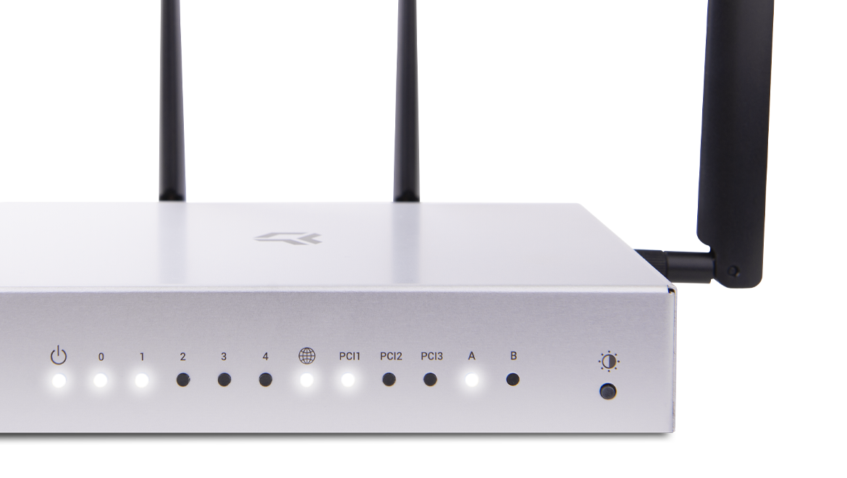
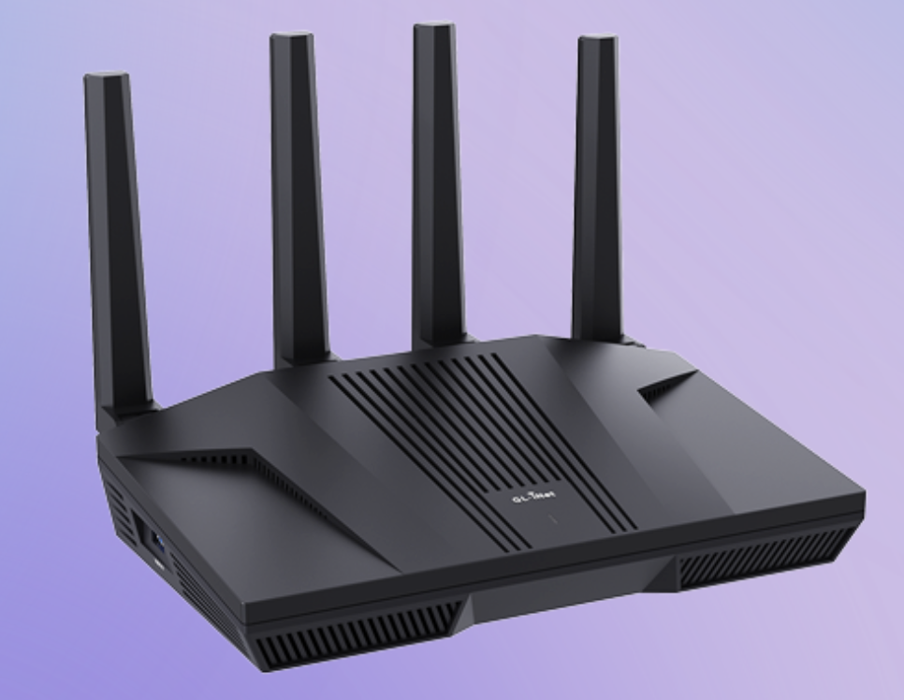
Postscript 2
GL-iNet
Turris Omnia
…also just flash your router with OpenWrt or get a MikroTik.

Slide 26

Postscript 3
RFC8290
Read it. Use it. Spread the word.
PS: Bandwidth is a lie!

Slide 27

Postscript 4
LibreQoS is built in Rust 🦀
https://pragprog.com/titles/hwmrust/advanced-hands-on-rust/

Slide 28

Visit Herbert at Rust Nation UK
19th & 20th Feb
Herbert - our Rust programmer - is giving a talk on Rust, C and C++ Interoperability, Feb 19th.
He’ll be manning the Ardan Labs booth on the 20th.
Stop by and say Hello!

