Slide 1




Add RISC-V support to your
favorite Operating System
RISC-V Devroom, FOSDEM’25
February 1, 2025

Slide 2
About
Adrian Vladu
Flatcar maintainer
Cloud Engineer
Github: @ader1990
Email: avladu@cloudbasesolutions.com

Slide 3
Outline
Why RISC-V
Why Flatcar Container Linux
Adding RISC-V support to Flatcar Container Linux
Demo time: Flatcar running on RISC-V

Slide 4
History
Found out about RISC-V two years ago at FOSDEM
Last year I saw some RISC-V boards at FOSDEM
Decided to buy one RISC-V board and see how it goes
Been tinkering for the past 10 years with ARM64 boards

Slide 5
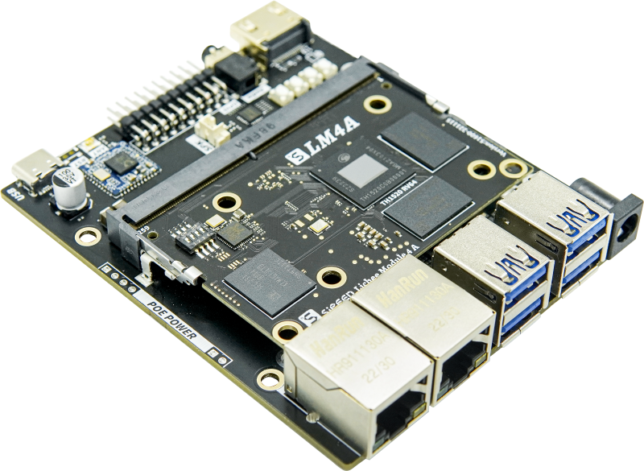
Owned RISC-V Boards
LicheePi4A

Slide 6
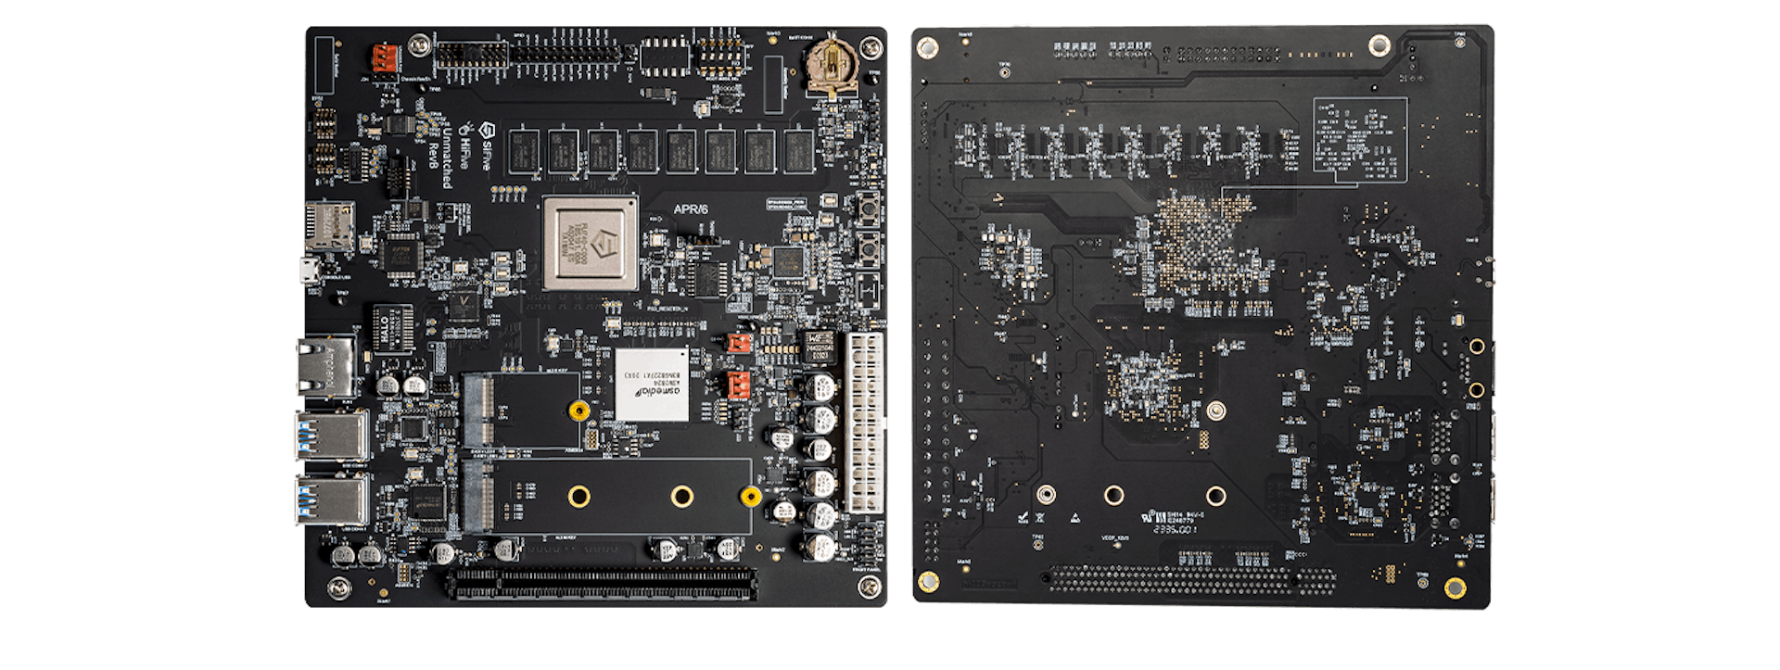
Owned RISC-V Boards
HiFive
Unmatched

Slide 7
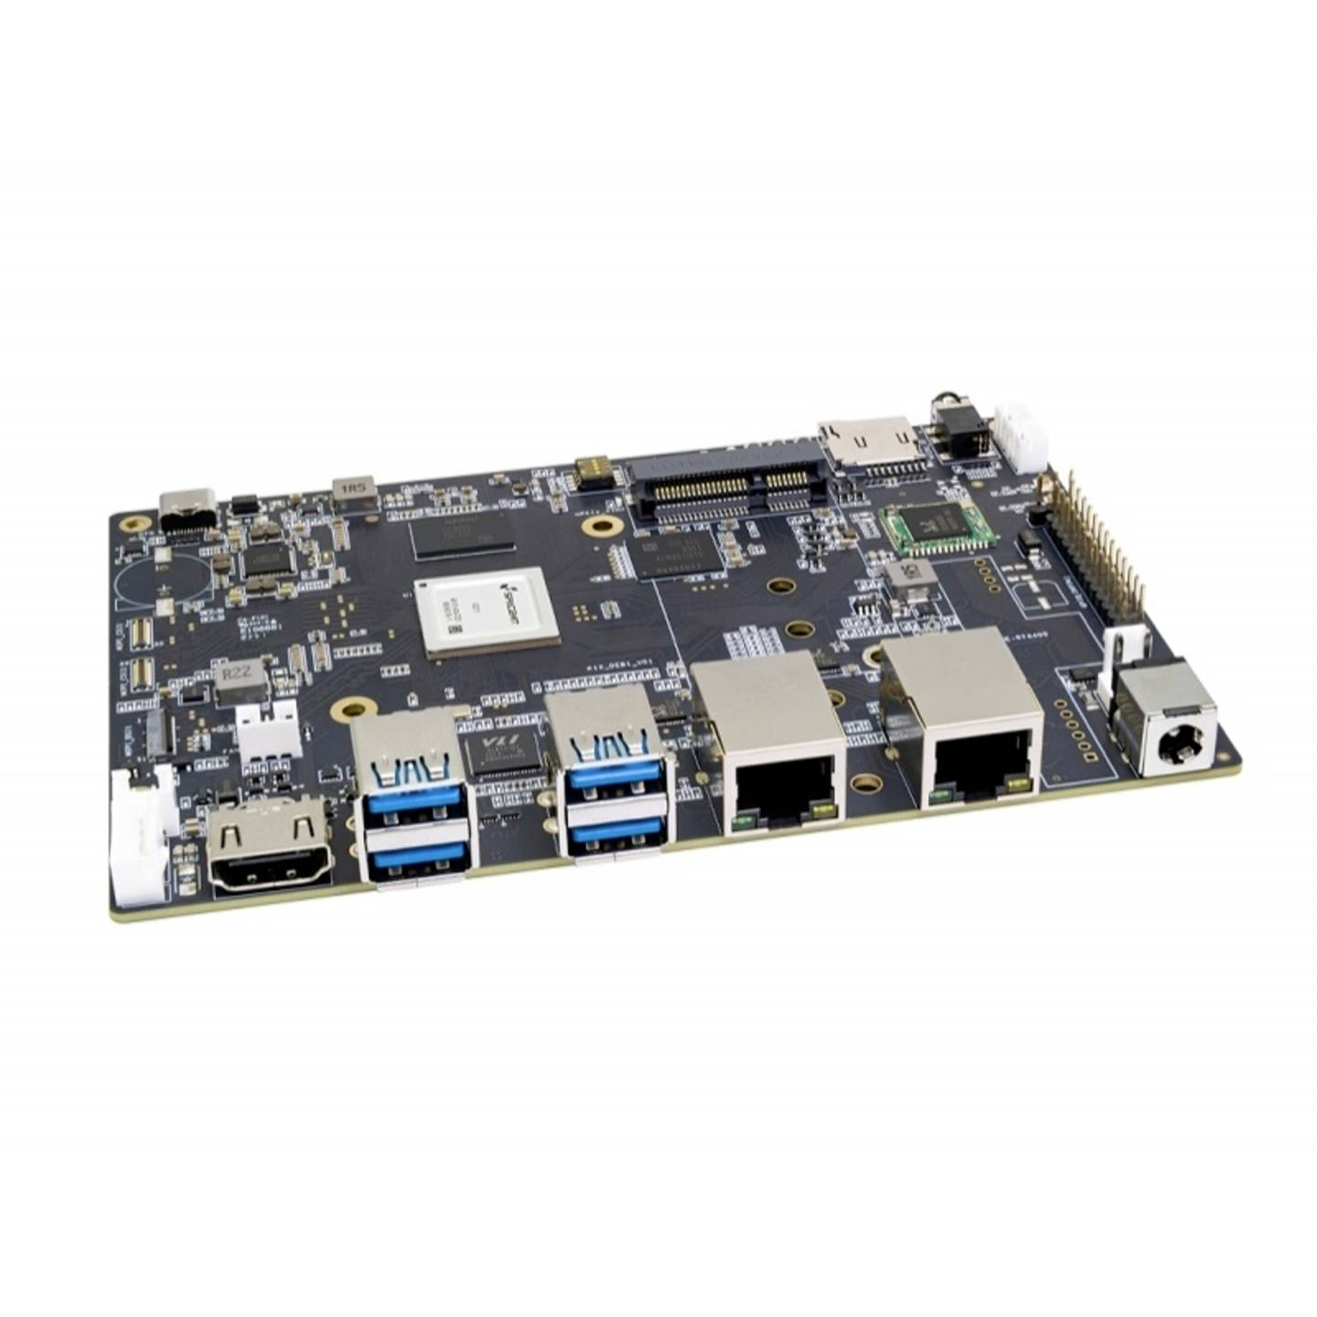
Owned RISC-V Boards
Banana Pi
F3

Slide 8
Why RISC-V
FOSS ISA - ‘Linux equivalent of the CPU ISAs’
Recent uptick in hardware availability
  Personal ownership
  Cloud based pay-per-time
For fun / tinkering with something new
Bright future ahead

Slide 9
Why Flatcar Container Linux
Compact, easy to run
Image based operating system
Secure and reliable by design
Containerization, kubernetization, Cloud Native world

Slide 10
Add RISC-V support: Flatcar ancestry
Drop-in replacement for CoreOS
Downstream fork of Gentoo
  https://fosdem.org/2025/schedule/event/fosdem-2025-4763-flatcar-and-gentoo-sitting-in-a-tree-a-collaboration-of-distributions/
  James "Chewi" Le Cuirot, Sunday, 9:30 AM, H.1302 (Depage).
Immutable OS
Upgrades done via A/B partitioning scheme

Slide 11
Add RISC-V support: Gentoo
Gentoo already has support for RISC-V (unstable ~riscv)
Investigated if I could run Gentoo on my LicheePi4A
Had to borrow the Linux kernel from the LicheePI4A
Gentoo worked afterwards
Every package needs to be compiled (very slow)
Flatcar should solve this issue via Docker and Alpine community

Slide 12
Add RISC-V support: Flatcar bill of materials
Flatcar SDK (Dockerized)
Flatcar packages
Systemd-sysexts
Flatcar image:
  Bootloader
  dm-verity
  Virtualization

Slide 13
Add RISC-V support: Flatcar SDK
Docker image
Based on Gentoo’s bootstrap workflow
Flatcar currently supports AMD64 and ARM64
ARM64 is cross-compiled on AMD64 machines
Use same workflow for RISC-V

Slide 14
Add RISC-V support: Flatcar SDK
riscv64-cros-linux-gnu
riscv64gc-unknown-linux-gnu
Add profile based on the Gentoo ~riscv profile
  Inherit default/linux/riscv/23.0/rv64/lp64d/systemd
  GCC flags: march=rv64gc -mabi=lp64d -g
Install rustc cross-compiler for RISC-V (Flatcar requires ~500 crates)
Install qemu-riscv64-static / binfmt
  Needed by some packages Makefile

Slide 15
Add RISC-V support: Flatcar packages
coreos-overlay packages
  Inherited from CoreOS
  Some are Flatcar only packages
  Updated manually and infrequently
Stable packages
  Gentoo
  Mirrored once a week
Most of the work needed was on the coreos-overlay packages
  To add the ~riscv keyword
Some stable Gentoo packages needed work too
  Work was upstreamed on some already

Slide 16
Add RISC-V support: Flatcar packages
Boilerplate work done
Success building the Flatcar SDK?

Slide 17
Add RISC-V support: Flatcar packages
Limit packages to only AMD64/ARM64 architectures
  kexec-tools
  azure-vm-utils
  app-emulation/amazon-ssm-agent
  sys-boot/shim
  sys-boot/shim-signed
Enable/fix upstream Gentoo support for:
  tpm2-tools
  efivar
  Python libffi: ffi.h not found
  Golang architecture mapping
Map correctly the target for RUSTC
  RISCV:riscv64gc-unknown-linux-gnu:riscv64-cros-linux-gnu

Slide 18
Add RISC-V support: Flatcar packages
Linux Kernel
  Remove Xen and Hyper-V from the RISC-V config
  Testing with QEMU software emulation required extra work
  CONFIG_USB_XHCI_PLATFORM=y
  CONFIG_PCI_HOST_GENERIC=y
  efi=debug earlycon=sbi
  add risc-v qemu_fw_cfg support to Linux kernel 6.6
Docker
  Needed some build change related to LD_PRELOAD

Slide 19
Add RISC-V support: Flatcar systemd-sysext
Enable RISCV64 architecture for sysexts
Docker
Kubernetes
Now we have a ready Flatcar root filesystem built with all the packages
Success?

Slide 20
Add RISC-V support: Flatcar images
Bootloader
  Use RHEL patches on top of grub2
  Fix Flatcar grub2 patches for RISC-V (inherited from CoreOS)
  Investigate/Document OpenSBI or EDK2 to boot Flatcar on QEMU software emulation
dm-verity
  Add 0x160 (352) offset where to put the verity hash in the vmlinuz
Virtualization
  Unfortunately, I have tried to enable CONFIG_KVM=y on my Banana Pi F3 with no actual success. There “seems” to be no available RISC-V CPU on the market, with H extension (virtualization extension)
  The only option now is to use QEMU software emulation
  https://www.linkedin.com/posts/robin-randhawa-8335423_bhyve-hypervisor-on-hifive-premier-p550-activity-7273022906392027137-AEMc

Slide 21
Add RISC-V support: Flatcar demo time
QEMU emulation
EDK2
OpenSBI
https://github.com/ader1990/scripts/releases/tag/riscv-poc-07-jan-2025

Slide 22
Add RISC-V support: Flatcar demo time
Docker and containerd come as systemd-sysexts
  Compilation not needed anymore
K3S is a viable option on RISC-V to run Kubernetes
  https://github.com/CARV-ICS-FORTH/kubernetes-riscv64?tab=readme-ov-file#acknowledgements

Slide 23
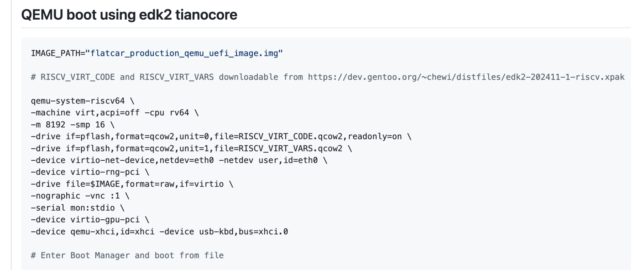
Add RISC-V support: Flatcar demo time

Slide 24
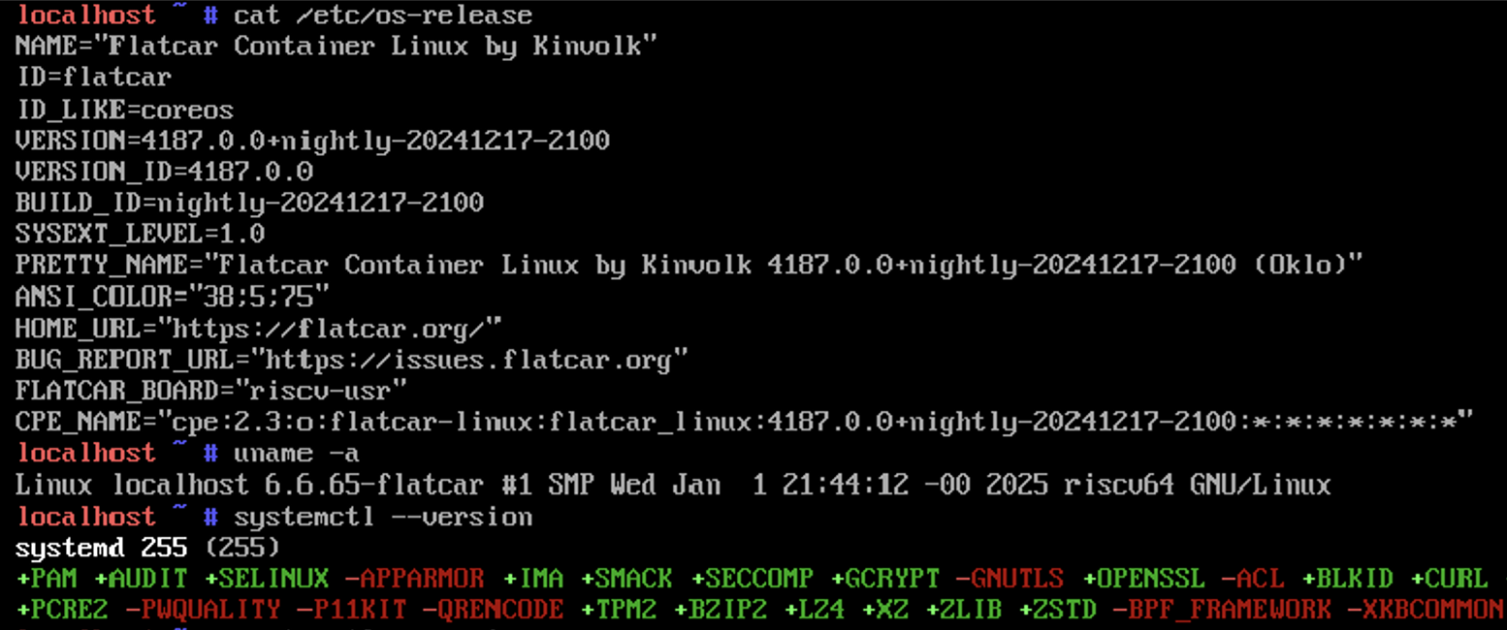
Add RISC-V support: Flatcar demo time

Slide 25
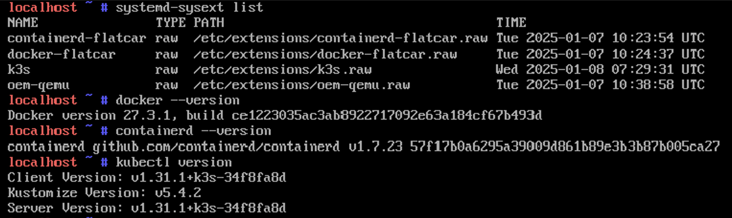
Add RISC-V support: Flatcar demo time

Slide 26
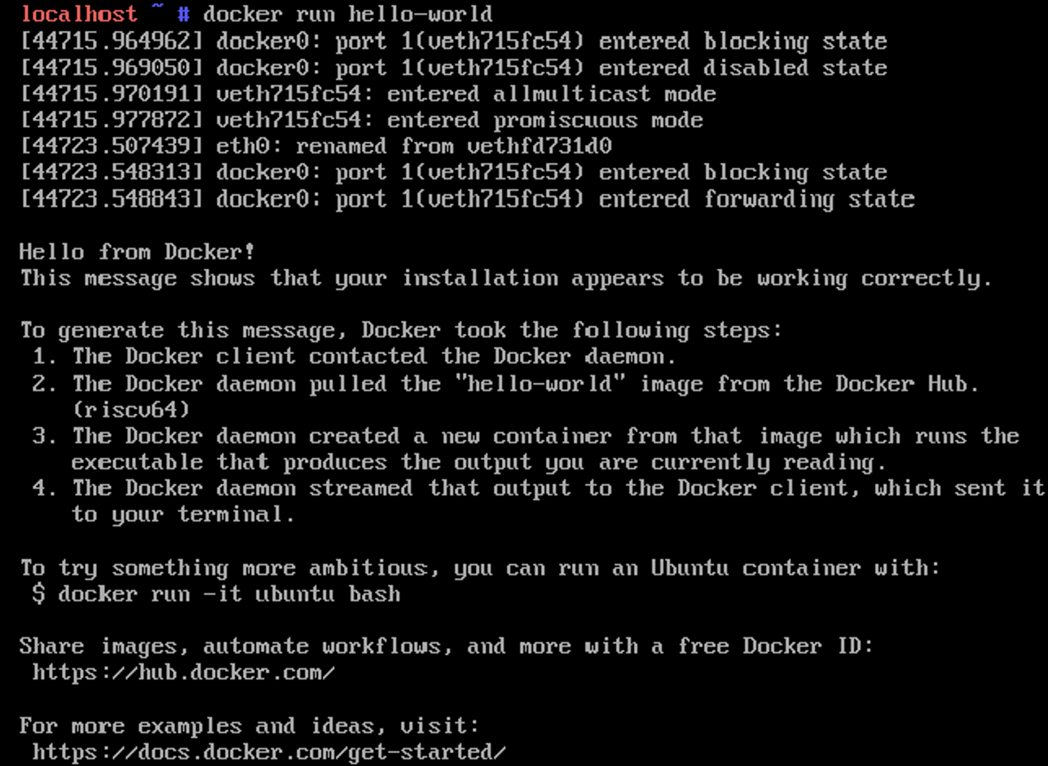
Add RISC-V support: Flatcar demo time

Slide 27
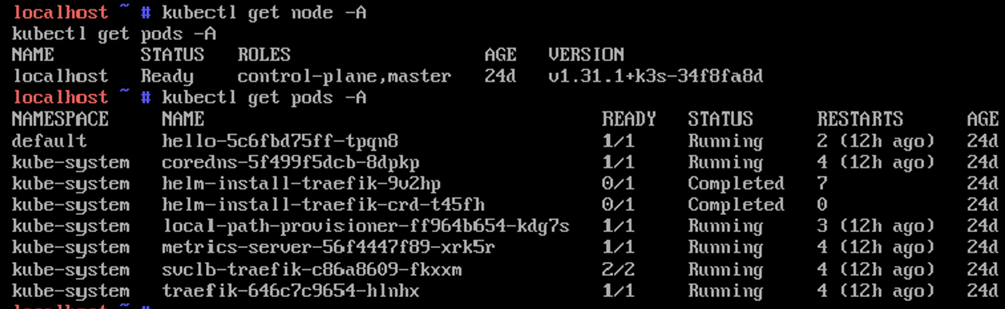
Add RISC-V support: Flatcar demo time

Slide 28
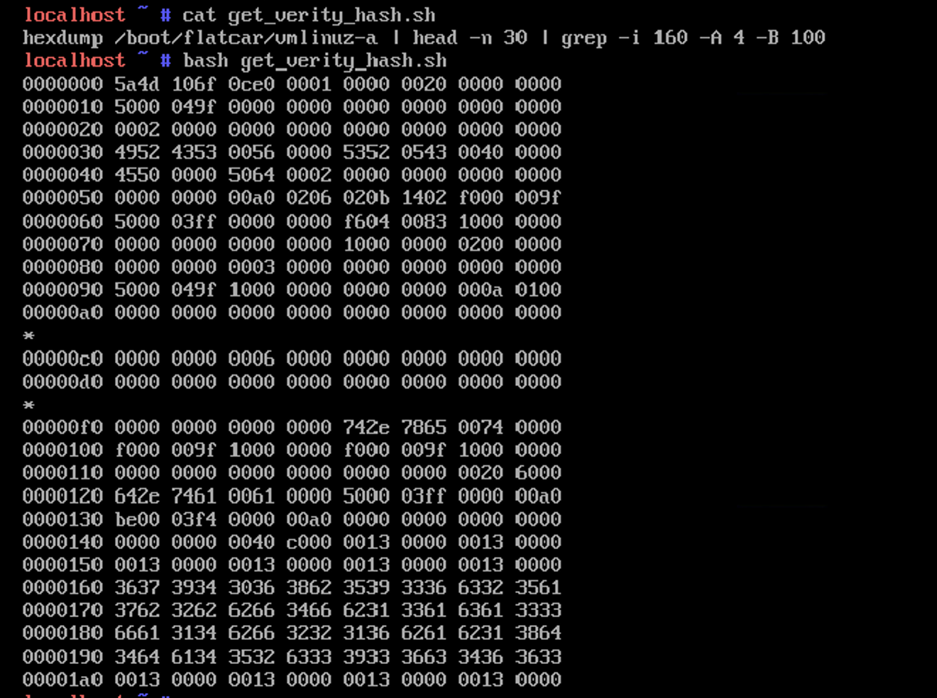
Add RISC-V support: Flatcar demo time

Slide 29
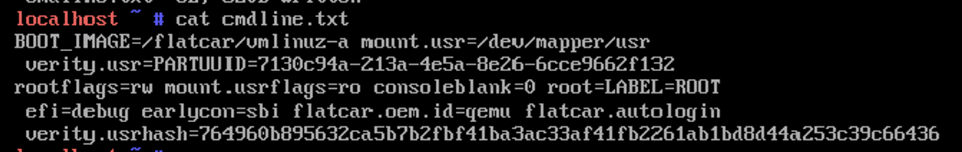
Add RISC-V support: Flatcar demo time

Slide 30
Add RISC-V support: Takeaways
Software support looks great on RISC-V
Most of the issues that had to be solved were related to cross-compiling and mix-and-match arch quirks
Kernel/bootloader/dm-verity required special attention
One can run Kubernetes on RISC-V, which opens the door to <ANY> software
Testing is slow as the only options now are
  Test on hardware boards - takes time to flash SDcards/NVMEs and build special kernel sources, special kernel CONFIGs (rabbit hole)
  For example, because of this, Ubuntu has to ship a separate image for every board version
  QEMU without KVM is very slow

Slide 31
Add RISC-V support: Flatcar future work
More work required for official support
  Feedback from community needed
  CI integration
  More polishing
Run Flatcar on physical RISC-V boards
Run Flatcar on QEMU KVM RISC-V vms
Upstream all the existing patches to Gentoo

Slide 32
Add RISC-V support: Links
Main Flatcar issue
  https://github.com/flatcar/Flatcar/issues/1420
Flatcar Work in progress:
  https://github.com/ader1990/scripts/tree/ader1990/riscv-poc-v2
Flatcar images available (currently not officially supported):
  https://github.com/ader1990/scripts/releases/tag/riscv-poc-07-jan-2025

Slide 33
Add RISC-V support: Question time
Ask me anything

Slide 34
Wait, but give me a real world scenario
https://app.devcon.org/schedule/J3SWYT
Ethereum is one of the biggest running software in the world
  Biggest peer-to-peer Virtual Machine implementation by far
  Multiple instances that converge and communicate
Can latest gen RISC-V boards run it?
Improvement needed to have the hashing algos implemented with RISC-V vector extensions
Discussion in progress to have the Ethereum Virtual Machine (Stack based) implemented directly with RISC-V instruction set
https://vitalik.eth.limo/general/2024/10/26/futures5.html

