Slide 1
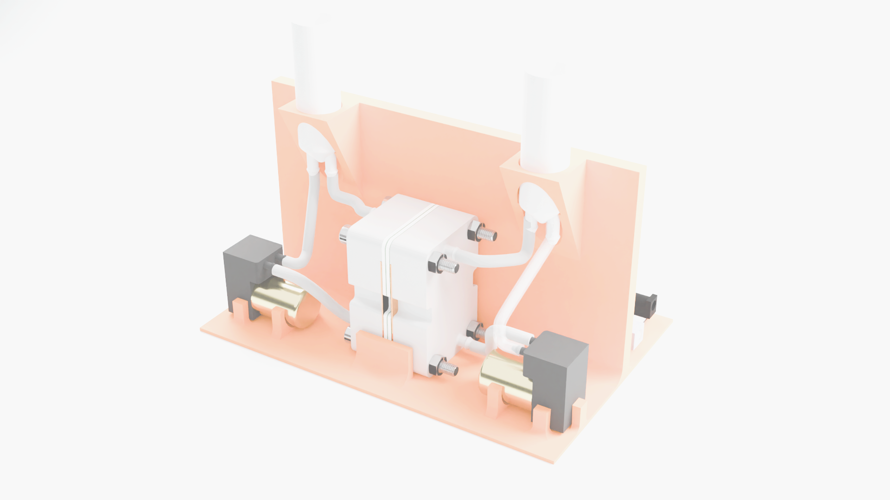
Building an Open-Source Battery for Stationary Storage
Daniel Fernández Pinto, Ph.D.
Flow Battery Research Collective
Josh Hauser
Utrecht University/FAIR Battery Project
Kirk Smith, Ph.D.
Flow Battery Research Collective
Sanli Faez, Prof.
Utrecht University/FAIR Battery Project
FOSDEM, February 2025

Slide 2

Flow Battery Research Collective: Who are we?
A brand-new community of researchers, energy storage users, and enthusiasts who want to help develop and democratize technologies for affordable, sustainable energy storage
We are trying to build an open-source battery for storing solar and wind energy.
https://fbrc.dev

Slide 3
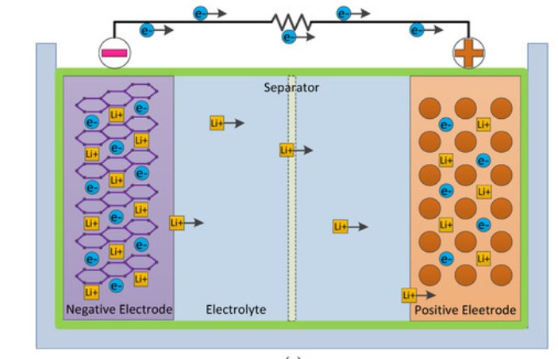
Li-ion batteries
https://www.mdpi.com/2076-3417/10/4/1264

Slide 4
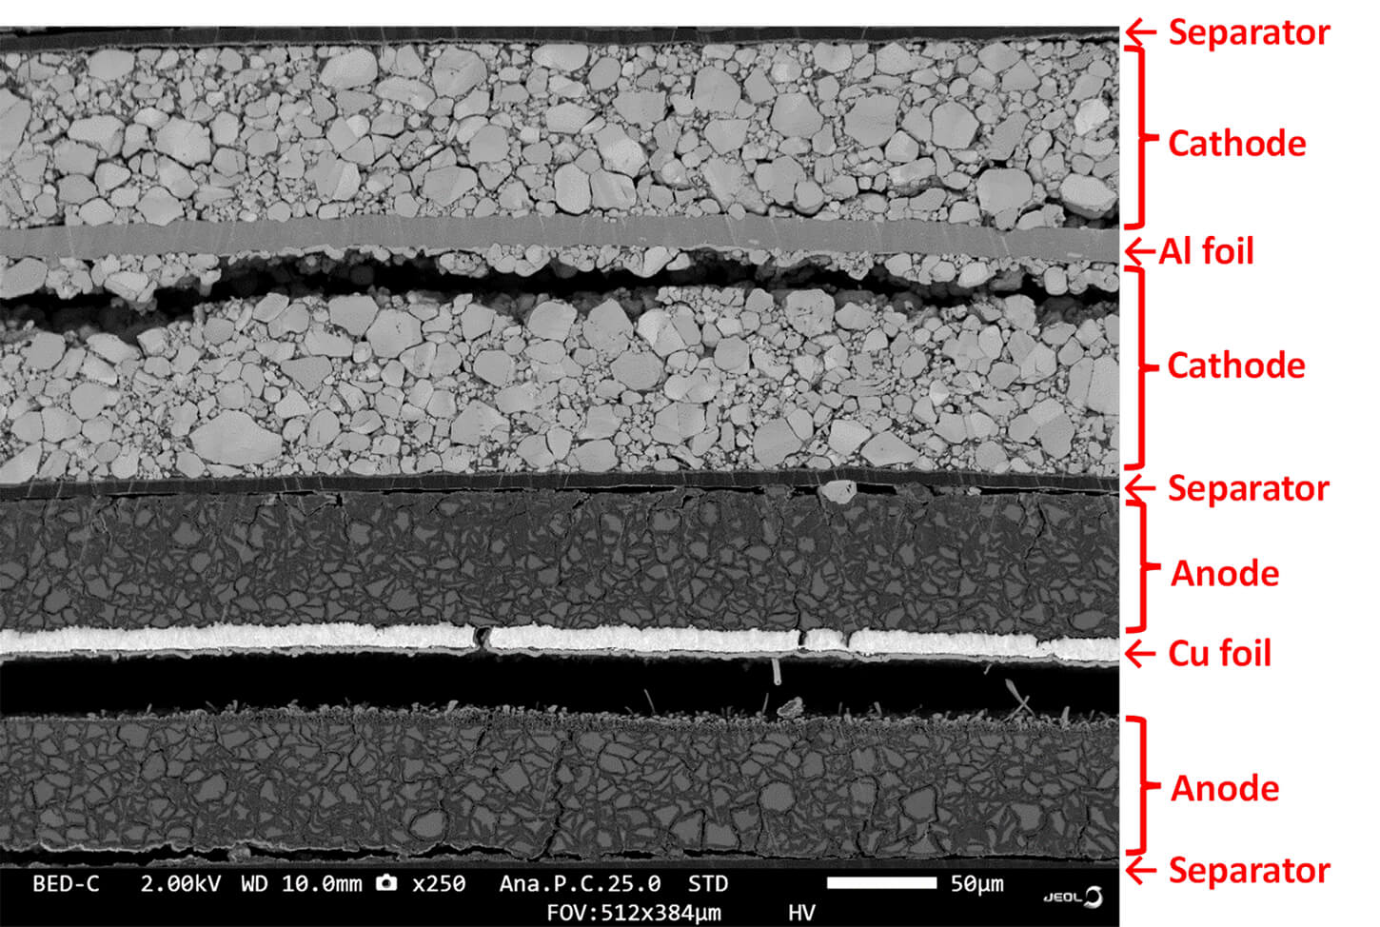
https://www.jeolusa.com/NEWS-EVENTS/Blog/pristine-cross-sections-of-batteries

Slide 5
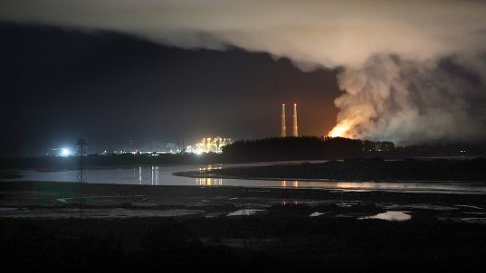

Slide 6
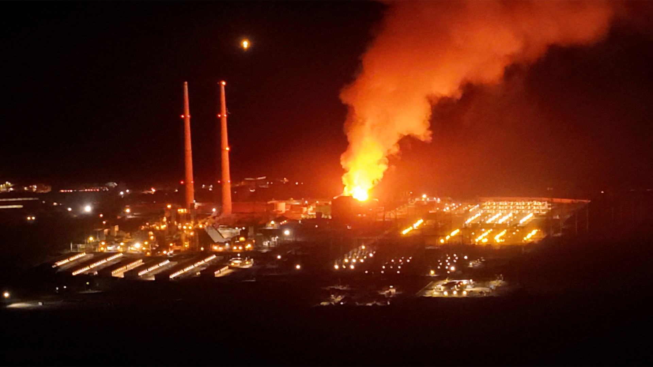

Slide 7
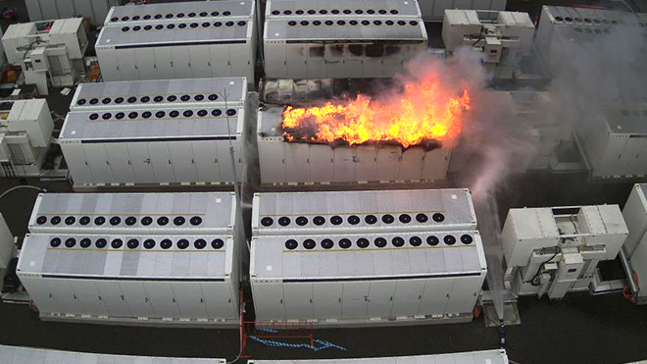

Slide 8
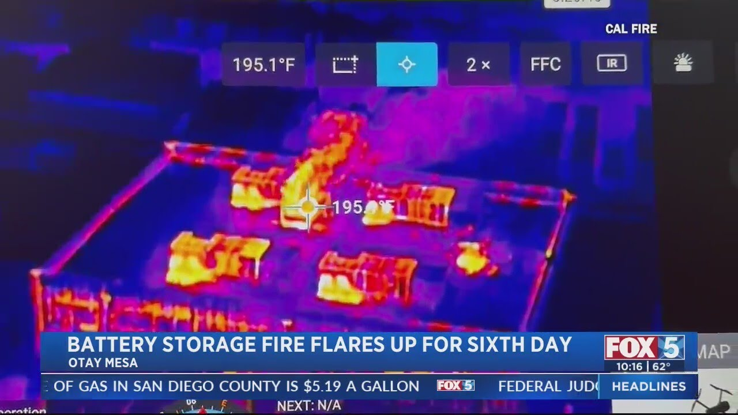

Slide 9
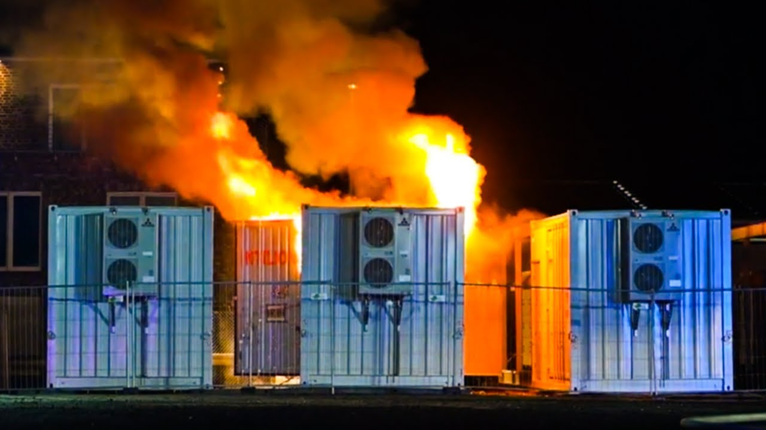

Slide 10
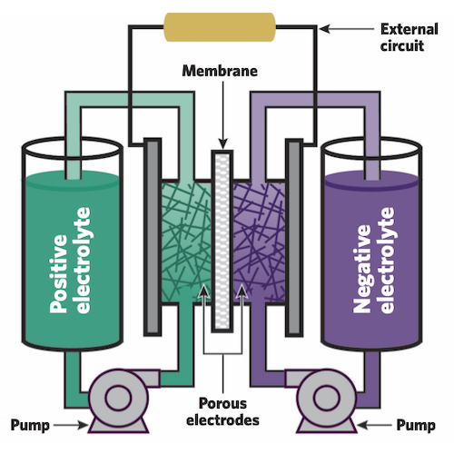
What is a redox flow battery (RFB)?
https://news.mit.edu/2023/flow-batteries-grid-scale-energy-storage-0407

Slide 11
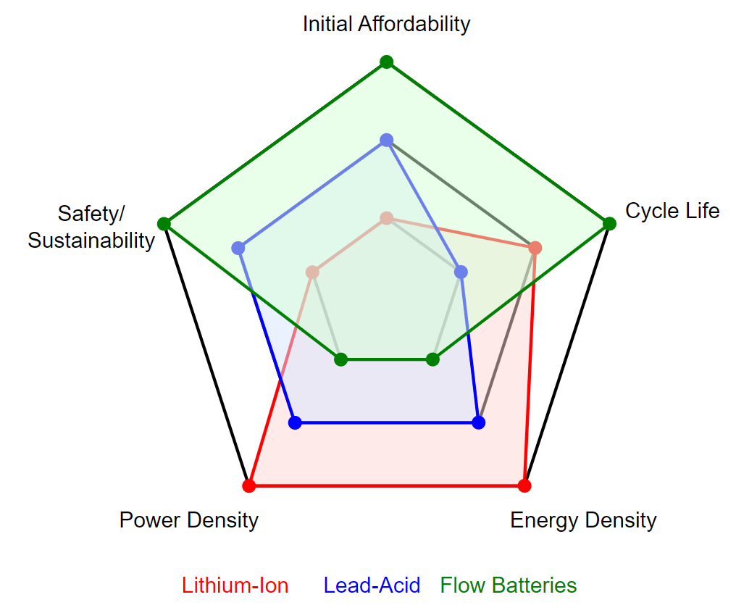
Can RFBs compete?

Slide 12
Why open-source?
No complete open-source flow battery architecture exists.
Flow battery research suffers from reproducibility issues because of variability in research setups.
No large scale open-source flow battery cell exists.

Slide 13
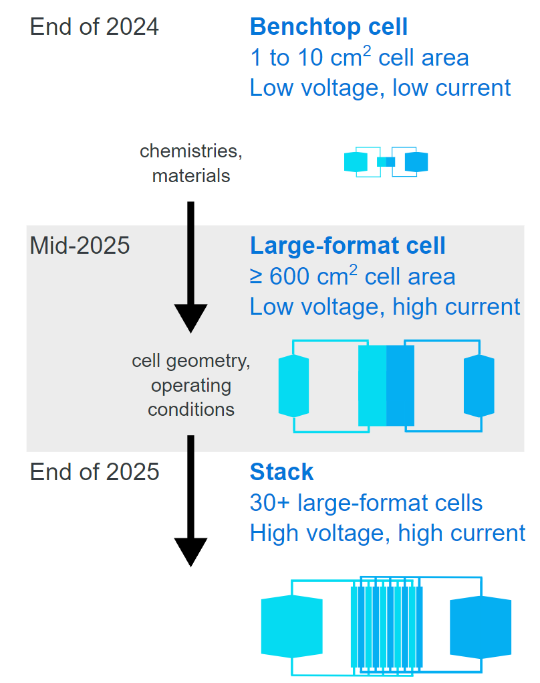
Our roadmap

Slide 14
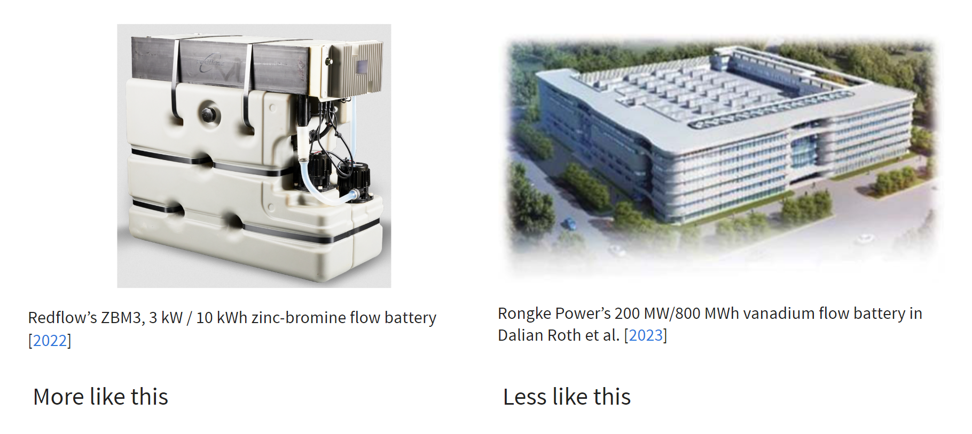
What scale?

Slide 15
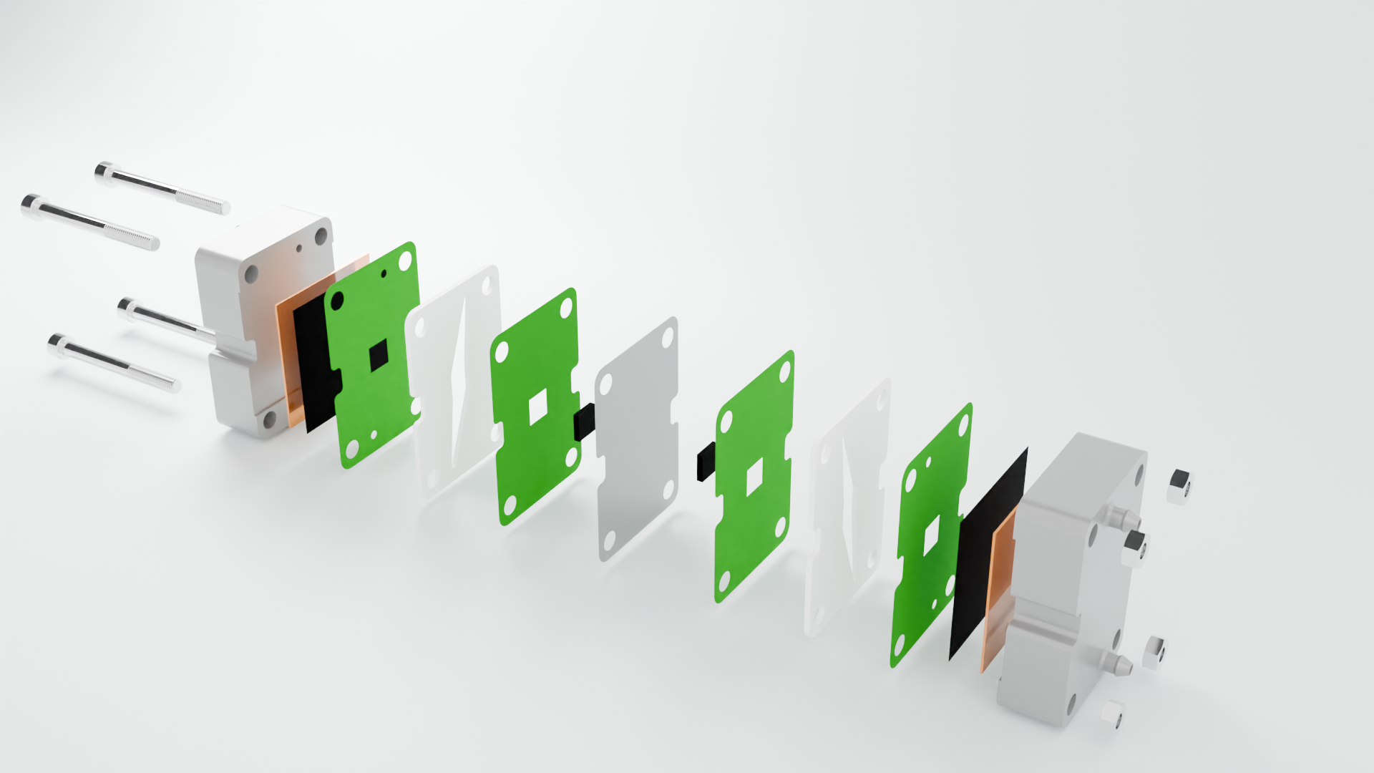

Slide 16
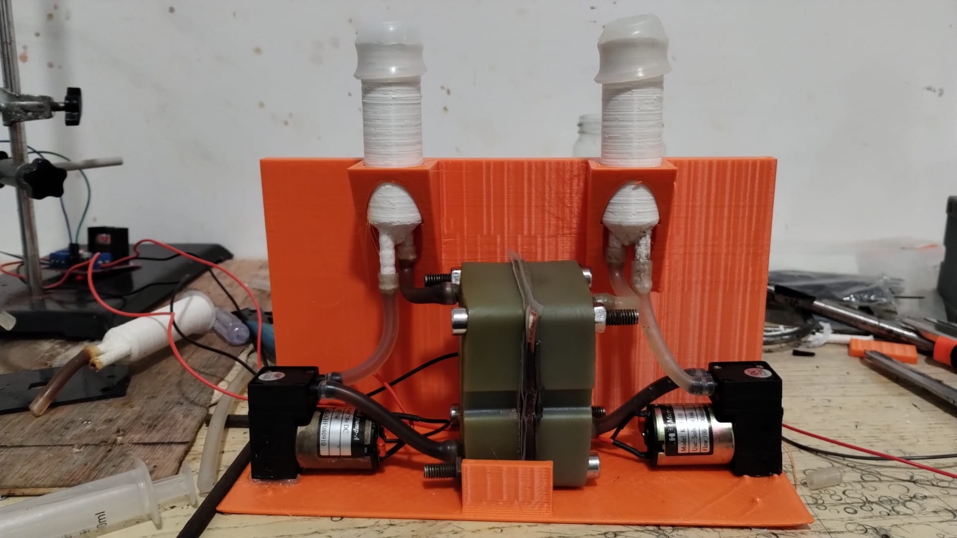
First prototypes

Slide 17
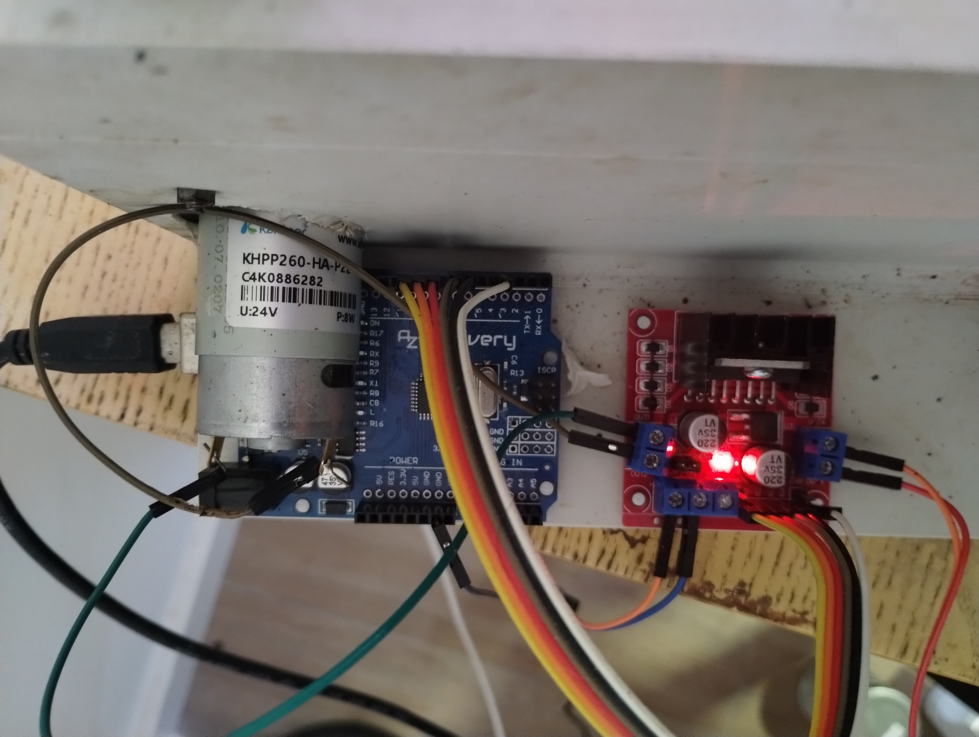

Slide 18
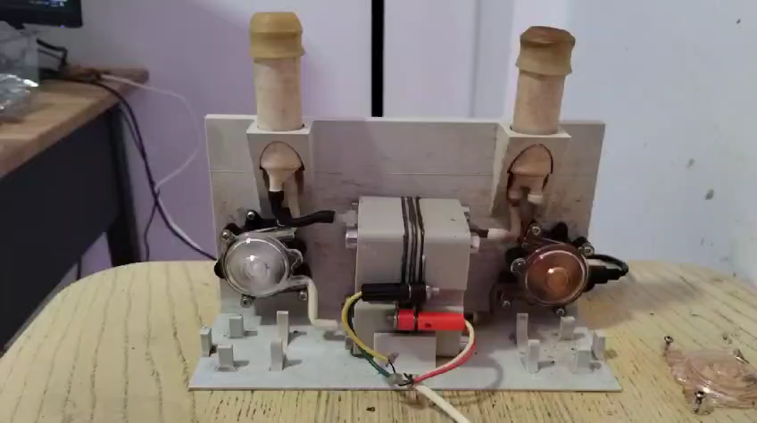

Slide 19
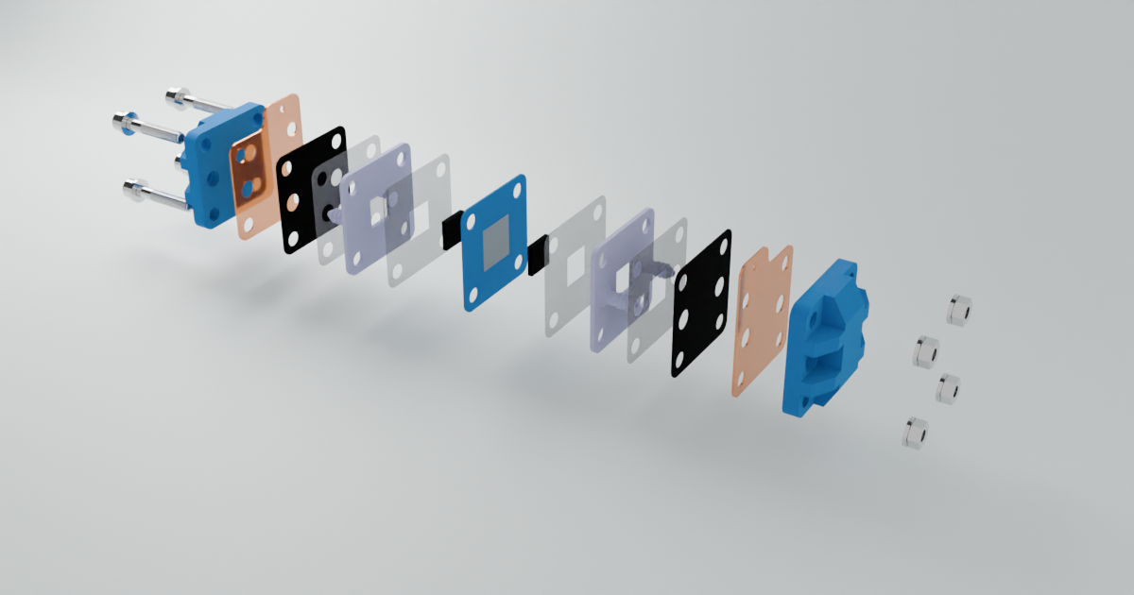

Slide 20
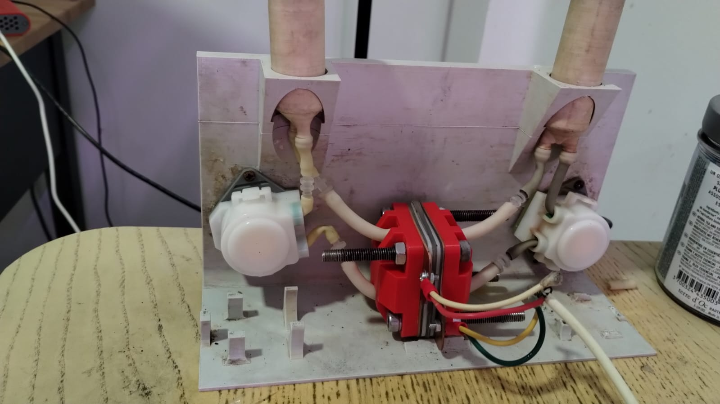

Slide 21
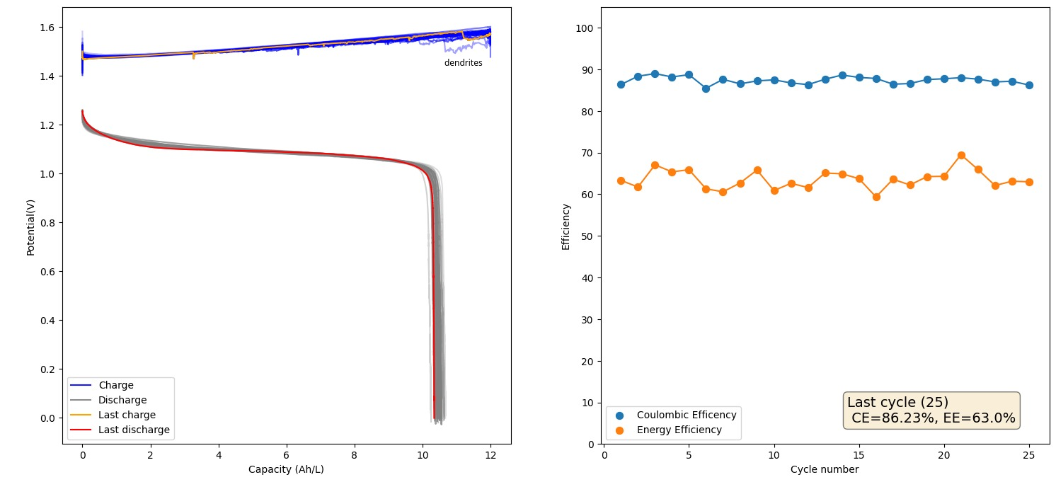
Current performance: low concentration, 100 mAh/cm
1 m ZnCl2, 2 m KI, KAc buffer, 5 mL each side, photopaper separator, 30 mA/cm², 100 mAh/cm², over 5 days

Slide 22
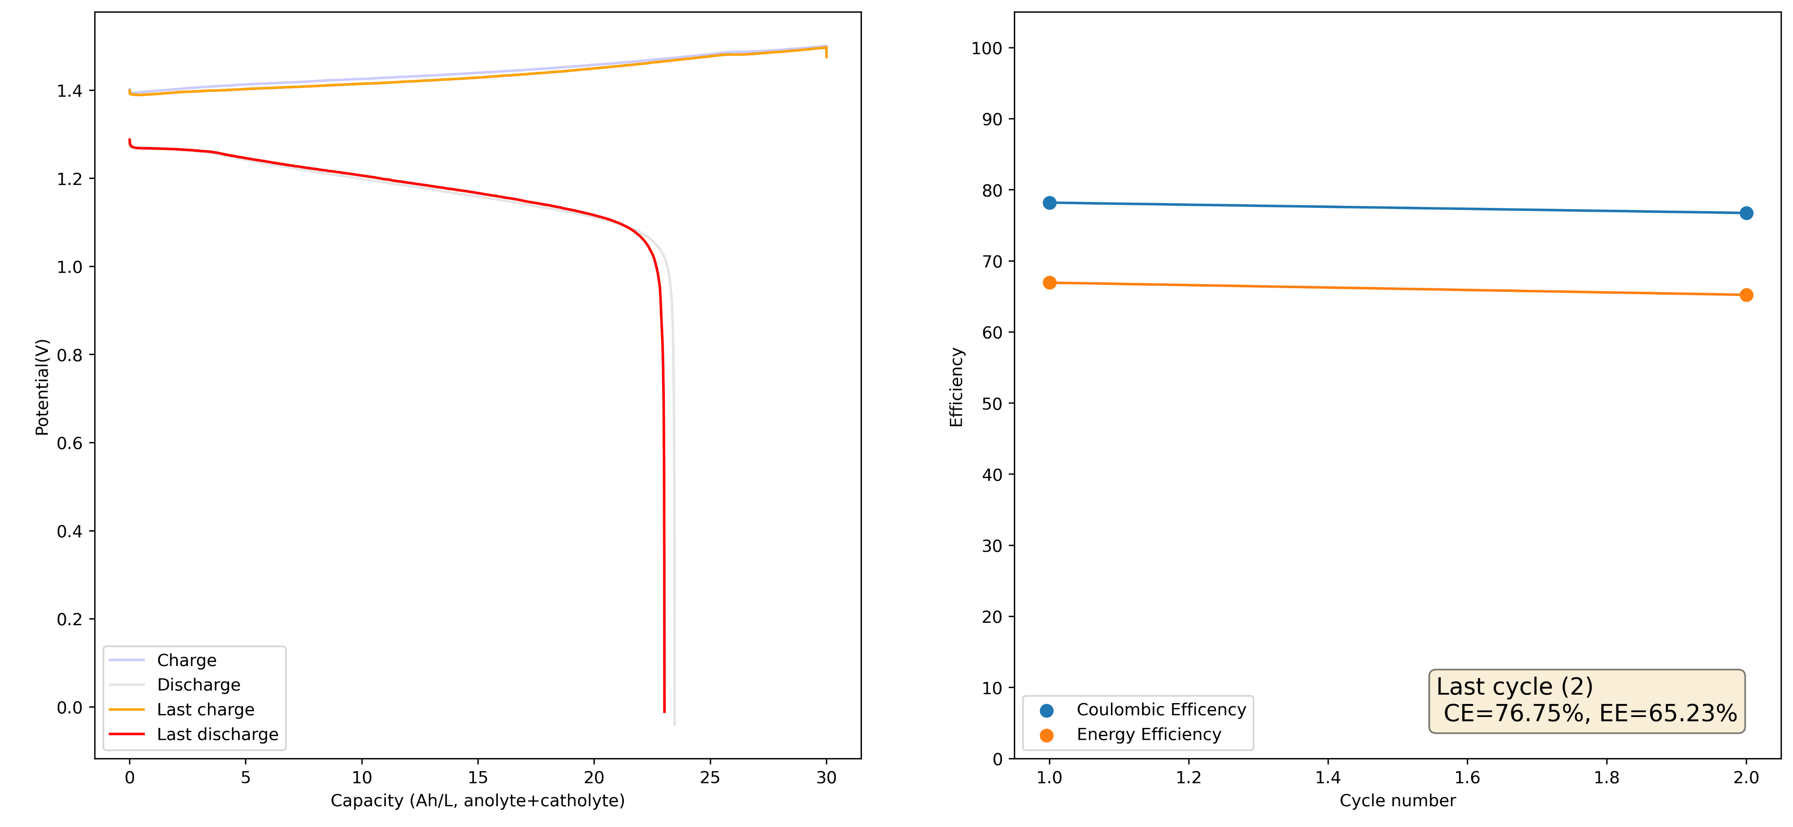
Current performance: medium concentration
2 m ZnCl2, 4 m KI, 2m NH4Cl, 5 mL each side, Daramic AA-900 separator, nonconductive felt for Zn, 30 mA/cm², 300 mAh/cm²

Slide 23
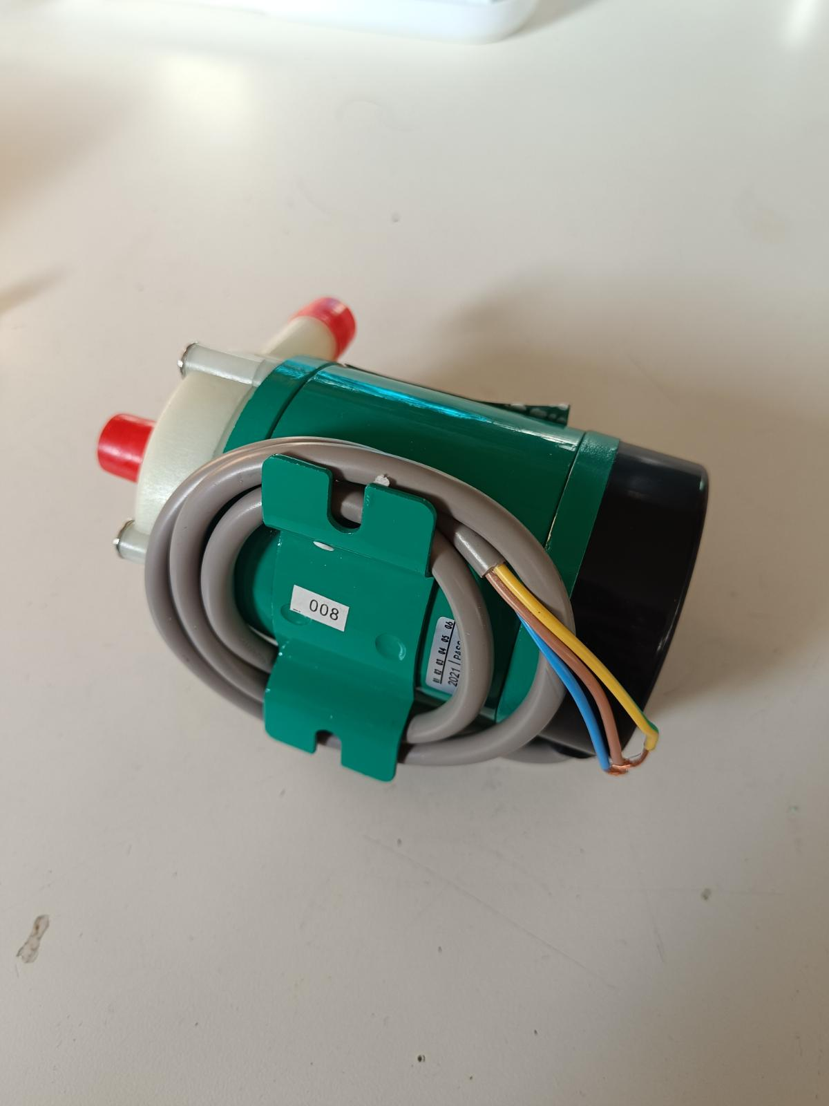

Slide 24

How to get involved?
Build a kit using our online documentation and designs.
Test 3D printing of our small and large scale flow frames.
Test different tubing materials or pumps.
Build and test larger scale cells (with only water for now!).
Build a BMS including pump control for larger scale flow batteries.

Slide 25

Acknowledgements
Josh Hauser, Sanli Faez & FAIR Battery Team.
Kirk Smith, chief engineer
Conference organizers!
Financed by Nlnet’s NGI0 Entrust Fund.

