Slide 1

SBOMs and Cryptographic Algorithms
Status and Next Steps
Matias D’Aloia
Software Engineer matias.daloia@scanoss.com
FOSDEM 2025
2025-02-02

Slide 2

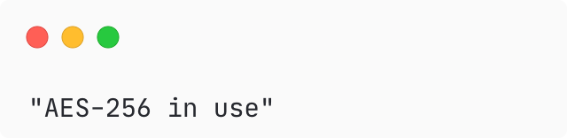
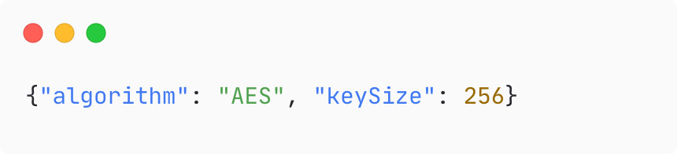

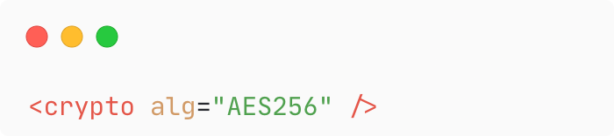
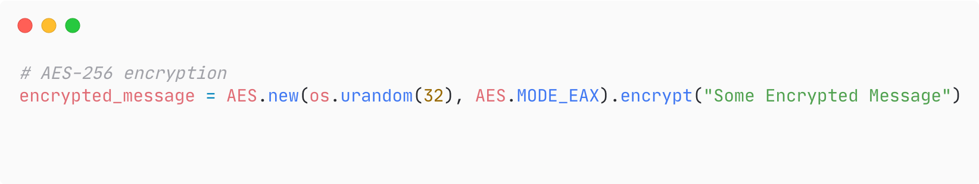
THE CHALLENGE
The Crypto Identification Problem
Imagine if crypto algorithms were declared using arbitrary formats – like restaurant reviews.
⭐⭐⭐⭐⭐
9.2/10
👍👍👍👎
“Excellent”
SCANOSS Journey
01
Notes:
Restaurants analogy
Different rating systems→ How to even compare?
Challenge → Crypto detection → Everyone differently
Block good security and compliance → Accurate SBOMs and standardization is key
Introduce myself + SCANOSS + Share 2 updates: crypto dataset release + SPDX decision to adopt standard
By the end → learn how to use new standards + find crypto + stop building the same tools over and over

Slide 3
THE IMPACT
Why Standarized Crypto Identification Matters
To our Key Stakeholders:
  Trade compliance teams need accurate ECCN classifications for Export Control
  Security teams must adhere to NIST standards on CAVP (Crypto Algorithm Validation Program)
  Companies are increasingly concerned about PQC (Post Quantum Cryptography)
  Auditing requirements continue to grow
For the entire community and to SCANOSS:
  Standarization SAVES EFFORT and RESOURCES
  Standarization boosts collaboration
SCANOSS Journey
02
Notes:
THE IMPACT:
Significant Across multiple fronts → Read the bullet points
SOMETHING CRUCIAL“ ::: Standarization” SAVES MONEY.
We started spending lot of resources → opening this not only save us but the community save costs
We help the community be more efficient

Slide 4

OUR PROPOSAL FOR THE COMMUNITY
An Open Crypto Algorithm Dataset
Crypto algorithm definition list
Simple data structure and attributes (proto-taxonomy)
Machine-Readable format, so extensible
Reference code for algorithms' list detection
Battle-tested in production
SCANOSS
03
Notes:
The solution: present the dataset
Before diving into journey:
What? Collection of crypto algorithm definitions and detection patterns
Read the bullet points.
EMPHASIS on →
Not theoretical
battle-tested in production
scanning billions of files
big organizations understand crypto composition

Slide 5
OUR JOURNEY
Our journey: …towards Open Data
2022-2023
Open Source & SPDX Collaboration
Customer Requests
Keyword Matching
2021
2024-2025
SCANOSS
04
Notes:
These are the key milestones we've reached so far. Now, let's dive into the details of our journey.

Slide 6

2021
Driven by Customers Needs
Customers frequently asked: 'Can you tell us which crypto algorithms are in this open-source project?’
This wasn't just an internal need; it was a recurring request from real customers.
We recognized the importance of addressing this critical need for our customers.
SCANOSS
05
Notes:
2021:
Read the first question → simple, right?
BUT → It’s not when dealing with billions of files and 1000x projects
Focus on that this came from real customer needs.

Slide 7
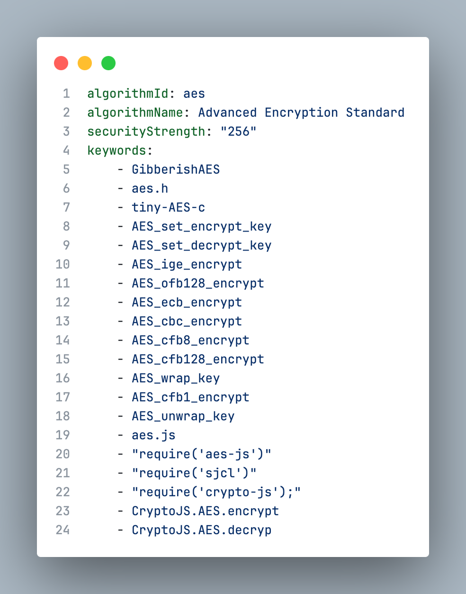
2022-2023
Keyword Matching: A Practical Start
🧠 Sometimes, simple is the smart way!
One definition file per crypto algorithm
Effective for large-scale scanning
Allowed us to be precise on the detection
SCANOSS
06
Notes:
2022-2023:
Embrace simplicity → Keyword matching
One definition file with patterns and identifiers
Justify for scale
Also this is quite precise → e.g. Differentiate AES-128 from AES-256
BUT → Something happened:
Customers non-oss projects?
New crypto libs and frameworks rise
We realized:
Something this valuable, why keep private?
Customers involved, contributing
Open the door. So we did

Slide 8
2022-2023
Keyword Matching: A Practical Start
Sometimes, simple is the smart way!
One definition file per crypto algorithm
Effective for large-scale scanning
Allowed us to be precise on the detection
We realized:
What about non open-source projects?
New crypto libraries and frameworks
The community was already involved
SCANOSS
06
Notes:
2022-2023:
Embrace simplicity → Keyword matching
One definition file with patterns and identifiers
Justify for scale
Also this is quite precise → e.g. Differentiate AES-128 from AES-256
BUT → Something happened:
Customers non-oss projects?
New crypto libs and frameworks rise
We realized:
Something this valuable, why keep private?
Customers involved, contributing
Open the door. So we did

Slide 9
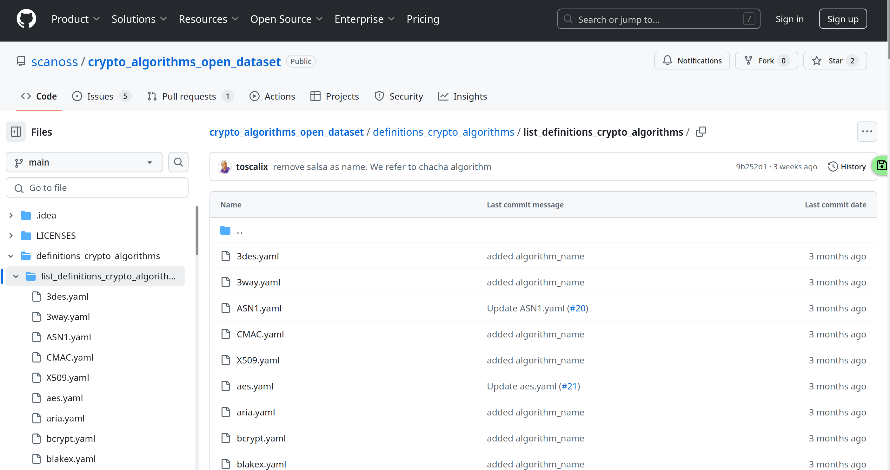
2024/2025
Open to the World: Standardization and Community
Released the dataset under CC0 License
From de-facto standard → To SPDX collaboration
SCANOSS
07
Notes:
2024:
Two big moves:
Released via CC0 license → closest thing Public domain that exists in copyright law
De-facto standard → Work with SPDX

Slide 10


DEMO
Seeing it in Action
Demo repo branch
SCANOSS
08
Notes:
Let me show you what this looks like in practice...
It’s standardized → Integrated in CI/CD pipelines, SBOM, compliance checks

Slide 11
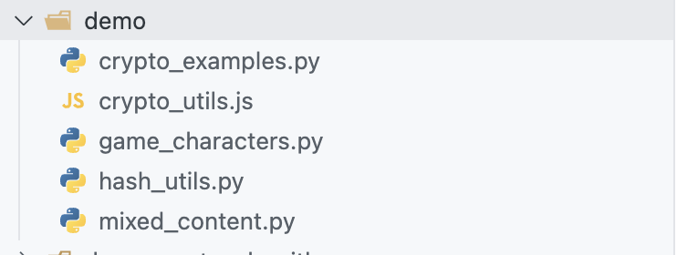
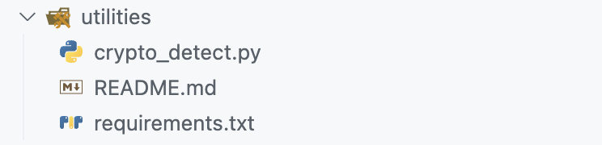
EXAMPLE
Seeing it in Action
Files containing crypto algorithms
Example script for detection
SCANOSS
09
Notes:
Let me show you what this looks like in practice...
It’s standardized → Integrated in CI/CD pipelines, SBOM, compliance checks

Slide 12
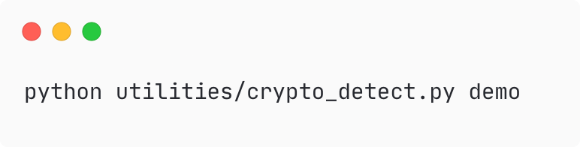
EXAMPLE
Seeing it in Action
SCANOSS
10
Notes:
Let me show you what this looks like in practice...
It’s standardized → Integrated in CI/CD pipelines, SBOM, compliance checks

Slide 13
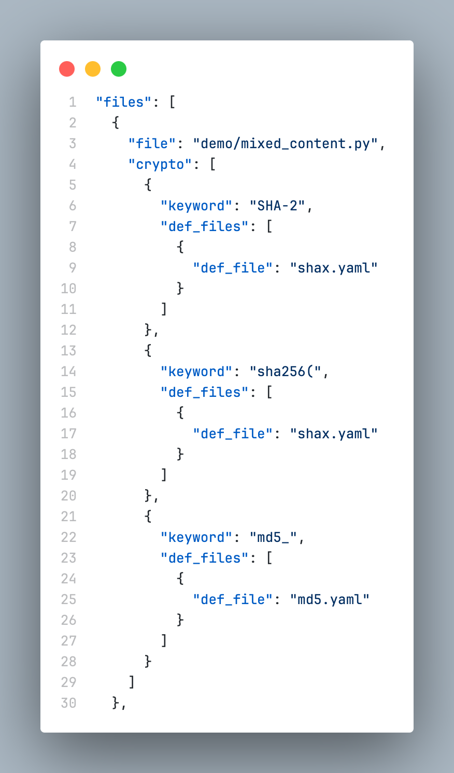
EXAMPLE
Seeing it in Action
SCANOSS
11
Notes:
Let me show you what this looks like in practice...
It’s standardized → Integrated in CI/CD pipelines, SBOM, compliance checks

Slide 14
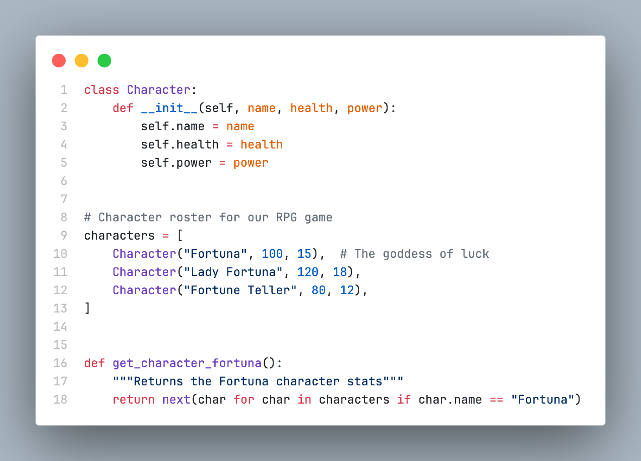
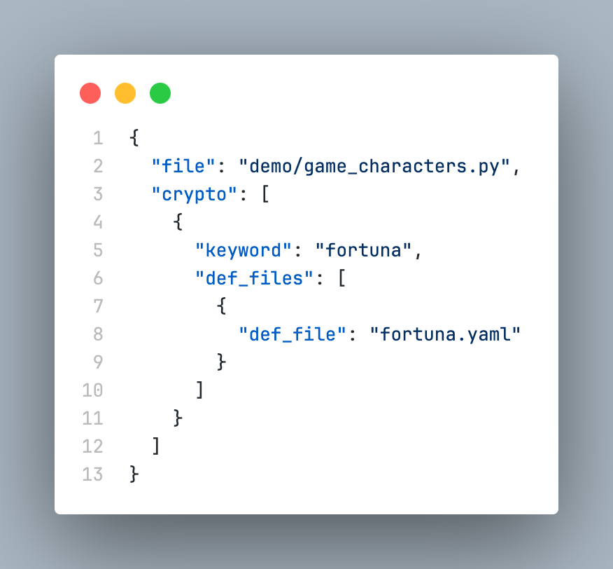
CHALLENGES
Beyond Keyword Matching: Addressing Context
Keyword in a different context:
SCANOSS
12
Notes:
Challenges:
Keyword matching?
False positives? Context? Are just a few examples
Keyword → coincidence
Comment → do the opposite
Maybe AI could help? Or convincing false positives?
Not perfect crypto tool → standardize how we describe

Slide 15
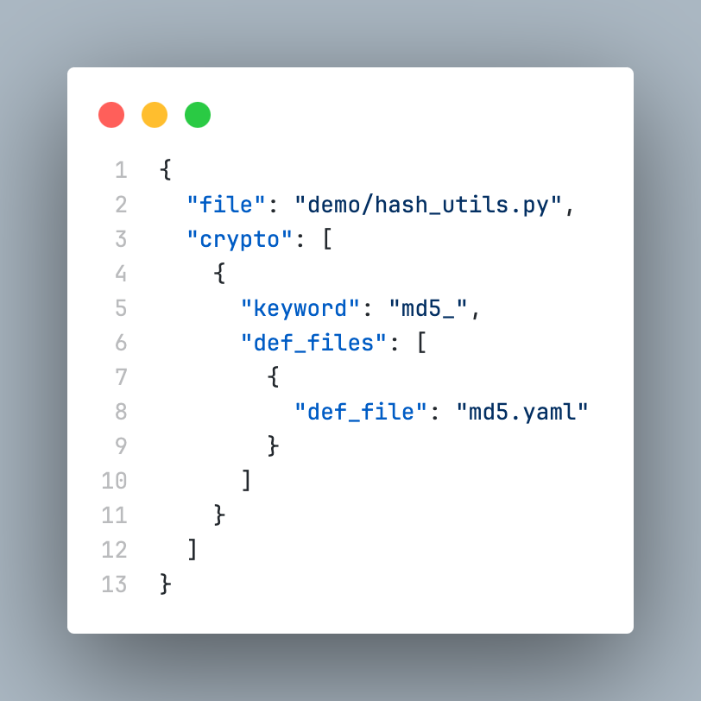
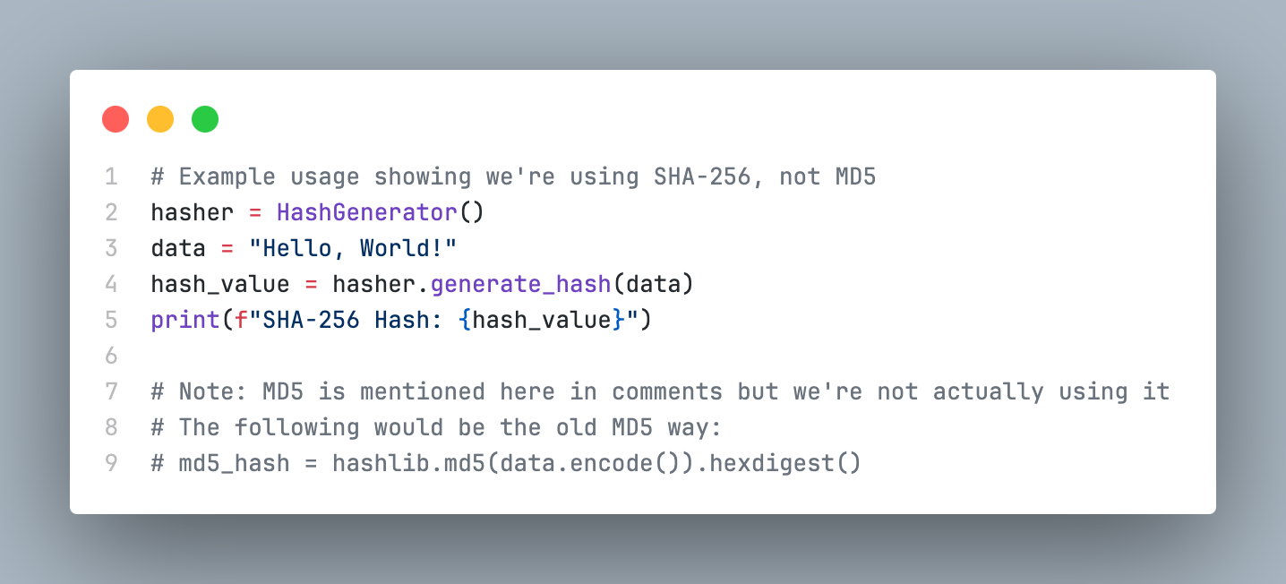
CHALLENGES
Beyond Keyword Matching: Addressing Context
Misleading comment:
SCANOSS
13
Notes:
Challenges:
Keyword matching?
False positives? Context? Are just a few examples
Keyword → coincidence
Comment → do the opposite
Maybe AI could help? Or convincing false positives?
Not perfect crypto tool → standardize how we describe

Slide 16
THE FUTURE
Looking Ahead
Software Transparency Foundation
New Implementations
Community Growth
SCANOSS
14
Notes:
2025 and beyond:
Exciting!
Moving to STF → From company driven to community driven
New languages
Community takes ownership

Slide 17
GET INVOLVED
Call For Participation
Improve the Dataset
Create New Implementations
Share Real-World Use Cases
Explore AI/ML for Context
SCANOSS
15
Notes:
GET INVOLVED:
Project gets better → More people help
We all have Different skills and experiences → can make tool stronger → Everyone can help and contribute
Show 4 ways to contribute

Slide 18


Speaking The Same Language
Standardized crypto identification enables better collaboration and a more secure software ecosystem
SCANOSS
16
Notes:
Closing:
Ive mentioned restaurant ratings → OSS we work together → need to speak the same language to do it effectively
That is what this is about → We have this solution We know works and helps, we want all to be involved
Repo is open, tools are there and we’re looking forward to see what you all can do with it

Slide 19


Thank You!
SCANOSS SCA Open-Source Tools: https://github.com/scanoss
Crypto Algorithms Open Dataset: https://github.com/scanoss/crypto_algorithms_open_dataset
Purl to CPE: https://github.com/scanoss/purl2cpe
STF Web: https://www.softwaretransparency.org
osskb.org Web: https://osskb.org
SCANOSS
17

