Slide 1


Accelerating Digital Transformation in Europe: The Role of Digital Public Goods and Open Source Collaboration
Amreen Taneja, Standards Lead
Digital Public Goods Alliance

Slide 2
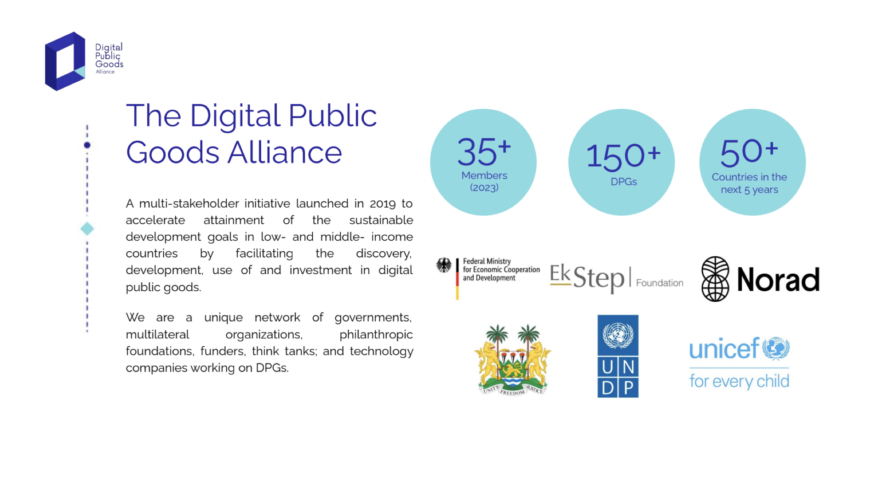
45+
Members
180+
DPGs

Slide 3
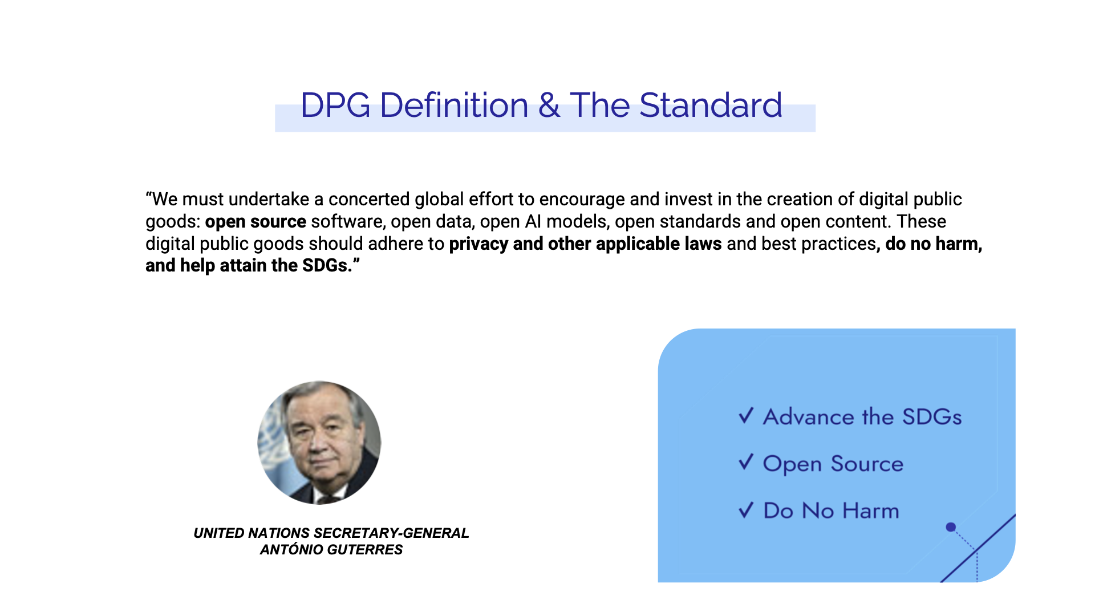
Digital technologies: electronic tools, systems, devices and resources that generate, store or process data.
Digital Public Goods
Public Good: a commodity or service that is provided without profit to all society members, either by the governments, private individuals or organisations which that benefit the public well-being.

Slide 4
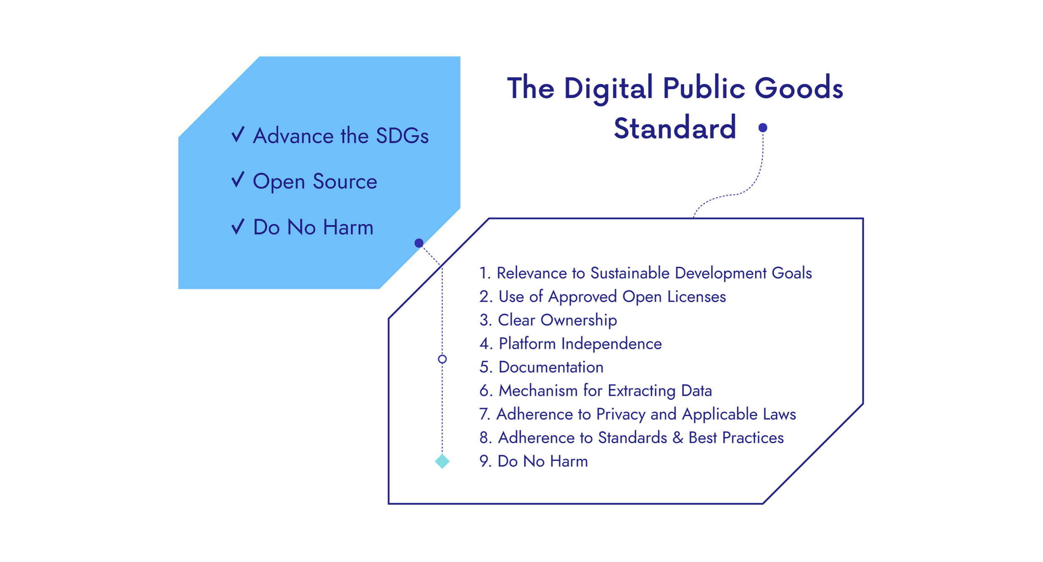
Digital Public Goods

Slide 5

1. Relevance to the Sustainable Development Goals
2. Use of Approved Open Licenses
3. Clear Ownership
4. Platform Independence
5. Documentation
6. Mechanism for Extracting Data
7. Adherence to Privacy and Applicable Laws
8. Adherence to Standards & Best Practices
9. Do No Harm by Design
9.a) Data Privacy & Security
9.b) Inappropriate & Illegal Content
9.c) Protection from Harassment
DPG
Verification

Slide 6

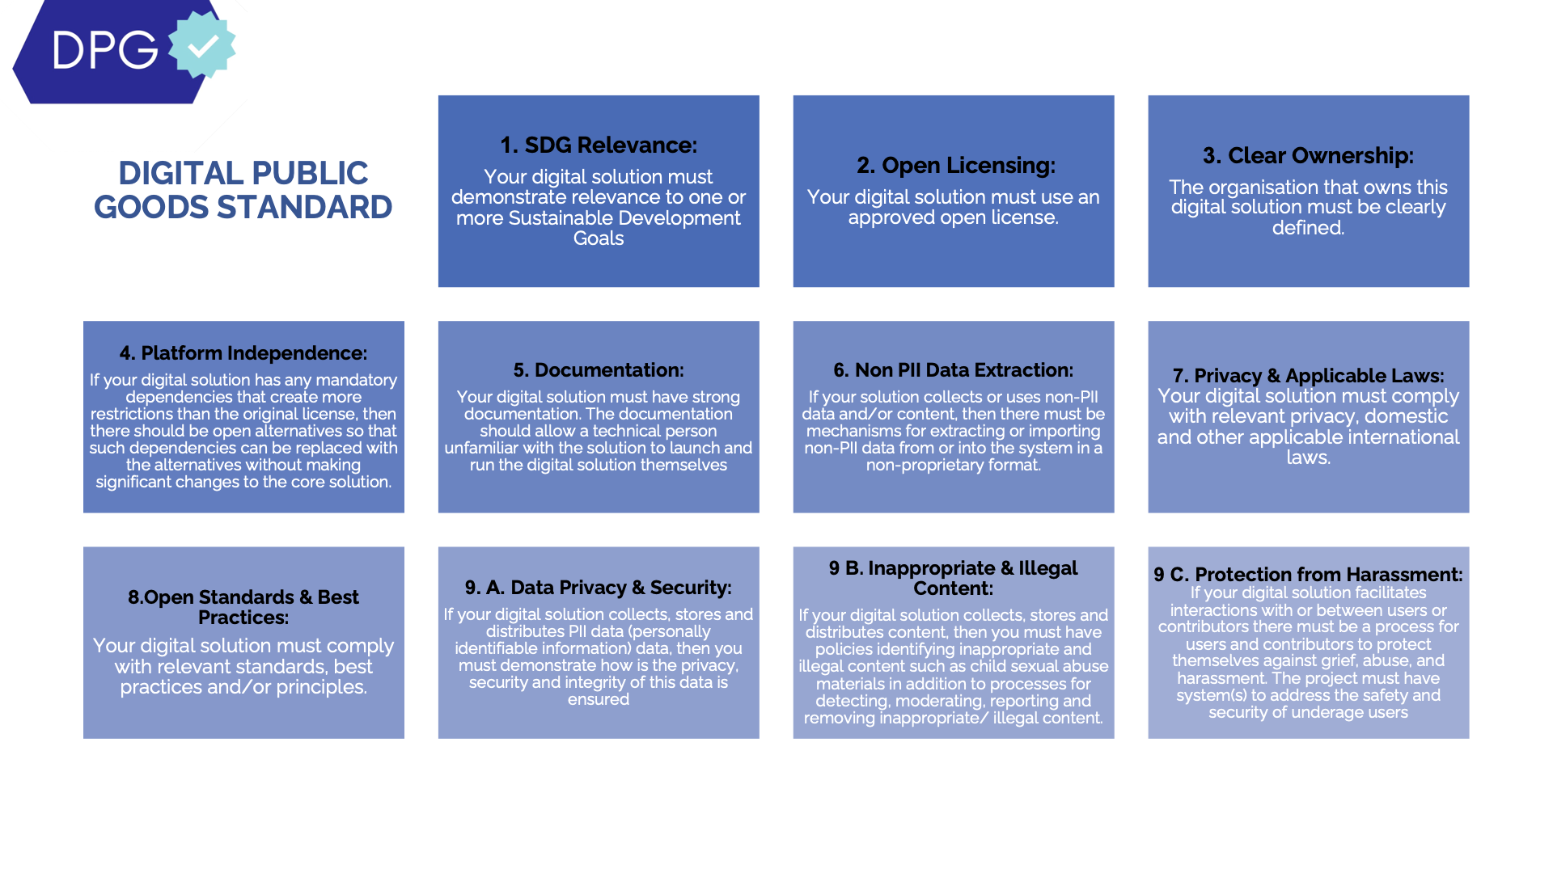
digitalpublicgoods.net/standard

Slide 7
Why are DPGs important?
Adoptability
Transparency
Interoperability

Slide 8


Primero
A digital public good for social services
FOSDEM 2025
Jean Pierre LeJacq
CTO & CISO

Slide 9
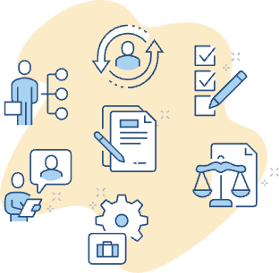
Case Management & Safeguarding
UNICEF & Primero
  Program started in 2014
  Digital Public Good
  Global platform for child protection
  Adaptable workflow, forms, practices
Social, health, and constituent services
  Foster care placement – intake case, assess needs, identify risks, select foster parents, monitor, coordinate support, report
  SafeSport violation – receive complaint, investigate incident, conduct interviews, adjudicate, resolve, determine actions

Slide 10
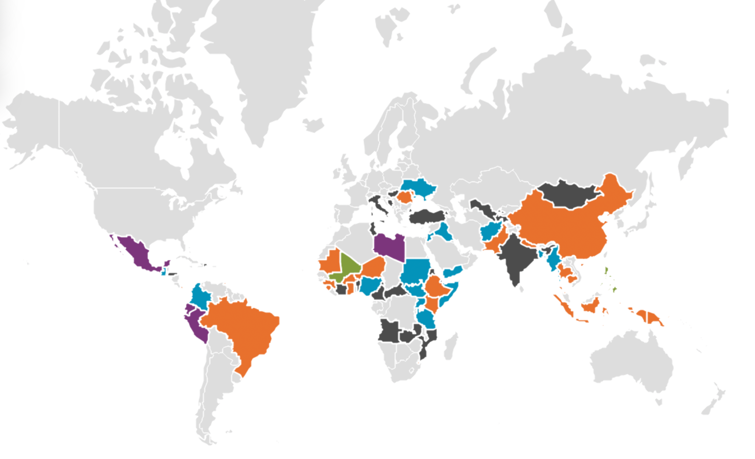
Primero Globally
79 Implementations
62 Countries
15.5 K Users
1.69M Cases

Slide 11
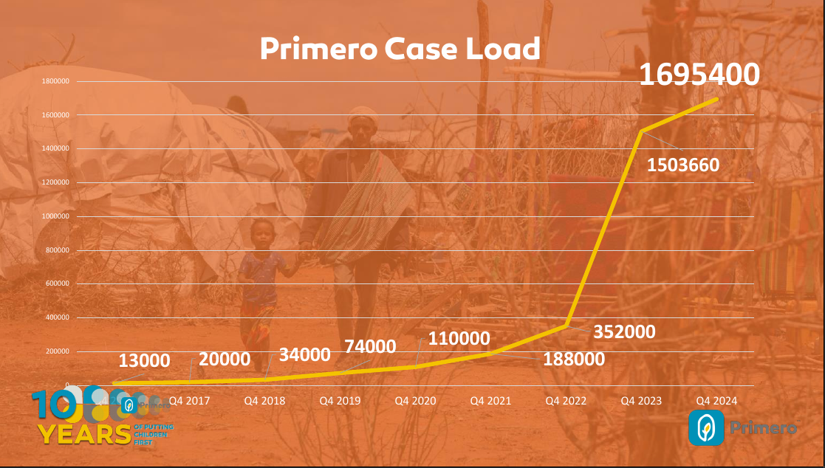

Slide 12
Primero is more than open-source software
A governance structure, led by the Primero Board, that provides strategic direction and risk mitigation for Primero.
Several deployment models including fully hosted solutions.
A large and active community of non-governmental organisations (NGOs), government agencies including:
  UNICEF (lead sponsor), UNHCR, Save the Children, IRC, Terres des hommes, …
  National and state governments including China, Ghana, Hungary, Italy, Romania, Ukraine, …
Certified Digital Public Good (DPG) with software licensed under the GNU Affero GPL 3 and source on GitHub.
Sustainability strategy to bring Primero to new markets through partnerships with for-profit companies such as Salus using an innovative Contribution in Kind model.

Slide 13



Primero deployment options
Tier 1
DIY
Access the open-source repo to set up your own Primero instance. Unlimited access to the Primero Community and all documentation.
Tier 3
UNICEF Hosted SaaS
Fully supported hosting on UNICEF's Azure cloud. Includes support to deploy, configure, operate, remote training, regular upgrades and technical support.
Tier 4
Hybrid
Support to install production server locally. This includes support to deploy, secure, operate, remote training, regular upgrades and technical support.

Slide 14
Primero in Europe
Romania
  Collaboration of UNICEF and government agencies to register and support children fleeing the war in Ukraine.
  Local IT company, on contract with government, has pulled the open source and forked it for custom additions: user identity management and SSO, custom dashboards.
  Open source contributions back to the core product of some features.
  Locally hosted.
Hungary
  Budapest city government is implementing a child protection social services case management system.
  Technology implementation by the city's IT team.
  Careful scrutiny by the national cybersecurity authority. Security testing
Ukraine
  Child protection services by local and international NGOs for children affected by the war
  Parallel to a government-led initiative, no data exchange
  UNICEF-hosted. UNICEF is not subject to national regulation (UN "privileges and immunities") but voluntarily complies with what it can

Slide 15
Primero in Europe - Themes
Compliance with regulation
  Serious review of privacy and security
  But different partners emphasize different issues–so there is no generic set of requests that satisfy everybody
Local capacity and interest in self-hosting
  Governments less interested in letting UNICEF do the hosting for them
Quality open source contributions
  Good collaboration and communication with UNICEF product owners and dev community
Challenges with integrating national eGovernment systems
  No unified beneficiary identity

Slide 16
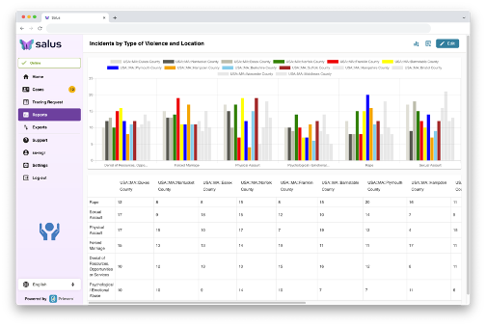
Innovative Public-Private Partnership
Salus-UNICEF Partnership
  Decade of work building Primero
  Contributions-in-Kind
  Shared Commitment to Primero as a DPG
Salus offers commercial SaaS
  Subscription pricing – per seat per month
  Multi-tenant SaaS Infrastructure
  Primero & RapidPro
  Additional Tools
  Sector-specific Configuration Templates
  Customization & Support Services
Support social, health, and constituent service providers in the US & CA
  Child & Family Services, Behavioral Health, Addiction, Elder Services
  Workplace & Campus Safeguarding

Slide 17

More information about Primero
Main website: https://www.primero.org/
Primero support hub: https://support.primero.org/
Demo: https://support.primero.org/popups/try
My contact info:
Jean Pierre LeJacq
Salus CM
CTO
email: jeanpierre.lejacq@salus-cm.care
website: https://salus-cm.care/
linkedin: https://www.linkedin.com/in/jean-pierre-lejacq/

