Slide 1

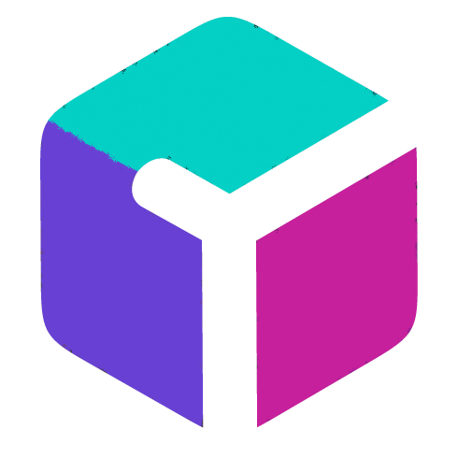


Robrix
A pure Rust multi-platform app for chat and beyond
Kevin Boos
Project Robius Tech Lead
Principal Architect @ Futurewei
Matrix devroom
February 2nd, 2025

Slide 2
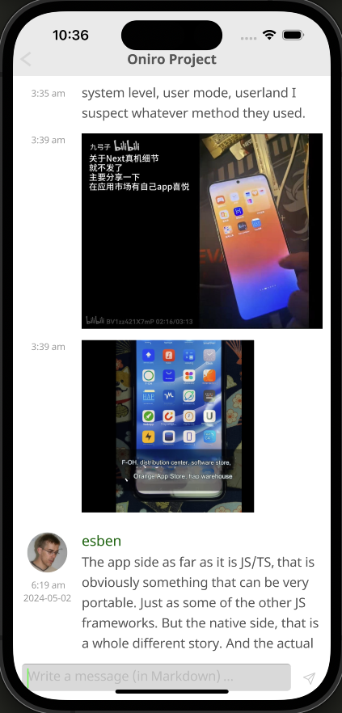
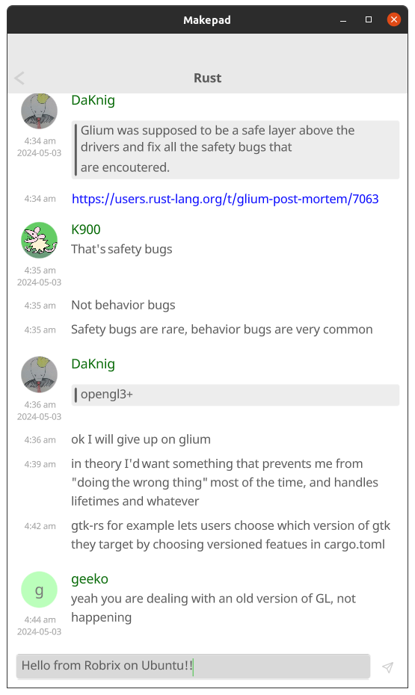
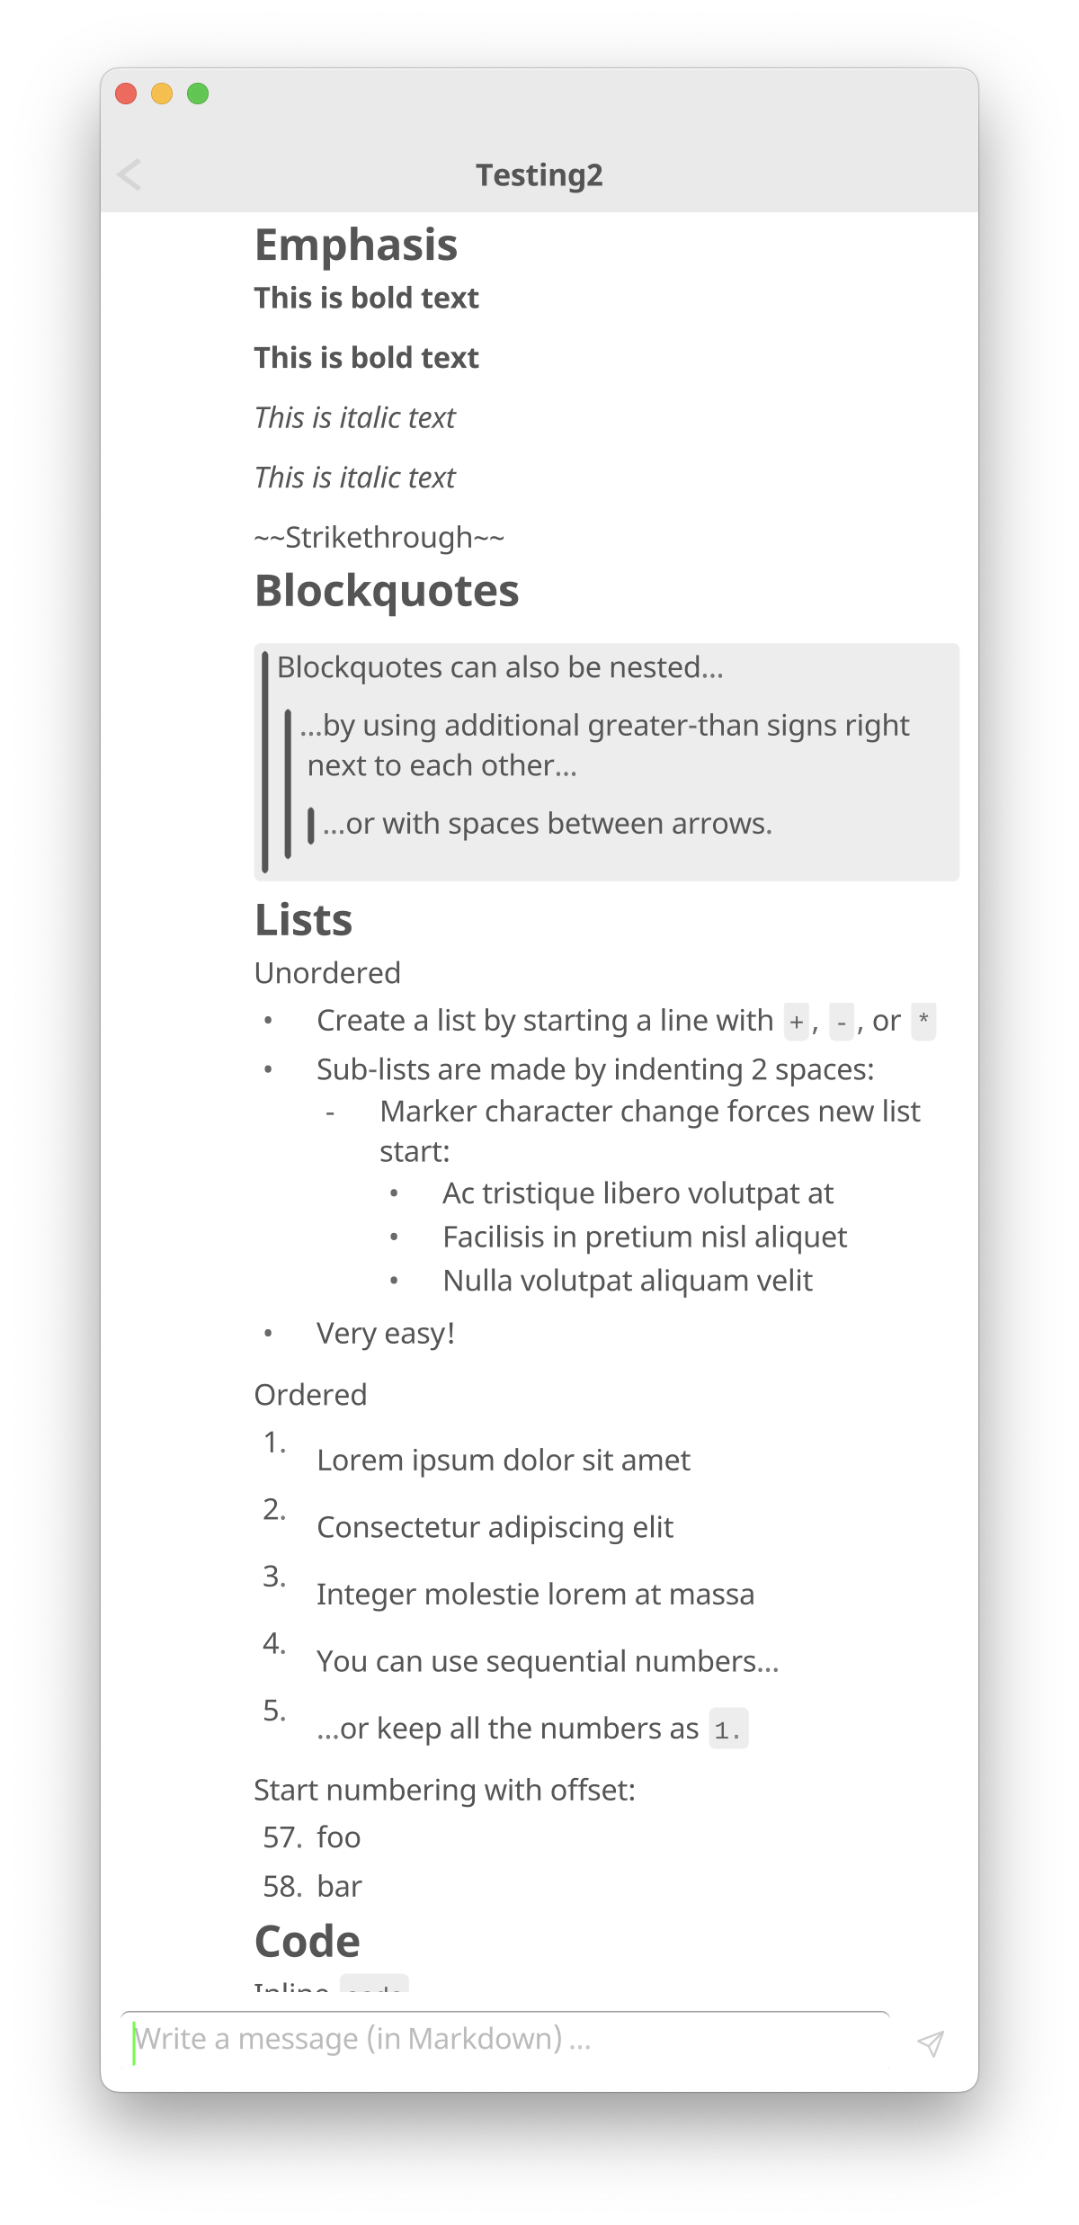
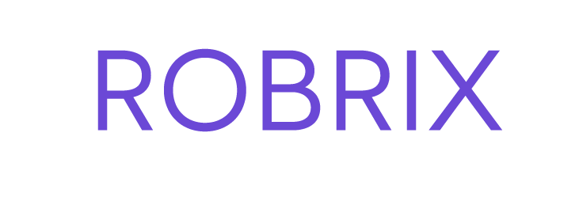
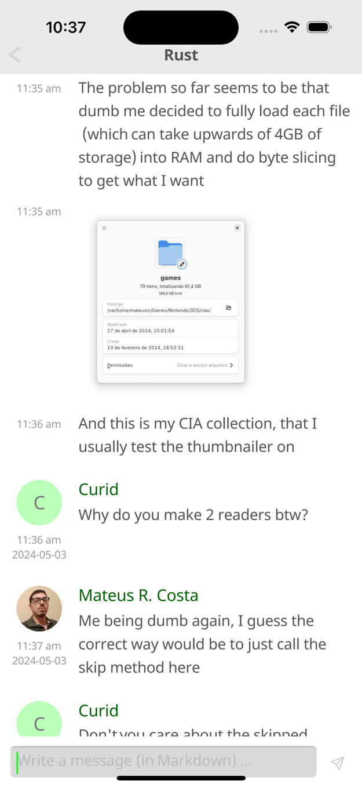
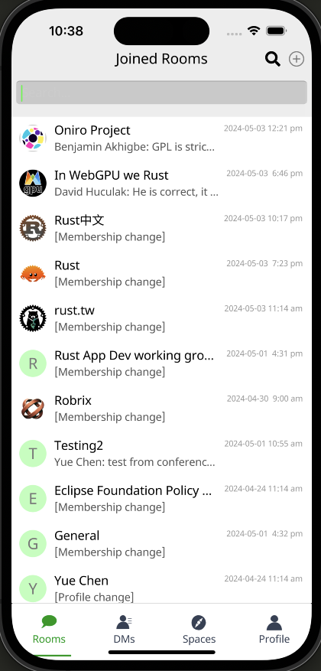
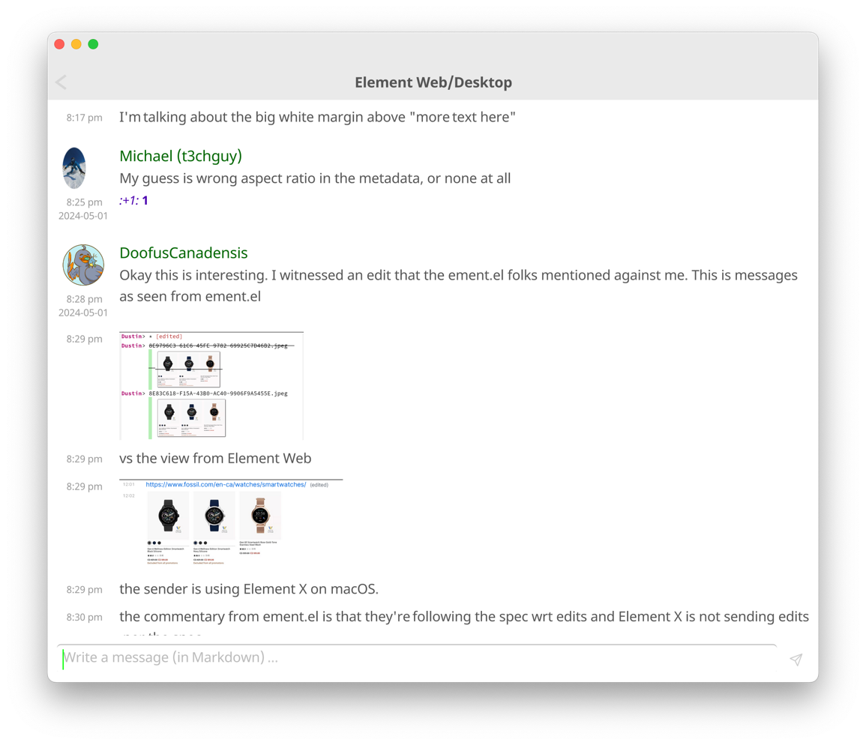
One code base, many platforms

Slide 3
Background & Motivation

Slide 4
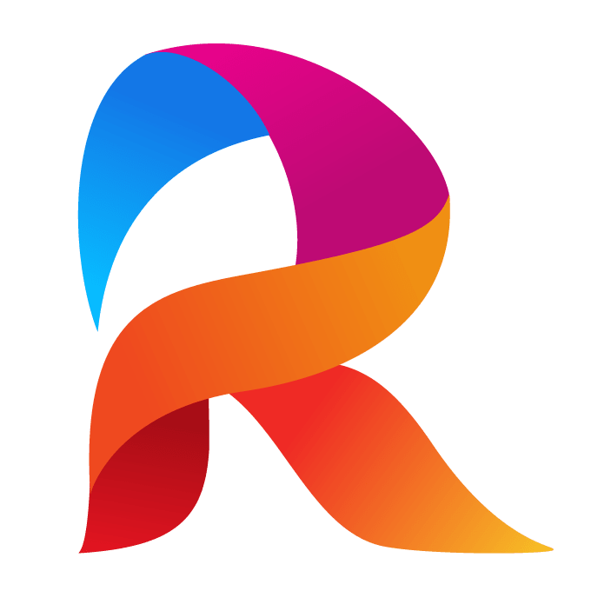

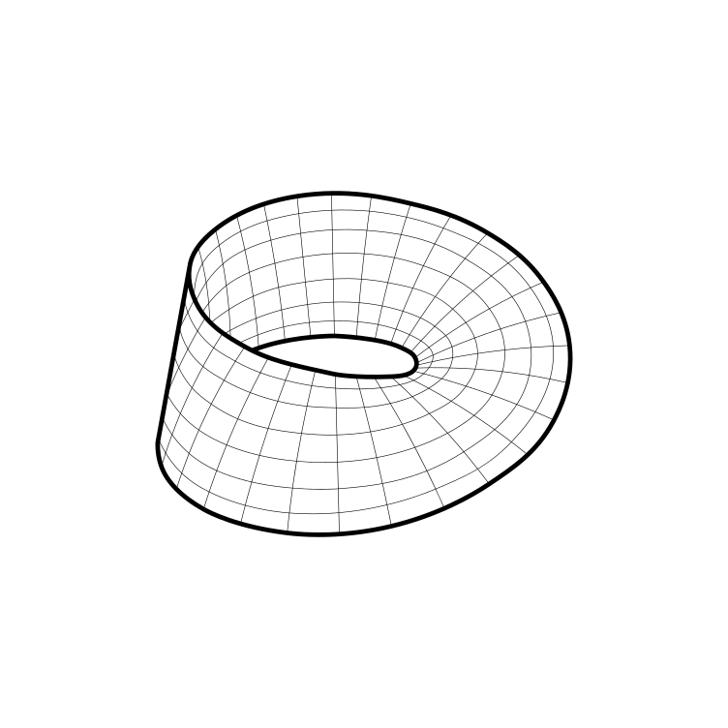
Project Robius goals at a glance
Create a multi-platform app dev experience fully in Rust
  leverage the robust, safe, and performant Rust ecosystem
  avoid dealing with multiple languages/environments
  never write a single line of platform-specific code
Make Mobile a first-class concern in the Rust community
  the Rust experience on Mobile has felt neglected
Devs can:
Notes:
Robrix is part of a larger project, called Robius, which strives to enable developers to write powerful, immersive multi-platform apps in Rust, with the goal being that Devs can...

Slide 5
Background — Project Robius app dev framework
Fully open-source, decentralized, and community-driven
  Independent collaborators across US, Europe, Aus/NZ, S. America, China
All components are also written entirely in Rust
But why Robius? … there are already great Rust UI toolkits out there
  egui, Iced, Slint, Leptos, Tauri, Dioxus, Makepad, Xilem, Freya, Ribir, …
→ There’s more to app dev than just drawing a GUI!
Traditionally, Rust apps have been “less Rust, more other code”
  (a small Rust core surrounded by big platform-specific wrappers
Notes:
There are quite a few projects that experiment with how to build a great GUI using Rust; Dioxus, tauri, makepad, Xilem and the linebender project, etc.
But to build a fully-featured app these days, you need an awful lot more than just UI and basic input events.
That's what Project Robius is all about: we leave UI design to the experts, and step in to fill the gaps everywhere else in the app dev environment.
This includes everything from complex build systems, support for platform-specific APIs and OS services (with nice Rust abstractions for each class of functionality), signing/packaging/bundling/distributing apps, and more.
Everything is entirely open-source and decentralized. Nothing is owned or controlled by one party, and we welcome contributions from anyone and everyone.

Slide 6
Why Robrix, though?
Needed a key app to drive Robius development
  “What kind of app is highly demanding?” (of UI & platform abstractions)
  A modern chat client!
    Requires network, geolocation, file/image access, audio/video capture & playback, system notifications, clipboard, rich text formatting & input, persistent device storage & cache, connectivity mgmt, biometric auth, secret key storage, and so much more!
  Why Matrix?
    Shares our values: open-source, decentralized, community-driven,
    and now focused on Rust
Notes:
There are quite a few projects that experiment with how to build a great GUI using Rust; Dioxus, tauri, makepad, Xilem and the linebender project, etc.
But to build a fully-featured app these days, you need an awful lot more than just UI and basic input events.
That's what Project Robius is all about: we leave UI design to the experts, and step in to fill the gaps everywhere else in the app dev environment.
This includes everything from complex build systems, support for platform-specific APIs and OS services (with nice Rust abstractions for each class of functionality), signing/packaging/bundling/distributing apps, and more.
Everything is entirely open-source and decentralized. Nothing is owned or controlled by one party, and we welcome contributions from anyone and everyone.

Slide 7
Why Robrix, though?
Needed a key app to drive Robius development
  A modern chat client is quite demanding
  Matrix aligns with our values & goals
But then... since we’ve already started, why stop there?
Let’s go further!
  Can we make a unique Matrix client for power users / productivity?
  Can we make Robrix into a central “hub” for federated services?
    Focus on the needs of open-source community & developers
    Combine Matrix, ActivityPub, local AI LLMs, source code tools, etc.
The better the app, the stronger the case for Rust app dev!
Notes:
There are quite a few projects that experiment with how to build a great GUI using Rust; Dioxus, tauri, makepad, Xilem and the linebender project, etc.
But to build a fully-featured app these days, you need an awful lot more than just UI and basic input events.
That's what Project Robius is all about: we leave UI design to the experts, and step in to fill the gaps everywhere else in the app dev environment.
This includes everything from complex build systems, support for platform-specific APIs and OS services (with nice Rust abstractions for each class of functionality), signing/packaging/bundling/distributing apps, and more.
Everything is entirely open-source and decentralized. Nothing is owned or controlled by one party, and we welcome contributions from anyone and everyone.

Slide 8
Goals & Roadmap
Notes:
Project Robius has quite a few goals and technical requirements, which you can read about in full on our website or github page.
For now, in the interest of time, I’m going to just discuss a select few.

Slide 9
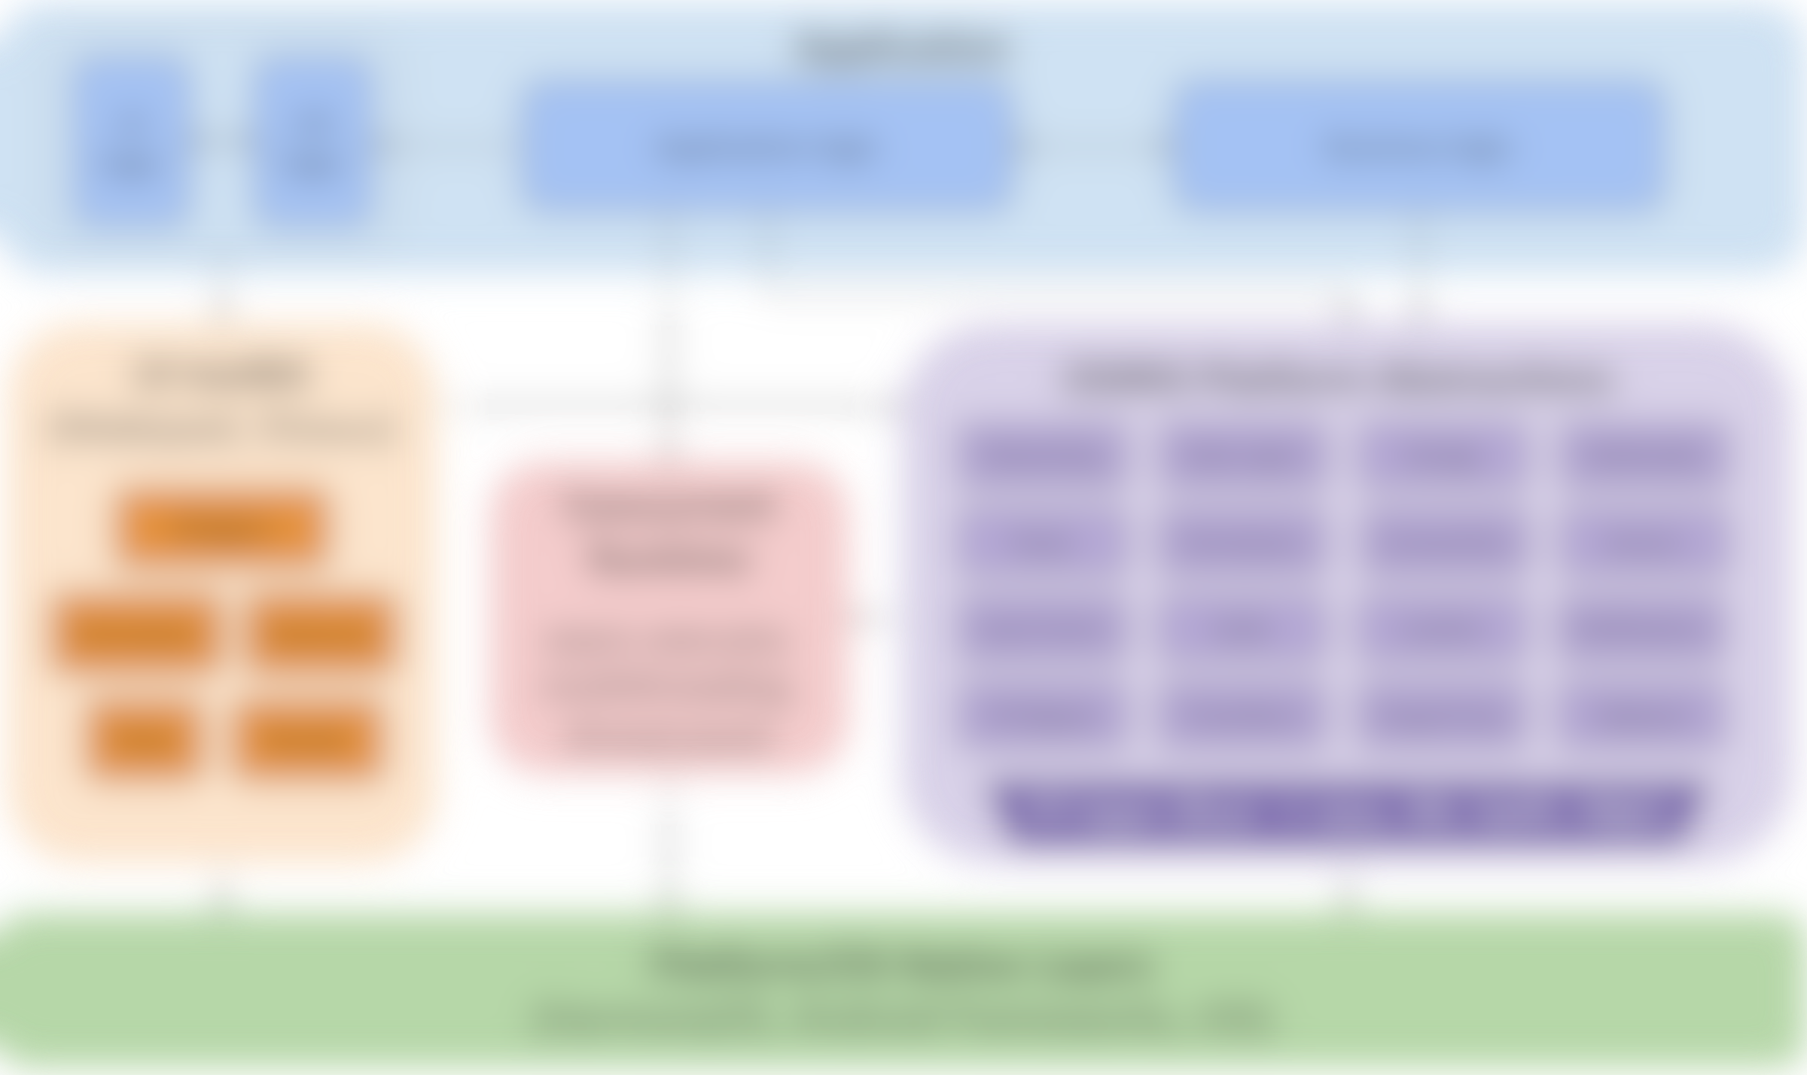
Main Robius goal: create reference design of full system stack
Application
UI logic
UX logic
Application logic
Business logic
runtime components
UI toolkit
(Makepad, Dioxus, etc)
Platform Abstractions
Concurrency Mgmt library
Networking
Location
Storage
Multimedia
Widgets
Power
Permissions
Connectivity
Sensors
main UI thread token
async tasks
Animation
Actions
Other Events
Keychain
Dialogs
Notifications
Events
Drawing
IPC/Signals
Time/Alarm
Drag & Drop
Clipboard
bkgd thread workloads
comm. primitives
FFI layer (Rust → native language)
Platform/OS Native Layers
(Linux, macOS, Windows, Android, iOS, Web, HarmonyOS …)
details coming later…
Notes:
Our primary goal is to establish a complete, working example of everything beneath the app
Which must support major platforms/OS environments
UI toolkits – Makepad, Dioxus, Slint
Offers a variety of UI development options and styles
Generally cross-platform, with a focus on GUI design and workloads
Rust abstractions of platform and OS-specific functionality
Focus on non-GUI subsystems
Standard subsystems: networking, storage, audio, time
UI-adjacent services: notifications, clipboard, drag & drop
Mobile-oriented:
Sensors/actuator: accelerometer/gyro, ambient light, pressure, temp, vibration, location, buttons, LEDs, biometrics
Multimedia: camera, mic, speaker
Touch screen, display brightness
Connectivity: WiFi discovery, bluetooth, NFC, USB, phone modem
Power: battery, charging, idle/standby/awake status
Permissions management: declaring, requesting, revoking
Goal: easy to integrate into a UI app as a dependency
Low-/zero-cost abstractions, as close to native as possible
Future: high-level, off-system mobile services
RESTful APIs: mapping, authentication, Google Play services, etc
Can likely use or start from the foundation of Open Mobile Hub
App dev-focused Concurrency management framework/library
Speaking from personal experience, it can be quite cumbersome and difficult to integrate and balance together many different execution contexts
Async tasks, which many SDKs force upon the user
Native OS Threads
The almighty main UI thread, which often has significant platform-enforced responsibilities and powers – difficult to handle and properly remember what workloads can only be run on the main UI thread
Balancing
Communicating between all of these different contexts without
thread pools, and CPU/multicore abstractions

Slide 10
Application
Application
UI / UX
Robrix App
Architecture
(Matrix parts)
Robrix’s needs guide
Robius development and
implementation priority
Writing/using Robrix forces us to dogfood Robius components
  and Makepad, of course, which needed many new features to support Robrix
Rooms list
Room view
Rooms browser
Application logic
Business logic (SDK use & more)
Persistent settings
Show notifs.
Local msg search
Jump to event
Event query
Join/
leave room
message send/recv
Read receipt
Settings, Themes
In-app notifs.
Context menus
Member info
Image viewer
Video display
Create or delete room
Quick replies
Access camera, mic, speaker
Login, session management
Account management
Reactions, read receipts
Search
Rich text format
Authentication
Multimedia streaming, calling
Input reaction
File/media dialog
Threaded view
UI ↔ SDK comm/sync
and more!
UI toolkit
(Makepad)
Concurrency Mgmt library
Platform Abstractions
Concurrent Runtime
async executor,
multithreading,
thread pools
thread token:
&mut Cx
Networking
Location
Storage/Cache
Multimedia
Widgets
async task pool
Input Events
Keychain
Connectivity
Notifications
Animation
Actions
channels, segqueues, etc
Authentication
Permissions
Dialogs
Clipboard
Events
Drawing
thread-local caches
FFI layer (Rust → native language)
Platform/OS Native Layers
Notes:
If we map this design of a full system stack to a specific app, it would look like this for Robrix.
Note that you obviously don’t need to understand every detail here.
In this case, we are also including the entire application component in the diagram, as we’re also responsible for developing.

Slide 11

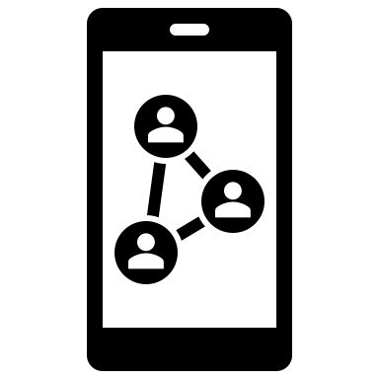


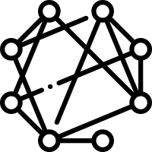
Overall Roadmap
Q1
Stage 1: publish app with fundamental Matrix client features
Basic messaging, login, app persistence, E2EE support
Flesh out sufficient App Dev ecosystem and UI toolkit for major platforms
Stage 2: Matrix client for “power” users, plus AI integration
Feature parity with existing major clients (incl. administrative features)
Responsive UI design with productive (IDE-like) multi-room view
Local LLM runtime for AI chat bots & conversation summaries
  Key point: does not jeopardize E2EE or data sovereignty
Stage 3: central “hub” for federated & open-source services
Collect multiple services: chat, discussion forums, code + issues + PRs,
announcements/microblogs, feed of notifications/activity/news
Identity management via OpenWallet
Q3
> Q4
Notes:
Stage 1: [now] Robrix as a simple Matrix client
Try to reach fundamental featureset to prove Robius works
(whilst building the entire UI & App Dev ecosystem)
Structure of Robrix
Arch diagram of Robius, then Arch diagram of Robrix
Then actual block diagram of software components in Robrix
e.g., UI main thread, using Makepad components, using background threads, tokio for async, matrix rust SDK, the app talking to robius components off to the side, which talk directly to the platform
Demo of Robrix
Stage 2: [within 1 year] Robrix as a power-user Matrix client
Approx feature parity with existing clients
Plus more: side-by-side-by-side layout of horizontal panes (desktop, tablet, foldable)
Visually beautiful and customizable
Fast nav, keyboard-driven interaction mode
Integration of local LLMs for many benefits without jeopardizing E2EE or data sovereignty:
AI-assisted chat synopses, topic analysis, “what you missed”, etc
Automatic public chat-bot response channels to help newcomers to large open-source communities
Stage 3: [1+ year out] Robrix as a central hub for federated services
Introduce our vision for other services: ActivityPub, mastodon, lemmy, code/reviews (github)
All the stuff the open-source community wants, all in one place
Singular idenity management & support via integration with Open Wallet Foundation

Slide 12
Roadmap Stage 1

Slide 13
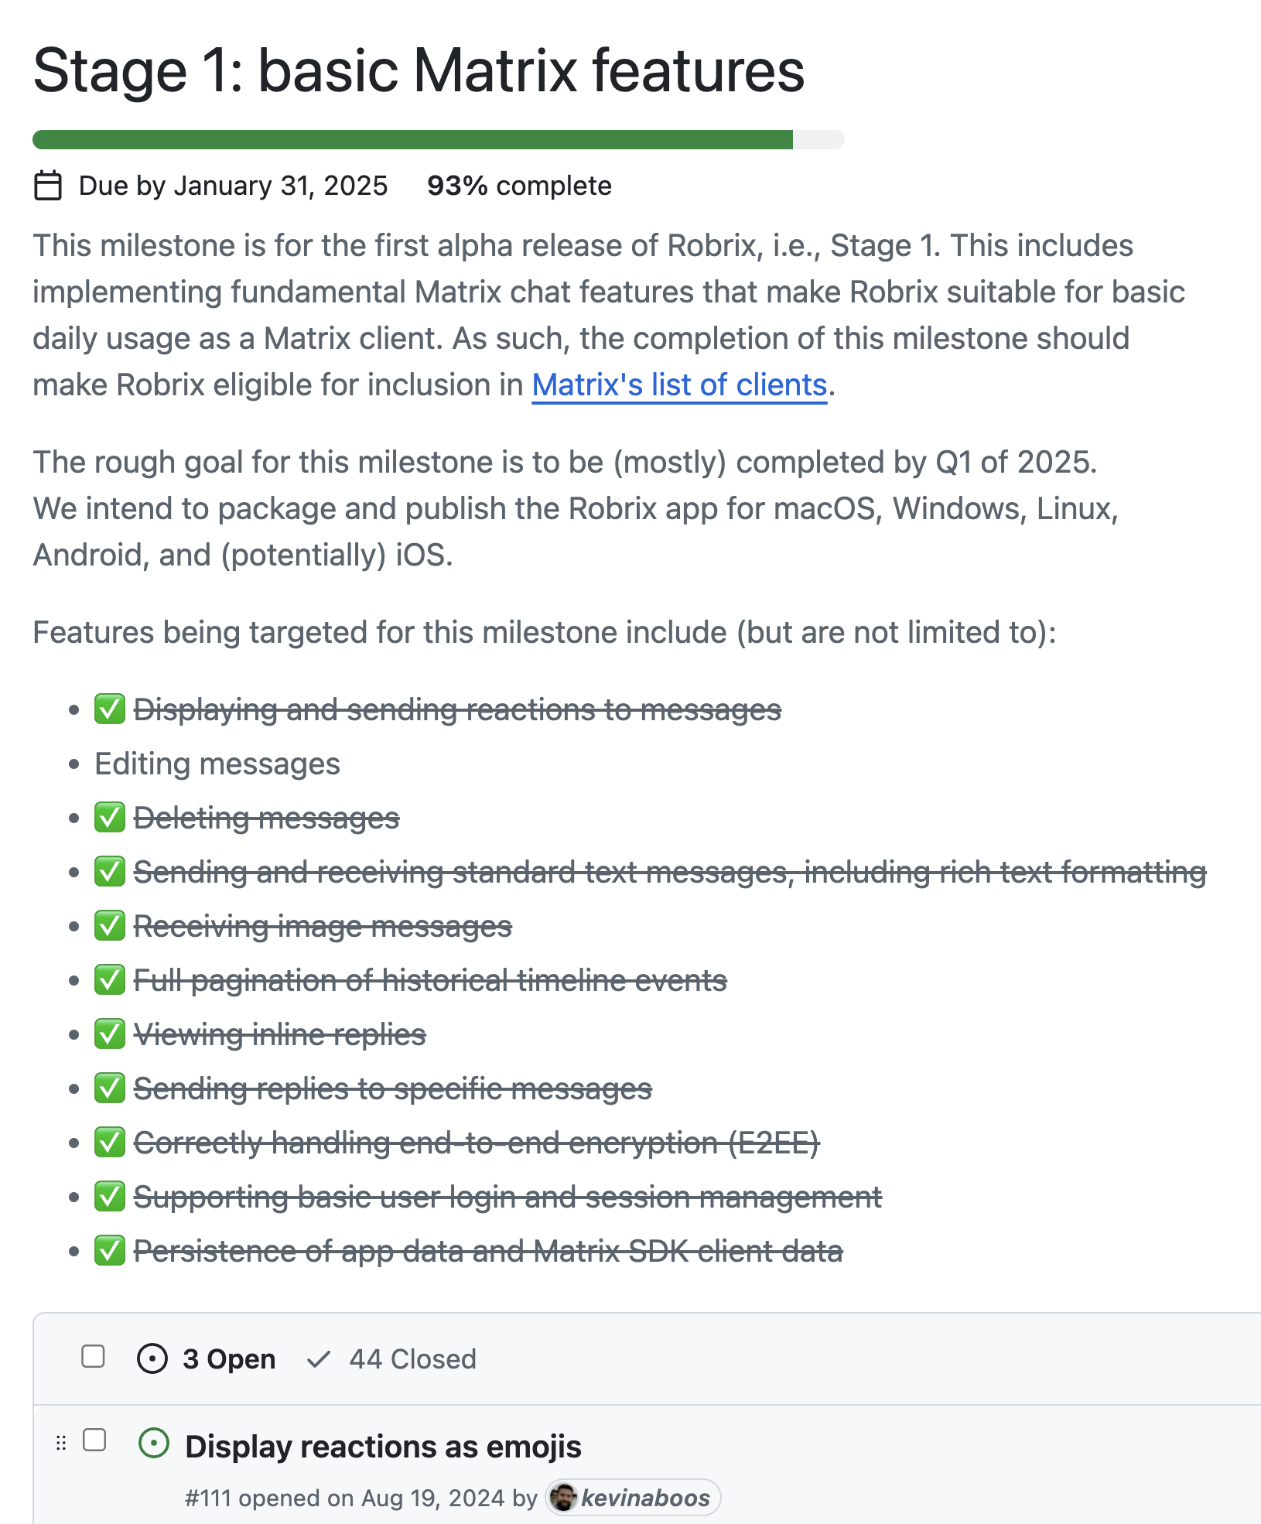
Stage 1: the basics
✅
Realize Matrix client fundamentals
  Login, rooms list (sliding sync),
  basic messaging, replies, reactions,
  rich text formatting, images,
  E2EE support, app persistence
Publish pre-alpha versions of Robrix
  Requires enhanced build tooling for releasing, signing, packaging
Establish app framework for
high performance and efficiency
  Despite inherent async/concurrency
  Key: do “nothing” on main UI thread

Slide 14
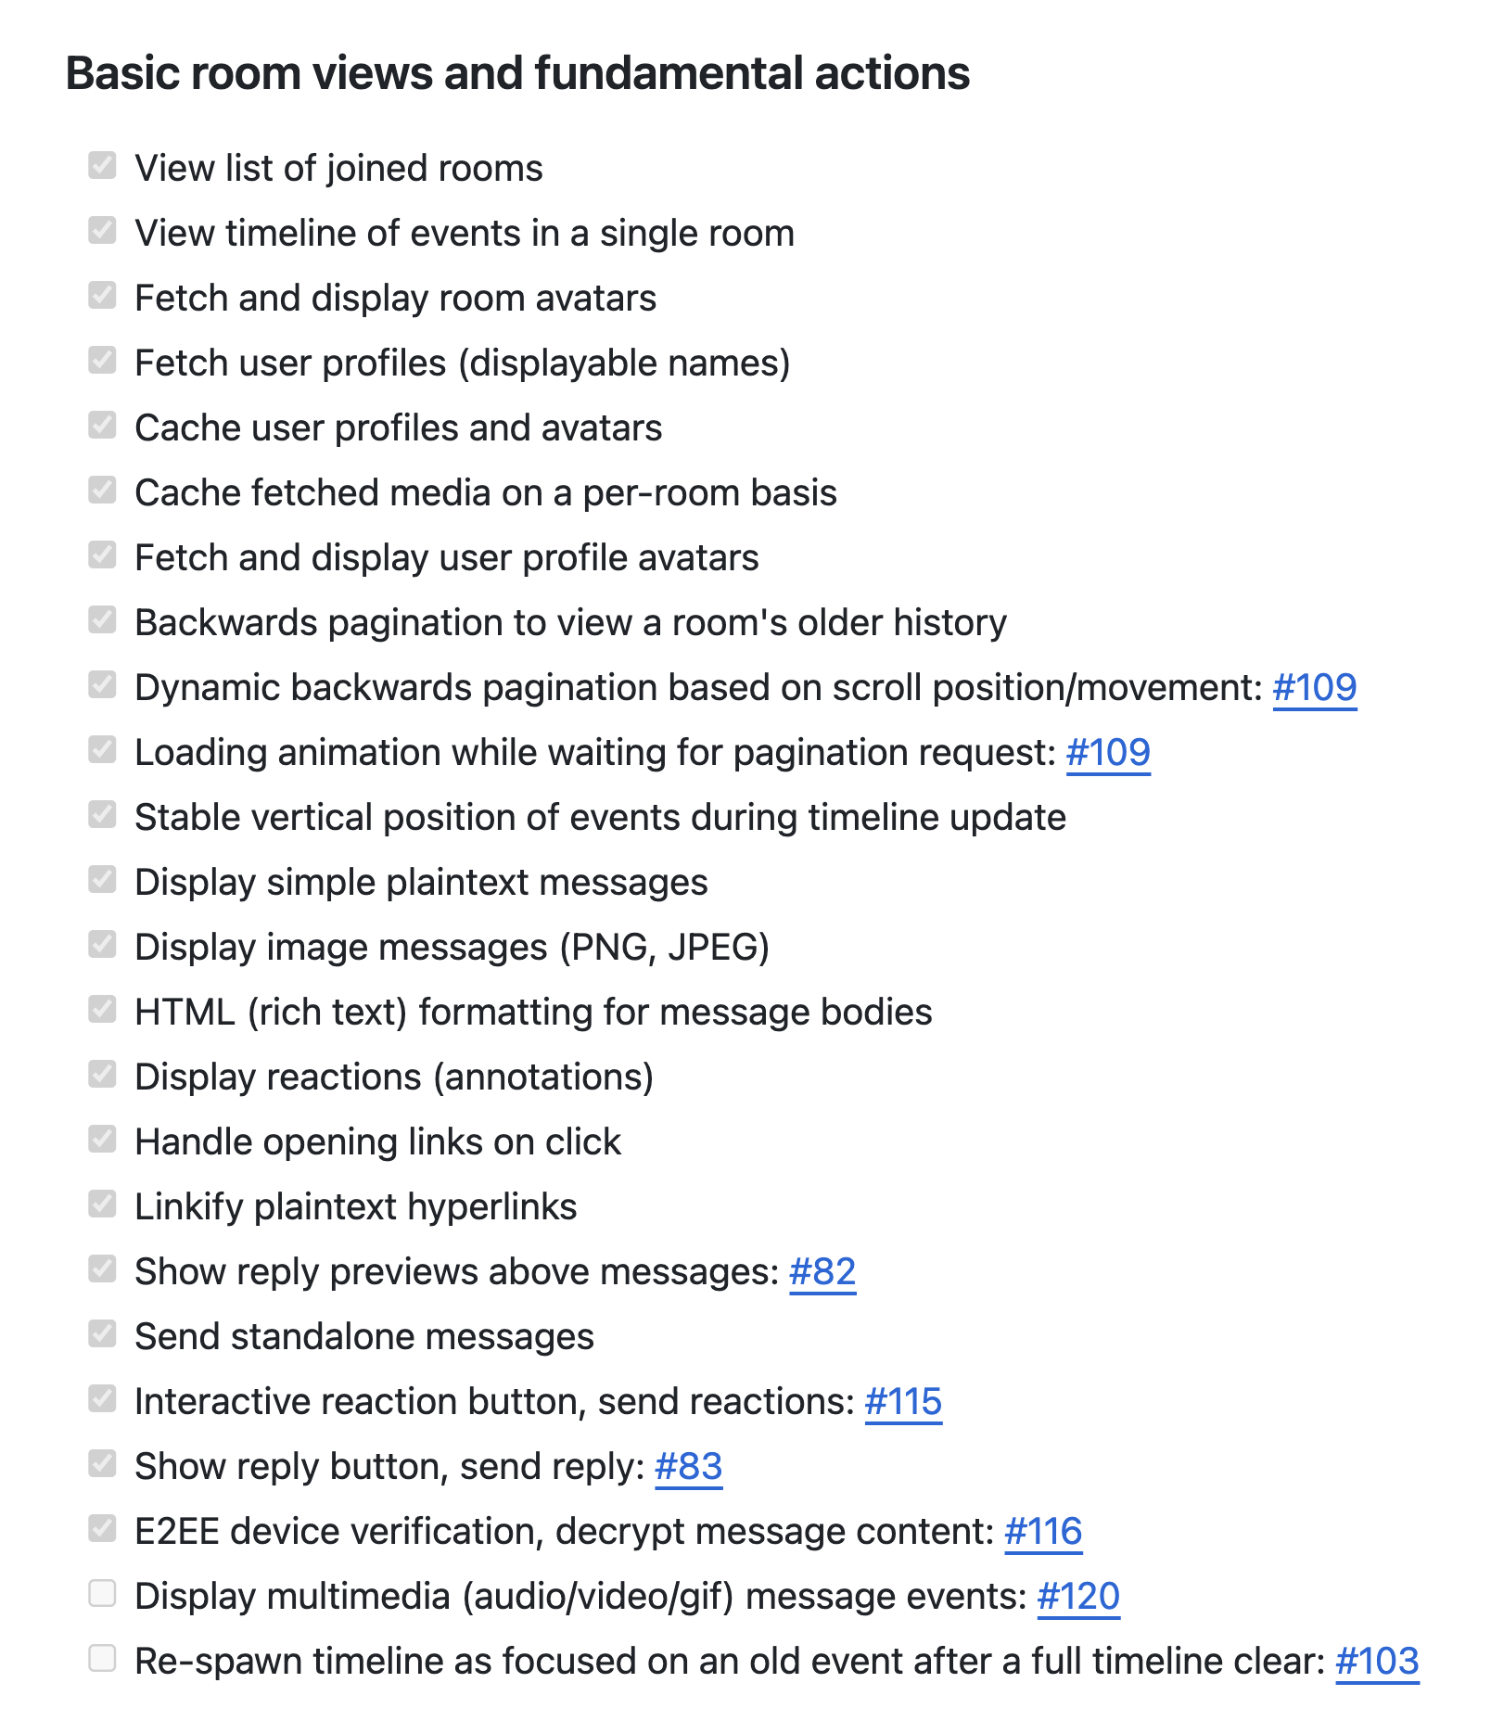
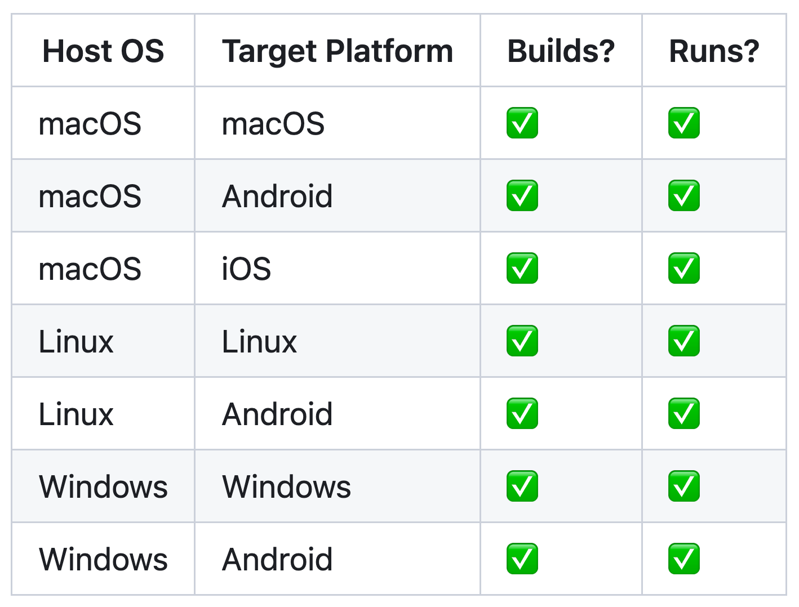
Gradually checking items off our feature tracker
Complete platform support from the beginning

Slide 15
Targeted platform abstractions / OS service APIs
System notifications
Biometrics & authentication
File/image picker dialogs
Context menus (custom, native)
Menu bar (desktop only)
Rich clipboard
Drag & Drop
Default URI/Intent handling
Content sharing to foreign app
Native font access
Input Method Editors (IME)
Native gesture recognition
Connectivity management
  WiFi, Bluetooth, NFC, nearby devices
GPS/Location access
Multimedia capture
  Device discovery & configuration
  Camera – snapshots, video, settings
  Audio – input, MIDI, playback
Sensors
Native alarms, timers
Keychain (secret storage)
Power management/status
App lifecycle state transitions
OS-standard data directories
and so much more …

Slide 16
Current status (EOY 2024)
System notifications
Biometrics & authentication
File/image picker dialogs
Context menus (custom, native)
Menu bar (desktop only)
Rich clipboard
Drag & Drop
Default URI/Intent handling
Content sharing to foreign app
Native font access
Input Method Editors (IME)
Native gesture recognition
Connectivity management
  WiFi, Bluetooth, NFC, nearby devices
GPS/Location access
Multimedia capture
  Device discovery & configuration
  Camera – snapshots, video, settings
  Audio – input, MIDI, playback
Sensors
Native alarms, timers
Keychain (secret storage)
Power management/status
App lifecycle state transitions
OS-standard data directories
and so much more …
Notes:
Most of these, but not all, are useful within Robrix but not technically mandatory.
Approximate proposed order:
Biometrics/authentication
Open URI / share object to another app (Intents, “sharesheet”)
Geolocation
System notifications
Native file/image picker dialog
Native font access (fallback for UI-packaged font stack)
Registration as default app (Intent handler)
Native rich clipboard access with full-MIME types
Native context menus

Slide 17
demo time! for future/offline viewers: the demo included an overview of Robrix running on macOS and Android.
Check out our git repo and run it on your own machine here: https://github.com/project-robius/robrix
17
Notes:
go over structure of components we’ve designed
Custom HTML parser & renderer
Extremely lightweight, no web engine, no CSS
Custom caching layer for drawing & populating UI widgets
Able to integrate with fine-grained events from Matrix SDK

Slide 18
Major Robrix-driven implementation challenges
⭐️
Realizing all the practical, unexciting UI features
Exposing & abstracting platform APIs / OS services
Handling complex multi-step builds (Rust + others)
  Standardizing compilation of non-Rust system glue layers
  Supporting platform-specific toolchains and linking conventions
  Defining and executing pre- and post-compilation steps
Packaging: bundling, codesigning, distributing apps
  Required for system notifications, geolocation (and so much more)
Maintaining high performance in the face of concurrency and async
  Key objective: do “nothing” on main UI thread
  But, UI & other select platform functions must run on “main” thread
  Certain APIs require async, others forbid async
Contending with multiple vastly different UI toolkits
⭐️
all across
disparate
platforms
⭐️
Notes:
Robrix has driven a lot of our implementation efforts over the past year. Two of the most major categories of implementation work has been on the UI side and on the platform feature side.
Most of what you just saw in the Robrix demo did not exist in Makepad before last year, including basic things like rich text formatting, mouse button abstractions, context menus, “adaptive view” widgets that respond to changes in window size
Permissions handling
Collecting and merging permissions from app, UI toolkit, dependencies

Slide 19
We manually manage mixed concurrency contexts
direct function call
sync –> sync channel
sync –> async channel
async –> sync channel
non-blocking requests to async funcs
responses from async funcs;
visual updates from backend server
UI main thread
Background thread
in async runtime pool
App main func, draw routines, event handlers
Background thread
non-blocking requests
to bkgd (sync) functions
App logic calling async platform APIs
App logic calling sync platform APIs
Nested sync requests, which may also (rarely) require async functions
App logic using Matrix
non-blocking
media lookup
(fast path)
Makepad UI toolkit
media cache
(shared memory)
insert fetched media (sync)
insert fetched media (async)
Robius Platform Abstractions
Matrix SDK
Platform/OS Native Layers
Notes:
App main thread is managed by and talks to the Makepad UI toolkit
Obviously want to avoid blocking this thread at all costs
Sends off requests that require synchronous operations to background threads
Sends of requests that require async operations to background threads that are managed by an async executor that can run async tasks
Certain platform-specific functions must only be invoked on main thread
But, many service SDKs are built atop async/await
e.g., the Matrix SDK requires async for many of its features (exposes only async fn()s)
Should not run async workloads on UI main thread
We have other non-async work that we also want to in the background
In total, we must contend with 3 categories of workloads
Currently use multiple types of channels, queues, and condvars to facilitate inter-context communication
Aim to create a better design here that helps to abstract away the manual tedium of passing messages across many kinds of channels

Slide 20
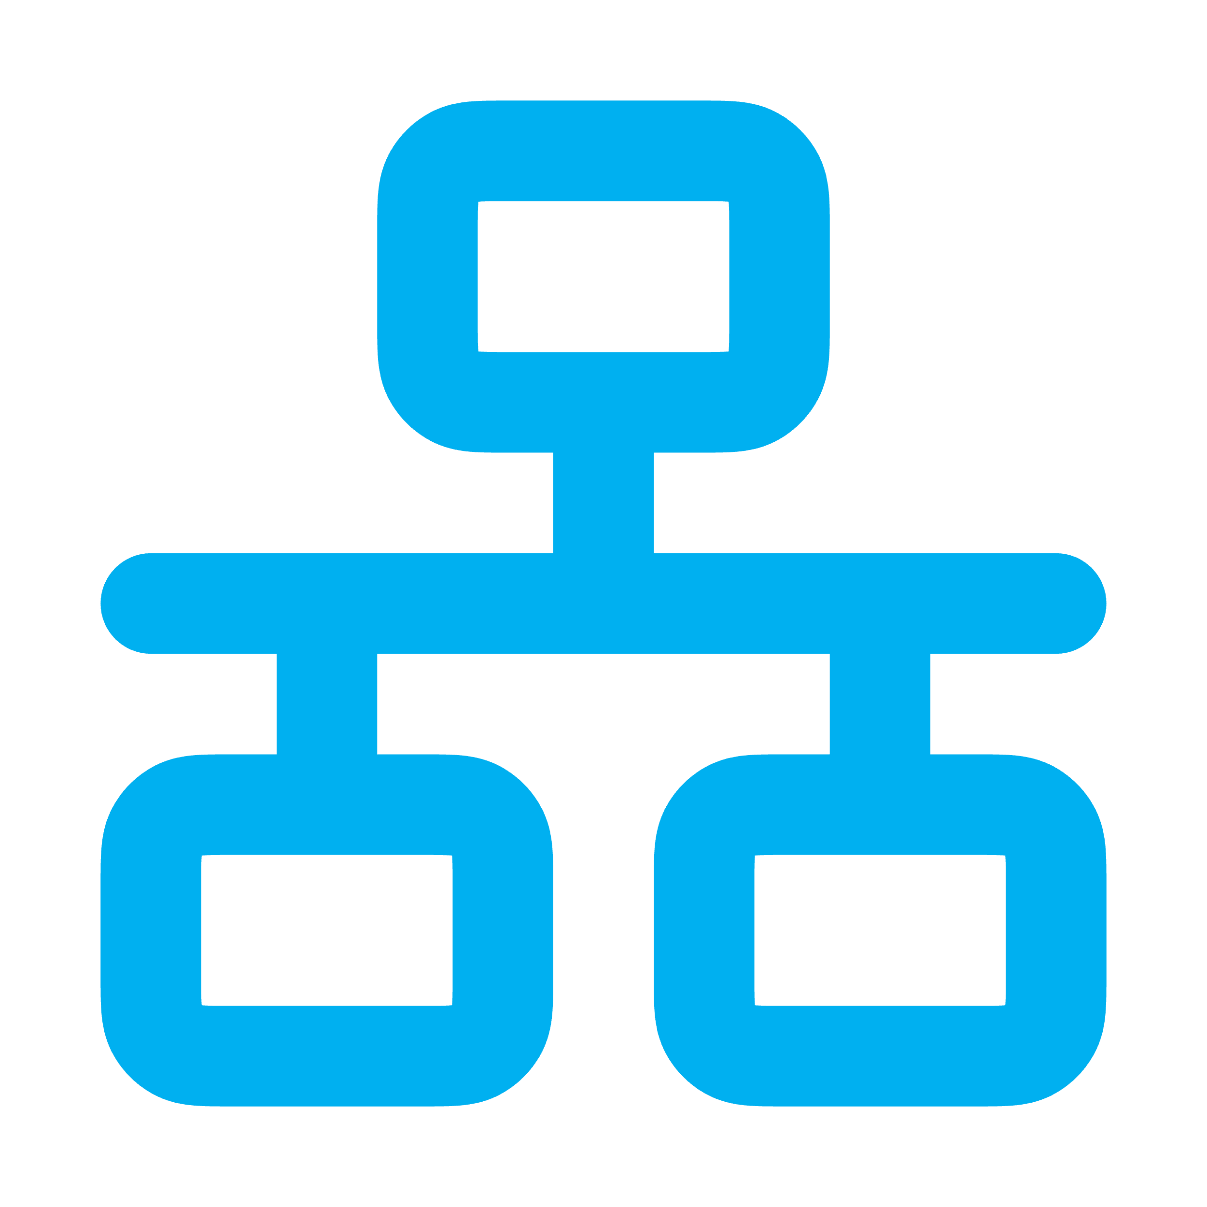
A challenging example: device verification
direct function call
sync –> sync channel
sync –> async channel
async –> sync channel
UI main thread
Background thread(s)
Async task(s) pool
1
Register verification handler
2
Incoming verification request
3
Display verification prompt
User accepts or rejects
4
Send accept/reject to other device
5
Wait for other device response, forward to UI, start SAS verification
6
Display SAS prompt, emoji
User confirms /denies match
7
Send SAS confirm/deny to other
9
✅
Display final result
8
Wait for other to confirm/deny
Makepad UI toolkit
Matrix SDK
Other device
OS/Platform Native Layers & Robius Platform Abstractions
Notes:
The most challenging incarnation of this that we’ve encountered, which is the verification modal.
Multiple finite state machines operating in different execution contexts, which both must be kept in lockstep together and in sync with another Matrix client instance (the one doing the verification)
This is incredibly difficult to implement given the constraints of what you can and should do on the main UI thread (i.e., not acquiring locks, not awaiting on an async task, etc)
Also the constraints of where async tasks can run, and which SDK APIs and system APIs require invoking in an async or sync context, or may be a blocking vs. non-blocking call
Note that this diagram excludes a vast amount of complexity surrounding timeouts, handling cancelations from both the local user and the other foreign device, restarting or being tolerant of network errors,
GOAL: to make this a lot easier for future app devs
Will be part of our future concurrency management framework

Slide 21


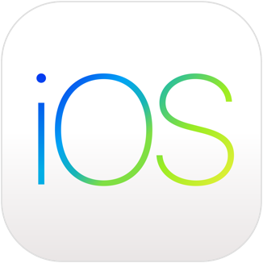


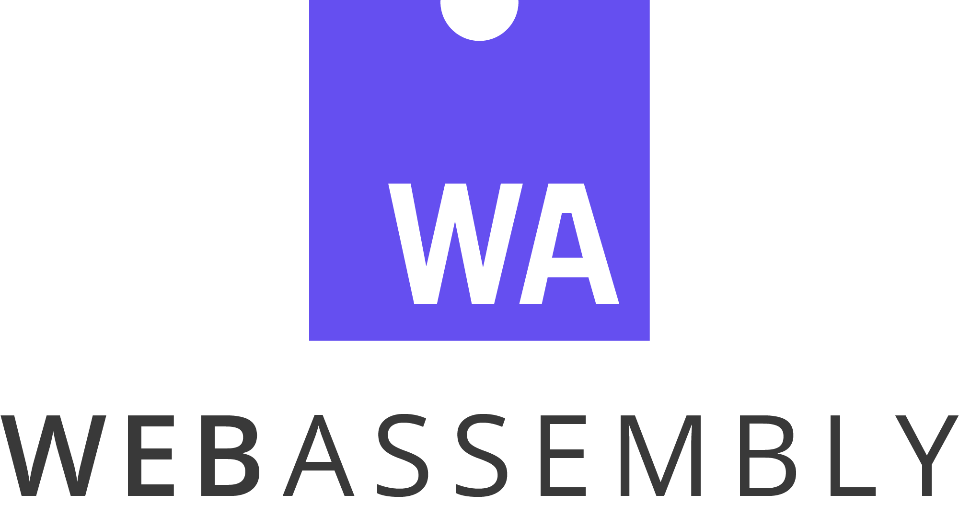

Major platforms already supported; others to come
Desktop
  macOS
  Linux (Debian-based, X11)
  Windows
Mobile
  Android
  iOS
Web/WASM
  Waiting on Matrix SDK
OpenHarmony OS
  Waiting on availability
  and platform integration
Q2-Q3

Slide 22
Roadmap Stages 2 & 3

Slide 23
Stage 2 — a Matrix client for power users
Feature parity with existing clients
Responsive UI with side-by-side panes & dockable tabs
  Visually beautiful and customizable across desktop, tablet, foldable, mobile
  Fast navigation with keyboard-driven interaction mode
Integration with local LLMs to leverage AI benefits
  Automated topic analysis, chat synopses of “what you missed”, etc.
  Chatbot response channels to help newcomers in
  large open-source project communities
  Local-only LLM runtime preserves E2EE & data sovereignty
Notes:
Explore Integration of local LLMs (à la Moxin) for many benefits without jeopardizing E2EE or data sovereignty:
AI-assisted chat synopses, topic analysis, “what you missed”, etc.
Automatic public chat-bot response channels to help newcomers to large open-source communities.
Some sort of AI features: auto-response bots for simple/frequent/easy questions, some sort of AI assistant to help you pick out key important messages from a long backlog

Slide 24
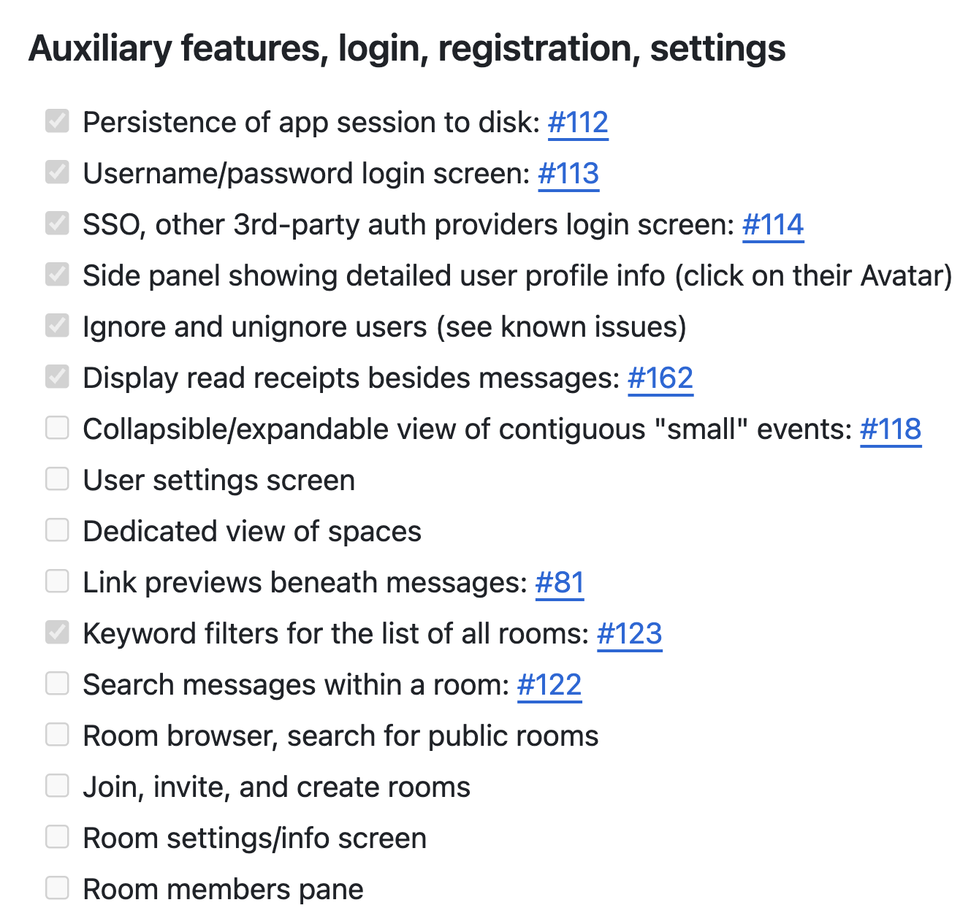
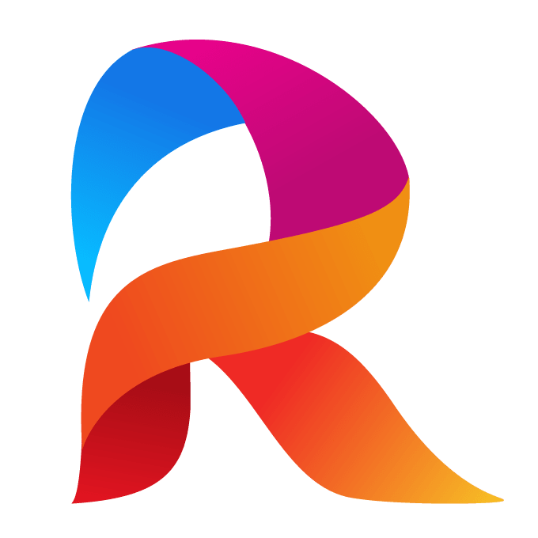
A. Reach feature parity with existing clients
Features that
don’t drive Project Robius development

Slide 25
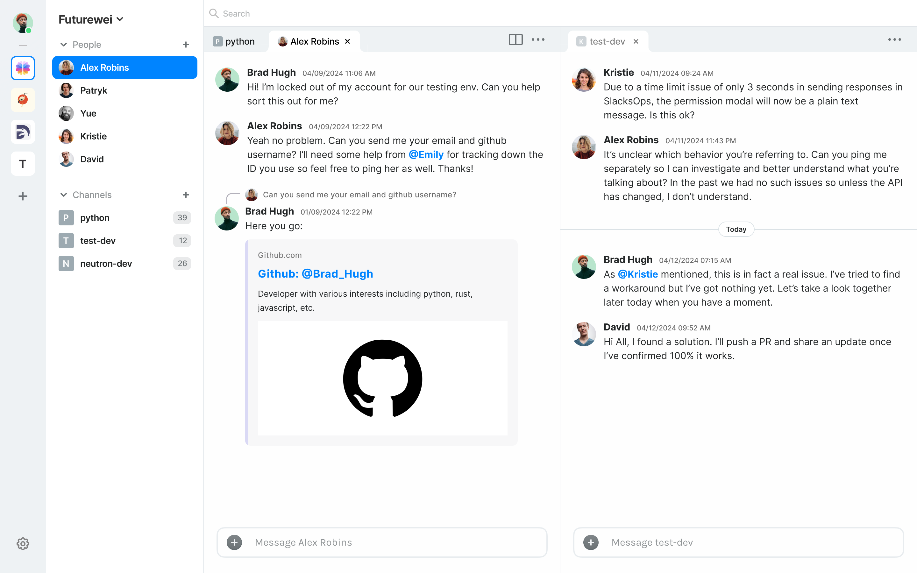
B. Multi-pane dockable tab UI
(the original design proposal)

Slide 26
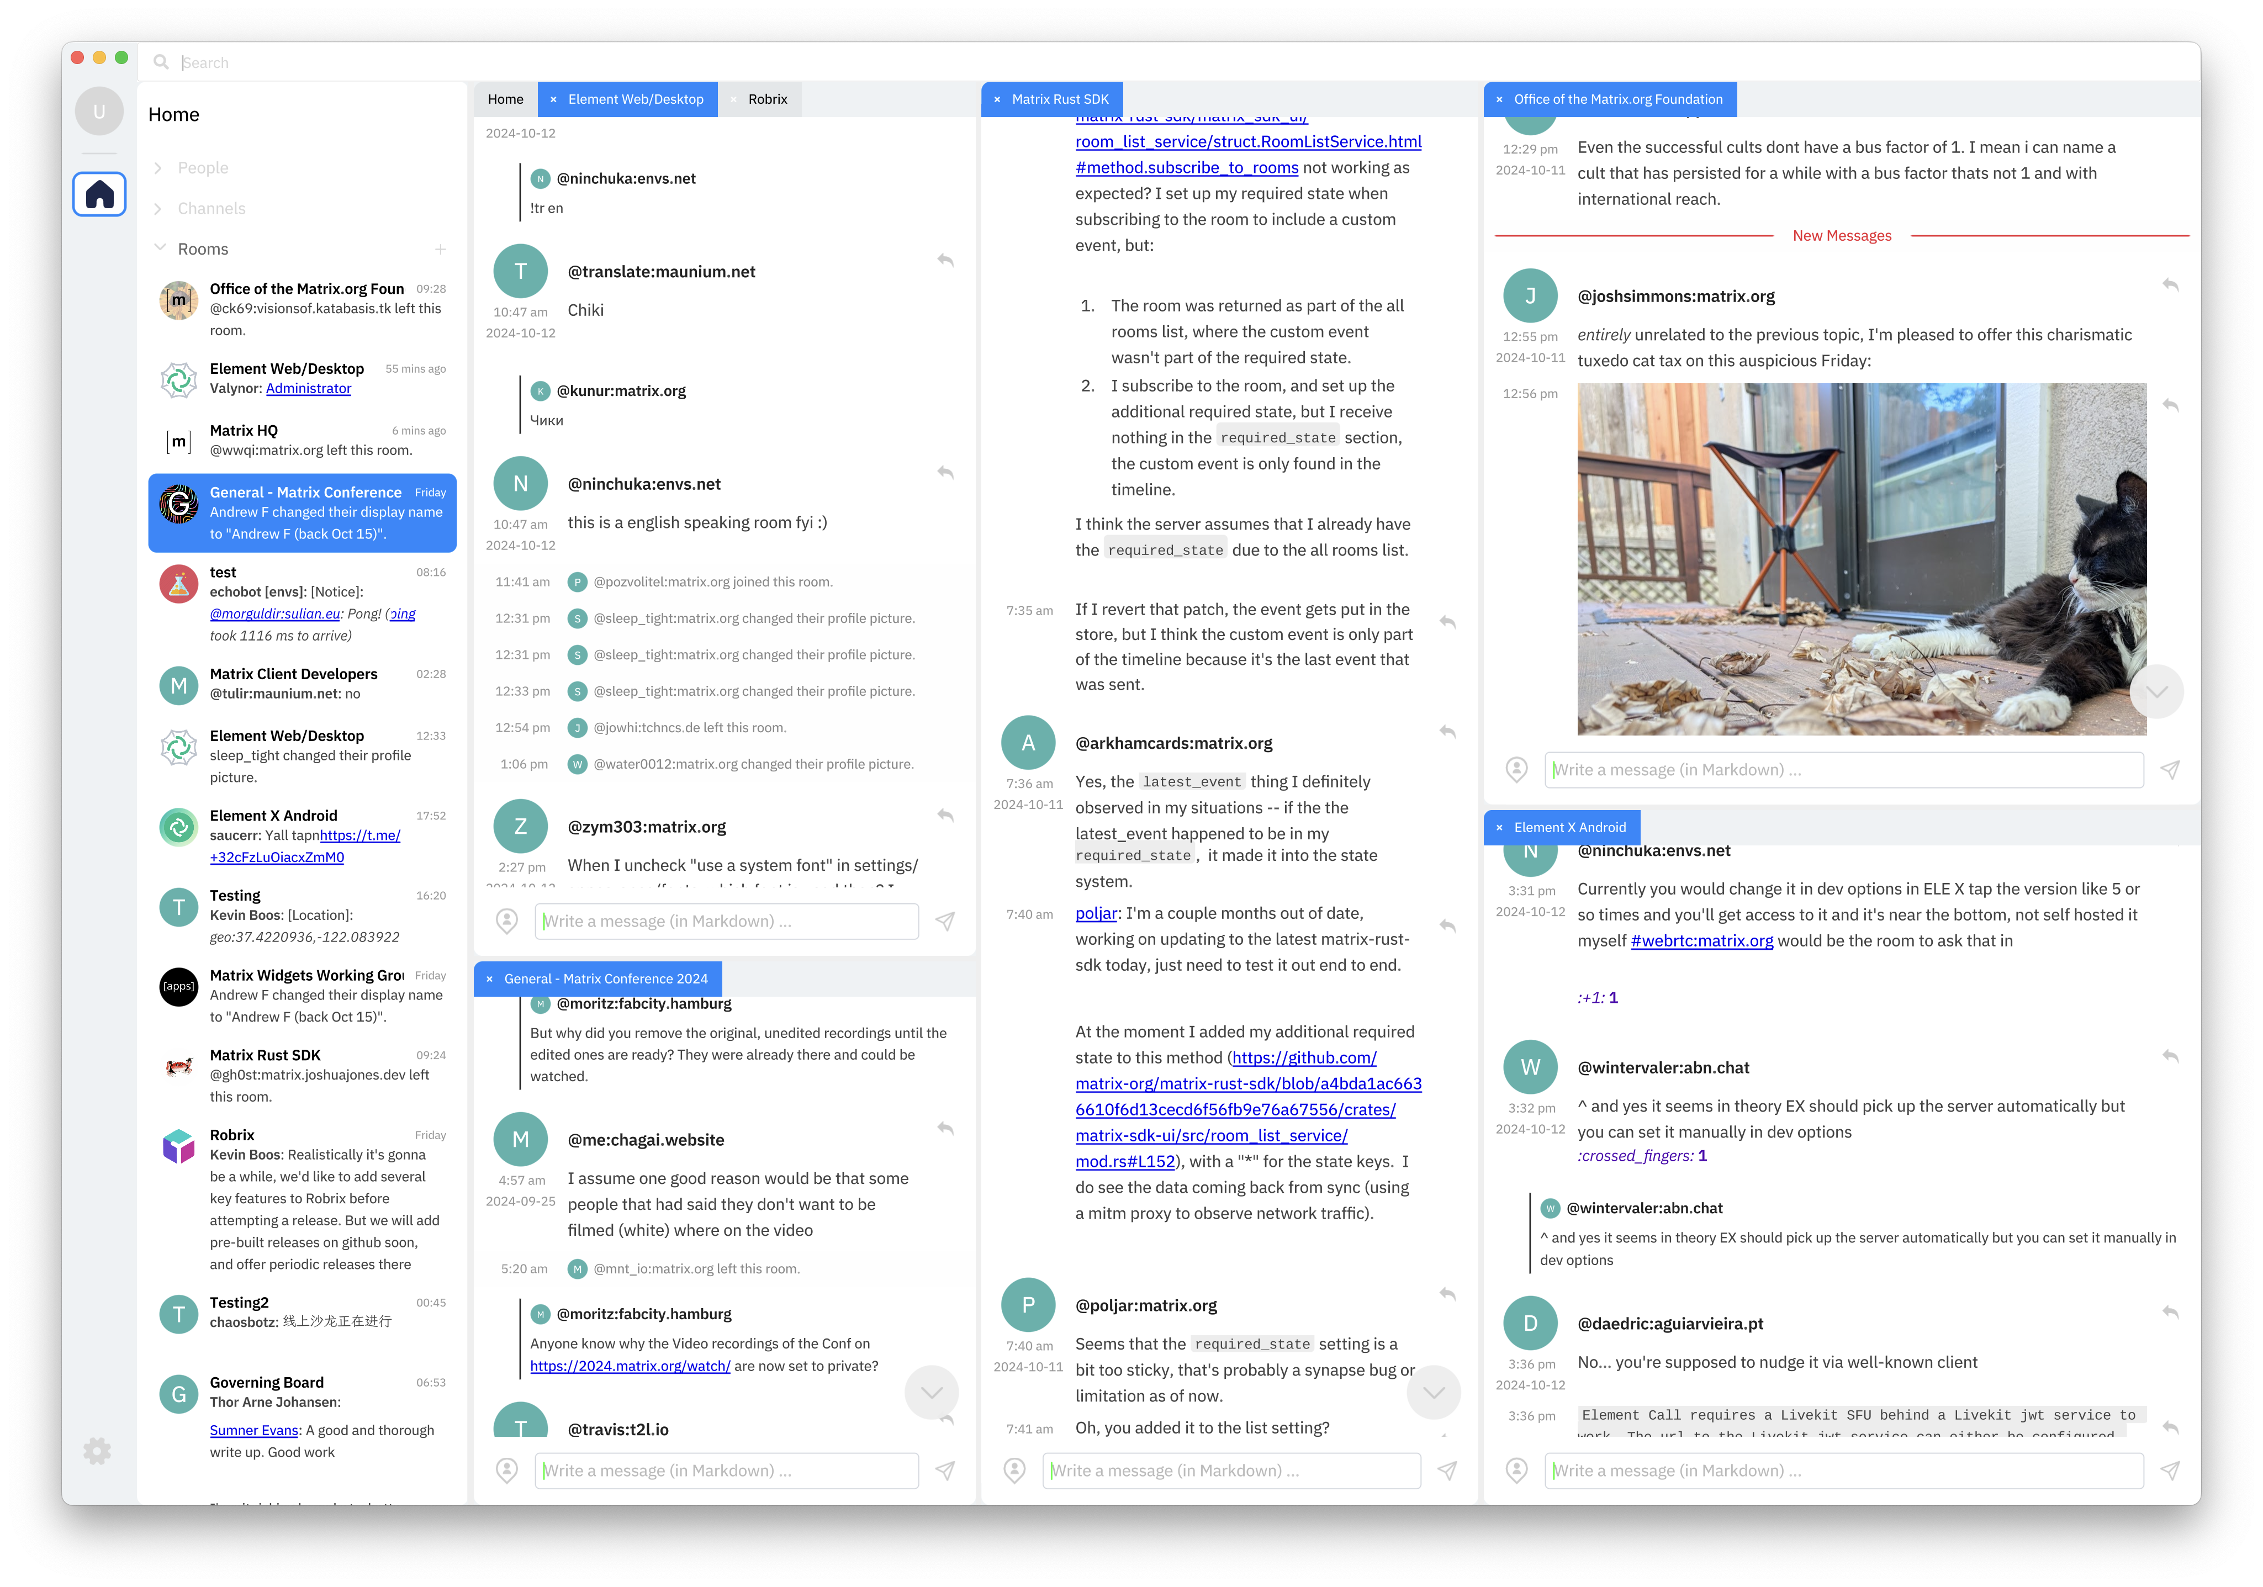
Robrix’s actual
"IDE" UI
Auto-adapts to screen sizes
  Same code works on Desktop, Mobile, Tablet...
Unlock productivity for work/social chats (just like IDEs)

Slide 27

C. AI capabilities via local-only LLM integration
Discord’s chat topic summaries
Wouldn’t it be great to enable this (and more) for Matrix chats?
  But how can this work without giving an AI service access to all of your data?
Local LLMs — benefit from AI without jeopardizing E2EE, data sovereignty
  Auto-handle public FAQs in an open-source project community
  “Action items”: AI identifies important messages & to-dos from a long backlog
  “What’s happening”: AI-driven conversation summaries & topical analysis
Longer-term: Matrix as a medium to share LLM agent recipes, chatbot demos
Notes:
Future integration with Moxin, another Project Robius app being developed:
“The Moxin App also integrates with the social community. It now supports an open-source model database/model card. The community can help improve the model card and add and validate more models. Also, we plan to fully integrate with the federated Matrix ecosystem so people can share the agents' recipes and demo their little bots, which ChatGPT or other tools do not provide as of today."

Slide 28
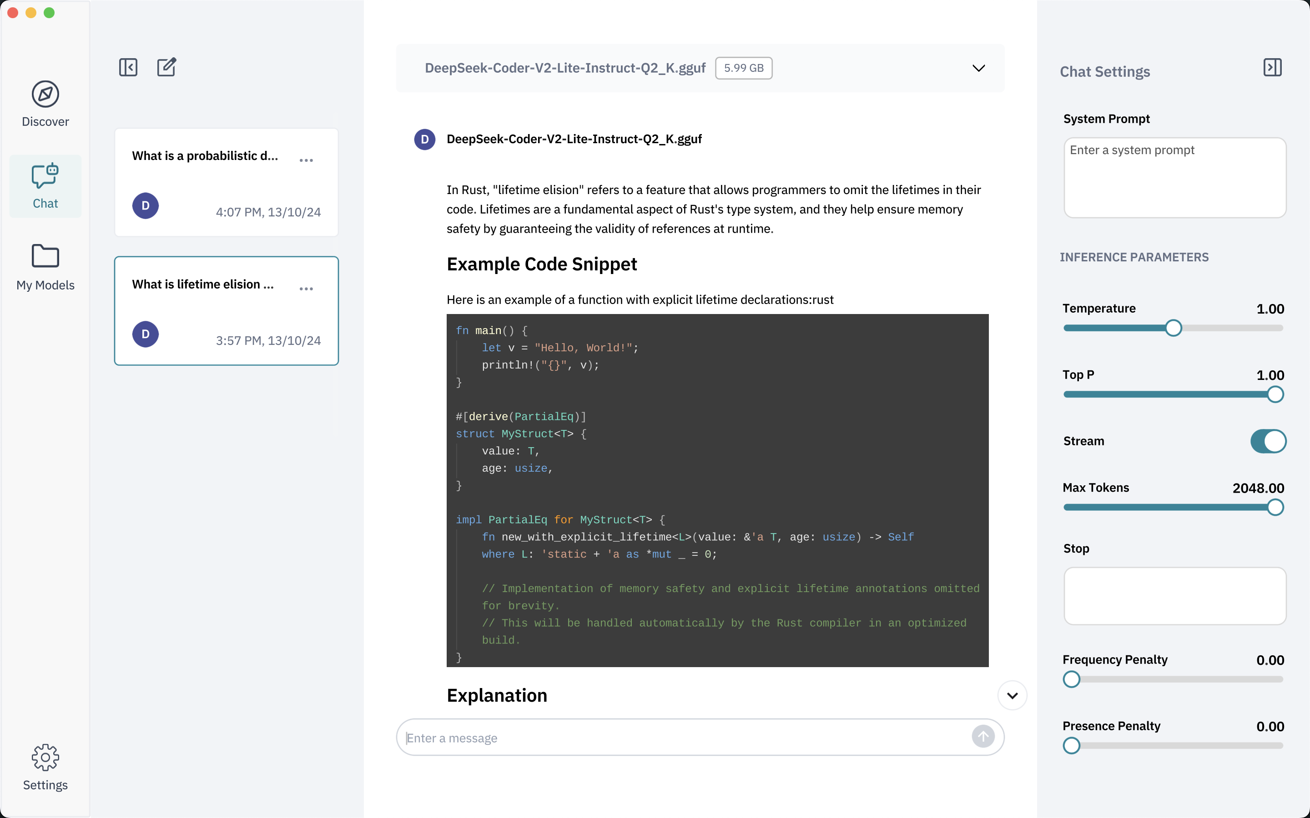
Robrix will leverage Moxin’s existing featureset
Moxin is another Robius app
  Also drove development of widgets, platform crates, packaging logic
  Models run locally using WasmEdge,
  a cross-platform WASM LLM engine
Work has already begun to separate the discovery, download, execution, and configuration of LLMs from the app’s UI frontend
Coming soon: more modalities beyond LLM agents
Notes:
Moxin is another Robius app
Also drove development of widgets, platform crates, packaging logic
Models run locally using WasmEdge, a multi-platform WASM LLM engine
Work has already begun to separate the discovery, download, execution, and configuration of LLMs from the app’s UI frontend
Coming soon: more modalities beyond LLM agents

Slide 29
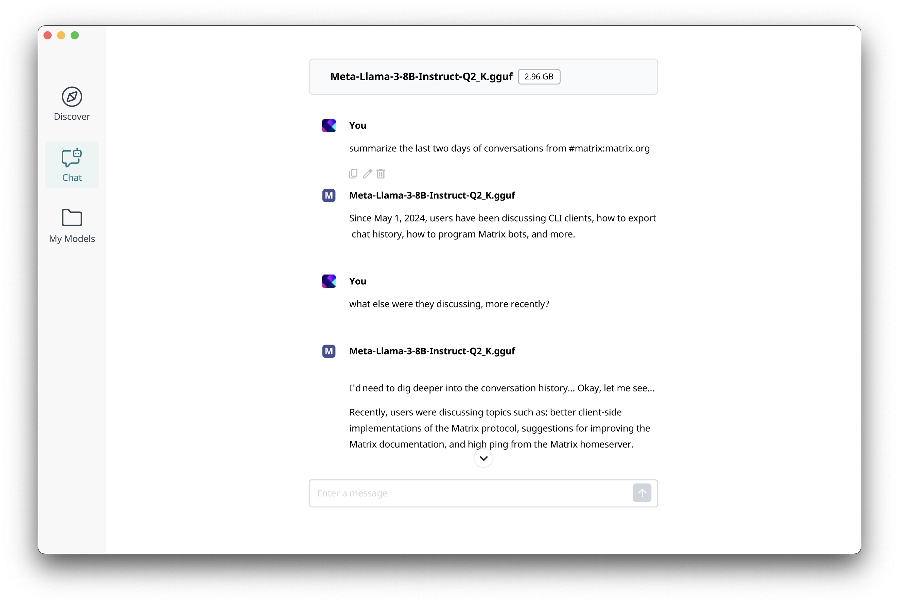
Robrix in-app AI LLMs
AI Chat
via a local Moxin installation

Slide 30
AI Chat
AI model is user’s choice

Slide 31
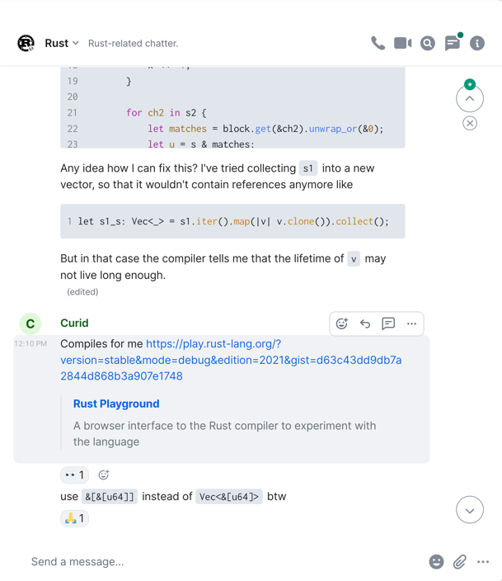
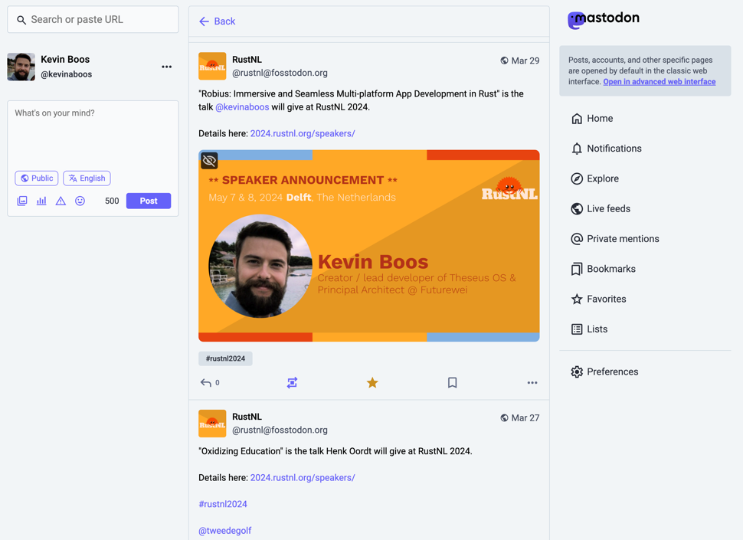
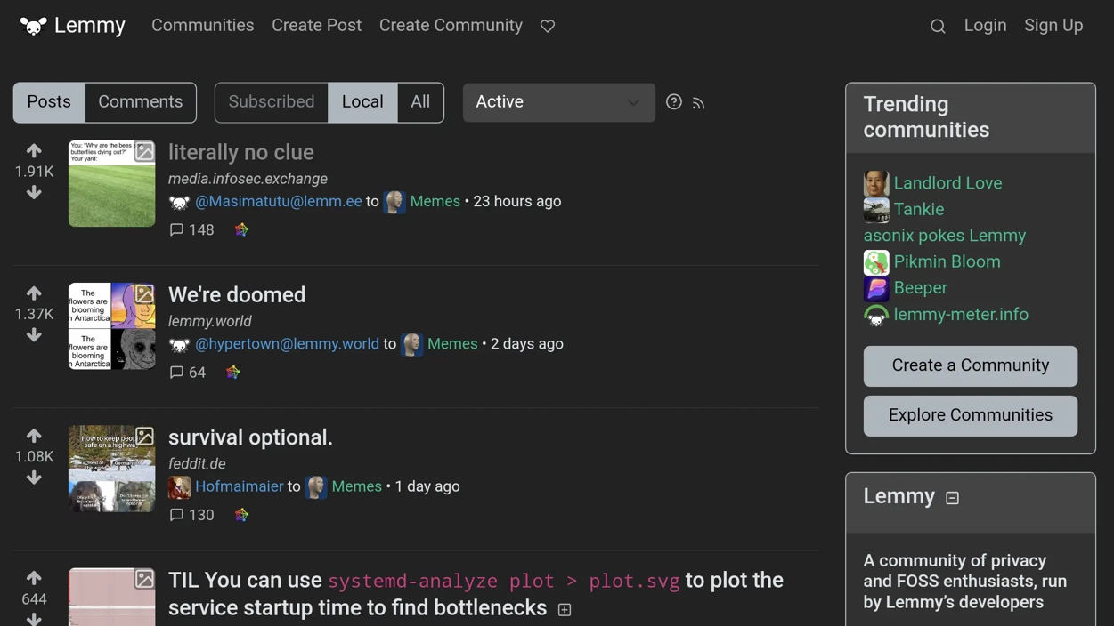
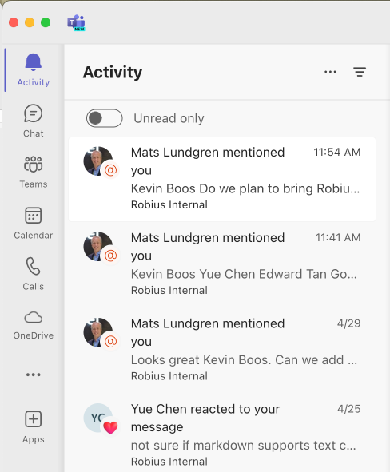
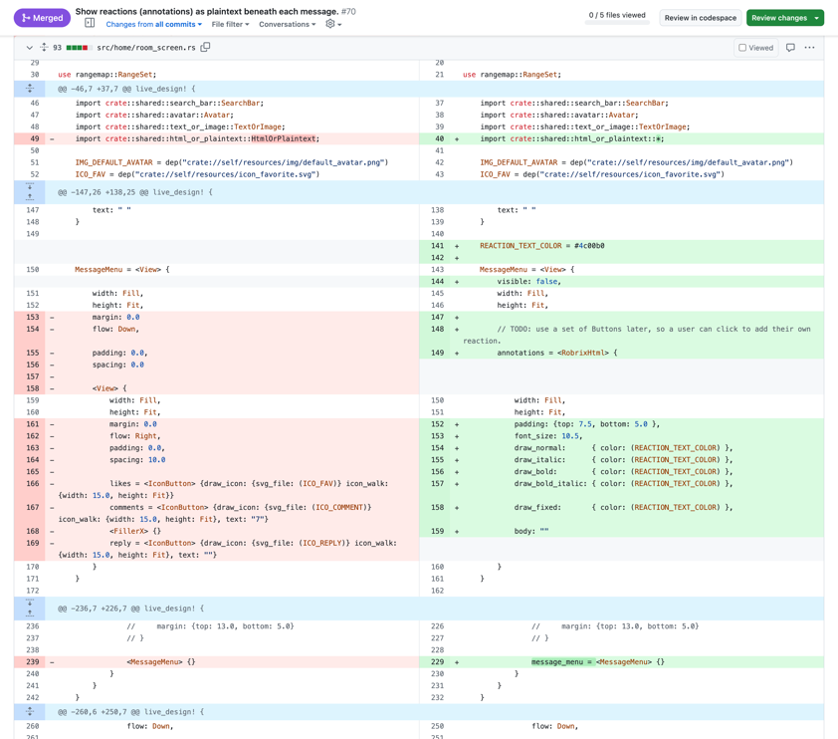
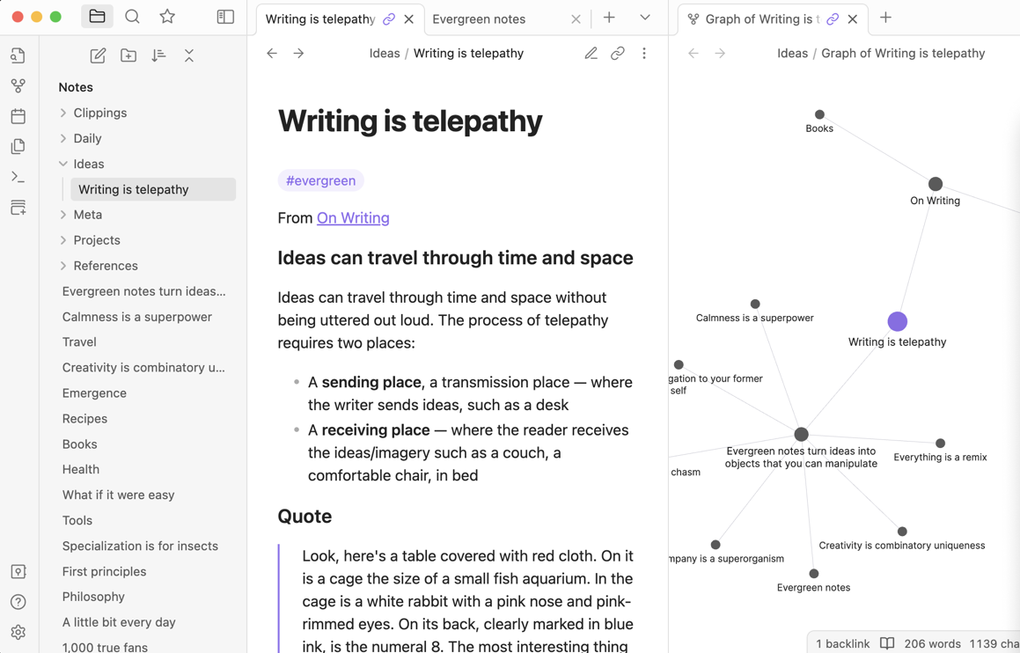
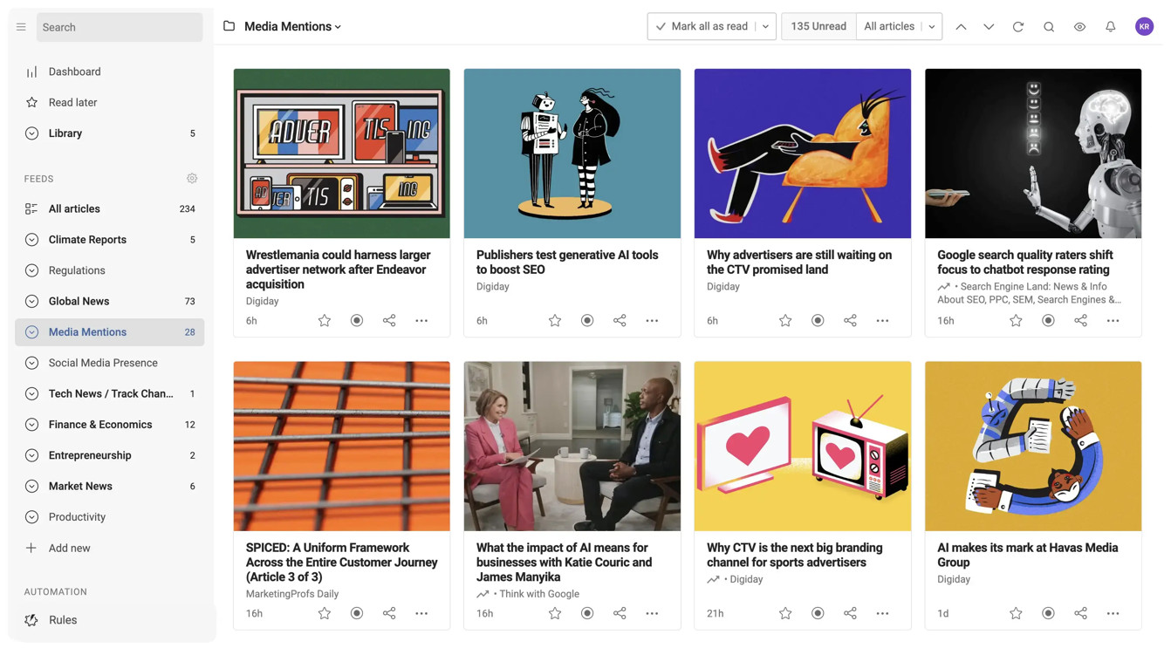
Stage 3 — a community hub (for open-source)
Chat (Matrix)
Microblogs (Mastodon)
Community Forums (Lemmy)
Notifications, activity pane
Code [re]view (git)
Notes
News feeds (RSS)
Notes:
This is the part of the talk that most relates to the concept of a next-gen internet.
We envision developing Robrix into a community hub app of sorts, that can collect multiple services: ActivityPub (Mastodon, lemmy, code/reviews (github)
→ All the stuff the open-source community wants, all in one place
----------------
0. Data sovereignty (a user owns their data, can host & manage it, exposed via common federated standard APIs)
1. Place to host code (Gitlab, Github, etc)
2. Place to host chat (Matrix, etc)
3. Place for announcements, micro-blogs (Mastodon, twitter, etc)
4. Place to collect notifications across multiple services (Github updates/following, username tags on GH/matrix/mastodon/etc, replies/DMs on matrix & mastodon,
5. Place to collect discussion forums
6. Place to show news feeds (RSS feeds, etc)
----- Extras: -----
7. Place to host and view notes (Obsidian, Evernote, Google keep, etc)
Potential for novel "combo" features: easily publish tweets/toots on Mastodon and Matrix posts about a GitHub release for your project

Slide 32


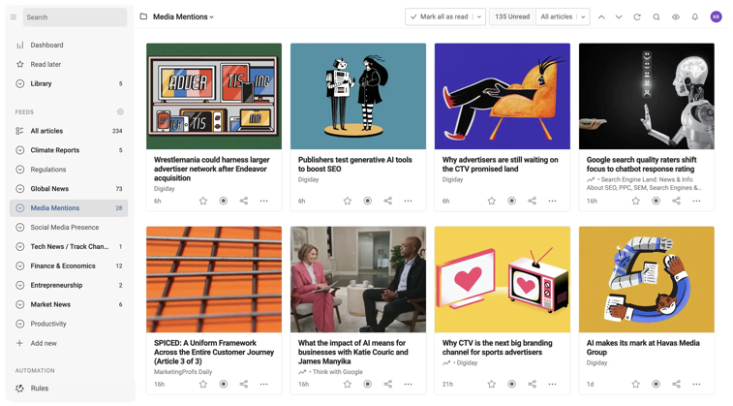

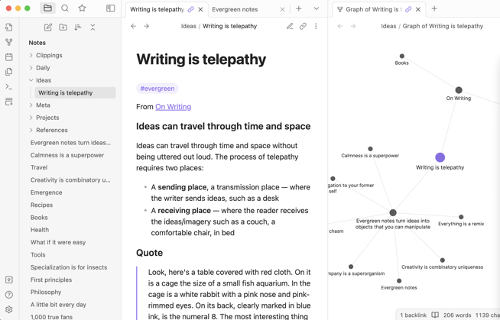
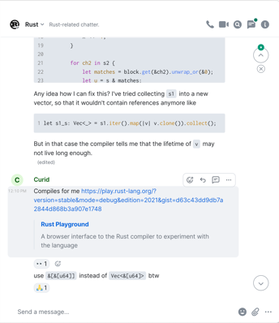

Collect multiple federated services in a single experience
robrix
Microblogs (Mastodon)
Community Forums (Lemmy)
News feeds (RSS)
Code [re]view (git)
Notes
Chat (Matrix)
Potential for
powerful combo features & actions
Notes:
Collect multiple services: ActivityPub (Mastodon, lemmy, code/reviews (github)
Singular identity management via integration with Open Wallet Foundation
----------------
0. Data sovereignty (a user owns their data, can host & manage it, exposed via common federated standard APIs)
1. Place to host code (Gitlab, Github, etc)
2. Place to host chat (Matrix, etc)
3. Place for announcements, micro-blogs (Mastodon, twitter, etc)
4. Place to collect notifications across multiple services (Github updates/following, username tags on GH/matrix/mastodon/etc, replies/DMs on matrix & mastodon,
5. Place to collect discussion forums
6. Place to show news feeds (RSS feeds, etc)
----- Extras: -----
7. Place to host and view notes (Obsidian, Evernote, Google keep, etc)
8. micropayments as a financial "like" (kudos) that can be given for microblogs, release announcements, etc
Key feature: use an OpenWallet single sign-on for all of those services
Potential for novel "combo" features: easily publish tweets/toots on Mastodon and Matrix posts about a GitHub release for your project (then collect financial kudos on any of the three -- see below)

Slide 33

Identity mgmt. via OpenWallet
robrix
Decentralized ID provider
Integrate with client for extra out-of-band functions
Notes:
Singular identity management via integration with Open Wallet Foundation’s work
Robrix can act as a bridge to streamline identity management across many different services, but we will start with Matrix
We hope to integrate OpenWallet into the actual Matrix spec in order to provide a working initial implementation, which is required as part of Matrix’s spec proposal and RFC process
But at first, Robrix will act as the experimental testing grounds for bootstrapping OpenWallet as an identity provider.
If we can integrate this with Matrix’s new MAS architecture (the Matrix Authentication Service), then using a local self-managed wallet to own and provide your identity could be as easy as logging in with SSO like google, apple, etc
Potential for novel "combo" features: easily publish tweets/toots on Mastodon and Matrix posts about a GitHub release for your project (then collect financial kudos on any of the three -- see below)

Slide 34
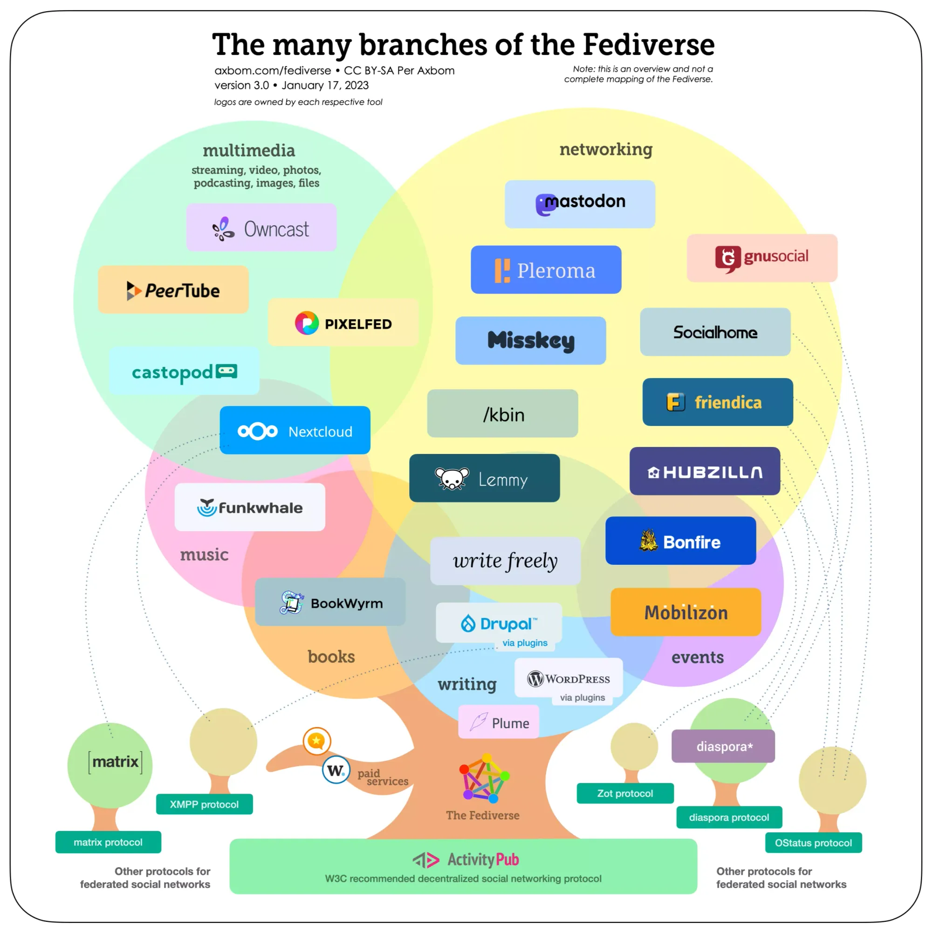
Many other service categories exist
Most based on ActivityPub
Image sharing | Pixelfed
Music sharing | Funkwhale
Podcasting | Castopod
Video hosting | PeerTube
Full blogging | Wordpress, Plume, etc.

Slide 35
make it easier to use & discover decentralized/federated services
35
Notes:
We hope that with these additions, Robrix will make it easier and more inviting to use and discover the vast array of federated services out there across the internet.

Slide 36
Wrapping up, but looking forward
Robrix & Robius are just getting started!
  Many challenges remain: UI design, platform support, build tooling
  Continue driving collaboration with Rust UI/App ecosystem, lang/libs team
Robrix aims to provide value back to the Matrix community
  Not just an app — an external user of matrix-rust-sdk
    An independent, multi-platform test case for the SDK that shows off its power!
    Also a bit of a forcing function for correctness + documentation clarity 😬 😬
  Strives to be a good answer for “how can I use this SDK function”?
    Simple, “non-enterprise” coding style within a fully-fledged app environment
For more, check out two recent blog posts: robius.rs/blog/
  A 2024 retrospective, and 2025 roadmaps for Robius and Robrix

Slide 37













Acknowledgments
Rik Arends
Edward Tan
Alex Zhang
Klim Tsoutsman
Poon Yong Quan (Alan)
Tyrese Luo
Sebastian Michailidis
Julian
Montes de Oca
Cassaundra Smith
Yiming (Aarav) Lu
Guo KeZhen (Cork)
Eddy Bruël
Jorge Bejar

Slide 38






Thanks!
Interested? Please reach out:
@project-robius/robrix
#robrix@matrix.org
#robius@matrix.org
@kevinaboos

