Slide 1


Distributed Databases: Essential or Optional
Peter Zaitsev
Founder at Percona
1 Feb 2025

Slide 2


Databases
Design comes from Single Node Systems (MySQL, PostgreSQL)
Designed to be distributed from day one (TiDB, Yugabyte, Cassandra, Vitess)

Slide 3
Approach to High Availability and Scalability
Replication (multiple complete copies of data, single node execution)
Distributed Databases (multiple partial copies of data with distributed execution)

Slide 4
No Single Node Can run “Facebook”
Distributed System is essential at Scale
Application Level Sharding
“Proxy” Sharding (Vitess)
“Sharding” Built in In the Distributed Database

Slide 5
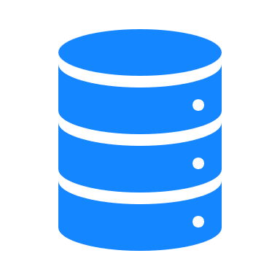


The Tradeoff
Sharding and Efficient Distributed Processing are Complicated
Application Level sharding was employed due to database technology limitations
General Wisdom now – you should not have application developers dabble in distributed data processing

Slide 6
Here comes the “BUT”
1
2
3
Distributed databases are a lot more complicated
Even “Fully Managed” solutions do not solve all the problems
There are more failure scenarios you as application developer have to be aware of

Slide 7
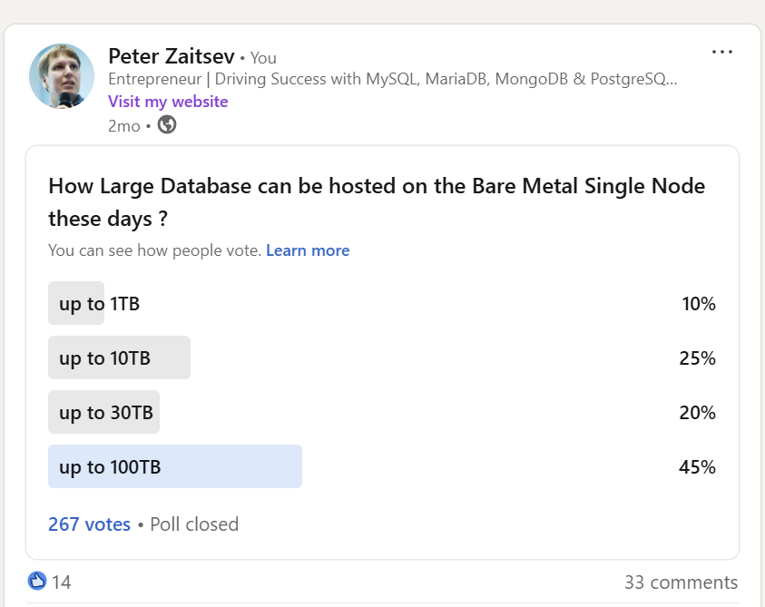
How Large Can you Go?
Notes:
Some suggested over 100TB is well possible

Slide 8
Really Big Iron
AWS: u7inh-32tb.480xlarge
1,920 vCPUs
32TB of Memory
$$$$$$$$$$$$$$$$$$$$$

Slide 9



Modern Commodity Hardware
192 CPU Cores
1.5TB Memory
40GB/sec EBS Storage Bandwidth

Slide 10
Performance and Scalability
1
2
3
Modern MySQL can run 4.000.000+ simple queries per second on commodity single node
Hundreds of Thousands of “Moderate” queries Per Second is More Typical
Note: Scalability is Not Linear and Workload Dependent

Slide 11
Mind Maintenance
Normal Operations can be well performing at 100TB Scale
It is Maintenance what can be a challenge
Adding Index or some other “Rebuild” on 100TB scale using single node resources takes time
Backup/Restores can be problematic
Parallel Execution Capabilities are must

Slide 12
Database Use
Primary Operational (“Place and Order”)
Secondary Operational (“Show ads for related Products”)
Observability (Keeping System Running and Performing)
Analytical(“Monthly Sales Per Country”)
…

Slide 13
Sources/Types of Data
Human Generated Data
“Small Amount”
Machine Generated and Telemetry Data
Can be 10s to 1000s times more

Slide 14
Types of Applications
Self Hosted for Internal Use (Your internal JIRA Blog)
Small Web Applications (Your Company Blog)
Multiple Enterprise Clients (Salesforce)
Massive “Public” Applications (TikTok, Facebook)

Slide 15




Distributed Databases Need
Self Hosted for Internal Use
Typically not Needed
Small Web Applications
Typically not Needed
Multiple Enterprise Clients
May be Needed for Larges Tenants and Cross Tenant Functionality
Massive “Public” Applications
Typically Essential

Slide 16
The Challenge
Some developers choose “web scale” database, they do not need, others are cut off-guard by having picked database which does not scale

Slide 17
Not “One Choice Fits everything”
Many Organizations chose to use both Single Node and Distributed Databases for Different Applications and Data Processing Needs

Slide 18
Let’s Connect!
https://www.linkedin.com/in/peterzaitsev/
https://twitter.com/PeterZaitsev
http://www.peterzaitsev.com

Slide 19
THANK YOU!
percona.com

