Slide 1



Advanced Test Harness Infrastructure for Validating ARM and FPGA-based Systems
Ștefan Răus
Notes:
Hello everyone and thank you for joining me today at FOSDEM 2025.
My name is Stefan, and I’m leading one of the DevOps teams from Analog Devices and I’m excited to present you today an automated way of testing a custom Linux Distribution across a wide range of hardware platforms.

Slide 2
The Need
Quality
Performance
Testing
Integration
Automation
Manual
Testing
Regression
Testing
Smoke
Testing
Integration
Automation
Security
Testing
Continuous
Testing
Unit-level Tests
Notes:
This presentation is focused system-level testing, showing its importance in software and hardware integration.
To ensure that all individual software components work together, there is required a robust testing infrastructure.

Slide 3

Quality
Performance
Testing
Integration
Automation
Manual
Testing
Regression
Testing
Smoke
Testing
Integration
Automation
Security
Testing
Continuous
Testing
Unit-level Tests
The Need
Notes:
Some key attributes like “integration”, "automation" or “coverage" are some of the “must-have”s to deliver high quality products.
A reliable testing infrastructure, besides accelerating tests execution, it also reduces the probability of finding bugs in “Production”.

Slide 4







Analog Devices Kuiper Linux
Free, open-source Embedded Linux Distribution
Based on Debian, but customized ADI products, including:
  1300+ Linux Device drivers for Analog Devices products
  Pre-built boot files for 140+ FPGA-based platforms and 30+ RPi-based designs
  Development applications and tools, software libraries and a variety of examples for quickly ramping up projects
Zynq
Zynq MP
Versal
Arria10 SOC
Cyclone5 SOC
Agilex
Raspberry
Pi 2, 3, 4, 5
  GitHub Repo: https://github.com/analogdevicesinc/adi-kuiper-gen/tree/staging/kuiper2.0
  Kuiper Overview: https://www.analog.com/en/resources/evaluation-hardware-and-software/embedded-development-software/kuiper-linux.html
  FOSDEM Optimizing Kuiper Linux release: “Refining the Release Strategy of a Custom Linux Distro”
Kuiper sources
Configure & Build
ADI Linux Package Repo
Triggered @PRs/pushes
Packages
Metadata
Dependencies
Build status back to GitHub
1 February 2025
Notes:
The custom Linux distribution I’m talking about is called "Analog Devices Kuiper Linux“ and it is a free, open-source distro, customized for Analog Devices signal chain. Kuiper Linux comes pre-equipped with essential components, like device drivers, pre-built boot files for Analog Devices solutions, as well as a wide range of development utilities, libraries, and a lot of examples.
The system supports multiple hardware platforms - AMD and Intel FPGA-based platforms, Raspberry Pi and also , recently, NXP.
To streamline the software management, Kuiper Linux incorporates a custom Linux Package Repository. This is included by default in the Kuiper Linux image, ensuring ease of use for both - “Testing” and “Production” environments.
For more details regarding how Kuiper release process got optimized, you can see the talk “Refining the Release Strategy of a Custom Linux Distro” presented by my colleague, Andreea, from 6:00 PM, also in “Testing and Continuous Delivery” thread.

Slide 5






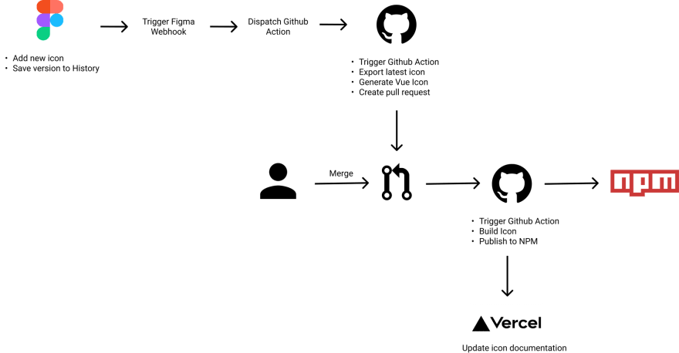






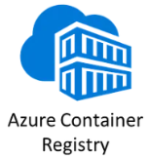


Software Components’ CIs
Build &
Run Unit Tests
Artifactory
Triggers: GitHub PRs / pushes / tags or manually
Linux Package Repository
GitHub
Artifacts
Notes:
The continuous integration flow for individual software components is done using the classic CI tools, such as Jenkins, Azure Pipelines or GitHub Action.
The CIs builds software components across various operating systems and the resulting output binaries, which might be Linux Packages, Windows Installers or just archives, are saved in GitHub Releases, Package Manager or internal servers.
This streamlined approach not only improves efficiency but also ensures traceability, version control, and artifacts accessibility, making it easier to integrate and deploy those into the larger systems.

Slide 6


Hardware Testing Flow
Artifacts from Internal Servers
D
Run on each hardware setup
HDL Build
Setup HW boards with specific boot files
Run Custom
Automated Tests
Log Results
Linux Build
Developer
Notes:
The testing process in hardware closely mirrors the one in software.
The workflow typically begins with specific boot files being written onto the hardware boards and configure them for testing.
Automated tests are executed in parallel across multiple hardware setups, reducing in this way overall testing time and increasing efficiency.
Because popular testing frameworks available in the market are typically designed – even for application-level testing – even for one single hardware platform - we have created our own testing framework, called "Hardware Test Harness”.
It is designed to unify testing across a wide range of hardware platforms, enabling consistent execution.

Slide 7

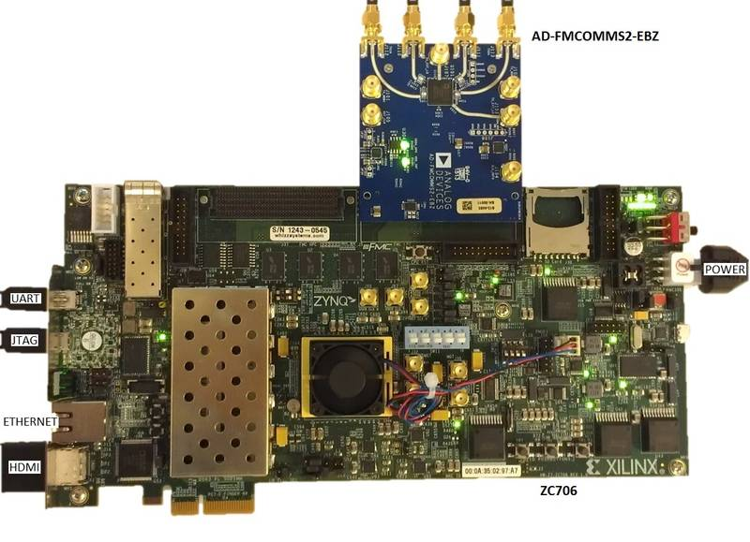
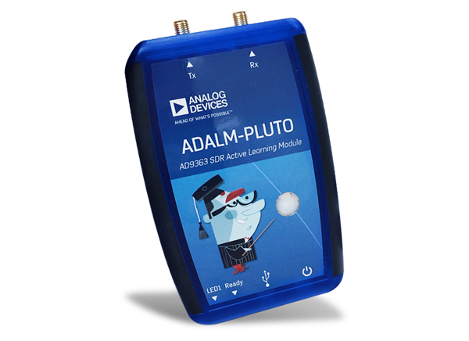

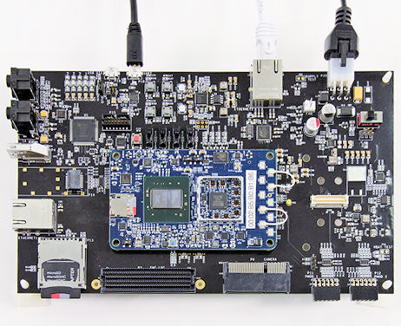
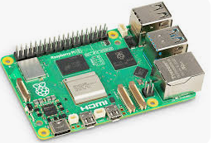


Hardware Test Harness Topology
Jenkins
Agents
Hardware
Setups
Jenkins
Server
HW Connect
Build
Servers
Run Job
Run Job
HW Connect
Run Job
Pushes PRs
HW Connect
Notes:
Builds are triggered by pushes or Pull Requests in GitHub. Multiple repositories are monitored – like HDL, Linux, libraries or applications - and changes in any of them will trigger the entire testing process –
Once the builds passes, the resulted binaries are saved on internal servers - in this case JFrog Artifactory – and then the main Jenkins job is triggered.
The main Jenkins job begins by downloading the binaries from Artifactory and writing them onto the hardware platforms that are connected to each agent.
After this, the automated tests are distributed and executed. These automated tests are mostly written in Python and have specific tags to indicate hardware compatibility.

Slide 8
Hardware Test Harness Topology
Jenkins
Agents
Hardware
Setups
Jenkins
Server
HW Connect
Build
Servers
Run Job
Run Job
HW Connect
Run Job
Pushes PRs
HW Connect
Notes:
Why do you think we need an intermediate Artifactory server?
Well – the intermediate server is required for several reasons:
- the main one is that the Hardware Test Harness is distributed across multiple physical locations, requiring a centralized system to share binaries
another one is to handle concurrency – since multiple repos are implied, so this server will act as a buffer
and it ensures also better organization and versioning of binaries, making the process more scalable

Slide 9
Hardware Test Harness Topology
Jenkins
Agents
Hardware
Setups
Jenkins
Server
HW Connect
Build
Servers
Run Job
Run Job
HW Connect
Run Job
Pushes PRs
HW Connect
Notes:
The Jenkins Agents needs to be physical machines…
Can you guess why?
The primary reason is that these agents directly control the hardware setups, including power management, UART connections, Ethernet, and in some cases JTAG interface.
What about the build server? Any guess why it’s not just a cloud VM?
Build servers needs in the local network - even if they are physical or virtual machines - because the builds require a lot of computational resources and specific licenses – a good example are the FPGA projects – requiring Xilinx or Quartus license.

Slide 10
Managing automated tests
Source
Test Pipeline
Test Executor 1
Target Board 1
Test Manager
Test Executor 2
Target Board 2
Results
Test Executor 3
Target Board 3
Test triggers
(scheduled, manually,
GH hooks)
Power
10
Notes:
A good framework should be adaptable to different types of hardware and testing scenarios.
It should be modular enough to accommodate changes, such as adding new Device-Under-Tests or modifying test cases.
Many times, there is necessary a test manager to queue, distribute and execute tests
I will come back to this… let’s go first through some implementation details.

Slide 11

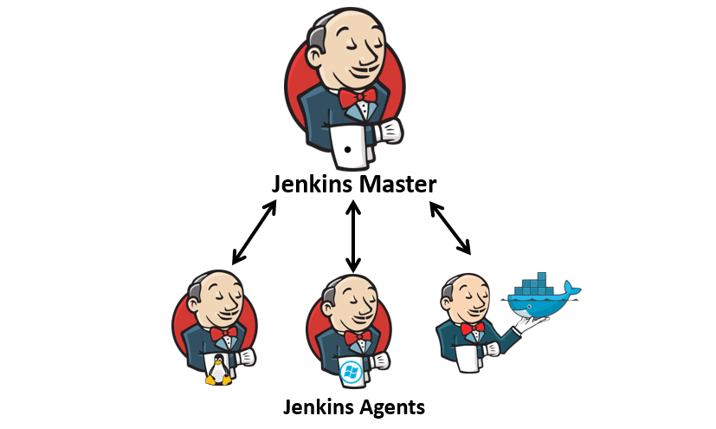
Tools Used
  Jenkins
  Can be hosted without external servers
  No requirement on source control
  Better cross project flows
  Easy integration with different tools
  Declarative / Scripted groovy pipelines
  Big online community and many plugins
  JSL, DSL, triggering, locking resources
11
Notes:
As main tool, there was used chosen Jenkins.
- It can be hosted independently without relying on an external server
- integrates easily with tools like GitHub, or Artifactory
- and benefits from a very large online community for support.
Additionally, Jenkins Shared Library, Dynamic Script Language, and Resources Locking proved to be extremely useful for our usecase.

Slide 12
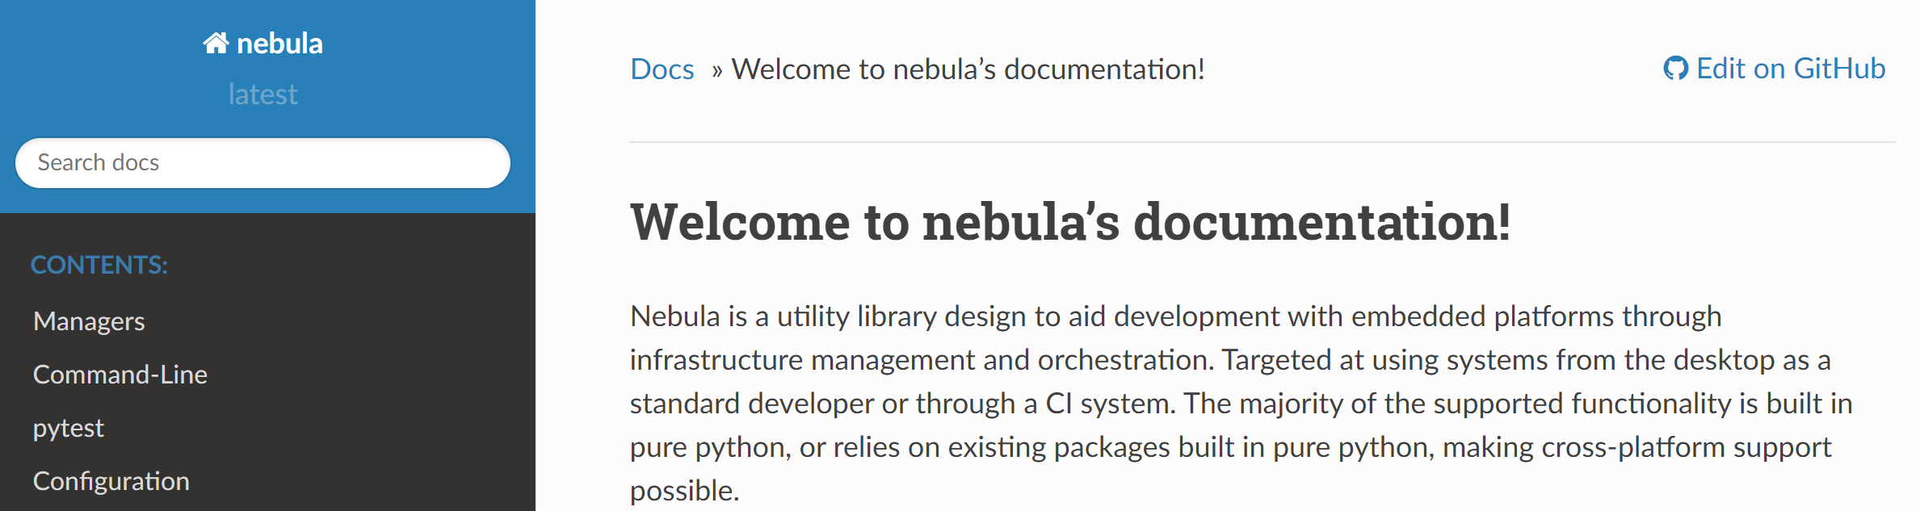
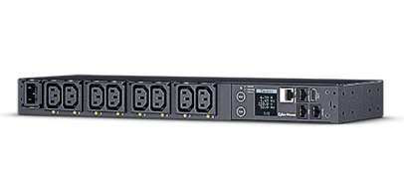
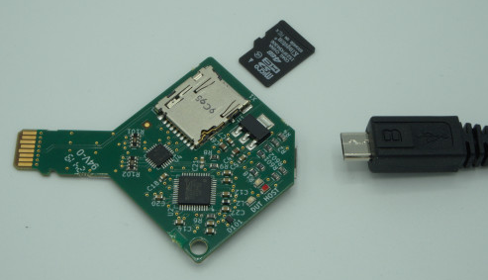
Tools Used
Nebula
  “In-house” developed tool, written in pure python
  Library for managing hardware setups interfaces, such as UART, JTAG, Ethernet, USB, PDU etc
  Designed to handle booting process for different hardware platforms in different ways and with different failure modes
  Manages the situation when hardware setups hang on booting, or binaries to be tested are broken
Manager for:
https://nebula-fpga-dev.readthedocs.io
UART
Ethernet
JTAG
PDU
USB
Others
Notes:
Another tool used is “Nebula”.
This tool was developed by us and consists in a collection of Python scripts that manage hardware connections, such as sending UART commands, configuring Ethernet IPs, sending files through SSH, and so on.
By using the "Power Distribution Unit“s and "USB-SD Card MUX“s – both being available to buy on the internet - we have the full control completely remotely. Hardware setups can be physically rebooted and we can overwrite the whole SD card.
More than that – since both of them can be controlled through Python, we have integrated them in Nebula – so we covered in this way the situation when hardware setups goes into bad states.

Slide 13
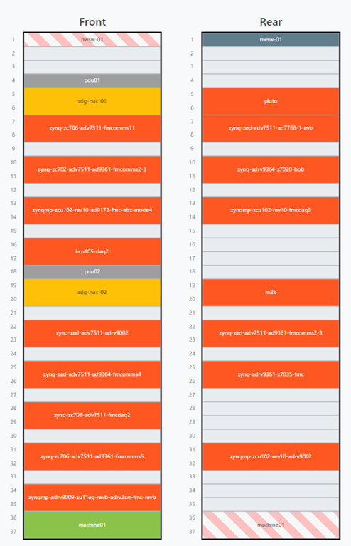

Tools Used
NetBox
Organizes the DUTs, Jenkins agents, PDU outlets, Ethernet switches and other connections in the test harness
Used to generate nebula-config.yml which contains information about DUTs, such as:
  platform, board connected to it
  boot files used from SD Card
  Ethernet and serial addresses
Requires maintenance only if there are changes in the hardware setups (DUTs added / removed / rearranged)
https://netboxlabs.com/docs/netbox/en/stable/
13
Notes:
As we added more hardware setups, we needed a tool to keep tracking of all the "Devices Under Test" and that's where NetBox comes in.
NetBox is a free, open-source tool originally designed for modeling and documenting network racks, but it also fits our use case perfectly.
We use it to generate Nebula configuration files — YAML files that contain information about every DUT - as platform, the board plugged into it, IP address, PDU outlet, and USB connections.
The NetBox configuration needs to be updated only when new DUTs are added, removed, or rearranged.
All data stored in NetBox is backed up to Artifactory, and it can be restored easily if something goes wrong.

Slide 14

Tools Used
Jenkins Shared Library
JSL is a groovy library for automating test execution and managing pipelines
Comprehensive library that handles setting up virtual environments, locking resources, executing tests, and collecting results
Some examples where JSL is used:
  Update agents’ tools (nebula, docker)
  Update BOOT files
  Log test result artifacts
https://github.com/sdgtt/jenkins-shared-library
14
Notes:
Jenkins Shared Library is a very good way to centralize groovy code and reuse it in multiple Jenkins pipelines.
It contains definition for common functions and pipeline steps that can be shared across different Jenkins files, improving reusability, modularity, and consistency.
We use it in multiple pipeline stages to:
update agents’ tools (such as nebula), send files to HW setups, running tests and collecting logs
This approach ensures an efficient process of updating and maintaining the same pipeline functionality across all Test Harness instances.

Slide 15


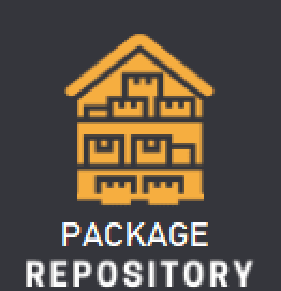

Continuous Testing
Send hardware tests results back to GitHub CI status
GitHub repos
HDL
Linux
libraries
applications tools
Hardware
Test Harness
Build & Run
Unit tests
Triggered by PRs and pushes
Built Artifacts
Send build status and unit-level tests results back to GitHub
Build Kuiper Linux sources and add SW components
Send hardware tests results back to GitHub CI status
Notes:
By extending the previous Continuous Integration diagram to cover also testing, this is how it looks like.
Behind it, there are few tens of build pipelines, implemented in Azure, GitHub Actions or Jenkins, and over ten physical build servers.
For most of them, besides the build status, also test results from hardware testing is sent back to GitHub.
Some software components, such as libraries, are tested individually on hardware. If all tests pass successfully, the corresponding binaries are stored in Artifactory or Linux Package Repository. In other cases, the artifacts are first stored in Artifactory and tested afterwards.
Linux packages are created automatically at each push. Ideally, those packages will be uploaded automatically under "Testing" environment. From there, they can be installed on Kuiper Linux for further testing or just used internally as pre-released versions.
On the other side, whenever there are changes in the Kuiper sources, new Docker Containers are created, being used by other CIs. This ensures that everything is consistently built and validated across environments.

Slide 16
Accessing tests results
Notes:
Let see now how the results visualization was handled.

Slide 17
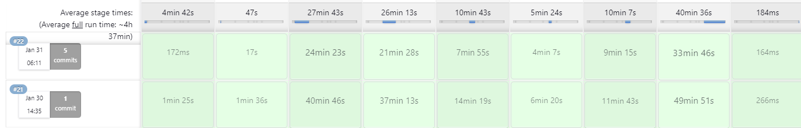
Accessing tests results
Notes:
The easiest way was to manually verify status of Jenkins pipelines.
This method didn’t give us any details about what stage failed and on which hardware setup, and no overview on tests results.

Slide 18
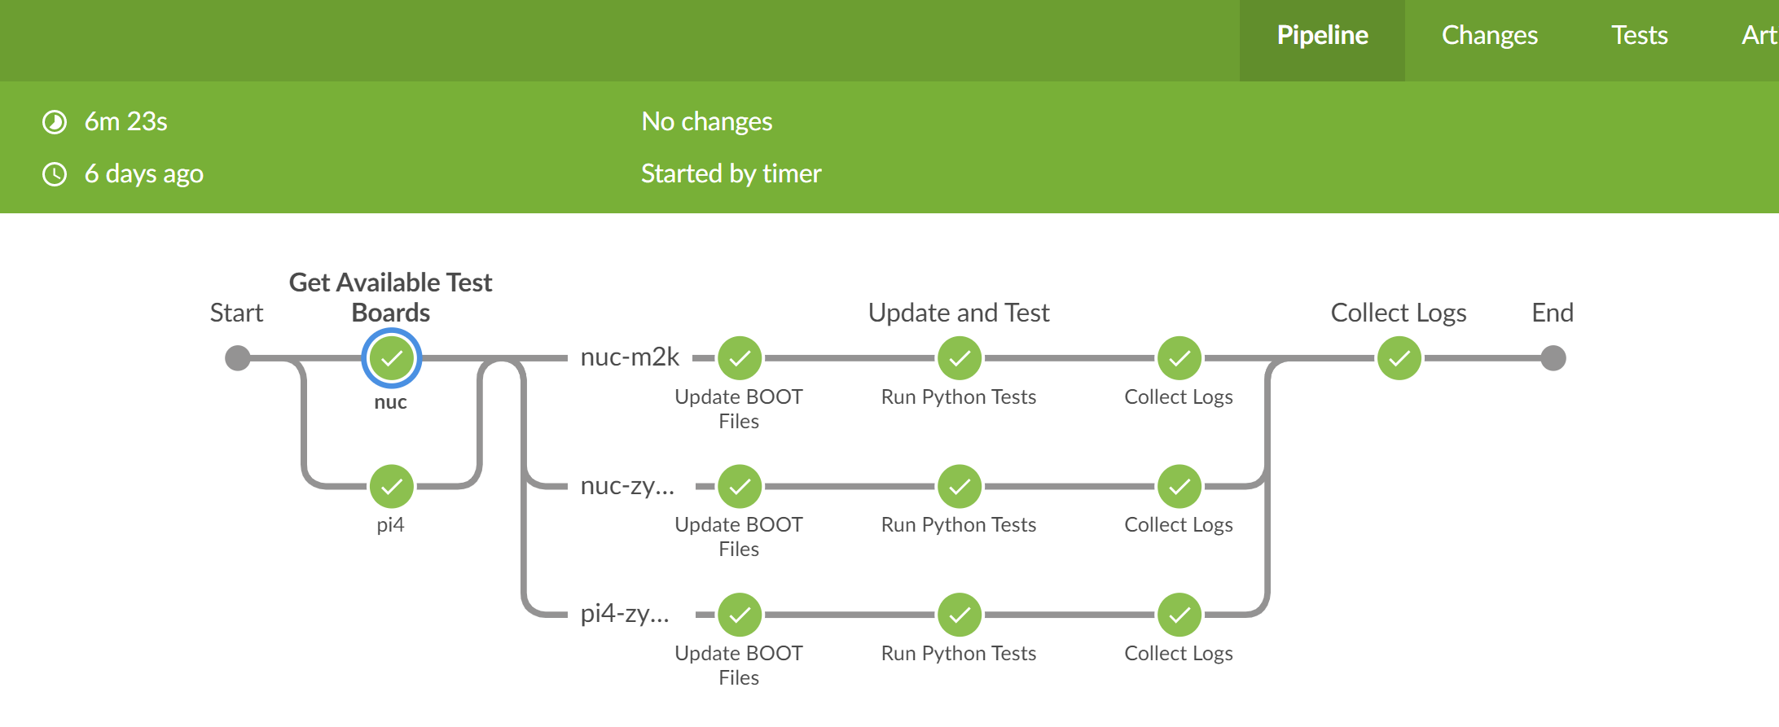

Accessing tests results
Jenkins
Blue
Ocean
Notes:
So, we switched to Blue Ocean view. A bit better, right?
For those who don’t know, Blue Ocean is a jenkins plugin that offers a good visualization of parallel stages.
We could see now the status of al the stages on all the hardware setups, becoming a bit easier to know what failed and why.

Slide 19
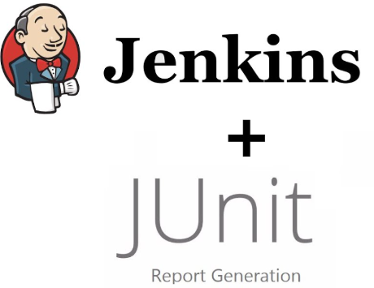
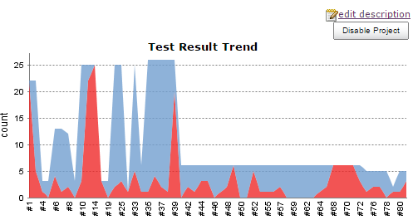
Accessing tests results
Notes:
But still couldn’t see all the details.
So the next step was to converted results in XML and use JUnit Jenkins Plugin for visualization.
But even so, this method requires logging into jenkins and visually inspect the results at every run.

Slide 20
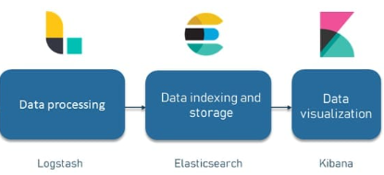
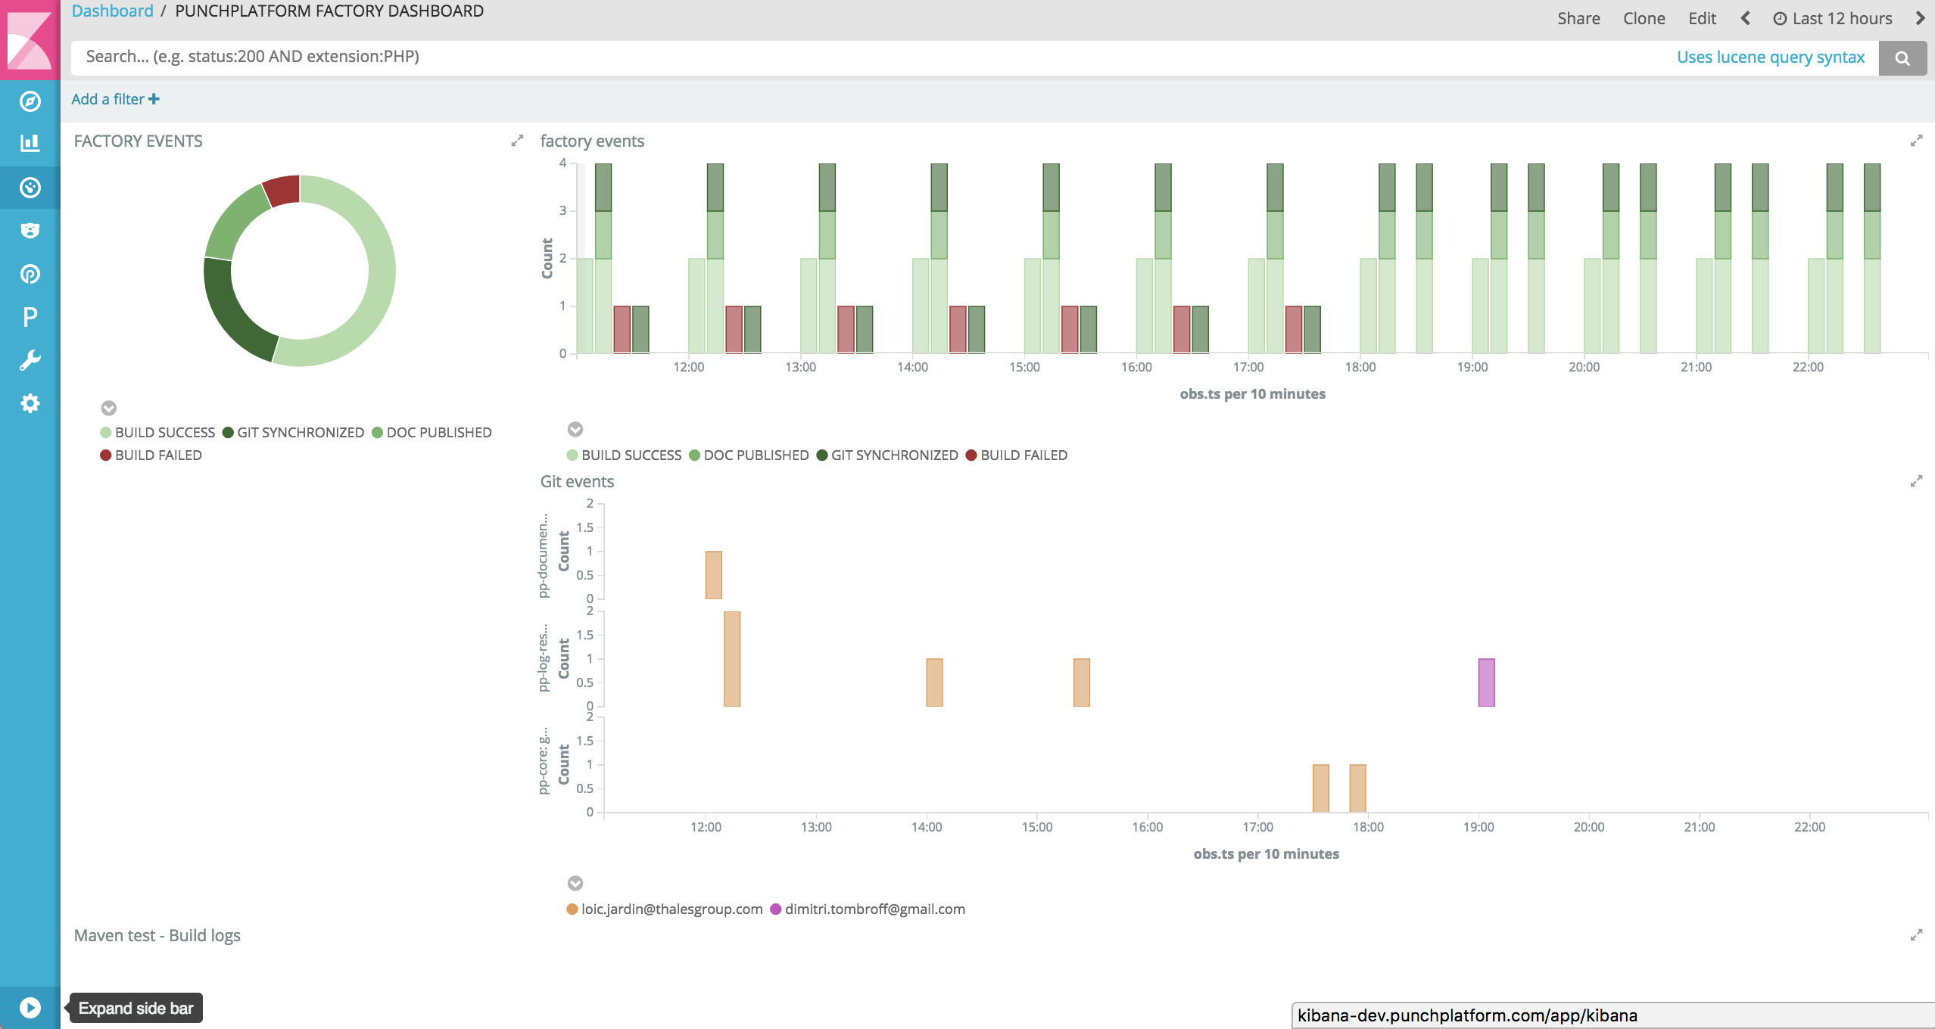
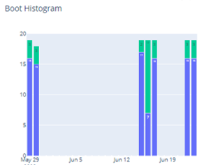
Accessing tests results
Notes:
We have started to use even more powerful tools.
Log Stash for processing results, Elastic Search for storing them in database and Kibana for generating graphs.
At this point we also created a webpage with multiple dashboards, and we introduced the ability to create and apply filters.
This new implementation eliminates the need of going through each jenkins job to see results details.
But developers where still needed to look over the graphs to check the status before pushing their changes.

Slide 21
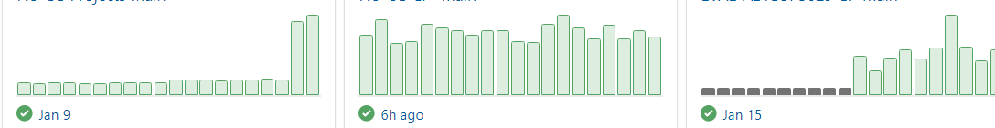
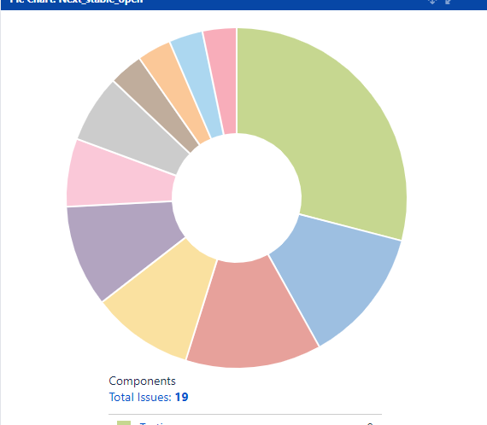
Accessing tests results
Notes:
So actually… in all the cases, developers were still needed to manually look over the results – even if the results were shown in a nice way - tables, graphs or dashboards
It was not feasible to handle a big number of repositories and Pull Requests in this way… and we were needed to close the loop completely.

Slide 22
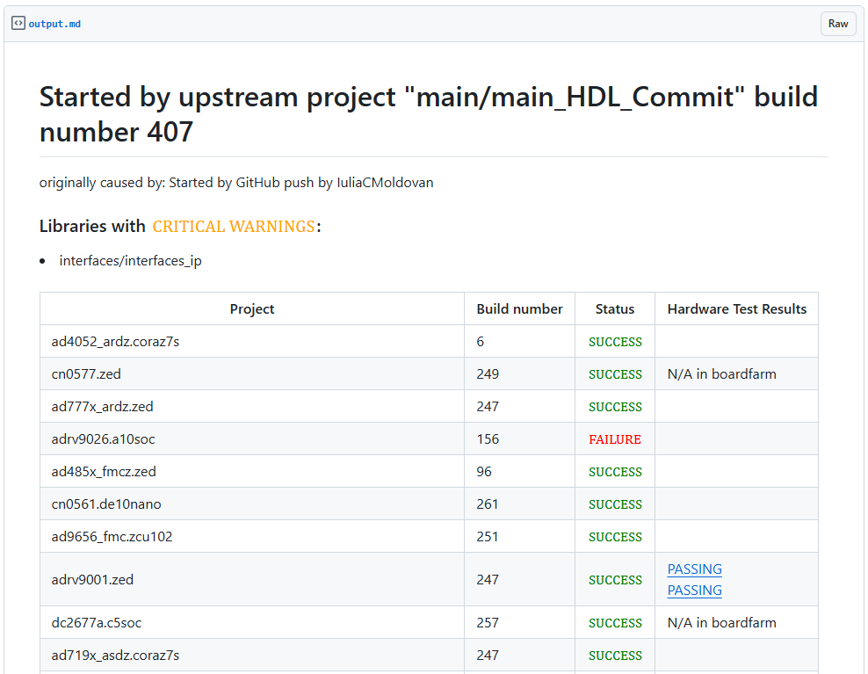
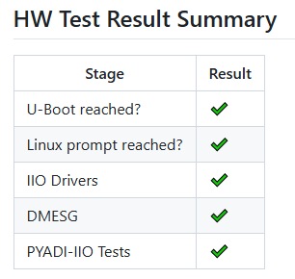
Accessing tests results
Notes:
The most important step in the implementation was to bind hardware tests results back to the GitHub Pull Requests.
The main challenge was to ensure that private data from our internal build & test environment — such as internal IPs, Jenkins links, or any other sensitive information — would not be exposed in public repositories. At the same time, it was very important to provide sufficient information about the build status and testing results to aid developers.
The answer was GIST, combined with secure SSH tunneling !
With this system in place, we were finally able to enable "Require CI Status to Pass" setting on GitHub repositories. This ensures that only changes that pass builds and don’t broke automated tests are allowed to be merged, increasing the overall stability and reliability of the codebase.

Slide 23
Recovering hardware setups
Start with a valid setup (“golden boot files”)
With UART or SSH
Write binaries produced by PRs/commits pushed and hit a physical reboot
NO
YES
Does the board
booted fine?
Check with UART or SSH
Starting “Recovering procedure”
Sanity check to verify the board booted fine
Use JTAG or USB SD Card MUX
Write again “golden files” and reboot
New changes didn’t affect the booting. Overwrite “golden boot files” with latest ones that passes.
NO
YES
Does the board
booted fine?
HW setups got broken
*Single situation that requires manual intervention
Sanity check verify that the board booted fine
Run python automated tests
New changes broke the booting flow
Publish results to GitHub as a GIST
Notes:
The final step needed to achieve a fully automated testing framework was to implement a mechanism for recovering hardware setups from bad states.
One common issue arises when boot files produced by the CIs are faulty. In this cases, hardware setups can hang during the boot process and remain stuck. The framework detects these failures and attempts to recover the affected boards through various methods.
As part of this process, we maintains a set of "golden files“ — a reliable baseline of boot files that are overwritten with the latest set of files that passes successfully. They serve as a fallback option, allowing to set the hardware setups back up and running, and – of course – to be prepared for next set of files to test.
However, the rare scenario when the hardware setups are physical damage, remains the single situation that requires manual intervention.
This recovery mechanism ensures that the testing framework remains resilient, minimizes downtime, and increase the efficiency of testing framework.

Slide 24


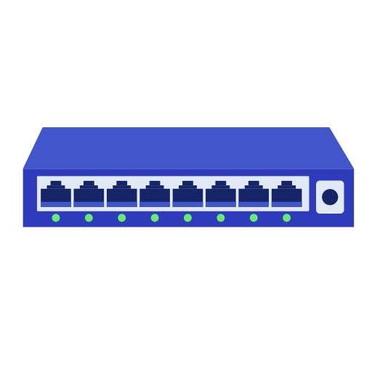


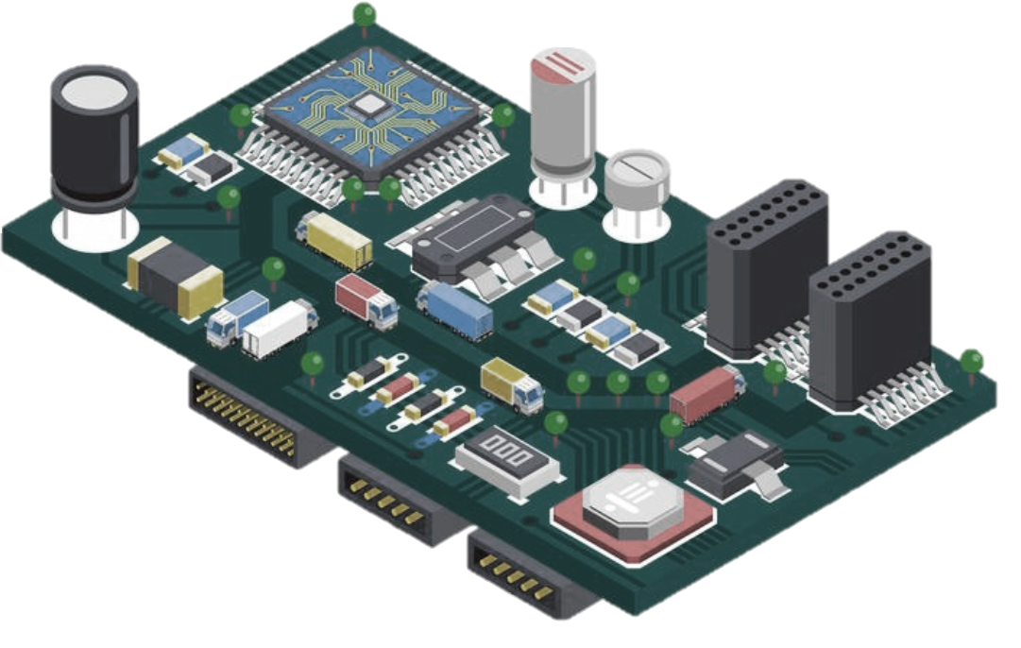
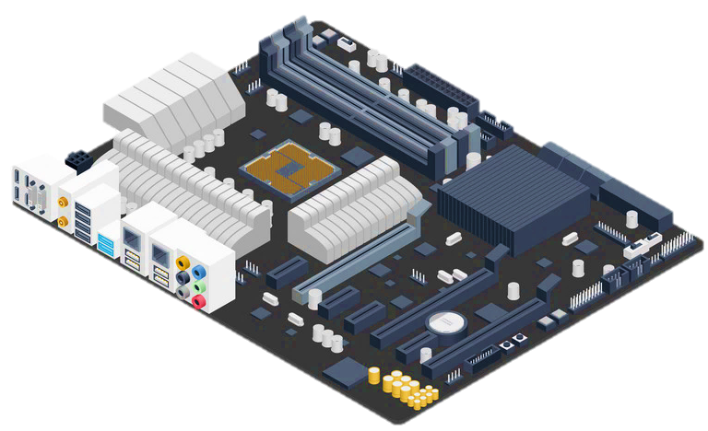
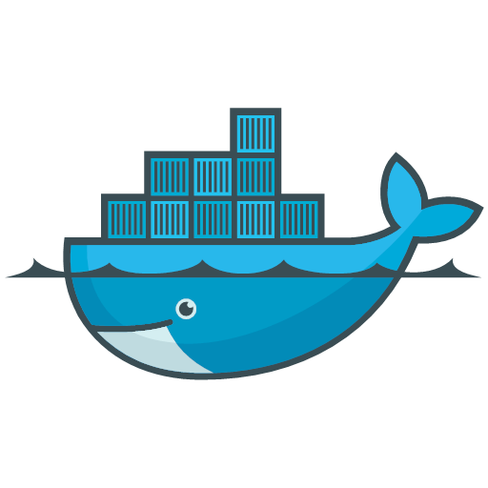




Hardware Test Harness Design
Jenkins File /
Test Pipeline
Network
Switch
C / C++ Tests
Connections
Network
UART
JTAG
PDU
Jenkins Agents
Pytest
Python Tests
MATLAB
Tests
Jenkins Server /
Test Manager
Nebula
Telemetry
Docker Containers
Devices Under Test
Test Executors
Test Triggers
(scheduled, human, PR / push hooks)
Tests Results
PDU
Elastic
Search
Kibana
Jenkins
Blue Ocean
Notes:
Now that I have gone through all the details, let’s see how the overview design looks like!
On the left side, you can see the triggering mechanism, multiple jenkins files and Jenkins server. The server manages the testing requests queue, ensuring efficient resource allocation – and also merges results from all test harness instances and prepare them to be published.
Then are the jenkins agents - by deploying agents inside Docker containers, we’ve successfully connected multiple hardware setups to a single physical machine, optimizing resource usage.
Test harness supports tests written in different programming languages as Python, C, C++, or MATLAB.
Hardware boards are locked only while tests are running on them. Otherwise, they remain accessible for remote connections, allowing team members to perform debugging or development work.
Test results are well-structured and presented clearly, ensuring that any defects are identified and addressed in early stages.
This comprehensive system increases efficiency, maintains stability, and enhances the overall reliability of the testing process.

Slide 25




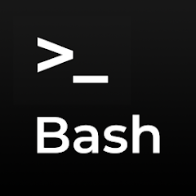
Hardware Test Harness in Real World
Notes:
But… let’s see how the hardware setups look in real life.

Slide 26
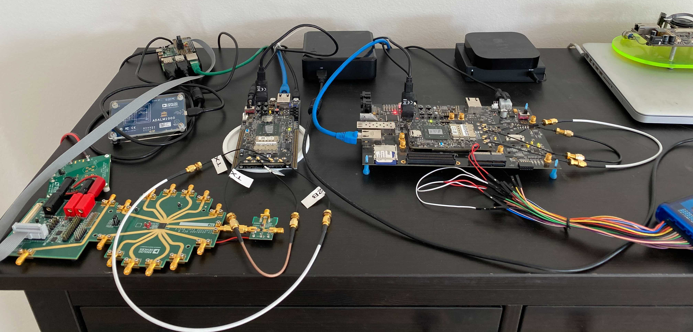
Hardware Test Harness in Real World
Jenkins
agent
Ethernet
Switch
RPi 4
M1K
ADRV9361s
M2K
ADAR100
Notes:
This is how the prototype looked in early beginning stages.
There were just a few hardware boards connected and lying around on a desk.
At that point, we were working on adding support for multiple platforms and using Raspberry PIs as Jenkins agents?

Slide 27
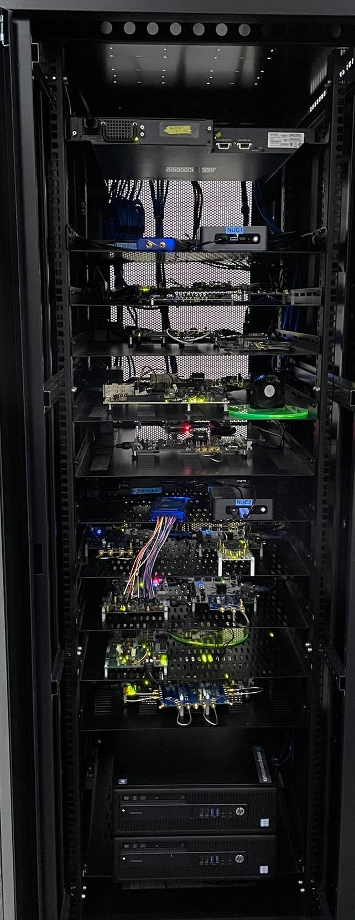
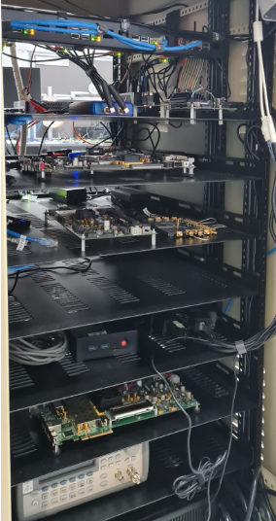
Hardware Test Harness in Real World
Jenkins
agent
Ethernet
Switch
RPi 4
M1K
ADRV9361s
M2K
ADAR100
Notes:
And this is how Test Harness looks now.

Slide 28
Conclusions
Hardware Test Harness:
- supports multiple platforms (FPGA- and ARM-based)
- tests can be written in different languages (C/C++, Python etc)
- complex triggering mechanism
- managed queue
- distributed across different physical locations
- robust recovery mechanism
- well-structured results returned in GitHub
Notes:
In conclusion:
- We have managed to implement a complex testing framework that can be triggered from multiple GitHub repos but still keeping Cron and manuall triggers.
- hardware setups remain accessible for remote connections, allowing colleagues to perform debugging or development.
- it supports multiple platforms and can run tests in different languages.
The resources got optimized by using Jenkins agents inside Docked containers
- and there is a robust recovery mechanism in place, where manual intervention is required only in exceptional situations.
- Also, the test results are well-structured and bind back to GitHub, ensuring that bugs are found as early as possible.
So, that’s how we streamlined the software and hardware integration and the testing process.

Slide 29
Thank you !
Email: stefan.raus@analog.com

