Slide 1
The Art of Fleet-Wide Kubernetes Observability: 3 Core Strategies
FOSDEM 2025
Monitoring and Observability Track
Pratik Panda
Site Reliability Engineer, RedHat
Mitali Bhalla
Site Reliability Engineer, RedHat
Notes:
Coming from our experiences of working on a large fleet of K8s clusters as a managed service, this talk will provide insights into scaling and managing fleet wide observability effectively.

Slide 2
Agenda
What is Fleet-Wide Observability?
The Observability Challenge at Scale
Looking at the 3 Strategy
  Metrics: Identifying What Matters
  Alerts: From Noise to Actionable Signals
  Correlation: Connecting the Dots
Implementing Fleet wide Observability
Looking Ahead – The Future of Observability
Q&A

Slide 3
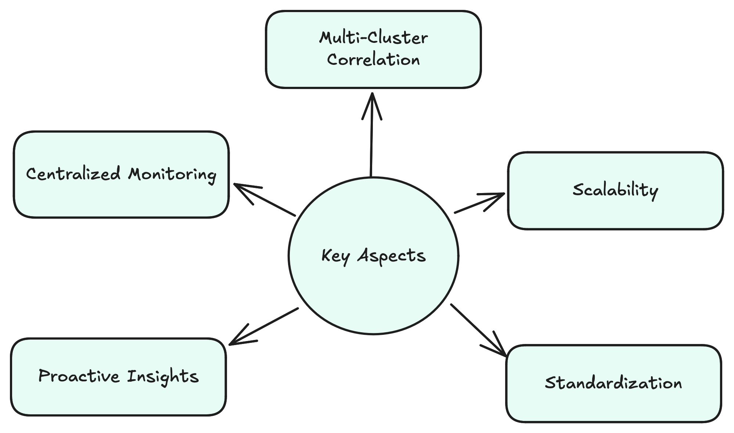
What is Fleet-Wide Observability?
Notes:
"Fleet-wide observability is the ability to monitor, analyze, and derive insights across a distributed fleet of Kubernetes clusters, applications, and infrastructure in a unified and scalable manner."
Centralized Monitoring:
Single-pane-of-glass visibility into all clusters and workloads.
Cross-Cluster Correlation:
Identify patterns and anomalies across multiple clusters.
Scalability:
Handle metrics, logs, and traces from thousands of nodes and applications.
Proactive Insights:
Detect, predict, and resolve issues before they impact the system.
Standardization:
Use consistent frameworks for metrics, logging, and tracing across the fleet.

Slide 4
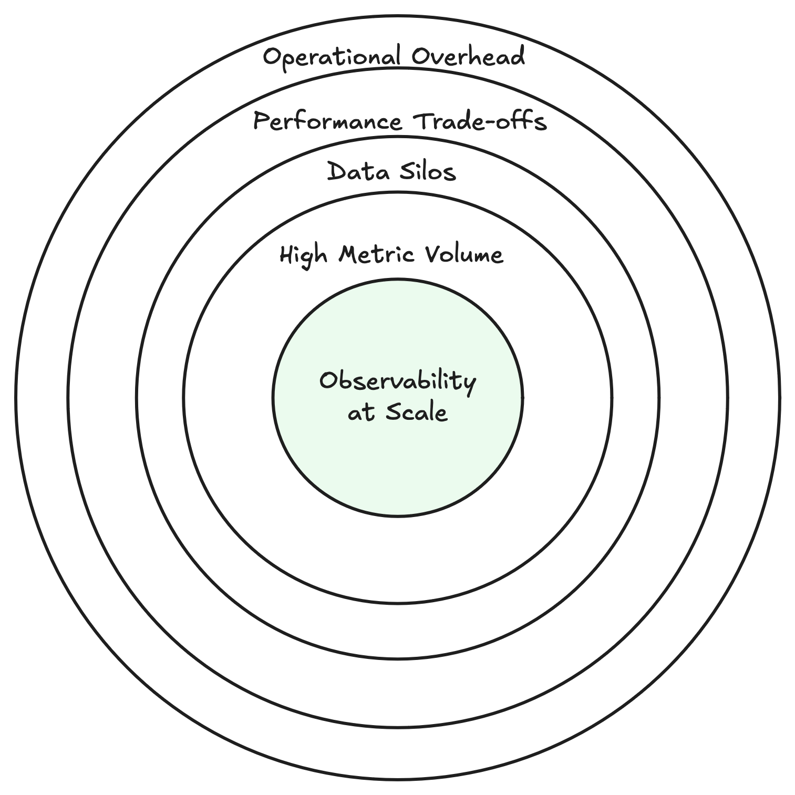
The Observability Challenge at Scale
Notes:
High Metric Volume
"Millions of data points generated across clusters every second."
Impact: Hard to differentiate between meaningful signals and noise.
Data Silos
"Metrics, logs, and traces stored in fragmented systems."
Impact: Cross-system troubleshooting becomes slow and inefficient.
Performance Trade-offs
"High cardinality metrics strain storage and processing."
Impact: Increased costs and delayed analysis.
Operational Overhead
"Maintaining consistency across diverse environments is complex."
Impact: Manual efforts reduce reliability and scalability.
Scaling observability isn’t just about collecting more metrics—it’s about managing complexity, ensuring consistency, and driving actionable insights from data without overwhelming teams or systems

Slide 5
Metrics: Identifying What Matters

Slide 6
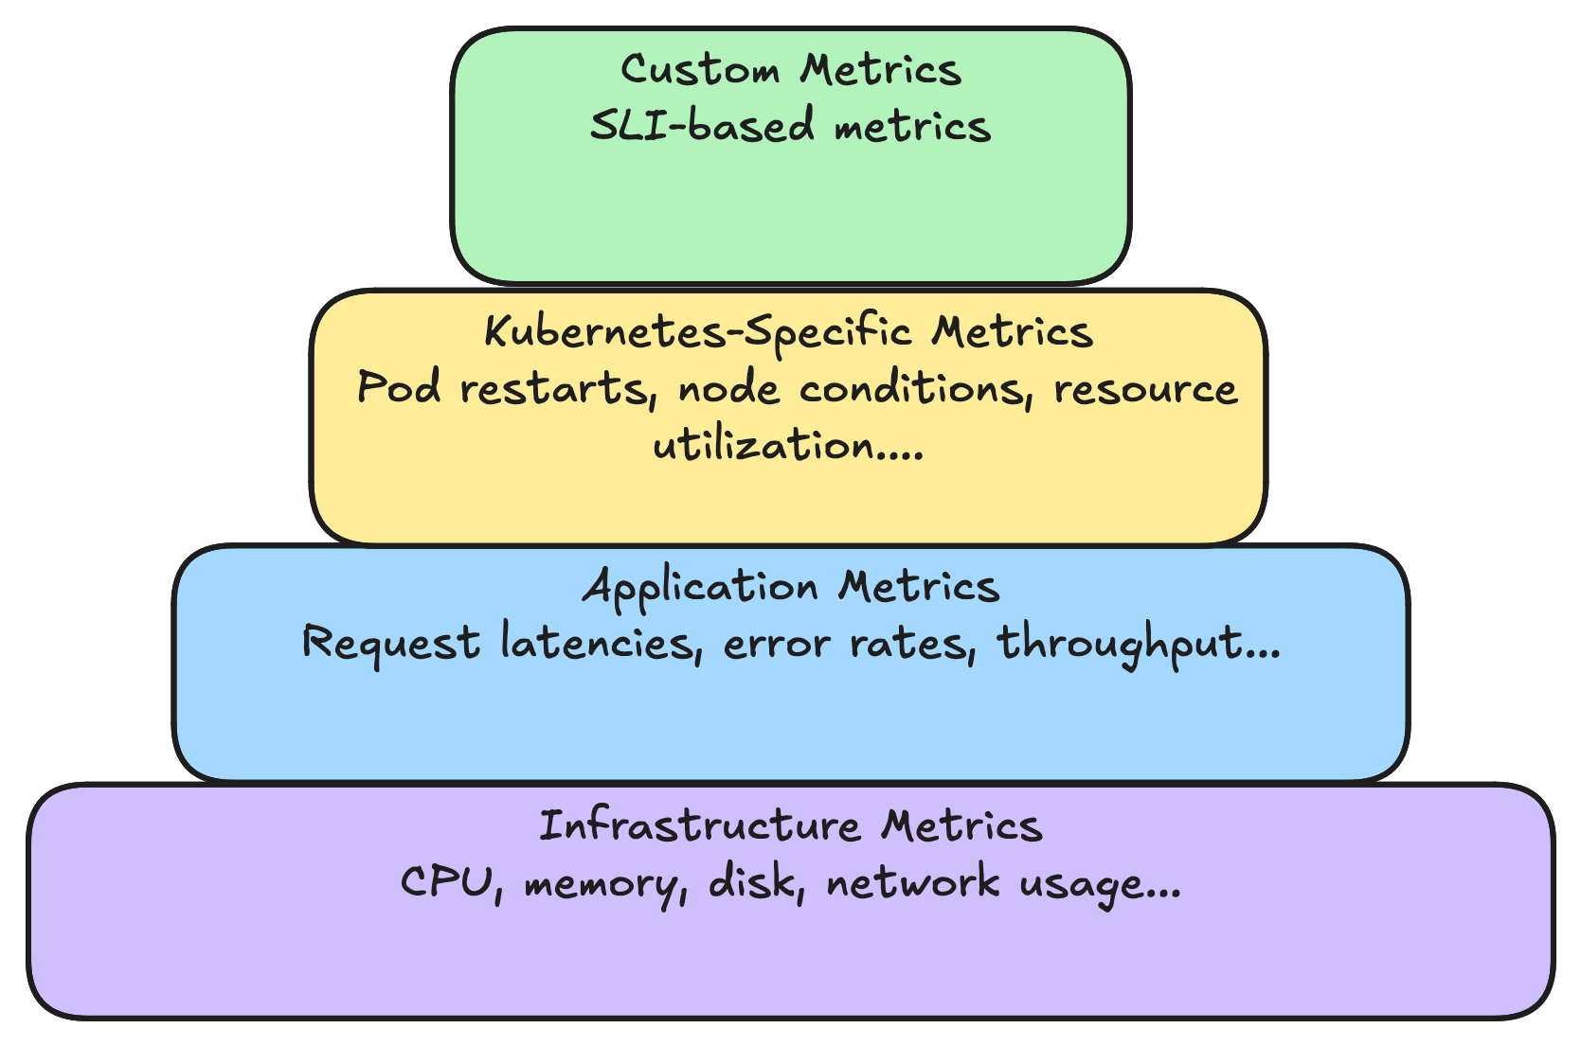
The Metrics That Matter in Kubernetes

Slide 7
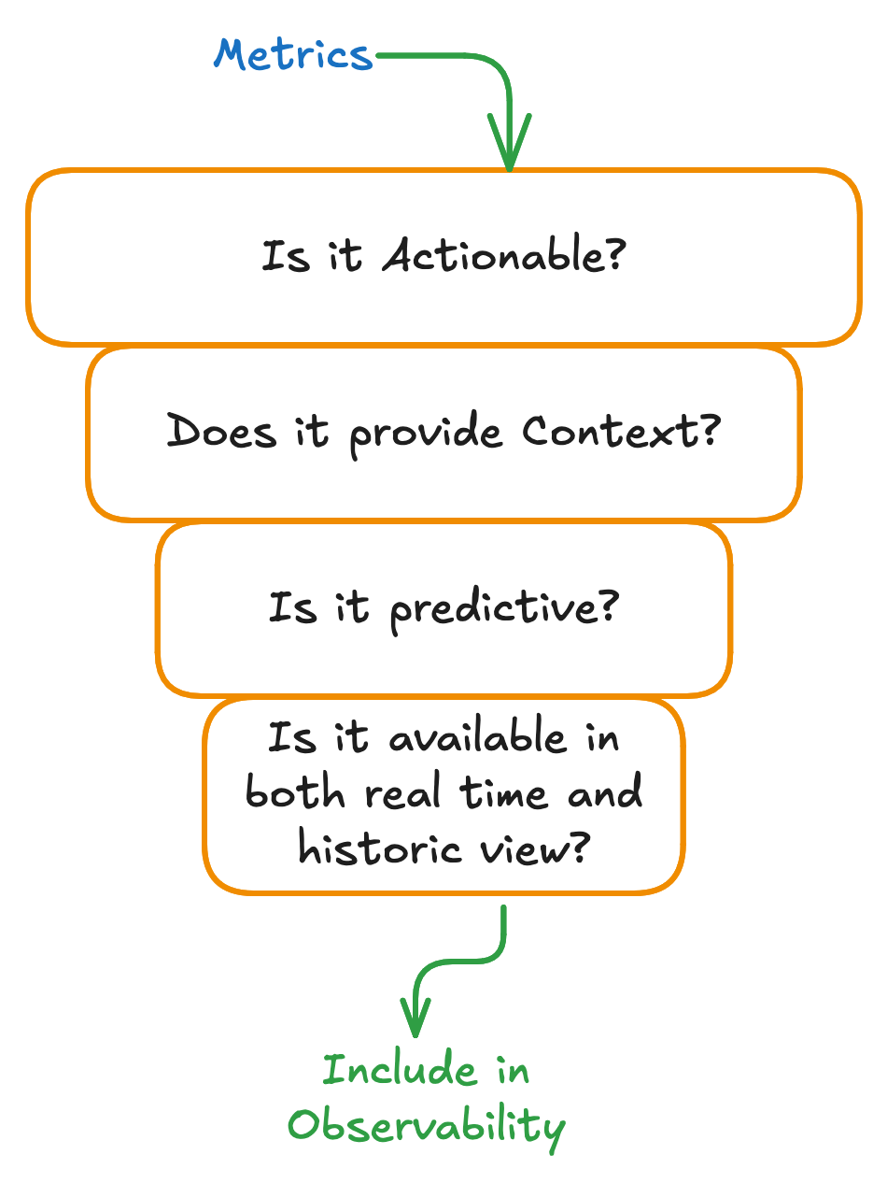
What Makes a Metric Useful?
Notes:
"A metric is actionable if it directly informs an operational decision. It should tell you when and where to act. For example, if you notice a pod crash-looping frequently, it’s a clear signal to investigate the pod’s logs, check probes, or adjust resource configurations."
"Metrics shouldn’t exist in isolation. They need to provide insights within the broader operational context. For example, a spike in CPU usage only makes sense when you compare it to the workload demand. Is this spike expected due to increased traffic, or is it an anomaly?"
"The best metrics don’t just tell you what’s happening now; they help you predict what might happen. For instance, monitoring trends in node memory utilization can indicate a potential OOM (Out of Memory) issue. This allows you to proactively scale resources or optimize memory usage before the issue impacts workloads."
"Observability requires both live monitoring and trend analysis. Real-time metrics help you respond to immediate incidents, like a failing service. Historical metrics help you analyze trends, identify recurring patterns, and make data-driven decisions."

Slide 8








Things That Mislead and How to Avoid Them
Overcollection
Lack of Standardization
Ignoring Cardinality
Reactive Monitoring
Focus on high-signal, high-value metrics.
Adopt a consistent monitoring framework.
Be selective with label usage.
Prioritize proactive, SLO-driven metrics.

Slide 9
Alerts: From Noise to Actionable Signals
Notes:
Transforming noise into actionable signals is crucial for maintaining reliability, reducing alert fatigue and improving incident response. It involves refining and organizing raw system data to identify meaningful insights that can help in decision making and remediation actions.
Alert Fatigue: Too many alerts lead to inaction or ignored issues.
False Positives: Alerts triggered by insignificant issues waste time and resources.
No Context: Alerts without enough detail don’t help teams resolve issues quickly.
Ineffective Thresholds: Alerts set too high or too low miss critical incidents.

Slide 10
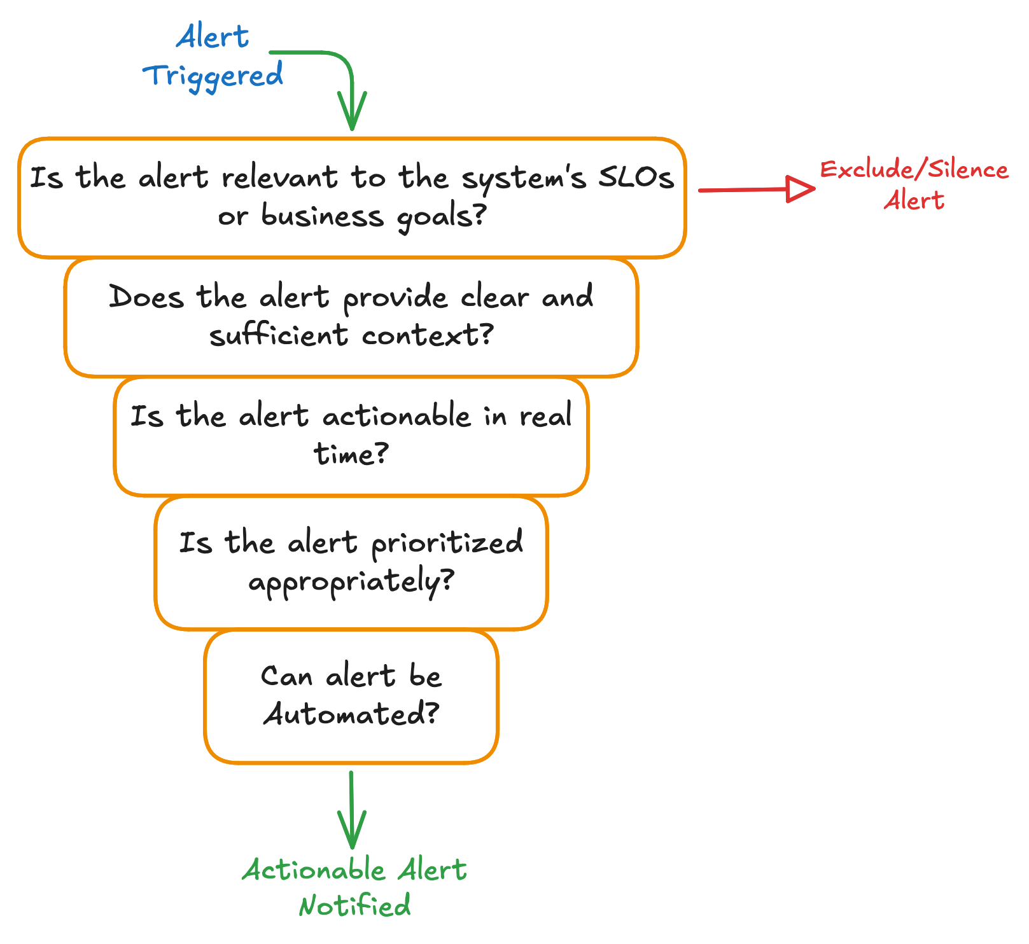
What Makes an Alert Actionable?
Notes:
Clear Context: Provide detailed information about the issue (logs, traces, affected services).
Relevant: Only alert for issues that impact SLOs or key business goals.
Timely: Alerts should be actionable in real time, without unnecessary delays.
Prioritized: Alerts should be categorized by severity and impact (e.g., Critical, Warning, Info).
Automated Remediation: Where possible, automate responses to common issues (e.g., scaling pods).

Slide 11
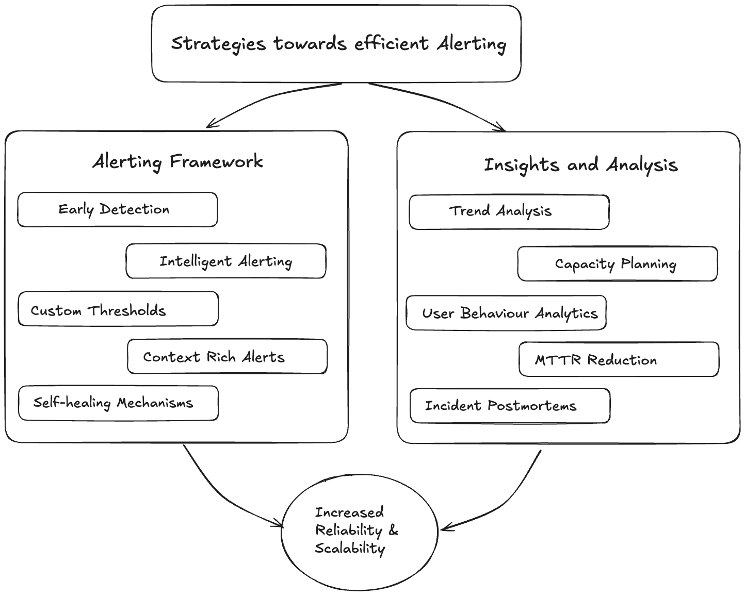
Journey to Alerting Effectiveness
Notes:
Early Detection: Identifying potential failures before they escalate.
Intelligent Alerting: Using AI/ML-based anomaly detection to reduce noise and focus on real threats.
Custom Thresholds: Setting dynamic rather than static thresholds to minimize false positives.
Context-Rich Alerts: Enriching alerts with logs, traces, and remediation steps such as SOPs to speed up resolution.
Self-Healing Mechanisms: Automating recovery actions, such as restarting failed services.
Trend Analysis : Identifying performance degradation over time.
Capacity Planning: Using historical data to forecast resource needs.
User Behavior Analytics: Detecting unusual patterns that might indicate upcoming failures
MTTR Reduction: Insights help engineers fix issues faster by correlating alerts and logs.
Incident Postmortems: Learning from past incidents to prevent future occurrences.

Slide 12
Correlation: Connecting the Dots

Slide 13
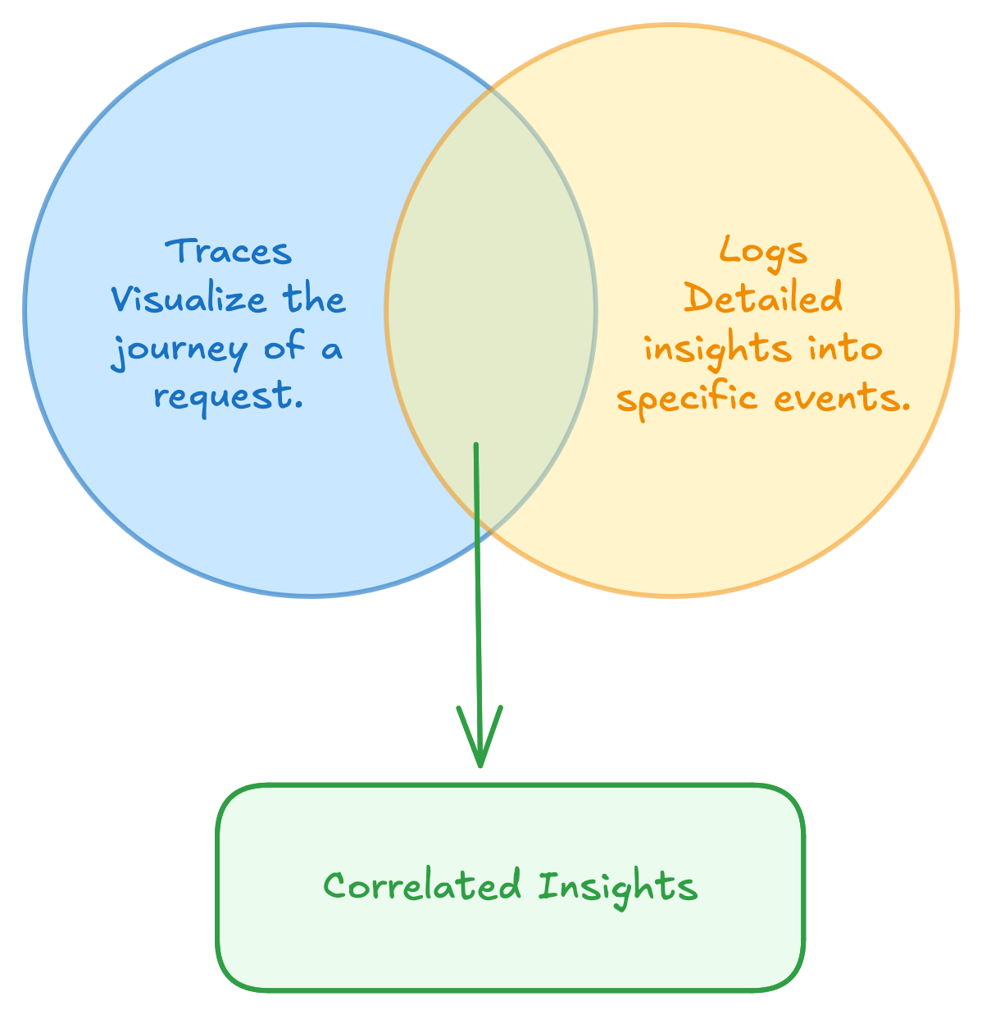
Logs and Traces: The Context and The Journey
Notes:
Logs: The Context
Purpose: Provide detailed event-level information for root cause analysis.
Use Cases:
Debugging: Trace code execution and error details.
Audit Trails: Track changes and user actions.
Example: A log entry showing a database connection failure.
Key Benefit: Explains the "why" behind an issue.
Traces: The Journey
Purpose: Map the lifecycle of a request across services.
Use Cases:
Identify Bottlenecks: Pinpoint latency in a service.
Dependency Mapping: Visualize service interactions.
Example: A trace showing a slow API call caused by a delayed database query.
Key Benefit: Shows the "how" a request flows through the system.
Logs + Traces Together
Combine logs (details) and traces (flows) for complete visibility into system behavior

Slide 14
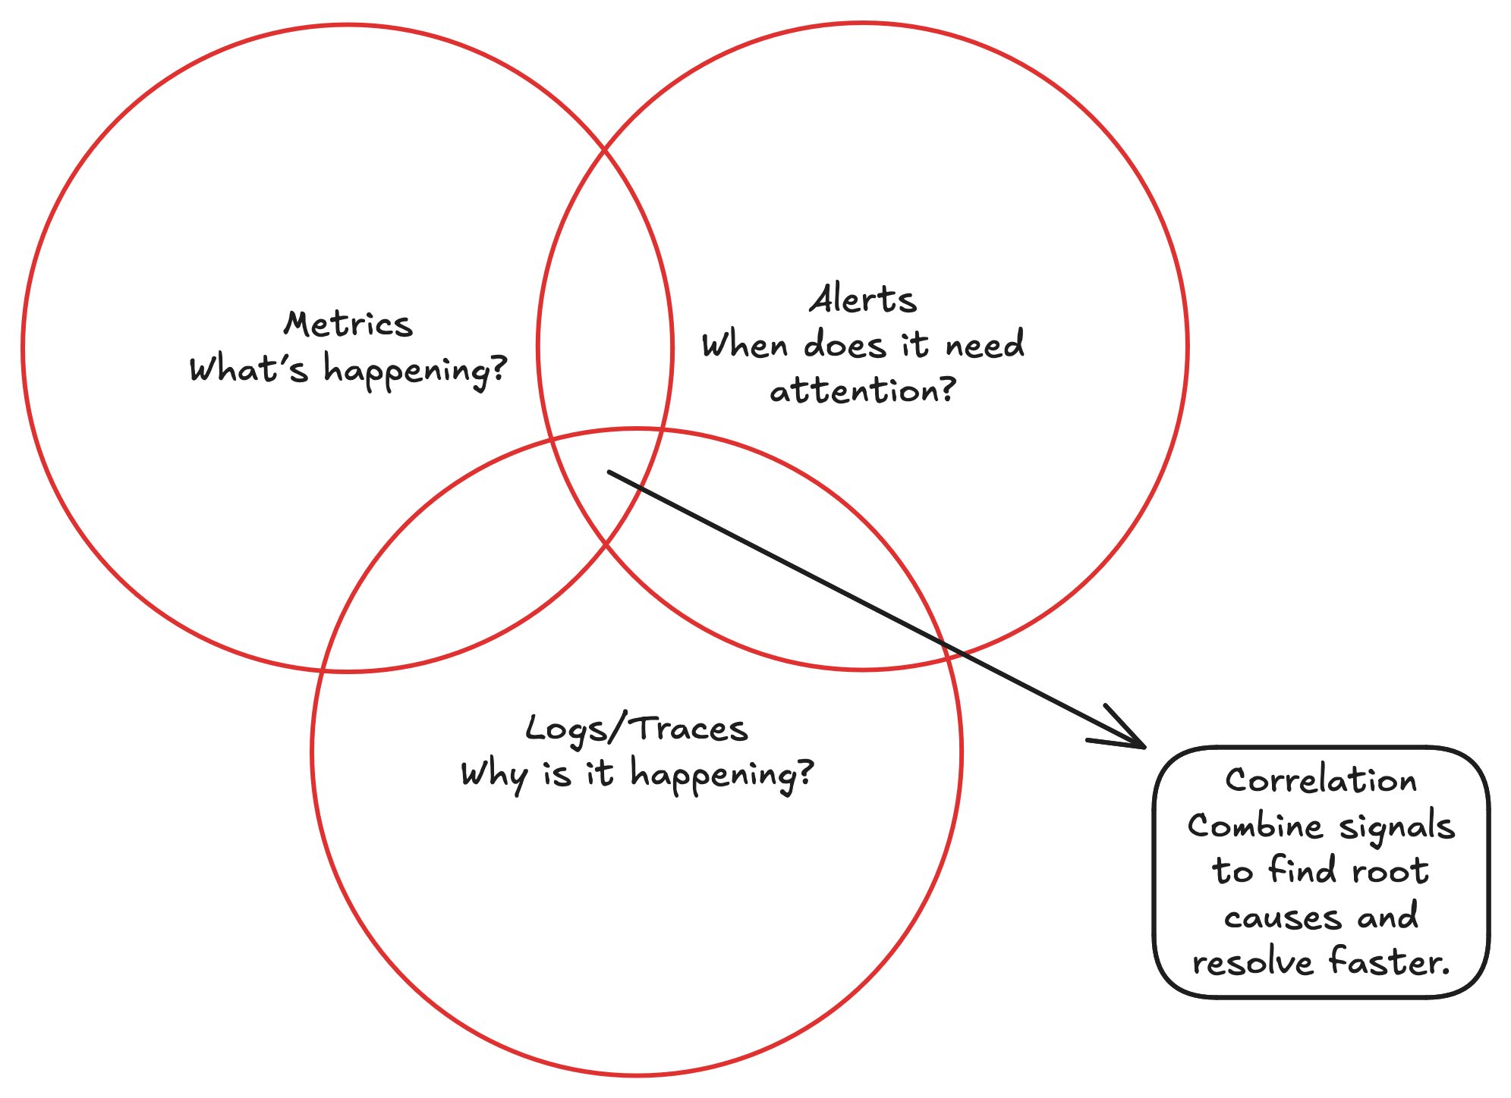
The Complete Fleet Observability Picture
Notes:
Observability isn’t just about individual metrics, alerts, or logs—it’s about connecting these signals to understand the bigger picture and resolve issues faster."
Triad of Observability:
Metrics: Quantitative data to monitor system performance.
Example: CPU utilization spikes.
Alerts: Triggers for attention when thresholds are breached.
Example: High response times generating a critical alert.
Logs: Contextual information to debug the root cause.
Example: Logs reveal a configuration error causing response time issues.
Correlating Across Data Sources:
Combine metrics, alerts, and logs to:
Identify the what (metrics).
Prioritize the when (alerts).
Investigate the why (logs).
Practical Example:
Scenario:
Metric: Application latency increases.
Alert: Response time breaches the SLO.
Log: Database connection timeout is causing latency.
Resolution: Pinpoint the issue faster by correlating these signals.

Slide 15
Implementing Fleet wide Observability
Leveraging the concepts of SLIs, SLOs, SLAs
Notes:
The principles of SLOs are essential for providing a structured framework for assessing, managing, and maintaining reliability while balancing user expectations with operational effectiveness.

Slide 16
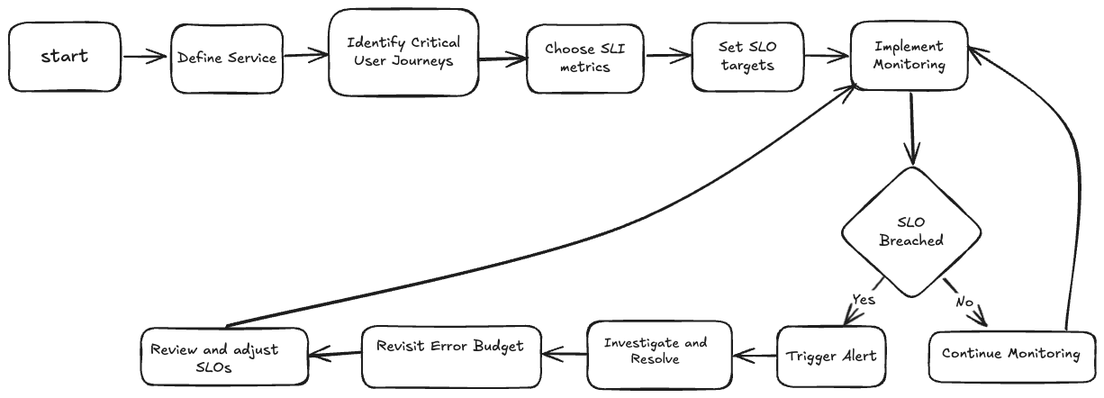
Setting SLOs for key services

Slide 17








Benefits of SLO Driven Approach
Optional section marker or title
Scalable Reliability Management
Proactive issue Management
Consistency across services
Error Budget Framework
Alerting and Insights
Enhanced User Experience
Aligned goals across teams
Key focus on customer impact
Reduced Downtime
Unified Metrics
Prioritized Efforts
Continuous Improvement
Business-Driven Observability
Notes:
Consistency across services : Providing an environment of uniform monitoring and troubleshooting, which further limits service dependencies and enhances performance.
Business-Driven Observability - Helping to align business and technical needs, also providing end to end visibility which enables a better customer experience.

Slide 18




Looking Ahead - The future of Observability
AI-Driven Insights
Cloud Native and Cross Cloud Provider
Automated Remediation
Open Standards & Interoperability
Notes:
AI-Driven Insights – Machine learning and AI will play a bigger role in detecting anomalies, predicting failures, and automating responses.
Automated Remediation – Systems will move from passive monitoring to proactive, self-healing capabilities that resolve issues without human intervention.
Open Standards & Interoperability – Open-source initiatives will become the backbone of observability, ensuring vendor-neutral and flexible integrations.
Cloud-Native & Serverless Monitoring – Observability will evolve to better handle ephemeral and serverless workloads, providing deeper insights without adding performance overhead.

Slide 19
Q&A

Slide 20
Thank You!

