Slide 1
VPP TLS Plugin: Enhancing Performance with Asynchronous Operations
FOSDEM-2025
Varun Rapelly, Principal Engineer
Venkata Ravichandra Mynidi, Sr. Principal Engineer
February 2nd, 2025

Slide 2
Agenda
Introduction about VPP TLS Plugin
Our Contribution
Advantages of DPDK User Space Crypto Drivers
Asynchronous Crypto Processing in TLS Plugin
Performance Comparison
Future Scope

Slide 3
VPP TLS Plugin
VPP TLS Plugin is designed to provide Transport Layer Security (TLS) protocol support within the VPP framework.
Integration with
TLS Libraries
Integrates with popular TLS libraries: OpenSSL, Picotls, and MbedTLS
Handles cryptographic operations, including encryption, decryption and certificate management
New Transport Type
TLS application acts as a new transport type.
Behaves as an application from the underlying TCP transport perspective and as a transport from the client application's perspective
Session Management
Plugin manages TLS sessions by establishing connections, performing handshakes, and maintaining session states.
Uses a context to handle the encryption and decryption operations, ensuring data integrity and confidentiality
Configuration
TLS configuration parameters (CA certificates, server certificates, private keys) can be configured using the startup configuration file

Slide 4
Our Contribution to TLS Plugin
  Creating & initializing async events for SSL handshake, read and write jobs
  Implemented handlers to handle the completions of handshake, read and write async events
  Implemented separate queues for handling the completed SSL handshake and read/write events
  Verified with Marvell OpenSSL Engine leveraging H/W Crypto accelerator
  Leveraged DPDK crypto drivers for Marvell OpenSSL Engine implementation
  Review Links
    https://gerrit.fd.io/r/c/vpp/+/41591
    https://gerrit.fd.io/r/c/vpp/+/42070/

Slide 5
Advantages of DPDK User Space Crypto Drivers
Poll Mode Drivers (PMD)
DPDK uses PMD for crypto devices helps in achieving high performance by reducing the overhead associated with interrupt handling
Performance
Due to reduced context switching and direct access to h/w DPDK crypto drivers can achieve lower latency & high throughput
Asynchronous Processing
DPDK crypto drivers supports asynchronous burst processing can amortize the cost of crypto operations across multiple packets maximizes performance when offloading to hardware accelerators
Flexibility
DPDK crypto framework supports both hardware-accelerated and software-based crypto operations.
Session Management
DPDK's session management APIs optimize repeated cryptographic operations by reusing parameters.
Standardized API
DPDK's standardized API simplifies integrating cryptographic functions, abstracting hardware specifics for developers.

Slide 6
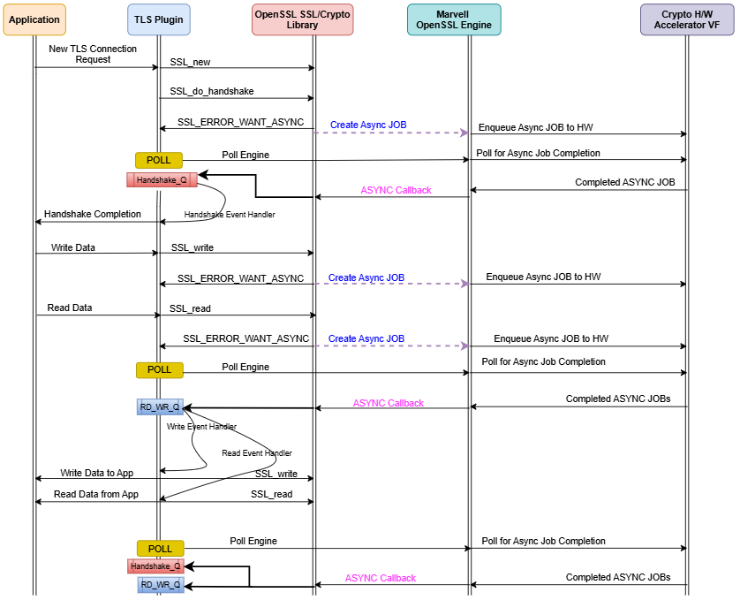
TLS Plugin - Asynchronous Crypto Flow

Slide 7
Performance Comparison
Notes:
  Tested using “HTTP TPS” application using Curl
  Cipher: ECDHE-RSA-AES256-GCM-SHA384
  RSA Size: 4K

Slide 8
Performance With Pipeline & Record Sizes

Slide 9
Future Scope
Upstreaming Marvell OpenSSL Engine as a separate plugin
OpenSSL Provider support to TLS Plugin
Optimizing Performance with multiple workers
Performance Tuning with multiple pipes

Slide 10
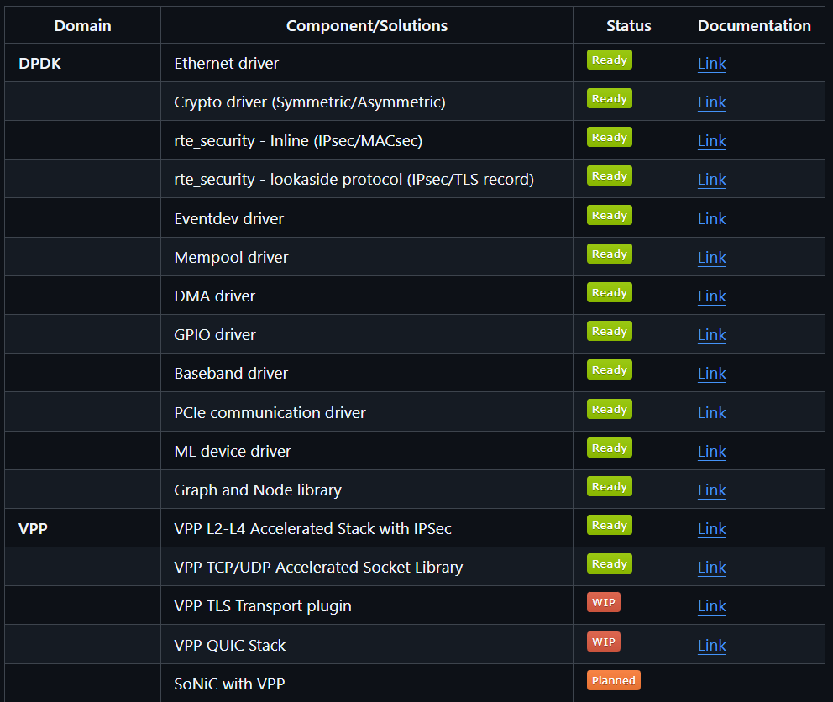
Marvell DAO
DPDK
VPP
VirtIO
OVS
AI/ML
https://github.com/MarvellEmbeddedProcessors/dao

