Slide 1

Raiders of the Lost Hard Drive
Michał Pleban

Slide 2
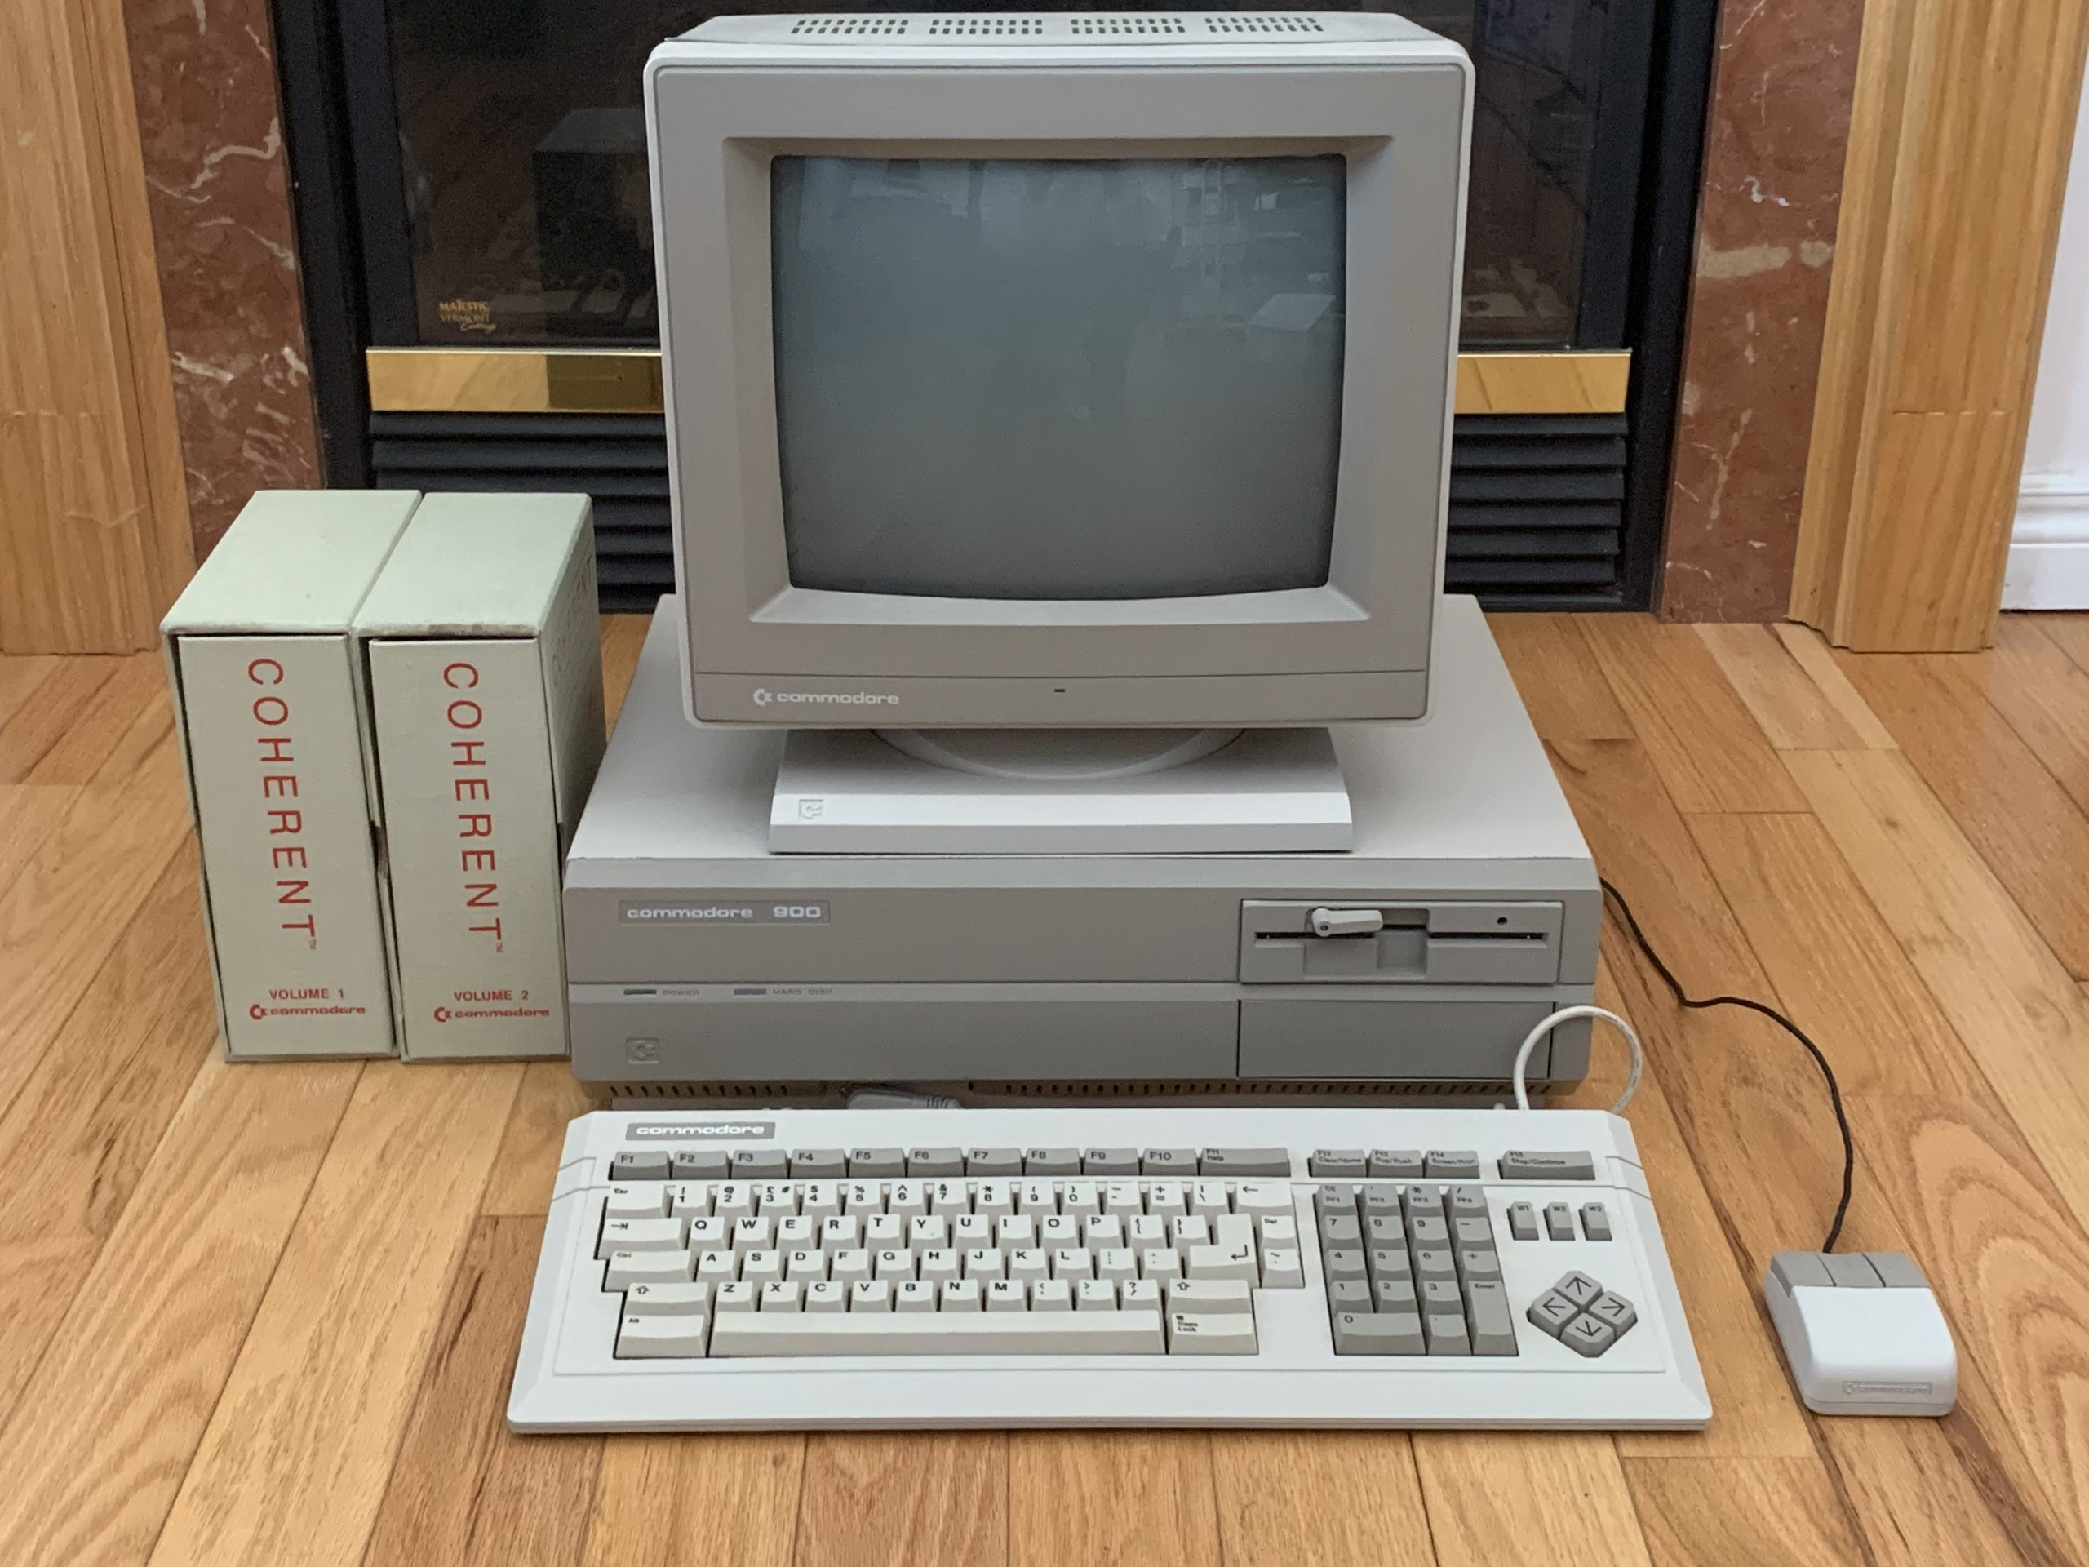

Commodore 900

Slide 3

Commodore 900 specs
Prototype Unix workstation from 1985.
Z8000 CPU (16 bit) @ 6 MHz.
512kB - 1 MB RAM.
20 MB MFM hard drive + 1.2 MB floppy drive.
80x25 text / 1024x800 bitmap video output.
Coherent 0.7.3 operating system (Unix-like).
Discontinued as Commodore focused on the Amiga.
Only a few dozen exist in the world.

Slide 4
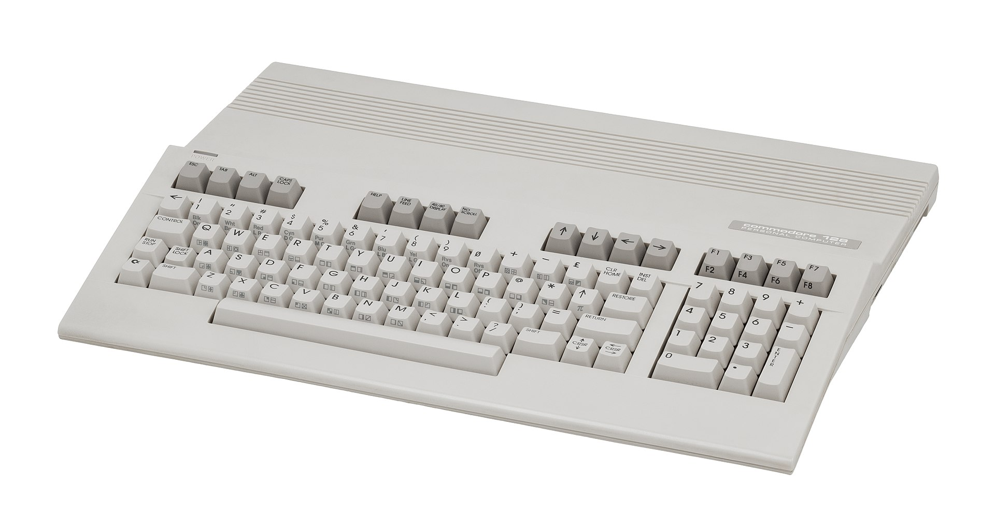
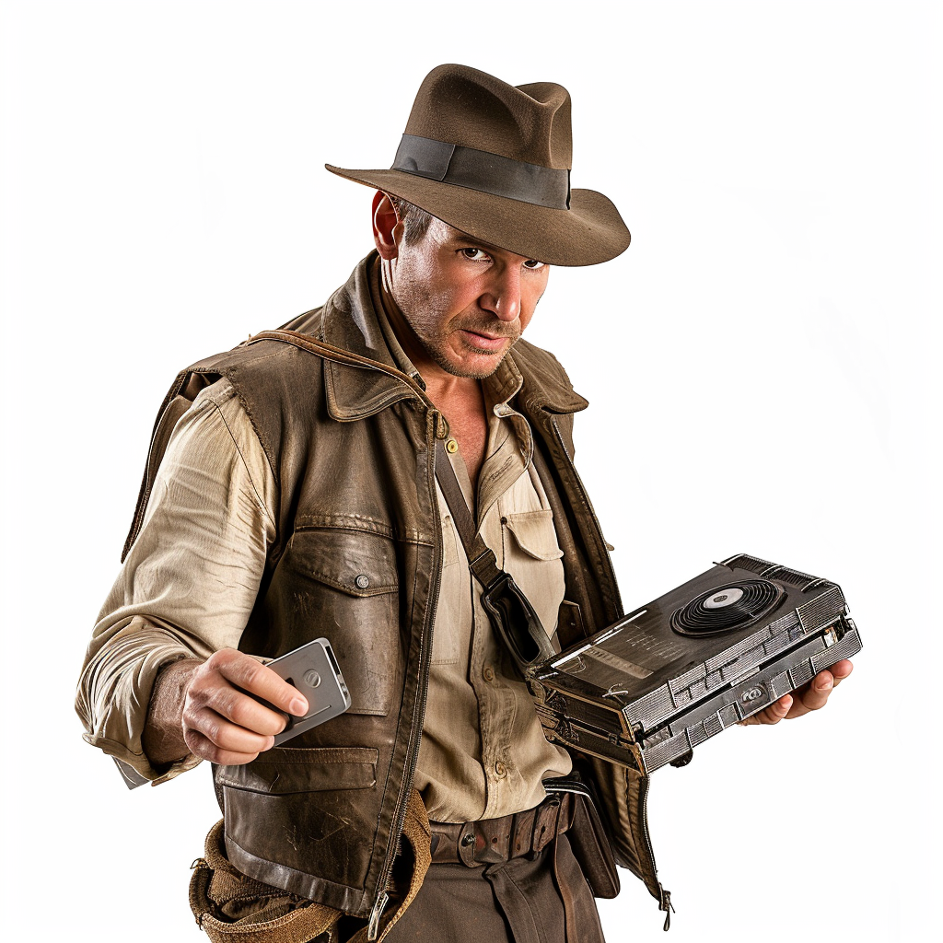
Commodore 128
The 8563 VDC chip for 80 column display was originally developed for the Commodore 900.

Slide 5
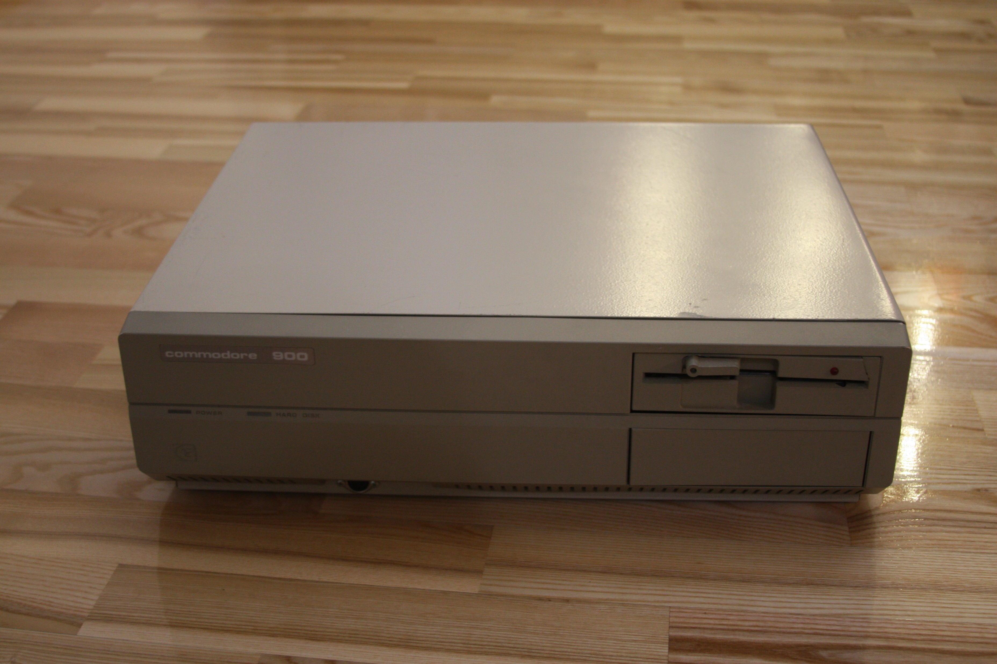

My Commodore 900 (2014)

Slide 6
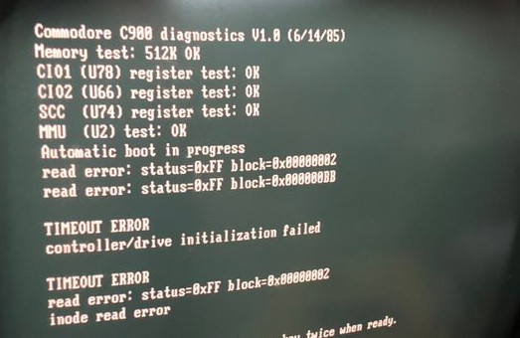

What is error FF?

Slide 7

Let’s have a look at the BIOS…
00:0038 21 00 00 80 LD R0,#0x0080
00:003c 3a 87 00 fc SOUTB 0x00fc,RL0
00:0040 3a 87 11 f8 SOUTB 0x11f8,RL0
00:0044 3a 87 13 f8 SOUTB 0x13f8,RL0
00:0048 3a 87 14 f8 SOUTB 0x14f8,RL0
00:004c 21 00 9e 00 LD R0,#0x9e00
00:0050 7d 0b LDCTL REFRESH,R0
00:0052 34 00 ff aa LDAR R0,0x0000
00:0056 7d 0c LDCTL PSAPSEG,R0
00:0058 7d 1d LDCTL PSAOFF,R1
00:005a 83 22 SUB R2,R2
00:005c 21 03 00 40 LD R3,#0x0040
00:0060 14 00 00 00 ff 00 LDL RR0,#0x0000ff00
00:0066 3a 87 20 f8 SOUTB 0x20f8,RL0
00:006a 3a a7 01 f8 SOUTB 0x01f8,RL2
00:006e 3a 07 0f f8 SOUTB 0x0ff8,RH0
00:0072 3a 87 0f f8 SOUTB 0x0ff8,RL0
00:0076 3a 17 0f f8 SOUTB 0x0ff8,RH1
00:007a 3a 97 0f f8 SOUTB 0x0ff8,RL1
00:007e a8 00 INCB RH0,#1
00:0080 f3 8a DJNZ R3,0x006e
00:0082 c8 c0 LDB RL0,0xc0
00:0084 3a 87 00 fc SOUTB 0x00fc,RL0
00:0088 bd 01 LDK R0,0x1
00:008a 5e 08 80 00 0b fe JP T,0x00:0x0bfe
00:0090 14 02 08 00 00 00 LDL RR2,#0x08000000
00:0096 a0 3c LDB RL4,RH3
00:0098 a0 24 LDB RH4,RH2
00:009a a1 4c LD R12,R4
00:009c b3 c1 ff fe SR R12,2
Written mosly in C
Only a few pages of source available
The rest needs to be disassemled…

Slide 8

BIOS disk access
Disk controller attached to the memory via DMA.
BIOS stores the disk command at the beginning of the memory.
The controller understands SASI commands (predecessor of SCSI).
The BIOS writes 0xFF in the status byte, the disk controller overwrites it.
If the BIOS reads back 0xFF, then the disk controller did not respond.
Why?

Slide 9
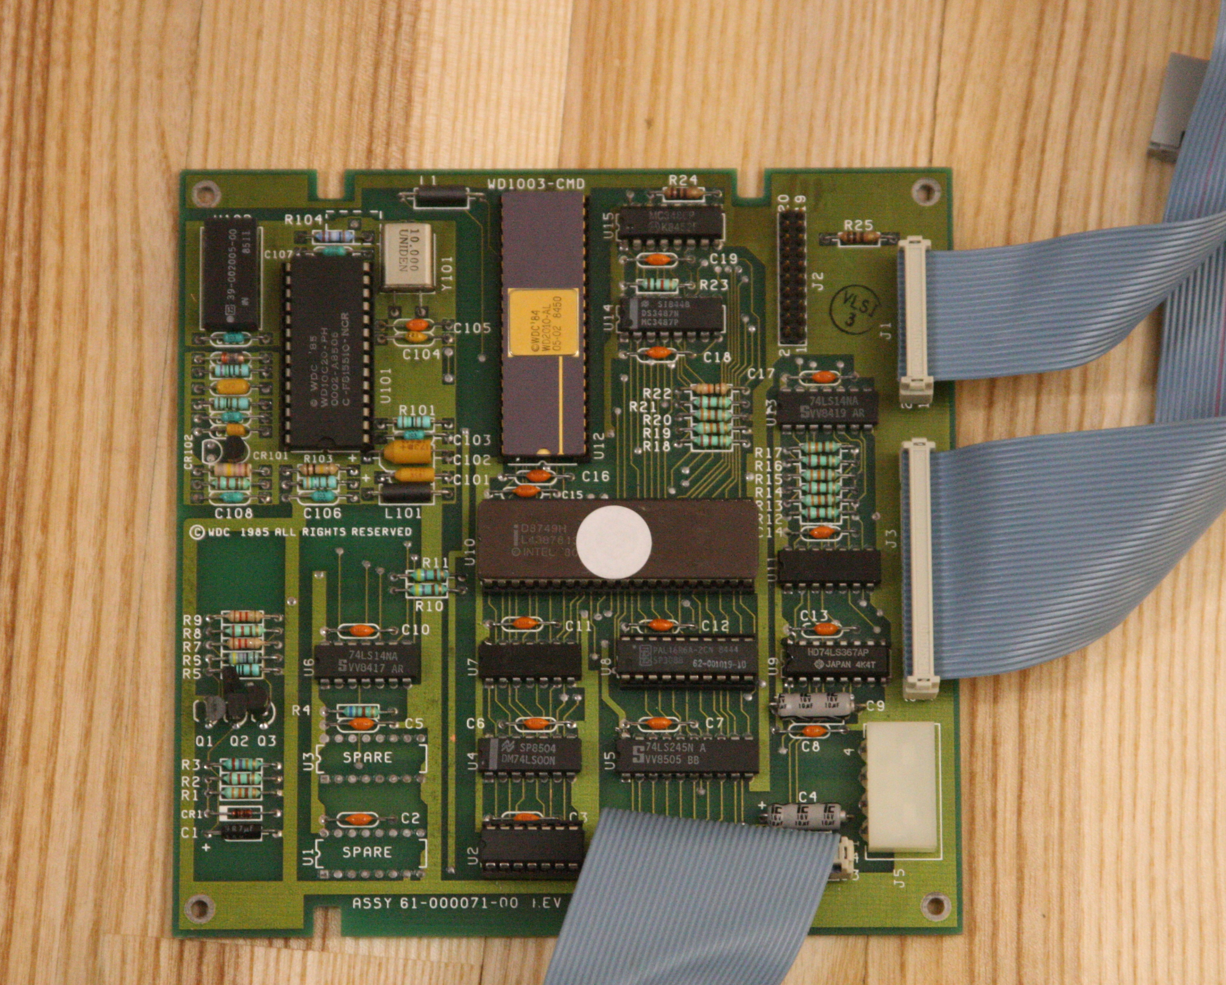

Disk controller: WD1003-CMD

Slide 10

Fixing the disk controller
Replaced a broken 74LS14 chip.
Replaced Western Digital MFM controller chips.
Programmed and replaced the 8048 MCU.
Disassembled and analyzed the firmware.
Contacted the firmware author on LinkedIn.
Replaced the hard drive.
Still not working!

Slide 11


Getting a new hard drive

Slide 12
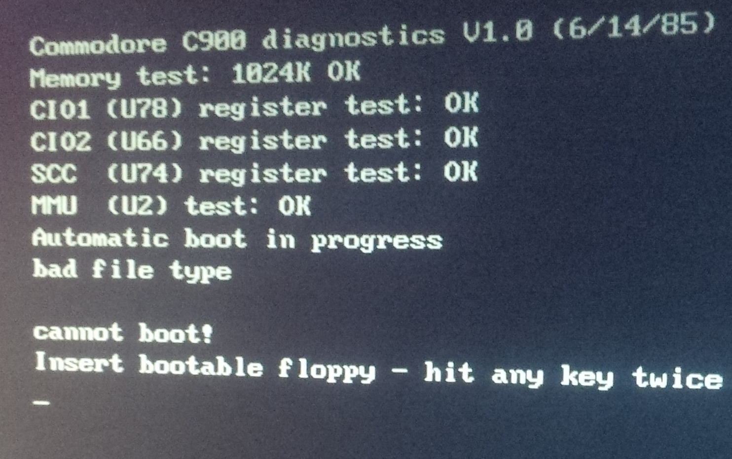

Bad file type FTW!

Slide 13


Formatting the disk
Do not press any key twice!
Press 1, then 9 → go to Machine Language Monitor.
Use the E command to write bytes to memory.
Write SASI command 04 (format unit) to the beginning of memory.
Status: command not implemented

Slide 14

Formatting the disk (really)
sub format()
{
my $i = shift;
my $ret;
$time = time();
# Start debugger
&out("d");
# Lay out track format command
&out("e 08|0000");
&out("0600");
&out(sprintf("%04X", $i));
&out("1100");
&out("0804");
&out("0100");
&out("0000");
&out("FF00");
&out("0000");
&out("x");
# Set PC to disk access routine
&out("R pc 0000111E");
# Call the routine
&out("c");
&out("c");
sleep(1);
# Start debugger
&out("d");
# Check the command status
$ret = &out("e 08|000C");
&out("x");
# Exit
&out("c");
return substr($ret, 19, 2);
}

Slide 15

Installation floppies
Download the floppy images from the Internet
… but how to put them on real floppies?
Images are 1.2M in size
… but the machine uses GCR instead of MFM.
Commodore 8250 floppy also uses GCR
… but the sectors are 512 bytes long, not 256.
Hack the 8250 to use 512-byte sectors
… but the track density is 96 TPI, not 100 TPI.

Slide 16
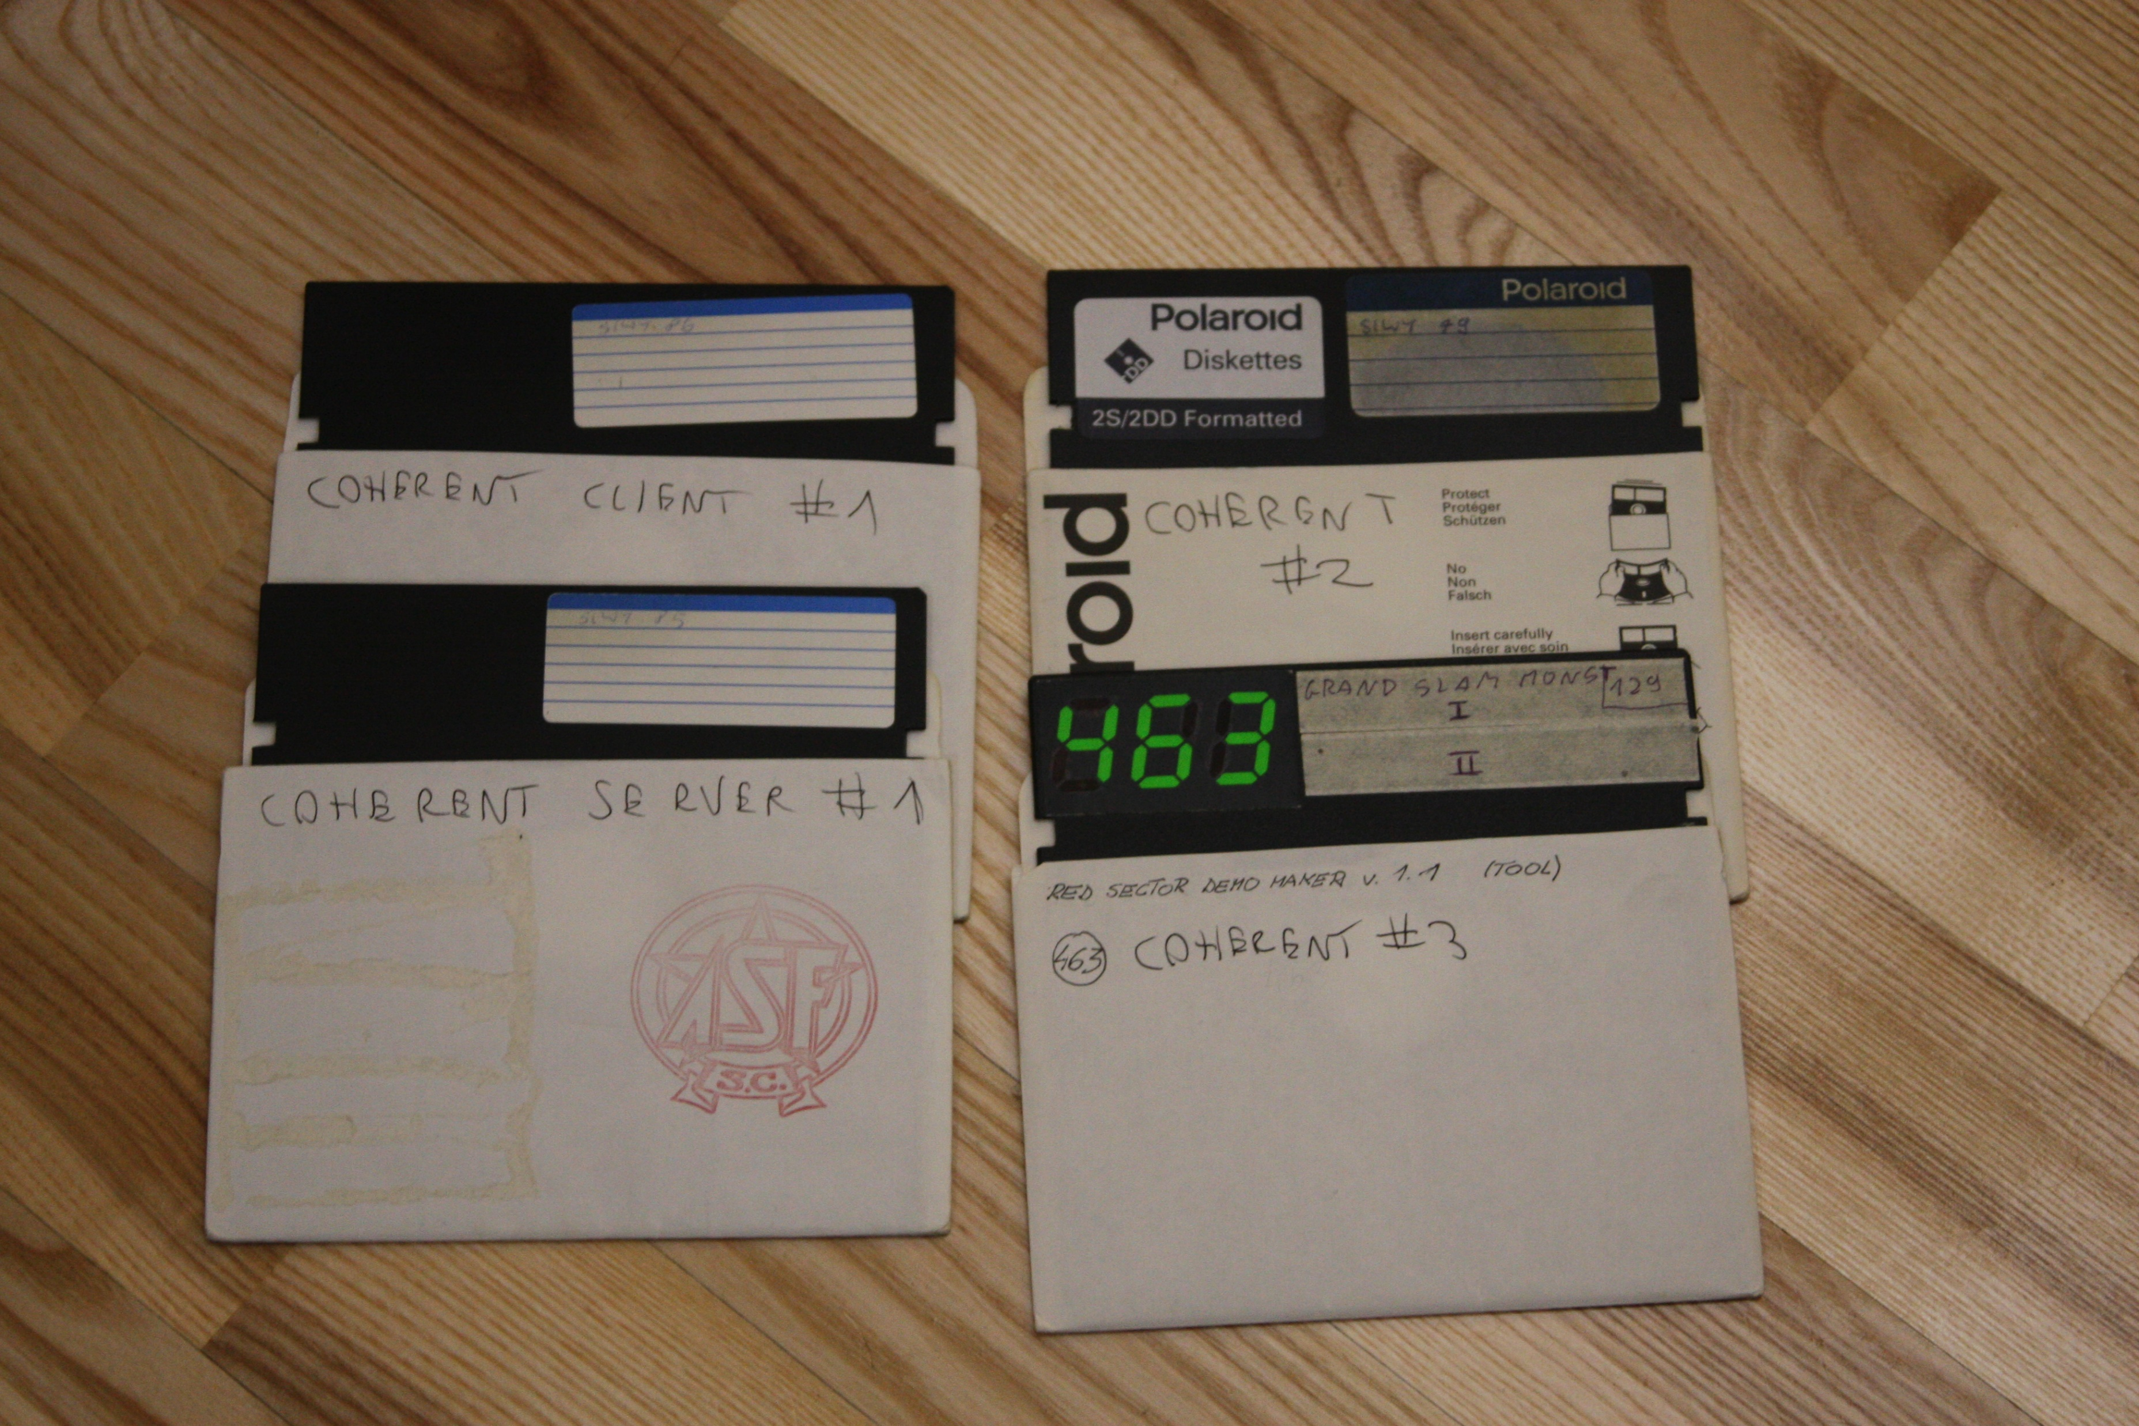

Installation floppies

Slide 17
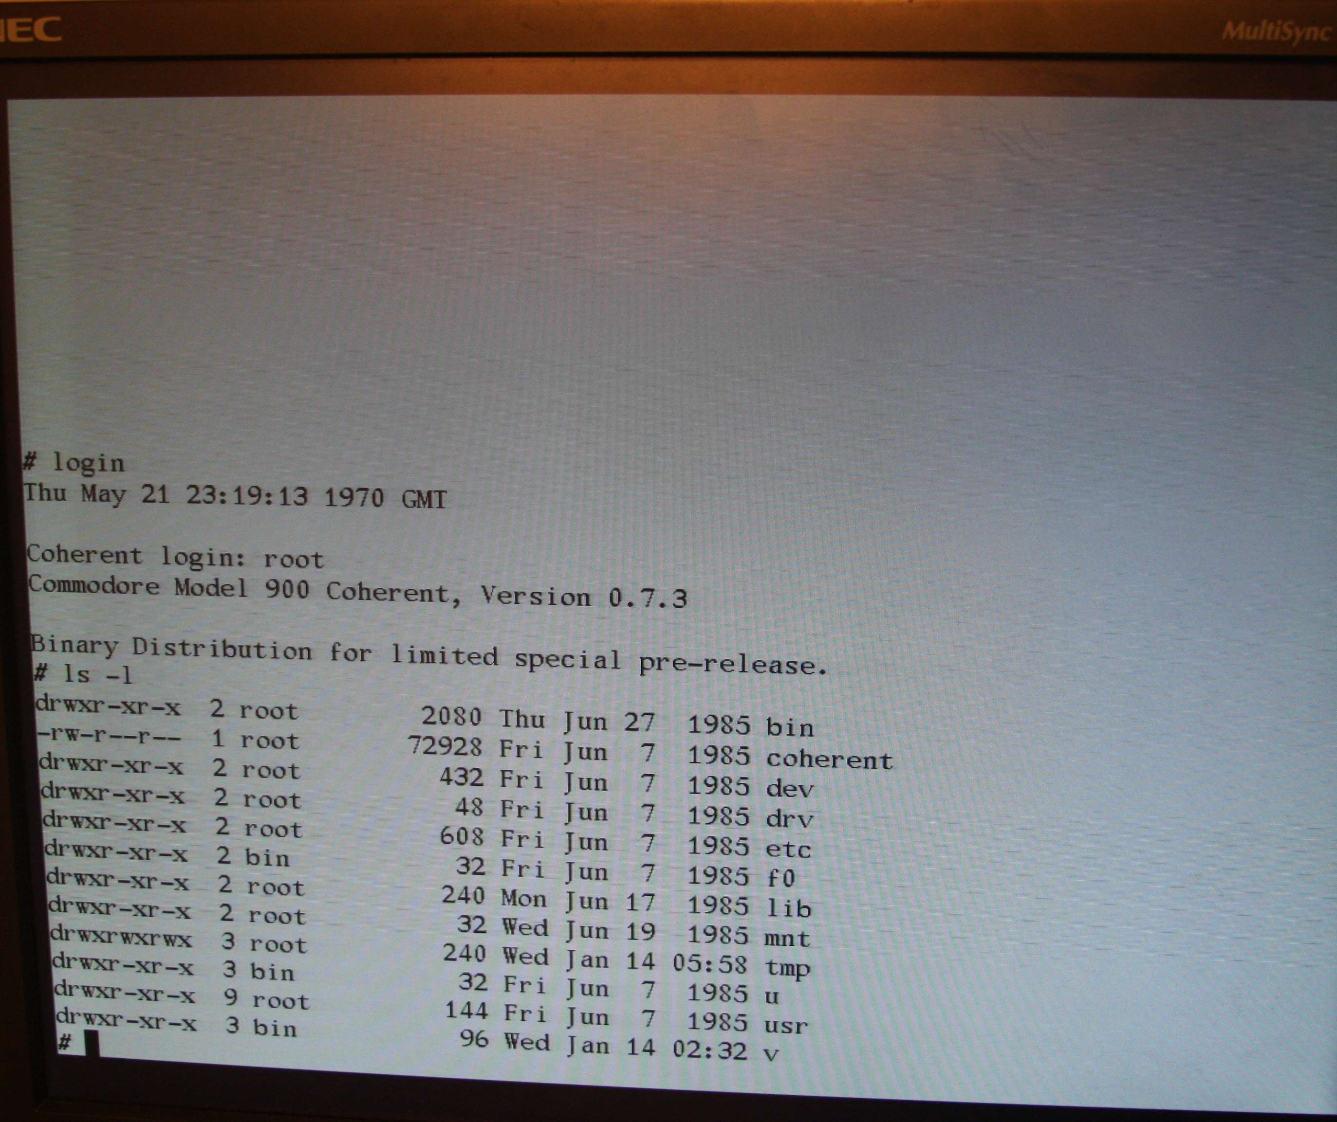
Look mom, I am root!

Slide 18

Thank you for your attention!

