Slide 1
ArduPilot : Trusted, Versatile and FOSS autopilot for all and everything
Pierre Kancir - FOSDEM 2025

Slide 2
About Me
French guy with accent
Robotics engineer since 2013
Work with SME on mobile robots : Drone-in-box, Food delivery, inflatable robot arm, patrol rovers, etc.
Contributor in FOSS robotics since 2014 : ArduPilot, ROS1, etc.

Slide 3
ArduPilot
Autopilot ? System that allows autonomously without constant manual control. It consists of hardware (flight controllers, sensors, and actuators) and software (algorithms for navigation, stability, and mission execution).
Versatile - rich in features with support for a large number of flight controllers, sensors and frame types
Trusted - reliable and predictable
Open - both in terms of software and in our team’s organisation and governance

Slide 4
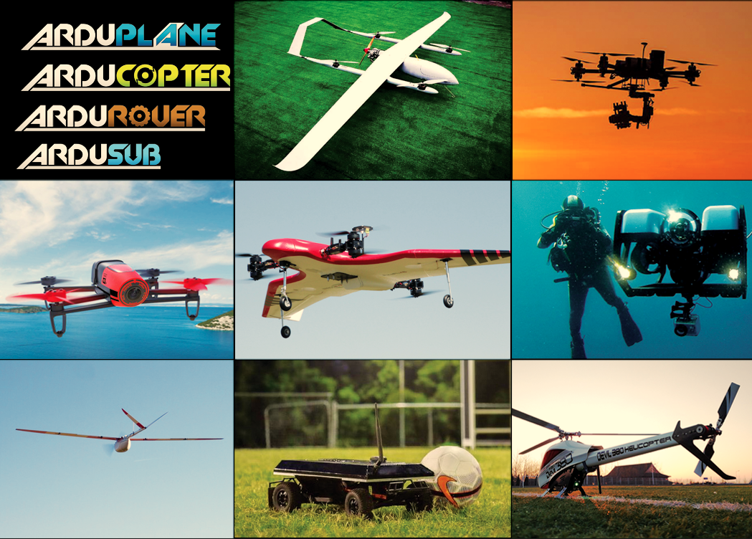
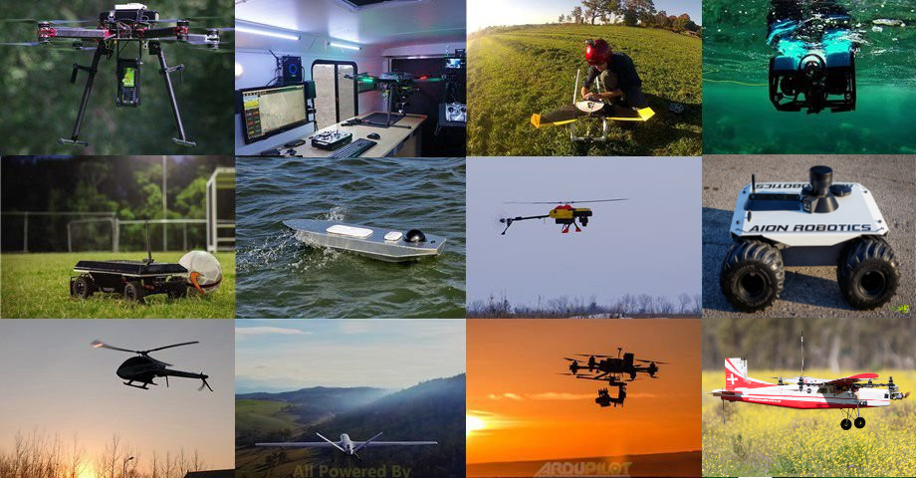
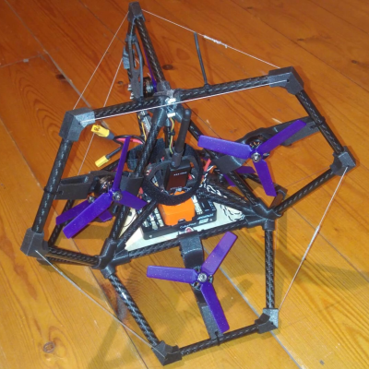
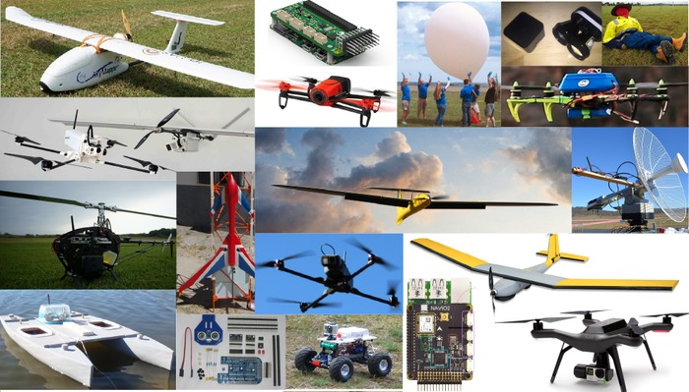
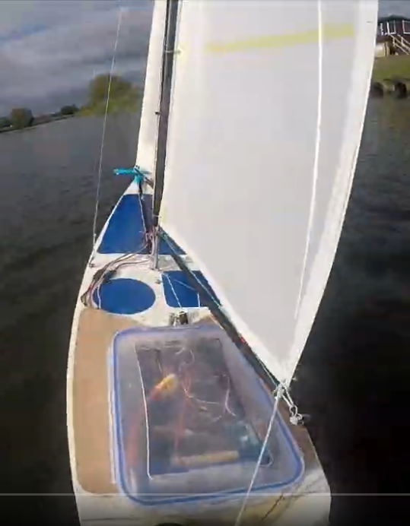
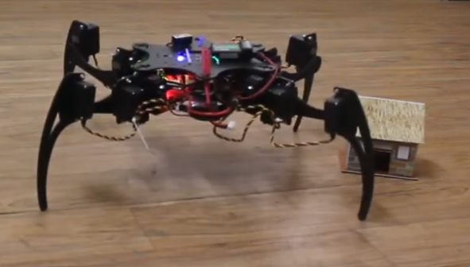
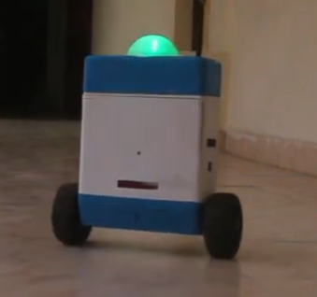
ArduPilot Plateforms

Slide 5
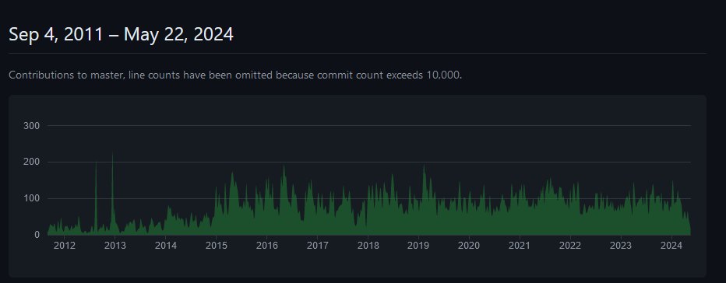


Lots going on ...
Very active development
over 6k commits per year (on average 16/day)
over 400 contributors : > 18K forks, > 11,6K Github Stars
supports over 100 flight controllers and variants
many 100s of thousands of vehicles (at least)
Focus on ChibiOS RTOS on STM32
ArduPilot Partner program
  commercial support and development

Slide 6
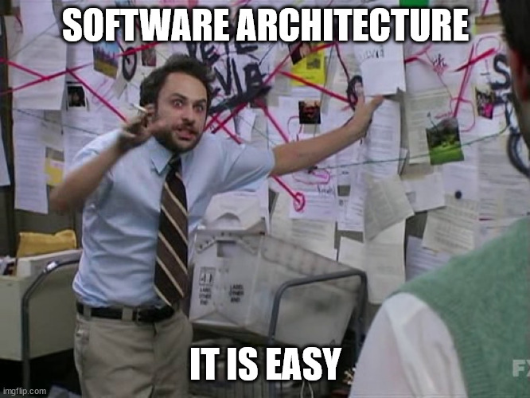
Sofware Architecture

Slide 7
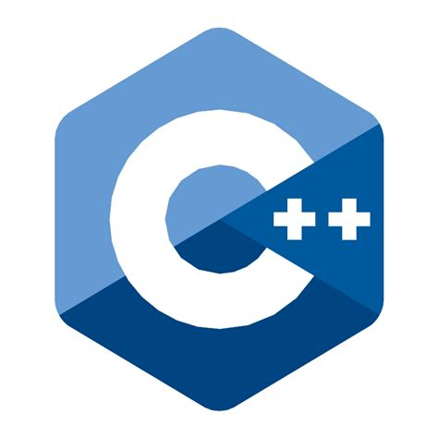
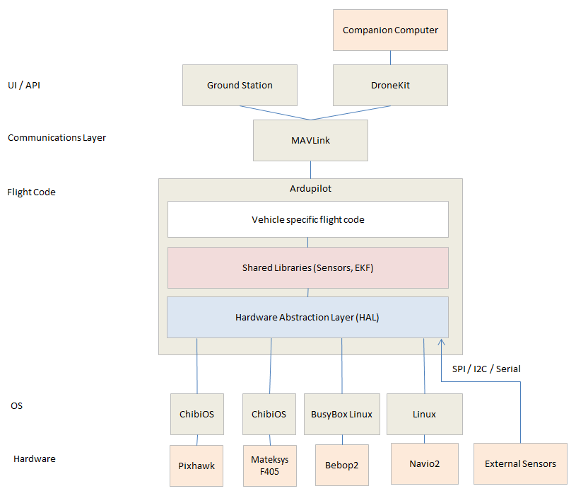


ArduPilot : architecture
pymavlink/ROS/…
FreeRTOS
ESP32
™
https://ardupilot.org/dev/docs/apmcopter-code-overview.html

Slide 8
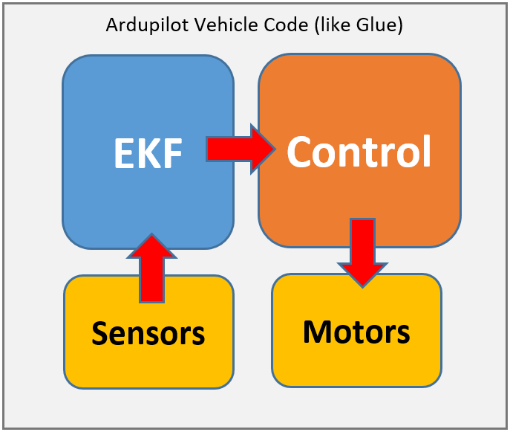
Easy flow

Slide 9
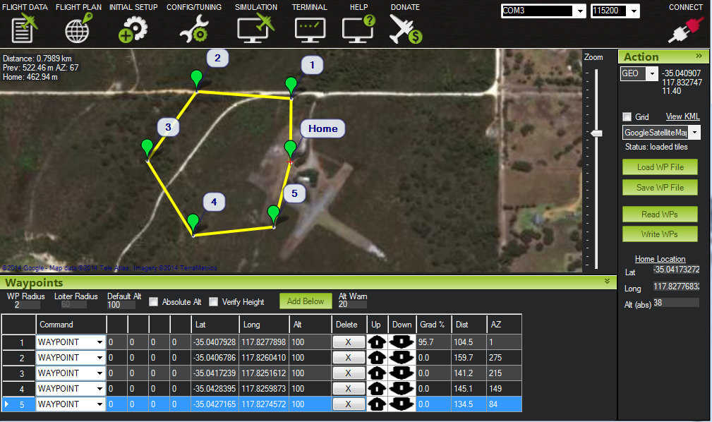
Generic autopilot
RTOS/Linux
Autopilot
STM32
IMU
GPS
Sensors
Lidar, sonar, etc
GCS
Wireless Comms
Radio
Radio

Slide 10


Slide 11
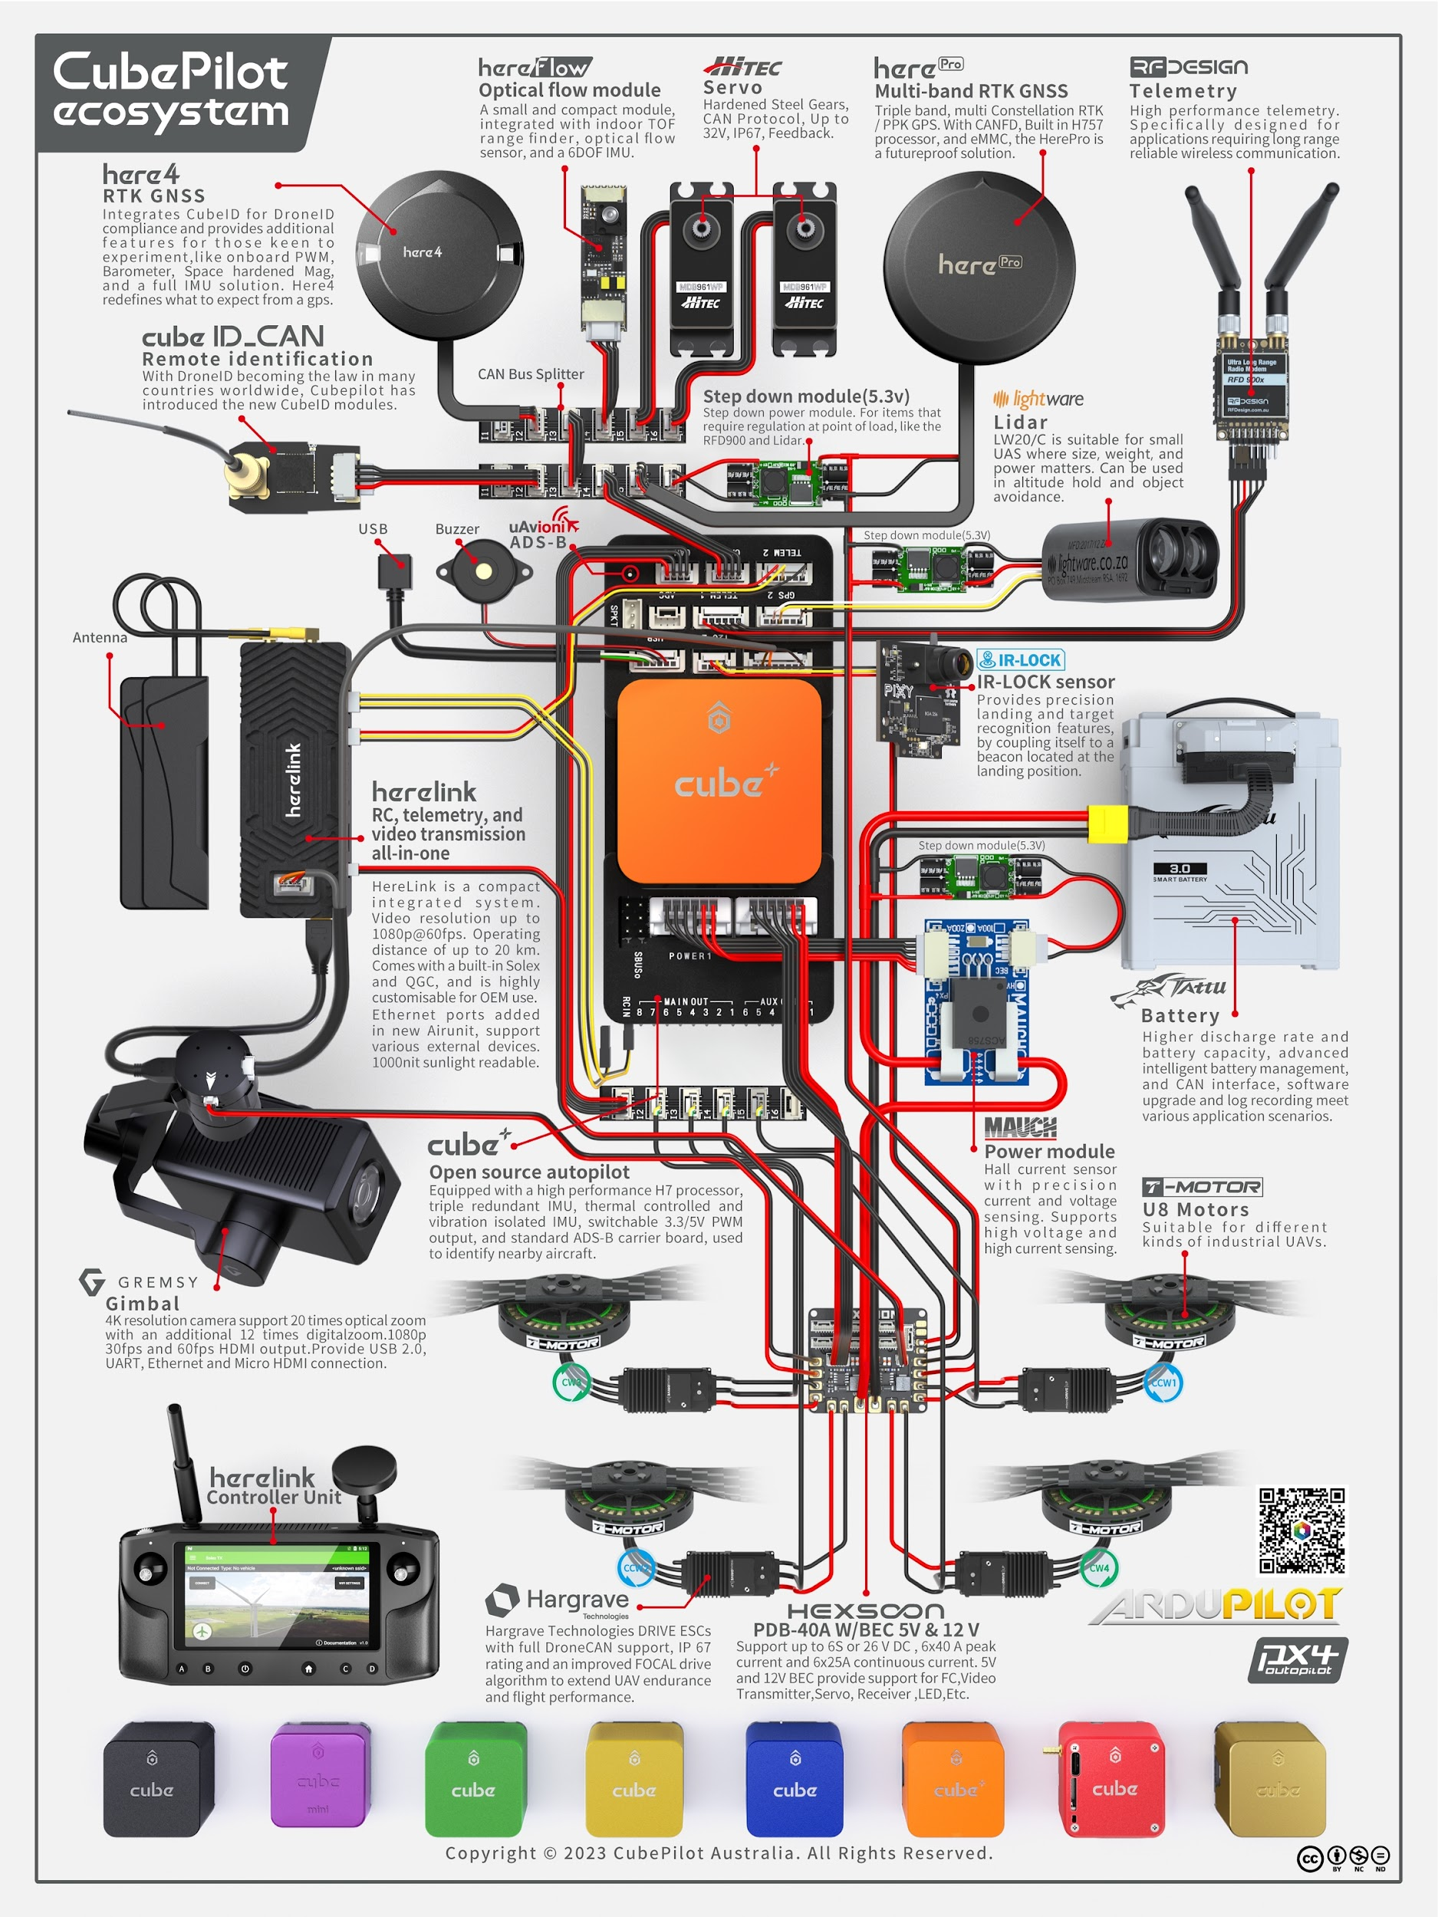
With Hardware Picture

Slide 12


Slide 13
External Embedded Control
RTOS/Linux
Linux
Wired Comms
Companion Computer
Camera
Some software
Autopilot
STM32
UART/CAN/IP
LiDAR
IMU
FROST
AI
GPS
Sensors
Lidar, sonar, etc
GCS
Wireless Comms
Radio
Radio

Slide 14

ROS?

Slide 15
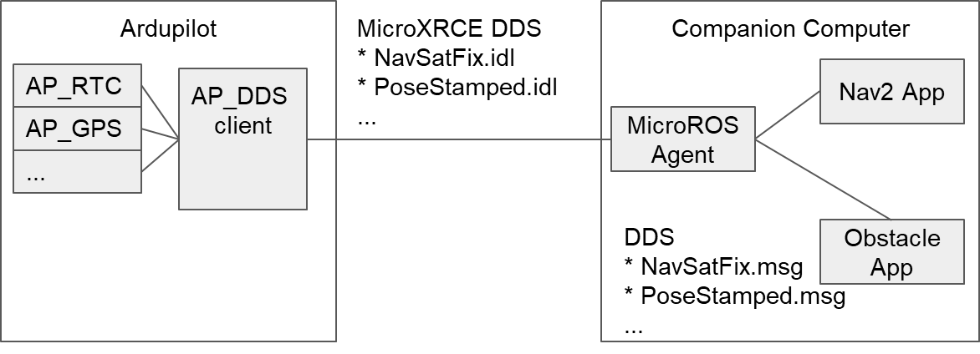
Architecture With XRCE DDS (ROS2 for men)
No more mavros bridge
ROS 2 applications use REP-147
  (Standard interface for Aerial Vehicles)
  Stable within a ROS version
Faster than MAVLink (200Hz+)
Still support GCS over MAVLink

Slide 16

SIMULATIONS

Slide 17
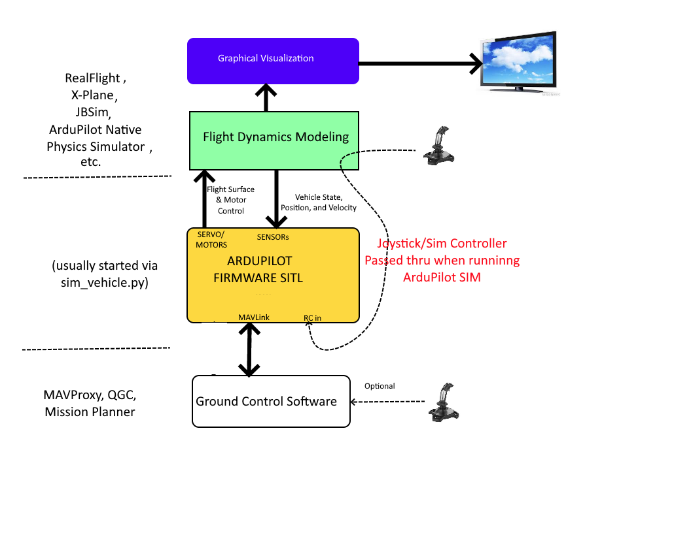
SITL ARCHITECTURE
Avantages :
  Simple
  Fast Learning curve
  Ressource cheap
  Can use real hardware
  Hal garantie portability
  Easily extensible
Drawbacks :
  Vehicle base sim : NO Environment
  Capabilities limited
  Too much Parameters

Slide 18
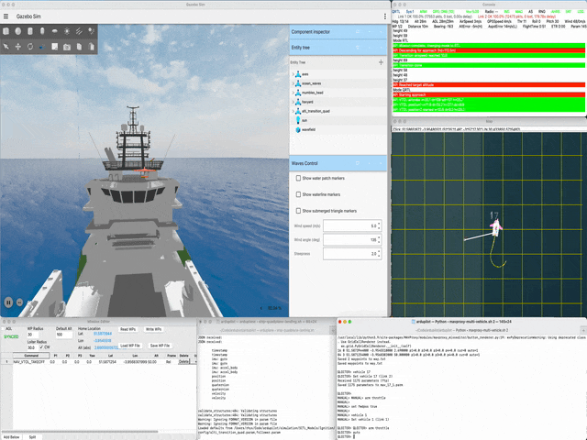
Gazeo multi-vehicle
Alti-transition quadplane.
Multi-vehicle simulation.
Ship subject to wave action.
GPS beacon set on ship deck.
ArduPilot: Moving platform takeoff & landing.

Slide 19
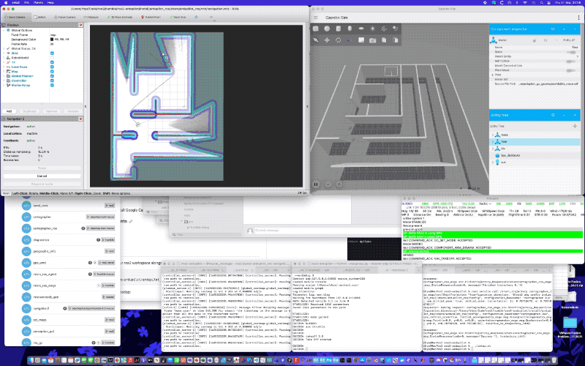
GSOC
2023 ArduPilot GSoC projects
Arsh Pratap (DDS extensions)
Pedro Fuoco (GPS denied nav)
Packages used
ArduPilot SITL
Micro XRCE DDS
ROS 2 Humble
Gazebo Garden (or Harmonic)
ros_gz bridge
nav2
More detail on ArduPilot Discourse
gsoc-2023 gps denied autonomous
gsoc-23 improvements for dds

Slide 20


Slide 21

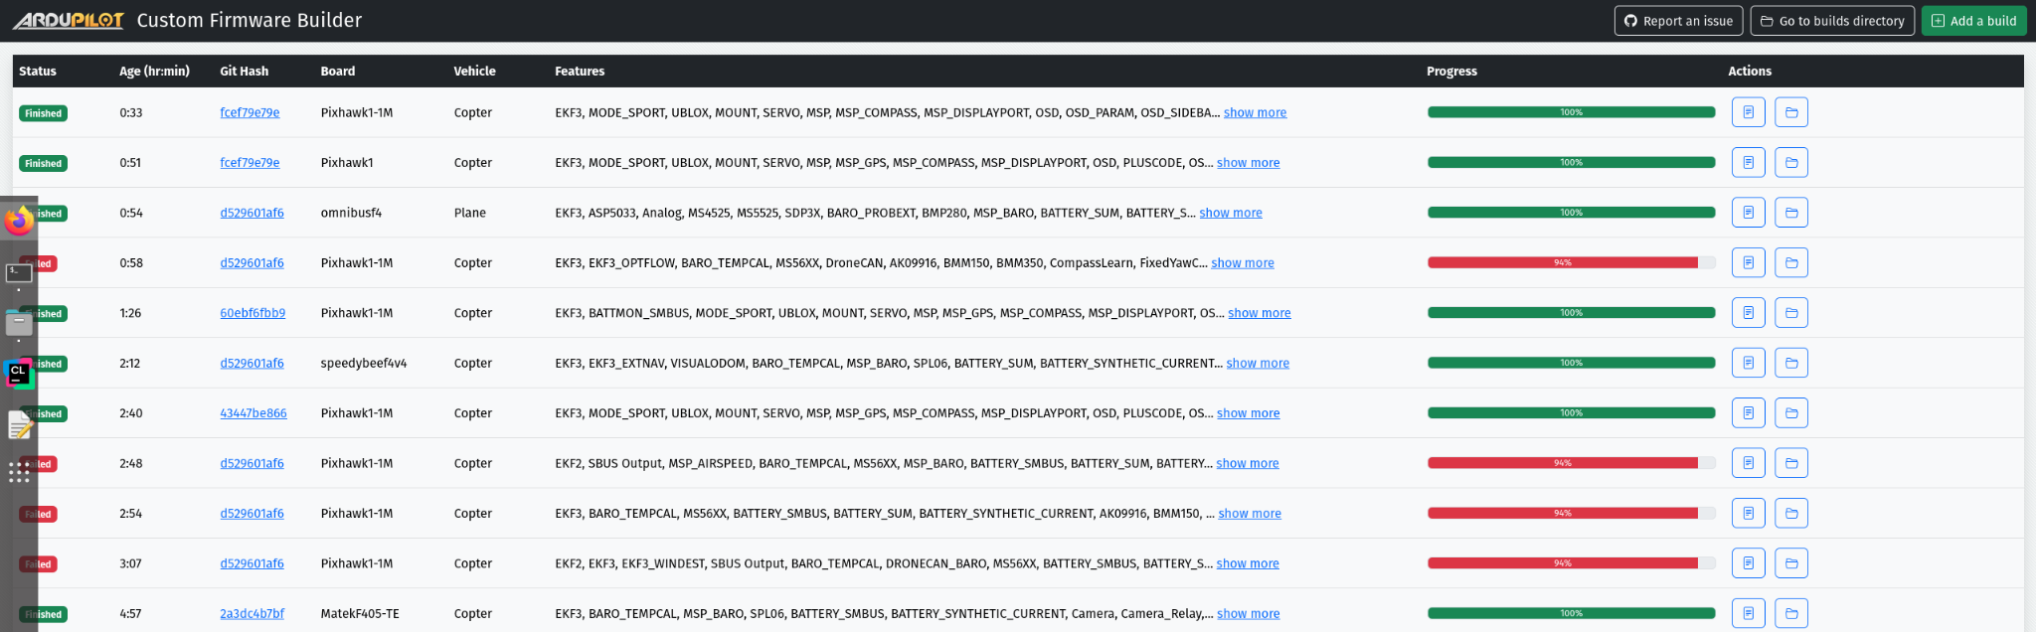
Useful Subprojects
AP Periph : use ArduPilot Libs/code for non autopilot device
MethodicConfigurator : Advanced and simple tuning guide and guideline
Custom Firmware Builder :
Online Custom firmware build
== I'm allergic to cmdline
Webtools : web based review tools

Slide 22
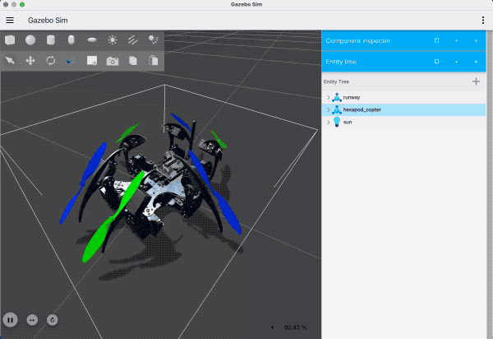
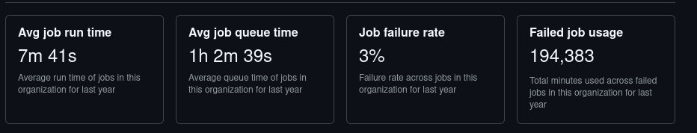
What are we looking for 2025 ?
Better CI again: Github Actions struggles
  Avg 75 targets (boards, sim, OS, etc) per PR
Better GCS
Better newcomers experience
More fun vehicles and use case
PoC for experimental frame suggested by @Buzz, David Buzz, implementation by Rhys Mainwaring
- 6 rotors + 16 (4 x 3 + 2 x 2) leg actuators.
- Lua (6 ch. Dynamics Scripting Matrix) + 16 scripting ch.
- https://github.com/ArduPilot/SITL_Models/pull/96.

Slide 23
ArduPilot Community
Thriving, friendly community
Main website and documentation ardupilot.org
Discussion and support site discuss.ardupilot.org
Developer chat on discord https://ardupilot.org/discord
Active commercial partner program https://ardupilot.org/about/partners
Source code https://github.com/ArduPilot/
Two dev calls a week
  Tuesday morning AU time (US friendly time)
  Wednesday evening AU time (EU friendly time)
  join on discord, new devs welcome
Contact :
pierre.kancir.emn@gmail.com

