Slide 1
European standards to serve both public transport and rail
Demystification of NeTEx, SIRI and TOMP API 2.0
FOSDEM 2025 - Railways and Open Transport

Slide 2
Let’s meet!

Slide 3





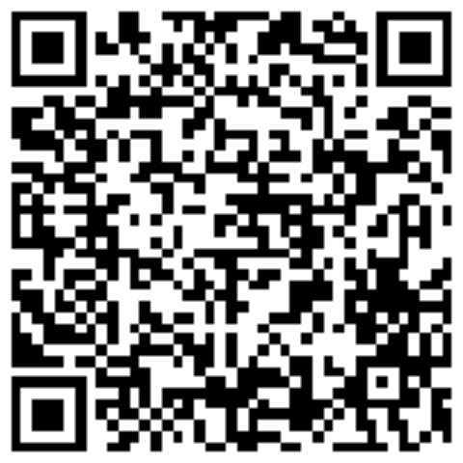



I am Brede.
Journey Planner, Team Owner @ Entur
brede.dammen@entur.org
Oslo, Norway
brededammen
Using standardisation as a tool, an open-source evangelist, building community and infrastructure for the future
Norwegian, English
github.com/opentripplanner
github.com/entur

Slide 4

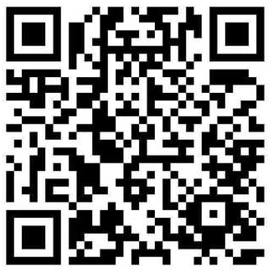
I am Edwin.
Software architect @ Dat.mobility/Goudappel
evdbelt@dat.nl
Netherlands
edwinvandenbelt
Effortless mobility for everyone via shared
and interoperable standards
Dutch, English

Slide 5

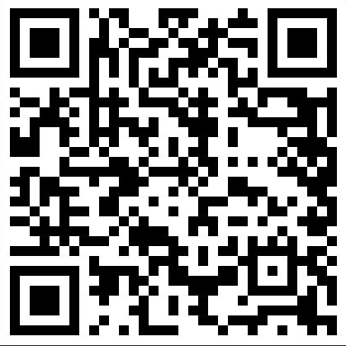
I am Tu-Tho.
Group Lead @ GT7 (AFNOR, BNTRA, CN03)
tutho@ttandj.com
Paris, France
tuthothai
Building communities and their inclusion,
leveraging technology and collective intelligence
French, English, Vietnamese, Spanish

Slide 6
Railways meet Public Transport

Slide 7
European legal framework
For Multimodal travels
Legal act: MMTIS Delegated Regulation
The spirit: support trip planning across Europe based on open data
Recommended standards
  For static data: NeTEx
  For real-time data: SIRI
For Railways
Legal act: TSI Telematics Delegated Regulation
The spirit: support rail travel across Europe
Recommended standard for the planning phase: NeTEx

Slide 8




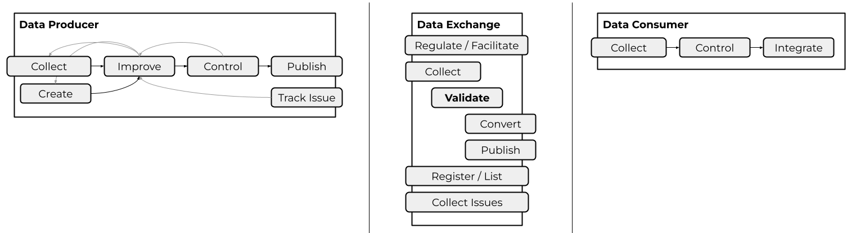
National Access Point (NAP)
But we need to focus on them
Transport Operators and
Public Transport Agencies
Journey planners, ticketing systems & Other data consumers
NAPs
They need harmonised data for
Routing systems
Passengers information, incl. Fares information
Booking systems
Etc.

Slide 9
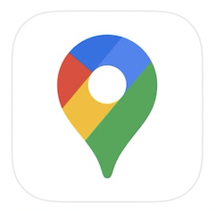
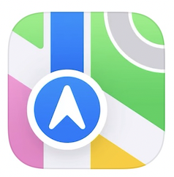























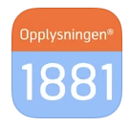

From a route planner perspective
National stop place registry
Route planning system
NAP
OpenStreetMap
Local realtime system

Slide 10
European standards for all

Slide 11

Why use Open Standards?
Technical data exchange formats for public transport data exchange
💁How do you describe a bus stop?
💁How do you describe a rail service?
💁How do you update a specific journey with real time forecast?
💁How do you describe seating arrangements?
💁How do you describe access rights and conditions?
💁How do you describe static and dynamic pricing rules?
NeTEx
(exchange format static
data - Timetables)
SIRI
(exchange format dynamic
data - real time data)
Because open standards
✅ Establishes common terminologies and concepts
→ All speak the same “language”
✅ Allows data exchange at predictable ability & cost
→ All use a common exchange format
✅ Prevents national, sector or provider-specific format lock-in
→ Increases interoperability and markets opportunities
Transmodel
(Conceptual data model)
Reference model for information in the public transport sector

Slide 12
Transmodel ecosystem & de-facto standards
Transmodel
GTFS Schedule
GTFS Realtime
GTFS Fares
Passenger information
Trip
planning
Real-time
Trip updates
Query Stats
GBFS/TOMP-API
Fare
Management
Offers
Sales,
Validation &
Control
Transaction
Settlement
Transportation
Network
Scheduling
Vehicle
monitoring
Historic
operations
Functional Area
Infrastructure
Assets
management
Operation
execution
Historic
usage
PLANNING
OPERATIONS
HISTORY
Before Travel
During Travel
After Travel
Time
NeTEx
SIRI
OpRa

Slide 13







Overview of NeTEx
Part 1: Public Transport network topology
  Organisations
  Places & Points of Interest
  Line, Routes, etc.
Part 4: European Passenger Information Profile (EPIP)
  Subset dedicated to passenger information applications / software
  The “closest” to GTFS schedule
Part 2: Scheduled Timetables
  Service calendar
  Timetables
  Connection details
Part 5: Alternative modes
  Subset dedicated to all alternative modes
  Where the mapping with GBFS can be found for passenger information
GBFS
Part 3: Fares information
  Fare structures & products
  Actual price data
  Sales conditions
Part 6: European Passenger Information Accessibility Profile (EPIAP)
  Subset dedicated to information on accessibility
github.com/NeTEx-CEN/NeTEx

Slide 14







Overview of SIRI
Timetable
  Production Timetable Service
  Estimated Timetable Service
Stop
  Stop Timetable Service
  Stop Monitoring Service
Vehicle Monitoring Service
Connection
  Connection Timetable Service
  Connection Monitoring Service
General Message Service
Situation Exchange Service
Facility Monitoring service
github.com/SIRI-CEN/SIRI

Slide 15
Diving into TOMP-API 2.0
github.com/TOMP-WG/TOMP-API

Slide 16

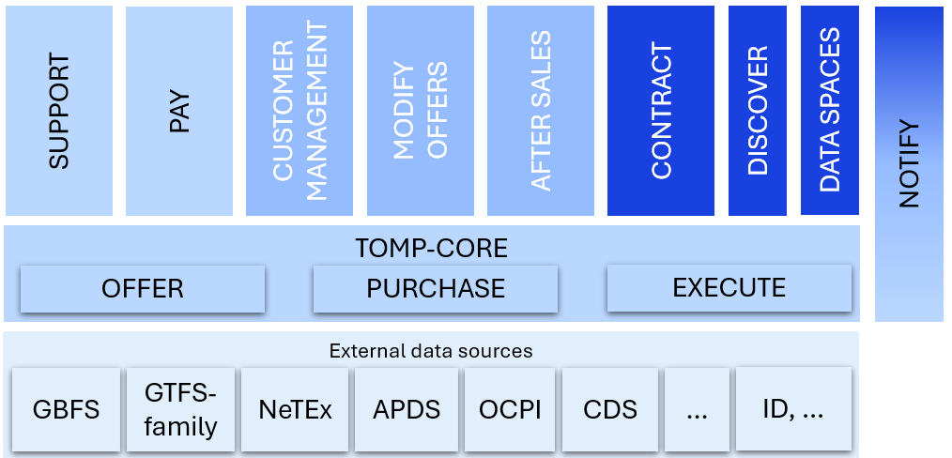
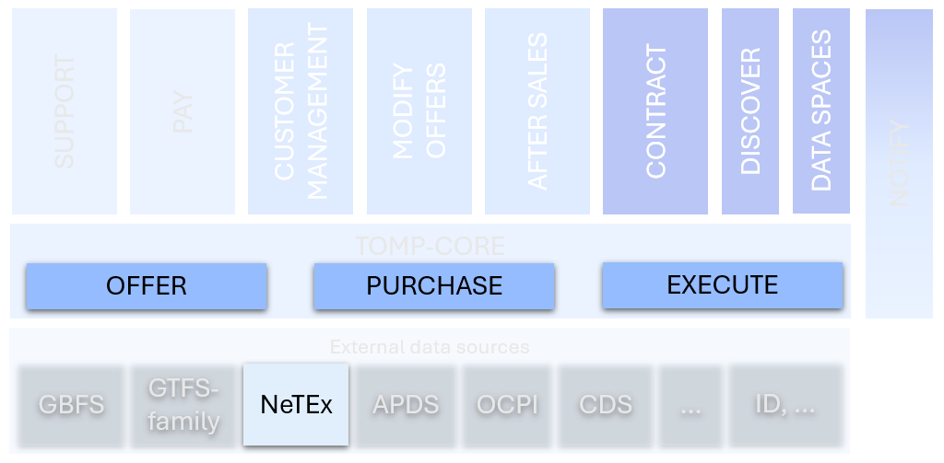
Context
Integration of societal goals
Governance & PP-cooperation
Integration of service offer
Bundling/subscription
Integration of payment/services
Single trip – find, book and pay
Integration of information
Multimodal travel planner, price info
No integration
Single, separate services

Slide 17
Building blocks
Transmodel
NeTEx
GeoJSON
OGC (Features)
TOMP-API v2.0

Slide 18
MVP – OGC
“Joint”
  Landing page : GET /
Offers
  GET /collections/offers/items
    Parameters using Transmodel (conceptual modal of a.o. NeTEx)
    Returns geoJSON, features represent offered packages
Purchase
  POST /collections/purchases/items/{offerId}
    Returns geoJSON, features represent legs (or products)
Execute
  GET /collections/packages/items/{id}
    Returns geoJSON, features represent legs, contains access to tickets/access information

Slide 19
Landing page
Landing page : GET /
Returns a (machine & human readable) overview of the API, including:
  General info (title, description, etc)
  Links: ‘the menu’, bootstrap links to start the TOMP process
    e.g. how to request offers (using extended RFC 8288)
  DataSources (non-OGC, RFC 8288)
    { "rel": "ARR",
    "type": "application/xml+netex",
    "href": "url to location of the NeTEx file" }
Notes:
This is NO HATEOAS

Slide 20
Request offers
GeoJSON
Features
Geometry
GET /collections/offers/items
? From=“gps:6.234,34.2395” or ”ARR:ScheduledStopPoint:3-3498B”
& validity={type:”SERVICE”,
serviceJourney:”ARR:ServiceJourney:613231:169:16969#LT:P818”}
Result: geoJSON with offered packages (includes legs with services, or products like day cards)
Each offer contains a link to a booking location, like a TOMP-purchase endpoint, a booking webpage or a deep-link into an app
Properties { type: package, id: DD3 }
Links:
details - GET /collections/offers/items/DD3
purchase - POST /collections/purchases/items/DD3
android – myapp:…
geometry
properties
links
geometry
properties
Notes:
This is NO HATEOAS

Slide 21
Get the ticket
GeoJSON
Features
Geometry
GET /collections/packages/items/DD3
Without leg-id: a package-GeoJSON
containing all legs
With a leg-id: a filtered package-
GeoJSON, wit the specified leg
Leg operations are in the ‘links’
segment of the leg (feature)
Package operations are in ‘links’
segment of the package
Properties { type: leg, id: DD3-1 }
Links:
travel_document – GET /collections/packages/items/DD3?elementId=DD3-1
[or a custom URL]
revoke – POST /collections/legs/items/DD3?elementId=DD3-1&operation=revoke_ticket
Properties: { type: package, id: DD3, … }
Links:
cancel – POST /collections/purchases/items/DD3
?operation=cancel
Notes:
This is NO HATEOAS

Slide 22

Motivation pitch
Transport Operators and
Public Transport Agencies
Journey planners, ticketing systems & Other data consumers
NAPs
They need harmonised data for
Routing systems
Passengers information, incl. Fares information
Booking systems
Etc.

Slide 23
Thank you!
Brede Dammen
brede.dammen@entur.org
Edwin van den Belt
evdbelt@dat.nl
Tu-Tho Thai
tutho@ttandj.com

