Slide 1
Unlocking Open-Source Capabilities in the Copernicus Data Space Ecosystem
FOSDEM’²⁵
31 January 2025

Slide 2
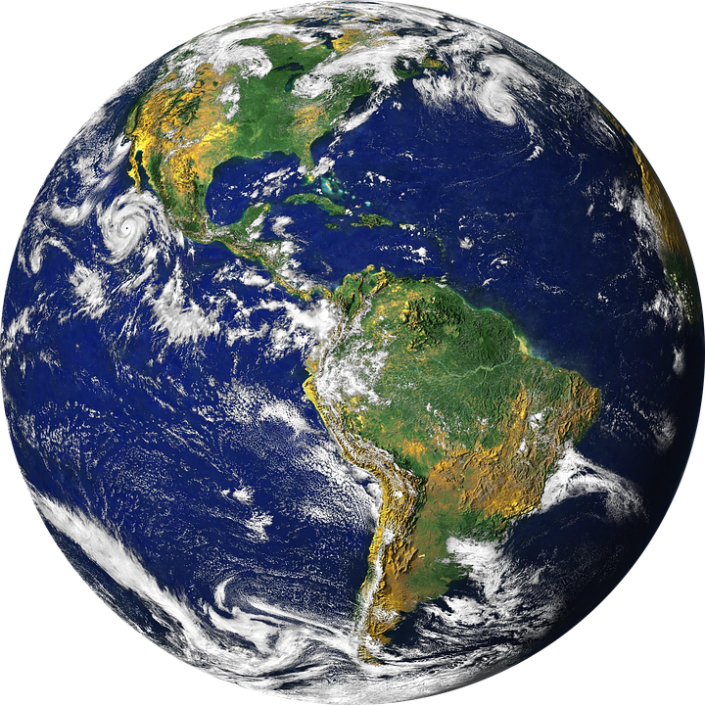
Content
What is Remote Sensing?
Earth Observation: Monitoring our Planet
Data to information
Introducing Copernicus Data Space Ecosystem (CDSE)
CDSE Components
  Data
  APIs
  Applications/Platforms
Community and support

Slide 3
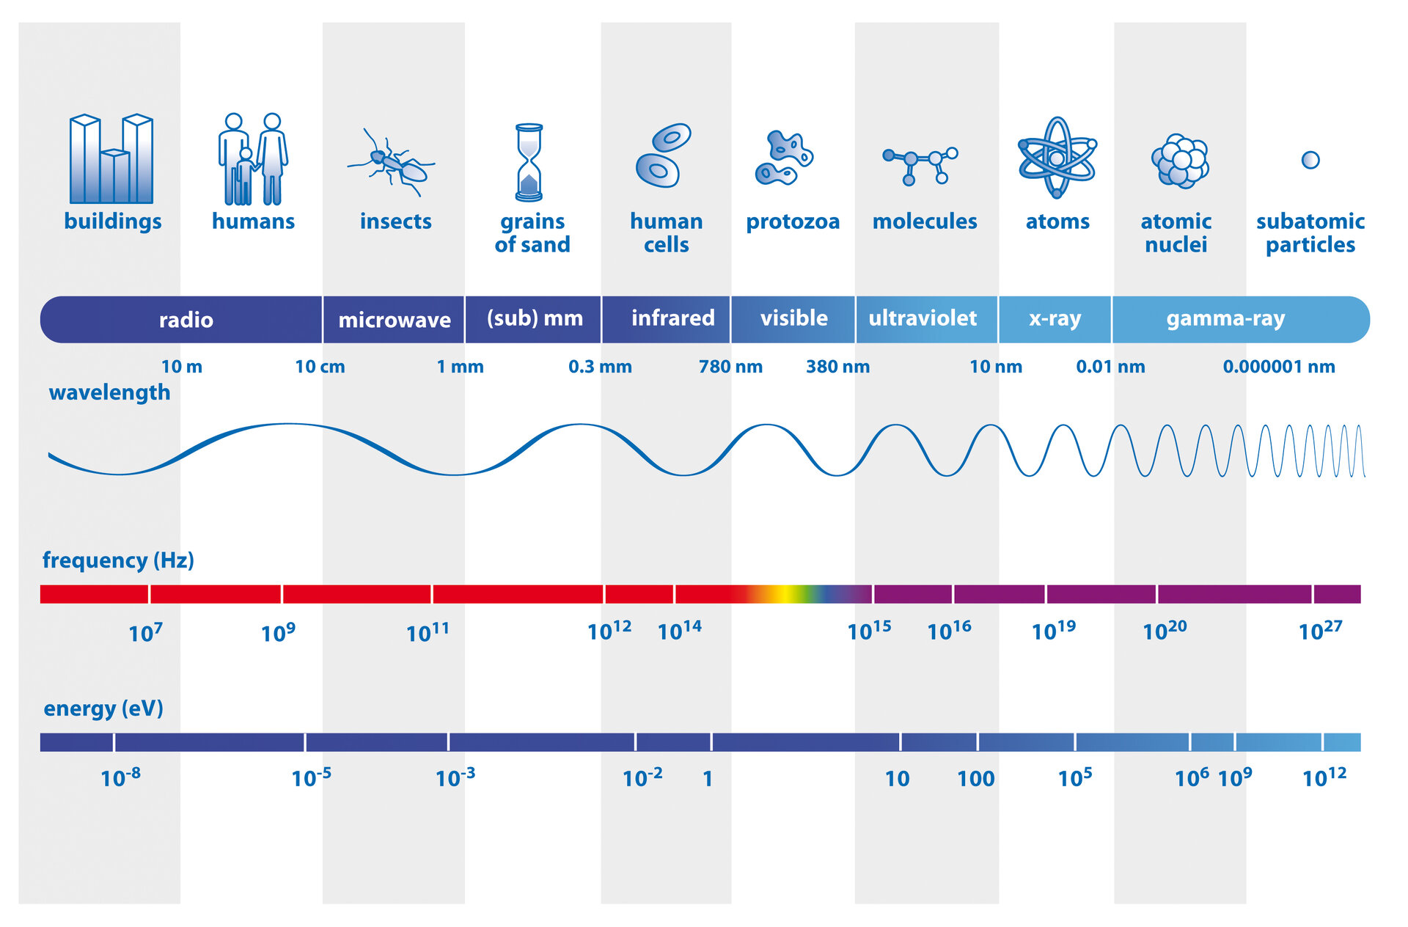
Quick Introduction to Remote Sensing
Naturally the best way to observe any phenomena is by looking at it.
As humans, we do this with our eyes.
Remote Sensing sensors aim to mimic this, detecting other parts of the spectrum, such as the ultraviolet and infrared wavelengths of the electromagnetic spectrum.
Credit: ESA / AOES Medialab
Definition: Remote sensing is the process of detecting and monitoring the physical characteristics of an area by measuring its reflected and emitted radiation at a distance (typically from satellite or aircraft).
Notes:
Naturally, the best way to observe any phenomenon is by looking at it—just as we do with our eyes. Similarly, sensors placed at a distance mimic this behaviour, but they also have the capability to detect other parts of the electromagnetic spectrum beyond what human vision allows. This entire process is known as Remote Sensing. In simple terms, it involves detecting and monitoring the physical characteristics of an area by measuring its reflected and emitted radiation from a distance, typically using satellites or aircraft.

Slide 4
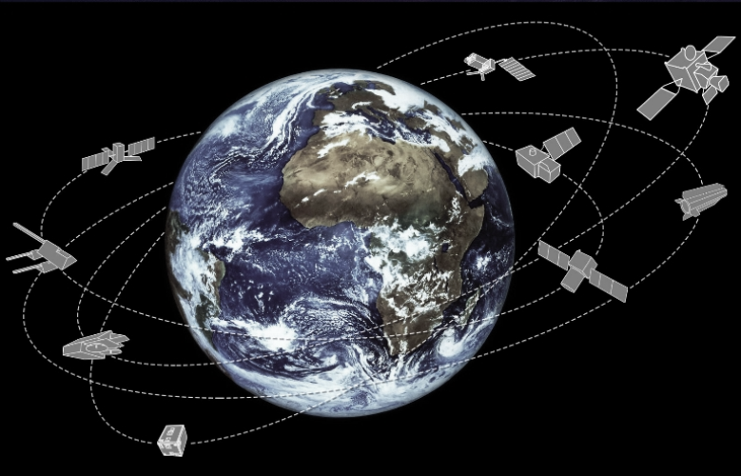
Earth Observation: Monitoring our Planet
Earth Observation (EO) can be defined as the process of acquiring observations of the Earth’s surface and atmosphere via remote sensing methods.
Obtain spatially and temporally continuous global maps.
Powerful tool for monitoring physical processes and human activities at all scales.
© ESA
Notes:
It is a Remote Sensing process where we acquire observations of the Earth's surface, both above and below it. EO satellites enable this on a global scale, continuously capturing valuable data. This process helps generate spatial and temporal maps, monitor physical processes, and track human activities across various scales.

Slide 5
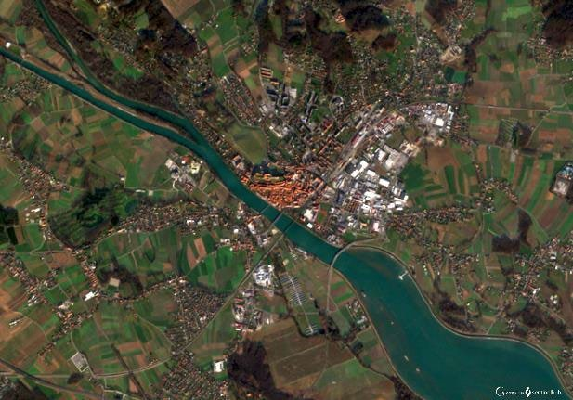
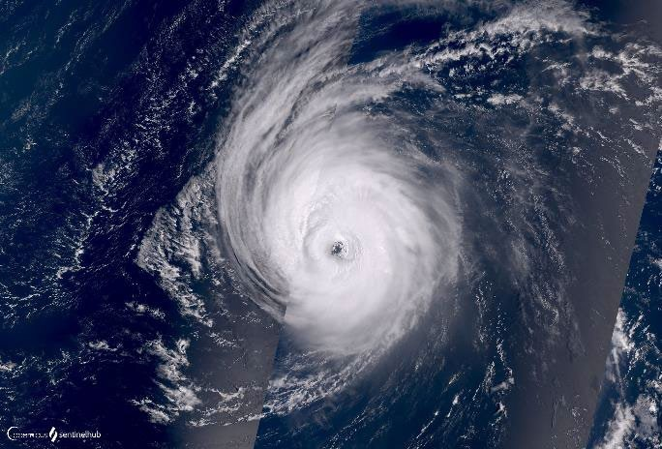

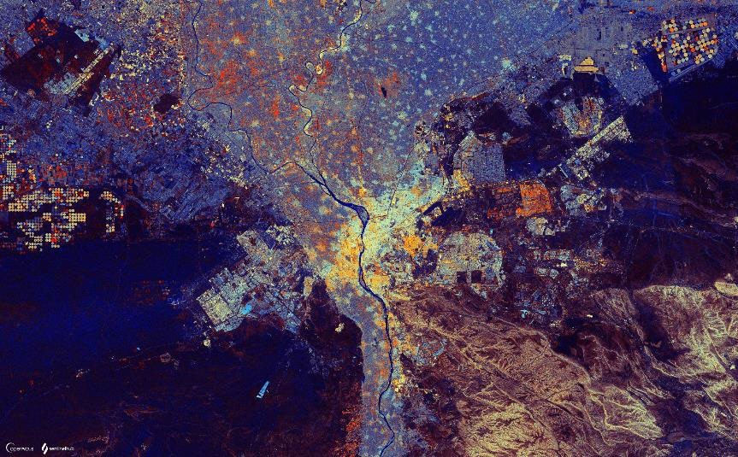
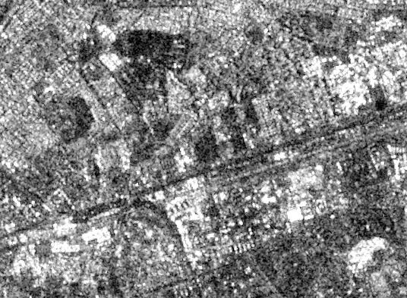
Remote Sensing Data into Insights
The acquired data are processed and analysed to extract different types of information
TBs of data are acquired every day.
Notes:
By analyzing EO data, we can make informed decisions on a wide range of topics—whether it's monitoring land surfaces, water bodies, temperature variations, urbanization, or other critical environmental factors. Every day, terabytes of data are collected, providing crucial insights for research, planning, and decision-making.

Slide 6
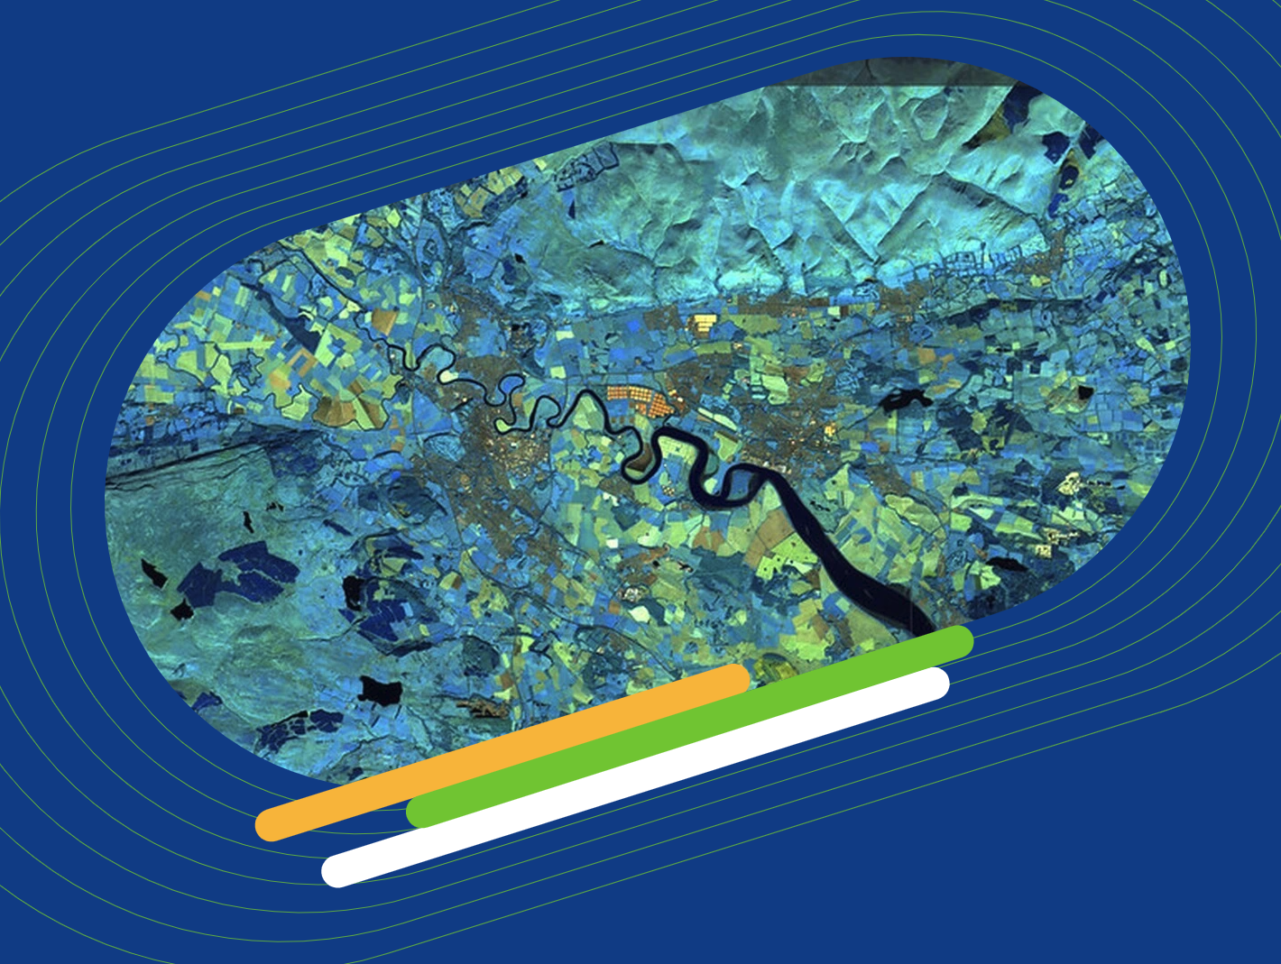
Copernicus Data Space Ecosystem (CDSE)
Immediate access to large amounts of open and free Earth observation data from the Copernicus Sentinel satellites and Copernicus Contributing Mission
This service will be the largest, immediately available data offer, available for download, streaming and on-demand processing with a wide range of cloud options.
It empowers users with the tools and resources.
Notes:
With the ever-growing volume of EO data, managing and accessing it has always been a challenge. To address this, the Copernicus Data Space Ecosystem (CDSE) was introduced. This platform provides immediate access to vast amounts of open and free EO data at one place, along with a set of processing tools to facilitate analysis and application.

Slide 7
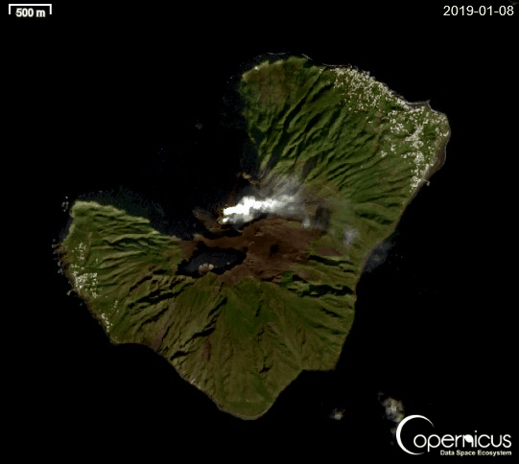
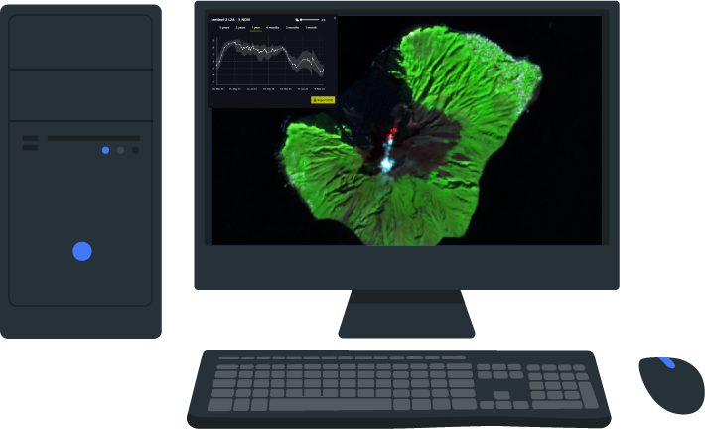
Copernicus Data Space Ecosystem
Data Access
Data Processing
Data Visualization
Notes:
In summary, CDSE is a user-centric platform that provides access to EO datasets, offers a range of tools for data processing, and data visualization.

Slide 8









CDSE components
What is Copernicus Data Space Ecosystem?
Streamlined data access with API-s
Additional
EO Data
CCM Data
Federation and user identity services
Sentinel Data
Cloud Computing Capacity
Online Code Labs and Interfaces
Copernicus Browser
Open
Ecosystem
Onboard Code Repositorites

Slide 9

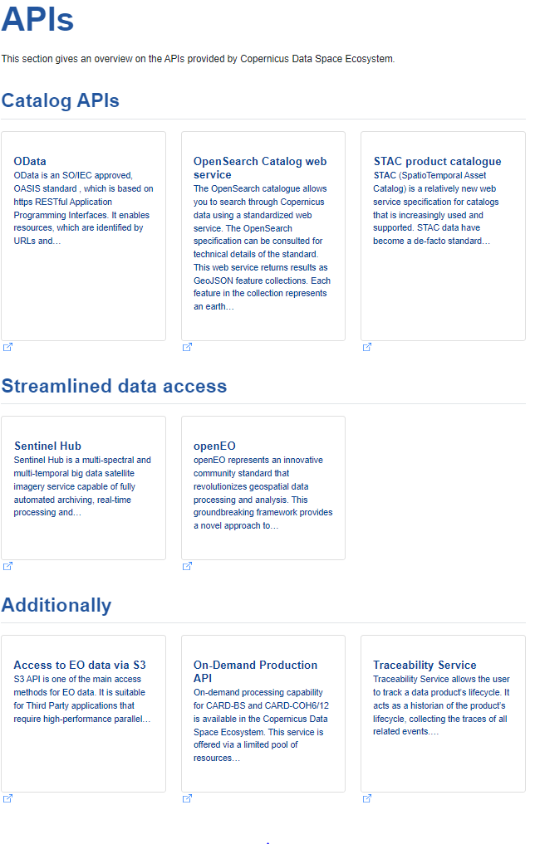
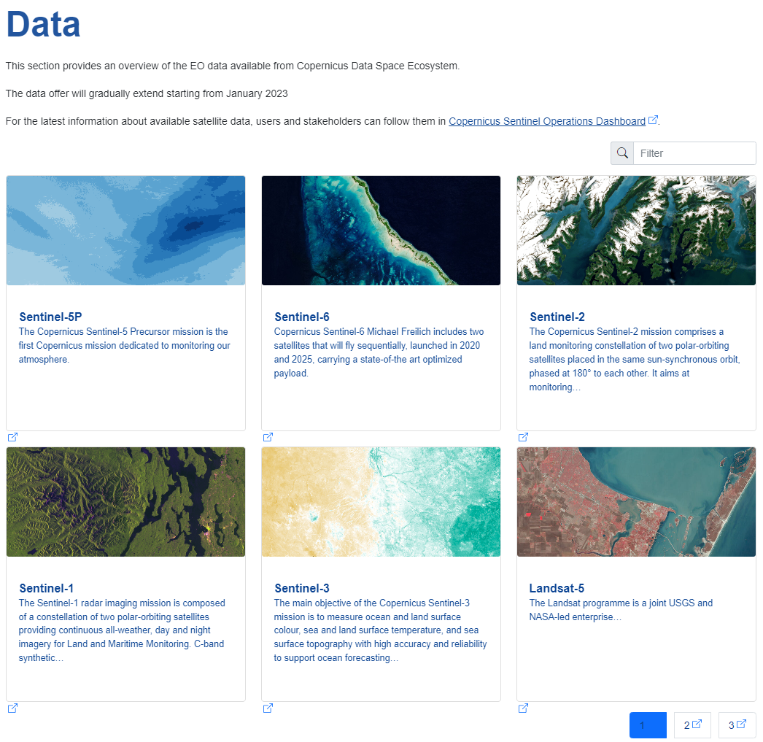
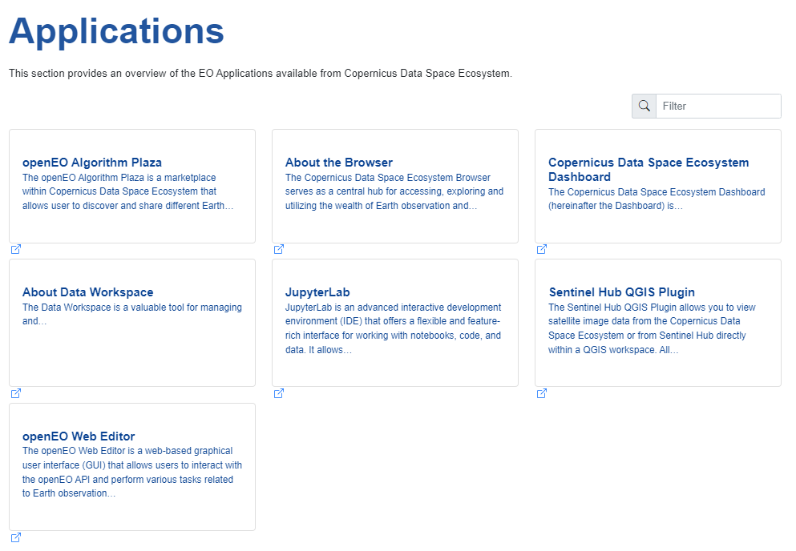

Data Access and Processing API: openEO
CDSE components
All Copernicus Sentinel Data

Slide 10
With openEO
openEO instance in Copernicus Data Space Ecosystem
Simple data access & processing for multiple Earth observation datasets
Scalable and efficient processing capabilities
A standardized system that works across different platforms
Independence from underlying technologies and software libraries
Supporting principles of FAIR (Findable, Accessible, Interoperable, and Reusable) data and Open Science, e.g. transparent workflows for reproducibility

Slide 11
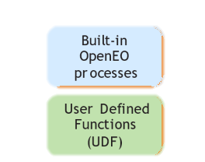
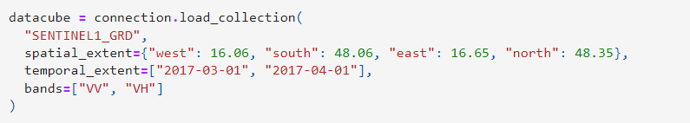

openEO Workflow
CDSE components
Authenticate
Load collection
Apply Algorithm
https://processes.openeo.org/
https://open-eo.github.io/openeo-python-client/udf.html
General Process
User-defined functions
Write results

Slide 12
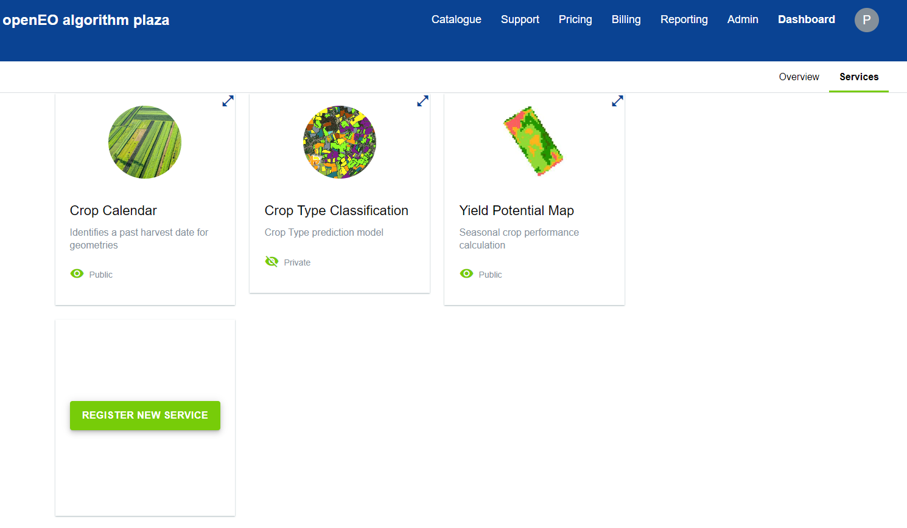
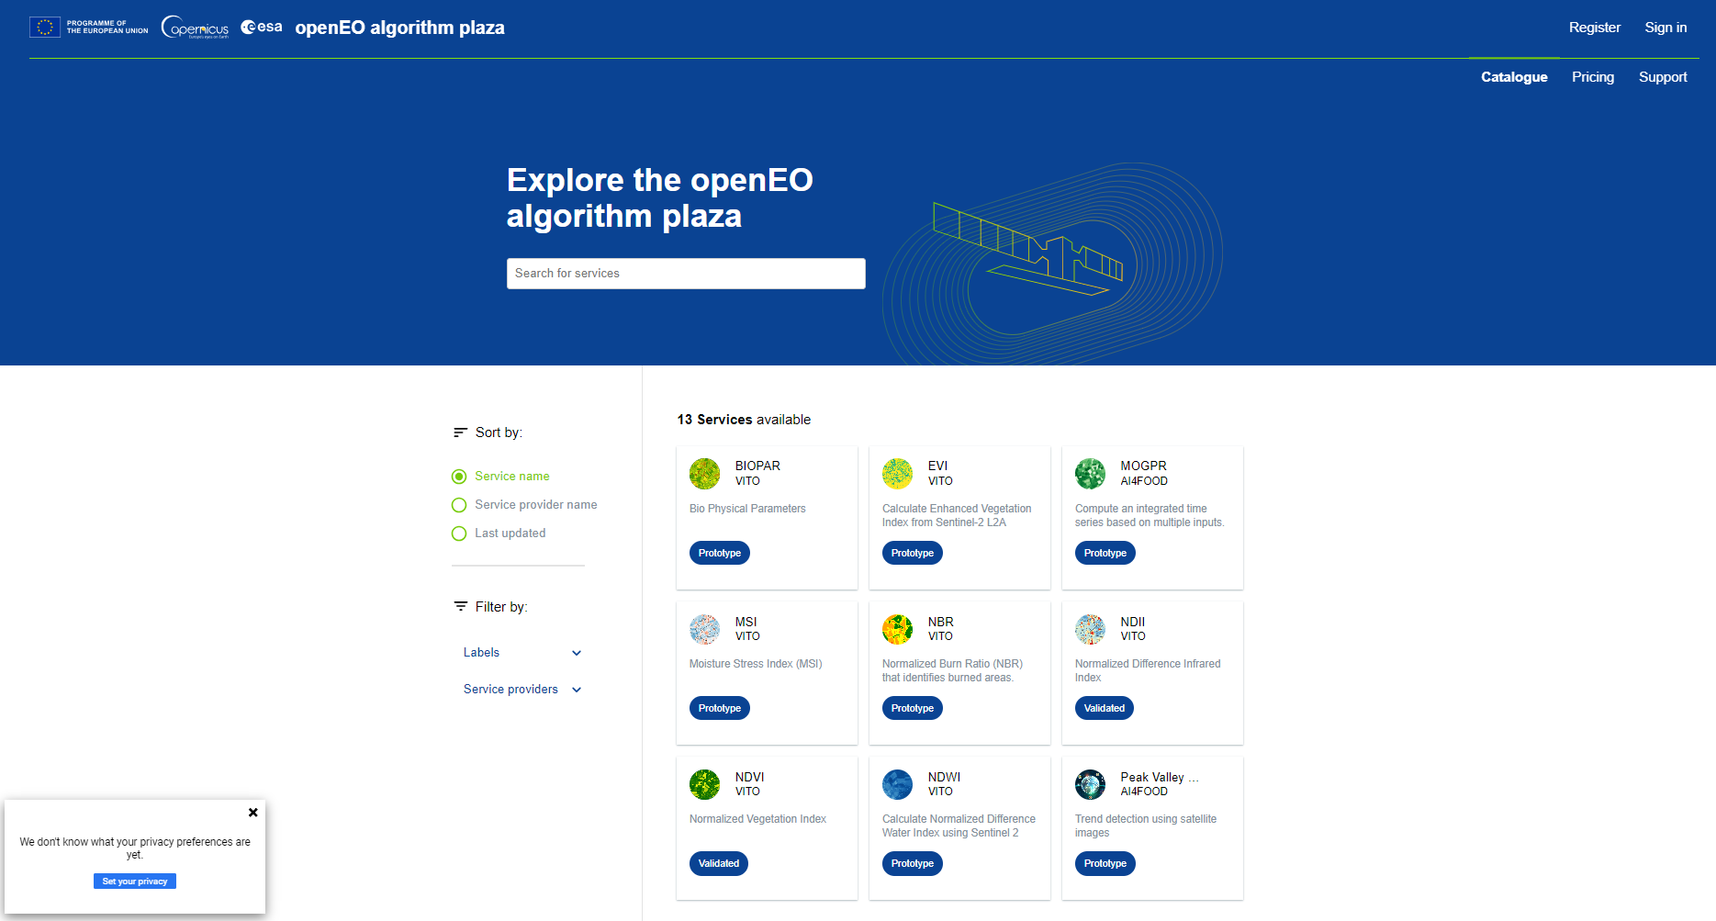
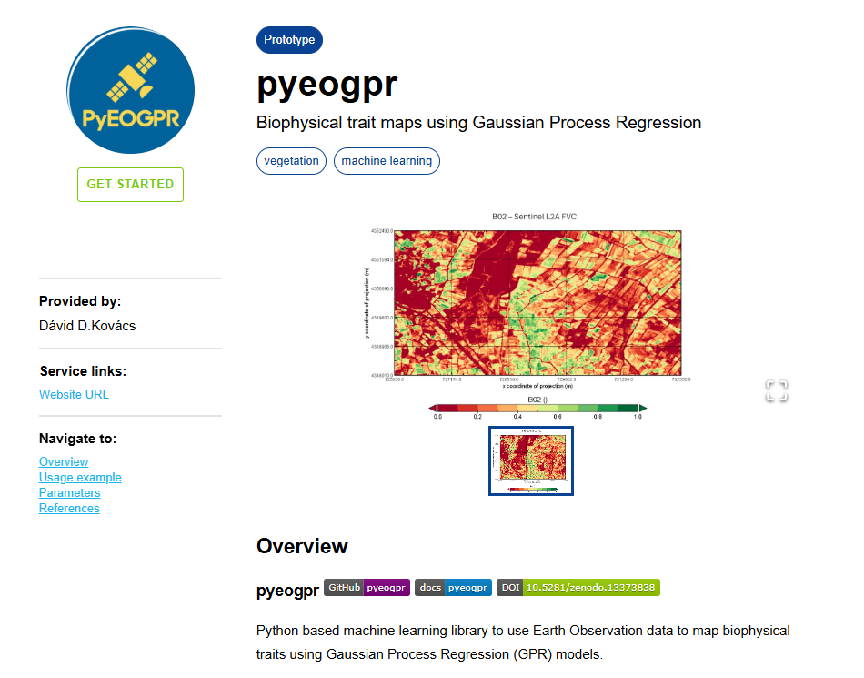
CDSE Components

Slide 13
Demo
CDSE Component; openEO
https://jupyterhub.dataspace.copernicus.eu/
https://github.com/Open-EO

Slide 14
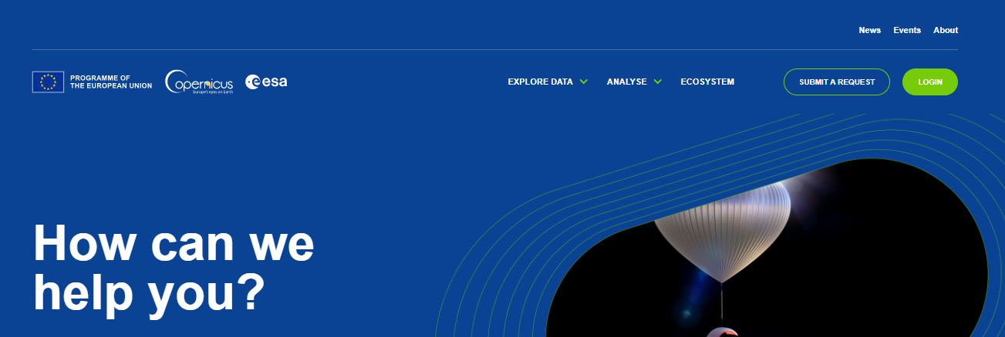
Community and Support
Datasets generated by federated parties and individual users
Codebase, free and commercial algorithms
Use cases, network of processing pipelines
Collaboration
  In this public, independent, open platform

Slide 15
A free, public platform for EO-based solution development
Share your datasets to reach a wide range of collaborators
Share your analysis tools and products for operational use
Use the official, authoritative IT component of the Copernicus Programme
A Transformative Solution for Earth Observation

Slide 16
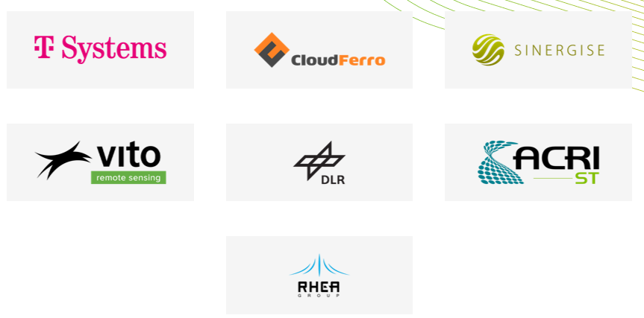
Thank you for your attention
On behalf of the whole consortium
Pratichhya Sharma
pratichhya.sharma@vito.be
Notes:
Slide for subtitle / new section in the presentation

Slide 17
CDSE components
The full and up-to-date authoritative source
for all Sentinel user data, digitally traced
for a permanent record of authenticity
Immediately available, free and open data
https://documentation.dataspace.copernicus.eu/Data.html

Slide 18
CDSE components
Search for data in your country over a specific month or based on any criteria
Access and process EO dataset
https://documentation.dataspace.copernicus.eu/APIs.html

Slide 19
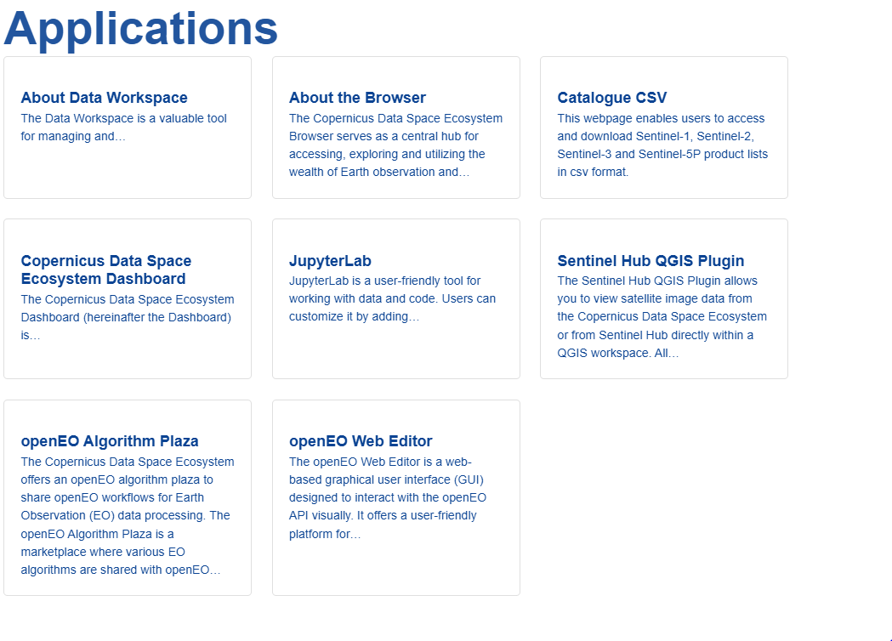
CDSE components
Can be used to access, process, and visualize Copernicus data.
For users, new to the Ecosystem: Copernicus Brower
Advance users, for interactive analysis: Jupyter Lab, openEO web-editor
Share and use EO workflows: openEO Algorithm Plaza
https://documentation.dataspace.copernicus.eu/APIs.html

Slide 20
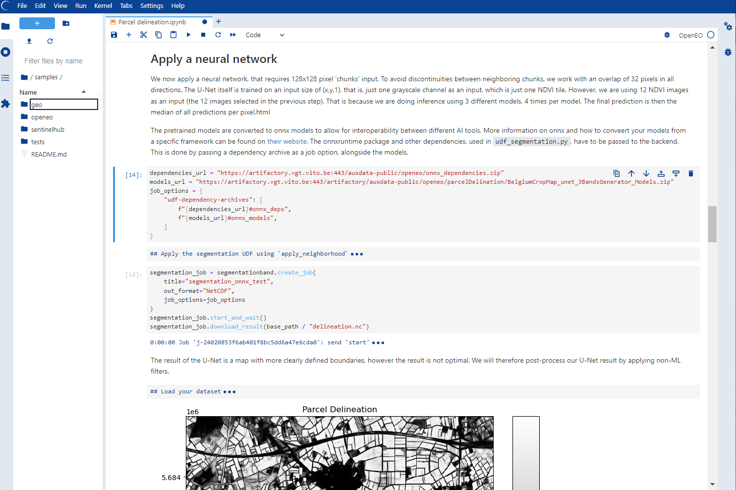
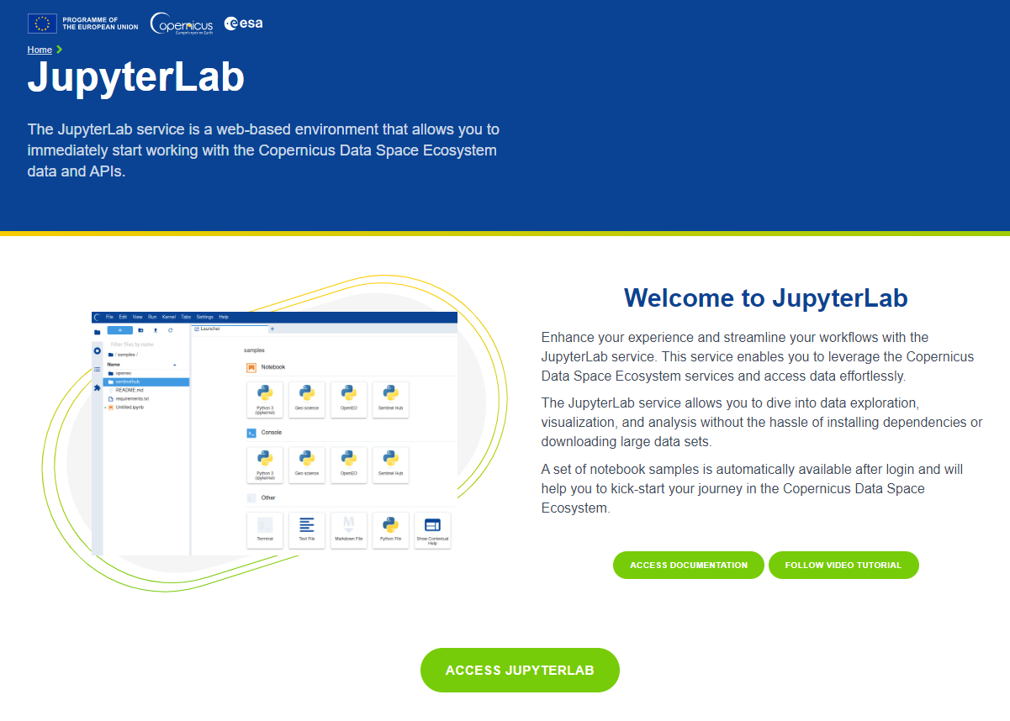
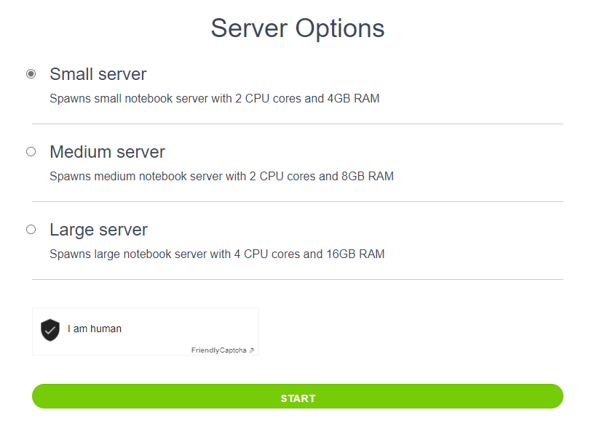
CDSE Components
Python Kernel
R Kernel

Slide 21
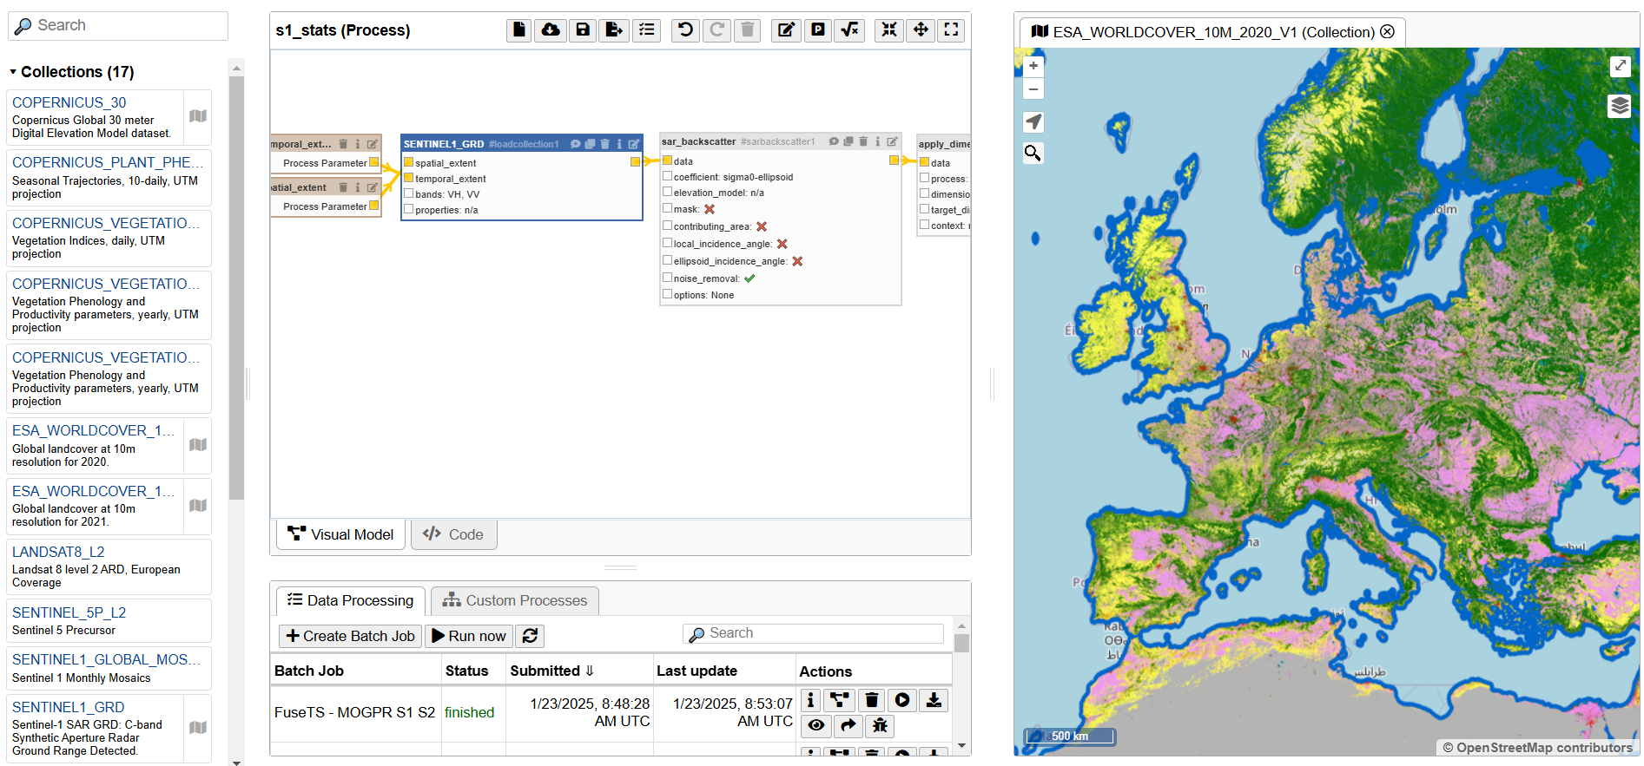
openEO web-editor
CDSE components

Slide 22
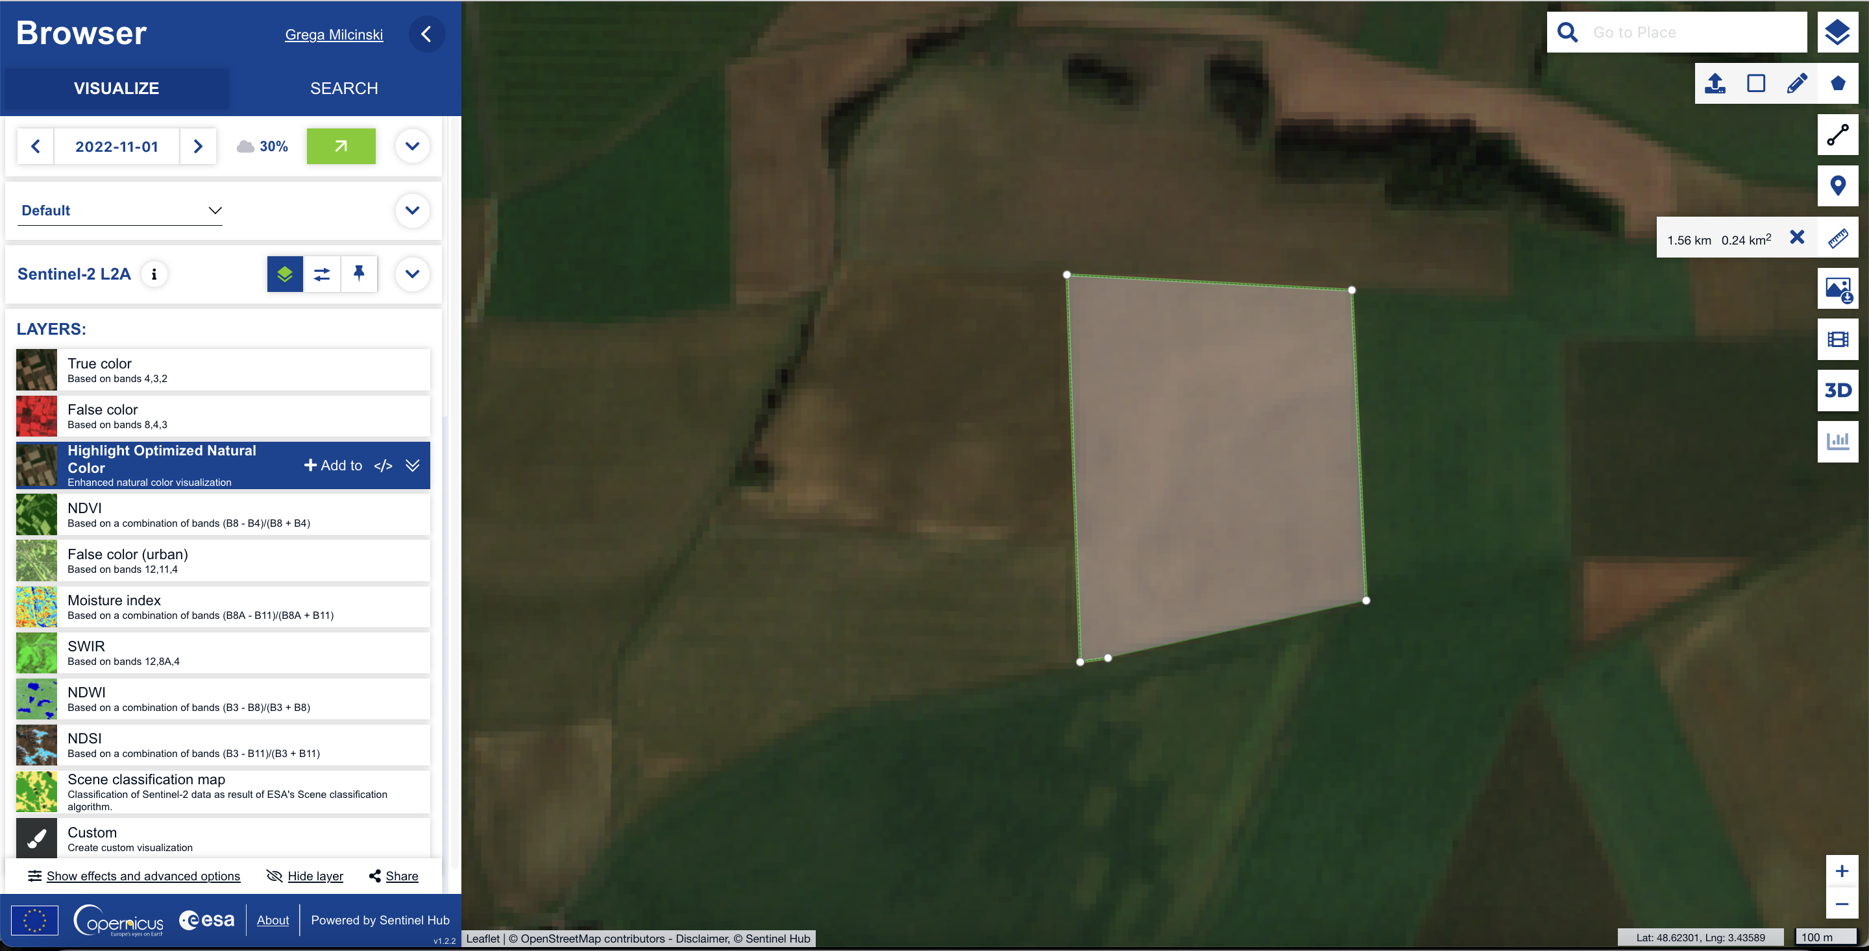
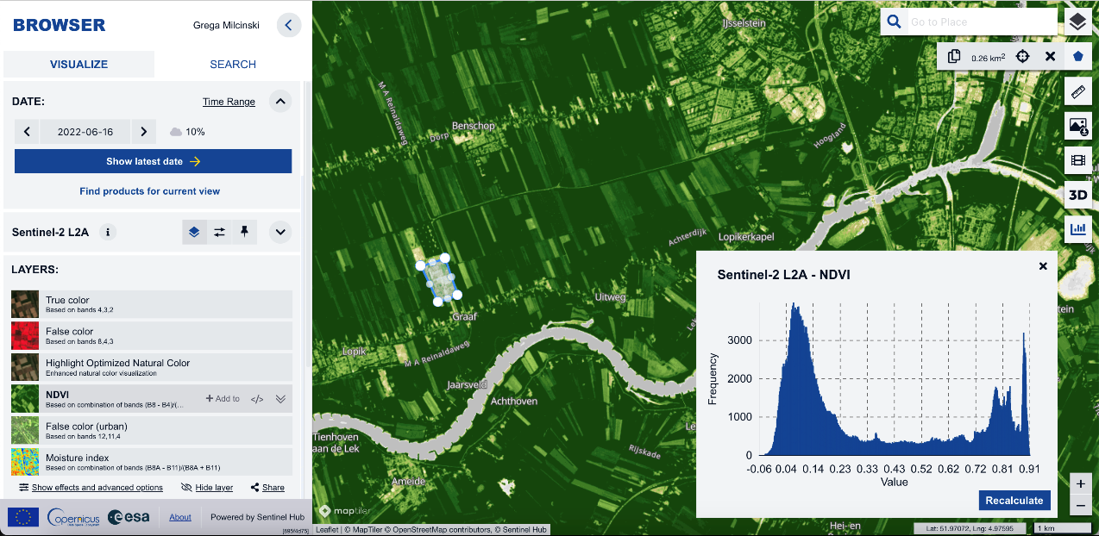
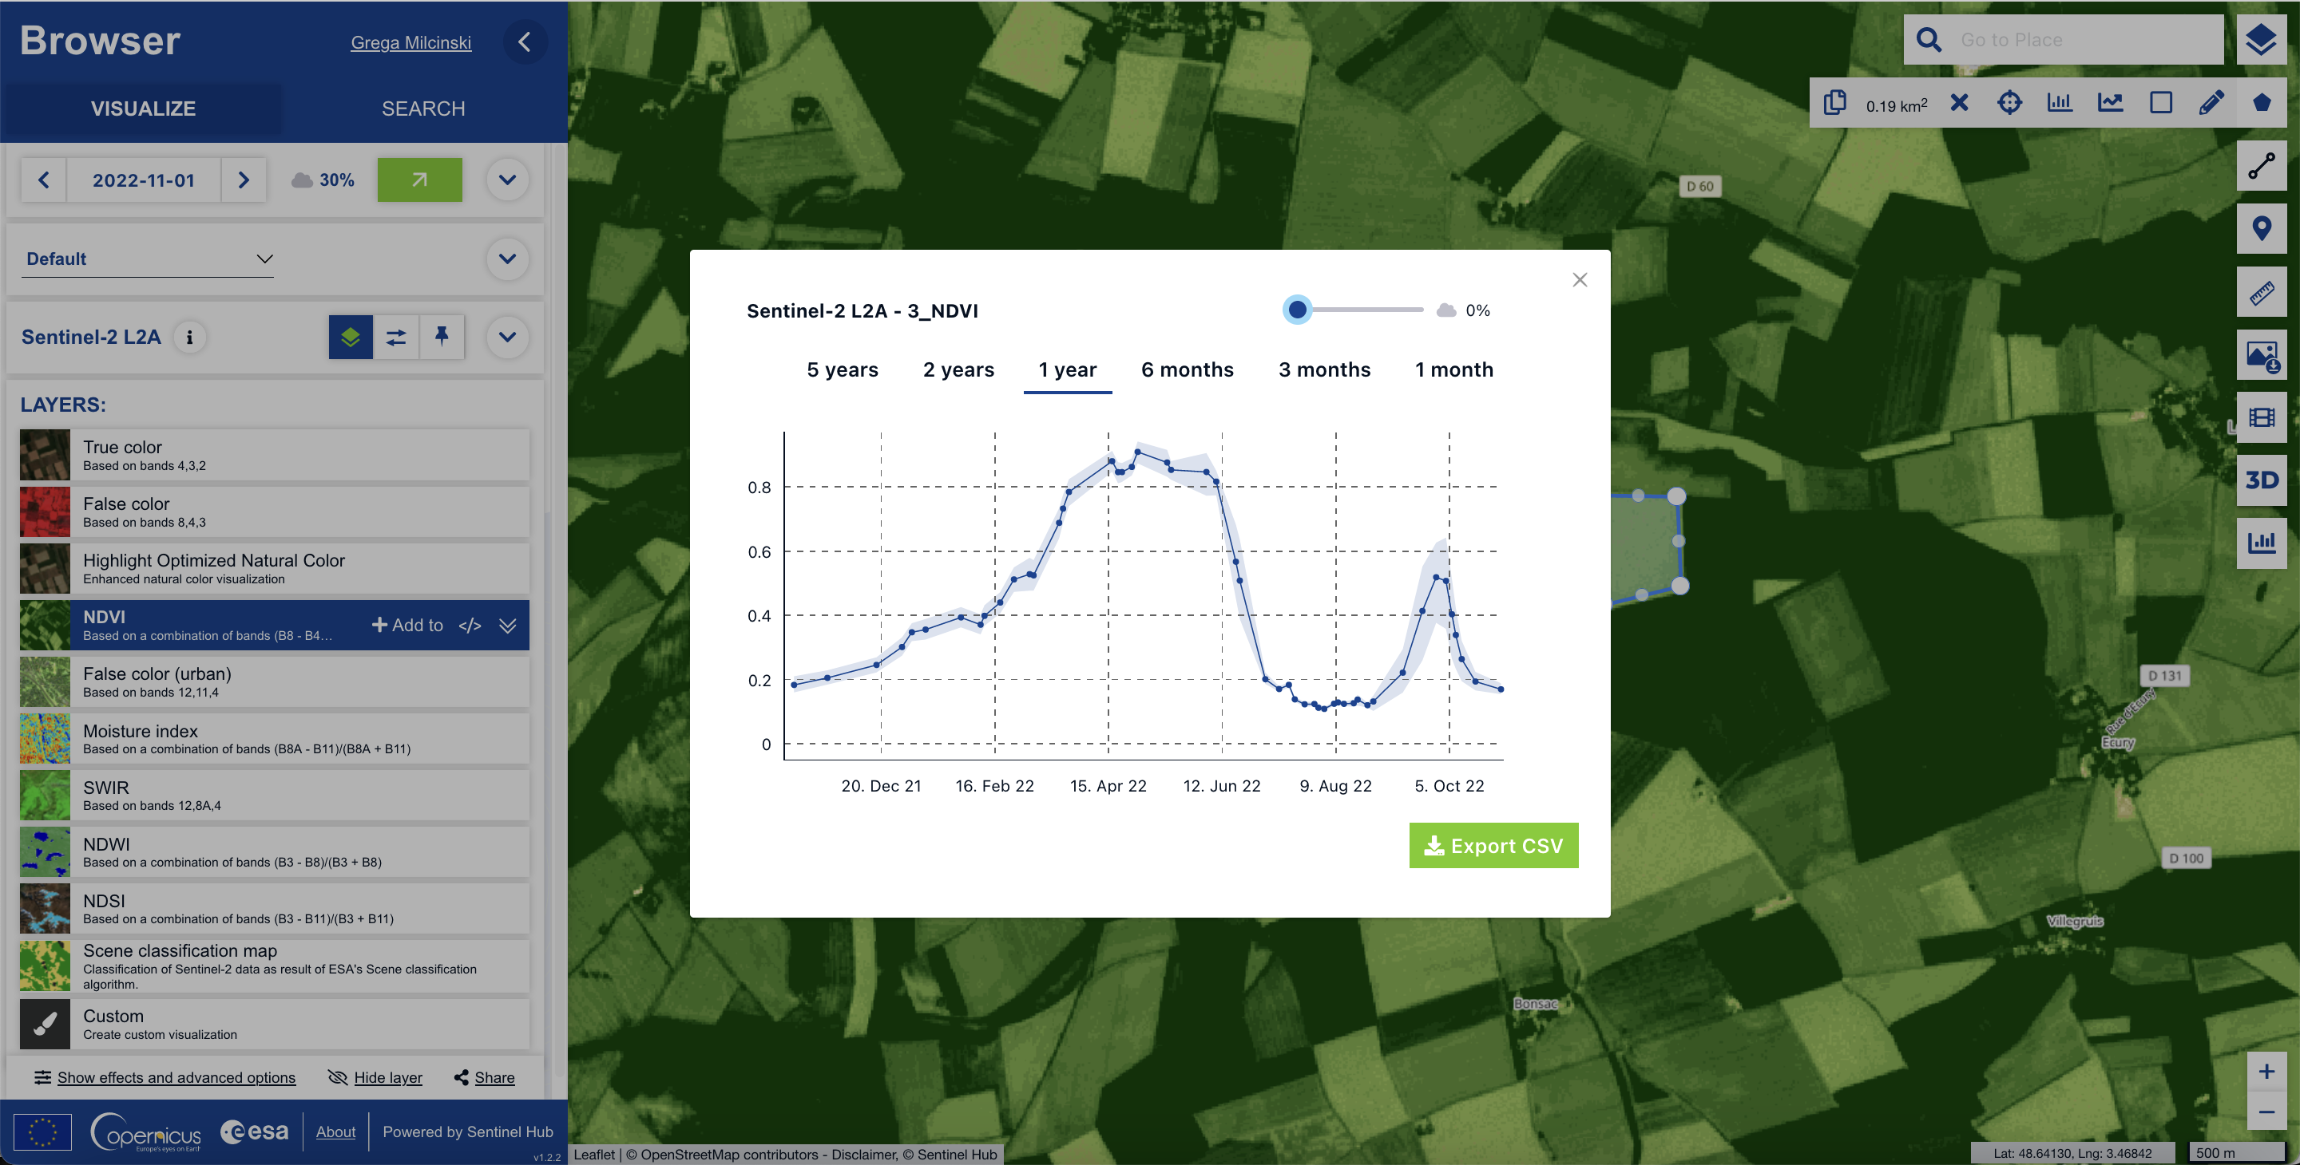
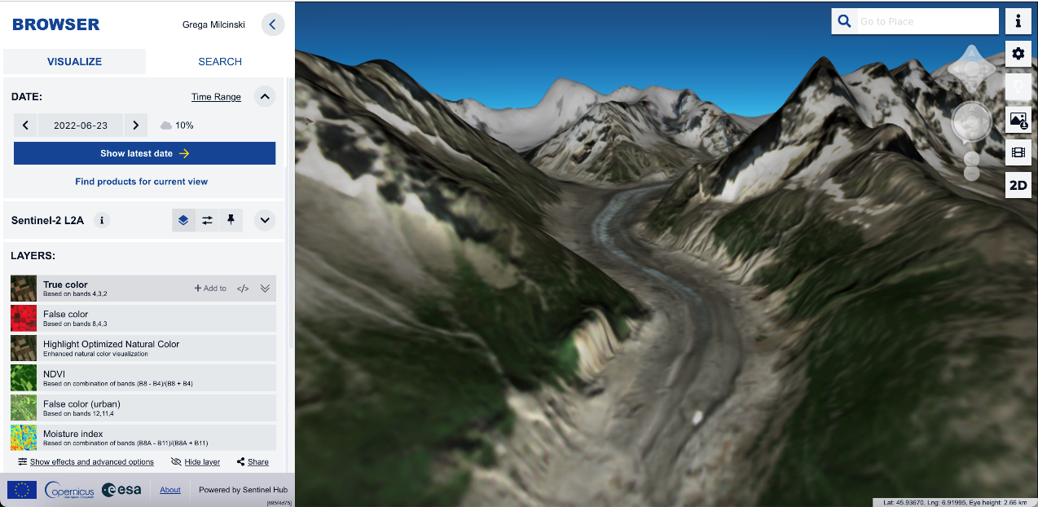
Copernicus Browser
https://browser.dataspace.copernicus.eu/
Free to use
  Overall analysis of Earth Observation data
  Visual comprehension
Interactive use
  No IT knowledge needed
  Perfect for downstream applications
Time series analysis
  Investigate crop phenology
  Yield prediction
3D exploration and visaulisation

Slide 23

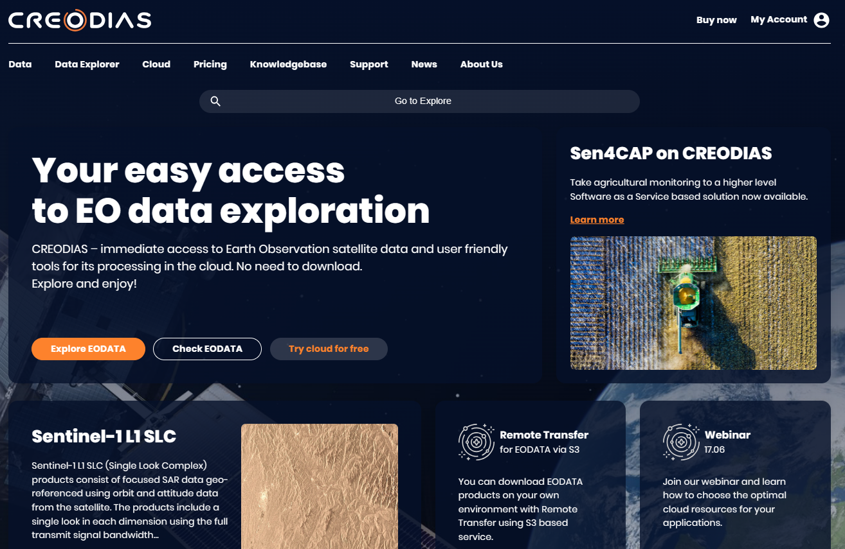
CREODIAS 2.0 – first commercial element of the Copernicus Data Access Ecosystem
Immediate access to EODATA
User friendly tools
Cloud services for data processing
Serverless processing
Competitive pricing
Premium support

Slide 24
Download vs API access
The legacy way – download-based data access
Data is available in pre-defined tiles
Rolling archive: current data is immediately accessible, but archive data has to be queried and made available
Raw data storage on the client side needed
Data has to be moved to servers or virtual machin es
Requires heavy investment
Difficult to scale up
The new way – API based direct server-side processing
Data available for your Area of Interest
All datasets immediately available, no delay for requesting current or archive data
No need to store raw data on the client side
Virtual machines can be used that already have the data on board
Much less investment needed
Can be scaled dynamically

Slide 25
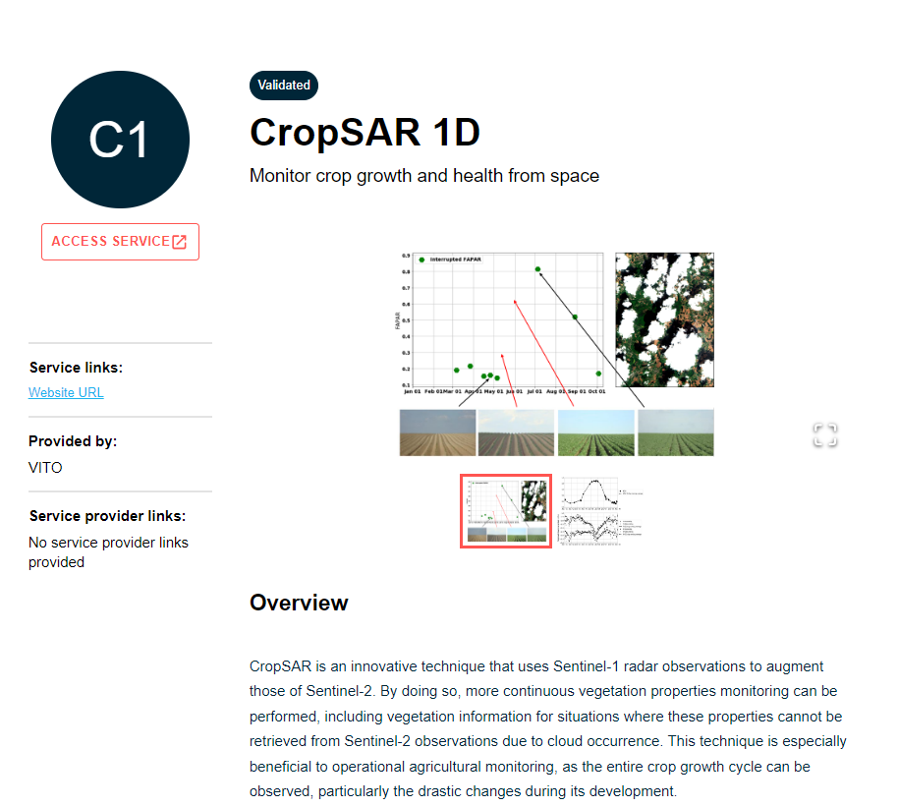
openEO Algorithm Plaza: A One-Stop-Shop for EO Solutions

Slide 26
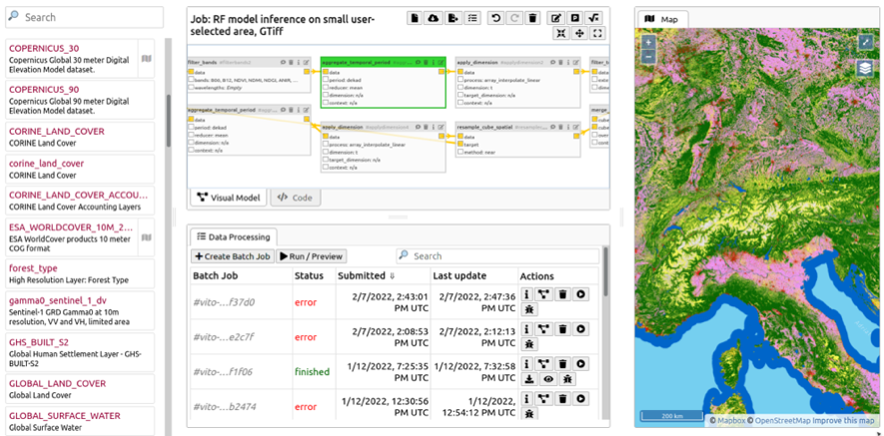
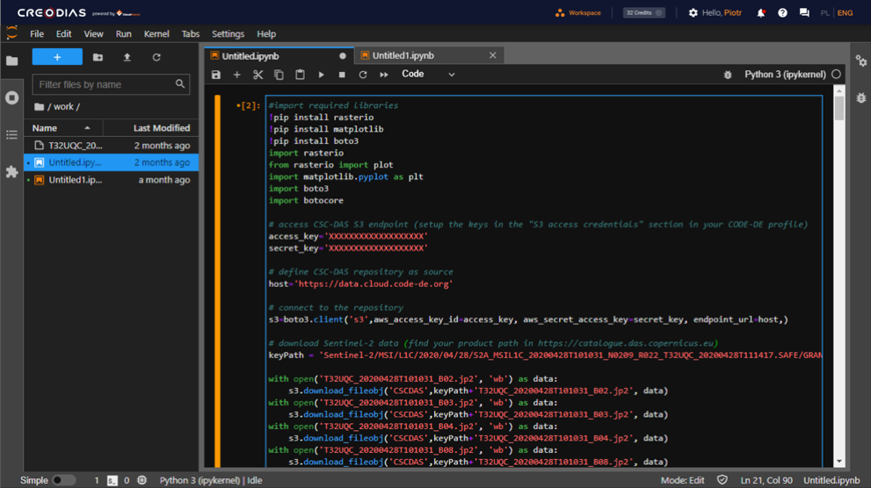
Data access and processing APIs
Discovery/catalogue (Copernicus Browser, STAC items, OData, OpenSearch)
Download products (S3, OData)
Streamlined access for custom algorithm implementation (Sentinel Hub, OpenEO)
SDK (Phyton, JavaScript)
Clients (JavaScript, Phyton, R)
Bring your own data (COG, zarr)
JupyterHub Phyton SDK with AI lntegration

