Slide 1

Advancing Java Profiling
Achieving precision and stability
with JFR, eBPF and user context
Jaroslav Bachorik (Datadog)
Johannes Bechberger (SAP)

Slide 2
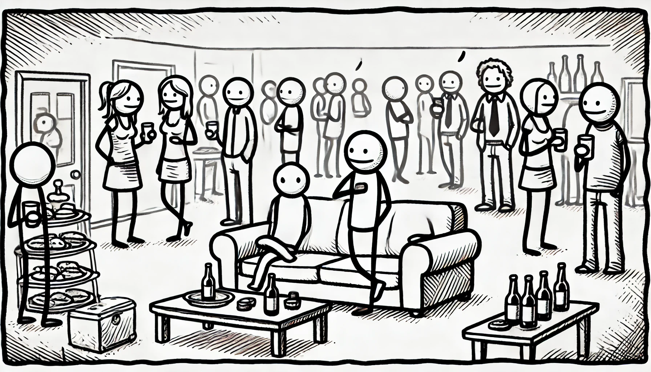
So, what do you do for a living?

Slide 3
Java Profiling

Slide 4
?

Slide 5
Tooling to collect data points to explain application performance and behaviour …

Slide 6
????????

Slide 7
A performance crime detective 🧌

Slide 8
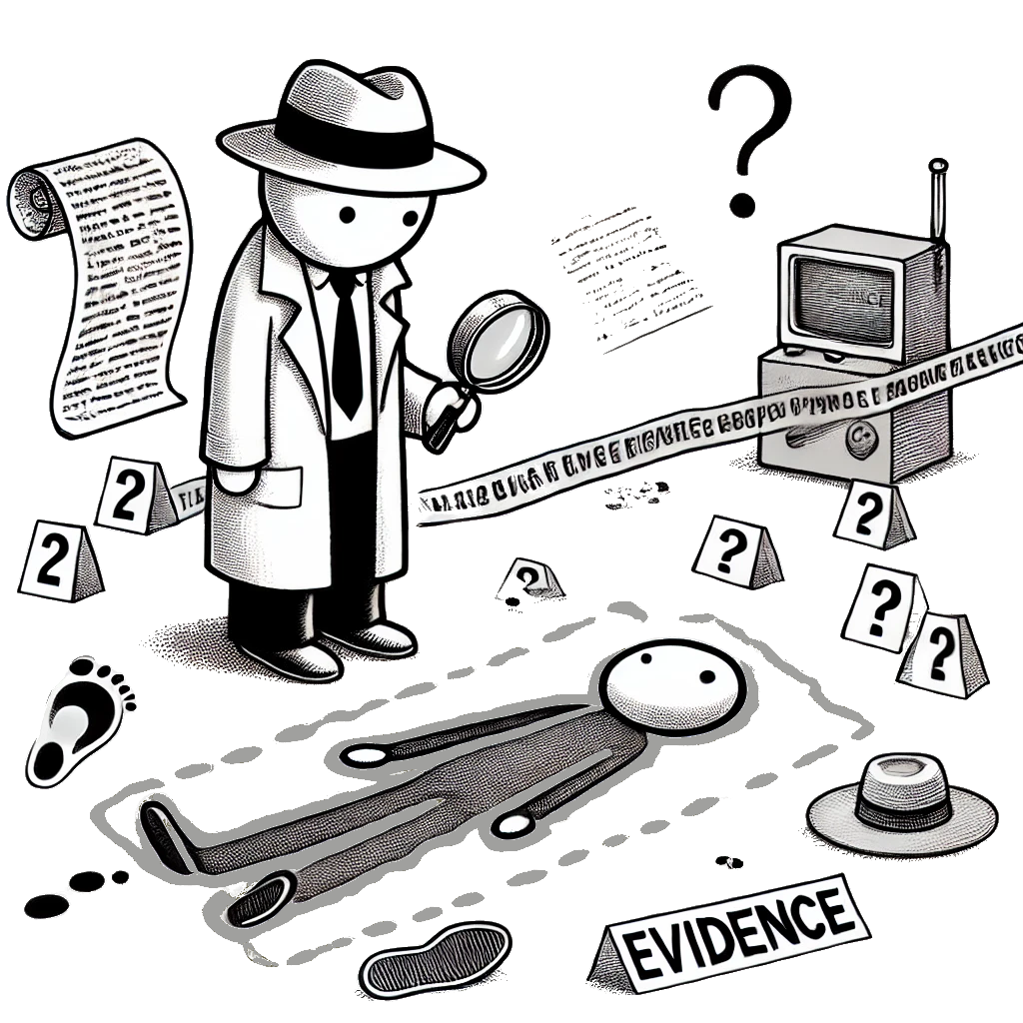
The Questions
How comes the pod is OOM-killed?
What is hogging the CPU?
Why is this service timing out?
Can they pack more containers
on a machine safely?
Notes:
Johannes: “and how one would do that?) (or something like that)
[JA]

Slide 9
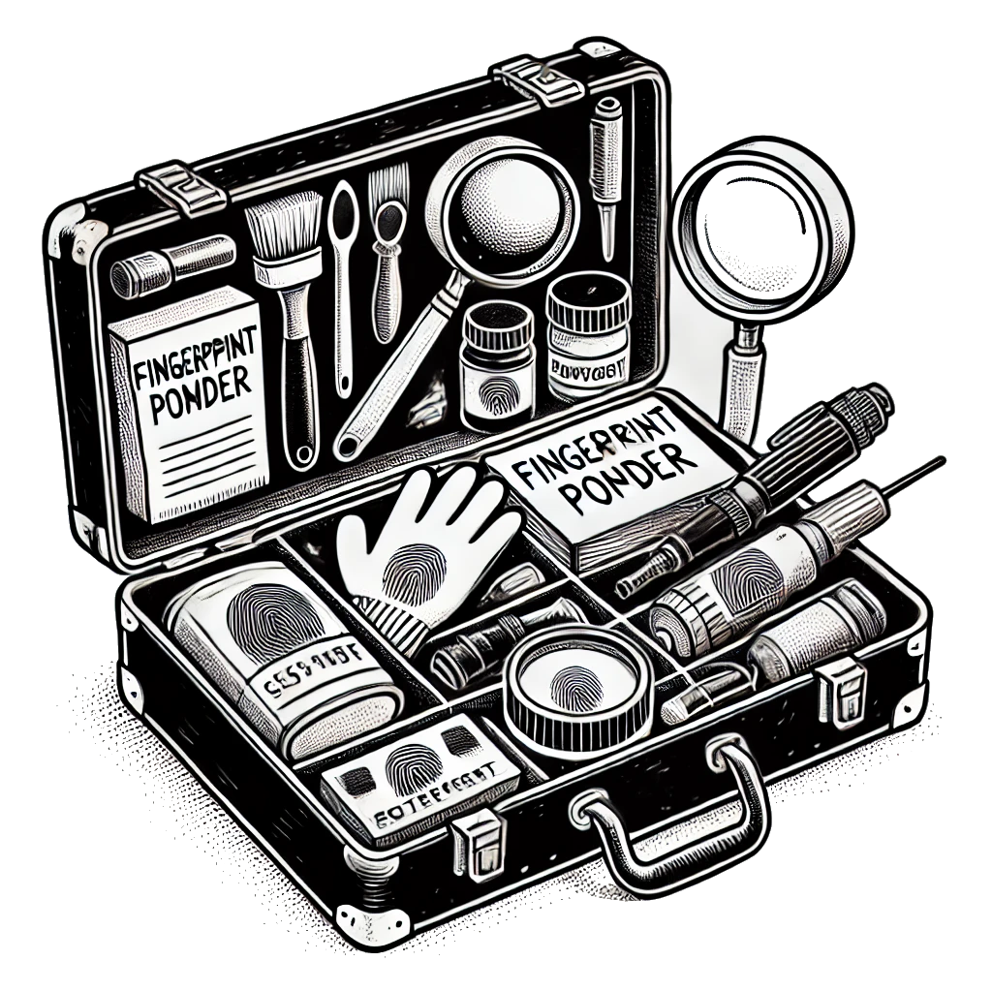

The Toolbox
JDK Flight Recorder
built-in JDK tool
Async-Profiler
well-established
OTel eBPF Profiler
shiny new
Commercial tools
JProfiler, YourKit
Notes:
[JO]

Slide 10
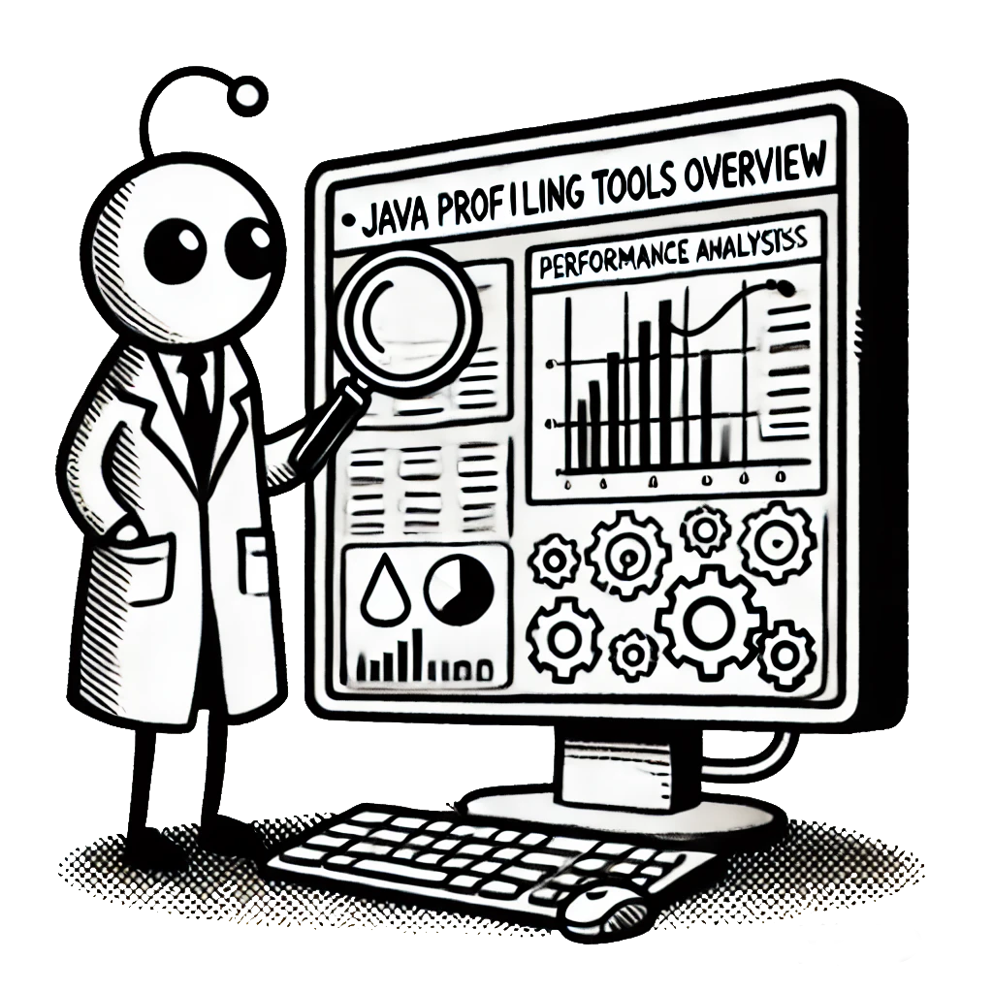
Java Profiling Tools Overview
Notes:
Johannes: “Hm, interesting, do you have any details for those?”
[JA]

Slide 11
JDK Flight Recorder (JFR)
A lightweight JVM tool for profiling and diagnostics, capturing runtime events like method execution, GC, and thread activity with minimal overhead.
Notes:
[1:00]

Slide 12
JDK Flight Recorder (JFR)
ExecutionSampleEvent
Thread
list
each N milliseconds
capture five stacktraces
pick next non-blocked Java thread
suspend thread
capture the thread stack
resume thread
:: end
T1
T2
T3
T4
T5
Processed: 0
Captured : 0
Errors: 0
Runnable
Blocked

Slide 13
JDK Flight Recorder (JFR)
ExecutionSampleEvent
Thread
list
each N milliseconds
capture five stacktraces
pick next non-blocked Java thread
suspend thread
capture the thread stack
resume thread
:: end
T1
T2
T3
T4
T5
Processed: 0
Captured : 0
Errors: 0
Runnable
Blocked

Slide 14
JDK Flight Recorder (JFR)
ExecutionSampleEvent
Thread
list
each N milliseconds
capture five stacktraces
pick next non-blocked Java thread
suspend thread
capture the thread stack
resume thread
:: end
T1
T2
T3
T4
T5
Processed: 1
Captured : 1
Errors: 0
Runnable
Blocked

Slide 15
JDK Flight Recorder (JFR)
ExecutionSampleEvent
Thread
list
each N milliseconds
capture five stacktraces
pick next non-blocked Java thread
suspend thread
capture the thread stack
resume thread
:: end
T1
T2
T3
T4
T5
Processed: 2
Captured : 1
Errors: 0
Runnable
Blocked

Slide 16
JDK Flight Recorder (JFR)
ExecutionSampleEvent
Thread
list
each N milliseconds
capture five stacktraces
pick next non-blocked Java thread
suspend thread
capture the thread stack
resume thread
:: end
T1
T2
T3
T4
T5
X
Processed: 2
Captured : 1
Errors: 1
Runnable
Blocked

Slide 17
JDK Flight Recorder (JFR)
ExecutionSampleEvent
Thread
list
each N milliseconds
capture five stacktraces
pick next non-blocked Java thread
suspend thread
capture the thread stack
resume thread
:: end
T1
T2
T3
T4
T5
X
Processed: 3
Captured : 1
Errors: 1
Runnable
Blocked

Slide 18
JDK Flight Recorder (JFR)
ExecutionSampleEvent
Thread
list
each N milliseconds
capture five stacktraces
pick next non-blocked Java thread
suspend thread
capture the thread stack
resume thread
:: end
T1
T2
T3
T4
T5
X
Processed: 3
Captured : 2
Errors: 1
Runnable
Blocked

Slide 19
JDK Flight Recorder (JFR)
ExecutionSampleEvent
Thread
list
each N milliseconds
capture five stacktraces
pick next non-blocked Java thread
suspend thread
capture the thread stack
resume thread
:: end
T1
T2
T3
T4
T5
Processed: 6
Captured : 5
Errors: 1
Runnable
Blocked
Notes:
Jaroslav: So, we can agree that this looks reasonable. Pretty bounded overhead and samples should be nicely distributed, right?
[JO]

Slide 20
Problems with ExecutionSampleEvent
T1
T4
10 ms
Notes:
Johannes: Hm, would not this sliding window affect how frequently we sample a single thread? I mean, if you have many threads it will take a while till you cycle back

Slide 21
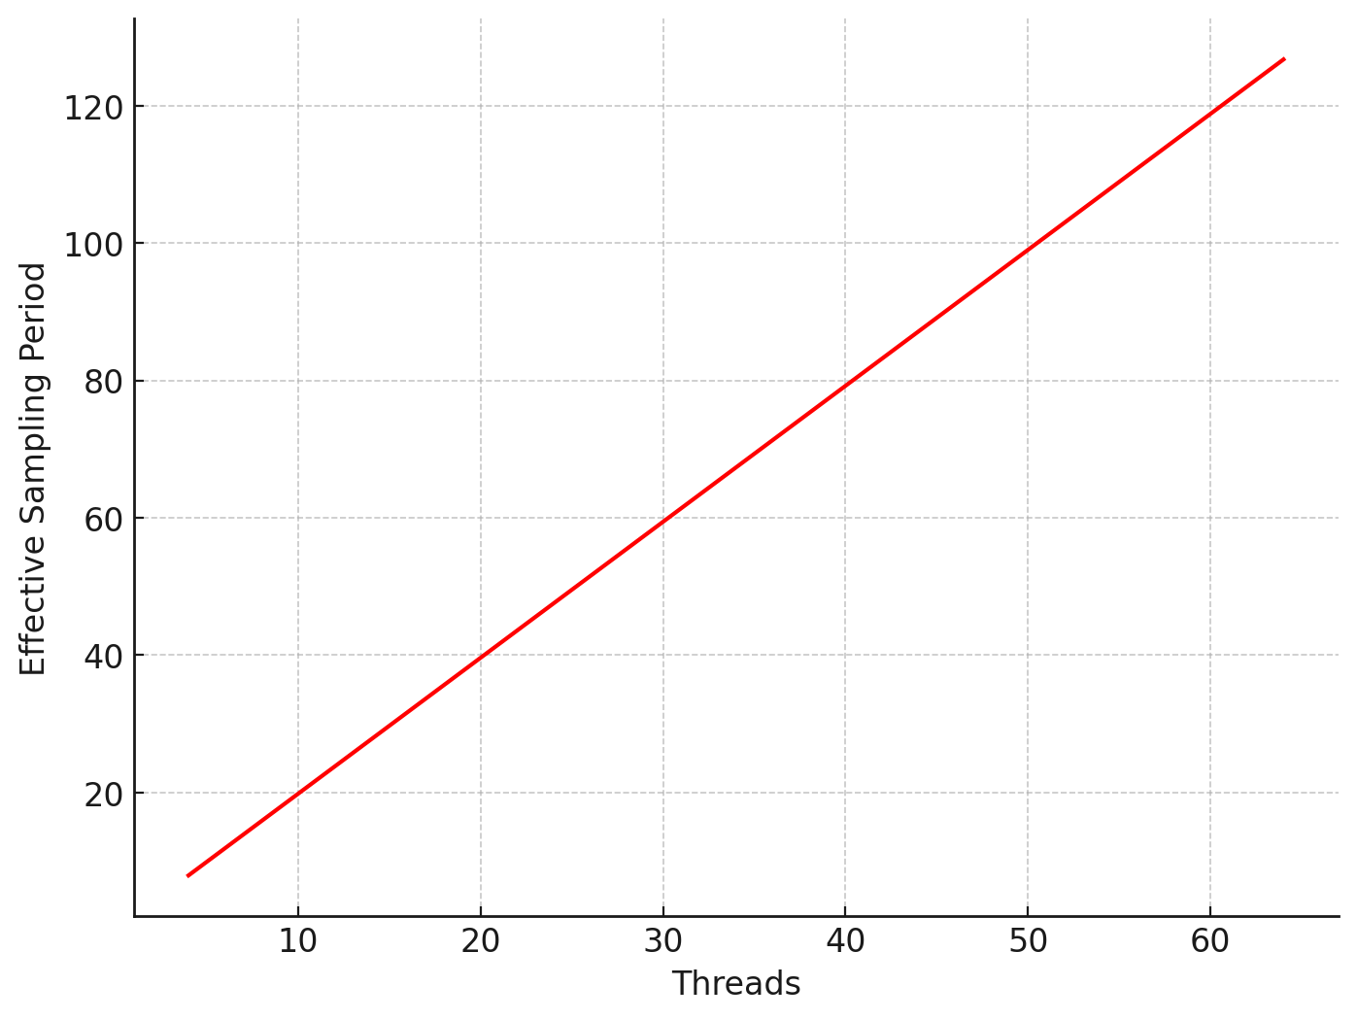
Problems with ExecutionSampleEvent
Effective Sampling Period
Notes:
Johannes: This would actually mean the the effective sampling period is much longer than the one set by the user 😱

Slide 22
Problems with ExecutionSampleEvent
Effective Sampling Period
Scales linearly with thread count
and stack-walk error rate

Slide 23
Problems with ExecutionSampleEvent
Effective Sampling Period
No clear relation
between CPU and samples

Slide 24

[1] https://speakerdeck.com/parttimenerd/inner-workings-of-safepoints
[2] https://psy-lob-saw.blogspot.com/2015/12/safepoints.html
Safepoint bias?
Notes:
5:00
Johannes: Well, but at least it is not safe point biased (short intro into safepoints and profiler bias)
[JA]

Slide 25
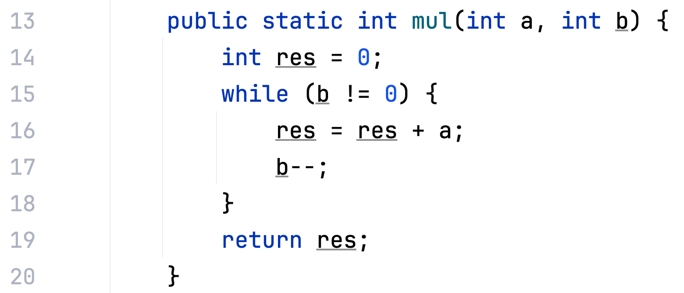
Symbolication and safepoints
Stack Trace
0x00000001155d8dc0
0x00000001155df1a4
0x00000001155d9de4
List of frames
Frame == address
Notes:
Change the code example

Slide 26
Mapping address to metadata
Interpreted code
preserves BCI
simple lookup
Compiled code
needs debug info by JIT
inlining complicates it

Slide 27
> java -XX:+UnlockDiagnosticVMOptions -XX:+PrintAssembly -jar multi.jar
# {method} {0x00000001314004c8} 'mul' '(II)I' in 'com/datadog/demo1/Multi'
…
0x000000011370d454: ; {other}
0x000000011370d454: 1f20 03d5 | 1f00 80f2 | 1f00 80f2 | ff43 0091 |
5301 0034 | 8a2b 42f9 | 0300 0014 | 8a2b 42f9
0x000000011370d474: f303 0c2a | b502 140b
0x000000011370d47c: ; ImmutableOopMap {}
;*goto {reexecute=1 rethrow=0 return_oop=0}
; - (reexecute) com.datadog.demo1.Multi::mul@13 (line 17)
…

Slide 28
# {method} {0x00000001314004c8} 'mul' '(II)I' in 'com/datadog/demo1/Multi'
…
0x000000011370d454: ; {other}
0x000000011370d454: 1f20 03d5 | 1f00 80f2 | 1f00 80f2 | ff43 0091 |
5301 0034 | 8a2b 42f9 | 0300 0014 | 8a2b 42f9
0x000000011370d474: f303 0c2a | b502 140b
0x000000011370d47c: ; ImmutableOopMap {}
;*goto {reexecute=1 rethrow=0 return_oop=0}
; - (reexecute)
com.datadog.demo1.Multi::mul@13 (line 17)
…

Slide 29
Biased toward safepoint

Slide 30
Debug info only at safepoints

Slide 31
> java -XX:+UnlockDiagnosticVMOptions -XX:+DebugNonSafepoints
-XX:+PrintAssembly -jar multi.jar
# {method} {0x00000001314004c8} 'mul' '(II)I' in 'com/datadog/demo1/Multi'
…
0x00000001130c15d4: ; {other}
0x00000001130c15d4: 1f20 03d5 | 1f00 80f2 | 1f00 80f2
0x00000001130c15e0: ;*iload_1 {reexecute=0 rethrow=0 return_oop=0}
; - com.datadog.demo1.Multi::mul@2 (line 15)
0x00000001130c15e0: ff43 0091 | 5301 0034 | 8a2b 42f9 | 0300 0014
0x00000001130c15f0: ;*goto {reexecute=0 rethrow=0 return_oop=0}
; - com.datadog.demo1.Multi::mul@13 (line 17)
0x00000001130c15f0: 8a2b 42f9 | f303 0c2a
0x00000001130c15f8: ;*iadd {reexecute=0 rethrow=0 return_oop=0}
; - com.datadog.demo1.Multi::mul@8 (line 16)
…

Slide 32
# {method} {0x00000001314004c8} 'mul' '(II)I' in 'com/datadog/demo1/Multi'
…
0x00000001130c15d4: ; {other}
0x00000001130c15d4: 1f20 03d5 | 1f00 80f2 | 1f00 80f2
0x00000001130c15e0: ;*iload_1 {reexecute=0 rethrow=0 return_oop=0}
; - com.datadog.demo1.Multi::mul@2 (line 15)
0x00000001130c15e0: ff43 0091 | 5301 0034 | 8a2b 42f9 | 0300 0014
0x00000001130c15f0: ;*goto {reexecute=0 rethrow=0 return_oop=0}
; - com.datadog.demo1.Multi::mul@13 (line 17)
0x00000001130c15f0: 8a2b 42f9 | f303 0c2a
0x00000001130c15f8: ;*iadd {...}
; - com.datadog.demo1.Multi::mul@8 (line 16)
…

Slide 33
Unbiased line mapping

Slide 34

-XX:+UnlockDiagnosticVMOptions
-XX:+DebugNonSafepoints

Slide 35
JDK Flight Recorder (JFR)
+++
---
Ubiquitous
Stable and safe
Fully supported
Not a real CPU sampler
Fails silently
No native frames

Slide 36
Async Profiler
Sampling CPU and HEAP profiler for Java featuring AsyncGetCallTrace + perf_events
[1] https://github.com/async-profiler/async-profiler
*
* till Sep 2023

Slide 37
Async-Profiler: CPU Time Sample
Kernel
thread ran N ms on CPU
raise signal for that thread
walk the stack
collect the sample
Signal Handler

Slide 38
CPU Time Sample: Implementation
Requires OS/scheduler support
Linux, MacOS
Samples proportional to thread activity
T1
T2
T3
10 ms
100 ms
Samples
7
6
3

Slide 39

CPU Time Sample: AsyncGetCallTrace
// not an official API; need to lookup the symbol
_asyncGetCallTrace = (AsyncGetCallTrace)dlsym(_libjvm, "AsyncGetCallTrace");
...
// in signal handler
ASGCT_CallTrace trace = {jni, 0, frames};
// ucontext provided for the signal
_asyncGetCallTrace(&trace, max_depth, ucontext);
// trace contains the collected stack trace
Unofficial

Slide 40
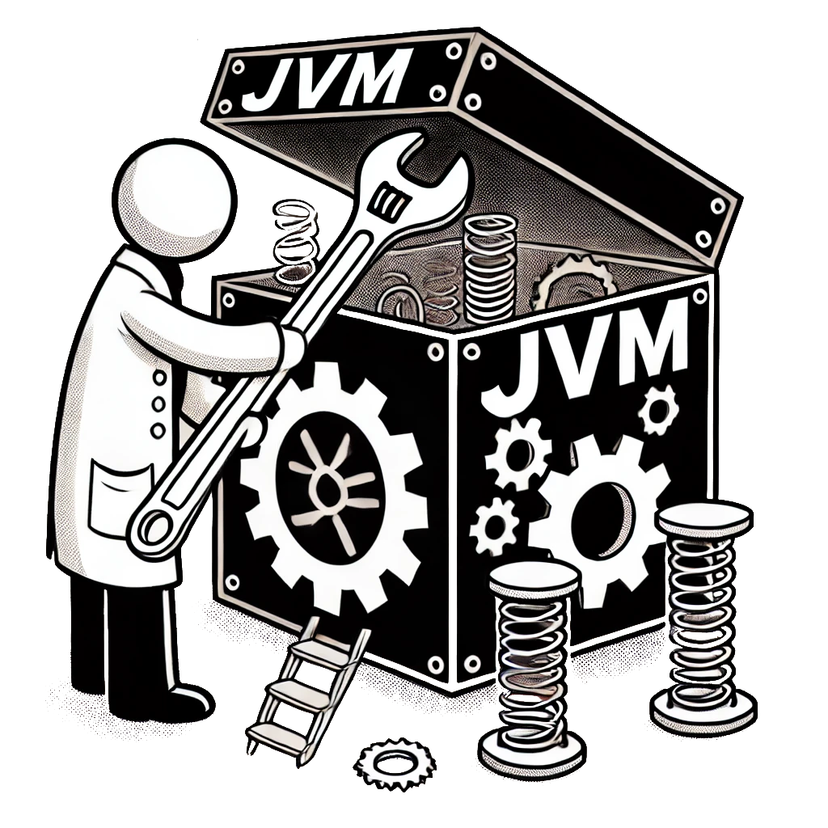
CPU Time Sample: vmstructs
vmstructs: a way to crack-open JVM internals
introduced for Serviceability Agent
allows creating stack-walker from scratch
permits error recovery

Slide 41
// not an official API; need to lookup the symbols first
uintptr_t entry = readSymbol("gHotSpotVMStructs");
uintptr_t stride = readSymbol("gHotSpotVMStructEntryArrayStride");
uintptr_t type_offset = readSymbol("gHotSpotVMStructEntryTypeNameOffset");
uintptr_t field_offset = readSymbol("gHotSpotVMStructEntryFieldNameOffset");
uintptr_t offset_offset = readSymbol("gHotSpotVMStructEntryOffsetOffset");
uintptr_t address_offset = readSymbol("gHotSpotVMStructEntryAddressOffset");
Unofficial, non-public API

Slide 42
void* klass = findKlass(); // retrieve JVM Klass name
Symbol* klass_name = klassName(klass);
vmstructs.cpp
// [macro] type, field, content
nonstatic_field(Klass, _name, Symbol*) \
nonstatic_field(Klass, _vtable_len, int) \
nonstatic_field(Klass, _class_loader_data, ClassLoaderData*) \
…

Slide 43
for (;; entry += stride) {
const char *type = *(const char **)(entry + type_offset);
const char *field = *(const char **)(entry + field_offset);
if (type == NULL || field == NULL) break;
if (strcmp(type, "Klass") == 0) {
if (strcmp(field, "_name") == 0) {
_klass_name_offset = *(int *)(entry + offset_offset);
} else if …
Symbol* klassName(void* klass) {
return *(Symbol**)(klass + _klass_name_offset);
}
Symbol* klass_name = klassName(klass);

Slide 44
Async-Profiler
+++
---
Proper CPU sampler
Versatile
Native frames
Fairly stable (with vmstructs)
Relies on JVM internals

Slide 45
OTel eBPF Profiler
Runtime agnostic sampling profiler based on eBPF
Notes:
Jaroslav: And here we have a new tool, fresh-from-the oven, figuratively speaking. Johannes, I know ebpf is your THING - would you mind walking us through this?
[JO]
12:00

Slide 46
OpenTelemetry (OTel) and profiling
OTel (Open Telemetry) [1]
CNCF (Cloud Native Computing Foundation) [2] incubating project
OTel Profiling Signal [2]
OTel Profiling Agent [3]
donated to CNCF/OTel by Elastic
Datadog full-host profiler fork [4]
[1] https://opentelemetry.io/
[2] https://www.cncf.io/
[3] https://github.com/open-telemetry/opentelemetry-ebpf-profiler/blob/main/README.md
[4] https://github.com/DataDog/dd-otel-host-profiler/

Slide 47
CPU Samples: The eBPF Way
Built on top of eBPF [1]
CPU time driven sample scheduling
same as async-profiler
using perf_events
[1] https://ebpf.io/
T1
T2
T3
10 ms
100 ms
Samples
7
6
3

Slide 48

eBPF is making the Linux Kernel programmable at native execution speed!

Slide 49
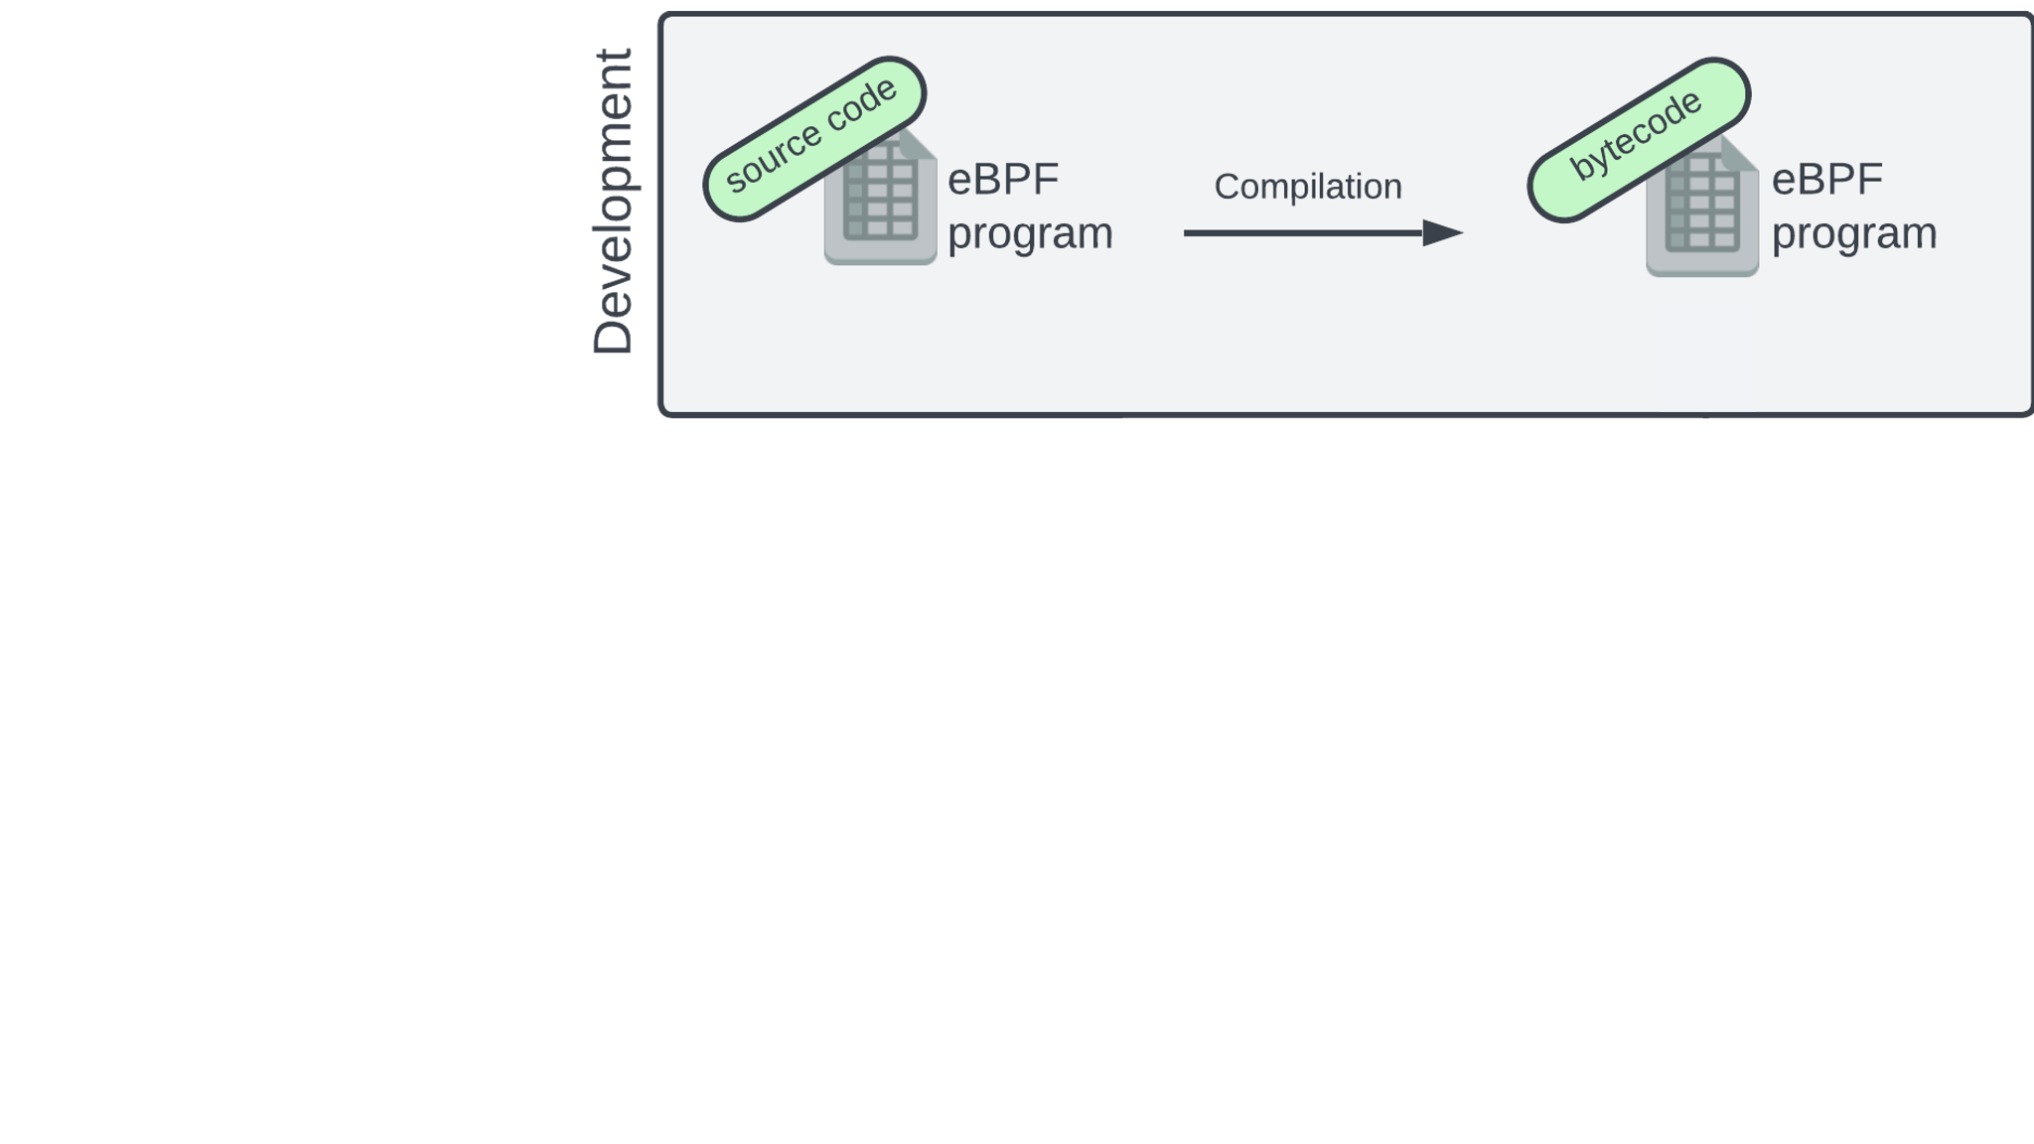
eBPF
runtime
Courtesy of Mohammed Abboulaide

Slide 50
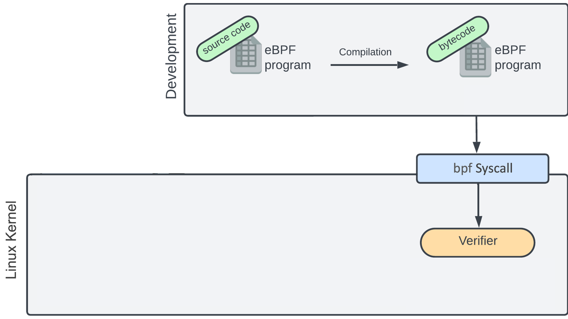
Courtesy of Mohammed Abboulaide
Notes:
verifier checks for halting of the problem. but doesn’t this run into the halting problem? No because eBPF restricts the level of recursion and instructions the program can execute
the verifier keeps us from running into the problems that crowdstrike had, where there kernel module mis-accessed an array

Slide 51
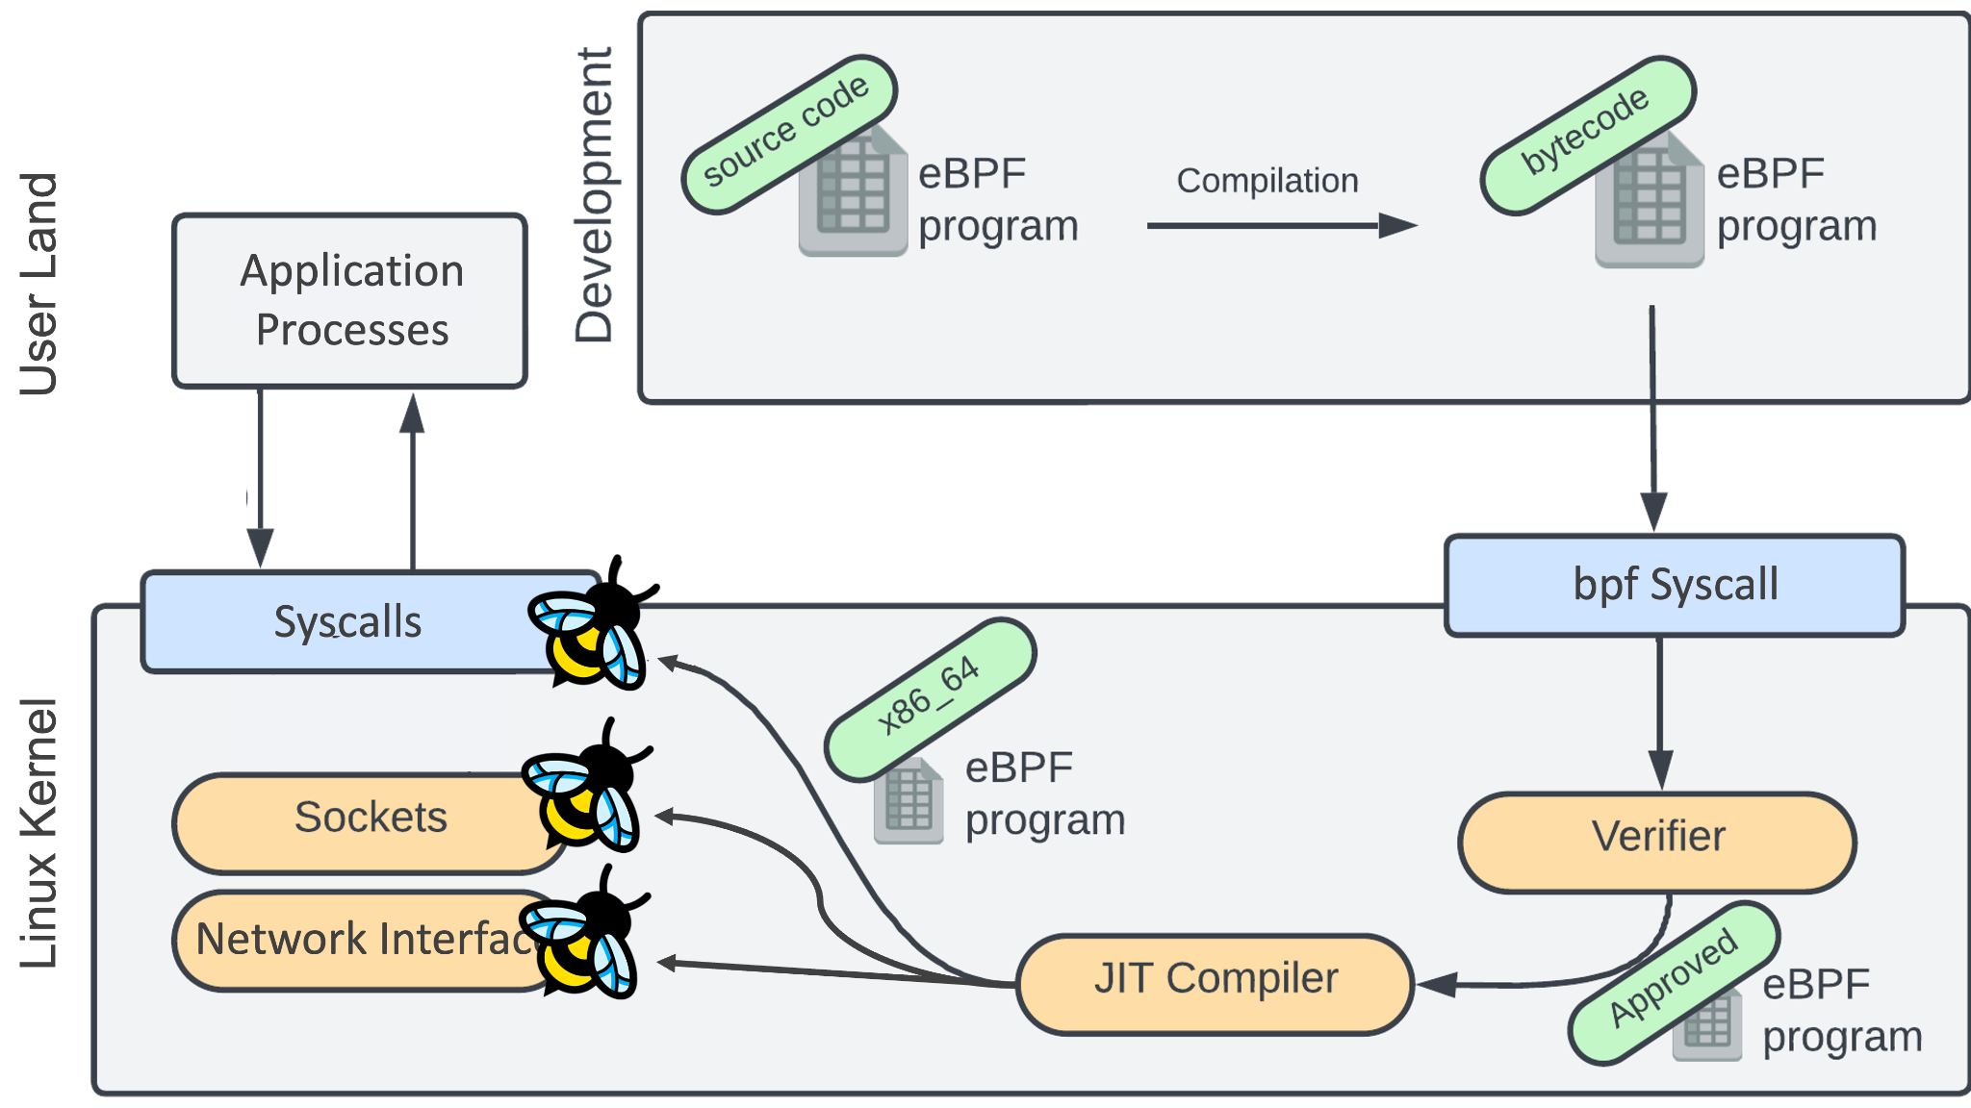
Courtesy of Mohammed Abboulaide

Slide 52
OTel eBPF Profiler
+++
---
Proper CPU sampler
Stable
Standardized
Supported (by OTel vendors)
Relies on JVM internals
Notes:
[JA]

Slide 53

Advancing Java Profiling
Notes:
Jaroslav: I must say, we already have a nice toolset at hand. Still, there are open possibilities for improvement …
[JO]

Slide 54
We focus on JFR

Slide 55
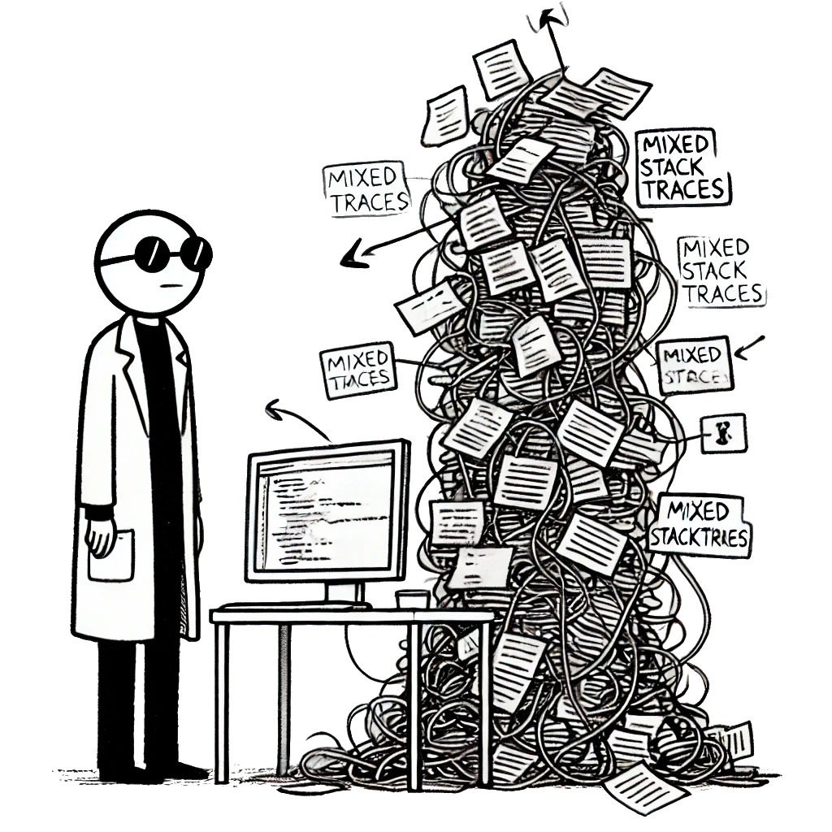
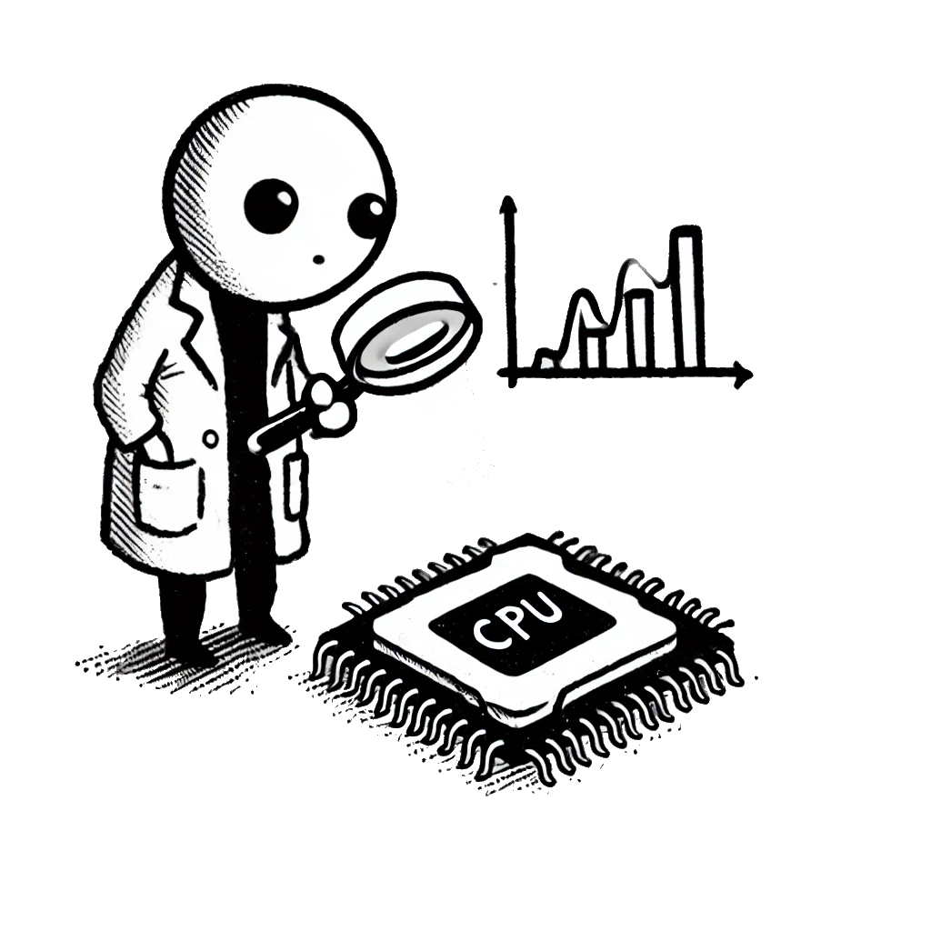
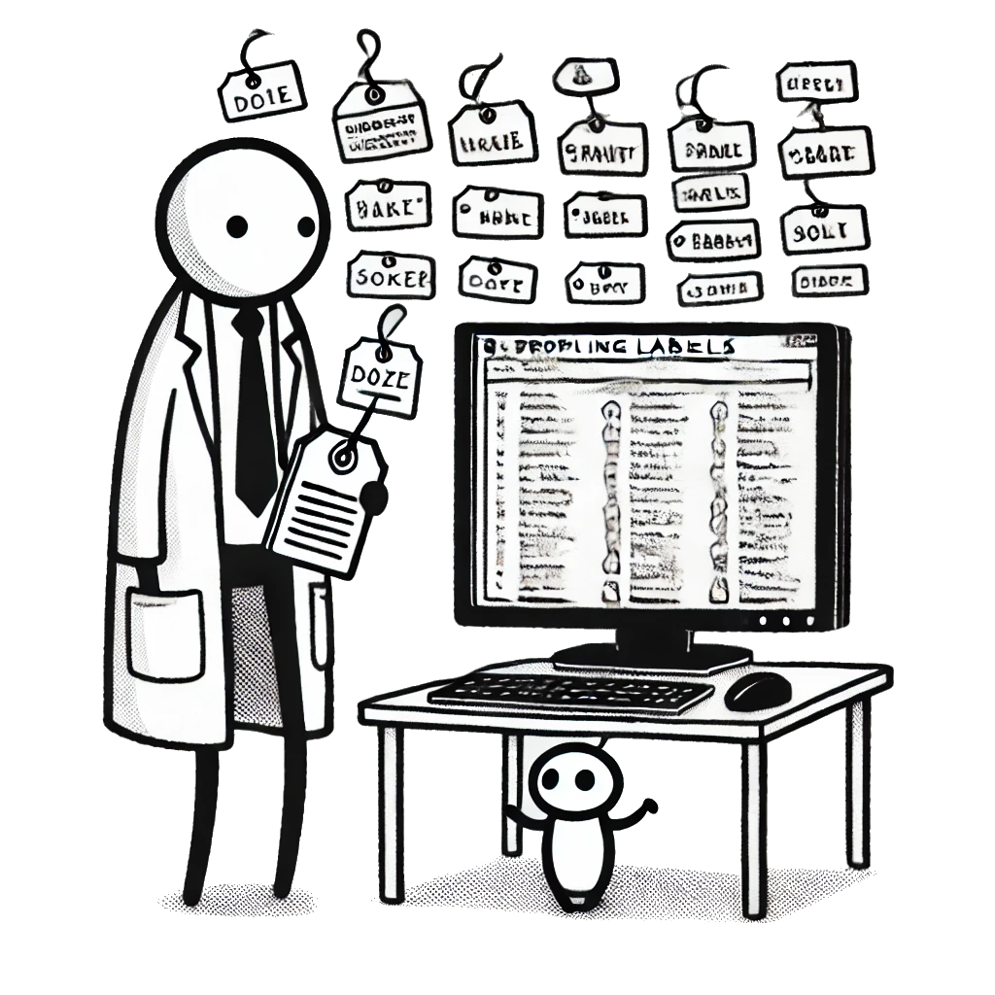
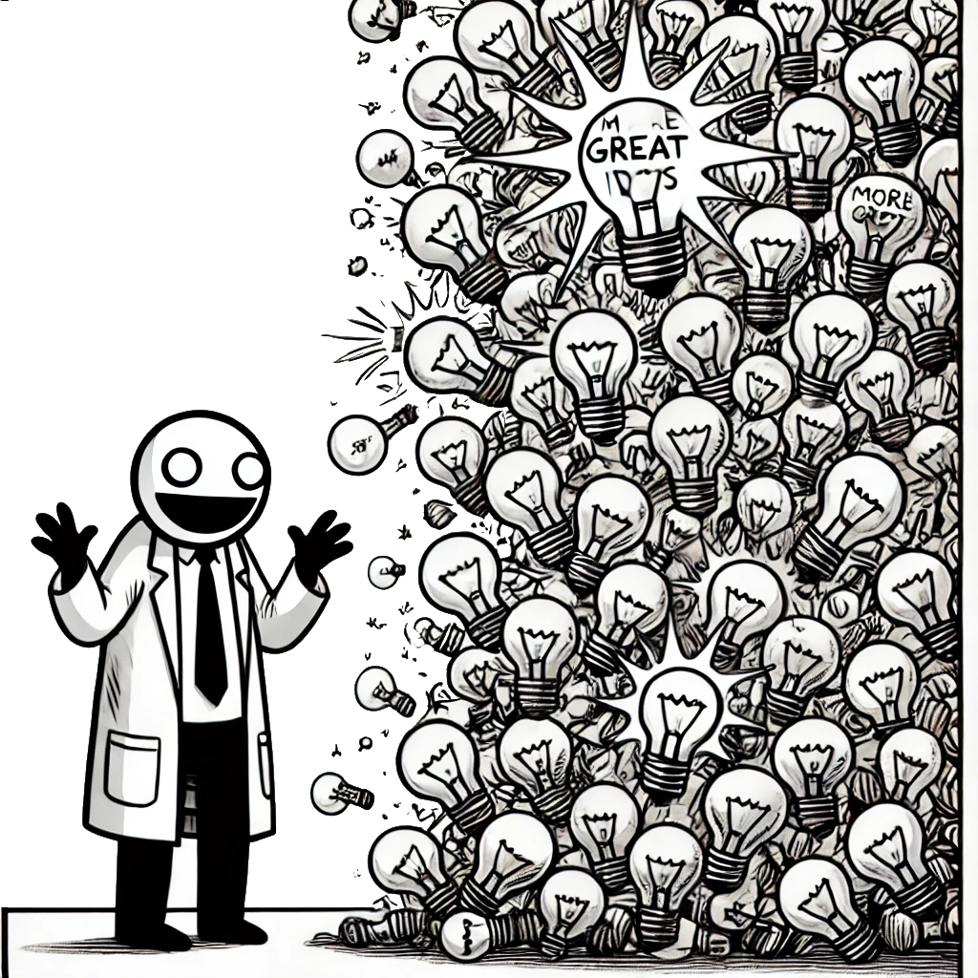
Improving JFR
Mixed
Stacktraces
Proper
CPU Sampler
Profiling
Labels
Perhaps
more?

Slide 56
CPUTimeExecutionSample
Using timer_create – Linux only
Proposed as “CPU Time Profiling for JFR” JEP [1]
Ongoing PR available for comments [2]
[1] https://bugs.openjdk.org/browse/JDK-8337789
[2] https://github.com/openjdk/jdk/pull/20752
Notes:
Add previous slide with reasons for JFR

Slide 57
JFR CPU Sampling
thread has consumed N ms
raise signal for that thread
Scheduler
symbolicate frames
emit events
JFR Thread
walk the stack
enqueue the trace
Signal Handler
Queue

Slide 58
JDK Flight Recorder (JFR)
+++
---
Ubiquitous
Stable and safe
Fully supported
Not a real CPU sampler
Fails silently
No native frames
Notes:
Johanes: Jaroslav, but I know you were also cooking something for JFR
[JA]

Slide 59
Profiling labels
Provide additional dimensions
REST API calls
Distributed tracing ID
Customer ID
… anything else that makes sense for the user
Allow slice’n’dice of profiling data
Sometimes also referred to as ‘Profiling Context’

Slide 60
Profiling labels
T1
S1-2
S3-6
S7-8
10 ms
8
samples
Aggregated stacktraces [Flamegraph]
Notes:
[JO]

Slide 61
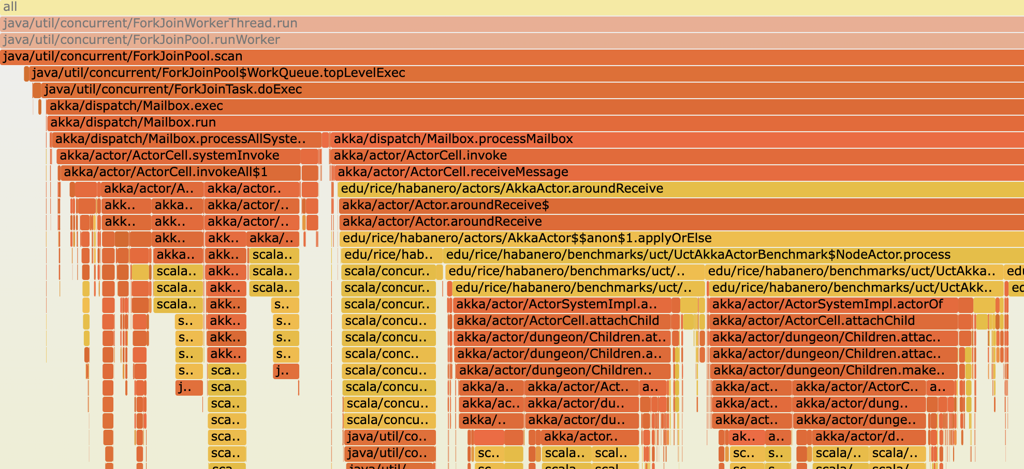
Quick poll: What is flamegraph?
https://www.brendangregg.com/FlameGraphs/cpuflamegraphs.html
Notes:
Johannes: I know this! This is a flamegraph (short description of flamegraph)
[JA]

Slide 62
Operations
T1
S1-2
S3-6
S7-8
REST
/api/showAll
DB
select * from …
UI
renderForm()

Slide 63
Customers
T1
S1-2
S3-6
S7-8
Big Customer

Slide 64
Slice’n’dice
All Samples

Slide 65
Slice’n’dice
REST
/api/showAll

Slide 66
Slice’n’dice
REST
/api/showAll
+
Big Customer

Slide 67
Profiling labels
Improved understanding, navigation and analytics
Rely on user specific context
Proved valuable in Datadog Java profiler
OTel is looking at adding labels to the eBPF profiler [1]
Experimental prototypes for profiling labels in JFR [2, 3]
[1] https://www.elastic.co/observability-labs/blog/continuous-profiling-distributed-tracing-correlation
[2] https://jbachorik.github.io/posts/seeing-in-context_1
[3] https://jbachorik.github.io/posts/different-shade-of-context
Notes:
Jaroslav: And what about the OTel profiler
[JO]

Slide 68

What about OTel profiler?
In a rather good place now
Just make sure vmstructs is still usable
And maybe try out some crazy ideas
libjvmunwind
closer integration with JFR

Slide 69


Thank you!
Resources
and links
Jaroslav Bachorik
@bachorikj
https://www.linkedin.com/in/jbachorik/
https://github.com/jbachorik
Johannes Bechberger
mostlynerdless.de
https://www.linkedin.com/in/johannes-bechberger/

