Slide 1


Slide 2


1 Feb, 2025
Matt Topol
ODBC Takes an Arrow to the Knee: ADBC

Slide 3
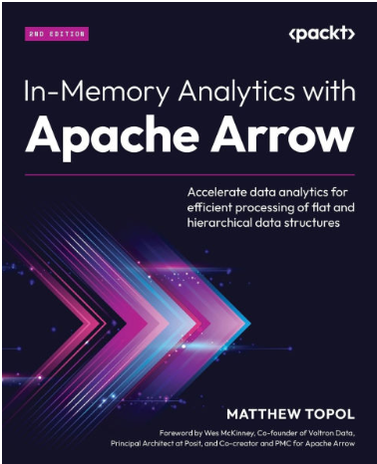


Who am I?
Email
zotthewizard@gmail.com
Author Of
“In-Memory Analytics with Apache Arrow”
Apache Arrow PMC
Staff Software Engineer at Voltron Data
Primary developer of github.com/apache/iceberg-go
github.com/apache/arrow-go
@zeroshade linkedin.com/in/matt-topol/

Slide 4

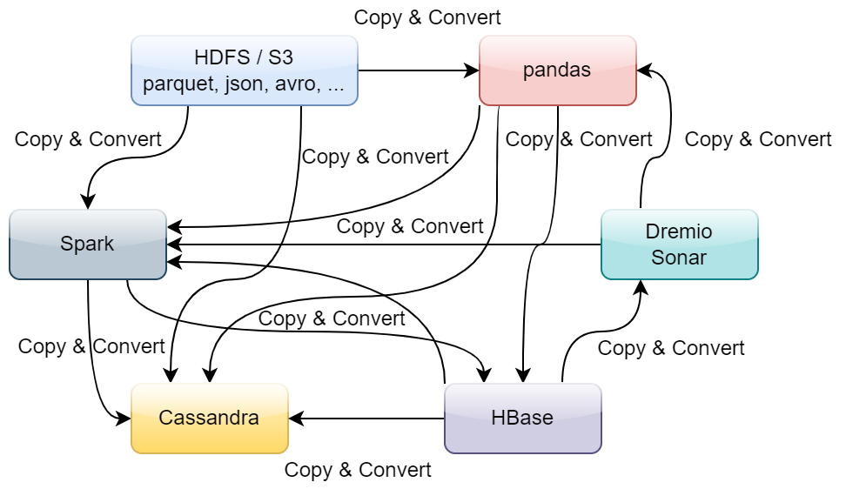
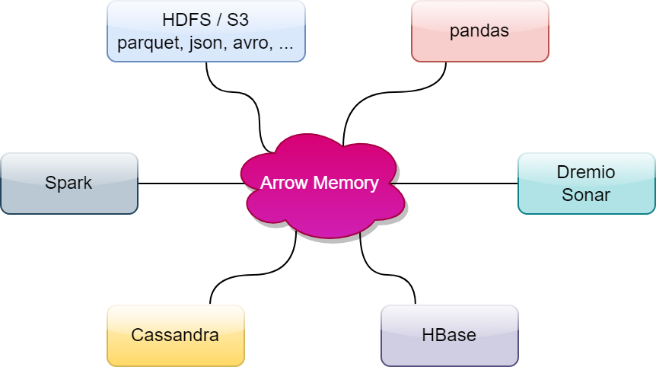
A Quick Primer on
https://arrow.apache.org
Polyglot!
Implementations in many languages:
Go, C++, Rust, Python, R, Java, Julia, MATLAB, Ruby, JavaScript, and more…
High Performance, In-Memory Columnar Format
No data serialization / deserialization required!

Slide 5
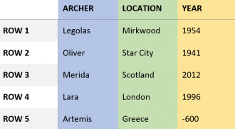
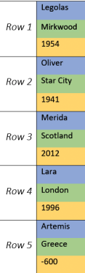
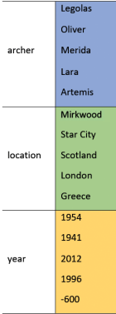
What is Columnar?
Table of Data
Row-Oriented
Memory Buffer
Arrow Columnar
Memory Buffer

Slide 6
Why Columnar?
Processors are most efficient when processing columnar memory data
More Efficient I/O
Lower memory usage
Significantly faster computation
Each column can be stored separately on disk
Read and write only the columns needed for a given query!
Example:
Get All Archers in Europe
Only need two columns (Archer, Location)
Columns stored separately on disk => each column brought into memory separately
Only need enough memory for the values in necessary columns, not entire rows!
Example:
Get All Archers in Europe
Read Location -> Get Indices
Read Archers -> Filter by index
Vectorized computation and memory locality.
Take advantage of multi-core processors
Example:
Calculate mean for Year column:
Only need one column! (Year)
Vectorized operations require contiguous memory
  Our column is already contiguous!

Slide 7
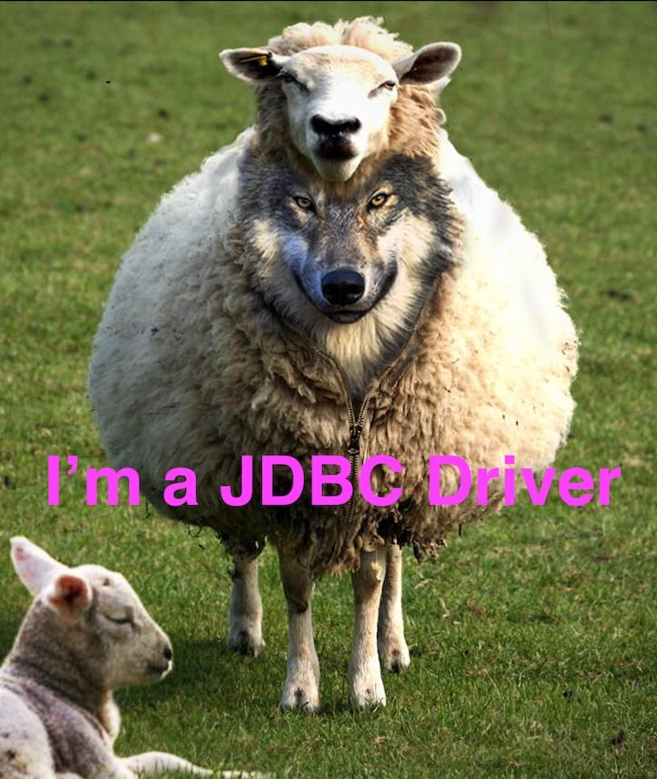
Most Common Interaction with Databases:
JDBC/ODBC

Slide 8
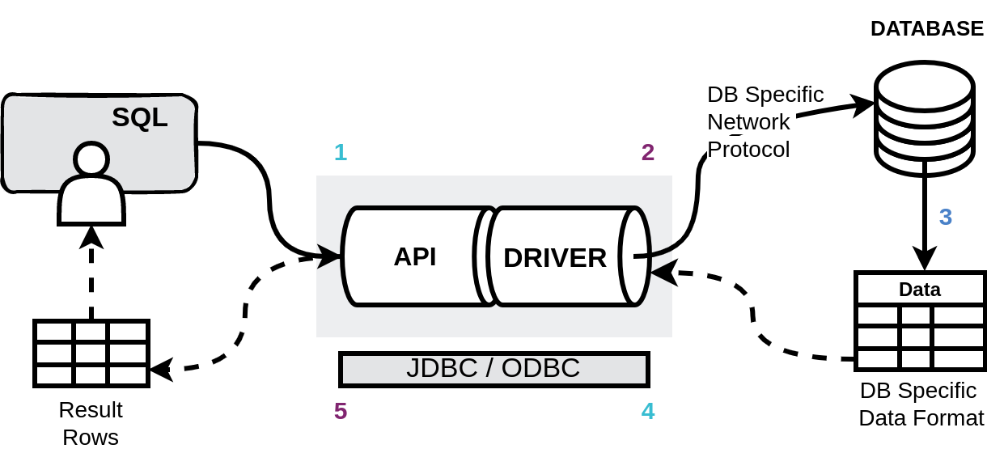
Using JDBC/ODBC
01
02
03
04
05
Submit Query
Driver Translation
Database
Driver Translation pt. 2
Iterate Results
Application submits SQL query via JDBC/ODBC API
Driver translates query to DB specific protocol and sends it
Query is executed and result set is returned in DB- specific format
Driver translates result set into format required by JDBC/ODBC
Application iterates over the result rows using the JDBC/ODBC API

Slide 9
Pros and Cons…
ODBC/JDBC aren’t easy!
JDBC/ODBC aren’t going anywhere
Existing usage: e.g. PostgreSQL, SQL Server, OLTP/CRUD applications, etc.
They handle nearly every use case you can think of
Conversion Costs
Columnar native databases are the norm now: e.g. DuckDB, ClickHouse, Google BigQuery, Presto, Dremio, etc.
Conversion libraries: e.g. Turbodbc, arrow-jdbc
Integration Costs
Integrate specific SDKs to avoid conversion costs…
Multiple complex integrations with varied connectors: e.g. Look at all Trino’s connectors!

Slide 10


Slide 11

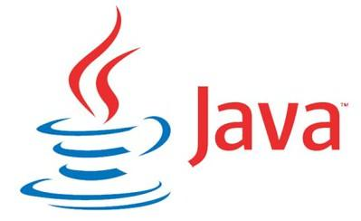
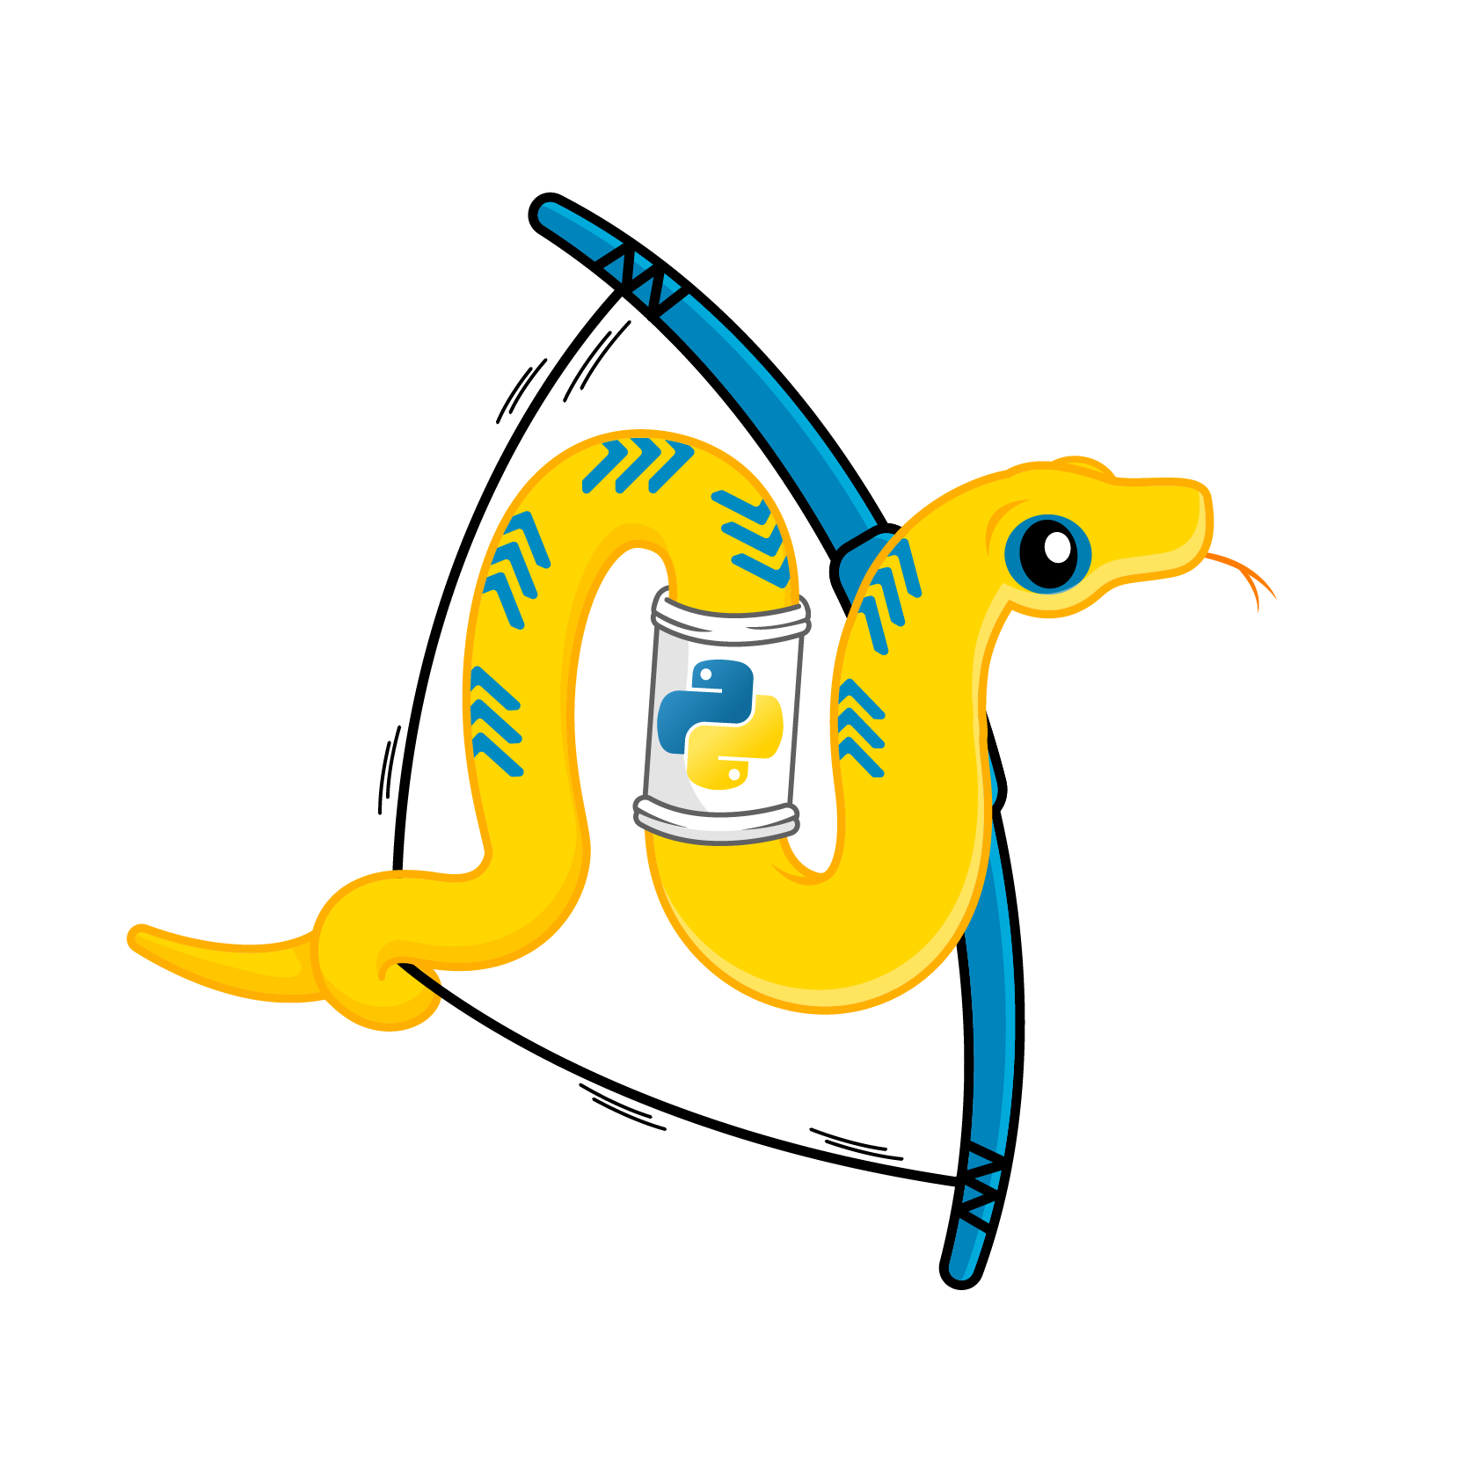
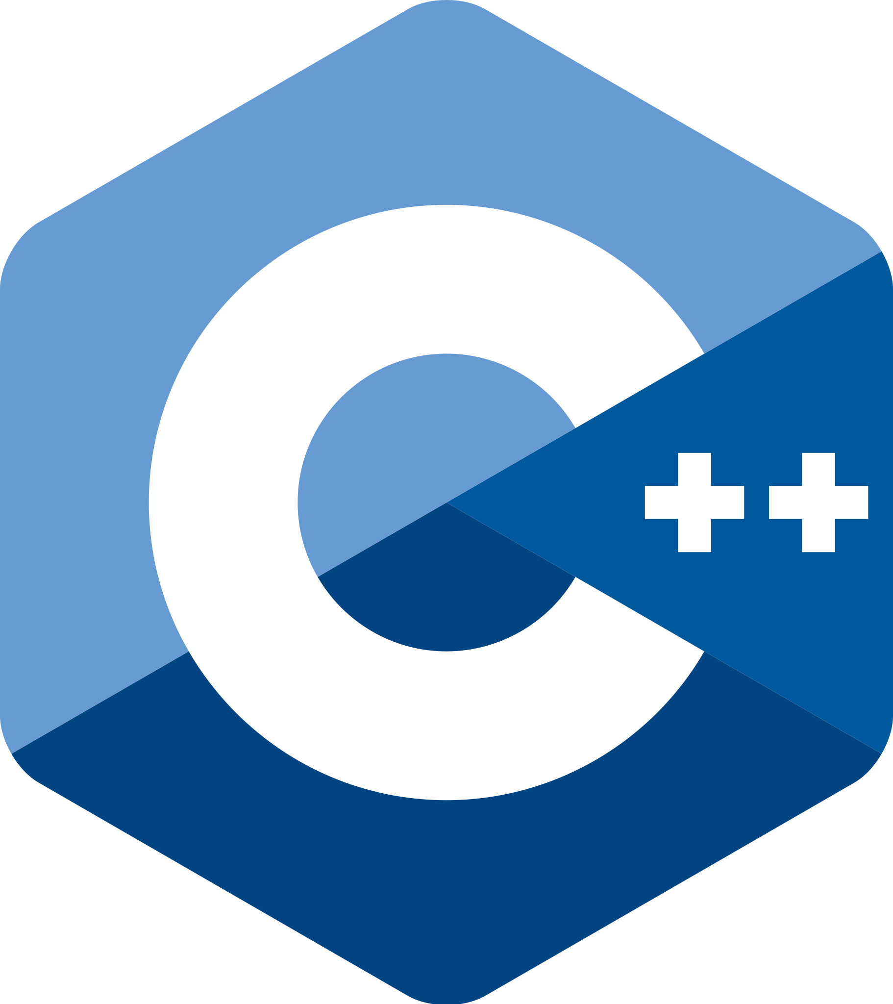



Arrow Database Connectivity (ADBC)
A columnar, vendor-neutral, minimal-overhead
alternative to JDBC/ODBC for analytical
applications
https://arrow.apache.org/adbc/

Slide 12
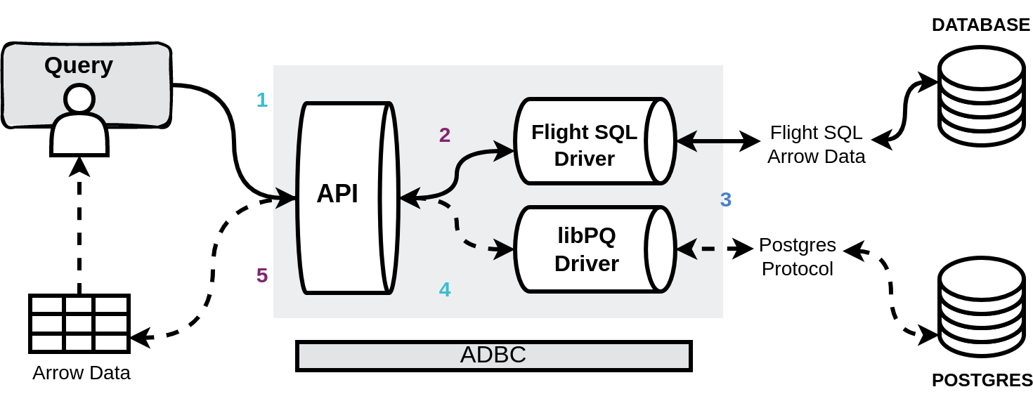
Let’s see that again…
01
02
03
04
05
Submit Query
Driver Translation
Database
Driver Translation pt. 2
Iterate Results
Application submits SQL query via ADBC API
Driver translates query to DB specific protocol and sends it
Query is executed and result set is returned in DB- specific format, ideally Arrow data
If Needed: Driver translates result set into Arrow data, otherwise it is just passed through
Application iterates batches of Arrow data

Slide 13




ADBC Specification
Arrow C Data Interface
ABI-compatible across releases
Zero-copy data movement
Zero-copy data movement
C API defined in adbc.h
API and Drivers under development
Semantic Versioning
Versioned separately from the Arrow project
Currently contains C/C++, Python, Go, Java, Ruby, R and Rust implementations

Slide 14
Where does ADBC fit?
 | Vendor Neutral (DB APIs) | Varies by Vendor (DB Protocols)
Arrow-Native | ADBC | Arrow Flight SQL BigQuery Storage gRPC Protocol
Row-Oriented | JDBC ODBC (typically row-oriented) | PostgreSQL wire protocol Tabular Data Stream (MS SQL Server)
ADBC doesn’t intend to replace JDBC or ODBC for general use, just for applications that want bulk columnar data access

Slide 15
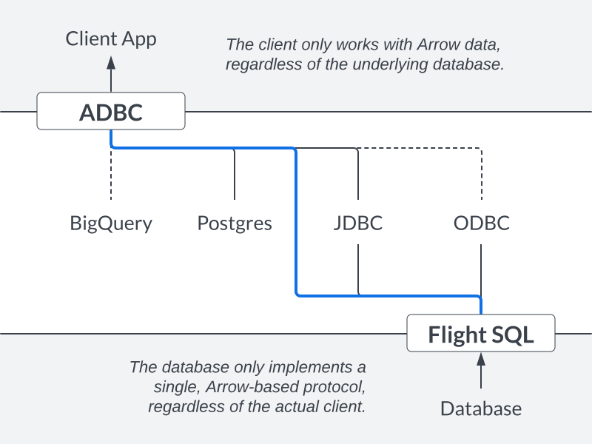
API vs Protocol
ADBC Complements Flight SQL

Slide 16
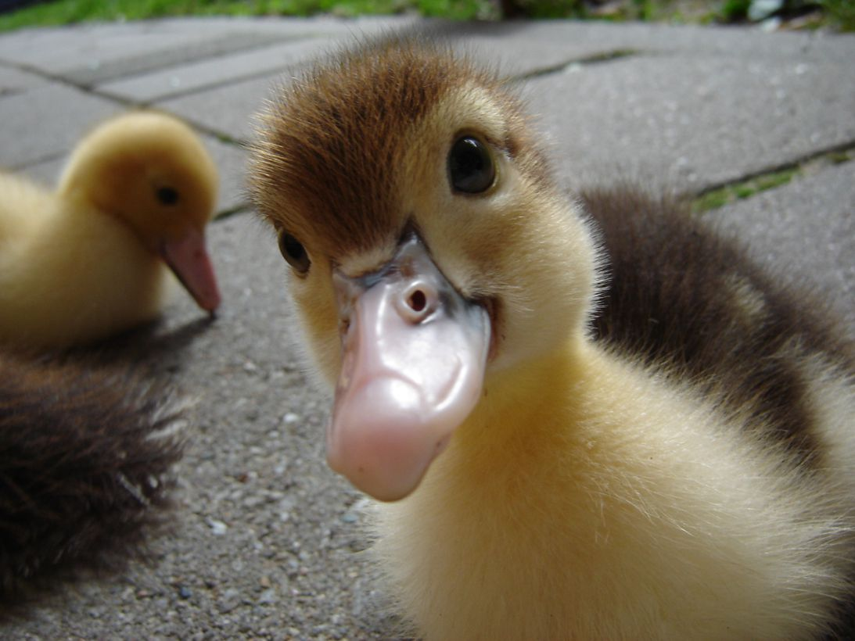
Performance Example
DuckDB benchmarked their ADBC driver: https://duckdb.org/2023/08/04/adbc.html
Benchmark on Apple M1 Max with 32GB of RAM
Output and insert line-item table TPC-H SF1
ODBC
28.149 s
0.724 s
ADBC
Winner!

Slide 17
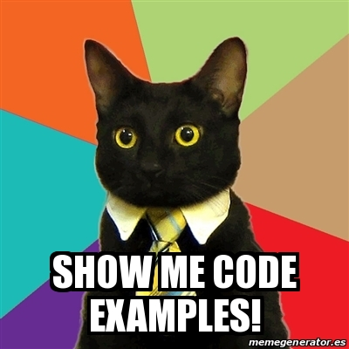

Slide 18
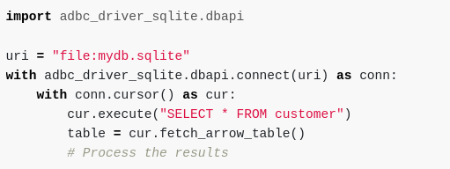
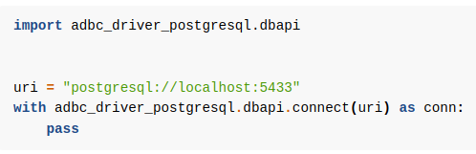
…
…
Python ADBC (DBAPI 2.0)
…
…
pip install adbc_driver_sqlite
pip install adbc_driver_postgresql
pip install adbc_driver_snowflake
pip install adbc_driver_flightsql
optionally:
pip install pyarrow

Slide 19
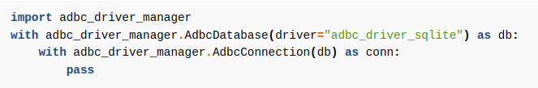
Python ADBC (Low-level API)
Driver Manager
Provides both low-level bindings and high-level DBAPI bindings
Allows loading arbitrary drivers that implement the C ABI
Example:
Existing driver packages leverage this
Other Systems take advantage of it too!
The python driver packages for pip install package the shared library for distribution by leveraging the driver manager
After you pip install duckdb, you can import adbc_driver_duckdb.dbapi to use ADBC with duckdb.

Slide 20
Driver Manager
Implements the ADBC API and delegates to
Dynamically-loaded drivers
Use multiple drivers simultaneously
Decouple from specific drivers
Makes drivers reusable in multiple contexts
  Ex: Go via CGO
PostgreSQL
Flight SQL
ADBC
C API
SQLite3
More Drivers…

Slide 21
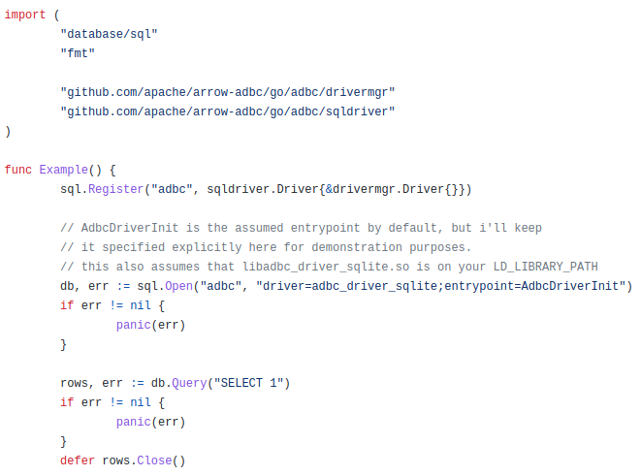
Go ADBC
ADBC Interface
Interfaces to implement
Enums
Anyone can implement, all can use
Generic Arrow-native interactions
Wrappers for ease of use
adbc/sqldriver - wrap any ADBC driver to be compatible with database/sql package
adbc/drivermgr - CGO connection to dynamically load any ADBC shared library
$ go get github.com/apache/arrow-adbc/go/adbc/driver/snowflake

Slide 22
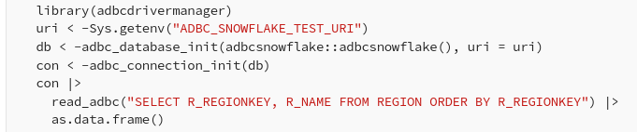
R Bindings!

Slide 23
Equivalent Concepts
Concept | ADBC | database/sql (Golang) | DBAPI 2.0 (PEP 249) | Flight SQL | JDBC | ODBC
Database Connection | AdbcConnection | Conn | Connection | FlightSqlClient | Connection | SQLHANDLE (connection)
Query State | AdbcStatement | - | Cursor | - | Statement | SQLHANDLE (statement)
Prepared Statement | AdbcStatement | Stmt | Cursor | PreparedStatement | PreparedStatement | SQLHANDLE (statement)
Result Set | ArrowArrayStream | *Rows | Cursor | FlightInfo | ResultSet | SQLHANDLE (statement)

Slide 24
ADBC
What would an ideal data system look like?
Explicit facilities to ingest batches of Arrow data into a database table.
adbc_ingest
Drivers can explicitly expose partitioned and/or distributed result sets for performance.
ExecutePartition
Specification defines transaction handling for rollback/commit if supported by the database.
Bulk Ingestion
Partitioned Result Sets
Transactions

Slide 25

Want more info?
https://arrow.apache.org/adbc/
More on Apache Arrow https://arrow.apache.org/docs/
Or get my book!
Examples in multiple languages: C++ / Python / Golang
Practical Examples for Arrow Flight, ADBC and other data science workflows
Amazon link for the book: https://packt.link/kjbT4
“In-Memory Analytics with Apache Arrow”

Slide 26

Thank You!
Learn more/get involved
https://arrow.apache.org/community/

