Slide 1


Slide 2
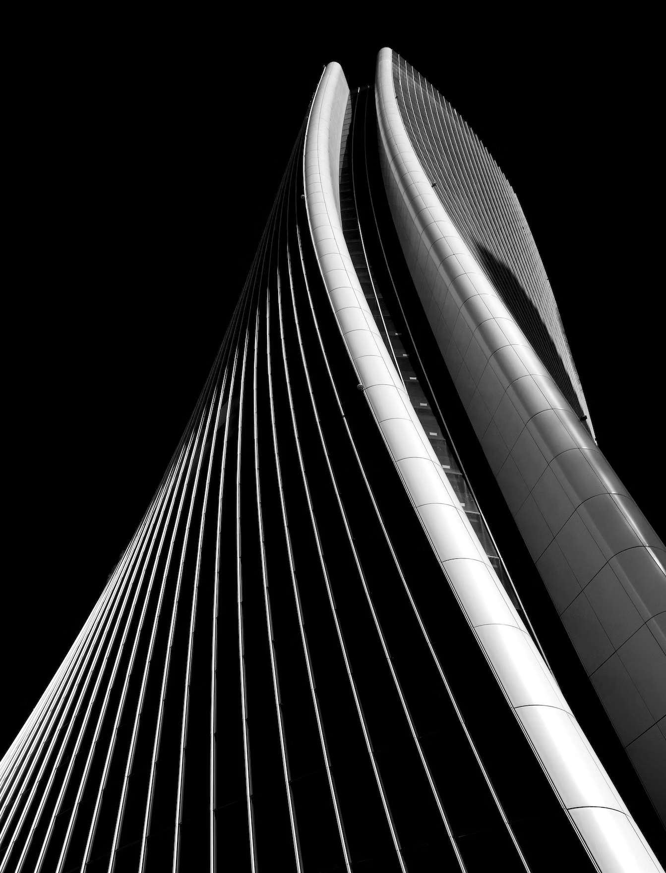

2 Feb, 2025
Matthew Topol
Apache Arrow: The Great Library Unifier
Voltron Data, Inc. Confidential and Proprietary

Slide 3

I Have A Confession To Make
AI/ML is NOT my expertise….

Slide 4
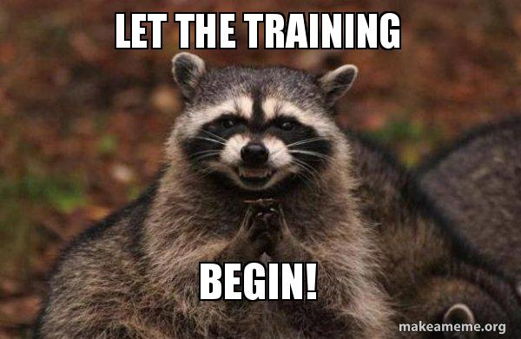
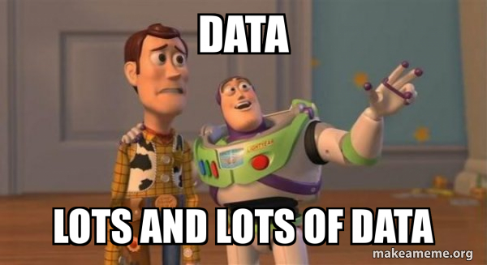
My (unsophisticated) take on ML
Magic Math??
Production Service

Slide 5
Libraries, tools, utilities, oh my!
01
02
03
Model Formats
Libraries
Data Sources
ONNX
JAR
PKI
GGUF
TensorFlow
PyTorch
Llama.cpp
RAPIDS
CNTK
JAX
HuggingFace
DataFrames
Feature Stores
Spark/Hive
Dataset Libraries
Parquet Files
CSVs

Slide 6
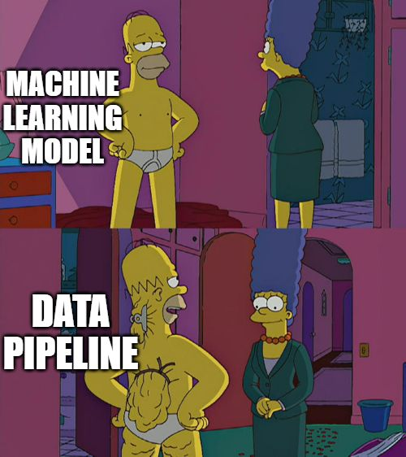
Potentially Controversial Opinion

Slide 7
Looking from a Data Pipeline perspective
Layers of processing and communication
Usually passed as tensors…
Preprocessing
Layer 1
Layer 2
Input
…
Postprocessing
Prediction
Layer n
Output
Notes:
After reading through tons of tutorials, examples, published OSS, the biggest constant is layers of processing

Slide 8
Pros and Cons
What functions are available?
cudf, TensorFlow, PyTorch, JAX, all have different benefits and drawbacks
Transformers available through HuggingFace
Cost of linking libraries together
Copying data because of incompatible layouts
Copying data between devices
Integrating UDFs
The new upstarts! (Many consolidating around Arrow)
Bauplan
LanceDB
GoodData

Slide 9
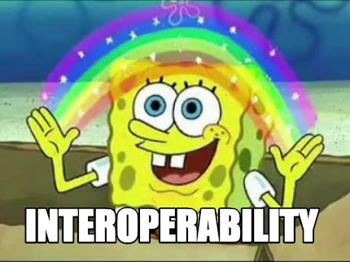
The point is

Slide 10
How is it done currently?
Common serialization and conversion
numpy
pandas
cupy
dlpack
Intermediate and cache files
Parquet
CSV
JSON
HDF5
Unnecessary Copying Slows You Down

Slide 11
What is Apache Arrow?

Slide 12

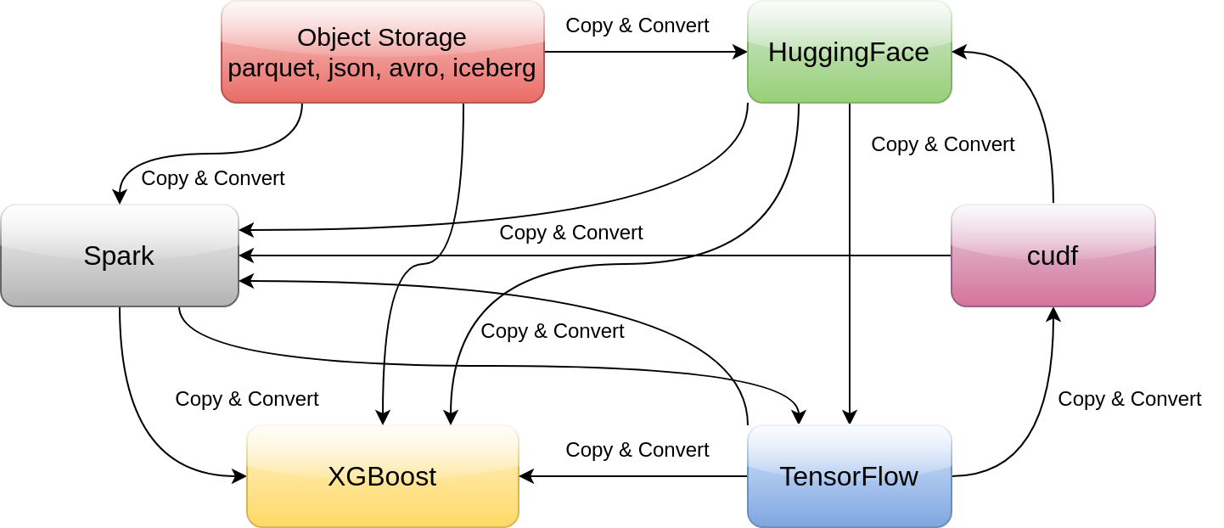
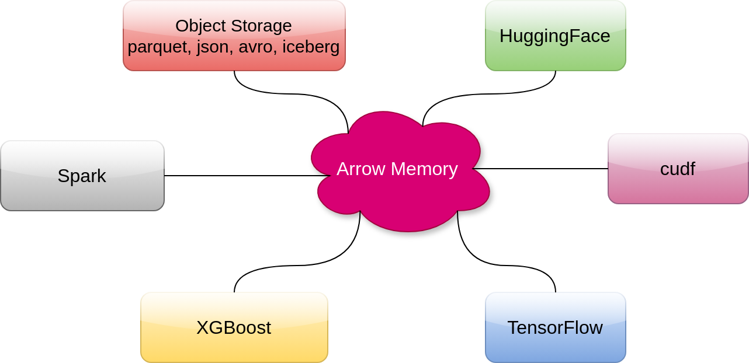
A Quick Primer on
https://arrow.apache.org
Polyglot!
Implementations in many languages:
Go, C++, Rust, Python, R, Java, Julia, MATLAB, Ruby, JavaScript, and more…
High Performance, In-Memory Columnar Format
No data serialization / deserialization required!

Slide 13
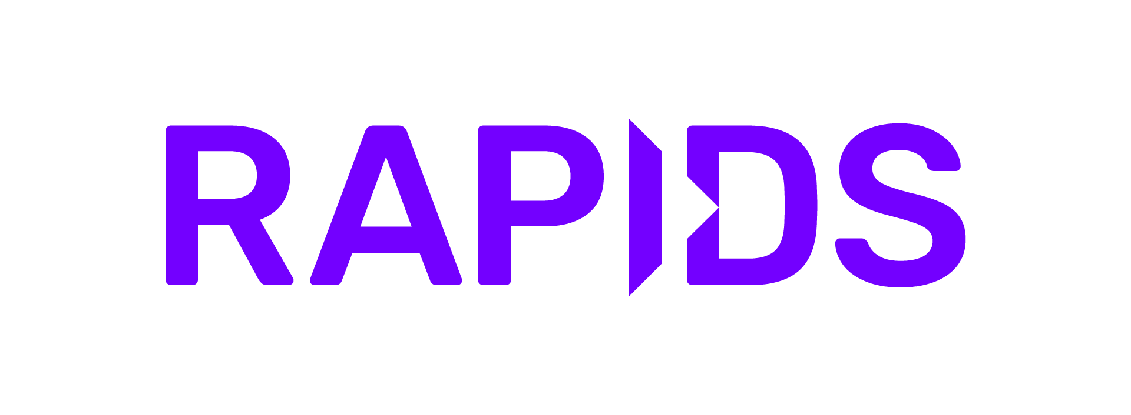


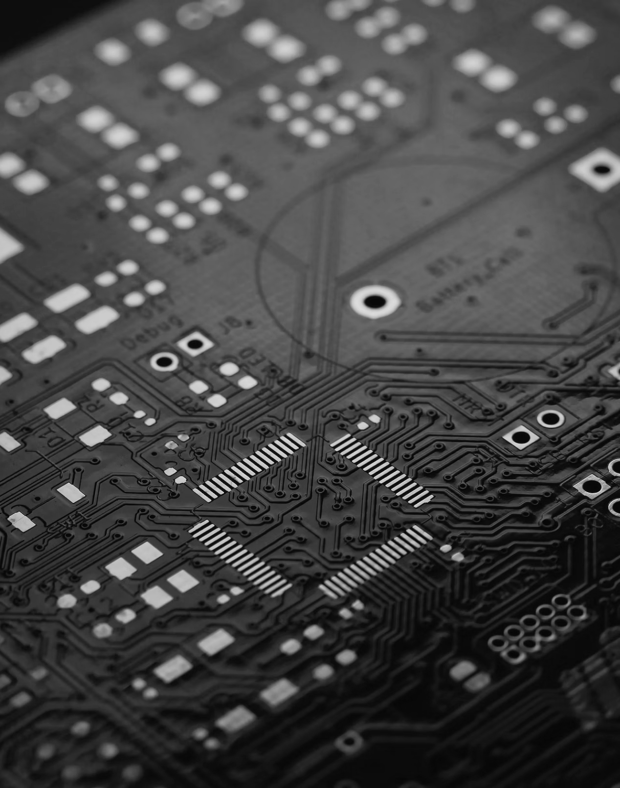

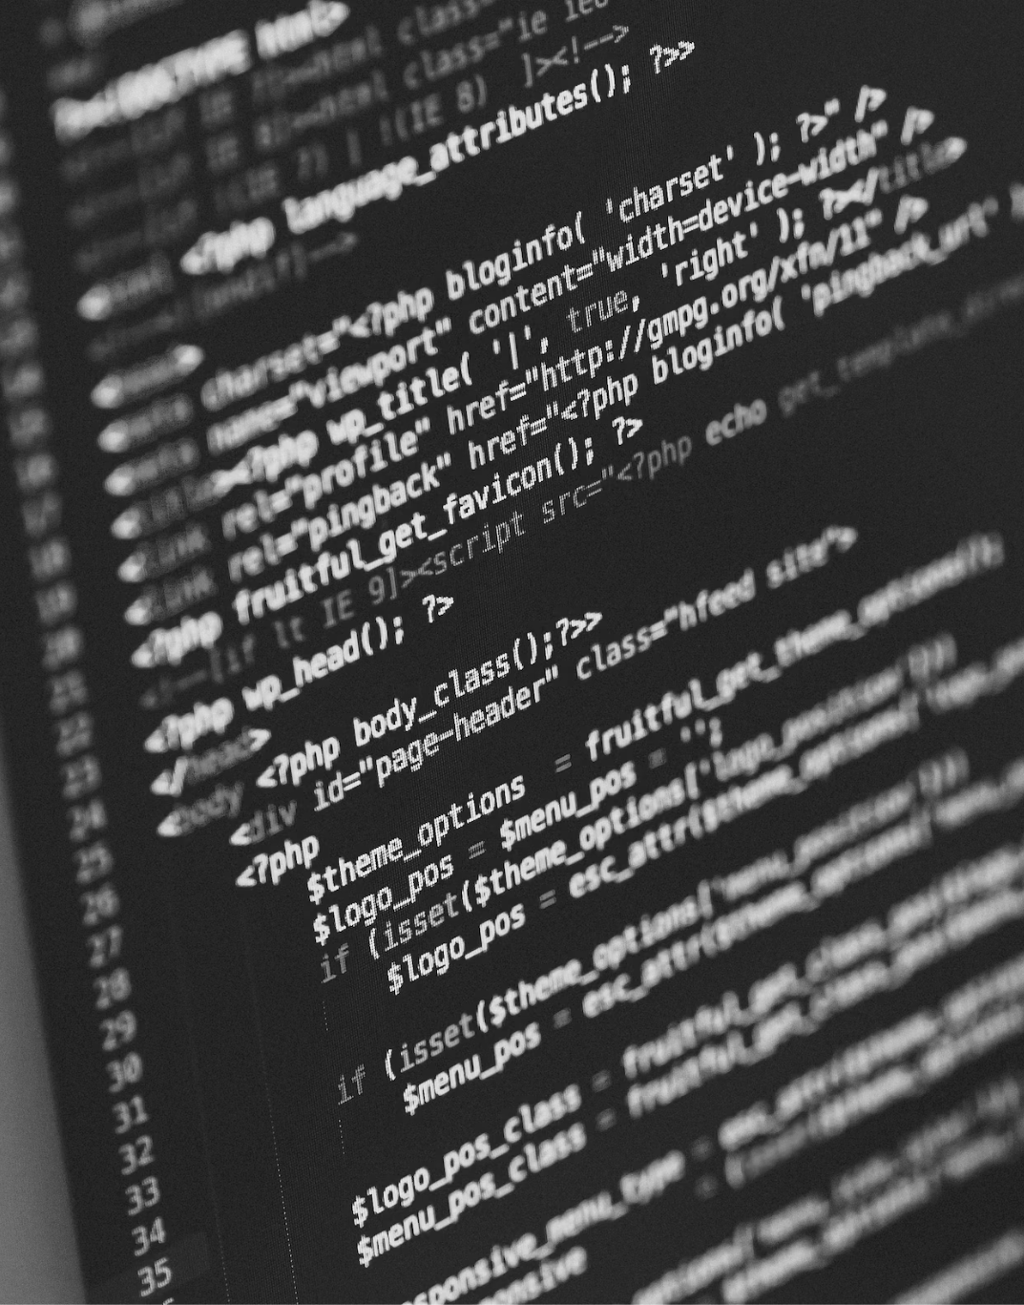
Chances are, you’re already benefiting
Arrow is already heavily used in the background of many popular libraries…
Nvidia
Polars, pandas
HuggingFace
Compute
The entire RAPIDS ecosystem of cudf, cuML, cuSpatial, cuGraph, etc. are built on using Arrow on the GPU
Polars is built on Arrow, pandas has a pyarrow backend
HuggingFace uses Arrow internally for efficient processing and larger than memory dataset caching.
DuckDB, Snowflake, BigQuery, and Apache DataFusion (among others) all support Arrow input/output

Slide 14
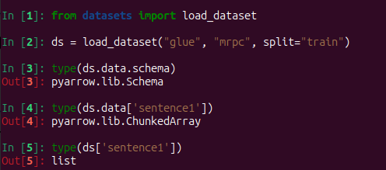
The Copies are often Hidden
Copy happens here!

Slide 15
So what am I proposing?

Slide 16



The Arrow Multiverse
Ecosystem
DataFusion, Parquet, BigQuery, …
Specifications: “Universal Columnar Format”
Format: in-memory arrays
IPC: how to (de)serialize arrays
C Data Interface: stable ABI for in-process interoperability
ADBC: columnar JDBC/ODBC
Libraries: “Multi-Language Toolbox”
C++, Go, Java, Julia, Rust, Python, …
nanoarrow: minimal, vendorable format + IPC + C Data for C/C++
Libraries
nanoarrow, PyArrow, arrow-rs, …
Specification
Format, IPC, C Data Interface, …

Slide 17
IPC & More
Other Arrow specifications layer higher-level functionality on top.
Arrow IPC
Arrow Flight RPC
Arrow Flight SQL
ADBC: Arrow Database Connectivity
Arrow C Data Interface
(De)serialize batches of arrays
Read/write from files or streams (e.g. HTTP)
ZSTD compression supported
Flight RPC: stream Arrow data via gRPC (HTTP/2)
Flight SQL: wire protocol for databases
Used by Dremio, InfluxDB, xtdb
JDBC/ODBC for Arrow data
Connect to BigQuery, Snowflake, & more with a simple Arrow-based API
Pass Arrow data zero-copy between libraries in-process
Works across languages, e.g. Java<->Python
Cross-device: CPU<->GPU

Slide 18
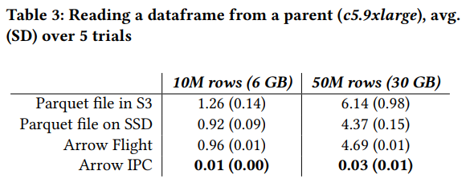
Leveraging Zero-Copy
Avoid copies when calling user-defined functions!
Source: Jacopo Tagliabue, Ryan Curtin, Ciro Greco (2024) Faas and Furious: abstractions and differential caching for efficient data pre-processing https://ieeexplore.ieee.org/document/10825377
Notes:
Reading intermediate data frames into UDFs

Slide 19
Interoperability using Apache Arrow
What are the benefits here?
Arrow IPC Files can be memory-mapped for larger-than-memory data processing. HuggingFace uses this for its on-disk dataset caching
Zero-copy sharing within a process, without build- or link-time dependencies
Supports any device to avoid forcing unnecessary cross-device copies
Efficient integration with various libraries (numpy, dlpack, polars, pandas, cudf)
Data retrieval (ADBC, parquet reading, etc.)
Data Transport (Flight, FlightSQL, Dissociated IPC)
Cross-language libraries
Memory Mapping
C Data Interface
Ecosystem

Slide 20
Data Type Compatibility
Arrow has you covered!
All the expected primitive data types
Support for complex types
  Maps, Lists, Structs, Unions
Extendable
  “Extention_type” built-in to the type system
  Canonical community extensions for geo spatial (GeoArrow)
And Introducing FixedShapeTensor and VariableShapeTensor
Canonical Extension Types
Underlying representation is a FixedSizeList
Compatibility!
Optional params
  Dimension names
  Permutations

Slide 21
Arrow Fixed Shape Tensor
Fixed Shape Tensor Physical Layout - Fixed-Size List Layout
Array of tensors (ndarrray)
[ [1, 2], [3, 4] ]
[ [10, 20], [30 ,40] ]
[ [100, 200], [300, 400] ]
array
validity bitmap buffer
None
values array - Fixed-size Primitive child array
validity bitmap buffer
None
values buffer
1 2 3 4 10 20 30 40 100 200 300 400
type: extension<arrow.fixed_shape_tensor[value_type=int32, shape=[2,2]]>
arrow array: [[[1,2,3,4], [10,20,30,40],[100,200,300,400]]]

Slide 22
Arrow Variable Shape Tensor
Type parameter: datatype
First dimension is length of the array
Data stored as StructArray
  data: List holding tensor elements in contiguous memory
  shape: a FixedSizeList<int32>[ndim], ndim
Elements are stored in row-major / C-contiguous order
  Permutation parameter can define other orders

Slide 23
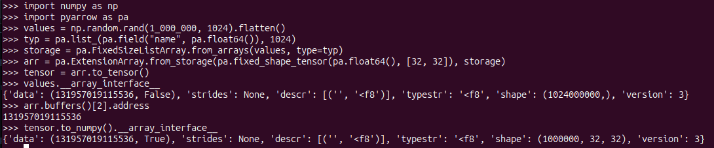
Example: Proof of Zero-Copy
Data Buffer Address
Is the same!
Shape is maintained!

Slide 24
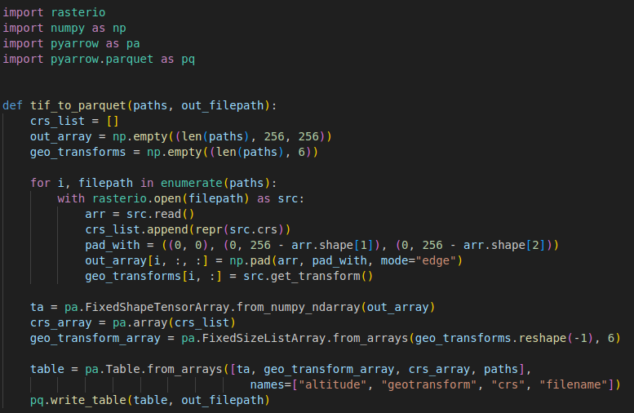
Example: Store Tensors in Parquet
Zero-Copy!

Slide 25
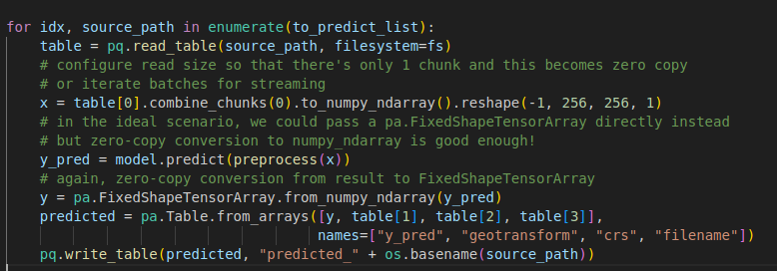
Example: Use tensors for inference

Slide 26
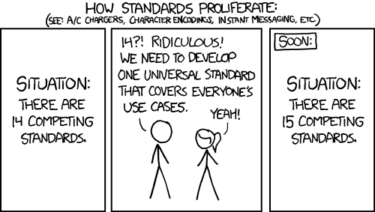
Okay… But Why?

Slide 27


Arrow Supports More
Existing interoperability has limitations
DLPack, NumPy, cuPY, numba
Apache Arrow C Device Interface
Only support numeric types (mostly)
  Must be fixed-width
Does not support “null” values
Some only support CPU or only some devices
Difficult to extend
Does not support GPU synchronization / events
Wide support of semantic types
  Including complex types, lists, structs, maps
Supports “null” values via validity bitmap
Same device support as DLPack
Extendable via extension-type
Allows passing GPU events for syncing
Converts to/from numpy and dlpack for compatibility with existing libs

Slide 28
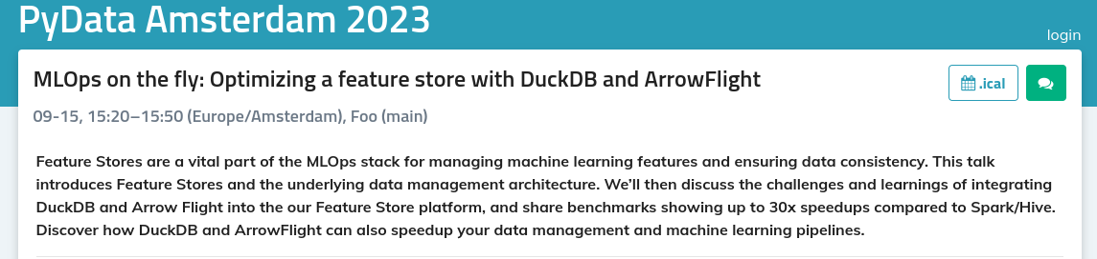

Slide 29
Keep Data on the Device
Pre-process on GPU, keep it there for training!
Zero-Copy Arrow Data
Move to GPU
Preprocess on GPU
Layer 1
Layer 2
Input
Training on GPU
…
Postprocessing
Prediction
Layer n
Move to CPU
Output
Notes:
After reading through tons of tutorials, examples, published OSS, the biggest constant is layers of processing

Slide 30
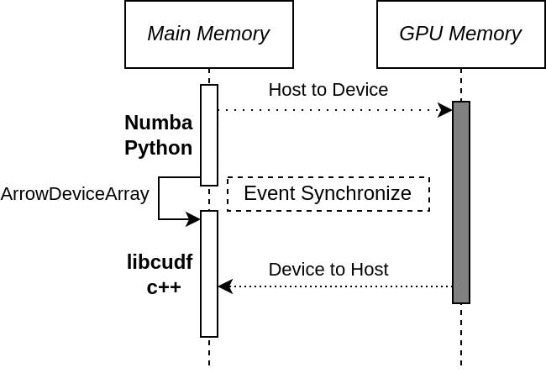
A Contrived Quick Demo…
Notes:
After reading through tons of tutorials, examples, published OSS, the biggest constant is layers of processing

Slide 31






The Goal, Choose the best tools!
Flight
FlightSQL
ADBC
ML/AI App
cudf
Data Sources
TF
Arrow data
JAX
Py Torch
XG Boost

Slide 32
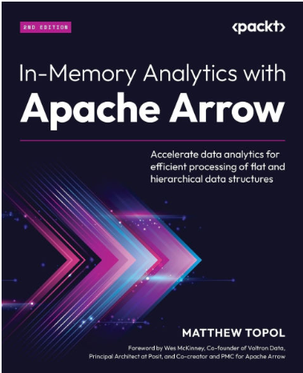


Wanna learn more?
Email
zotthewizard@gmail.com
Author Of
“In-Memory Analytics with Apache Arrow”
Apache Arrow PMC
Staff Software Engineer at Voltron Data
Primary developer of github.com/apache/iceberg-go
github.com/apache/arrow-go
@zeroshade linkedin.com/in/matt-topol/

Slide 33

Thank You!
Learn more/get involved
https://arrow.apache.org/community/

