Slide 1

augurs
A Time Series Toolkit for Rust
https://demo.augu.rs
1 February 2025
Notes:
Ask late joiners to take their seats quietly.
Welcome everyone, thank you for coming to my talk
How many people are here?!
I’m going to be talking about augurs!
augurs is a Rust library for doing time series analysis: more on that soon.
It also has Python and Javascript bindings, the latter of which are now being used in Grafana’s frontend to do on-demand, client side ML on time series

Slide 2

Ben Sully
Software Engineer
Notes:
Who am I?
I’m a software engineer at Grafana Labs, based in Sheffield, UK
In my spare time I like to go bouldering and run ultramarathons, which is totally normal I swear
I’ve been at Grafana for ~4 years now, working on the machine learning team.
Until very recently I used Rust only for personal projects (or hackathons), and Go/Python/Typescript for $work
My background is in statistics; I have an MSc in Statistics and worked a lot with time series in previous jobs

Slide 3
What is augurs? What can it do?
Lessons learned translating ML algorithms to Rust
Questions!
Bonus: Exposing a Javascript interface via Wasm
Notes:
Summary of the talk
Start off with some basic information about the project: a bit of history, background on time series, what it can do, why it exists, and most importantly the name
Next I have a bunch of things I’d like to share about translating ML algorithms to Rust
These things were often written 30 years ago in C++, R, S, or even Fortran, so it’s always a bit of a journey
Questions!
If we have time, I’ll share some things I’ve learned and exposing a JS interface via WASM where tradeoffs are different; some fun things to talk about there

Slide 4
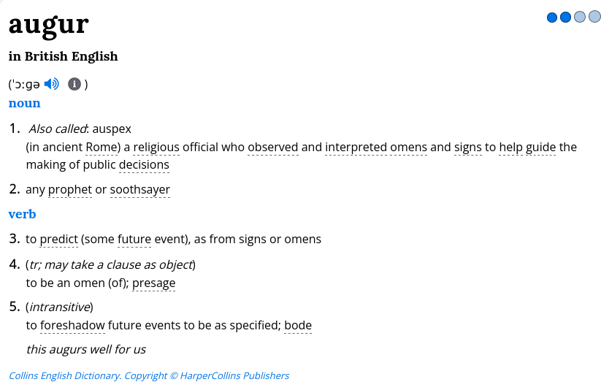
What’s with the name?
Domain name driven development: find a word in the thesaurus ending with ‘r’ or ‘rs’ and check if the domain exists
Notes:
Domain name driven development
This is probably the only time in my entire life I’ve come up with a half decent name.
Hopefully I get lucky with a second if I have a kid; maybe I’ll name them after a funny domain I find in the thesaurus too.

Slide 5
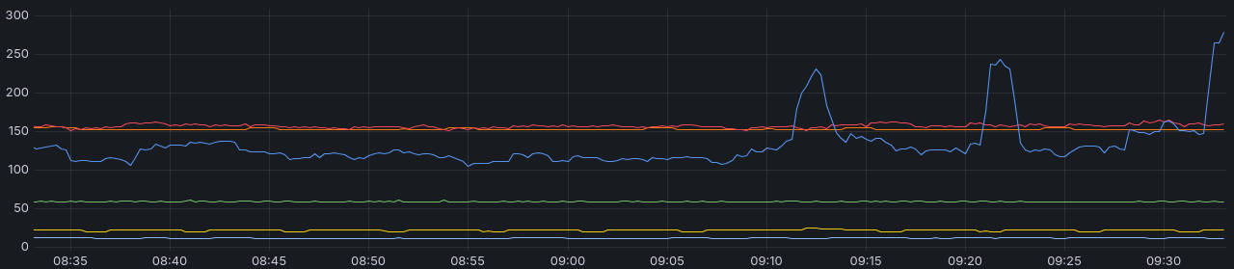
What is a time series again?
Simply a measurement of the same thing taken at (usually regular) time intervals
Computers love them!
  Values are just a whole bunch of numbers (usually floats)
  Timestamps are usually integers (e.g. seconds since epoch)
  Lots of tricks to optimize representation in memory and on disk
Notes:
I mentioned that augurs is a time series library.
Let’s quickly take a step back and cover what a time series is.
Fairly straightforward: a measurement of the same thing taken at usually regular intervals. So in this graph we have ‘time’ on the X axis, with several time series plotted in different colours; they go up and down over time.
Since they’re just numbers, there are tons of optimizations you can do when storing and processing them, which makes them fun to work with. Mostly out of scope here!
For readers, look at the ‘Gorilla’ paper (and the so-named Gorilla encoding) - https://web.archive.org/web/20240424194530/https://blog.acolyer.org/2016/05/03/gorilla-a-fast-scalable-in-memory-time-series-database/ is a good summary

Slide 6
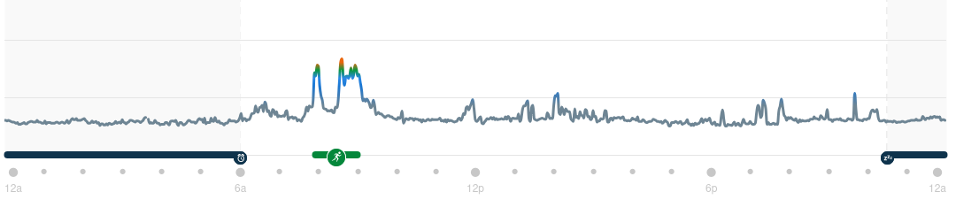
Real world time series
Environmental:
  temperature, sea levels, CO₂ levels
Software:
  memory usage, CPU usage, requests per second
Health:
  Heart rate, blood pressure
Economic:
  sales, stock prices, crypto prices if you must
…countless others
Notes:
Ubiquitous in the real world: some example uses here, but really the list is endless.
Here’s my heart rate tracked over one day last month!

Slide 7
What do we do with them?
👀
🚨
🤔
Visualise patterns and trajectories
Set thresholds for alerts and notifications
Identify anomalies and outliers
Notes:
Visualisation and data presentation
seeing seasonalities or trend
capacity planning, budgeting, making policy decisions…
Shorter term: alerts and notifications
email me if my disk usage goes over 90%
send a push notification if the exchange rate goes over $1.20
can be a static threshold or something more dynamic (hint)

Slide 8
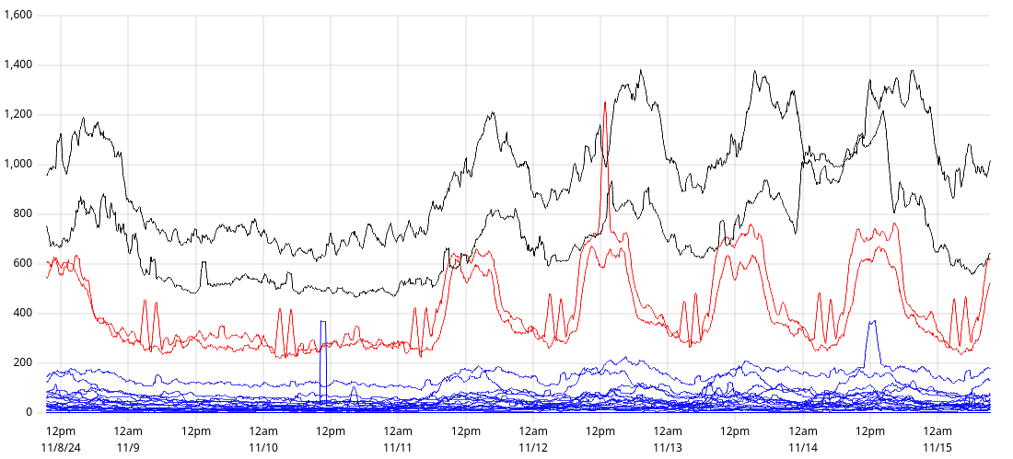
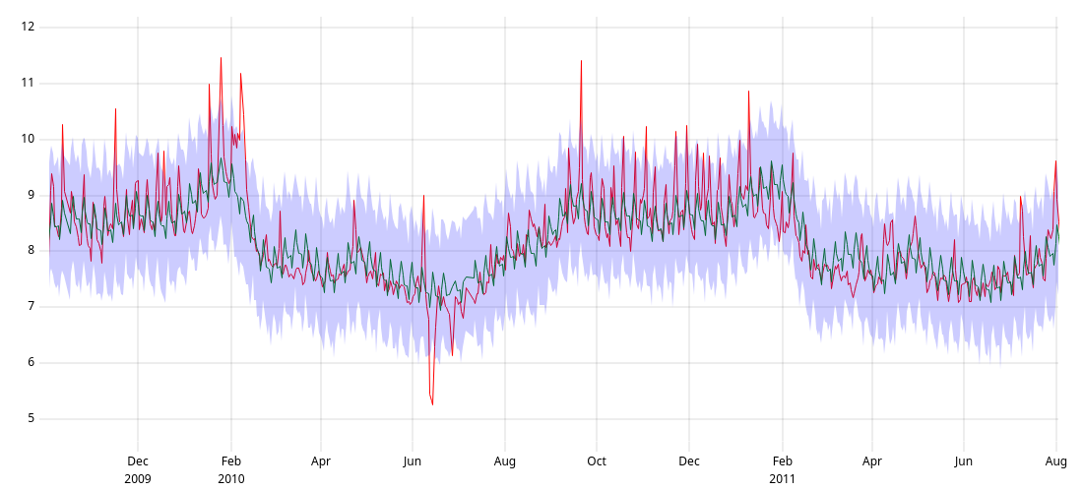
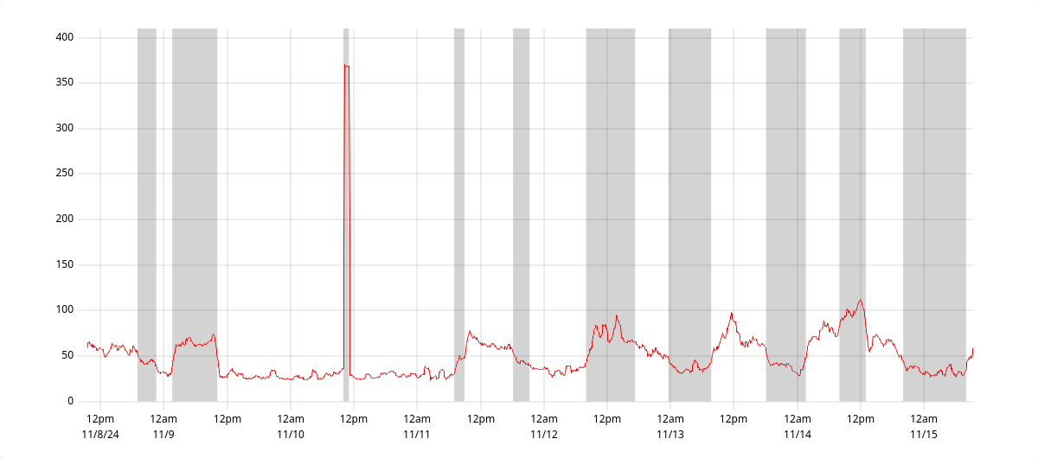
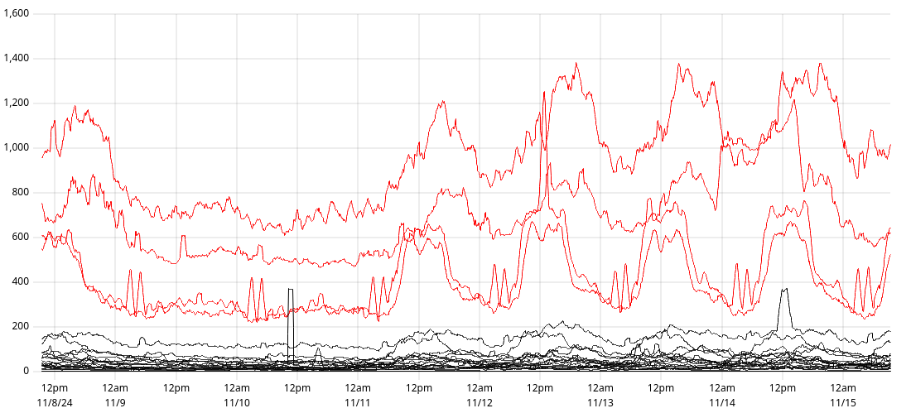
What is augurs?
Clustering
A Time Series Toolkit for Rust
Forecasting
Changepoint Detection
Outlier Detection
Notes:
So what is augurs and how does it fit into this? Well, it’s a time series toolkit designed to help you do those things in Rust.
More specifically, it’s a time series analysis toolkit

Slide 9
What is augurs?
Clustering
A Time Series Analysis Toolkit for Rust
Forecasting
Changepoint Detection
Outlier Detection
Notes:
As someone on Reddit was very eager to point out, it doesn’t concern itself with some of the more basic time series functionality such as resampling or .
Instead it implements various machine learning algorithms that are designed to operate on time series:
Forecasting: classic example. predict the future! (with lower/upper bounds)
given a time series up to time t, predict the values at time t+1 (or t+10, etc).
also give me prediction intervals so I know how accurate the prediction is.
Clustering: group series together
given lots of time series, group together those behaving similarly
In this screenshot we have hundreds of series, and three major groups in black, red and blue
Outlier detection: find series ‘misbehaving’
again given lots of series which should all behave similarly, identify any which don’t
Changepoint detection: tell me when the behaviour of a time series appears to change
This could be a sudden increase or decrease, or a sudden increase in variance

Slide 10
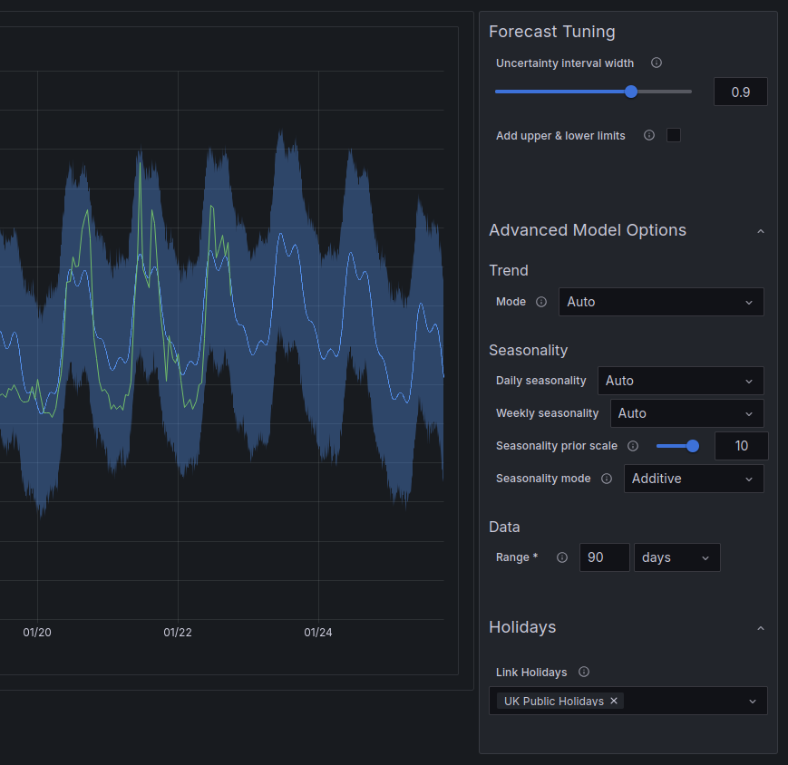
Forecasting
Predict future values, optionally with prediction intervals.
Examples:
forecasting sales or expenses
predicting capacity of servers to trigger auto-scaling
alerting when requests per second drops below expected lower bound

Slide 11


Forecasting algorithm comparison
Exponential Smoothing
(ETS)
Multiple Seasonal-Trend decomposition using LOESS
(MSTL)
Prophet
Well understood algorithm
Relatively new
More sophisticated
Only supports one seasonality
Supports multiple seasonalities
Can model more complex scenarios
Fast!
Still pretty fast
Slower
Notes:
Three main algorithms in augurs so far; here’s a very reductive comparison. At a high level, from left to right, they range from fast & low complexity to slow & high complexity.

Slide 12
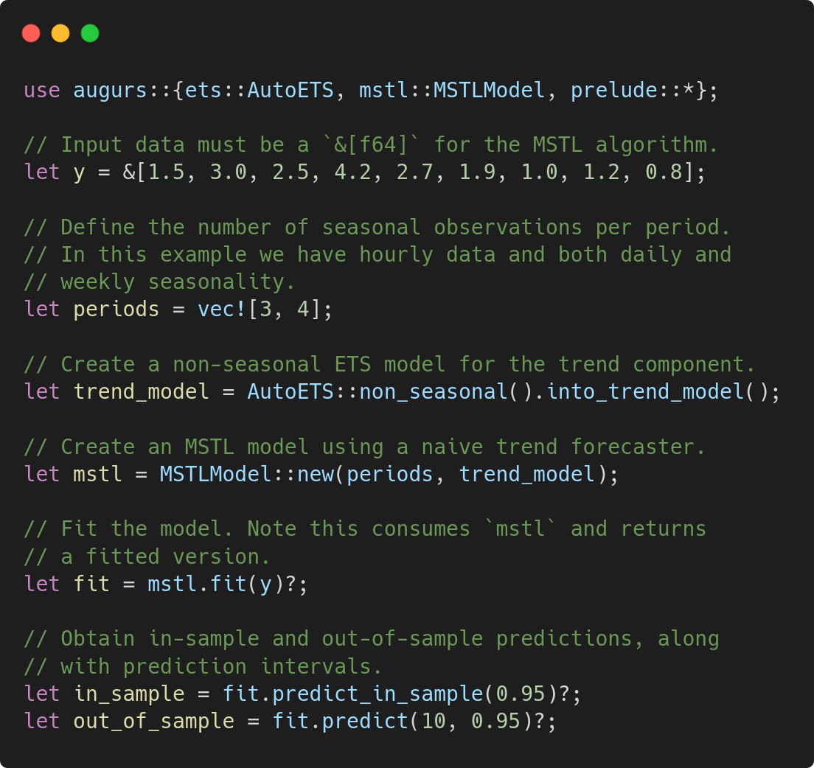
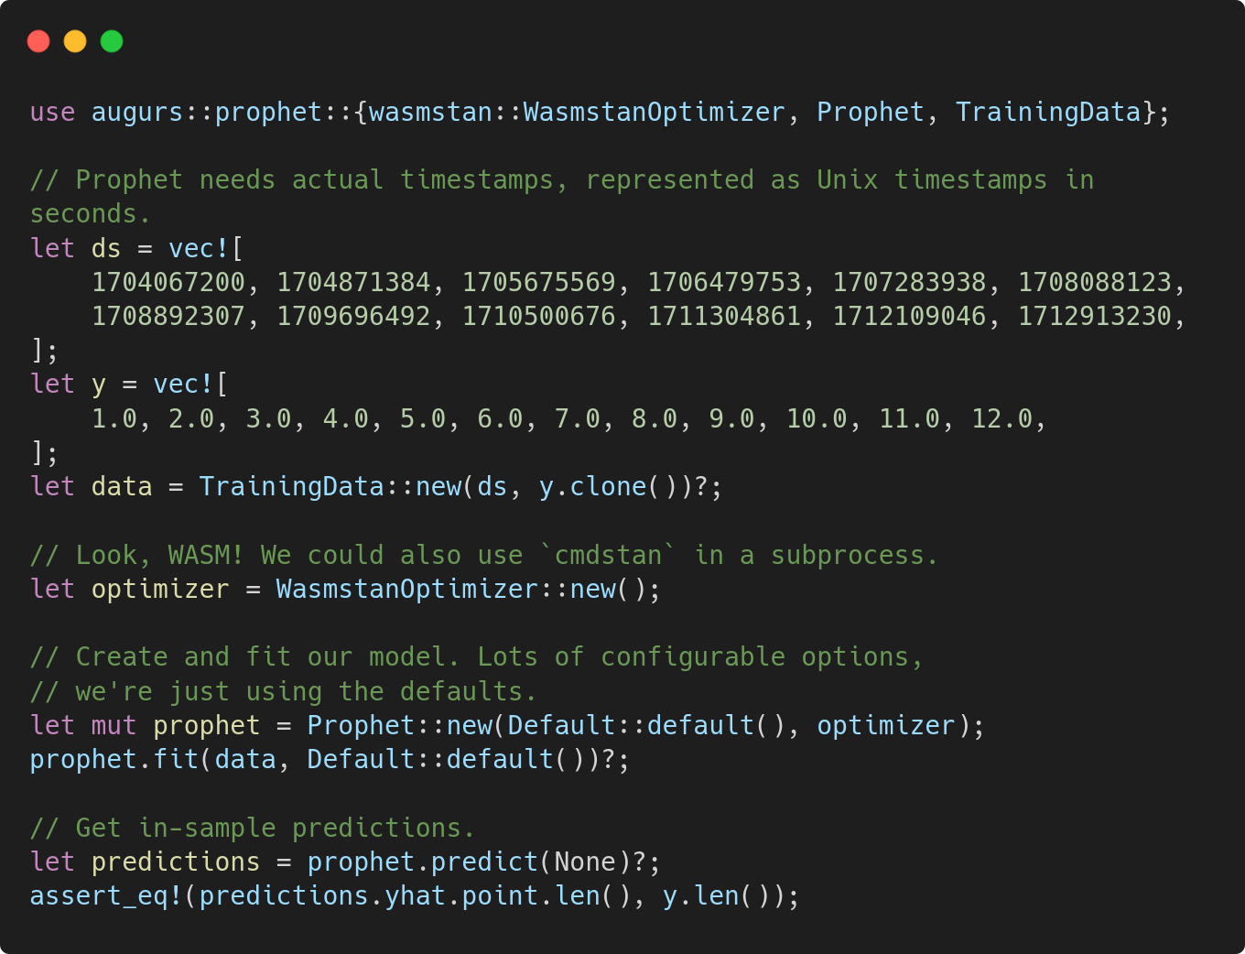
Forecasting code examples
MSTL & ETS
Prophet

Slide 13
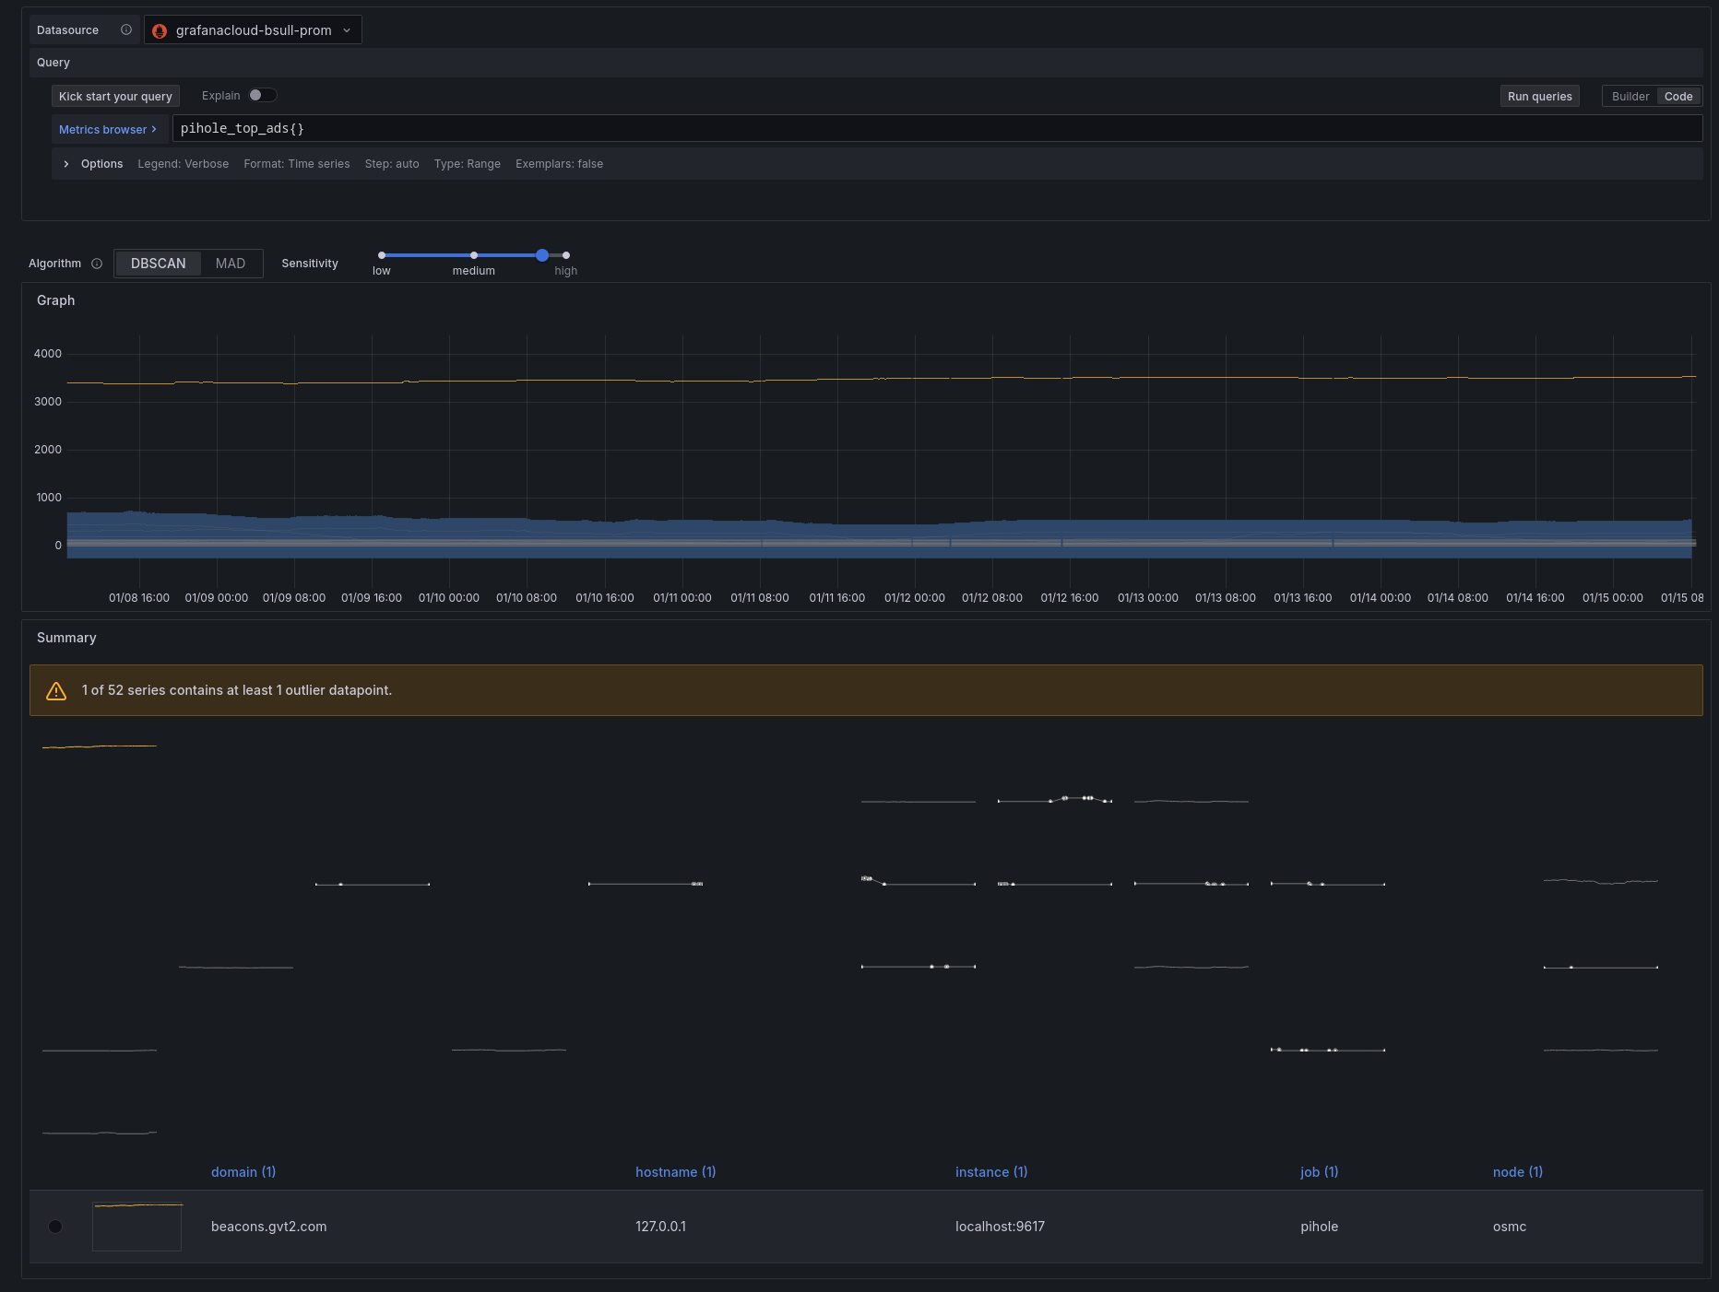
Outlier Detection
Used to identify when one or more series is behaving differently to the main group.
e.g. pods in a Kubernetes deployment
CO₂ levels across all rooms of a university
Notes:
Screenshot shows my ads blocked by domain in my pihole instance. Mostly the same, but whatever beacons.gvt2.com is, I hate it

Slide 14
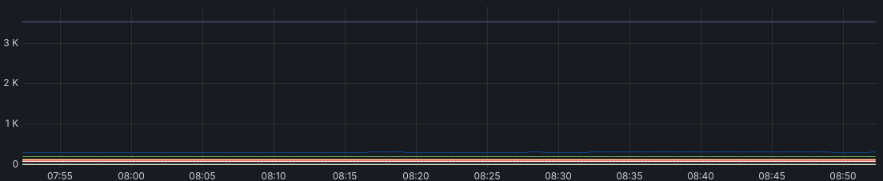
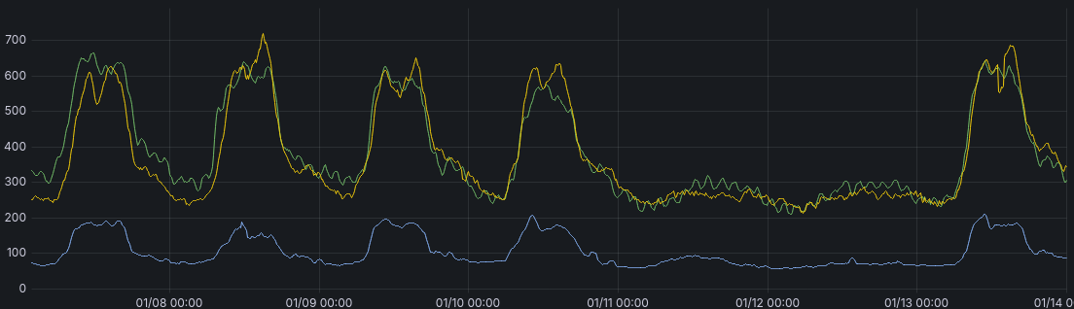
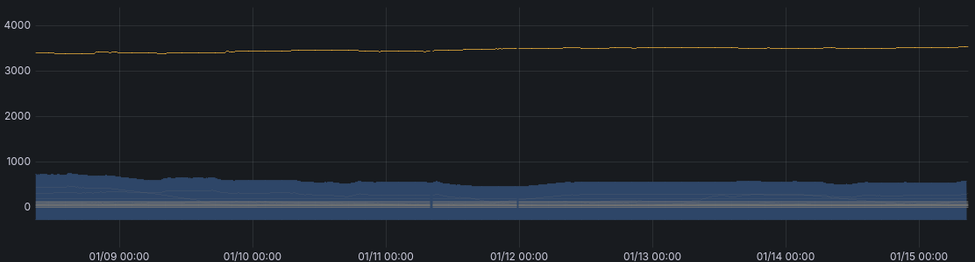
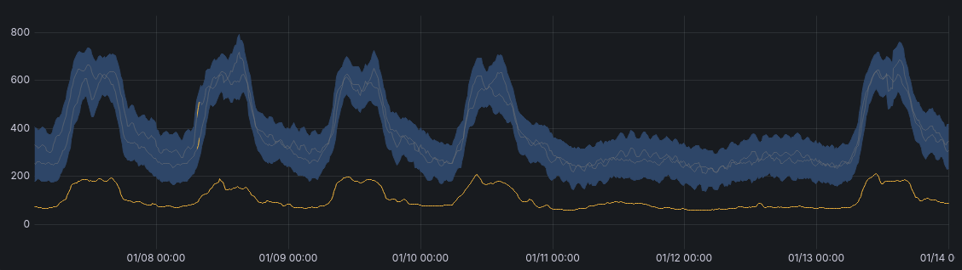
Outlier Detection algorithm comparison
Median Absolute Deviation (MAD)
DBSCAN
Used when series are constant
Used when series are moving together
Notes:
DBSCAN: Density-Based Spatial Clustering of Applications with Noise
Why would you ever use MAD over DBSCAN?
More intuitive - much easier to understand what it’s doing, just looks at how much each point deviates from the median
DBSCAN finds cluster centroids, flags things as noise, … just more complicated

Slide 15
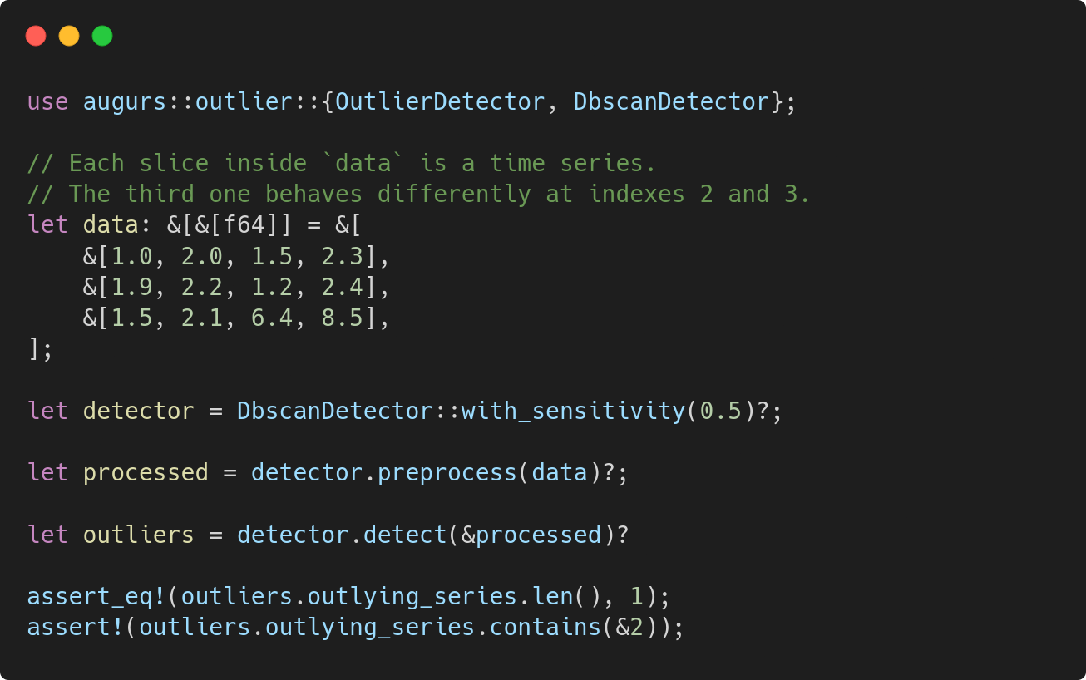
Outlier Detection code example
Notes:
DBSCAN: Density-Based Spatial Clustering of Applications with Noise
Why would you ever use MAD over DBSCAN?
More intuitive - much easier to understand what it’s doing, just looks at how much each point deviates from the median
DBSCAN finds cluster centroids, flags things as noise, … just more complicated

Slide 16
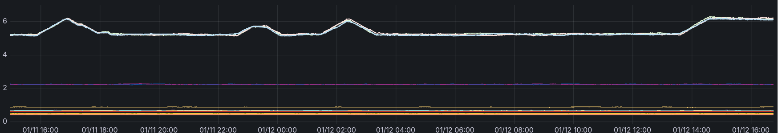
Clustering
Used to identify multiple groups of series
Especially useful if you have lots of unlabeled series and want to group them together
Examples:
Identifying hardware with similar characteristics (timings of sticks of RAM)
Finding patients with similar medical statistics

Slide 17
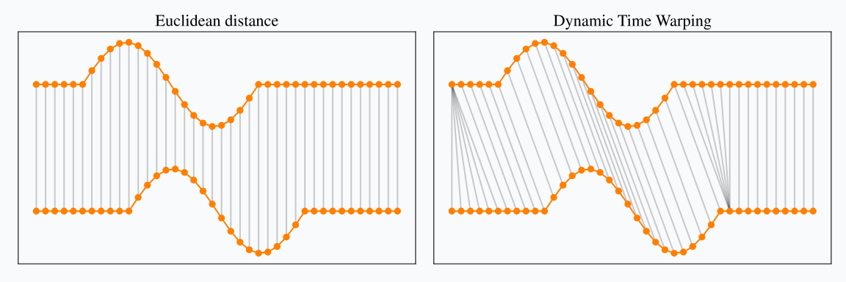
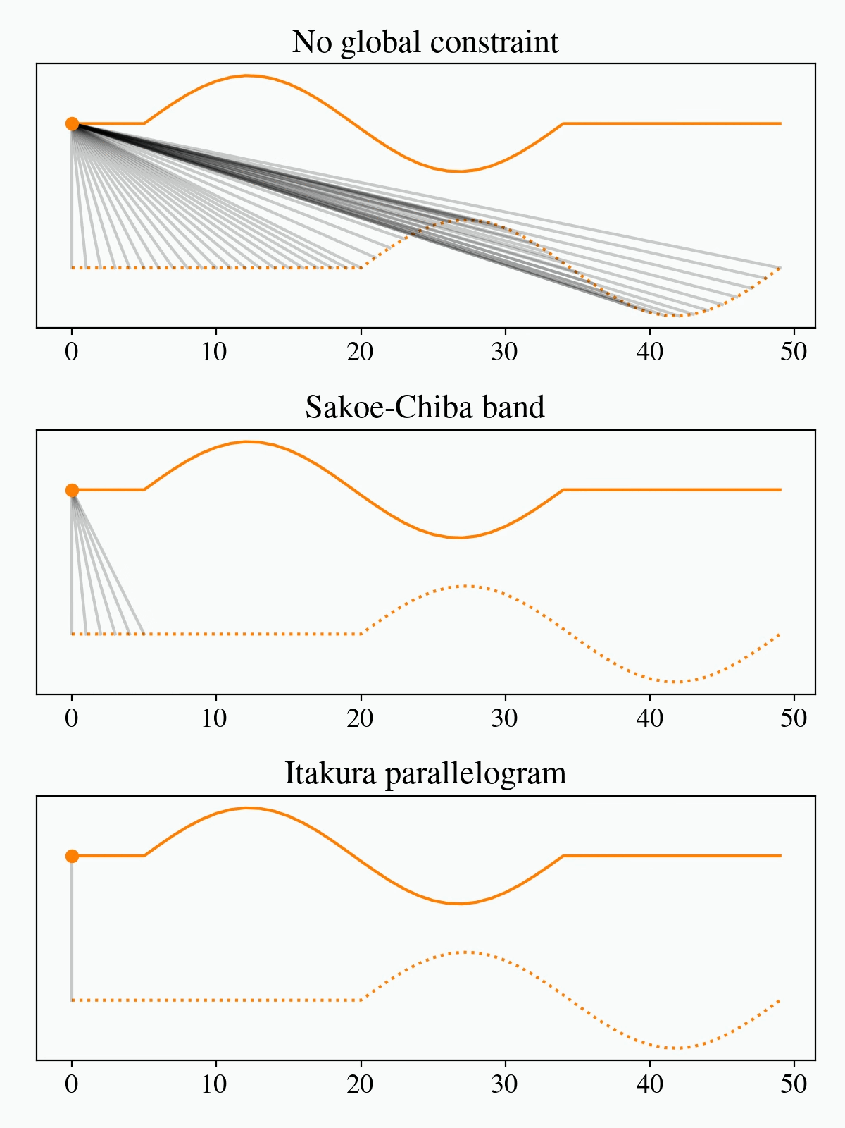
Clustering - distance matrix using dynamic time warping
Calculate distance between each pair of time series
Euclidean: compare both values at time t
DTW: use pairs of values that minimise overall distance
Naive algorithm is slow but there are ways to skip a lot of work! (See gif)
Ref: https://rtavenar.github.io/blog/dtw.html
Notes:
In augurs clustering is done in two steps. The first step is to calculate the distance matrix: pairwise distances between each time series, using Dynamic Time Warping.
Exact details are out of scope but the gist is: rather than comparing both values at time t, use pairs of values that minimise the overall distance (subject to some conditions).
At first glance this looks O(N^2), but with some constraints it can be sped up a lot.

Slide 18
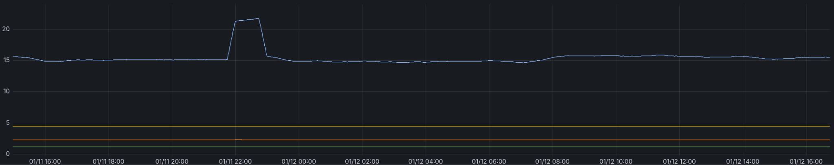
Clustering - distance matrix feeds into DBSCAN
DTW
Distance Matrix |  | Series A
 |  | 0 | 1 | 2 | 3
Series B | 0 | 0.0 | 1.3 | 2.4 | 6.8
 | 1 | 1.3 | 0.0 | 1.2 | 5.7
 | 2 | 2.4 | 1.2 | 0.0 | 7.4
 | 3 | 6.8 | 5.7 | 7.4 | 0.0
Series | 0 | 1 | 2 | 3
Cluster | 0 | 0 | 0 | 1
DBSCAN
Notes:
Once we have the distance matrix on the left, we feed it into DBSCAN (similar to outlier detection, but not quite the same). This gives us a cluster ID for each series.

Slide 19
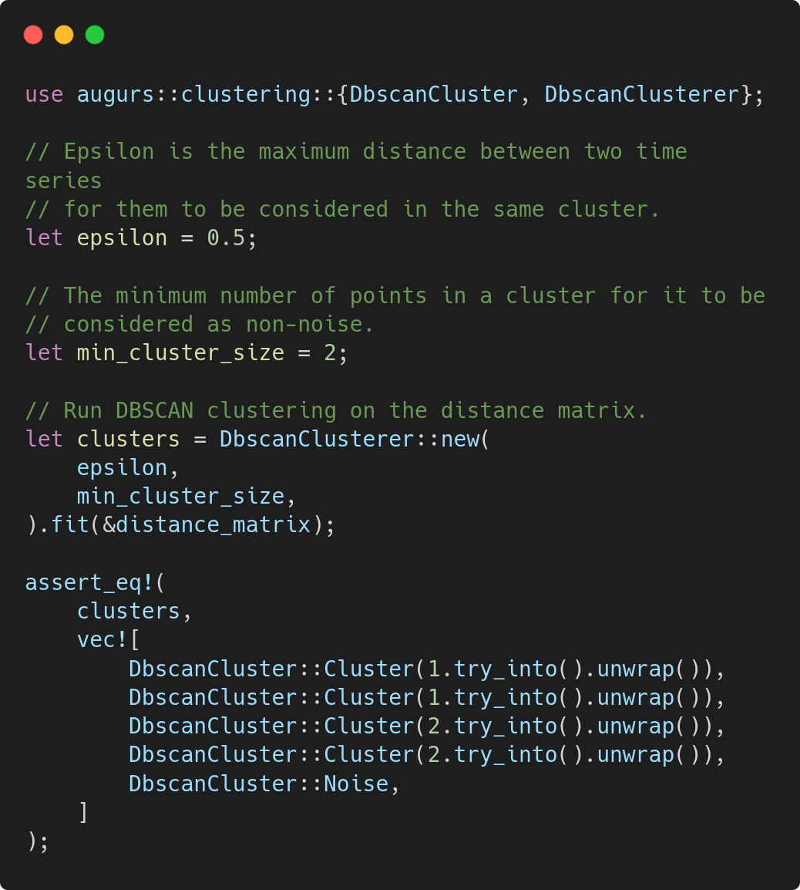
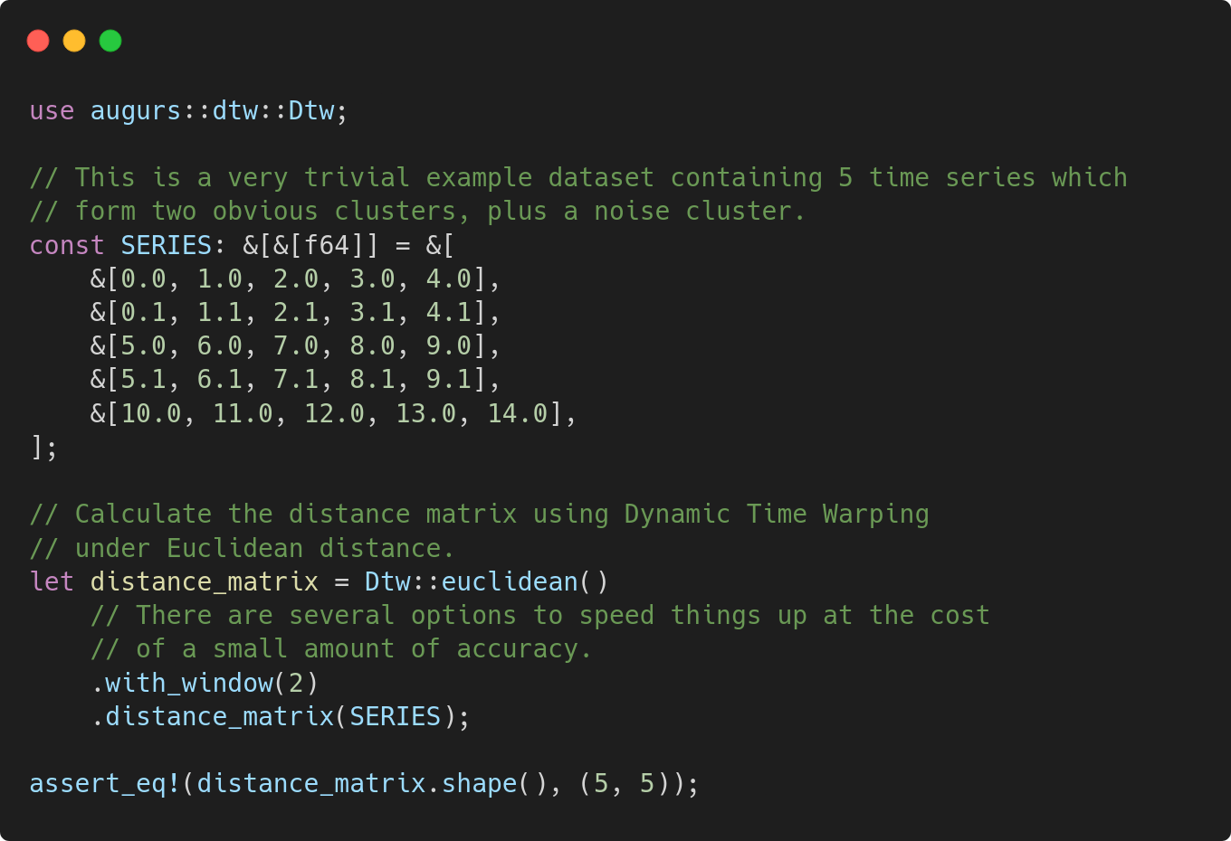
Clustering
Notes:
Again, define some data - multiple slices of floats.
Calculate distance matrix between these series, with optional params.
Then do the clustering. First set two important parameters needed by DBSCAN.
Then use the distance matrix we already calculated to discover clusters.
https://github.com/grafana/augurs/blob/main/examples/clustering/examples/dbscan_clustering.rs

Slide 20
Things augurs doesn’t do
Plotting time series
  Use plotters from Rust, or uPlot from Javascript, or countless options in Python
Time series data structures
  … with methods to resample, etc.
  I’m not sure if one of these exists in Rust?
Storage and compression
  It’s not a database, nor is it suited for one
  Use a time series database: Prometheus, InfluxDB, etc.
Notes:
I always find it useful to know when I shouldn’t use something.
Some of these may be obvious but not necessarily!

Slide 21
Why does it exist?
Existing implementations are spread across various R and Python libraries (or even Jupyter notebooks 😬)
Performance not always great, despite dropping down to C/C++/Fortran
  (which then makes it hard to debug)
Computation is often not that expensive: should be able to run in browser, avoiding round trips, but JS/Python/R not suitable
Notes:
I noticed a few things while doing ML on time series at Grafana and wasn’t really happy with the state of play.
Also I learned a lot along the way!

Slide 22
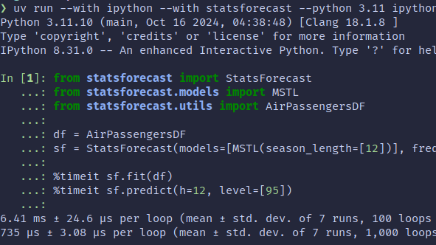
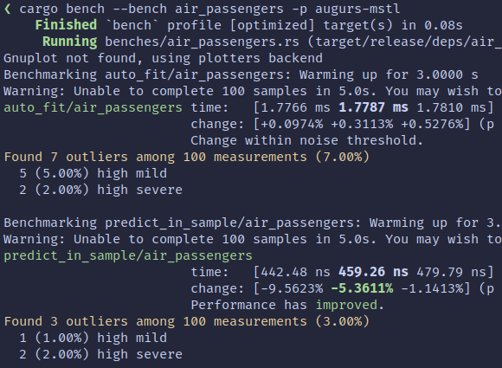
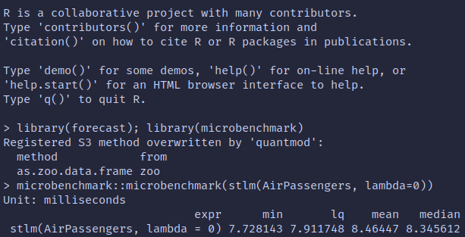
Why should you use it?
You want to analyse time series data…
Fresh, clean, tested code - easy to contribute, hack on or fix! 😊
Portable: Rust-only dependencies, thanks to Wasm
JS and Python bindings
Fast! (as always, take benchmarks with a huge grain of salt!)
Notes:
Well for starters you need some reason for caring about time series at all. But assuming you do…
Clean and tested code
Portable - Rust-only
Bindings for other langs
Fast
Haven’t done thorough comparisons but achieved 10x speedups even over numpy
- probably due to extra control, lazy operations and aggressive optimization

Slide 23
End of Part 1
Notes:
OK, that was a very high level overview of augurs. There are a few other things I didn’t have time to cover - check out the docs for more info!

Slide 24
What to expect when you’re translating
Notes:
Next up I’d like to talk a bit about the process of converting an ML algorithm from another language to Rust, and pass on some hard learned lessons.

Slide 25
High level process
Expectations
Find source implementation
Duplicate tests
Translate line-by-line
Refactor for idioms
Optimize
3 implementations
Tests? lol
This code sucks, I can write it better
I love idiomatic Rust! Obviously we should do this earlier
This bit looks fun, let’s do it now
… all disagree
Reality
Find multiple source implementations
Swap back and forth
Translate some functions line-by-line
Translate others idiomatically
Fire up that debugger
Moments of Frustration
Notes:
Naturally you’ll start off with good intentions and an optimistic, but sadly naive and misplaced, attitude towards the process.
It looks pretty sensible, right? Probably what the working with legacy code book says?
Well, the road to hell is paved with good intentions, and unfortunately there are a hundred and one things that will scupper this plan.
First you’ll find multiple implementations, probably in different languages, each with different tradeoffs.
None of them will have tests, but hopefully there is at least an example of each.
You’ll run the examples and see the results. They’ll all disagree. Fine, let’s choose the one which seems the most well-regarded, somehow.
Let’s get started! To begin with, translating is fine, but the code starts to look very strange, and you have to do crimes to get things to work in safe Rust. You decide to be a bit lax with the third step, and start blending in the fourth.
Things are going OK, but it sure would be nice to see if that promise of performance is paying off. Let’s do a bit of benchmarking now, just for fun…
The final process will look a bit more like this. The debugger step will turn out to be important anyway!
Let’s talk about some specifics.

Slide 26
Find source implementation
Duplicate tests
Translate line-by-line
Refactor for idioms
Optimize

Slide 27
Finding other implementations
Nothing will be perfect
Look for published papers
As few languages as possible
Otherwise you wouldn’t be rewriting it
Some implementations will be accompanied by a paper; this often helps explain motivations despite lack of tests/comments
Some R libraries use both C++ and Fortran routines and are very tricky to reproduce
Hopefully there’s already something on crates.io
Open source - this is table stakes
Tests, or at least plenty of examples
Recent commits, or a responsive author
Notes:
Keep an eye out for hidden complexity in other implementations.
As an example, R provides lots of builtins in the standard library for doing optimization. Don’t be surprised if you come across an algorithm which calls routines written in Fortran in the 70s. Good luck finding a version on crates.io!
E.g. for ETS, I had to rewrite the Nelder-Mead optimizer to get an exact match between R and Rust.
Ideally you won’t need to rewrite everything e.g. optimization - crates.io has lots of implementations already.

Slide 28
Find source implementation
Duplicate tests
Translate line-by-line
Refactor for idioms
Optimize

Slide 29
Testing and debugging
Take what you can get
Test implementation details
Get a big screen and a debugger
Any reproducible examples in books, papers, blog posts…
Testing the public API is great, but you have lots of internals to reproduce, and you need to know they work. You might throw them away, and that’s fine!
You’re gonna need to step through two implementations at once.
Be warned, patience required
Rust’s test framework makes this all very nice
Examples can become integration tests and benchmarks - helps exercise public API
Add comments judiciously; better yet, add assertions ( debug_assert!() )
Learn your debugger’s keyboard shortcuts!

Slide 30
Find source implementation
Duplicate tests
Translate line-by-line
Refactor for idioms
Optimize

Slide 31
Translating tips - working with arrays
Iterator and Itertools go a long way
Often enough to reproduce even obscure numpy funcs
Can be heavily optimized by rustc
Notes:
Low dependency count is the new cargo add.
So start off with just iterator/itertools!
Learn the adapters.
You might even get SIMD for free.

Slide 32
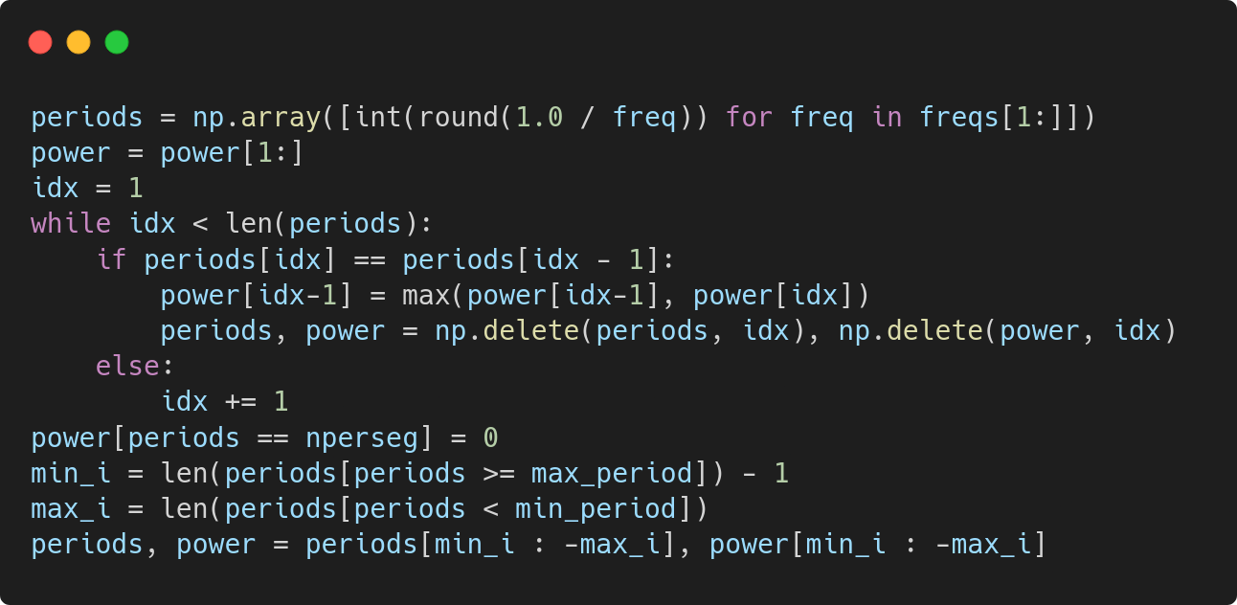
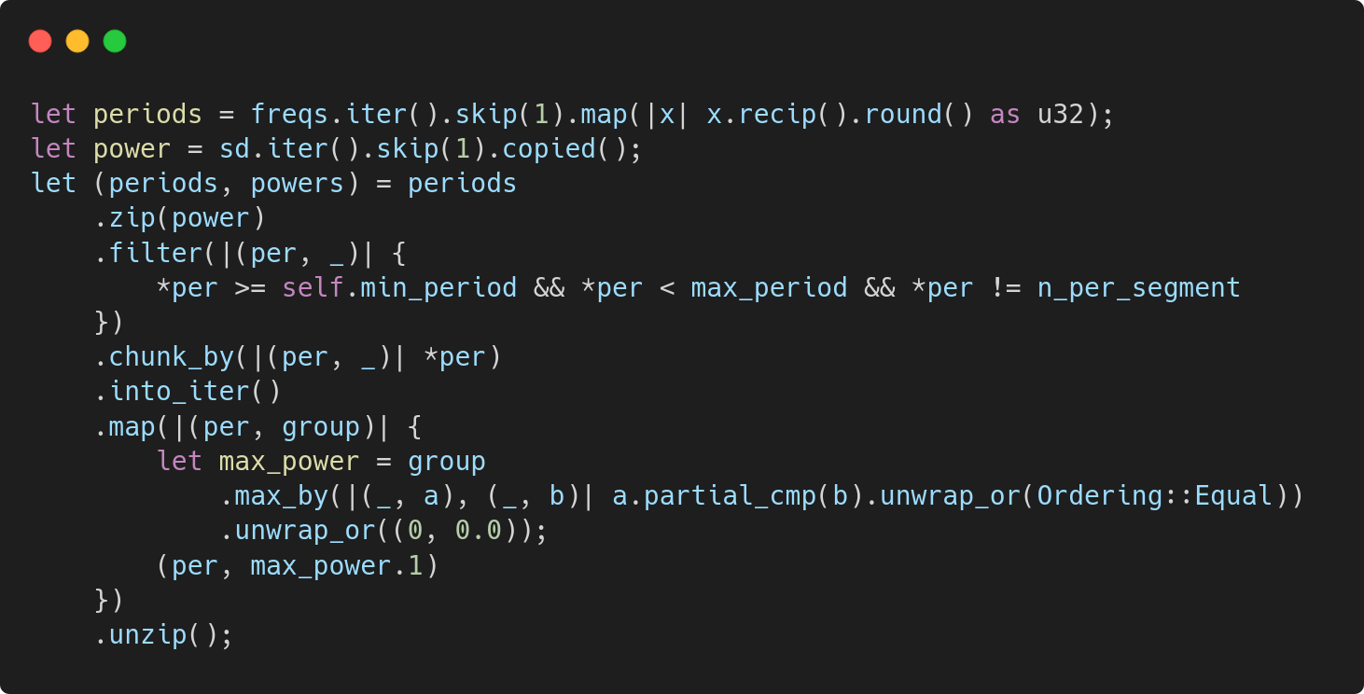
Translating tips - working with arrays
numpy
VS
Iterator & Itertools
Notes:
This is taken directly from the seasonality detection in augurs and the original Python package.
Exactly 2 allocations in the Rust version!
Much harder to say about Python version, but look at all that manual indexing, eww.

Slide 33
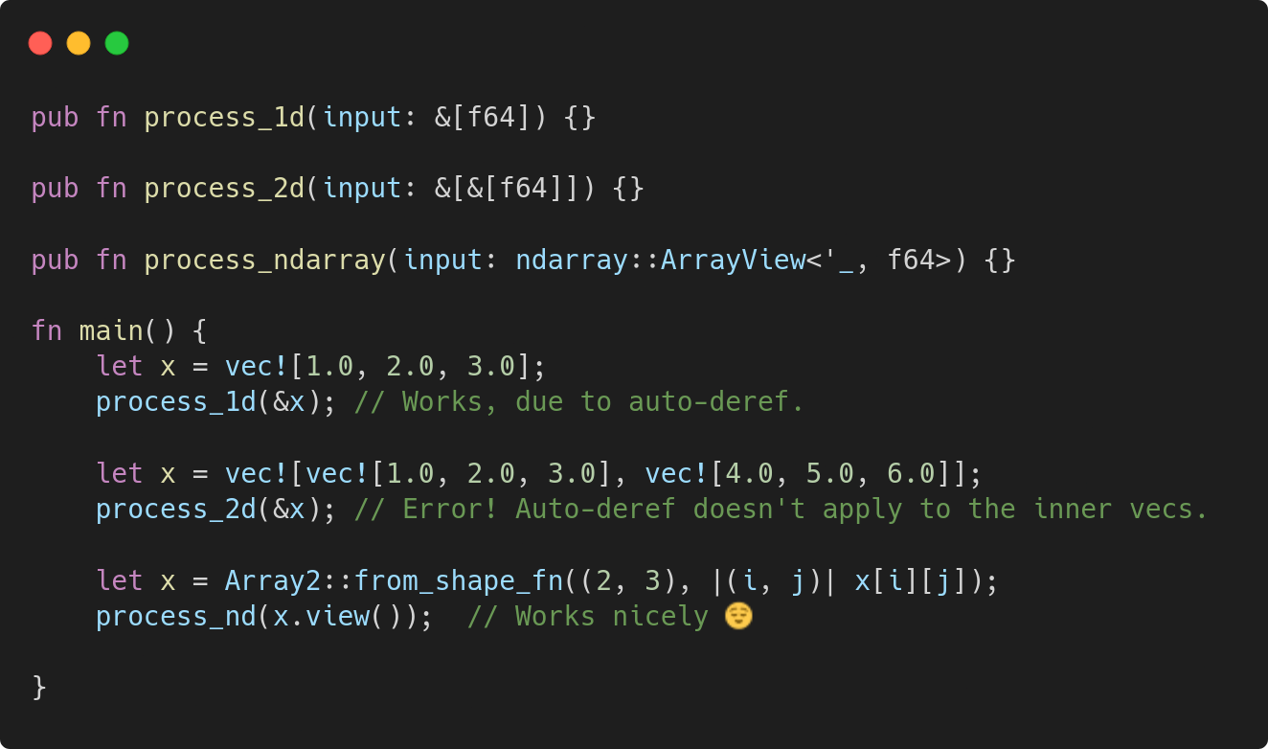
Translating tips - working with arrays
Working with 2D or higher arrays can be painful
  Vec<Vec<f64>> is inefficient - two levels of indirection
  Especially inconvenient as arguments to a pub fn
ndarray has you covered here
Notes:
This slide is quite low level, might need to split it into several and add code samples.
You’re going to be working with arrays, matrices, vectors, etc. Unless you’re working in high dimensions (>2), you can probably get by with iterator and itertools. The methods will often get heavily optimized by rustc and even outperform numpy.
If you do need to accept multidimensional arrays in your public API, keep in mind the limitations of deref coercion: a &Vec<Vec<f64>> can’t be derefed to a &[&[f64]] (or soundly transmuted, or anything like that, since they have different representations).
The ndarray crate is great here, and is probably the way to go.

Slide 34
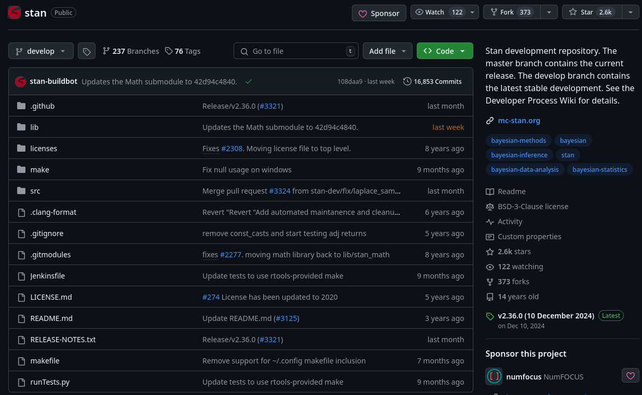
Translating tips - what about huge dependencies?
Stan (https://mc-stan.org) is a best-in-class framework for Bayesian inference
Written in C++, generally called in a subprocess, data passed in files
Used by the Prophet forecasting algorithm
No way we’re rewriting that.
We also want to run it in the browser!
Notes:
This is one of my favourite sections. What if the algorithm you’re writing has a large dependency you can’t afford to rewrite?
- this happened in augurs when translating the Prophet forecasting algorithm
- Prophet does a bunch of data transformations & feature calculations, then passes everything off to [Stan](https://mc-stan.org/) to do Bayesian inference. Rewriting Stan would be monumental (and likely career defining!)
- Stan is written in C++. 16,500 commits over 10+ years.
- we also want to run it in the browser, and don’t want a hard dependency on a C++ compiler at compile time

Slide 35
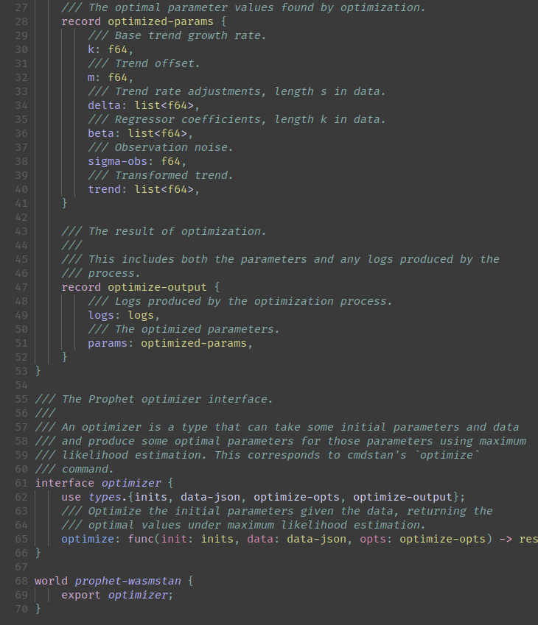
Idea: compile Stan to WebAssembly?
Is that even possible?
Surely there are Wasm-incompatible dependencies, like a filesystem?
Enter: the WebAssembly System Interface (WASI) and WebAssembly Component Model
Encapsulate interface using an IDL (WIT)
Write a tiny bit of C++ to implement it using Stan
Compile to a WebAssembly component!
Notes:
Can we compile to Wasm? This does feel pretty wild.
Until recently I would have assumed that any given C++ codebase could not be compiled to Wasm easily, due to various system dependencies:
Other libraries
Reliance on system/POSIX APIs
Random unsupported Wasm features (exceptions, 64 bit memory)
WASI makes this possible! It provides pluggable implementations of system interfaces, using the Component Model.
Not going to go into too much detail about the Component Model, but in short:
Define the interface using WIT, an IDL a bit like the protobuf definition format
Use some tooling to generate C++ stubs
Implement using a bit of C++ to hook those stubs up to Stan
Compile everything to a Wasm component (basically a Wasm module + embedded IDL + conversions)

Slide 36
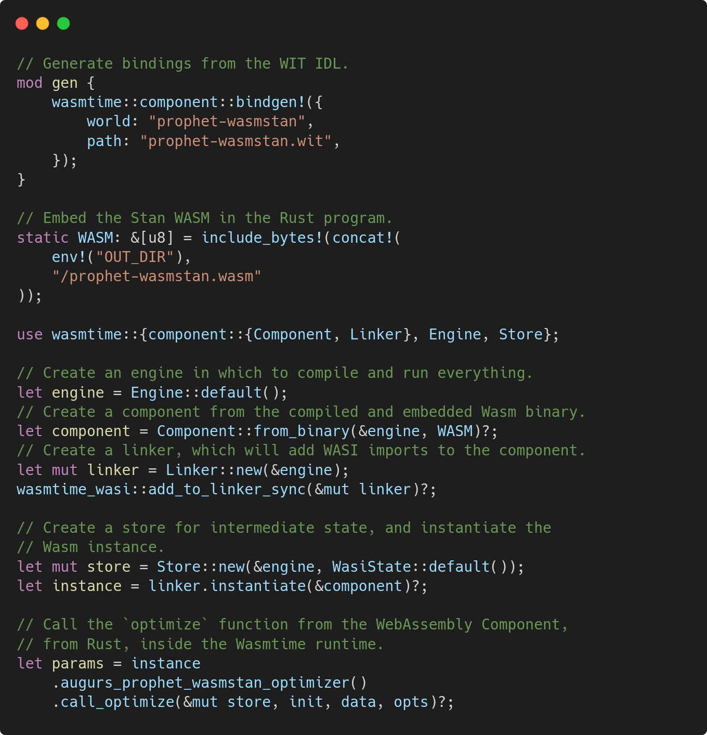
Use our WebAssembly Component from Rust
Back in Rust, use a bindgen variant to generate bindings
Embed the Stan WebAssembly
Set up the Wasmtime runtime
  Don’t worry about the details!
Call our optimize function
Notes:
On the other side, we want to call it from Rust. Here’s the code we use.
Point bindgen at the IDL file; it will generate Rust structs for us
Get the Wasm bytes from somewhere
Set up a Wasmtime runtime and link the WASI imports
Convert our original Rust types into the generated ones (pretty much free)
Call the function, which runs inside Wasmtime, at near-native speed
We can also call it from Javascript by using jco to generate JS bindings; this will handle instantiating the Webassembly etc

Slide 37
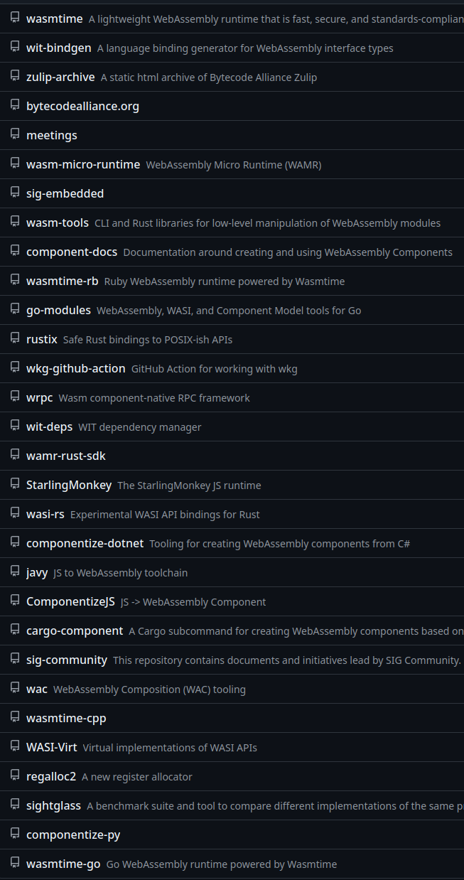
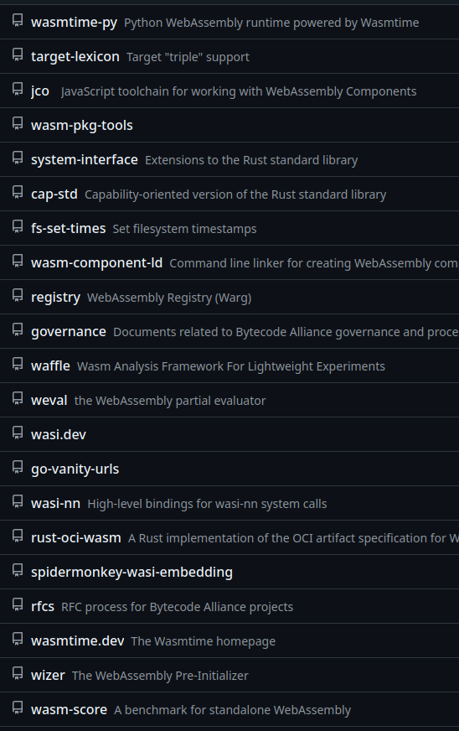
Wasm Components: Caveats
It’s still early days
  Lots of hacking around and reading source code
  Dozens of different tools to learn about!
Wasm doesn’t support certain features, e.g. exceptions
  We just hard abort in those cases; it’s not pretty
Can only be used from certain runtimes, for now
  Wasmtime is the only one that supports it
Notes:
It’s not necessarily ready for prime time yet, but I’m optimistic.
Just to be clear, I’m extremely grateful to the bytecodealliance folks for building all of this, it’s quite an incredible toolchain!

Slide 38
Find source implementation
Duplicate tests
Translate line-by-line
Refactor for idioms
Optimize

Slide 39
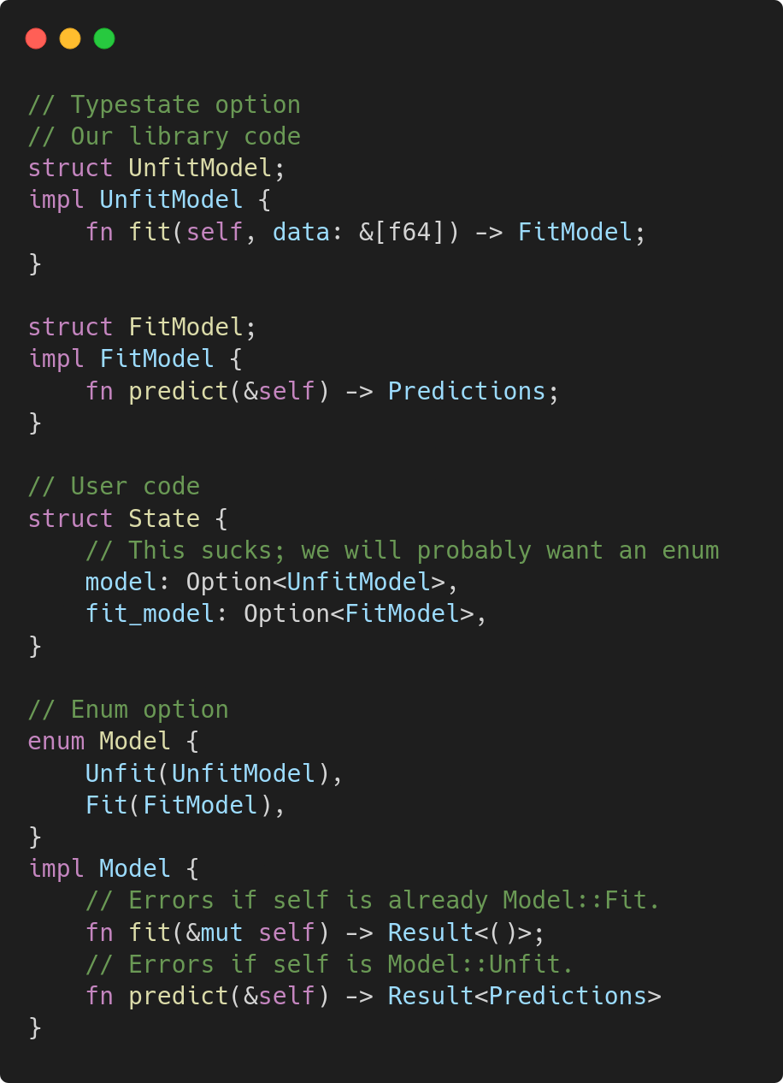
Idiomatic Rust tips - use the type system responsibly
Use typestate to avoid things being misused
  💪 when combined with affine types
Use enums when things need to happen at runtime
You will notice this when writing Python/JS bindings!
  Where anything can change at runtime…
Notes:
Once it comes to writing idiomatic code, you have a lot of options.
Chances are Rust’s type system is more expressive than the original language (C++, Python, R, etc).
Make use of Rust’s affine types to ensure certain types (e.g. an UnfitModel) can only be used once (takes self) and return a FitModel.
Downside: tricky to use if things change at runtime; users need to be able to store both
You can provide an enum as well, or just leave this to users.
Of course, this turns errors into runtime errors, instead.

Slide 40
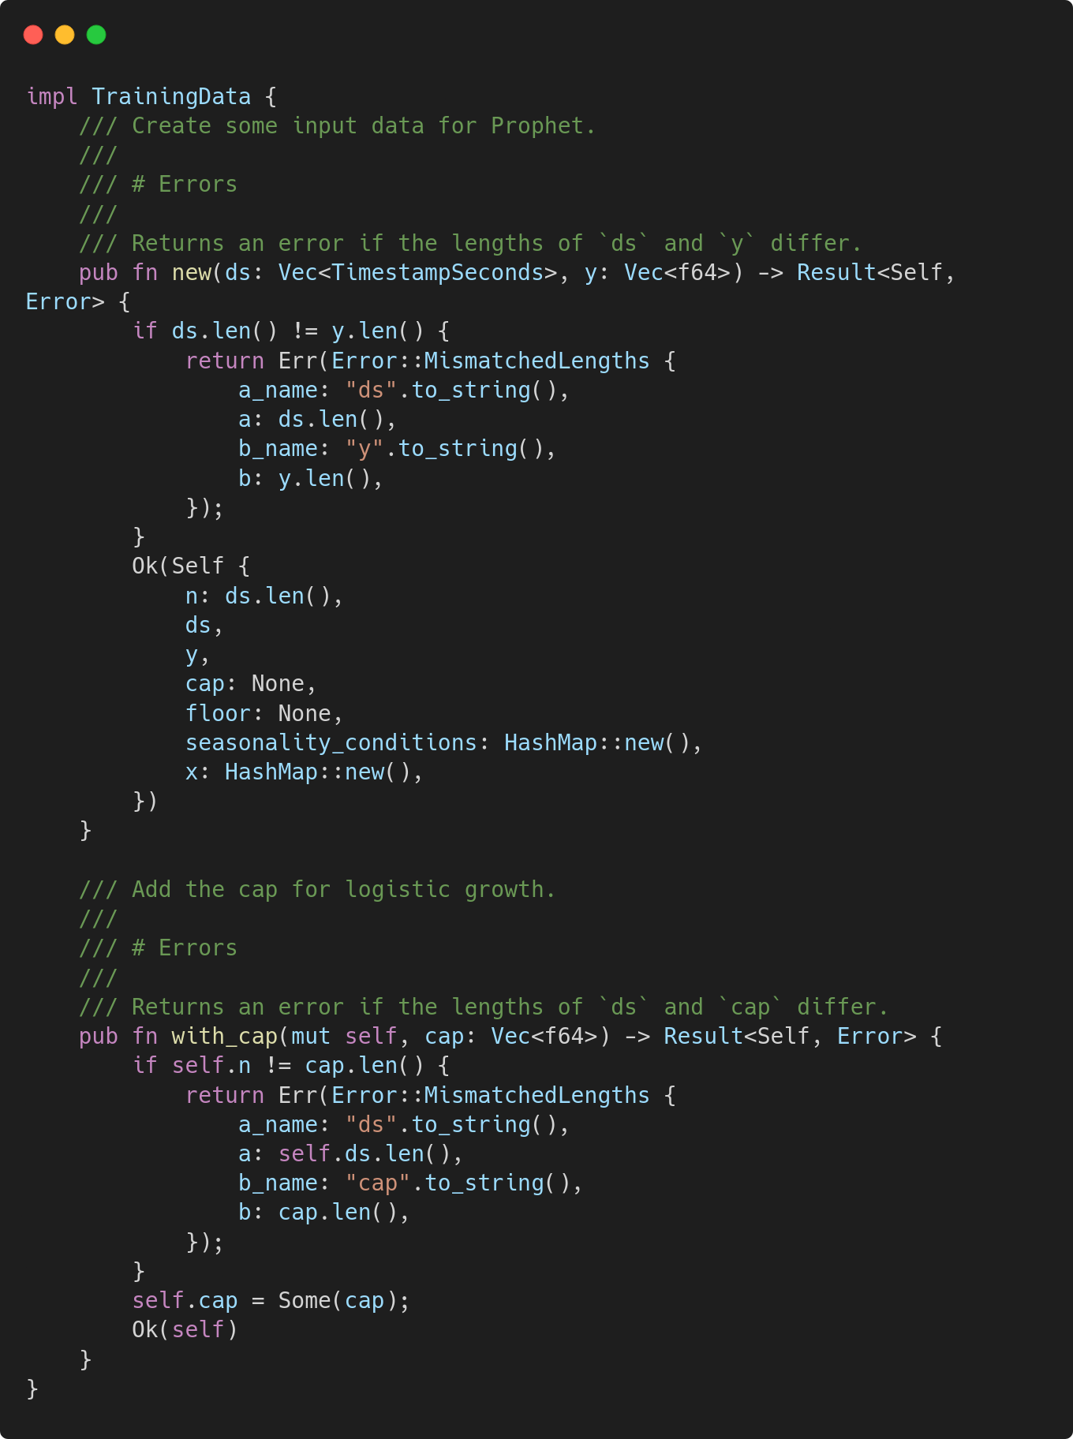
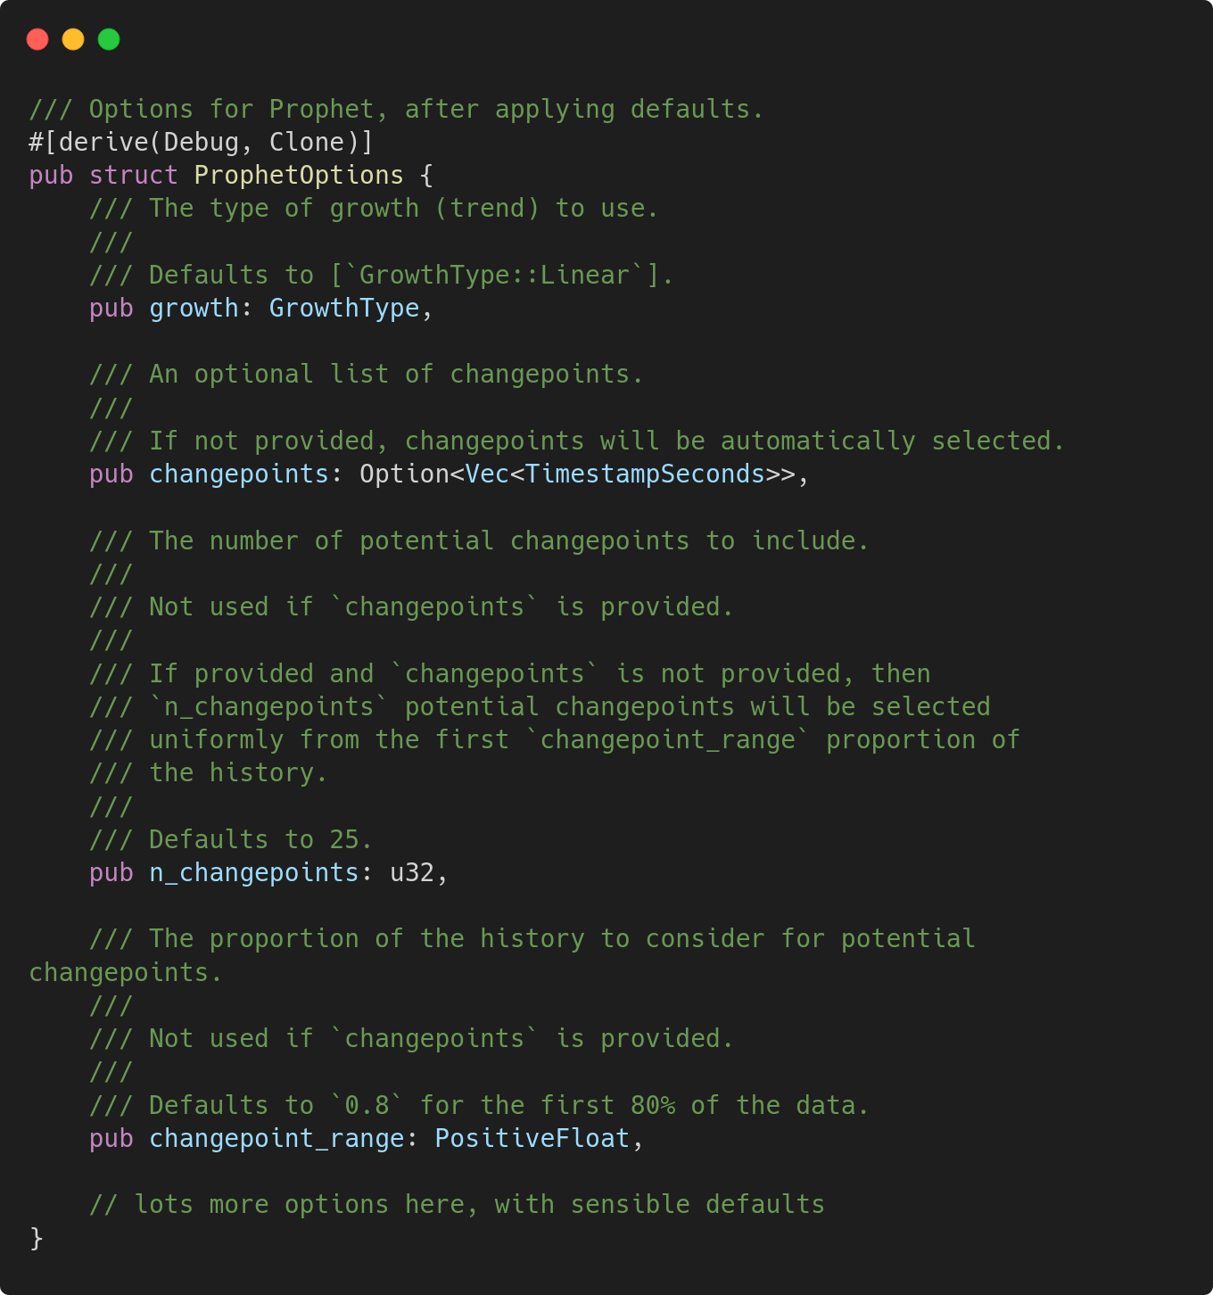
Builder vs config struct - definition
Builder pattern
VS
Config struct with public fields
Notes:
Implementations. Clearly one is more complicated, but allows for extra validation.
When I was writing this I thought ‘huh, that config struct should have #[non_exhaustive] on it for forwards compatibility’, but that isn’t possible - other crates can’t instantiate the struct.
So here, adding a field would be a semver breaking change!

Slide 41
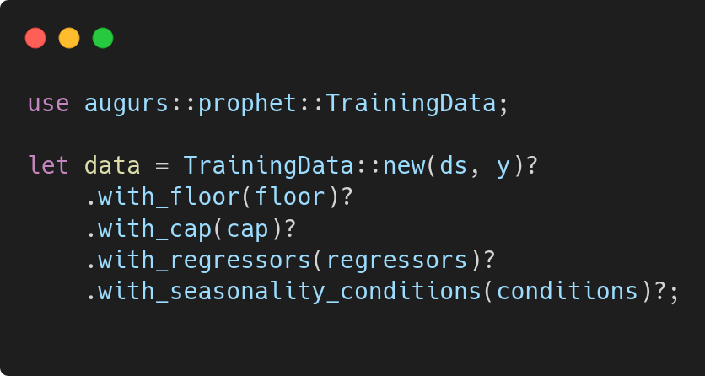
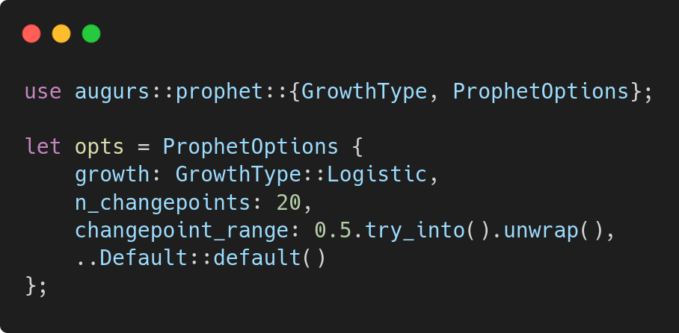
Builder vs config struct - usage
Builder pattern
VS
Config struct with public fields
Notes:
Lots more happening under the hood in the builder pattern example, but in a similar amount of code.
OTOH, the config struct is simply creating stuff, nothing crazy happening.

Slide 42
Builder vs config struct
Builder pattern
VS
Config struct with public fields
Flexible, futureproof, verbose
Simple, clean, less powerful
Better for complex, interdependent fields
Straightforward, no need to call build()
Can perform validation in setters
Validation of individual fields with newtypes
Trivial to add more fields later
Will get more powerful after RFC 3681
More code, verbose call site
Can’t really use #[non_exhaustive]
Consuming vs mutating 😱
Might need to switch to builder in future if you need more validation
Notes:
Builder pattern:
You can maintain internal invariants by doing more work inside the ‘setter’ methods, and optionally returning Result<T, E>
E.g. Prophet has a TrainingData struct; some fields are optional, but if provided they must be the same length
Builder allows us to verify that at construction time
Plenty of macros to simplify writing; see e.g. bon
Who even knows whether to use a consuming or mutating one…
Config struct:
Super simple, it’s just a struct holding a bunch of public fields
If some fields need individual validation (e.g. must be positive) can use newtypes to enforce
If you use #[non_exhaustive] then users can’t actually instantiate it using struct literal syntax. If you don’t, you can’t add more fields in future

Slide 43
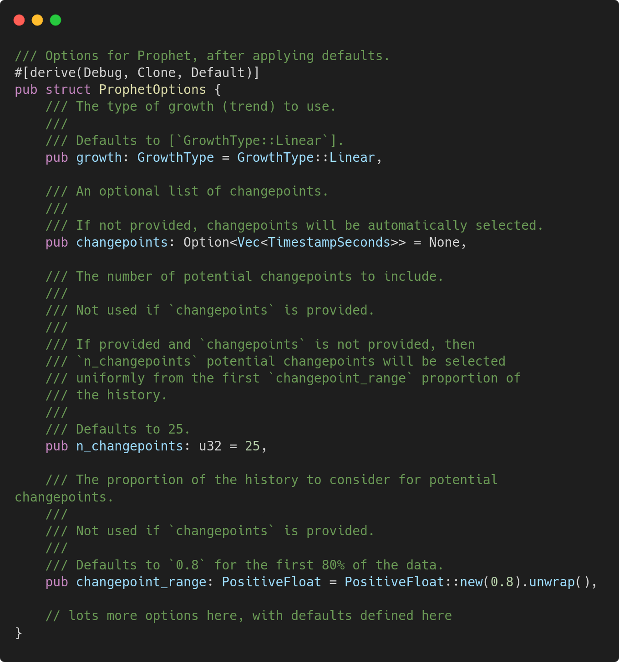
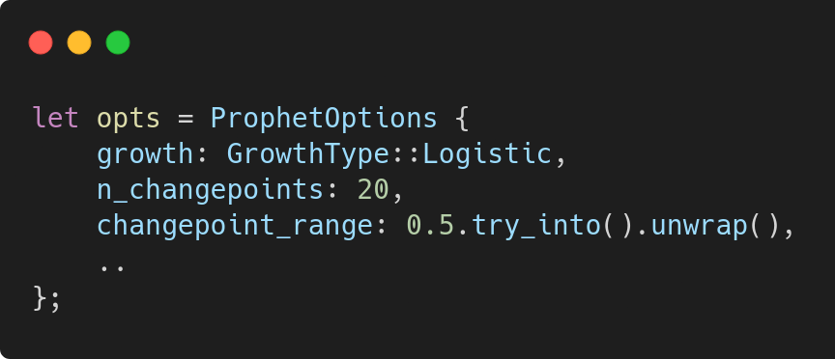

Config struct after RFC 3681
Definition
VS
Callsite
https://github.com/rust-lang/rust/issues/132162
Notes:
Not stable yet, but RFC accepted and being tracked - see the link attached.
Allows structs to declare defaults inline, and avoids the need for Default::default() at the callsite.
Might be enough to swing the needle towards config structs being used more often, but need to remember forward compatibility; any future fields must have defaults.

Slide 44
Find source implementation
Duplicate tests
Translate line-by-line
Refactor for idioms
Optimize

Slide 45
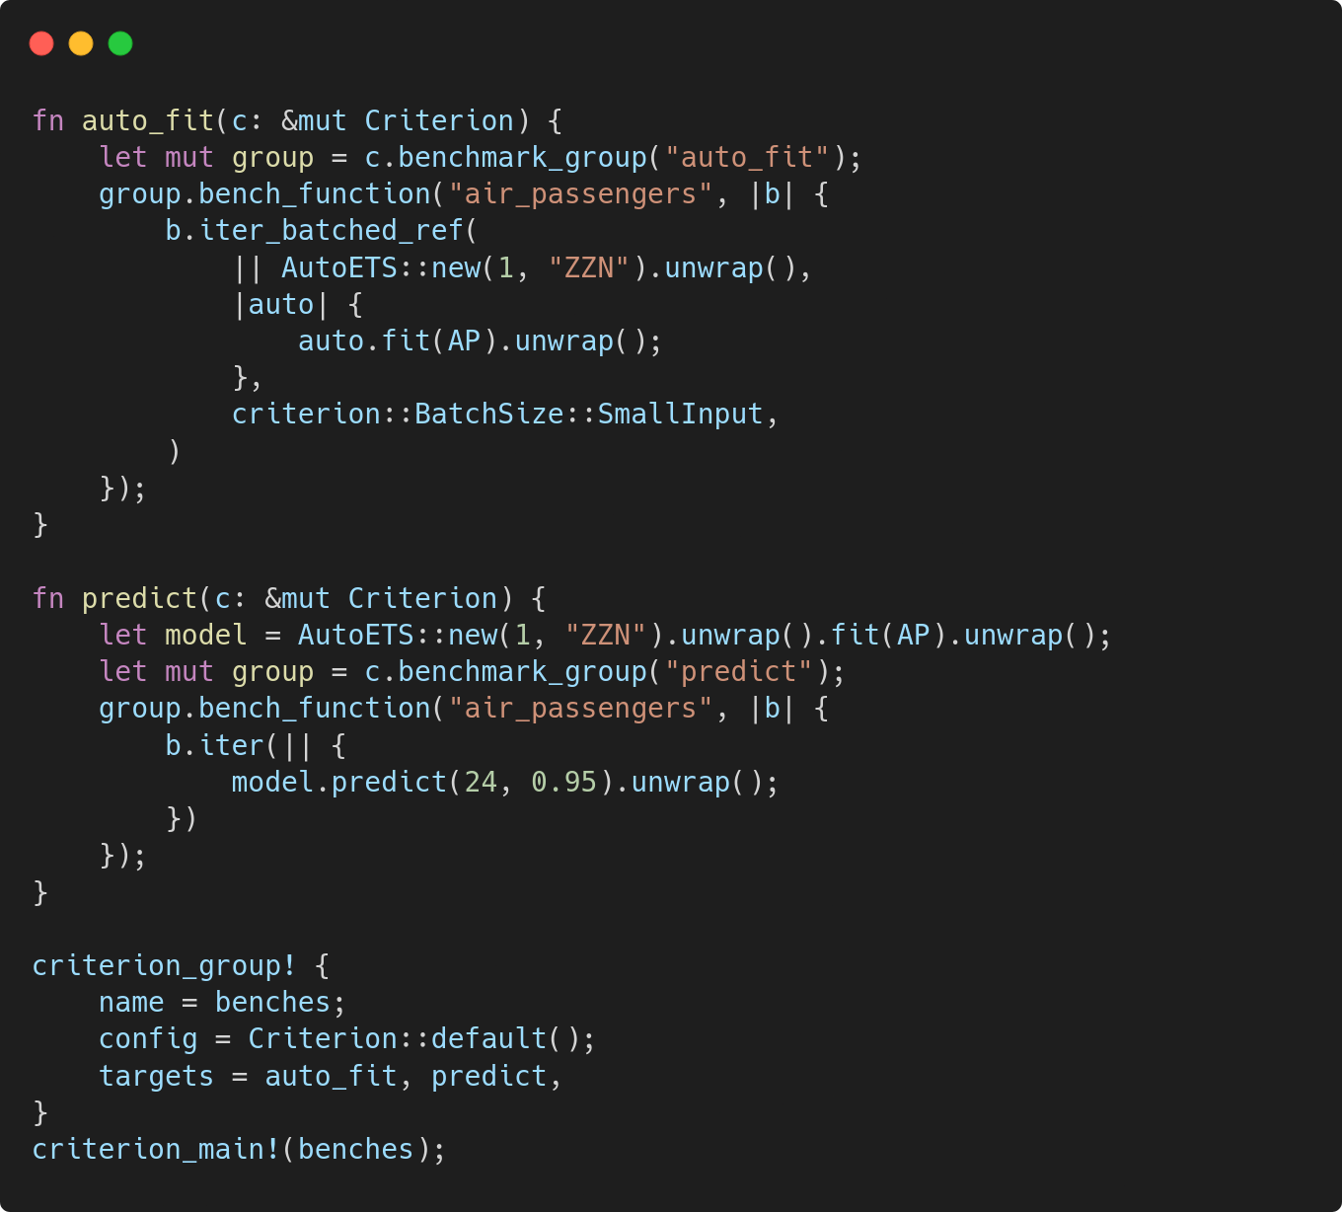
Benchmarking
Use the examples you found earlier as benchmarks
Write separate benchmarks for preprocess, fit, predict
Use criterion, and read about timing loops
  iter
  iter_batched
  iter_batched_ref
Notes:
Use real life examples as benches
Make sure you split benches up appropriately - e.g. ML needs preprocess/fit/predict but do it according to use case
The different ‘iter’ methods let you do the setup stage at different points. Use:
iter if you can just capture by immutable ref
iter_batched if you need ownership
Iter_batched_ref if you need a mutable ref
In this snippet we use:
iter_batched_ref for fit, since we need to mutate the model object
Iter for predict, since we just need an immutable ref

Slide 46
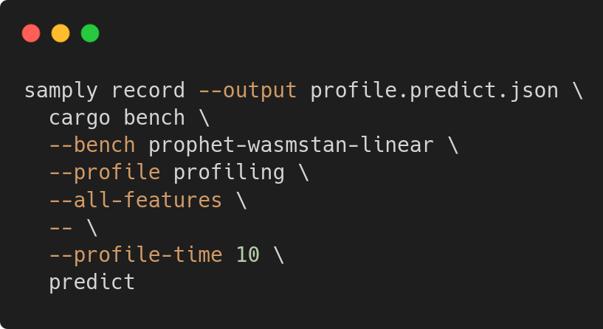
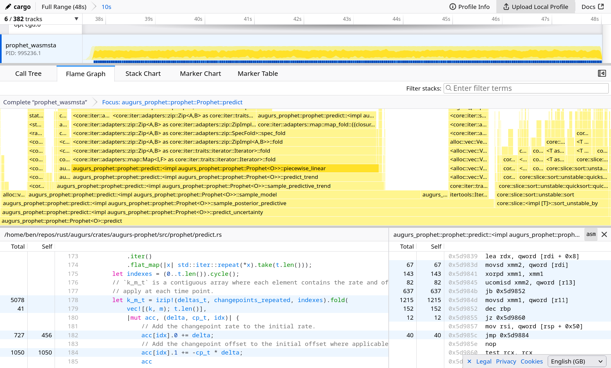
Profiling
Use samply to run benchmarks
Getting the invocation right is tricky…
  samply args
  cargo args
  criterion args
Shout out to the Firefox Profiler
  Samply opens this by default
  View call tree, flamegraph, source code with line counts, assembly…
  Upload and share with others
Notes:
The Internet will recommend various profilers. Samply has worked best for me.
Copy this invocation!
FF profiler is great. Can generally identify hotspots in seconds.
PS: Nicholas Nethercote is the GOAT here, see his Rust Performance book at see https://nnethercote.github.io/perf-book/profiling.html.

Slide 47
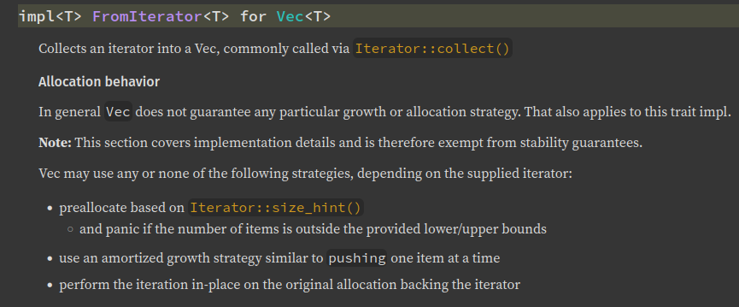
Optimization hints
To start with, slowness will probably be in unnecessary allocations. Some tips:
Preallocate with Vec::with_capacity()
Reuse the same &mut Vec<T>
Be aware of how Vec::from_iter allocates
  This is what underlies the magic of Iterator::collect(), so applies more often than you might think
This will probably get you quite far!

Slide 48
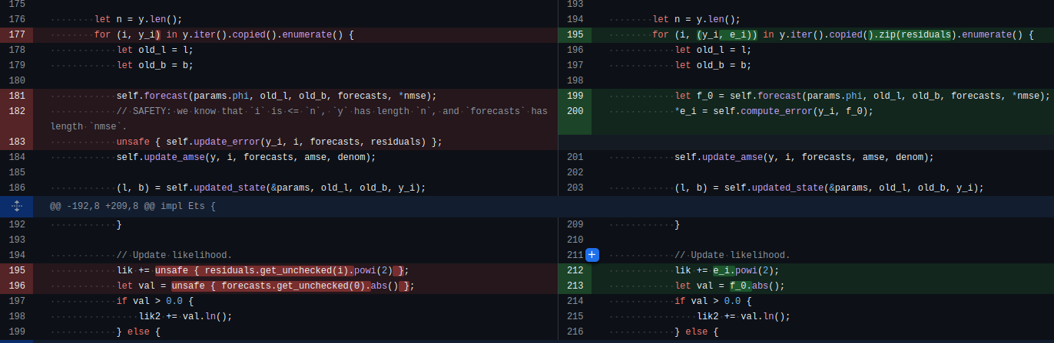
Optimization hints
Replace explicit indexing with Iterator::zip (or itertools::izip!)
Notes:
Benefits:
Eliminated bounds checks
Better cache locality
Remove unsafe (if you were using get_unchecked)

Slide 49
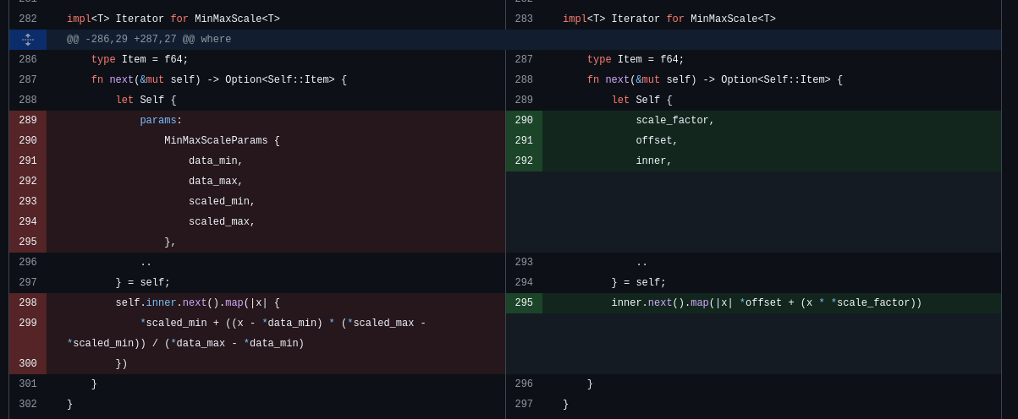
Optimization hints
Division (and sqrt) is slow, can you avoid doing it in loops? Store scaling factors instead.
Notes:
This is also one of the optimizations in the previously mentioned distance matrix calculation in dynamic time warping.
We want the total Euclidean distance between pairs of points.
Euclidean distance requires a sqrt! Instead we can sum the squares and do one sqrt at the end.

Slide 50
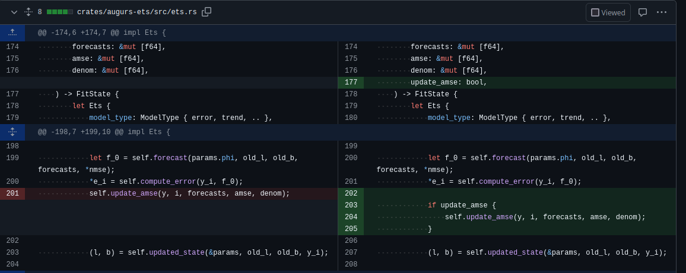
Optimization hints
When translating algorithms, they probably do unnecessary work in every iteration. Don’t!
Notes:
Sounds obvious right - don’t do extra work?
You’ll definitely find this in code written by scientists, researchers, statisticians etc who were less concerned about perf.
This doesn’t look expensive but it actually is, especially compared to a bool check which the branch predictor gets right most times.

Slide 51
End of Part 2
Notes:
Whew, that was a lot. Hopefully there were some useful tips there for anyone considering porting ML code to Rust.
(check timings)
Finally, let’s talk about creating Wasm bindings.

Slide 52
Next!
Try augurs
Port ML to Rust
Explore Wasm
The next time you have a time series!
Visit docs.augu.rs
10/10 experience, would repeat.
Both for complex dependencies and for JS bindings
Notes:
Try it out - there are tons of use cases.
Interested in ML, or need it for your system? Pick an algorithm and try it, you won’t be disappointed.
Wasm has tons of potential both in the browser and on the server - keep it in mind, not just for ML projects.

Slide 53


Thank you!
Have more questions or comments?
Join in at github.com/grafana/augurs
Or come and find me.
More information:
docs.augu.rs
grafana/augurs
demo.augu.rs
Notes:
Whew, that was a lot. I hope you found some of it useful!
There are many more hidden slides I couldn’t squeeze in, check out the full deck if you’re interested!

Slide 54
Bonus:
tradeoffs with Wasm bindings

Slide 55

Rust’s tooling is its superpower
Wasm is no exception here. Historically two major pieces:
wasm-bindgen
  export Rust functionality to JS
  import & call JS and web APIs from Rust
  pass complex data from JS to Rust & vice versa
  generate TypeScript bindings
wasm-pack
  build, package and publish to npm

Slide 56
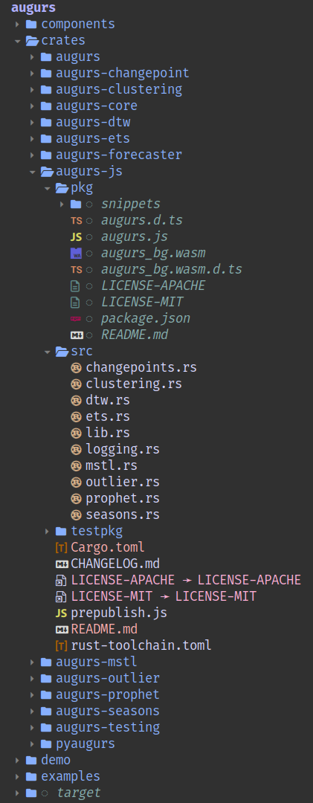
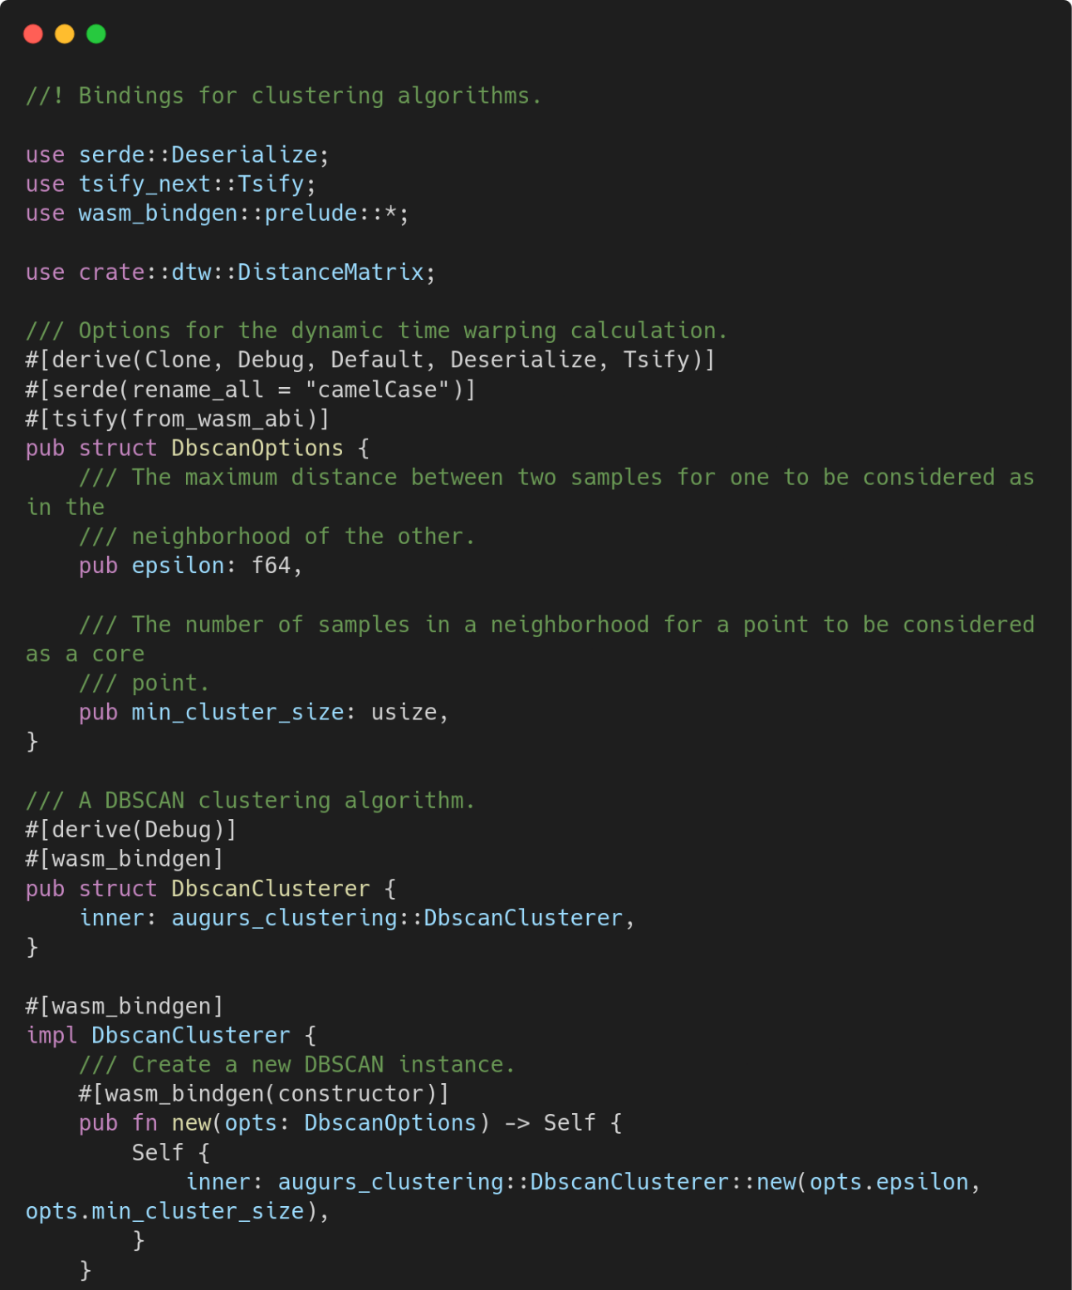
What did this look like?
Rust library crates
Generated npm package (JS + Wasm)
Mostly declarative bindings
Rust library crates
Notes:
This is how the code used to be laid out:
Cargo workspace
Crate per main piece of functionality, for Rust libraries
Wrapper crate, augurs
‘augurs-js’ crate with all JS bindings
pyaugurs crate with Python bindings using PyO3
Seems fine, right?

Slide 57
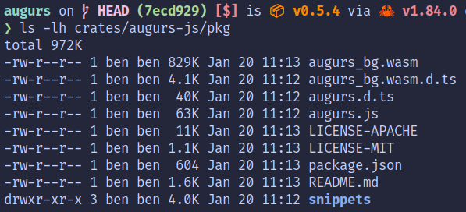
Problem?
Notes:
This was indeed fine until augurs got so big!
There’s now so much functionality it takes up nearly 1MB of Wasm.
Annoying for someone who just wants outlier detection (~100KB).

Slide 58
JS apps tend to use bundlers to build
Bundlers use ‘tree-shaking’ to remove dead code
Wasm cannot be split like this: it’s all or nothing
Notes:
There are ‘hacky’ prototypes of generating split Wasm modules pre the bindgen phase, but nothing ready for production.
Each Wasm module has its own protected memory so it’s non-trivial; can’t simply pass complex objects between them.
https://github.com/jbms/wasm-split-prototype
https://github.com/rustwasm/wasm-bindgen/issues/3939

Slide 59
Two possible solutions
Split up JS into separate crates
VS
Use the Component Model
Sticking with wasm-bindgen
Make the leap to jco
Keep using established tooling
Code splitting is somewhat forced upon us
Pushing the limits of what it’s for…
Much newer tooling
Use an interface-driven approach where code splitting is encouraged
Nascent; feels experimental
Cool
Bonus: bindings can be generated for other languages, not just JS

Slide 60



Option 1: split up JS
Notes:
Here’s our new layout: lots of little crates inside the js directory.
Each compiles to a single WASM module.
JS packages let us define ‘exports’, which are accessed like ‘subpaths’ as in the bottom snippet.

Slide 61

Option 1: split up JS - downsides
Notes:
It’s annoying to have to initialize everything separately!

Slide 62

Option 1: split up JS - downsides
Notes:
More of a dealbreaker: if you return a struct/class from one module to JS, it can’t be passed into another, even if the types appear to match on the Rust side.
This is due to each Wasm module having its own independent memory. You’re trying to pass a reference from 1 Wasm memory region to a second, which won’t work.
Only workaround is to convert to something JS-like (e.g. a Float64Array, or worse, an array or object), and pass that around.
Hard to catch with the type system, so results in fun runtime errors.

Slide 63
Option 1: split up JS - downsides
Before
After
Notes:
The overall sizes are hugely different!
If you wanted to use lots of different parts of augurs, you need to load over twice as much data over the wire.
(although the modules can be loaded concurrently).
This is because there’s no code sharing between modules; we might be including a certain dependency (like std) in every module.

Slide 64




Option 2: use the Component Model
Notes:
The alternative approach is to use the component model.
Here we declare our interfaces in an IDL; things can be split up more effectively. We get much smaller file sizes.
(note: I didn’t fully implement this so the ‘total’ size is irrelevant, but individual WASM modules are much smaller).

Slide 65

Option 2: use the Component Model
Notes:
Now we can use values returned from one Wasm module as arguments to a second Wasm module!
(this is actually because the return value is a Float64Array[] but it’s much more foolproof)

Slide 66
Option 2: use the Component Model - downsides
Now you have a new IDL!
Again: very new, so tricky to find examples and best practices
Lots of new tools
As always, there are trade-offs!
My advice: watch this space, but don’t use it in prod yet.
Notes:
New IDL
Lots of new tools
Trade-offs

