Slide 1

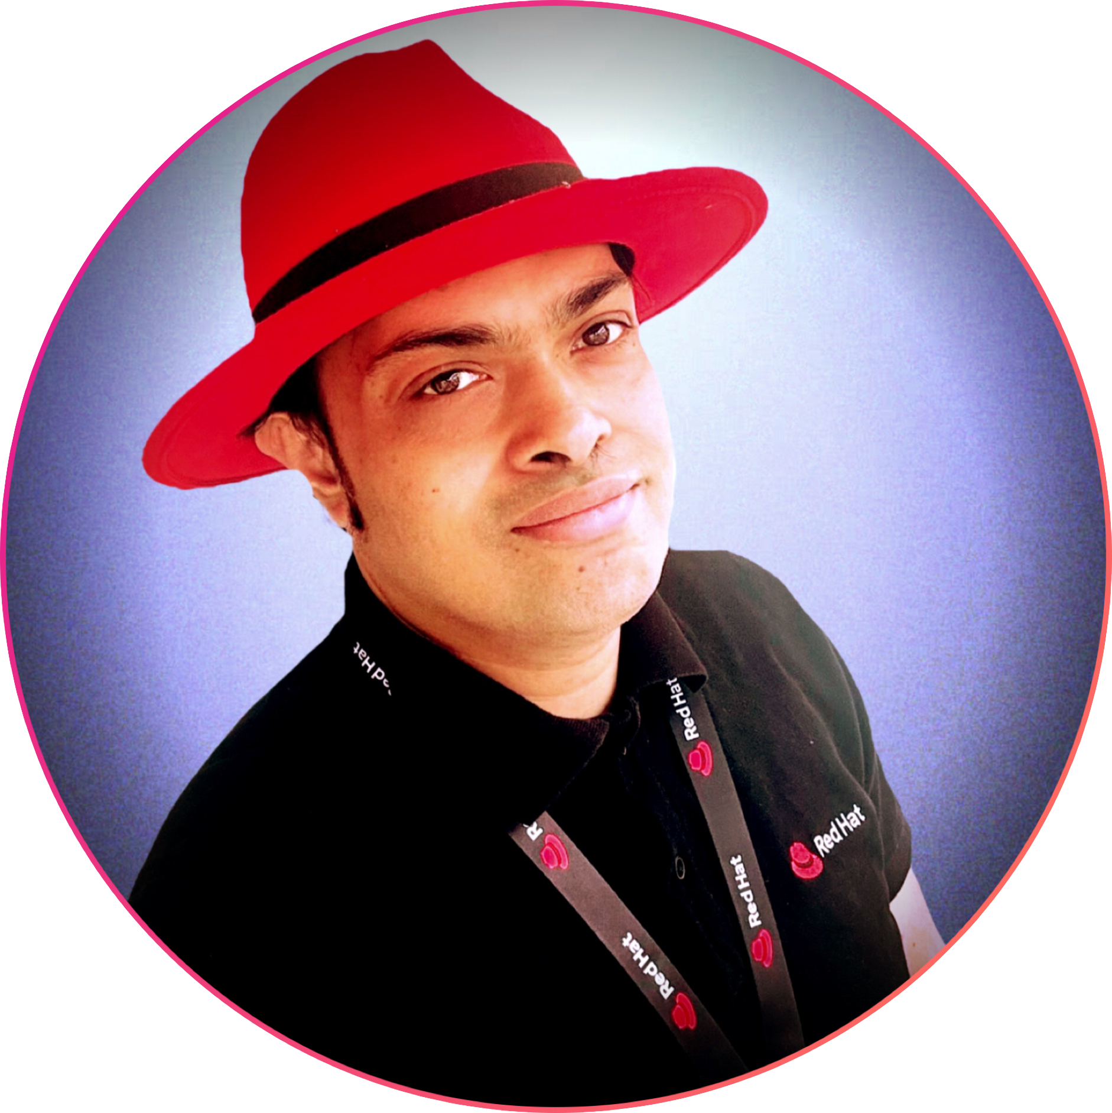
Introducing F-UKI, Guest Firmware in a UKI for Confidential Cloud Deployments
Anirban (Ani) Sinha
Principal Software Engineer, Virtualization, Red Hat.
anisinha@redhat.com.
FOSDEM 2025, Brussels, Belgium Feb 1-2 2025

Slide 2

People who are involved
Ani Sinha (Red Hat).
Vitaly Kuznetsov (Red Hat).
Alex Graf (AWS) (original idea).
Paolo Bonzini (Red Hat).
Gerd Hoffman (Red Hat).
Harald Hoyer (Matter Labs).
Huge thanks to Lennart Poettering for helping us with the UKI and systemd parts!
*F-UKI : UKI with Firmware, termed coined by Alex :-)

Slide 3
Agenda
Focus of the talk
Background
What?
Why?
How?
Using UKI to bring in firmware
Current Status
References

Slide 4

Agenda
Background
What?
Why?
How?
Using UKI to bring in firmware
Current Status
References

Slide 5
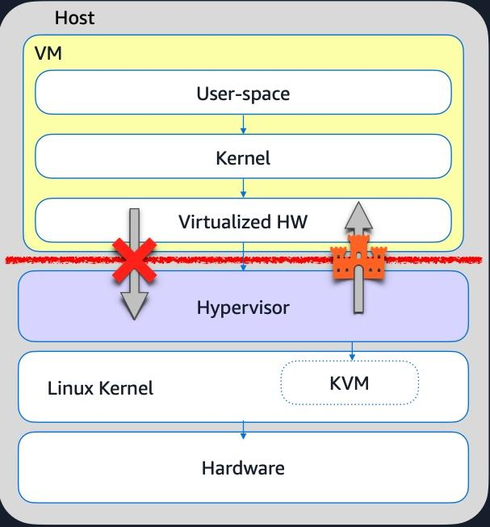
So what is a Confidential VM?
Background
Taken from Nicolas Saenz Julienne’s KVM Forum 2024 presentation

Slide 6

So what is a Confidential VM?
Background
Confidential VM provides protection from the host it runs on:
“Protection” means strong security boundary for all data in the VM. Malicious hypervisor or an actor having access (even privileged!) to the host should not be able to get access to the data.
The host is still able to disrupt execution of the VM, e.g. it can stop it.
Hardware (AMD SEV-SNP, Intel TDX) is responsible for encrypting memory and CPU state.
Storage encryption is necessary for security and must be done by the guest OS.

Slide 7
Verifying integrity at start - measured boot … (1)
Confidential VMs in the Cloud
Background
Measured Boot:
It is the process of computing and securely recording hashes of code and critical data at each stage in the boot chain before the code/data is used.
No validation. Simply a record of what code/critical-data was present on the system during boot.
Platform Configuration Registers in TPM store the incremental hashes/measurements securely (can not be modified once the update operation has completed on the newly extended measured hash) that become part of the final launch digest.
Intel TDX module provides measurement capability in HW (no need for TPM registers).
The measurements can also be stored securely in memory.

Slide 8
Verifying integrity at start - measured boot … (2)
Confidential VMs in the Cloud
Background
Measured Boot:
Firmware images must be measured.
Final launch digest is then sent to a remote attestation server that validates the digest and send keys to unlock secrets within the guest OS.
The guest OS can then decrypt the disk with the secrets.
Our work focuses mostly on measured boot.

Slide 9
Agenda
Background
What?
Why?
How?
Using UKI to bring in firmware
Current Status
References

Slide 10
The talk is focused on in-guest firmware update mechanism
What?
KVM Forum 2024 presentation
The focus is on the situation when host administrator != guest tenant (e.g. ‘cloud’ use-case).
The mechanism is mostly useful for Confidential VMs but in theory can work with traditional VMs too.

Slide 11
Agenda
Background
What?
Why?
How?
Using UKI to bring in firmware
Current Status
References

Slide 12
Why guest tenants are interested in supplying their own firmware?
Why?
KVM Forum 2024 presentation
Getting predictable, pre-calculated launch measurements
Implementing exclusive per-guest features and configurations
  Bring-your-own SecureBoot everything (and trust it!)
  A stateful vTPM implementation with runtime attestations
  …
and this is updateable during guest’s lifecycle, not only upon creation.

Slide 13
Why host owners are interested in providing the option to do in-guest firmware update?
Why?
KVM Forum 2024 presentation
For Confidential VMs, updating firmware can’t go unnoticed by the guest tenant
  Getting rid of the responsibility for non-trivial software which runs inside the confidential guest.
  Guests may break because of new, unexpected launch measurements.
  Tenants may be interested in what changed and in case of e.g. embargoed CVEs the information cannot be shared.

Slide 14
But why not just supply the firmware externally, as part of guest
VM image or separately?
Why?
KVM Forum 2024 presentation
The firmware will require a storage if supplied separately and this external storage will have to be linked to the VM’s lifecycle.
Storing the firmware as part of guest image (e.g. a file on ESP, separate partition,...) can be problematic:
  The host may not have access to guest storage at all (e.g. NVME passthrough with acceleration card).

Slide 15
Agenda
Background
What?
Why?
How?
Using UKI to bring in firmware
References

Slide 16
Firmware update mechanism using UKI … (1)
How?
Untrusted VM with standard cloud provider firmware
Trusted VM with firmware supplied by guest UKI
Guest private memory (encrypted)
Guest private memory (encrypted)
f-UKI
firmware
Shared memory
Shared memory
UKI puts in shared memory
Hypervisor copies fw to a fixed target address in guest private memory and resets VM.
firmware
Kernel image
Kernel image
These remain in guest shared memory and are validated by guest provided firmware
initrd
initrd
UKI tells hypervisor the memory addresses of boot components
UKI initiates VM reset/kexec using default cpu reset vectors
Hypervisor
Hypervisor

Slide 17
Firmware update mechanism using UKI … (2)
How?
SEV-SNP/TDX Guest memory after VM reset (trusted state with UKI provided firmware)
Can be standard firmware load address as per machine/arch
Trusted Firmware
(loaded by UKI)
0xffffffff
Guest private memory (encrypted)
0xffffffffab
Kernel image
Firmware validates kernel and initrd using its built-in hashes.
Guest shared memory (unencrypted, left as is as loaded by UKI between reboots)
0xffffffffcd
initrd
Addresses chosen by the UKI strategically to load boot components. It is then conveyed to the next stage firmware (packaged within UKI) using hypervisor interface.

Slide 18
Agenda
Background
What?
Why?
How?
Using UKI to bring in firmware
Current Status
References

Slide 19
Using UKI to bring in firmware
But why UKI for firmware? Or Why f-UKI?
Portable executable that can be executed by UEFI bios in a guest agnostic manner.
  Its already widely used in various distributions to load kernel, initrd etc.
UKI add-on allows customizations - for example separate initrd or kernel command line for separate systems based on use-case.
UKIs can be signed and measured and UEFI bios can only load UKIs and UKI add-ons from trusted vendors.
UKIs can be obsoleted/revoked using SBAT mechanism.
UKIs containing updated kernel/initrd etc can be installed using standard package management tools.
All of the above nicely applies for updating firmware images.

Slide 20

Using UKI to bring in firmware
So lets build a f-UKI …
$ ukify.py --help | grep efifw
--efifw DIR Directory with efi firmware binary file [.efifw section]
$ ukify.py build --efifw=/home/anisinha/ovmf-x86-smm-secure --output=/tmp/test.uki
The name of the directory is used as an unique identifier for the firmware image
Directory containing a single ovmf firmware image
$ ukify.py build --efifw=/home/anisinha/ovmf-x86-aws \
--efifw=/workspace/firmware/ovmf-x86-azure \
--output=/tmp/test.uki

Slide 21
Using UKI to bring in firmware
f-UKI bits … (1)
UKI calculates CHID values for a specific virtualized hardware
maps CHID to a hwid entry
Multiple firmware images can be bundled in the same UKI.
  UKI has a mechanism to load the correct one that is compatible with the current hardware.
  Calculates the “computer hardware IDs” (CHID) for the present hardware and matches a particular firmware (or say devicetree) with it.
The selected firmware can then load trusted kernel/initrd and command line whose hashes are known to the firmware as trustworthy.
Lennart covered this a little bit in his talk yesterday …
“Multi-Profile UKIs and other ways to supercharge your Unified Kernel Images”
UKI .hwids section has entries mapping CHIDs to fwid for efifirmware devices
maps to a specific firmware with fwid
UKI has multiple .efifw entries, each with a specific fwid

Slide 22
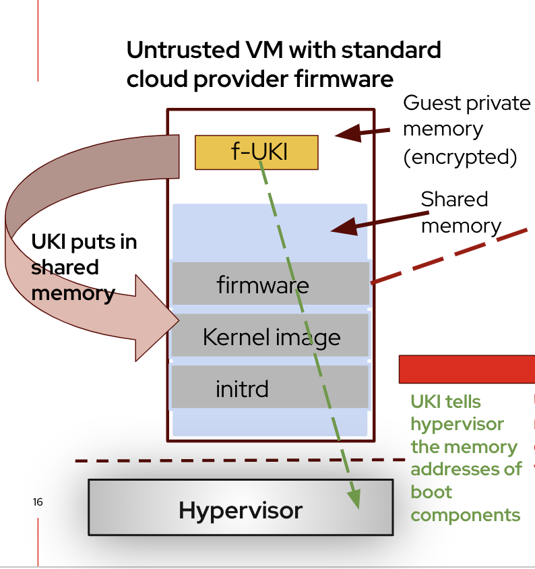
Using UKI to bring in firmware
f-UKI bits … (2)
Through a well known hypervisor interface (see green line in diagram), the UKI then convey the hypervisor the memory locations where these boot components (firmware, kernel, initrd, command line etc) are loaded.
UKI initiates reset of the guest to activate the packaged firmware and other boot components.
The UKI conveys information on where it loaded the boot components into memory for the trusted next stage firmware in UKI to consume after reset.

Slide 23
Using UKI to bring in firmware
f-UKI bits … (3)
How to build the support for hypervisor interface into UKI in a hypervisor agnostic manner?
  We are requesting inputs from the community to help us in this effort.
  QEMU uses fw-cfg. We need to build support/write a driver for fw-cfg in UKI.
What happens when there multiple initrd and kernel command lines are in UKI?

Slide 24
Agenda
Background
What?
Why?
How?
Using UKI to bring in firmware
Current Status
References

Slide 25


Current Status
Progress so far …
QEMU:
Some code reorgs needed towards enabling reset in CoCo merged!
QEMU hypervisor interface design proposal patch posted.
  Link to google doc where we had elaborate discussions later in references.
  See @qemu-devel link later in references for the latest patch.
Systemd:
Changes towards matching a firmware to a specific hardware merged!
adding a “efifw” UKI section to contain the UEFI firmware merged!
  WIP: update related documentations.
We need your interest and help in getting all the bits of work into upstream.

Slide 26

Agenda
Background
What?
Why?
How?
Using UKI to bring in firmware
Current Status
References

Slide 27
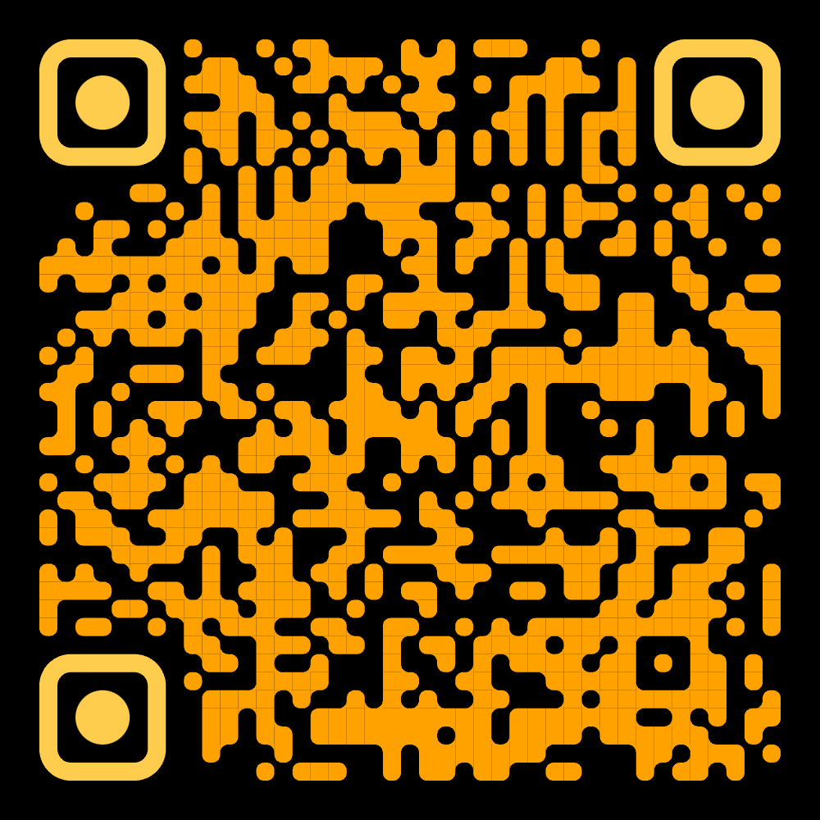

Upstream (QEMU, Systemd) activities
References
Hypervisor interface design doc:
  https://docs.google.com/document/d/14P5L2mwaGcfsKKnDkQL5dxi7j1Mc1rzXtbuvilA5xfU/edit?usp=sharing
QEMU hypervisor interface patch on @qemu-devel:
  https://mail.gnu.org/archive/html/qemu-devel/2025-01/msg05693.html
Systemd PRs:
  https://github.com/systemd/systemd/pull/35091 (merged!)
  Doc update: https://github.com/uapi-group/specifications/pull/131 (WIP)
  https://github.com/systemd/systemd/pull/35747 (merged!)

Slide 28
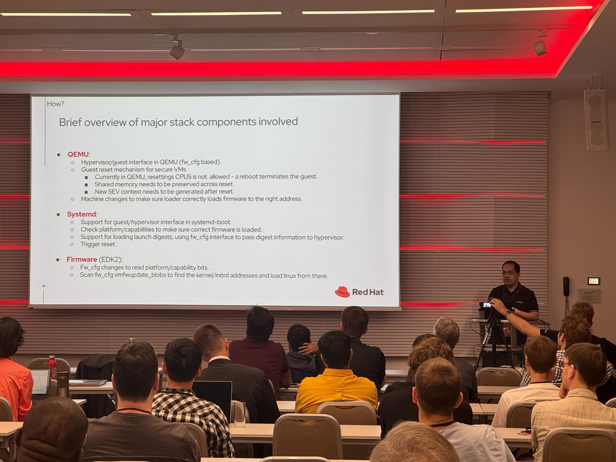
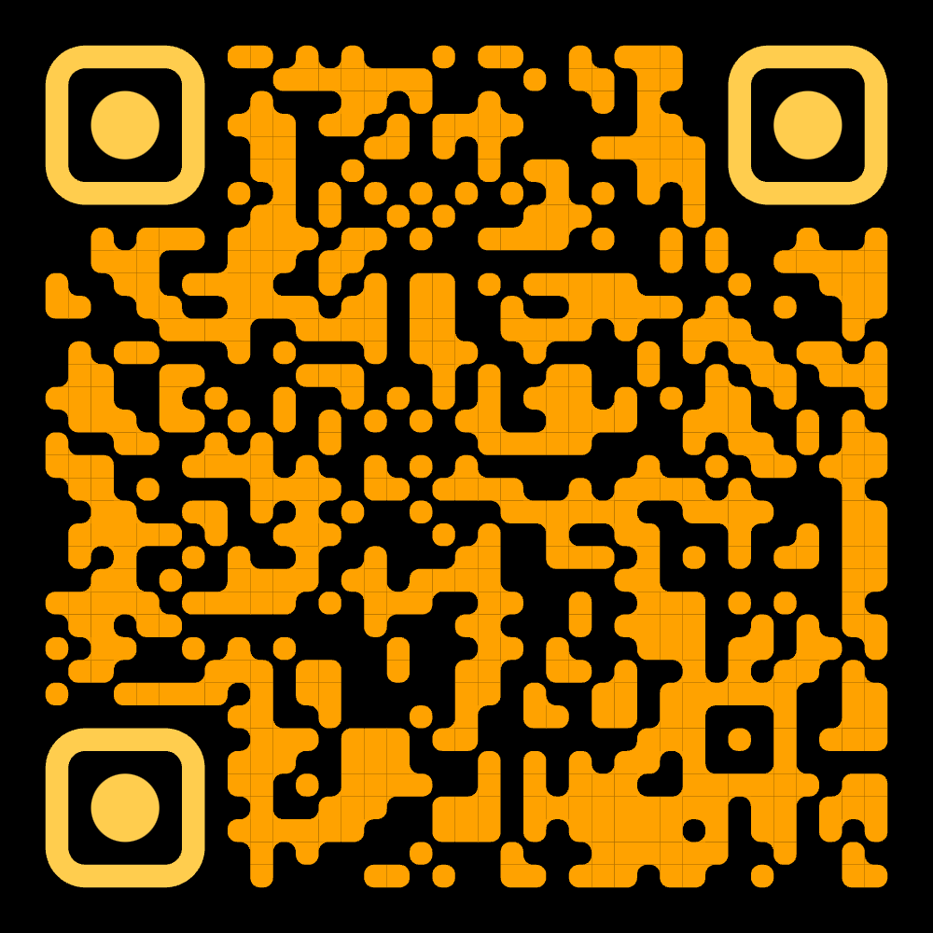
KVM Forum 2024 https://kvm-forum.qemu.org/2024/
References
Talk page: https://pretalx.com/kvm-forum-2024/talk/HJSKRQ/
Talk recording: https://youtu.be/VCMBxU6tAto?feature=shared
Demo: https://people.redhat.com/~anisinha/BYOF-demo.mp4
PDF slides: https://kvm-forum.qemu.org/2024/BYOF_-_KVM_Forum_2024_iWTioIP.pdf
Can also access these from my Red Hat page: https://people.redhat.com/~anisinha/
Photo credit: Anthony Davis, Red Hat.

Slide 29
Links to talks, specs and documentations …
References
UKI spec: https://github.com/uapi-group/specifications/blob/main/specs/unified_kernel_image.md
Emanuele’s FOSDEM 2024 talk on UKI/secure boot work Red Hat is doing https://archive.fosdem.org/2024/events/attachments/fosdem-2024-2024-uki-addons-and-extensions-safely-extending-ukis-kernel-command-line-and-initrd/slides/22125/Uki_addons_O97iYns.pdf
Lennart’s FOSDEM 2024 talk on systemd-boot and UKI https://archive.fosdem.org/2024/events/attachments/fosdem-2024-1987-systemd-boot-systemd-stub-ukis/slides/22834/systemd-boot_systemd-stub_UKIs_mNuvmv0.pdf
SHIM source: https://github.com/rhboot/shim/
SBAT details: https://github.com/rhboot/shim/blob/main/SBAT.md

Slide 30
Links to talks, specs and documentations …
References
Computer hardware IDS (CHID): https://learn.microsoft.com/en-us/windows-hardware/drivers/dashboard/using-chids
Secure boot and measured boot Microsoft page: https://learn.microsoft.com/en-us/windows/security/operating-system-security/system-security/secure-the-windows-10-boot-process
Controlling secure boot https://www.rodsbooks.com/efi-bootloaders/controlling-sb.html
Measured boot design https://trustedfirmware-a.readthedocs.io/en/v2.11/design_documents/measured_boot.html
Remote attestation using ephemeral TPM https://dl.acm.org/doi/pdf/10.1145/3627106.3627112
Intel TDX whitepaper https://cdrdv2.intel.com/v1/dl/getContent/690419
AMD Secure Encrypted Virtualization https://www.amd.com/en/developer/sev.html

Slide 31
Thank you
Red Hat is the world’s leading provider of enterprise open source software solutions. Award-winning support, training, and consulting services make
Red Hat a trusted adviser to the Fortune 500.

