Slide 1
Case Study: Measured Boot and Remote Attestation in Confidential Containers
Magnus Kulke, swe @Azure Core Linux
FOSDEM 25, Image-Based Linux and Boot Integrity Devroom

Slide 2
Containers? Pods? Boot integrity?
Confidential Containers (CoCo) is an effort to introduce Confidential Computing (CC) into the container ecosystem.
CC today is mostly built on top of Virtualization boundaries
K8S Pods: collocated processes in a sandbox, with shared namespaces & resources
CoCo wraps Pods into VMs

Slide 3

Typical container launch
K8s node
K8s API Server
Kubelet
K8s RPC
CRI Calls
K8s pod spec
Containerd
OCI Runtime Calls
Sandbox
process
Runc
process
…

Slide 4
Confidential container launch
K8s node
K8s API Server
Kubelet
K8s RPC
CRI Calls
K8s pod spec
OCI Runtime Calls
Containerd
Kata shim
Attestation Service
Confidential VM
Kata RPC
Sandbox
Kata Agent
process
Key Server
…
Guest Comp.

Slide 5
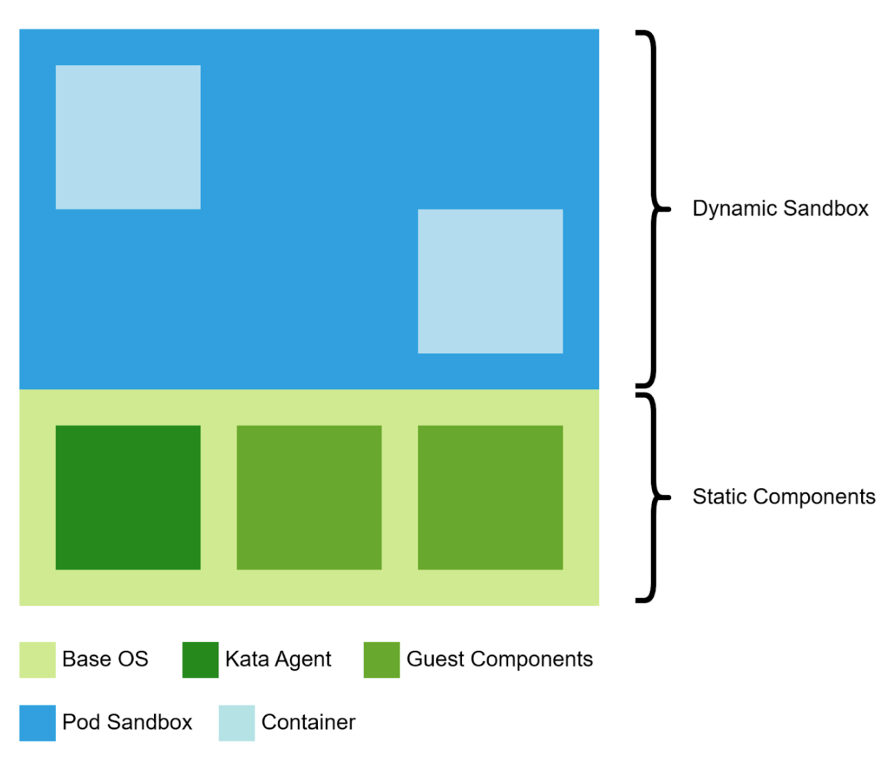
Confidential VM Components

Slide 6
Confidential VM & Measured Boot
Minimal Linux system for „utility VM“
Hosting static components to manage container sandbox and facilitate attestation
  Kata-Agent (container runtime)
  CoCo Guest Components
CC mandates integrity
  Trusting the Sandbox implies trust in the Guest OS
  All OS (+ FW) components need to be measured

Slide 7
Options
Package FW + Kernel + Kata-Agent as pid1 in initrd (w/o rootfs)
Charming b/c simple. Measurements can be precalculated easily
Problem: Attestation ceremonies are handled in discrete processes (3)
  Communicating via ttRPC
  Processes need to be orchestrated, supervised
  Kata-Agent’s role is diluted with pid1 tasks

Slide 8
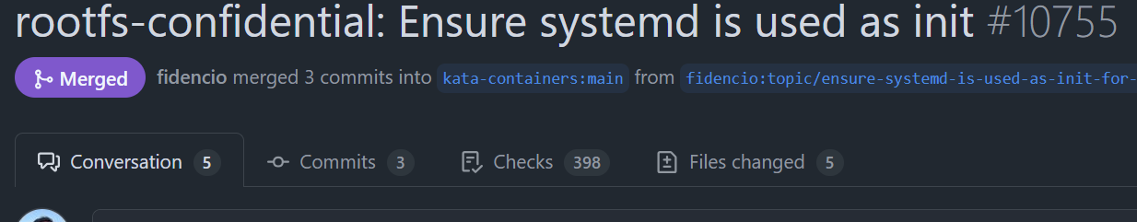
Use Systemd to manage components
Enables some use cases
  Apply per-vm configuration prior to kata-agent
Simplify agent code
Leverage Systemd‘s measured boot facilities
Just got merged 🎉

Slide 9
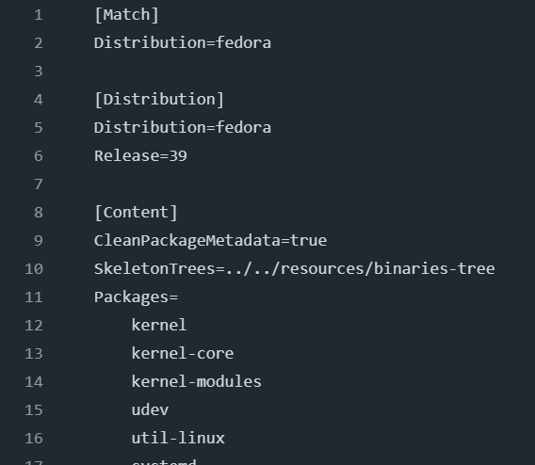
systemd/mkosi
“Make OS Image” (?)
Declarative
Rootless (runs in docker)
Supports many distributions (fedora, debian, arch variants)
For multiple architectures

Slide 10
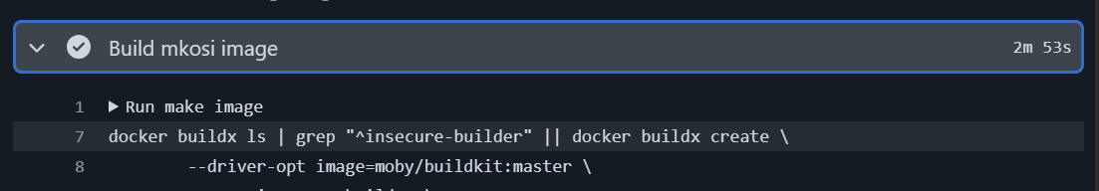
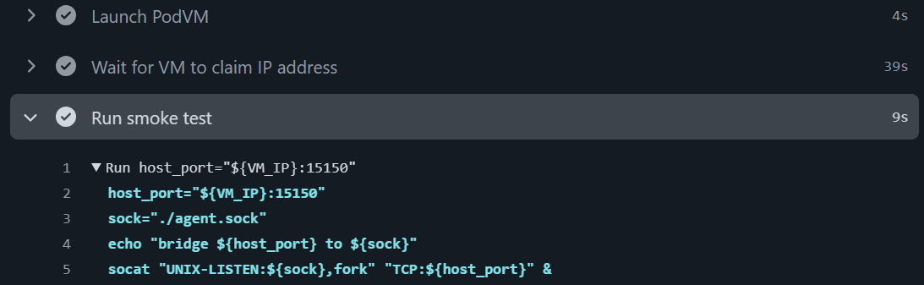
mkosi is fast!
Shortens debug cycles

Slide 11
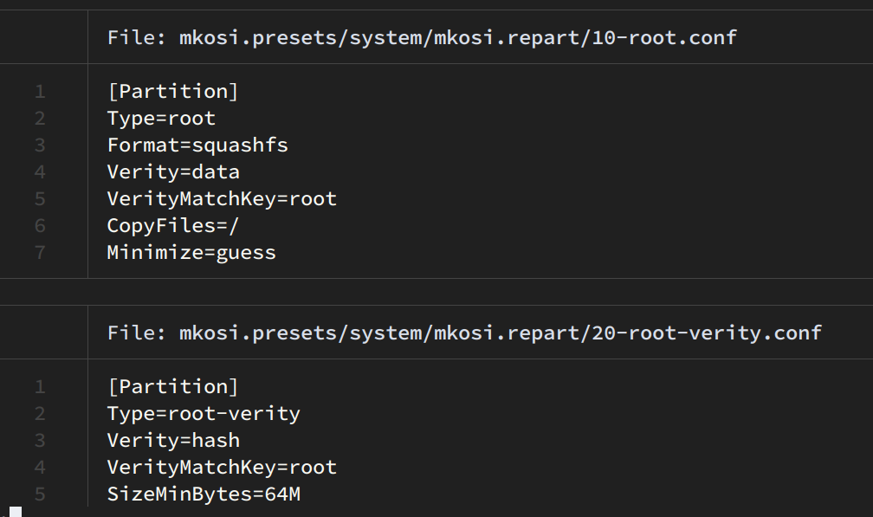
dm-verity setup is trivial
PodVM rootfs is immutable

Slide 12
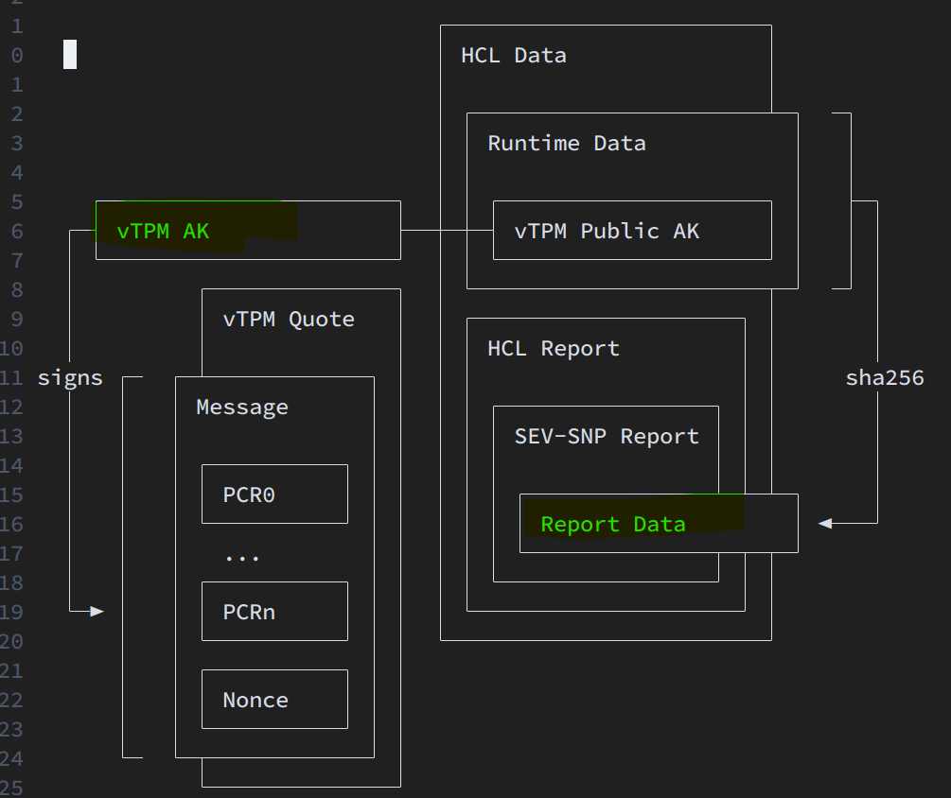
Detour: CVMs and vTPMs
Rich(er) userland/kernel support for TPMs
Paravisors / SVSMs
  Application in early boot
  Use privilege primitives to provide vTPM in CVM
  Isolated from Host + Guest OS, linked to HW Root-of-Trust
Host
VM
VMPL 0
vTPM
VMPL > 0
Guest OS
Notes:
CVMs typically provide facilities for (static) “launch measurements“
Intel TDX also has platform-specific registers, that can be extended at runtime

Slide 13
Using vTPM for Measured Boot
Linux TPM PCR Registry | UAPI Group Specifications (pretty crowsed 😬)
Static OS in PCR11 (UKI)
  Kernel, initrd, cmdline (verity root-hash)
Dynamic CoCo configuration in PCR8
  Claimed by grub (which we don’t use)
Attach vTPM quote to TEE evidence

Slide 14
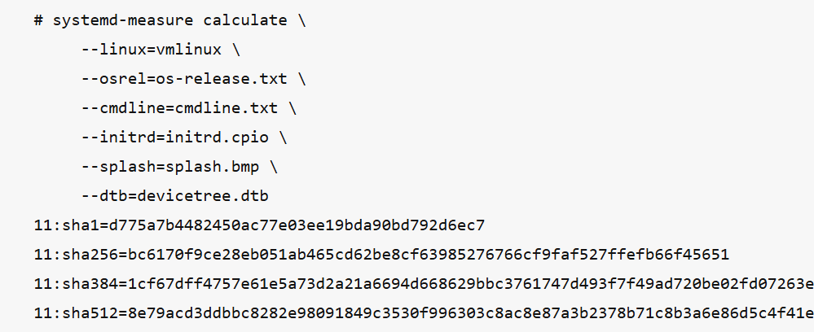
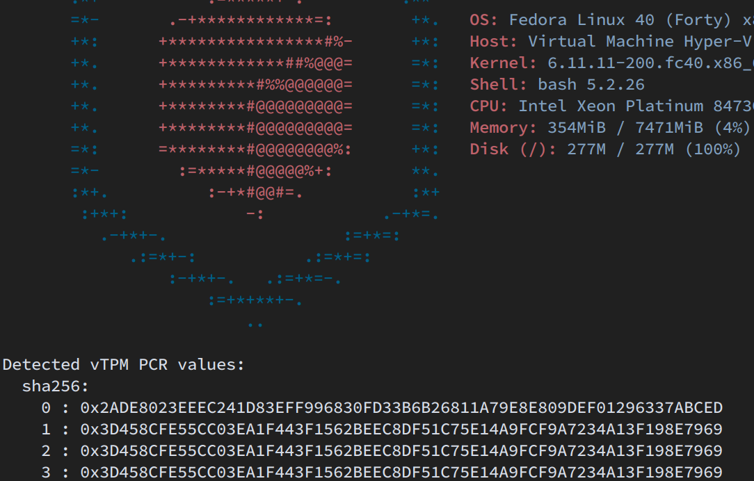
Calculate PCRs offline or via sw-tpm

Slide 15
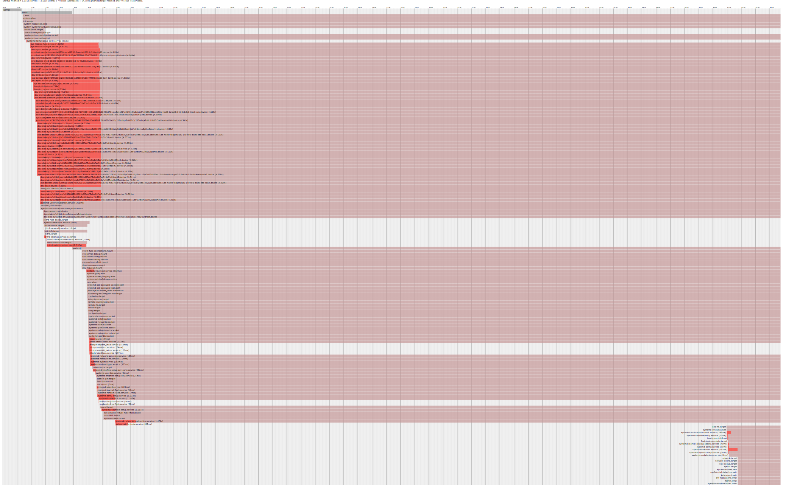
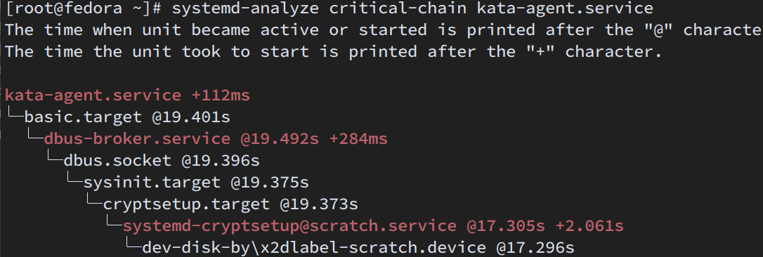
Optimize launch latency
VMs should start doing “container work” ASAP
systemd-analyze {plot,criticial-chain} are incredibly helpful
🤨

Slide 16
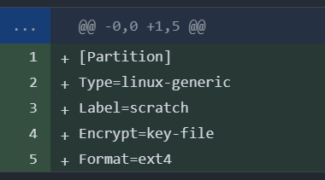
WIP: Encrypted workspace
Some container image are large (CUDA)
  HD Storage is untrusted per-se
  Tmpfs-backed image + runtime storage is costly
Option: use encrypted scratch space
  Add auto-growing partition
  Encrypt with random key
  Add repart + crypttab cfg

Slide 17
Future ideas
Leverage Sysext for more opionionated Base OS requirements:
  Plugin in CoCo sysext w/ kata + attestation tools
  Have predictable (composite) measurement of base + CoCo bins

Slide 18
Future ideas II
Support non-TPM TEE RoT HW in systemd tooling
  Like libtss for SEV-SNP, TDX, …
  Some UAPI standardization ongoing (configfs)
  Up now: Confidential GPUs…
  Up next: more attestable devices
    TEE Device Interface (TDI)

Slide 19
Summing up
Using tools from systemd‘s ecosystem CoCo can quickly build and iterate on an immutuble utility VM. for hosting containers
We can leverage Measured Boot facilities where feasible
Good template for similar requirements

Slide 20
thx!

Slide 21
References
Kata Containers - Open Source Container Runtime Software | Kata Containers
Confidential Containers
systemd/mkosi: 💽 Build Bespoke OS Images
OpenHCL: the new, open source paravisor
COCONUT-SVSM
Intel WP: Device Attestation Model in Confidential Computing

