Slide 1
Measurement and Attestation Schemes for Container Sandboxes
Magnus Kulke, swe @Azure Core Linux
FOSDEM 25, Attestation Devroom

Slide 2
Context
Confidential Containers (CoCo)
  CNCF project
  vendor neutral
  Facilitate confidential computing in the container ecosystem
Confidential Computing is (mostly) a VM technology
  Containers usually do not run in VMs
  Kata Containers adds virtualization as isolation layer

Slide 3

What is a typical container launch?
K8s node
K8s API Server
Kubelet
K8s RPC
CRI Calls
Containerd
K8s pod spec
OCI Runtime Calls
Sandbox
process
Runc
process
…

Slide 4
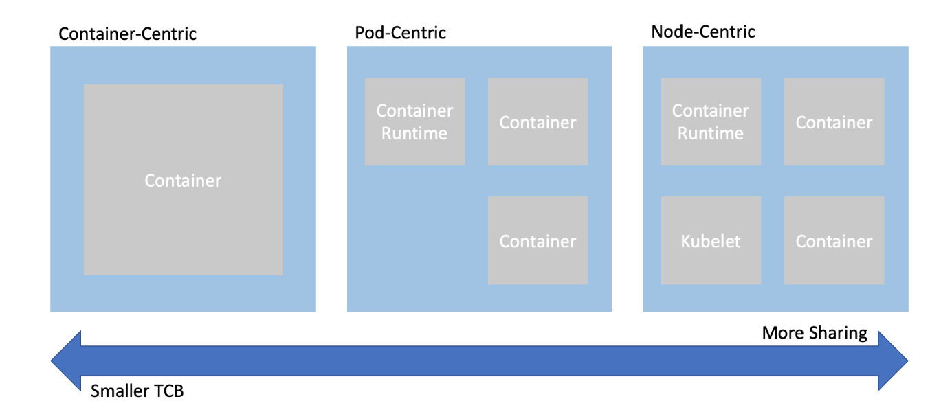
Sandbox?
Pod: Kubernetes deployment „atom“.
Set of collocated processes (containers) that share namespaces and resources
Good abstraction to introduce confidentiality boundaries

Slide 5
Confidential container launch
K8s node
K8s API Server
Kubelet
K8s RPC
CRI Calls
OCI Runtime Calls
Containerd
K8s pod spec
Kata shim
Confidential VM
Kata RPC
Sandbox
process
Kata Agent
…

Slide 6
… or with a remote CVM
K8s node
K8s API Server
Kubelet
K8s RPC
CRI Calls
OCI Runtime Calls
Containerd
K8s pod spec
Kata shim
Confidential VM
Kata RPC
Sandbox
process
Kata Agent
…

Slide 7
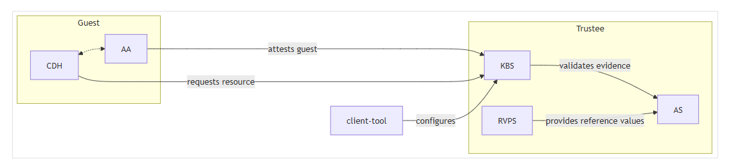
Attestation Architecture

Slide 8
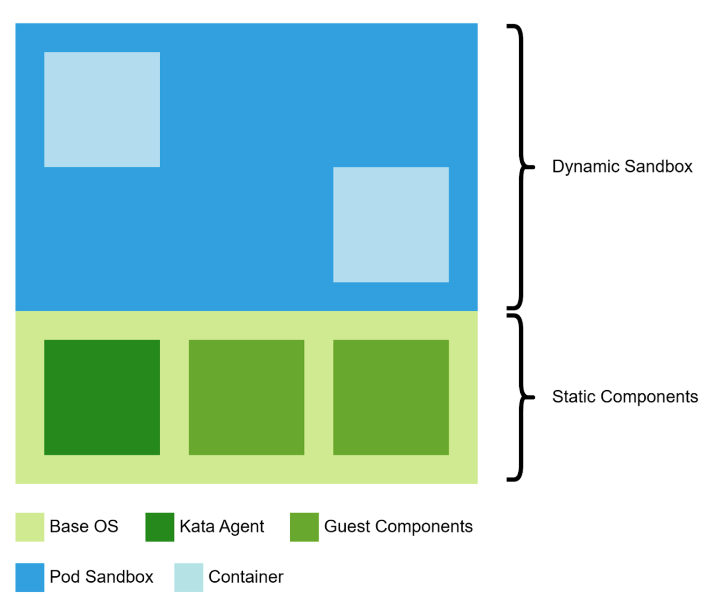
Static and dynamic components
?
Well covered: UKIs, dm-verity, systemd…

Slide 9
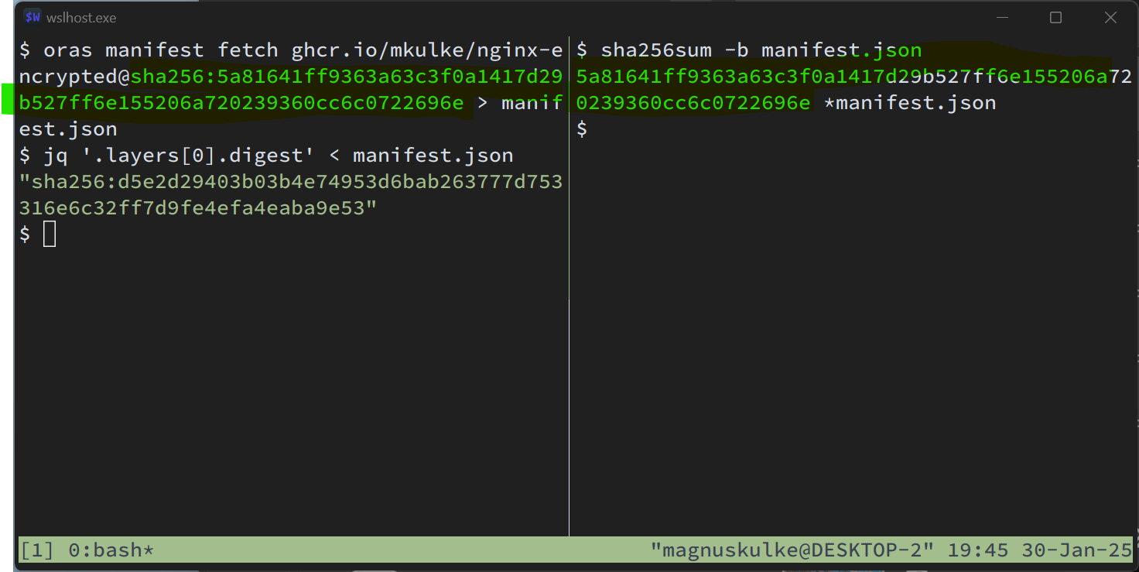
OCI images are content addressable

Slide 10
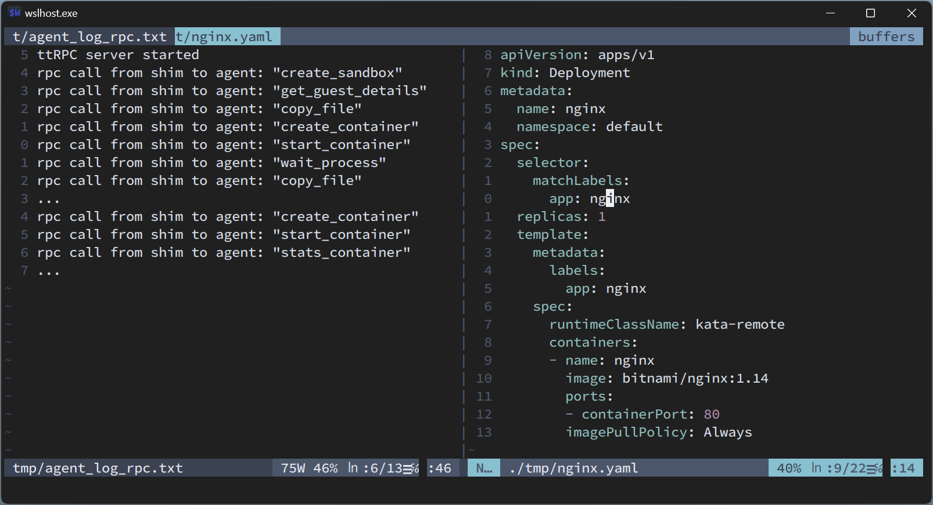
Sandbox with imperative control

Slide 11
Attesting a container environment
Objective:
  Ensure that only intended operations are executed within the sandbox (before releasing a secret)
Requires:
  A comprehensive measurement of the “container workload”

Slide 12
Challenges in dynamic environments
Dynamic Nature of Pods:
  Pods can have containers created, deleted, or updated imperatively.
  Dynamisms make it challenging to guarantee integrity.
Kubernetes Control Plane:
  Can and will adjust a user’s pod spec
  Examples: env variables, admission controllers

Slide 13
Options
Lock k8s control plane:
  Allow only “trusted” (predictable) operations
  K8s api surface is huge, increasing constantly
  Requires lots of glue code and ceremony
Effort underway: “split-api”

Slide 14
Options
Keep a log
  (Somewhat) like linux’ IMA
  Record Kata RPC + payloads into replayable log
  Not all TEEs provide registers that can be extended at runtime
  Some payloads are not predictable, b/c controlled by the env
  Verification is not trivial

Slide 15
Options
Policy in the TEE
  Describe invariants (image digest)
  Allow “acceptable” dynamism (env: SERVICE_*)
  Reject Kata RPCs by default
  cherrypick what’s required
Currently implemented in Kata-Agent
  Engine based on Rego (popular in container-land)
  genpolicy tool to generate policy from a pod spec

Slide 16
Plugging policy eval into the workflow
Kata shim
Confidential VM
Kata RPC
Sandbox
process
Policy engine
Kata Agent
…

Slide 17
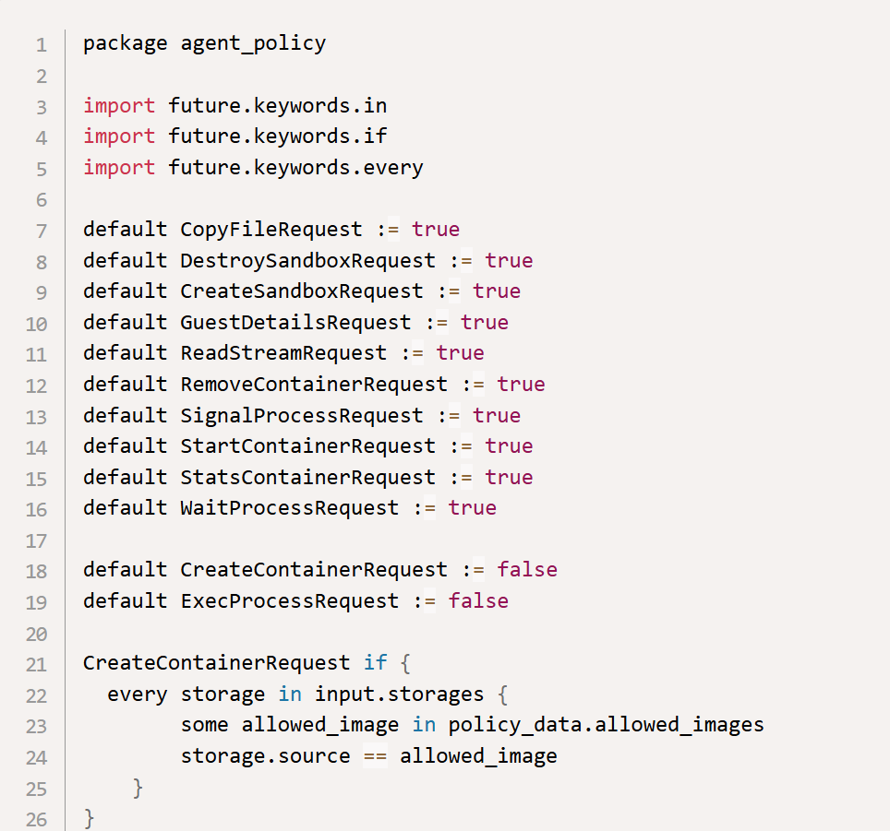
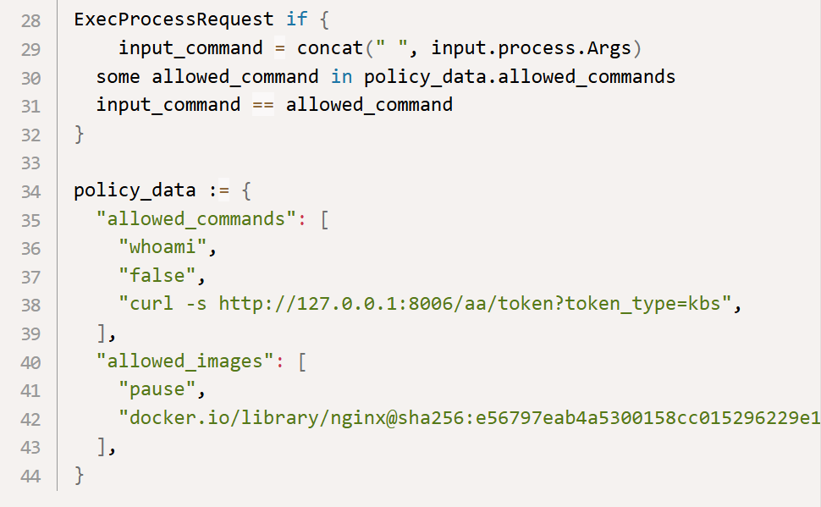
Example Policy

Slide 18
How to provide a policy to the TEE?
Policy is specific per workload
CVM images are generic
Provide it as measured configuration at launch
Link it to the TEE HW evidence
  Put hash in HOSTDATA (SEV-SNP), MRCONFIGID (TDX), part of signed HW evidence (verify in TEE)
  Extend runtime registers (vTPM)

Slide 19
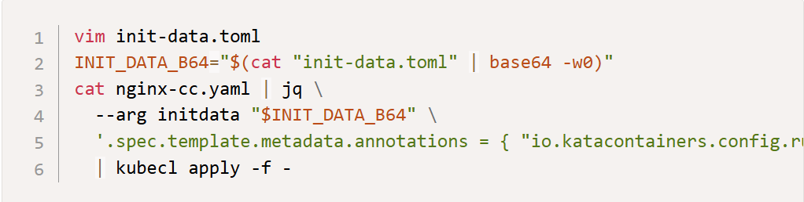
Init-Data Specification
Measured configuration for CoCo
TOML dict of path/file content
Currently being implemented
Available for some TEEs
Embed into Pod spec as annotation

Slide 20
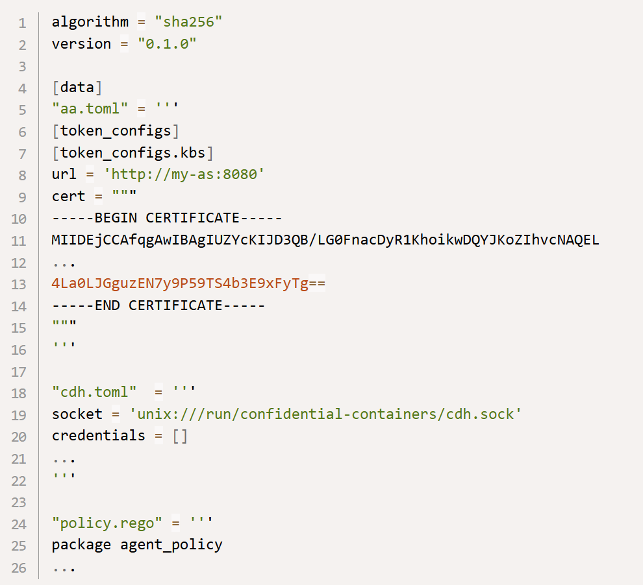
Initdata Example

Slide 21
Challenges
Policy is stateless, declarative
  Kata RPC is imperative
  What about more complex orchestration?
    launch container x first (init container) then container y
Ongoing effort: stateful policies

Slide 22
Challenges
Practical problems
  Size of policies?
    Policies can be quite large
    Pod annotation has limits
    Compression, splitting, bundling a library
  User experience is subpar
    Rego is modelled after Datalog
    Unusual paradigms
    Not trivial to write large policies

Slide 23
Challenges
Conceptual problems, maybe?
  Have to track kata’s RPC interface closely
    New exploit vectors can be introduced inadvertently
    Kata is not just for CoCo use case
    Need to keep tabs on API changes in semantics and implementation

Slide 24
Challenges
Runtime measurements
  (very) long running workloads in TEEs
    Examples: LLM inference, training tasks
    Continuous measurement to catch drift
  Not all TEEs have PCRs/RTMRs
  Can be retrofitted via privilege levels + paravisor/SVSMs.
“Composite” TEEs
  Confidential GPUs + Confidential CPUs
  Potentially more, e.g. accelerated NICs
  Attest individually? Chained?

Slide 25
Recap
Attestation for container sandboxes is tricky due to inherent dynamic nature.
“Offloading” verification to a policy is a viable mitigation
Few challenges remain, most seem manageable
But policy is maybe not fully adequate

Slide 26
thx!

Slide 27
References
Confidential Containers
Kata Containers - Open Source Container Runtime
Policing a Sandbox | Microsoft Community Hub
CoCo Initdata spec

