Slide 1
Bpftrace OOM profiler
Samuel Blais-Dowdy
Production Engineer

Slide 2
Agenda
Problem
Implementation
Results
Learnings

Slide 3
01 Problem

Slide 4
What is Scuba?
01 Problem
Real-time data ingestion
MapReduce architecture
Columnar data format
Similar to elasticsearch / splunk
Thousands of QPS

Slide 5
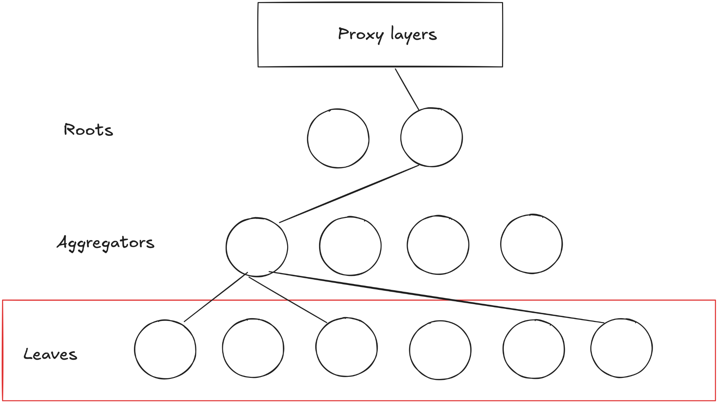
What is Scuba?
01 Problem

Slide 6
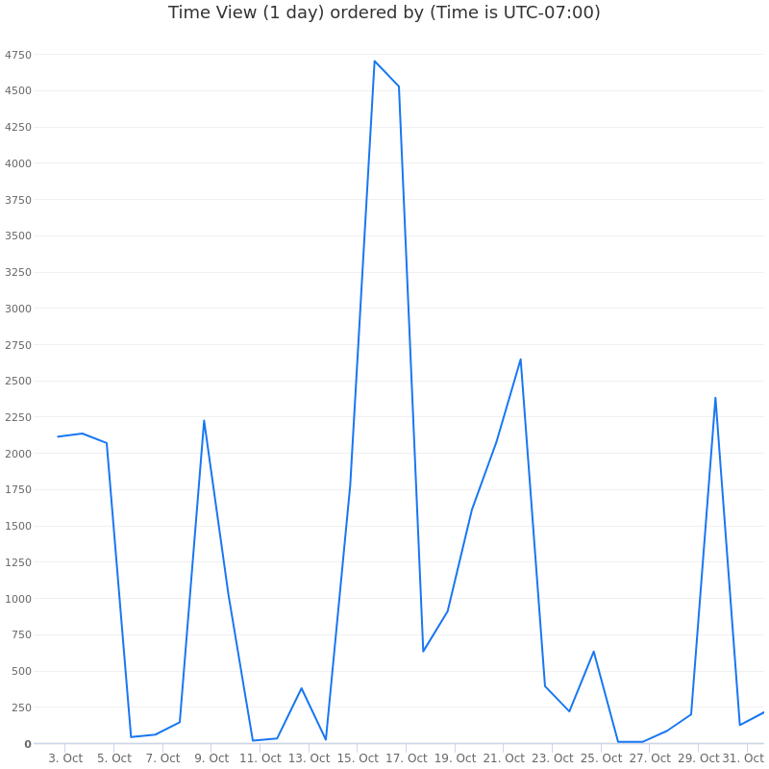
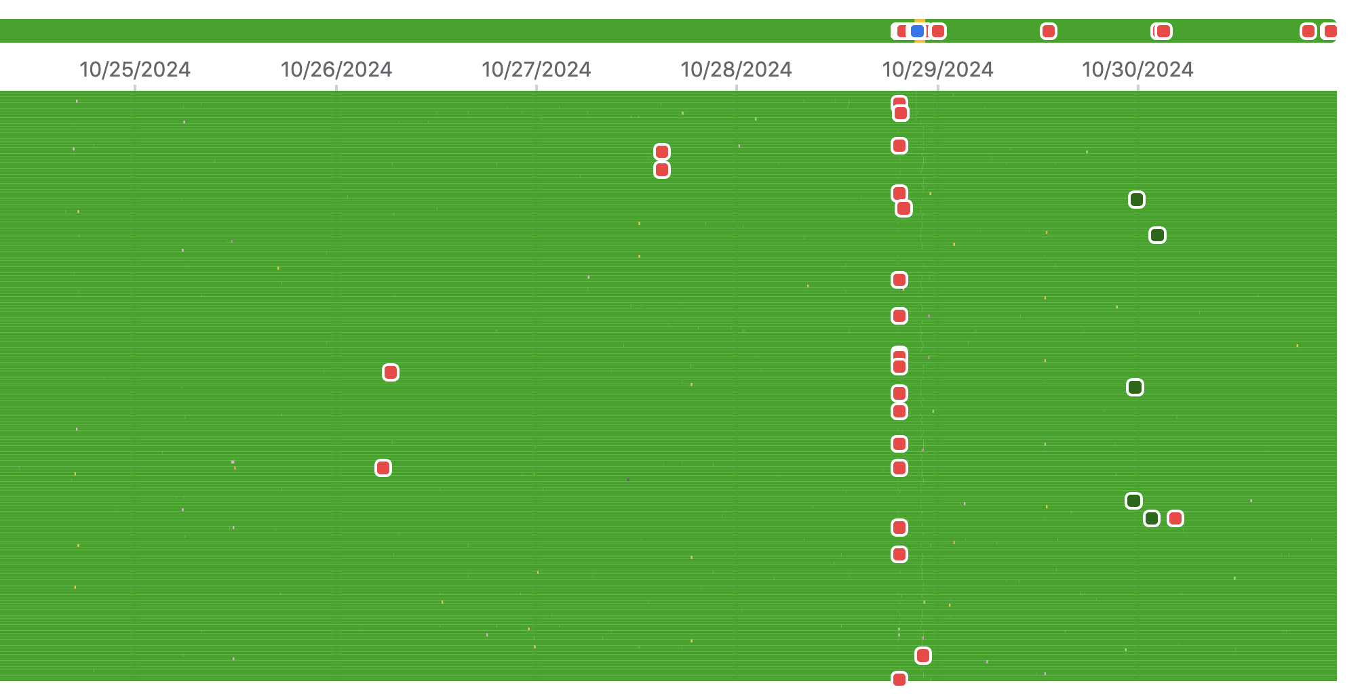
Too many OOMs
01 Problem

Slide 7
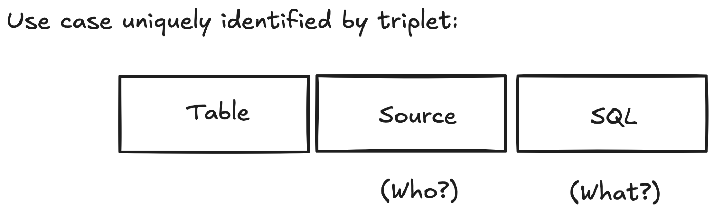
Goals
01 Problem
Unlock OOM observability:
  Easily identify expensive use cases
  Quickly block a use case causing wave of OOMs

Slide 8
02 Implementation

Slide 9
Proof of concept (v1) criterias
02 Implementation
Count triplets (table, source, sql) == aggregations
Collect data when facing memory pressure
Log aggregations AFTER we OOM
Use the least amount of memory (oil on fire)

Slide 10
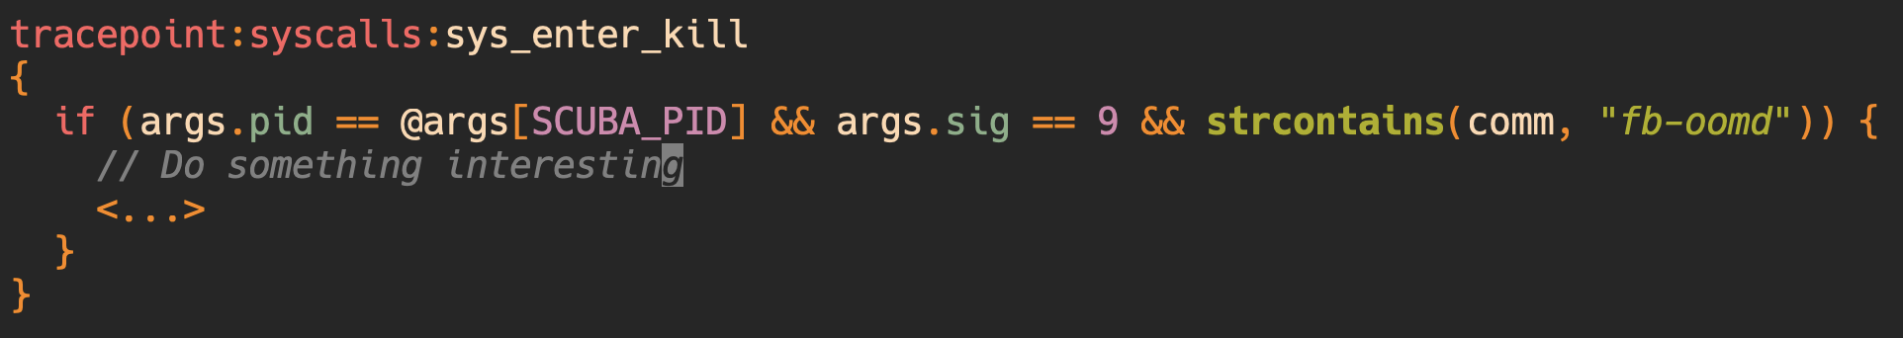
Why bpftrace?
02 Implementation
(fb-oomd) SIGKILL non-catchable & non-ignorable
Can’t be handled in user-space

Slide 11
fb-oomd
01 Problem
Open source: https://github.com/facebookincubator/oomd
systemd service
Sends SIGKILL
Better control over what gets killed (vs. kernel)

Slide 12
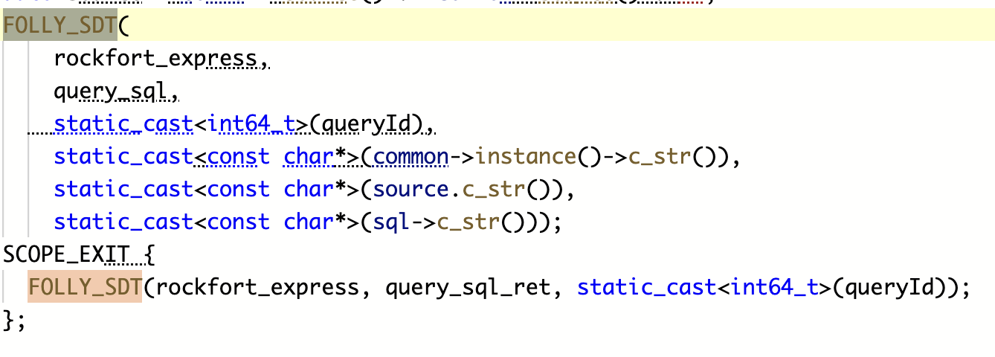
Collecting aggregations
02 Implementation
Folly USDT static tracing: https://github.com/facebook/folly/tree/main/folly/tracing
More reliable than uprobe

Slide 13
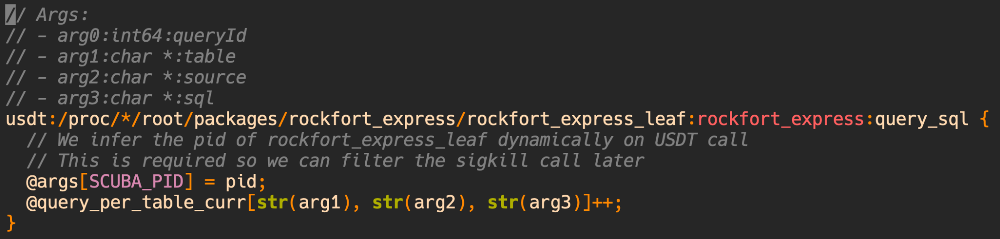
Collecting aggregations (continued)
02 Implementation
Count aggregations: (table, source, sql)
Save target pid “hack”: https://github.com/bpftrace/bpftrace/issues/3552

Slide 14
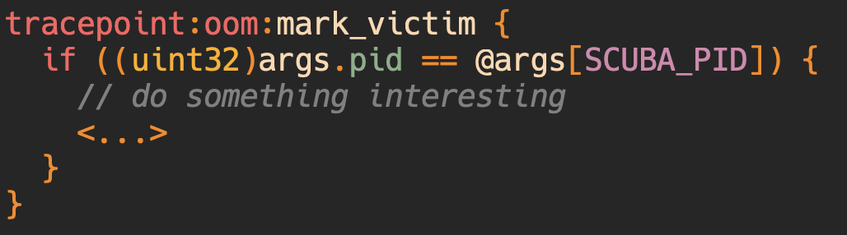
Kernel OOM - just to be safe
02 Implementation
Sometimes fb-oomd fails (< 3%)

Slide 15
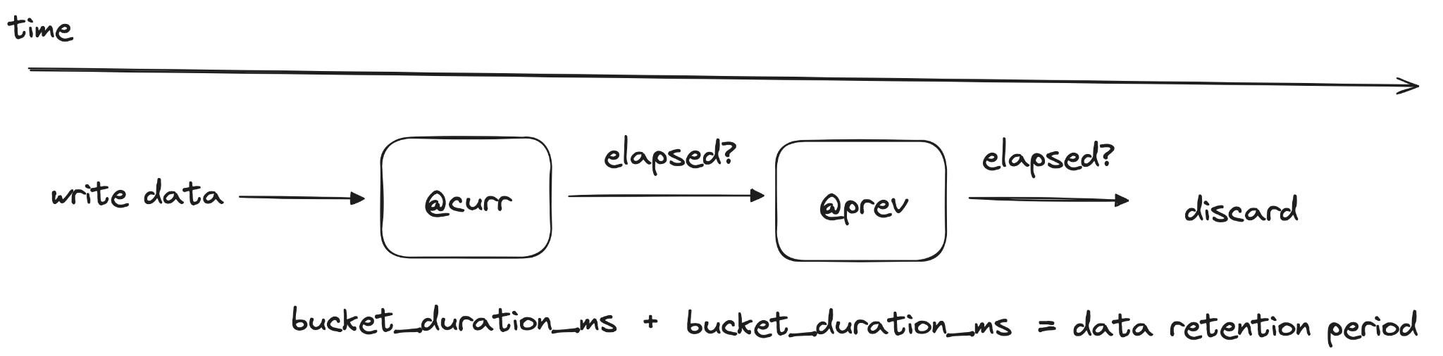
Avoid adding fuel to the fire
02 Implementation
Design criteria - lightweight, not use too much memory
Fixed data retention period (bucket implementation)

Slide 16
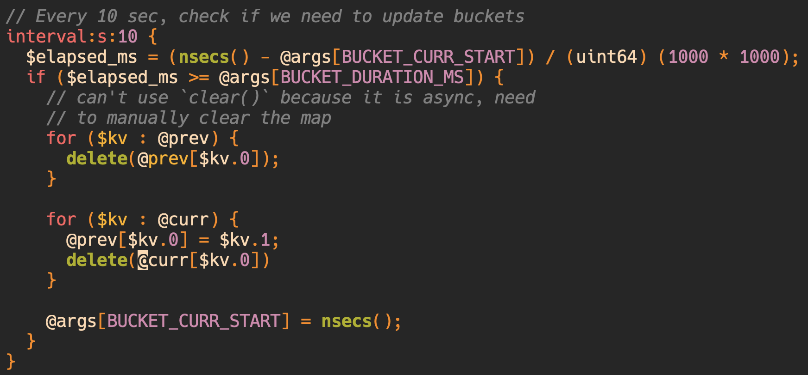
Fixed data retention period
02 Implementation

Slide 17
Issues with implementation
02 Implementation
Clunky, over-engineered
O(2n) implementation (iterate both buckets)
LRUHashMap to provide better alternative: https://github.com/bpftrace/bpftrace/issues/2954
Sync delete map requires for loop + delete(...): https://github.com/bpftrace/bpftrace/issues/3549

Slide 18
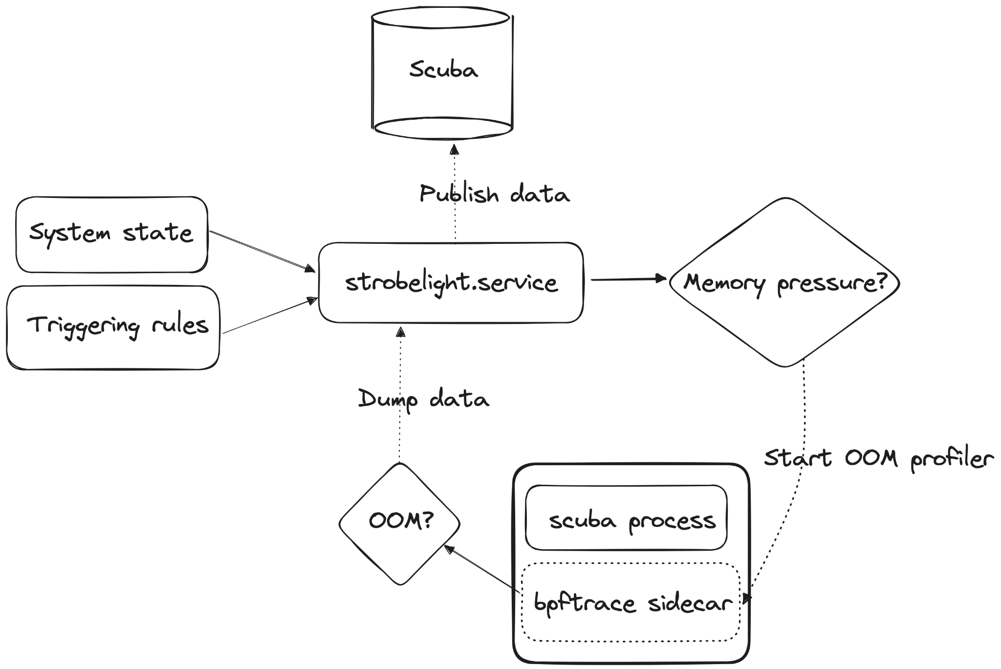
Running in production
02 Implementation

Slide 19
03 Results

Slide 20
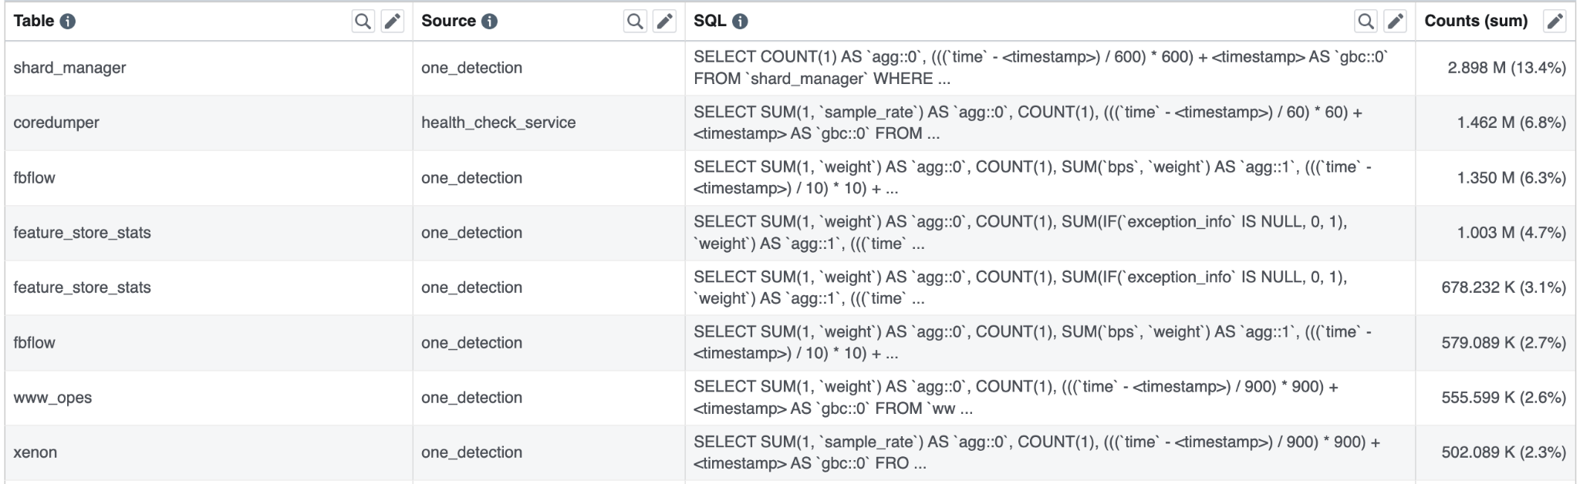
Pros
Cons
03 Results
It works !!
OOM centric dataset
Correlated with memory pressure
Noisy dataset
Catching < 10% OOMs
Frequent != expensive

Slide 21
Can we do better?
03 Results

Slide 22
One-up implementation (v2)
03 Results
Continuous logging, why just drop data?
  OOM detected (true/false)
Track one queryID per aggregation
Memory cost of aggregation
CPU cost of aggregation

Slide 23
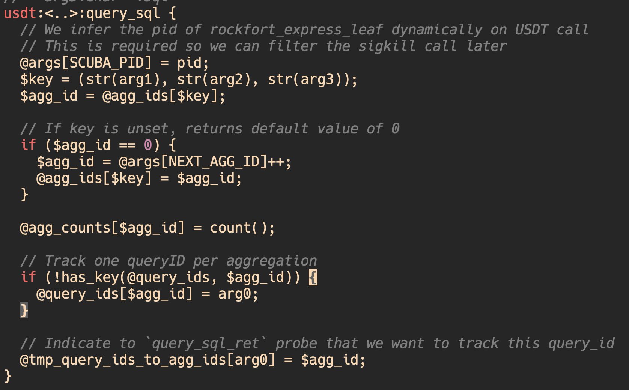
Refactor entry probe
03 Results
Aggregation ID to save memory
(2) Track one queryID per aggregation
(3) queryID <-> aggID

Slide 24
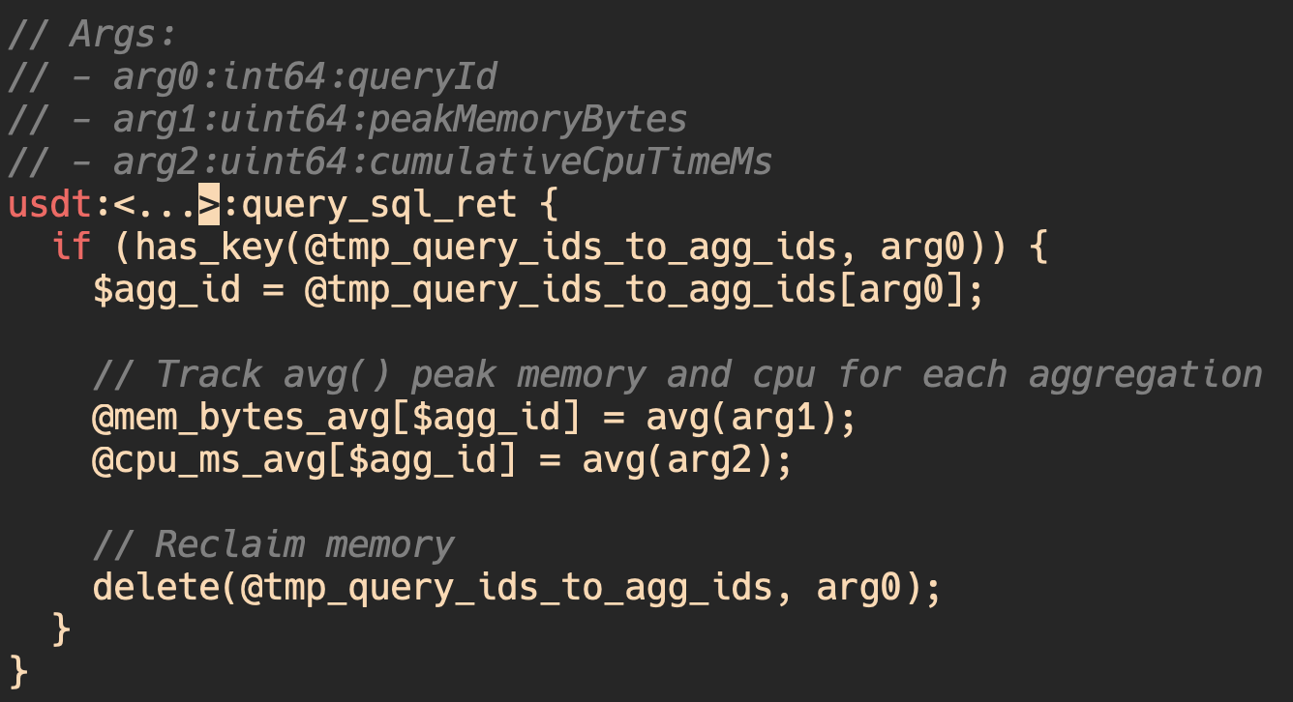
Add return probe
03 Results
Rolling avg() mem + cpu

Slide 25
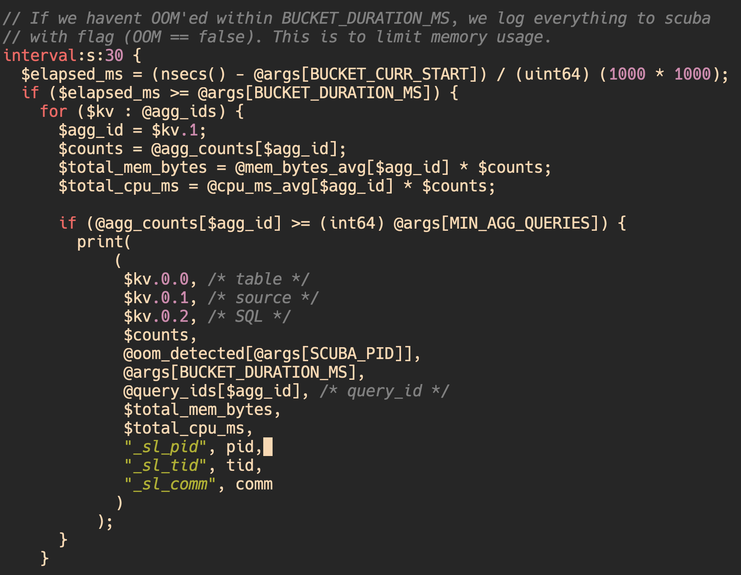
03 Results
(1) Filter OOM-only data
(2) Continuous logging

Slide 26
03 Results ??

Slide 27
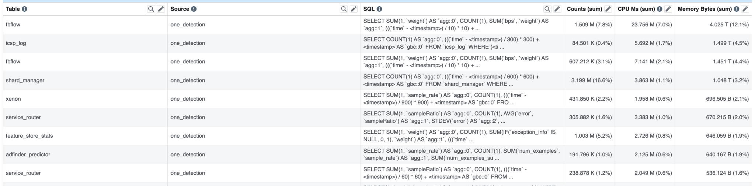
03 Results
Better data
Correlated memory pressure/OOM
Order By (mem, cpu)

Slide 28
Open questions
03 Results
How to best use the dataset?
How to confirm an aggregation is expensive?
Can we automate policing efforts?

Slide 29
04 Learnings

Slide 30
Learnings
04 Learnings
Bpftrace programming experience
Community (@Daniel Xu, @Jordan Rome)
Extremely powerful

