Slide 1
V2GLiberty: The open stack that could
Energy Flexibility
How we enable EV owners to be ahead of the industry, with open source software.
Notes:
Bezoekrers: Fluctis (Arthur B)
Libra (Marco Guzman)
Zandbergen (Student)

Slide 2
Who we are
Energy Flexibility
Smart backend for energy flexibility apps.
UX- & Service Design
for a positive impact.
Notes:
Heb Industial Design Engineering gestudeerd in Delft, in 2018 eCars module gevolgd.
Ben gedetacheerd UX designer bij Vattenfall
Ben V2G Liberty gestart omdat ik zelf met Energie transitie aan de slag wilde.
20

Slide 3
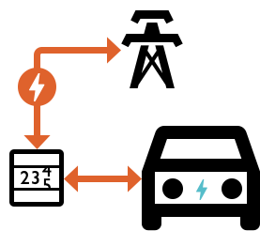
Vehicle-to-Grid:
What and why?
EVs which can send power back to the grid.
Support the grid
Use your own solar energy
Lower your energy bill
(buy low, sell high)
EPEX day-ahead price spreads within a day have grown 300%
Between 2019 and 2021.
(Source: Vattenfall Markt Expertise Desk)
www.thesun.co.uk
Notes:
Belangrijk in Energie Transitie
Helpt GRID te ontlasten
Helpt groene stroombronnen beter te benutten
Je gebruikt zelf meer groene/minder grijze stroom
Behind the meter, laadpaal even weggelaten, auto is batterij.
Kan huis van energie voorzien maar dat is niet essentie
Zonnepanelen zijn eigenlijk niet van invloed.
We kunnen (later) wel optimaliseren op eigen gebruik
Dynamic prices essential for Businesscase.

Slide 4
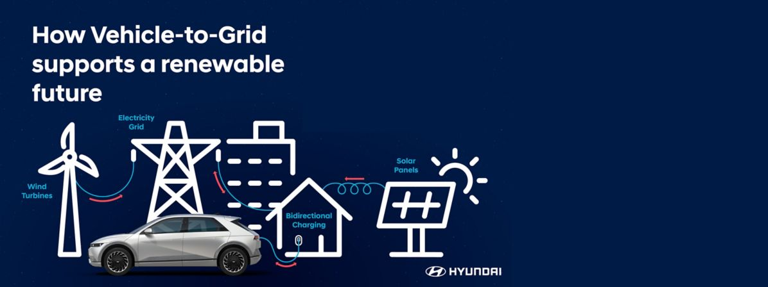
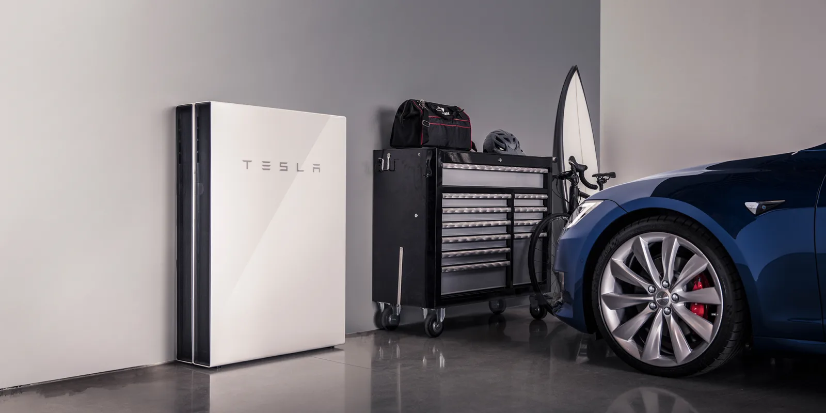
Where is it? Do we want it?
There are big plans, but industry is taking their time to build integrated (and possibly siloed solutions).
www.thesun.co.uk
Notes:
Belangrijk in Energie Transitie
Helpt GRID te ontlasten
Helpt groene stroombronnen beter te benutten
Je gebruikt zelf meer groene/minder grijze stroom
Behind the meter, laadpaal even weggelaten, auto is batterij.
Kan huis van energie voorzien maar dat is niet essentie
Zonnepanelen zijn eigenlijk niet van invloed.
We kunnen (later) wel optimaliseren op eigen gebruik
Dynamic prices essential for Businesscase.

Slide 5
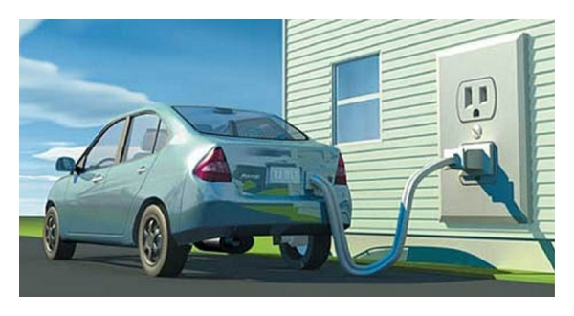
The V2G Liberty project
Kickoff: Fall 2021 in Utrecht
Now: 1 year of data, 5 new locations
Why?
Didn’t want to wait for industry
Showcase open source stack
Challenge ourselves
What will I show today?
Stack
Design
Some outlooks
Notes:
Elke ChaDeMo auto, Elivia, Outlander. Hopelijk snel meer
Raspberry PI kan maar oude laptop oid kan ook. Mag oud beestje zijn, hoeft niet hard te werken.

Slide 6
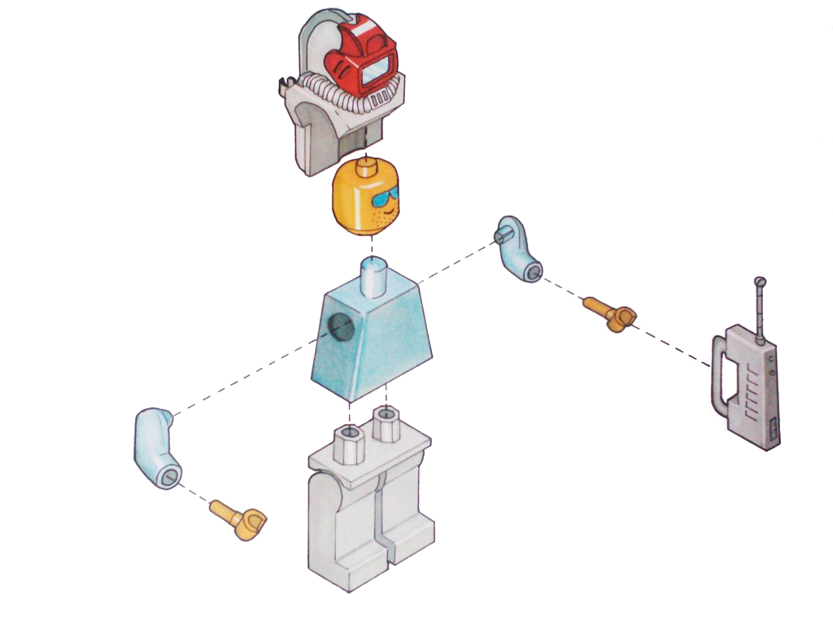
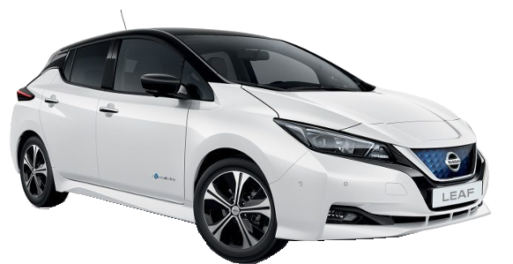
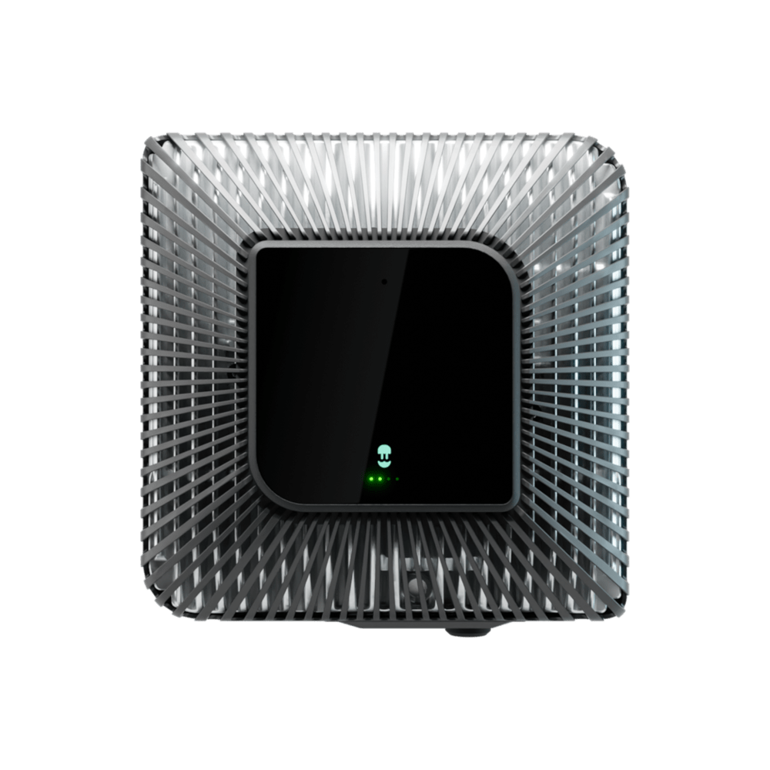
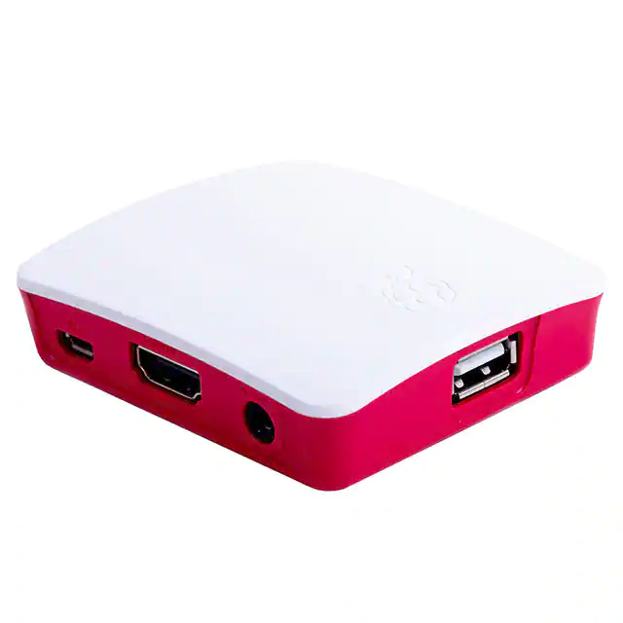
What do we need?
(what is available?)
V2G-capable charger (Wallbox Quasar ―
talks modbus, not yet OCPP)
EV with CHAdeMO
(Nissan Leaf)
Local computer (Raspberry PI)
Ideally, an energy contract with dynamic tariffs
… or even solar panels
Notes:
Elke ChaDeMo auto, Elivia, Outlander. Hopelijk snel meer
Raspberry PI kan maar oude laptop oid kan ook. Mag oud beestje zijn, hoeft niet hard te werken.

Slide 7
The software (HEMS)
Notes:
FlexMeasures
+ Kent prijzen
+ Kan optimale schema voor jouw situatie bepalen
+ zo’n 12x per uur
+ draait in de cloud, veilig, prive
+ daar hoef je verder niets mee…
20

Slide 8
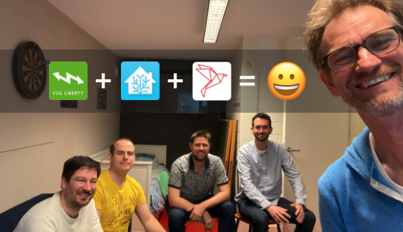
Home assistant
Among many others these companies provide add-ons for Home-assistant:
Software for home automation
Free & open-source
Cheap hardware
Local control → privacy
Web-based user interface (+ apps for Android and iOS)
Apple Homekit
Notes:
Basis
Home Assistant programmeurs enthousiast voor V2G Liberty
Samenwerking
20

Slide 9
FlexMeasures
FM’s goal is to answer this question: “What are the best times to run flexible assets, like batteries, heat pumps or industry processes?”
A platform for automating energy optimization throughout the day, to save CO₂ and costs.
Python
Developer-friendly (e.g. plugins, good docs, API, CLI, ...)
E-mobility, industry, built environment
Notes:
Calendar
Charge Now
Disconnect
Connect
20

Slide 10
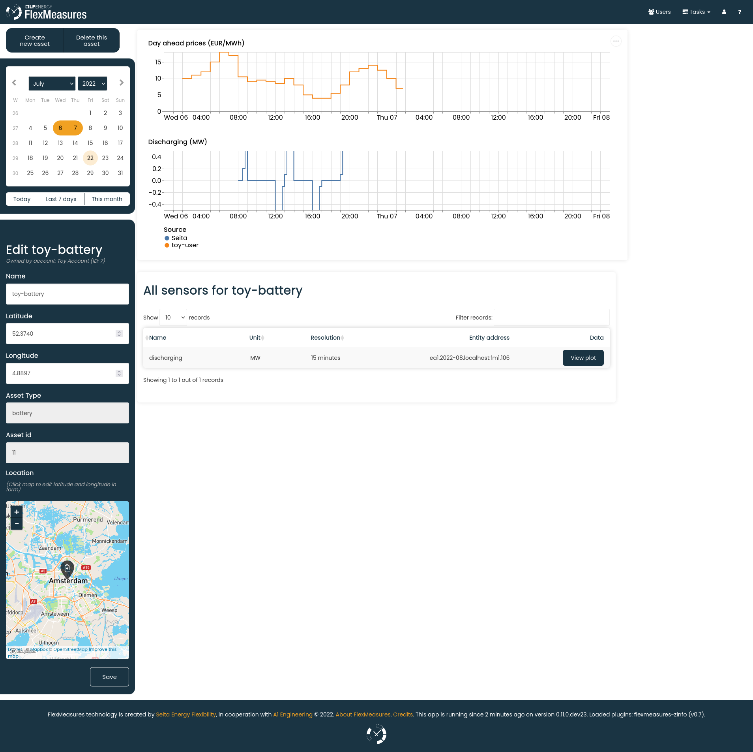
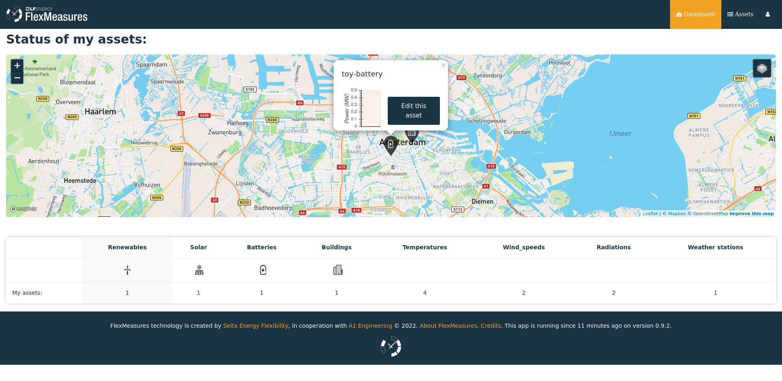
This is the back-office in FlexMeasures.
Usually, our partners build their own UI, like we did in V2GLiberty.
Notes:
Calendar
Charge Now
Disconnect
Connect
20

Slide 11
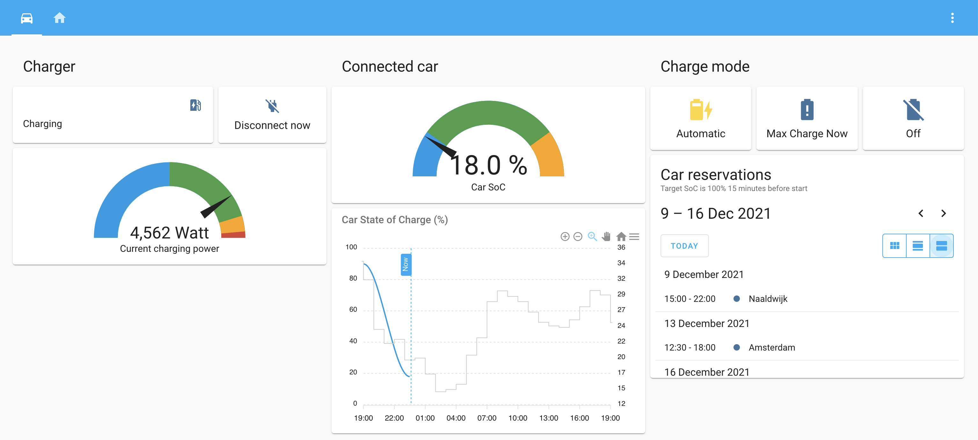
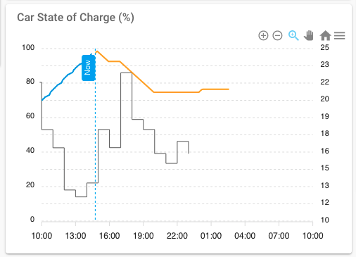
V2G Liberty – HomeAssistant plugin
Notes:
SoC = State of Charge = hoe vol zit de battery in %
Price – axis is flexible, it might be much more or muchless
20

Slide 12
User experience (😍)
V2G research has shown that drivers accept low minimum SoC as long as they can easily overwrite the automated system.
Should not ask constant attention
→ Automation, user in control
I’m always ready to ride
I can trust the system
It’s helping the climate
It’s cost-saving
→ Optimize (dis) charging
→ Protect the battery
We Hicks, unsplash

Slide 13
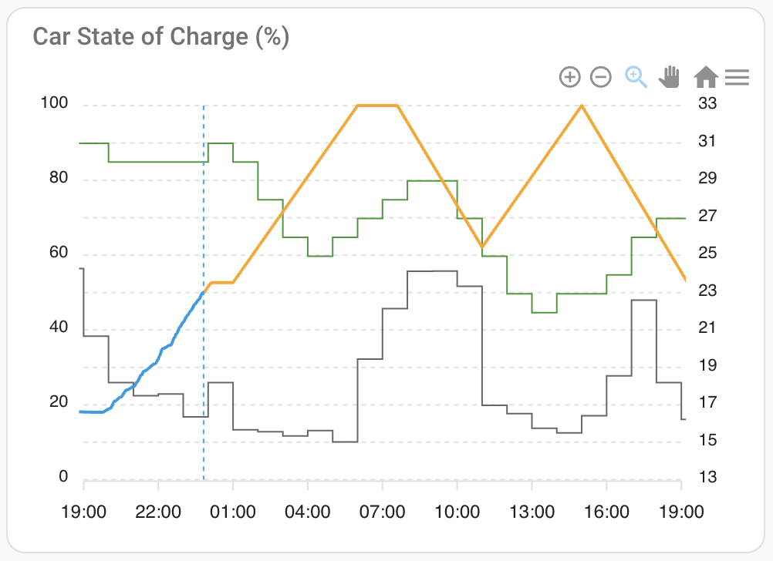
V2G Liberty Dashboard
Now
CO₂ / kWh
SoC planning
SoC axis in %
EPEX price
Price €ct/kWh
incl. taxes
(dynamic axis)
SoC history
Notes:
SoC = State of Charge = hoe vol zit de battery in %
Price – axis is flexible, it might be much more or muchless
20

Slide 14
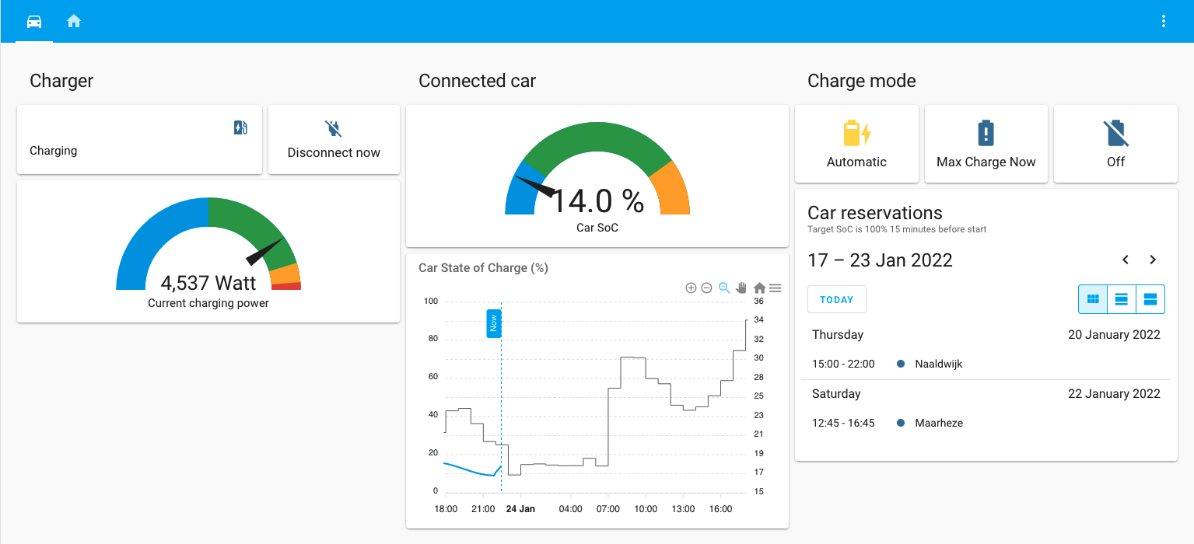
Auto returns with SoC < 20%
Directly charge maximum speed
Healthy SoC: 20 – 80%
Minimum SoC of 20% ≈ 60 – 80km
Notes:
Geen schedule opvragen, eerst naar 20%.
Later instelbaar door gebruiker

Slide 15
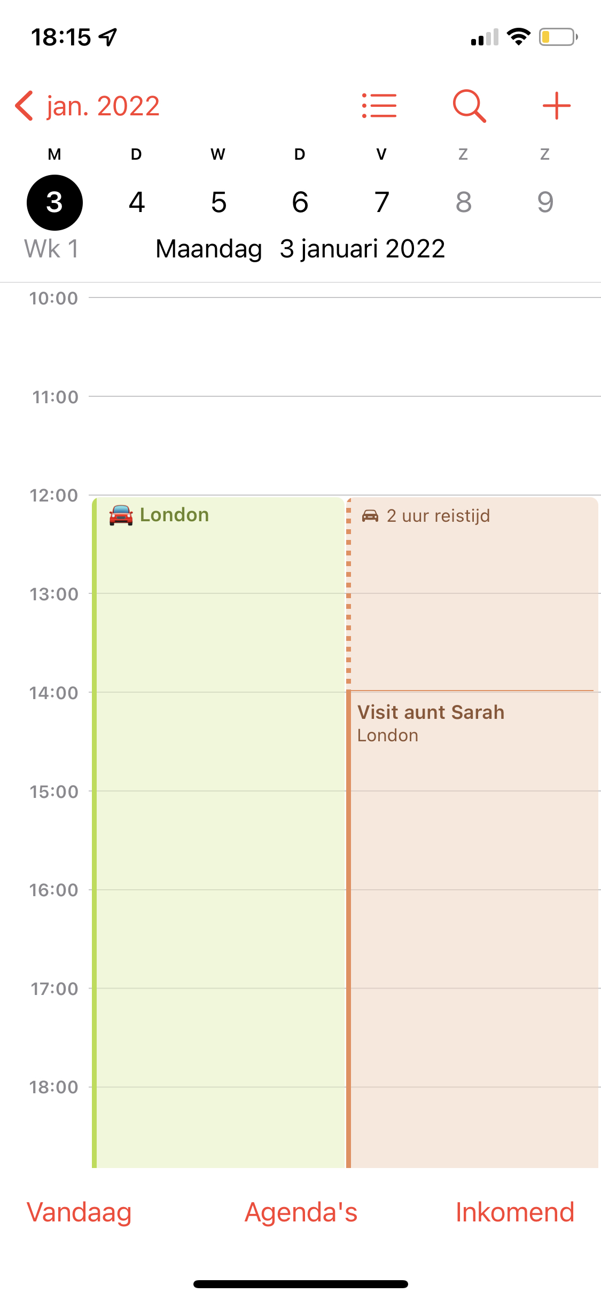
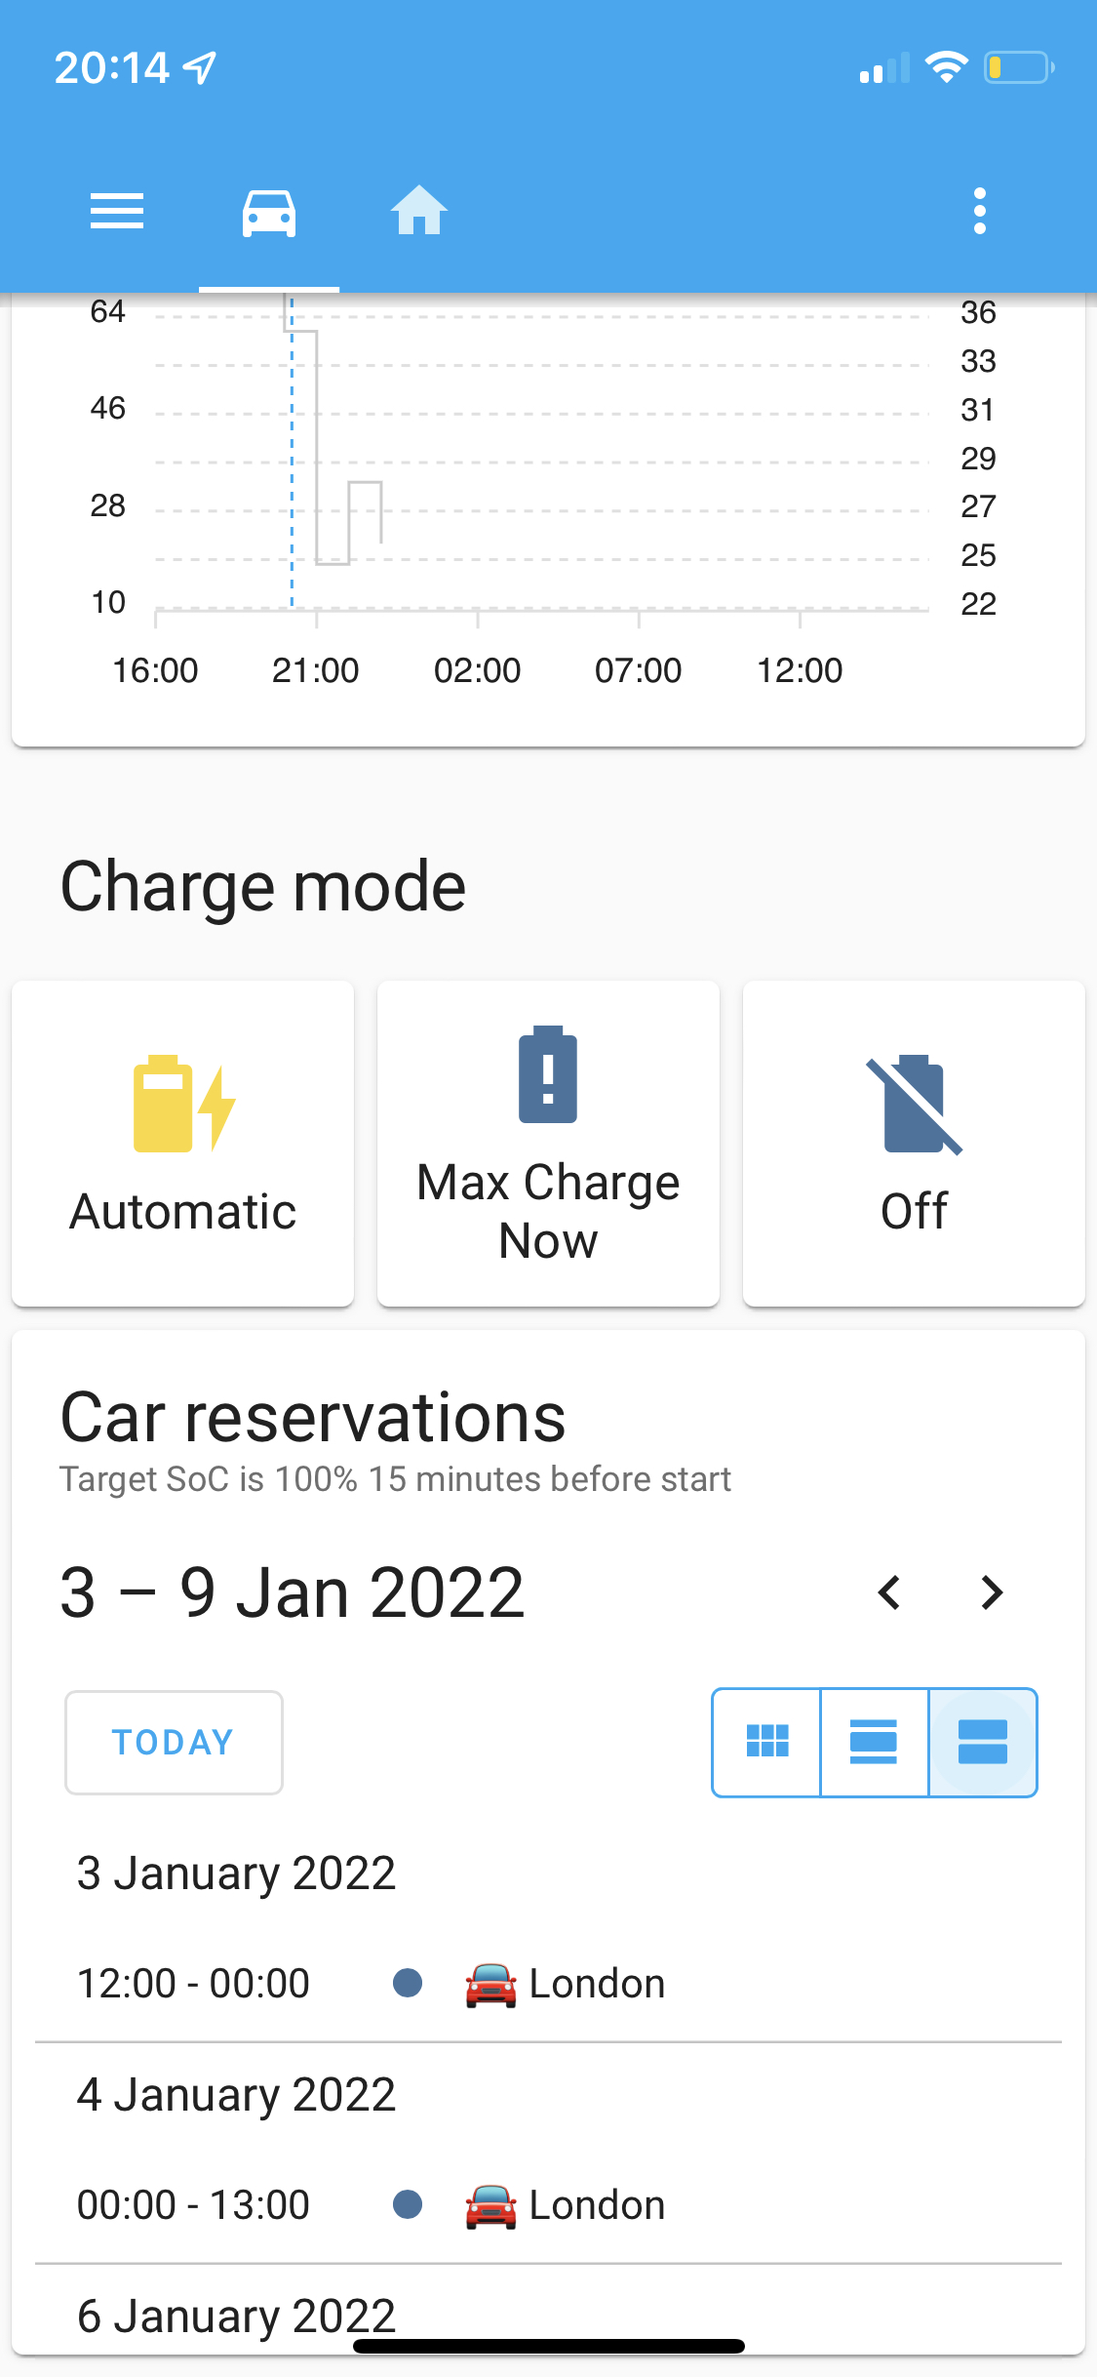
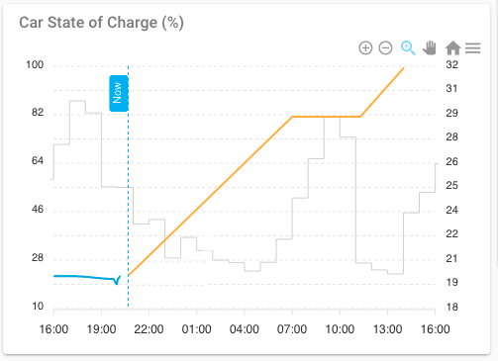
Car reservation → 100% SoC
Autom.
Autom.
Notes:
Liever live demo!!
We kijken nog naar een alternatief waarbij in de agenda’s (vd familieleden) zelf gekeken wordt en dan de code “EV-res” oid icm reistijd een min. Soc bereken. Dit heeft privacy consequenties, daarom nu (nog) niet voor gekozen.
Delay about 15 minutes..
Unreachable goals:
- Planned too late
- Connected too late
=> best effort
20

Slide 16
State
Installation effort could be lower Needs technical skills
If it works, it works (monitoring can be improved)
Users are happy, now 5 installations
Earnings up to > € 10 per day
EV energy costs € 0,06 per km With 20.000 km/year
For 95% of EV drivers the EV is their main car, 40% do not own an IEC (anymore).
Despite many options for car sharing, it seldom is a reason not to (also) own a car.
Notes:
Based on whole year of usage/epex prices
Afhankelijk van:
Batterij grote
% thuis/available
Min/max soc
Dit gaat waarschijnlijk toenemen
20

Slide 17
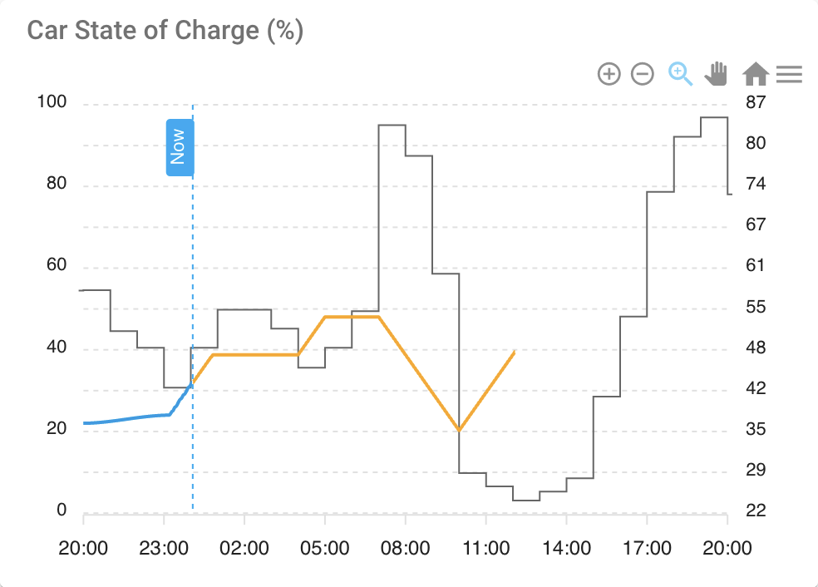
Business case
20000 km driven in 10 months (used for work and vacation), ~ €0,06/km
 | Energy |  | Costs
charge | 8.921 | kWh | € 2.640,45
discharge | 5.607 | kWh | € -2.448,80
netto | 3.314 | kWh | € 191,65
Compare this to no smart operation at fixed costs (€ 640)
or dynamic tariff (€ 1440). Recall that spreads are increasing.
Note: Investment for V2G Charger = x 4 normal charger.
Krakenimages, unsplash
Notes:
ARD
Maximum revenues
Still improving
Wallbox is cheaper already
We try to build a community
20

Slide 18
V2G Liberty roadmap
Easier installation
Update process automatable (via HA)
UI upgrades, KPIs
Learn from users
Support other chargers, cars, standards (CCS 2? OCPP?)
FlexMeasures roadmap
Optimize heat & e-mobility together
“Super-accounts” who manage sub-accounts
Optimizing towards network congestion support
Notes:
1. V2G Liberty app for Home Assistant / Docker
20

Slide 19
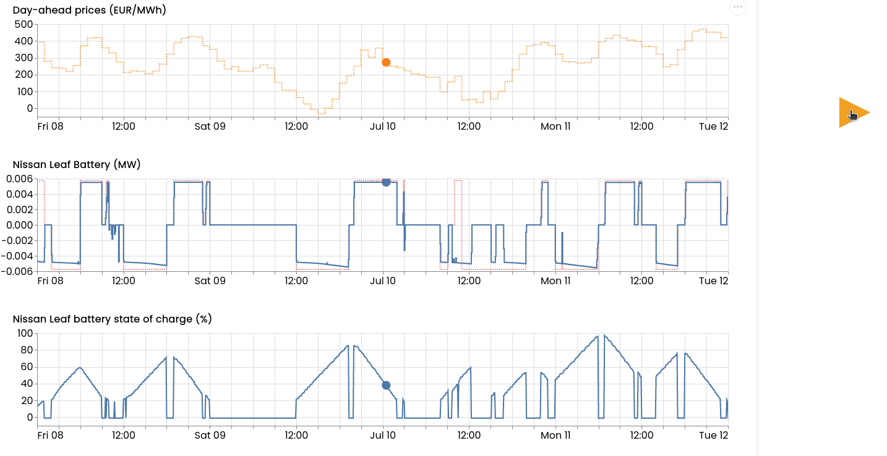

Slide 20
Questions?
Notes:
Intentie daarna door te gaan
Mogelijk samenwerking met Wallbox
Doen ons best op reactietijd max. 1 werkdag
Kunnen niet met contracten werken
Teamviewer
Je kunt ook later instappen en dat is er waarschijnlijk al meer geregeld.
Hoe staan jjullie tov zelf HA installeren (chat)??
<number>

