Slide 1
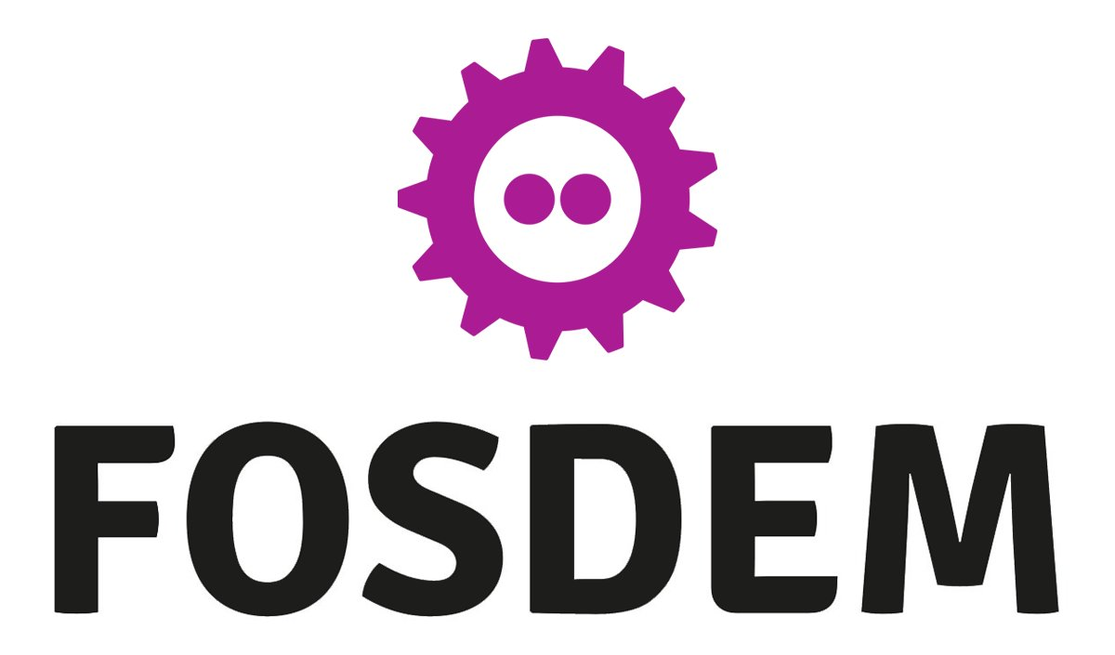
Why Public Database as a Service is Prime for Open Source Disruption
Peter Zaitsev,
CEO, Percona
February 2021

Slide 2
A Question
What DBaaS Has to do With “Distributions” ?

Slide 3
Distributions
Complex Systems, Multiple Components which Must work well together, providing a lot of value and convenience than setting up those components separately

Slide 4
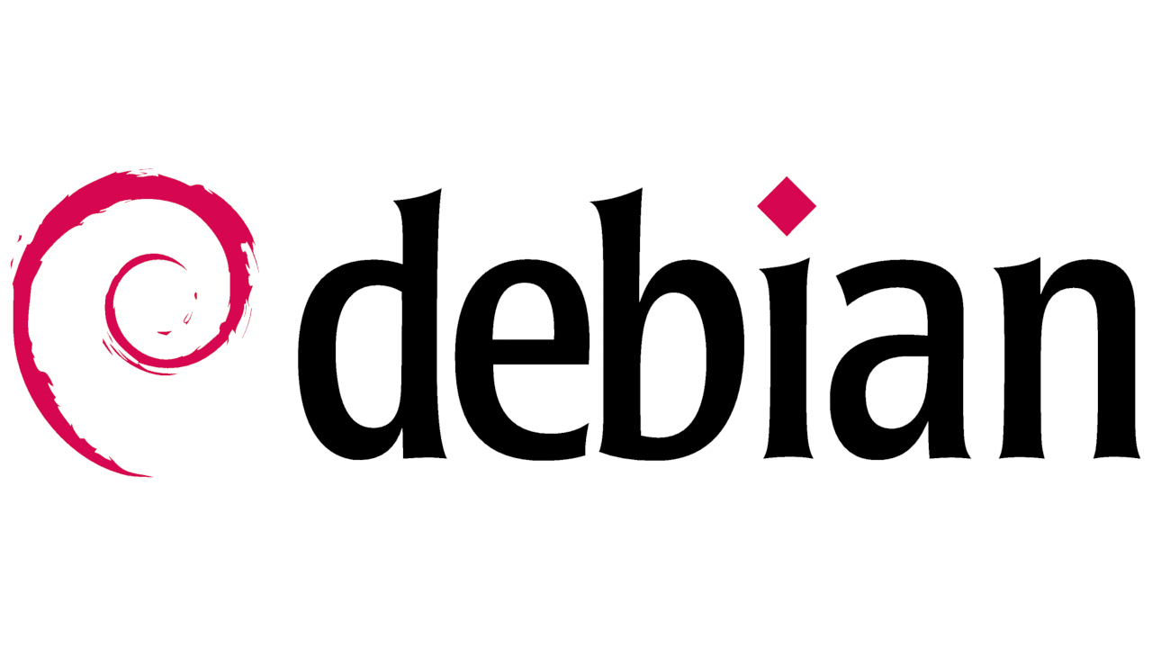
Distributions

Slide 5
Database Distributions – More than a Server
MySQL Enterprise
MariaDB Enterprise
Percona Distribution for MySQL
Percona Distribution for MongoDB
Percona Distribution for PostgreSQL

Slide 6
DBaaS
Taking “Designed to work Together” Distribution Concept
Making it available Modern way, through API

Slide 7
DBaaS has won
Unparallel convenience of using the database

Slide 8
Software Vendor Lock-in Sucks

Slide 9
Open Source to the Rescue

Slide 10
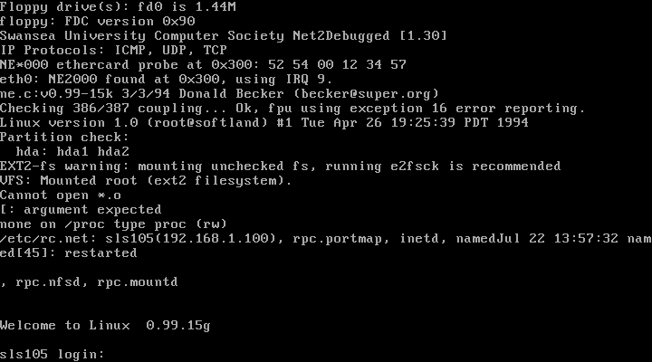
Early Days of Modern Open Source

Slide 11
Installation of Open Source Software
Download Sources, Patch and Compile
Tar.gz binaries and INSTALL
Packages with Dependencies - .deb .rpm
Package repositories APT and YUM
Docker, Snap etc

Slide 12
Never Ending Move towards Simplicty

Slide 13
DBaaS “state of art” simplicity for databases

Slide 14
Trend
Making it Easy
Reducing Barrier to Entry

Slide 15
Modern Open Source
Most Developers will not be able to build from scratch all tools they use

Slide 16
Not a bad Thing…
Allows us to use more complicated, more valuable software
More people can be Open Source Developers

Slide 17
The Dark Side

Slide 18
Next Simplification comes with Vendor Lock-In in the Cloud

Slide 19
The Cloud

Slide 20
Cloud Reality
Cloud Vendors, who compared clouds to Commodity Electricity
Want to Lock you in by advising most proprietary solutions of their platform

Slide 21
Choose your Cloud
You Have the Power to choose the way of Serfdom or way of Freedom

Slide 22
Current State
Easiest/fastest way to deploy Open Source (and Compatible) Software is to do it in the cloud, using Proprietary API

Slide 23
Choices for Database Deployment in the Cloud
Roll your own using commodity building blocks (Compute, Storage ETC)
Use Database as a Service (DBaaS) functionality

Slide 24
DBaaS Removes a lot of “Toil”
Managing High Availability
Database Patching
Backups
(Some) Performance Tuning
Easy to Scale

Slide 25
Power to Developers
You do not DBAs Help or Permission to Deploy the Database
You can Chose the Database you believe is best fit for problem at hands
And rely on Cloud Vendor to Keep it up and Running

Slide 26
Do not worry, DBaaS is Open Source Compatible
Limited, “Hotel California” Compatibility

Slide 27
DBaaS
Fully Managed DBaaS tends to be Overmarketed
Notes:
Illustration for something like “overpromise and underdeliver”

Slide 28
DBaaS
Developers chose and Use Databases directly without “supervision” of database professionals
Notes:
Image of might be kids doing something naughty when they lack supervision

Slide 29
Some relevant Stats
45% of Companies running at least some DBaaS (up from 40% in 2019)
22% Find Cloud Hosting to be more expensive than they thought
74% Of Respondents named Performance Issues their Most Significant Problem
https://www.percona.com/survey

Slide 30
DBaaS Premium is growing
$1314/year Software Premium for smallish instance (4 vCPU and 16GB Memory)
https://medium.com/@rbranson/rds-pricing-has-more-than-doubled-ef8c3b7e5218

Slide 31
DBaaS Vendor Lock-In
It may not be so painful now, but it is going to be painful in the future

Slide 32
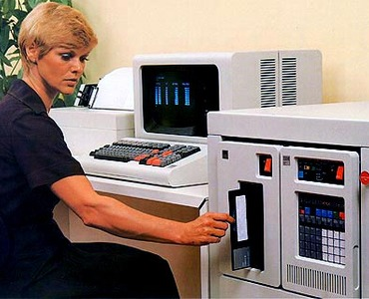
History Lesson
Oracle used to Save its customer from IBM Hardware Lock-in with Mainframe computers

Slide 33
Could We…
Get Public Cloud DBaaS Like Simplicity
But as Open Source Solution

Slide 34
Bad News
We’re Not there yet

Slide 35
Good News

Slide 36
Kubernetes
“Operating System” but for Cluster, rather individual hosts
Has a lot of Momentum
Universally Supported in Public, Private, Hybrid Cloud

Slide 37
What Percona is doing about it ?

Slide 38
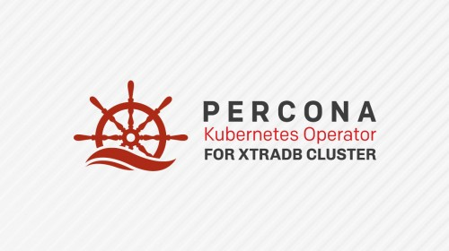
Percona Software for Modern World

Slide 39
Kubernetes Operators are not enough!

Slide 40
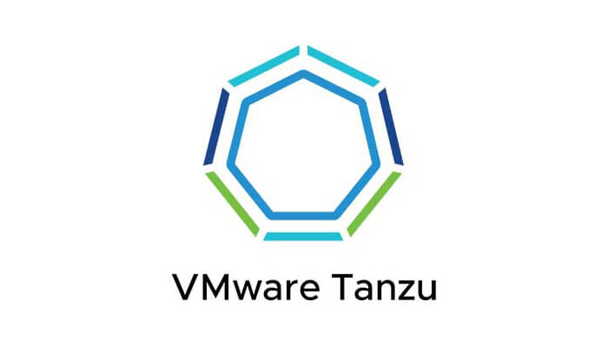
Our Vision
Provide AWS RDS-Like DBaaS Experience in Public and Private with Open Source Software and No Vendor Lock-in

Slide 41
Percona DBaaS CLI
Experimental Solution for those who wants to Get Open Source DBaaS without deep Kubernetes Understanding
https://www.percona.com/doc/dbaas-cli/index.html

Slide 42
DBaaS Preview in PMM
https://www.percona.com/blog/2021/01/12/the-preview-of-database-as-a-service-dbaas-in-percona-monitoring-and-management-is-now-live/

Slide 43
DBaaS has won
Unparallel convenience of using the database

Slide 44
Software Vendor Lock-in Sucks

Slide 45
Open Source to the Rescue

Slide 46
Thank you, Let’s Connect!
https://www.linkedin.com/in/peterzaitsev/
https://twitter.com/PeterZaitsev

