Slide 1
An opensource SPDM implementation for secure device communication
Jiewen Yao, Principal Engineer, Intel
Xiaoyu Ruan, Principal Engineer, Intel

Slide 2
Jiewen Yao
Jiewen Yao is a principal engineer in the Intel Architecture, Graphics, and Software Group. He has been engaged as a firmware developer for over 15 years. He is a member of the UEFI Security sub team, and the TCG PC Client sub working group.
He is the creator of the open source SPDMcode project.

Slide 3
Xiauyu Ruan
Xiaoyu Ruan is a principal engineer in the Security Architecture and Engineering group at Intel. He has 17 years of experience in cryptography and security architecture and implementation on embedded systems.
He is a co-author of DMTF SPDM specifications.

Slide 4
Part I - SPDM

Slide 5
SPDM
DSP0274 Secure Protocol and Data Model Specification
Part of Distributed Management Task Force (DMTF) Platform Management Components Intercommunication (PMCI)
SPDM1.0 (Dec 2019) – Device authentication and measurement
SPDM1.1 (July 2020) – Device session key establishment and secure communication (session)
SPDM1.2 (WIP, ETA Q2 2021) – See later slide for candidate features
Adoption: DMTF, PCI/CXL, MIPI, USB, TCG, …

Slide 6
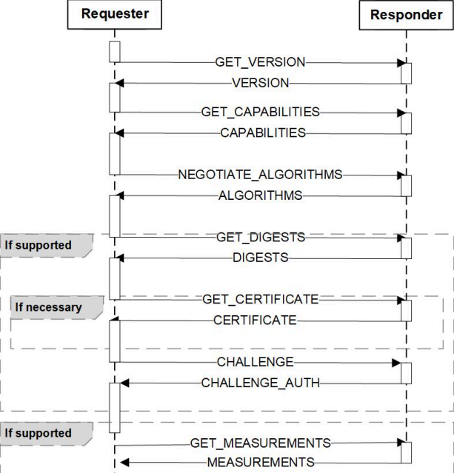
SPDM 1.0
Device Identification
Device Authentication
Device Measurement Collection / Attestation
* source: SPDM 1.0 specification

Slide 7
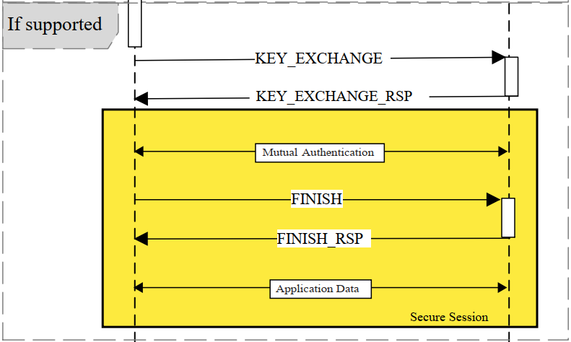
SPDM 1.1
Diffie-Hellman (DH) based Key Exchange +
(Mutual) Authentication
or
Pre-Shared Key (PSK) based Key Exchange
* source: SPDM 1.1 specification

Slide 8
SPDM 1.2 Candidate Features
Feature | Description
Set Certificate | A set of commands to manage certificate chains in slots 1-7. Could include CSR export and slot policies.
Eventing | Mechanism to send asynchronous events, related to SPDM, to a registered listener.
Multi-tier Authentication | A set of commands to authenticate devices behind non-transparent bridges. Under discussion, does the PA-RoT or intermediate device perform the authentication?
Smaller Certificates | Address the size issue with the current certificate / cert chain.
Measurement Manifests | Define a mechanism to produce a manifest of expected measurements for a given device, and modifications to the MEASUREMENTS command to report measurements in a way that is compatible with the reference manifest.
TCG DICE Support | Support the use of TCG DICE throughout SPDM, including in signature generation, Set Certificate, and events.
Reprovisioning | Mechanism to cause a device to generate a new set of Device Keys and invalidate all elements that depend on the existing Device Keys.
* source: OCP tech week 2020

Slide 9
Transport Layer Binding
SPDM Message
DMTF
SPDM over MCTP
PCI
Data Object Exchange (DOE)
USB
Control Transfer
DMTF
MCTP over SMBus
SMBus Device
PCI Device
USB Device

Slide 10
TCG SPDM support
Described in TCG PC Client Platform Firmware Profile Specification (Draft public review)
Device measurement (hardware/firmware) –> TPM
PCR2 (EV_EFI_SPDM_FIRMWARE_BLOB)
Device measurement (hardware/firmware configuration) -> TPM
PCR3 (EV_EFI_SPDM_FIRMWARE_CONFIG)

Slide 11
Part II - SPDMcode

Slide 12
SPDMcode
An open-source SPDM sample implementation (requester or responder).
It is BSD licence.
It is written in C language.
It includes a fake SPDM requester and responder in OS.
It can dump/trace the SPDM message flow.

Slide 13
SPDMcode design
SPDM Requester
Device
SPDM Responder
Device
Security Policy
Crypto Engine (Key, RNG, …)
Device RoT
Measurement
SpdmDevice SecreteLib
SpdmDevice SecreteLib
SPDMcode
SpdmRequesterLib
SpdmCommonLib
SpdmResponderLib
DSP0274 SPDM
SpdmSecured MessageLib
DSP0277 Secured Message
SpdmTransportXXXLib
DSP0275 SPDM Over MCTP
PCI DOE Message
SpdmDeviceIo
DSP0237 MCTP Over SMBus
PCI DOE mailbox
Crypto Engine
Crypto Engine

Slide 14
Feature
Implemented SPDM 1.0 and 1.1.
Support openssl/embedtls/3rdPartyCryptoLib as crypto engine
Support algos defined in SPDM. (SHA/SHA3, RSASSA/RSAPSS/ECDSA, FFDHE/ECDHE, AES-GCM/CHACHA20-POLY1305)
Programming Context :No heap, no global variable.
Execution Context: Link as OS Application, UEFI Driver, BMC module, etc.
Build in Windows (VS2019/Clang), Linux (GCC/Clang).

Slide 15
Additional work for SPDMcode consumer
Link a crypto library (maybe hardware accelerator)
Protect the private key
Provision the public certificate
Support random number seed and random number generator
Put SPDMcode in a protected execution environment
to prevent local attack or side channel attack, etc.
Provide transport layer send/receive function.
Implement proxy to handle device measurement
e.g. extend to TPM PCR or attestation
Support the different use case for SPDM secure session
e.g. PCI express key programming, link encryption setup.

Slide 16
Size
VS2019 (DLL) | Requester (K) | Responder (K)
Raw library, no crypto (X64) | 26 | 29
With mbedtls (X64) | 138 | 141
Raw library, no crypto (IA32) | 20 | 21
With mbedtls (IA32) | 110 | 111

Slide 17
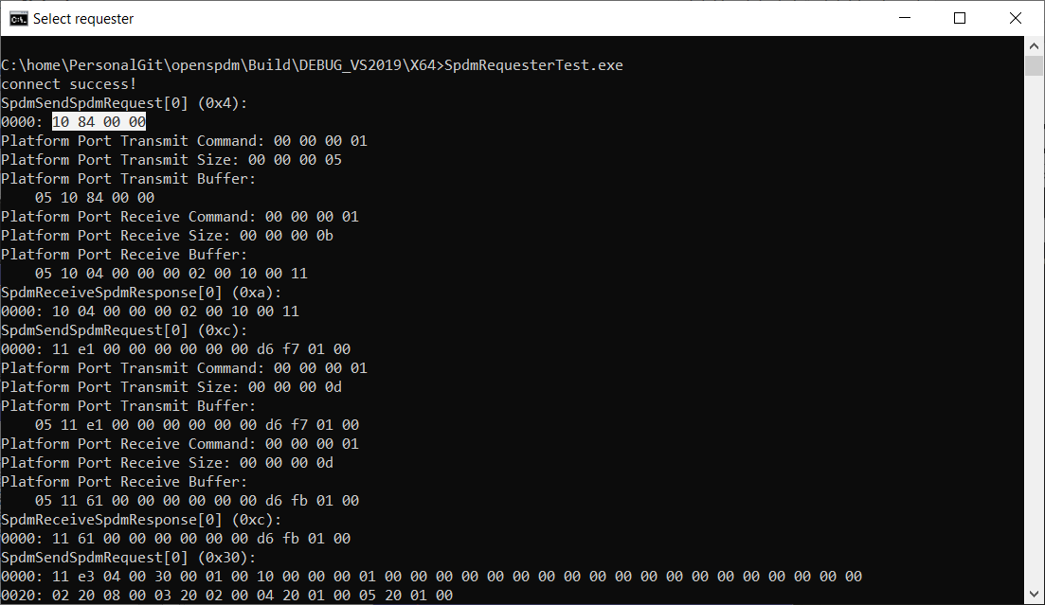
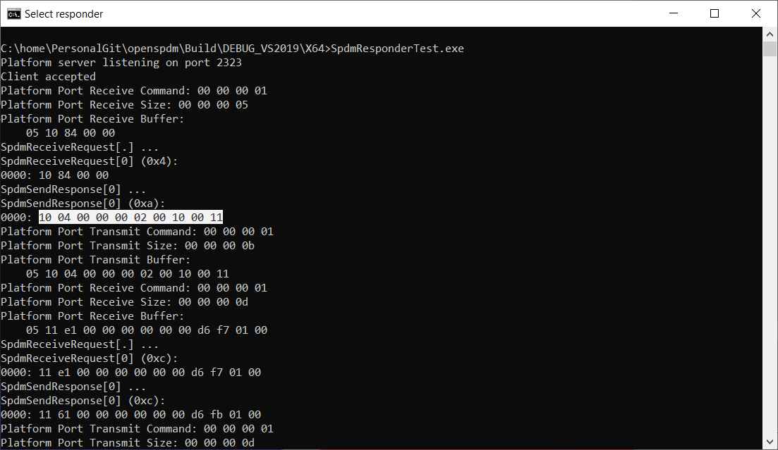
Demo (init connection)

Slide 18
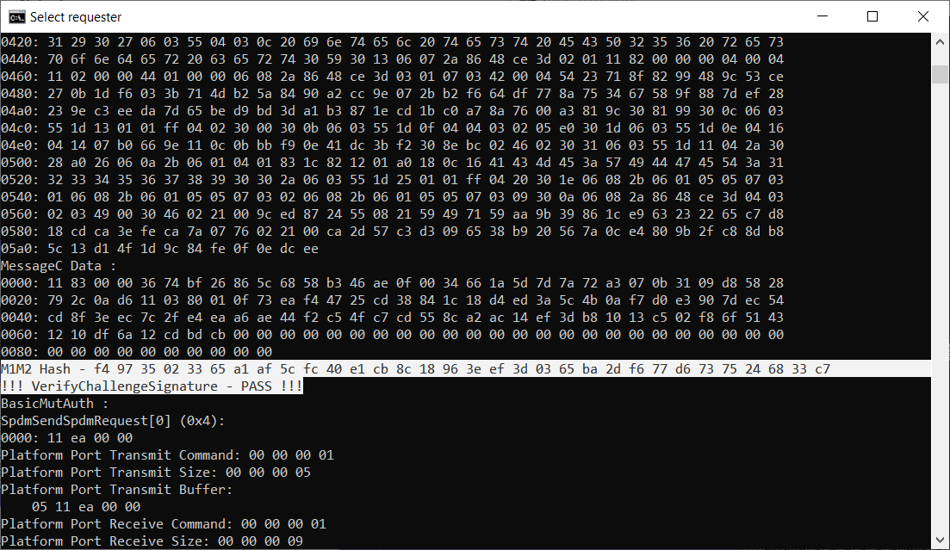
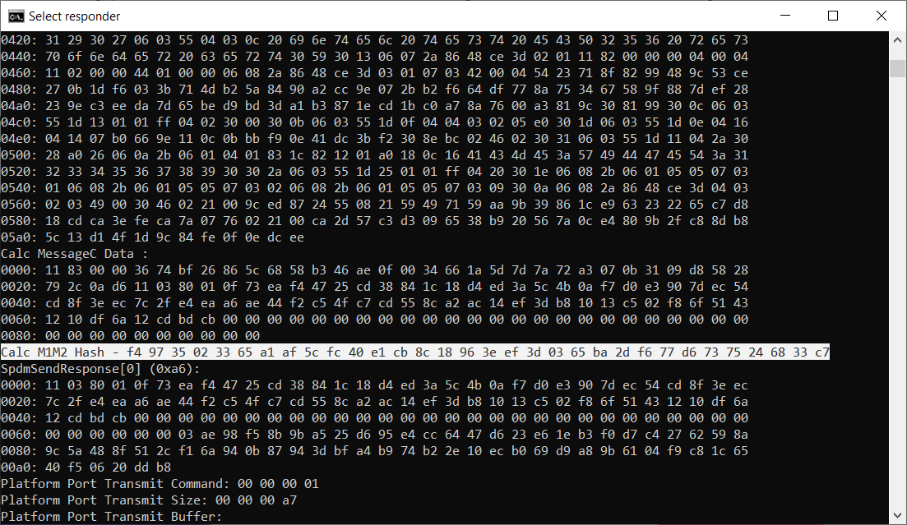
Demo (challeng/auth)

Slide 19
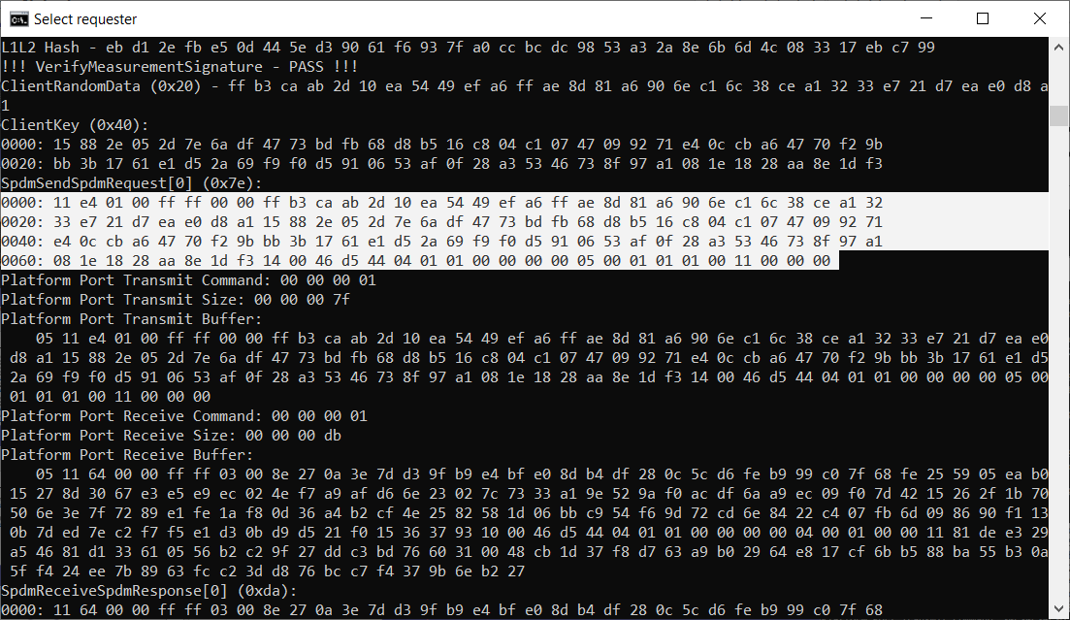
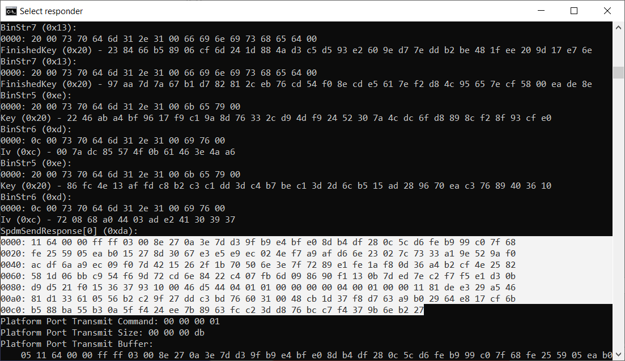
Demo (session creation)

Slide 20
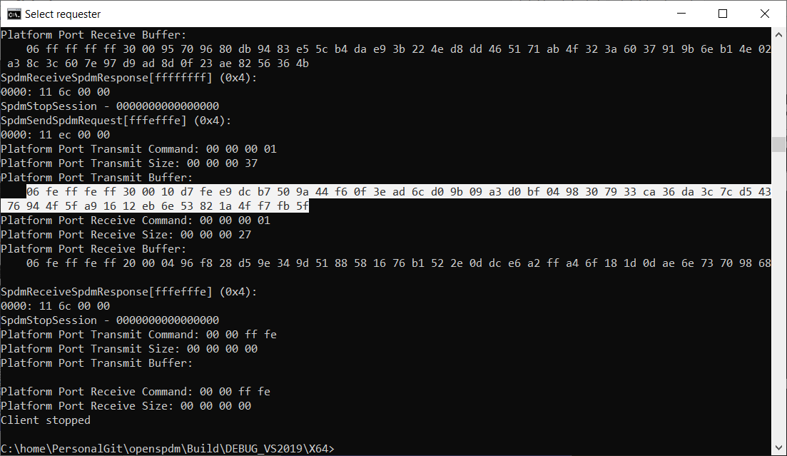
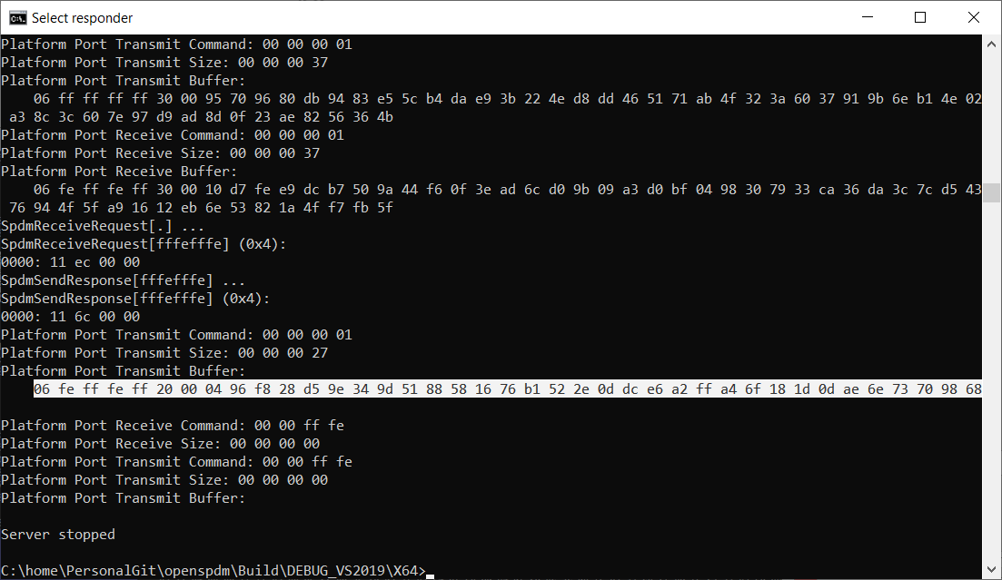
Demo (secured message)

Slide 21
SpdmDump tool
Similar to ssldump.
Assuming there is PCAP file available for all SPDM transation
Sample provided by SPDM responder emu or SPDM requester emu.
Parse PCAP file and dump all SPDM transation in OS.
Support different mode (default, quite, all)
Support different transport layer
MCTP or PCI_DOE
Support known SPDM vendor defined message dump.
IDE_KM
Support secured message dump
Need user input --psk or --dhe_secret.

Slide 22
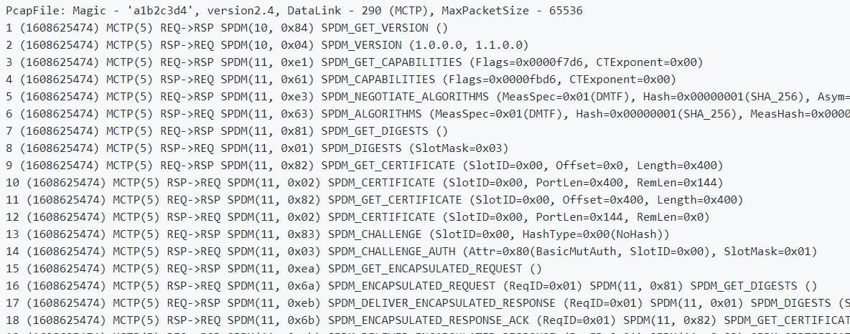
SpdmDump – SPDM over MCTP

Slide 23
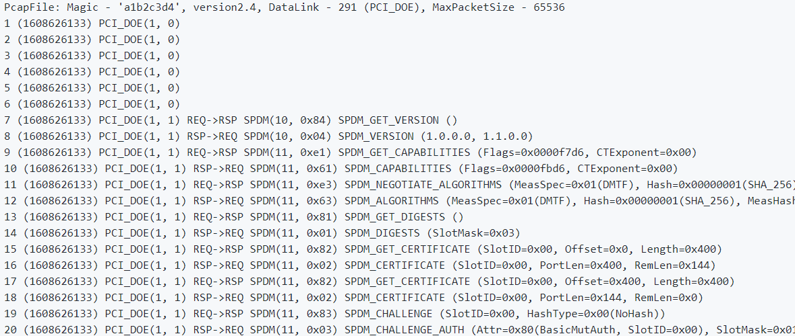
SpdmDump – SPDM over PCI_DOE

Slide 24
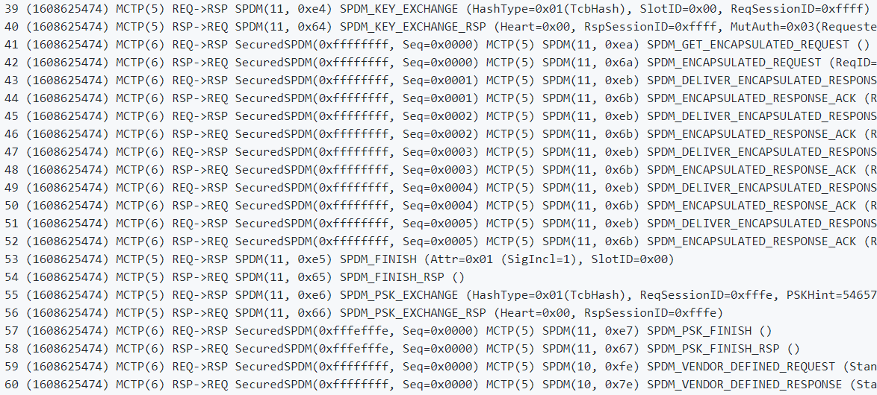
SpdmDump – Secured SPDM

Slide 25
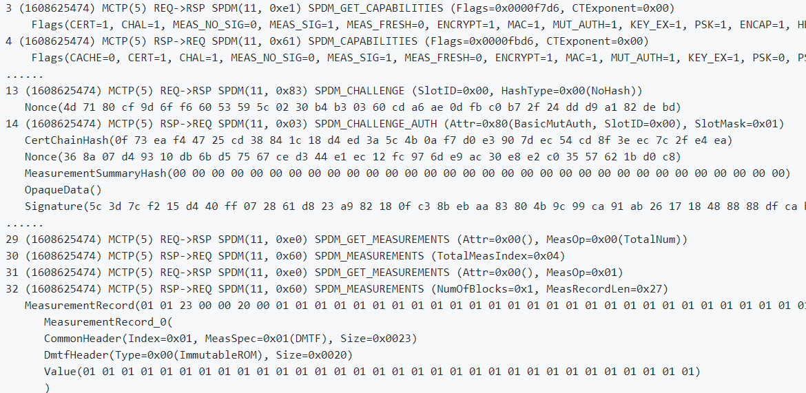
SpdmDump – dump all mode

Slide 26
Summary
SPDM specification
It is well adopted in multiple standard orgnizations.
SPDM can be used to authenticate device and collect measurement.
SPDM session can be used for secure communication between devices.
SPDMcode
It is an open source SPDM sample implementation.
It is BSD license and written in C.
It helps you learn SPDM and create SPDM capable devices.
SpdmDump tool can help you analyse SPDM transaction.

Slide 27
Reference
SPDM Specification
DSP0274 - Security Protocol and Data Model (SPDM) Specification
DSP0275 - Security Protocol & Data Model (SPDM) over MCTP Binding Specification
DSP0276 - Secured MCTP Messages over MCTP Binding Specification
DSP0277 - Secured Messages using SPDM Specification
DSP2058 - Security Protocol and Data Model (SPDM) Architecture White Paper
https://www.dmtf.org/standards/pmci
TCG SPDM Support
TCG PC Client Platform Firmware Profile Specification (Draft for review)
https://trustedcomputinggroup.org/wp-content/uploads/TCG_PCClient_PFP_r1p05_v22_02dec2020.pdf
PCI Support
ECR PCI Component Measurement and Authentication (CMA)
ECR PCI Data Object Exchange (DOE)
ECR PCI Integrity and Data Encryption (IDE)
https://pcisig.com/specifications/review-zone
USB Support
USB Authentication Specification
https://www.usb.org/document-library/usb-authentication-specification-rev-10-ecn-and-errata-through-january-7-2019

Slide 28
Reference
SPDMcode pre-production code / document
https://github.com/jyao1/openspdm
SpdmDump tool: https://github.com/jyao1/openspdm/tree/master/Tool/SpdmDump
EDKII pre-production code for device security
https://github.com/jyao1/edk2/tree/DeviceSecurity

Slide 29
Question

