Slide 1


ERASER: Early-Stage Reliability and Security Estimation for RISC-V processors
Karthik Swaminathan, Ramon Bertran, Schuyler Eldridge, Hans Jacobson, Alper Buyuktosunoglu, Pradip Bose
IBM T. J. Watson Research Center
Yorktown Heights, NY 10598
This research was developed in part with funding from the Defense Advanced Research Projects Agency (DARPA). The views, opinions and/or findings expressed are those of the author and should not be interpreted as representing the official views or policies of the Department of Defense or the U.S. Government. Approved for Public Release, Distribution Unlimited

Slide 2
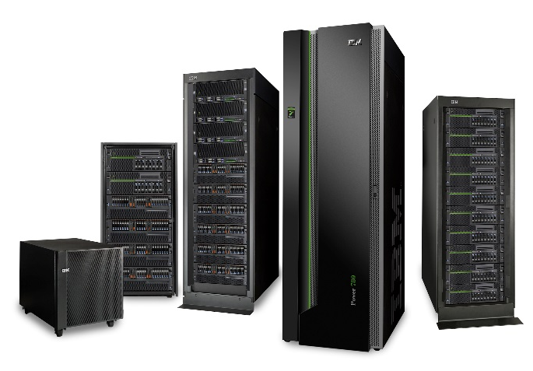

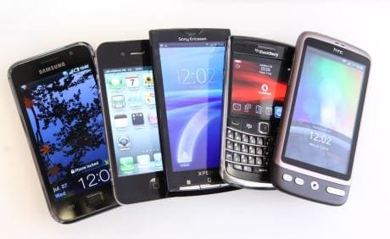
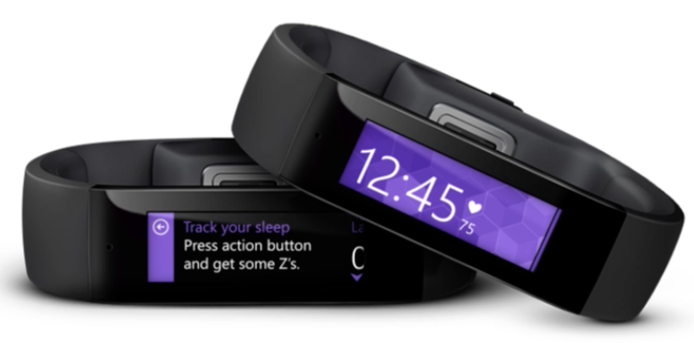



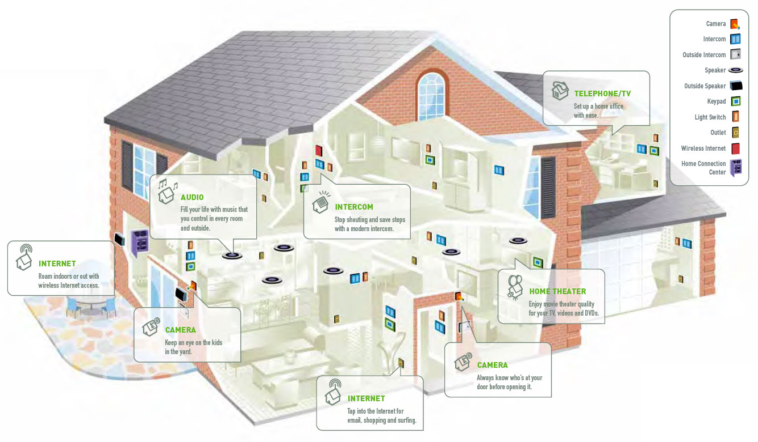
Resilience is functionality!
Reliability-aware design and operation
Harsh
environments
Computing
Servers, HPC, Mainframes,
Hyperscale systems
UAVs and drones
Healthcare
Communications
Resource
management
Automation
Safety
Tracking devices
Mobile phones
Robotics
Smart cities
Smart houses
Connected Cars
Notes:
It is imperative for modern day computing systems to account for reliability across the spectrum of application domains. Servers, mainframes and hyperscale systems, the chief source of revenue for IBM have to maintain high degree of error tolerance and reliable operation, the absence of which can lead to significant drop in efficiency, consequently resulting in loss of revenue and profit.
Emerging applications too require reliable operation under different conditions and harsh outdoor environments in several cases. When UAVs and drones used for surveillance, recon and other military missions fail, they can pose a significant security risk. Safety is of paramount importance in connected cars for instance, and faulty operation can severely compromise this.
What reliability offer on each domain?
Add mainframe to the upper left one
Reliability means functionality
Technology
IoT etc. Cognitive
Servers in the backend for Connected cars/UAVs and drones
+ more examples to add

Slide 3

Introduction
Sources of error in processors
X
X
IBM POWER9TM
Processors need varying degrees of protection, particularly against radiation-induced soft errors
Targeted errors, from malicious entities may also be a source of concern (eg. Rowhammer attacks)
Early Stage vulnerability modeling needed to implement appropriate mitigation features
ERASER: An open source framework for Reliability and security evaluation of RISC-V processors
asic.ethz.ch
fuse.wikichip.org
pymnts.com
Notes:
Processor design, as you may be aware, comes with a host of tradeoffs. Designers are constantly seeking tighter margins in a bid to improve performance and efficiency, with features such as increased max temperature, voltage scaling etc. However, this may result in serious reliability issues, which would necessitate design adjustments in terms of redundancy, parity, ECC etc, which in turn would force us against the power wall once again.
Start with power wall. Note importance for embedded and server class processors. Need for incorporating RAS features during the design stage before availability of Silicon.

Slide 4

The Big Picture
DSSoC’s Full-Stack Integration
Security and reliability- aware design

Slide 5
Key definitions and acronyms
Sr. | Term | Definition
1 | SER | Soft Error Rate – Indicates vulnerability of the processor to bit flips induced by cosmic radiation
2 | RAS | Reliability, Availability, Serviceability – Describes the resilience and functional robustness of processor
3 | ISA | Instruction Set Architecture
4 | CPI | Cycles Per Instruction – Standard performance metric for a processor
5 | Residency | Average period for which a latch’s state remains unchanged and is calculated as Total execution cycles/Number of data switches for the latch
6 | FIT | Failures in time, i.e failures in 1 billion hours of operation – A standard metric for processor vulnerability
7 | FIRRTL | Flexible Internal Representation for RTL – Intermediate representation for digital circuit, enabling circuit-level transformations

Slide 6
Early-stage RAS modeling – An overview
Various stages of processor design
Designer feedback
L0: Analytical evaluation
L1: Cycle-accurate simulation
L2: RTL-level simulation
L3: FPGA-based emulation
Processor fabrication
Too early - insufficient information on physical design!!
Too late in the design cycle to affect any changes!!!
Early-stage SER modeling
Providing in-flight feedback to design teams as the RTL evolves so that post-silicon surprises (e.g. power overrun or resilience shortfall) are minimized
Such developments in early-stage design are still at a nascent stage in the RISC-V ecosystem
ERASER evaluates “RAS-readiness”, or the effectiveness of protection techniques to minimize processor FITs and resist targeted errors
ERASER provides a comprehensive framework for vulnerability estimation and validation even at a pre-silicon stage of design for RISC-V processors!
Notes:
Important to carry out SER modeling as the RTL evolves so that RAS features can be incorporated into the design.

Slide 7
Components used in ERASER methodology
Microprobe – Bertran et. al, MICRO 2012, Eldridge et al. CARRV 2017
A code generation framework that enables advanced microbenchmark generation methodologies
Key features include
  Automated (micro-)architecture-aware test generation
  Pre-silicon and post-silicon tests for power, resilience, performance and functional validation
  New research innovation with proven impact on IBM POWER & Z Systems
Generic RISC-V port of Microprobe open sourced (available via GIT & PIP packages)
SERMiner – Swaminathan et al. DSN 2019
A tool for automated generation of stress marks that maximize the likelihood of a transient-failure induced error
It parses the switching files output from RTL simulation of the core model and generates latch-level data switching statistics.
Chiffre – Eldridge et al. CARRV 2018
Statistical and/or targeted fault injection into latches within a RISC-V core
FIRRTL passes that instrument specified circuit components with run-time configurable fault injectors

Slide 8
ERASER tool flow

Slide 9
Features of ERASER
Supports analysis of all latches in the design by means of RTL simulations of a single RISC-V core (eg. Rocket)
Switching/residency analysis aggregated across each RTL module (or macro)
Generation of stressmarks, or testcases used to evaluate worst-case vulnerability of these latches
Validation platform comprising of targeted/statistical fault injection into selected latches
Methodology demonstrated on Rocket core, but can be easily extended to other RISC-V cores

Slide 10
Methodology for generation of SER Stressmarks
Instructions
Instructions
…
…
…
I₁
I₂
…
I_{n}
I₁
I_{k’}
I_{k’’}
I_{n}
M₁
R₁₁
S₁₂
R_{1n}
M₁
R₁₁
R₁₂
0
0
R_{1n}
M₂
R₂₁
0
R_{2n}
M₂
R₂₁
0
R_{2k’}
R_{2k’’}
0
Macros
Macros
…
…
... I_{k’}
… I_{k’’}
I_{k}
0
0
0
0
0
M_{m}
0
R_{k2}
0
0
M_{m}
0
0
0
R_{mk’’}
R_{mn}
Macro switching dictionary
Sort in dec. order of switching until all macros are covered
Instruction sequence: used to generate stressmark
The SER stressmark should maximize utilization and/or residency across maximum number of macros (M) in the core
  SER vulnerability can be expressed in terms of macro coverage (M), residency of the instruction sequence (R) and instruction CPI
  Residencies of macros below a percentage 𝞺 of the maximum macro residency are set to 0. 𝞺 is a user-defined parameter between 0 and 1
  Joint SER metric (J_{s}) = M^{α}.R^{β}.CPI^{γ} (α,β,γ are empirically determined based on micro-architectural parameters. Here we consider α=β=γ=1)
Notes:
Switching activity per inst is sum of switching activity across all macros
Define switching activity as the average of the per instruction switching activity across all instructions in the sequence

Slide 11
Sample results
Evaluated workloads
  Insts: Single instruction type testcases across entire ISA: Used as baseline workload in our evaluation
  Stressmark: Seeks to maximize soft error rate by maximize residency and/or utilization
Generated stressmark shows higher residency and coverage than all single instruction test-cases!

Slide 12
Discussion and future work
Adoption across multiple computing platforms and ISAs
  Current methodology has been demonstrated on RISC-V and POWER-based* platforms
  Would enable analysis across embedded/mobile SoC domains with custom accelerator IPs
ERASER currently supports analysis of latches
  Future work will extend analysis to logic, on-chip memories
Further sources of vulnerability in addition to SER
  Processors are vulnerable to supply voltage noise, thermal and aging-induced failures, and other hard or permanent errors
Further architecture enhancements
  Exploration of architecture parameters in addition to dependency distance, eg. Cache/memory misses, buffer occupancy rates, speculative behavior etc
  Evaluation of units outside the core (interconnects, memory controller etc)
Application-level considerations
  Application derating can be obtained through fault injection techniques as well
  Development of an infrastructure for large scale fault injection simulation experiments

Slide 13
Summary
Early stage modeling of vulnerability an essential part of the processor design cycle both for reliability and security considerations
We propose a methodology, ERASER, for characterizing processor vulnerability at the latch-level
ERASER generates and evaluates stressmarks that maximize latch residency to determine the most vulnerable latches
ERASER also comprises of a fault-injection based validation toolchain to validate the vulnerability of these latches to bit flip errors

Slide 14
Important links
ERASER: https://github.com/IBM/eraser
Microprobe: https://github.com/IBM/microprobe
Chiffre: https://github.com/IBM/chiffre
Rocket-chip: https://github.com/chipsalliance/rocket-chip
DEMO TO FOLLOW!!

Slide 15
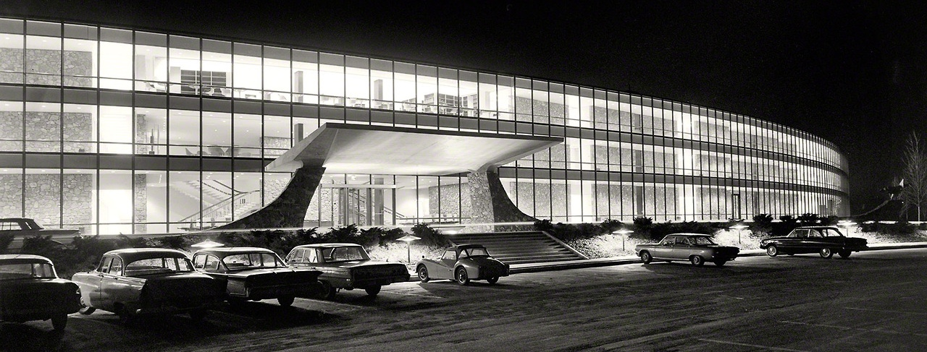
Thank You!
IBM T. J. Watson Research Center
IBM T. J. Watson Research Center
Photo by Balthazar Korab
Source: http://www.shorpy.com/node/15488

Slide 16
BACKUPS

Slide 17
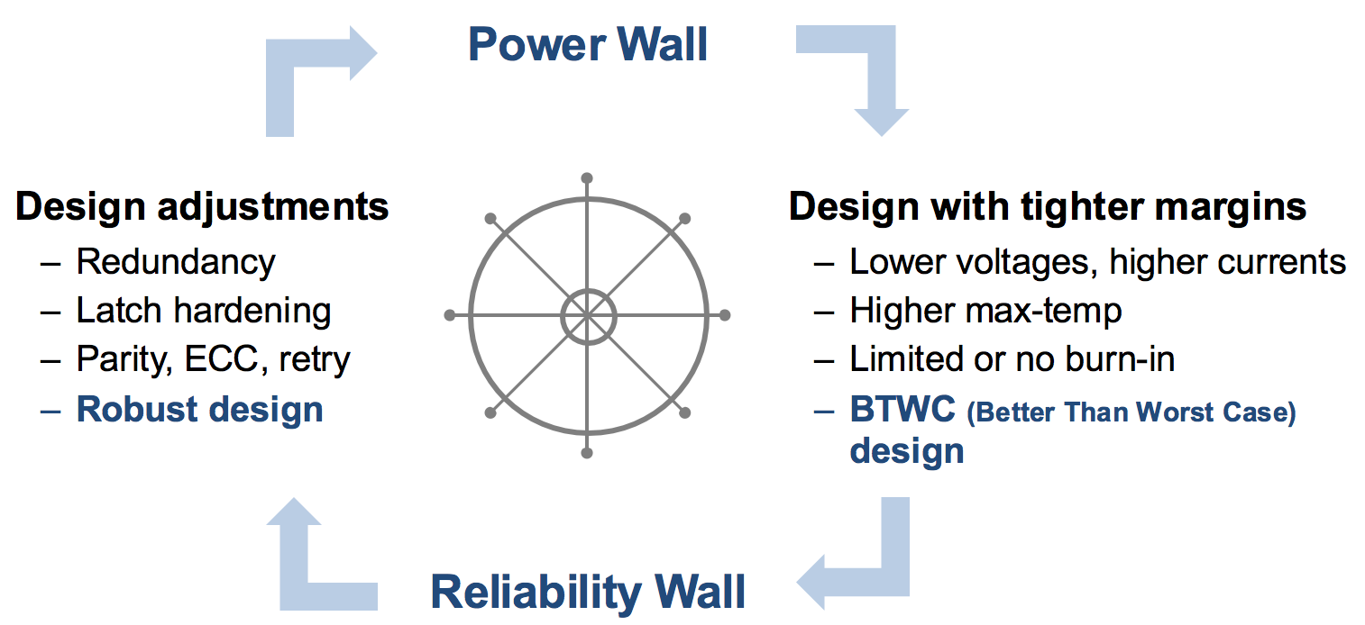
Introduction
Power-reliability tradeoffs in processor design
IBM POWER9TM
asic.ethz.ch
Processors of all classes need varying degrees of protection, particularly against radiation-induced soft errors (SER)
Targeted errors, from malicious entities may also be a source of concern (eg. Rowhammer attacks)
Need for determining processor vulnerability at Early Stage of design in order to implement appropriate mitigation features
ERASER: An open source framework for Reliability and security evaluation of RISC-V processors
fuse.wikichip.org
pymnts.com
Notes:
Processor design, as you may be aware, comes with a host of tradeoffs. Designers are constantly seeking tighter margins in a bid to improve performance and efficiency, with features such as increased max temperature, voltage scaling etc. However, this may result in serious reliability issues, which would necessitate design adjustments in terms of redundancy, parity, ECC etc, which in turn would force us against the power wall once again.
Start with power wall. Note importance for embedded and server class processors. Need for incorporating RAS features during the design stage before availability of Silicon.

Slide 18
RAS Methodology– Key definitions
Input: Single instruction test-cases covering entire ISA
Latch activity metrics:
  Instruction frequency: Number of instructions for which the target latch has non-zero activity.
  Latchbank activity: Average switching activity per target latch bank
  Latchbit activity: Average switching activity per target latch bit
Outputs: List of ‘vulnerable’ latches
  List of latches with high switching activity
  List of Set-once-and-forget (SOF) latches incl. configuration and reset latches set before start of run
  High Residency latches – Non configuration latches that hold state for long time
Latch characteristics aggregated across:
  Microarchitecture units
  Sub-unit Macros
Latch switching activity (example)
Latch /Inst | L1(0:3) | L2 | L3(0:5)
I1 | 0 | 3 | 9
I2 | 5 | 2 | 0
I3 | 0 | 7 | 0
Inst. freq. | 1 | 3 | 2
Latchbank activity | 1.67 | 4 | 3
Latchbit activity | 0.42 | 4 | 0.5

Slide 19
Introduction
IBM POWER9TM
Processors of all classes need varying degrees of protection, particularly against radiation-induced soft errors (SER)
Targeted errors, from malicious entities may also be a source of concern
Need for a methodology to determine processor vulnerability at Early Stage of design in order to implement appropriate Reliability, Availability, Serviceability (RAS) features
Sources: 1. asic.ethz.ch, 2. fuse.wikichip.org 3. pymnts.com
Notes:
Start with power wall. Note importance for embedded and server class processors. Need for incorporating RAS features during the design stage before availability of Silicon.

Slide 20
Types of workloads/stimuli for RAS/security modeling
Complete workloads (eg. SPEC 2017)
  Very large workload size (10s of billions)
  May not cover corner cases necessary to determine degree of protection
Single instruction testcases across entire ISA*
  Used as baseline workload in our evaluation
Stressmarks to maximize soft error rate
  Seeks to maximize residency and/or utilization
  Instrumental in dictating RAS strategy for processor
Our current focus is on comparisons between single instruction testcases and generated stressmarks
*R. Bertran, Systematic Energy Characterization of CMP/SMT Processor Systems via Automated Micro-Benchmarks, MICRO 2012

Slide 21
At what stage and granularity do we carry out SER modeling?
Designer feedback
L0: Analytical evaluation
L1: Cycle-accurate simulation
L2: RTL-level simulation
L3: FPGA-based emulation
Processor fabrication
Too early - insufficient information on physical design!!
Too late in the design cycle to affect any changes!!!
Early-stage SER modeling
Inst. Fetch Unit (IFU)
Inst. Scheduling Unit (ISU)
Vector/Functional Unit (VU)
Memory Unit (MU)
Pervasive Unit (PU)
Macros
(RTL modules)
Units
Processor Component Hierarchy
Distribution of macros across microarchitecture units
Notes:
How early should ‘early stage’ be?
Too many latches to effectively model SER at a single latch level.
We assume all latches in a single RTL module, or macro have a similar likelihood of a bit flip in the event of a radiation strike

