Slide 1
Profiling rust
Alexandru Ene

Slide 2
What to expect
Intro about myself
Intro about profilers
What is HawkTracer?
What is hawktracer_rust?
How it works?
LiveDemo (what can go wrong?)
Questions

Slide 3
About me

Slide 4
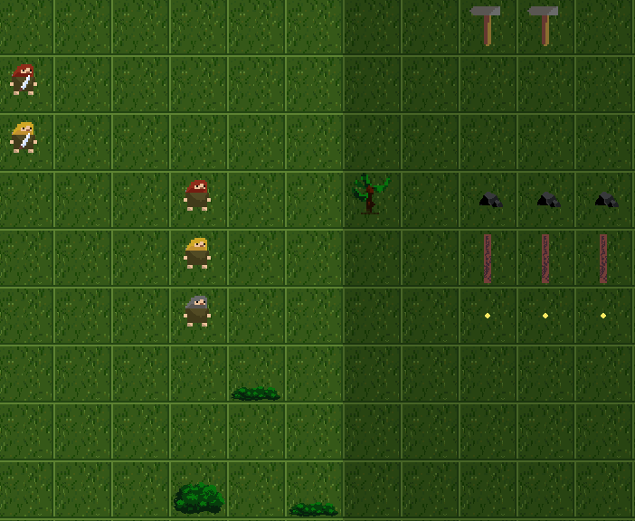

Slide 5
Profiler Types
Guessing profilers
Sampling profilers
Intrusive profilers

Slide 6
Sampling Profilers
Easy to use
I have tried CodeXL, VerySleepy (Windows)
Any similar linux tool will work (perf, etc.)
Kernel tracers like lttng or ETW

Slide 7
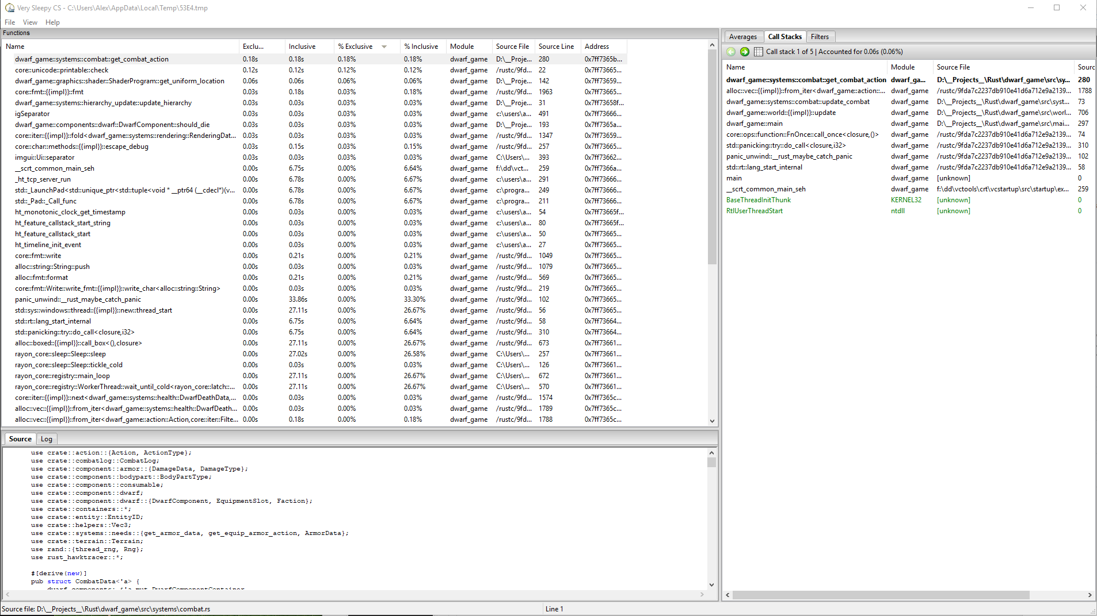
Sample output

Slide 8
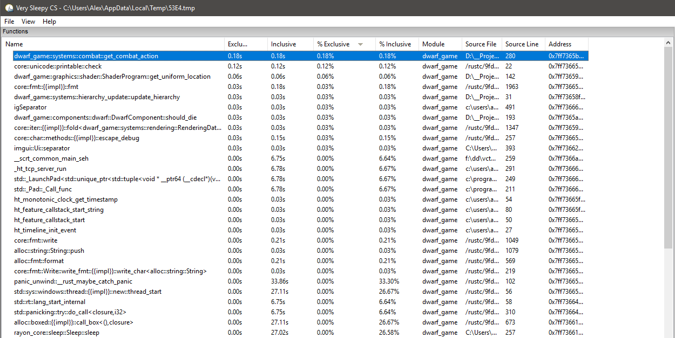

Slide 9
Intrusive profilers
Programmer defines what’s traced.
Accurate data. Nanoseconds not % of samples.
Useful to detect spikes of activity.

Slide 10
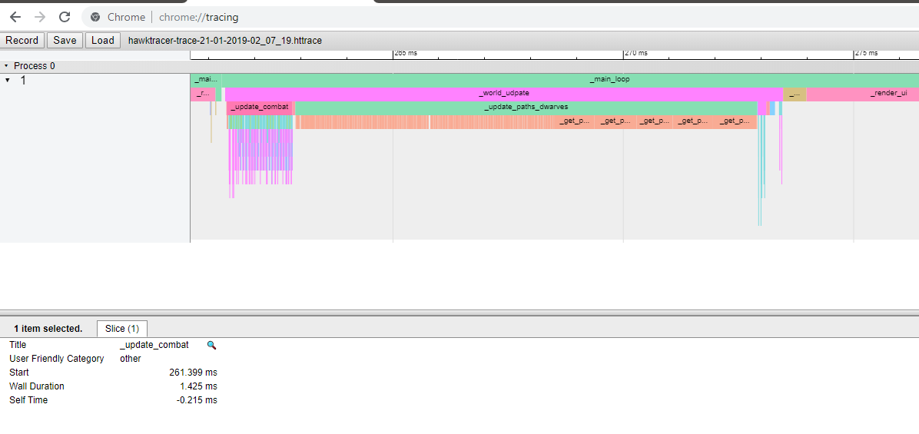

Slide 11
What is HawkTracer?
Intrusive profiler library made by Marcin Kolny.
It open-source - MIT licence https://github.com/amzn/hawktracer/
Targets low-end platforms (think single core < 1GHZ) so it has minimal overhead.
Can stream profiling data over network
Outputs available: chrome-tracing, callgrind, flamegraphs, more to come (hawktracer-converter)

Slide 12
What is HawkTracer?
Profiling Low-End Platforms using HawkTracer Profiler Marcin Kolny
Track: Free Tools and Editors devroom
Room: UD2.119
Day: Sunday 16:30 - 17:00

Slide 13
rust_hawktracer
Rust API for the HawkTracer profiler.
It has the following goals (in order of priority):
Low-overhead
Easy to use
Hard to make mistakes

Slide 14
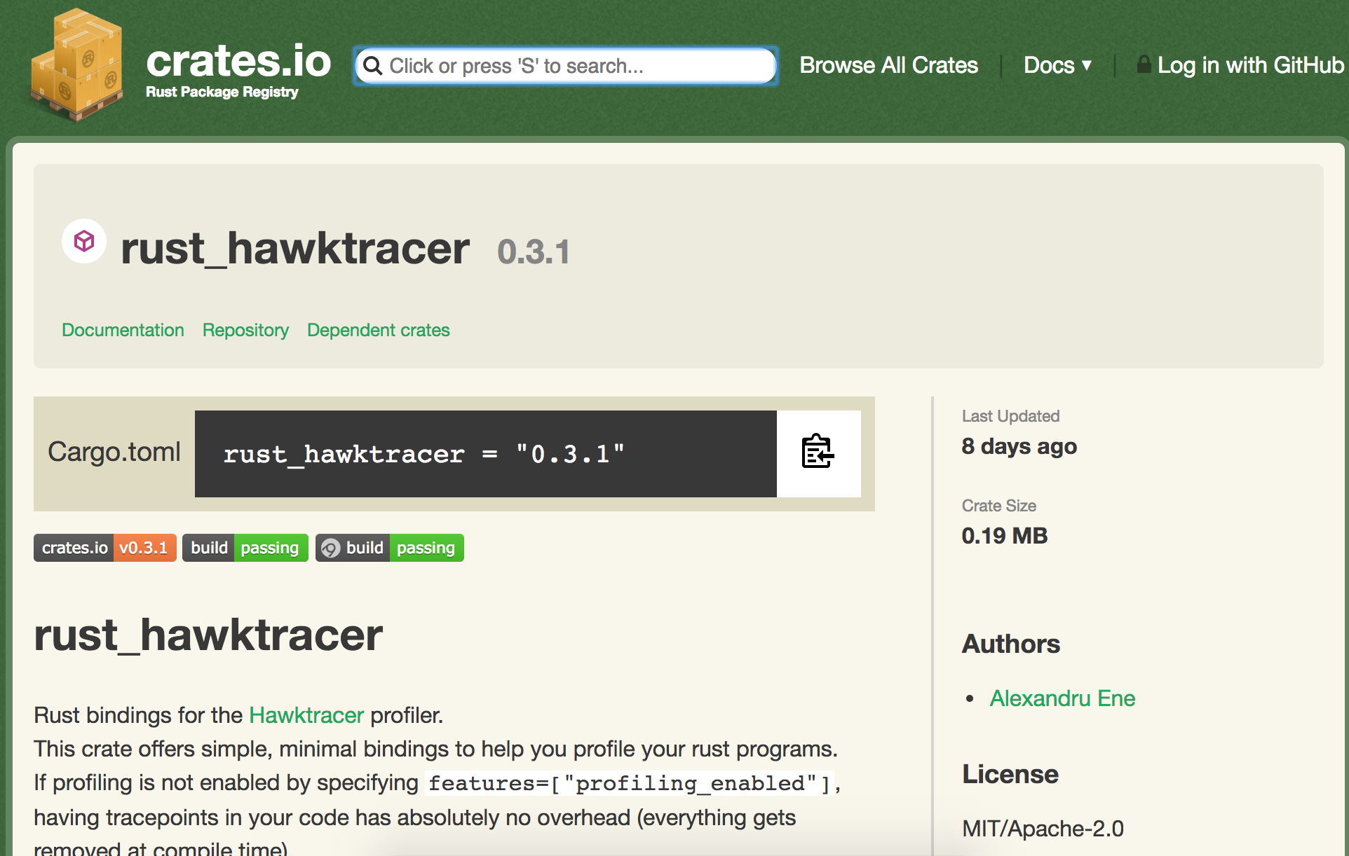

Slide 15
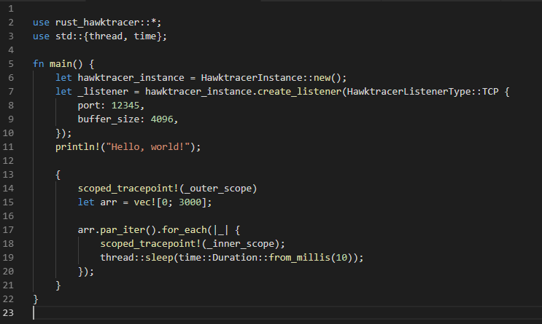

Slide 17
Profiling data pipeline
Your rust program
hawtracer-converter
Profiling Data (Binary)
rust_hawktracer
Chrome-tracing
(JSON)
Flamegraph
Callgrind format
Other formats on the way

Slide 18
Live coding demo time!

Slide 19
What's next?
More tracepoint types.
Stabilize API - Almost done™.
Better tool support
The new hawktracer-converter is also a Rust project !!!

Slide 20
Thank you
Twitter: @_AlexEne_
Twitch: twitch.tv/nomad_pixel
Github: https://github.com/AlexEne
Rust_hawktracer: https://crates.io/crates/rust_hawktracer
HawkTracer: github.com/amzn/hawktracer
Questions?

