Slide 1
Weaviate - The Decentralized Knowledge Graph
by Etienne Dilocker
full contact details on last slide
Saturday 2nd February 2019 / FOSDEM
Notes:
Weaviate is an open-source tool in the creativesoftwarefdn
The overall vision behind weaviate is the idea that all AI-related tasks can be reduced to semantic question answering
SeMI is a company that backs the development of the open source product and sells enterprise solutions on top of it (more later)

Slide 2
Our Plan for the next 30 minutes
What do we get out of it?
What is Weaviate?
What is the Contextionary that powers Weaviate?
What can you do with weaviate?
How have we built weaviate?
Live Demo
Spark your desire to try it out
Get Feedback from you
Notes:
What is Weaviate?
What is the Contextionary that powers Weaviate?
What can you do with weaviate?
How have we built weaviate?
Live Demo
There’s an easy way to try out Weaviate for yourself using docker-compose. More on that later
We appreciate speaking in front of a group of Graph Experts and really appreciate your feedback to form our design decisions

Slide 3
What is Weaviate?
Contextual
Decentralized
Knowledge Graph
github.com/creativesoftwarefdn/weaviate
Notes:
first github
then explain

Slide 4
Introducing the Contextionary
FANCY
ROYAL
HAMBURGERS
MAN
THRONE
CELEBRITY
WOMAN
KING
QUEEN
RULER
MONARCH
MALE
RICH
FEMALE
OPPRESSOR
WELL-SPOKEN
Notes:
Contextual
Based on contextionary
an AI-based Natural Language Tool to help add context to words
Ex1: King -Man +Women -> Queen
Result
We can make queries were we don’t have to do exact string matches, but match on context
“King” || “Queen” will not scale
Extremly helpful when we don’t know the ontology, either because it’s foreign data or the quality is not as good as we’d hope for

Slide 5
Contextionary: Other Examples
location vs. place vs. city
seal vs. seal
Notes:
Example 1: Three datasets of restaurants with different properties that really mean the same thing
Example 2: Disambiguation: Three homonoyms: Airplane, A level/flat surface, To Plane (wordworking)

Slide 6
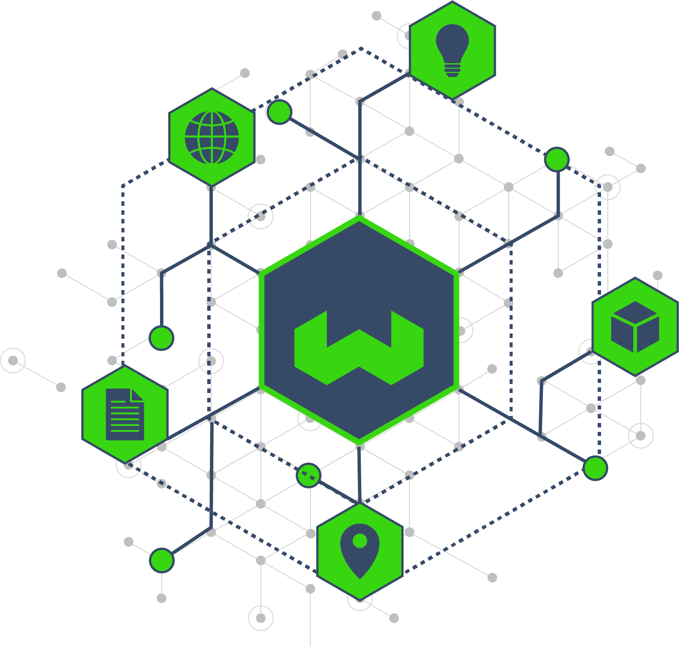
Decentralized
Standalone
Peer-to-peer network
own your data
enrich with other data
Connect weaviates to combine their strengths (e.g. a fast dataset with a large dataset)
Notes:
Standalone
Peer-to-peer network
own your data
enrich with other data
Connect weaviates to combine their strengths (e.g. a fast dataset with a large dataset)

Slide 7
Knowledge Graph
structured way to ask questions and receive answers (as you know from Google)
building on existing graph technologies: Graph Databases, GraphQL
adding more and more semantic tools to our infrastructure over time
Notes:
structured way to ask questions and receive answers (as you know from Google)
building on existing graph technologies: Graph Databases, GraphQL
adding more and more semantic tools to our infrastructure over time
Example: Ask Google a language question, receive an answer with your answer and related info
Semantic Tools
betting on Graph technology to resolve queries
while betting on semantic tools to understand queries
the combination of both will bring us closer to our vision that AI related tasks can be reduced to question answering

Slide 8
What can weaviate be used for?
Combine data across Industries without harmonizing ontologies
Easily gain more insights into data you already own
Enrich your data with publicly known, but previously inaccessible data
Find new customers
Fraud detection and other behavioral analyses
Notes:
Combine data across Industries without harmonizing ontologies
Easily gain more insights into data you already own
Enrich your data with publicly known, but previously inaccessible data
Find new customers
Fraud detection and other behavioral analyses
Examples:
Retailer and Bank - 4k on demand video subscriptions and TV Sales -> is there a correlation we can benefit from?
Mobile phone providers have movement data of postal codes, this can benefit retailers, restaurant chains (demographics), transportation industry, ....
Find customers: Seperation of concerns: Assume you are in a B2B industry -> compare potential customers to existing customers -> your main concern should not be to identify potential leads
Typical Machine Learning example: Spam detection other databases with behavioral data
Keep in mind, whenever this data is in weaviate it is always structured

Slide 9
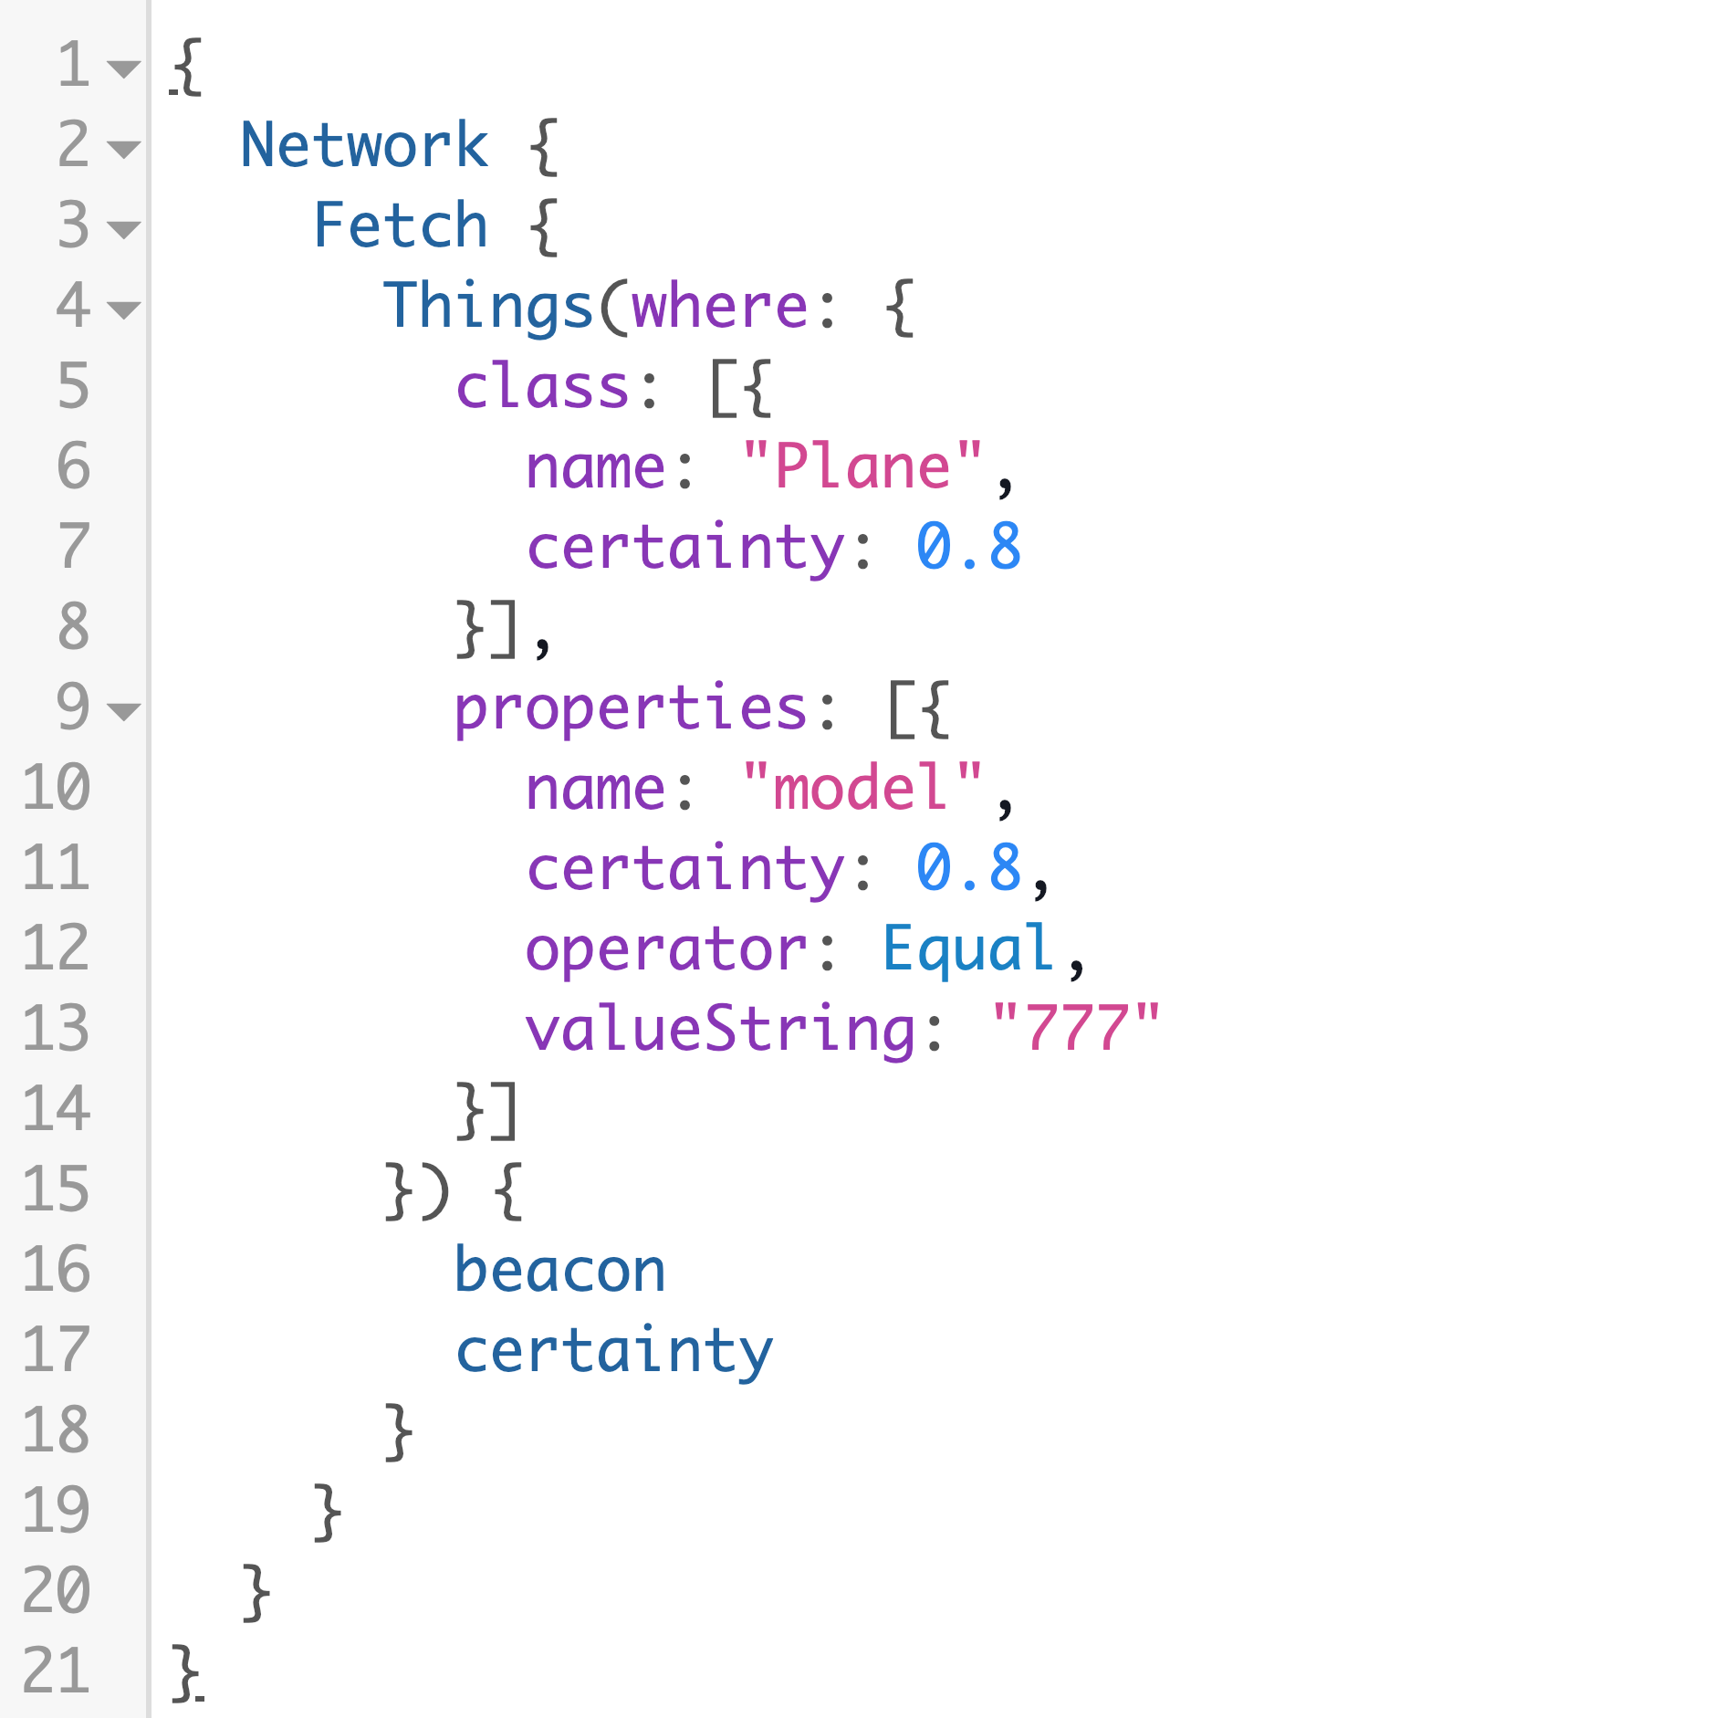
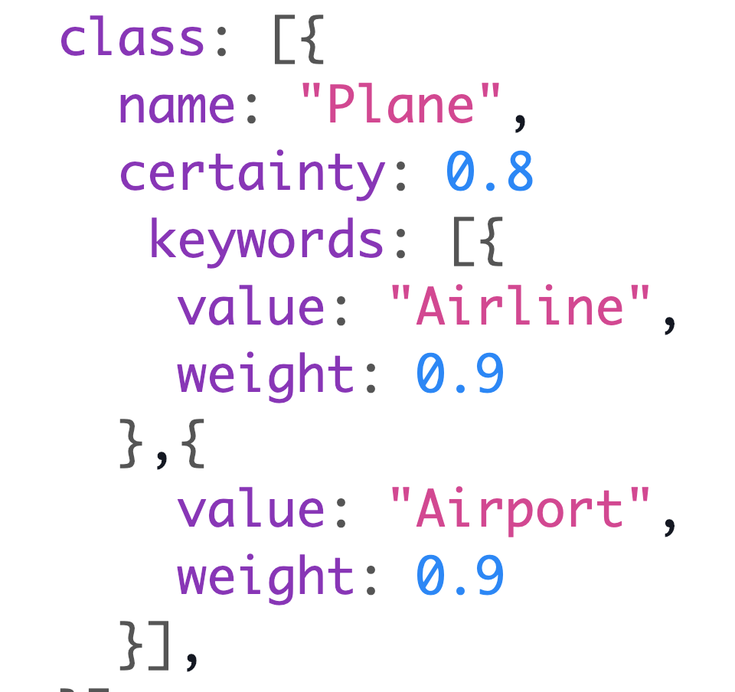
Example Queries
Notes:
What you need to know
Local vs Network Queries
Things are Things (“Airplane”), Actions are interactions (“Flight”)
Scenario: Every Airport operators a weaviate, filled by their local airport management system. Could be different at every airport. We have no way of knowing the ontology
As an aircraft service company we want to ask different airports about real time information about which airlines are currently on the ground

Slide 10
How is weaviate different from existing Graph Technology?
Weaviate does not replace, but enhance existing graph technologies.
Example: Should I use weaviate or a graph database directly? How do they differ?
Ease of use (GraphQL vs. SQL/Gremlin/Cipher etc.)
NLP and Contextionary
Modularity of Datastore (CAP-Theorem, pick what you need)
Janusgraph, Neo4j, RedisGraph, ...
Notes:
Weaviate does not replace, but enhance existing graph technologies.
Example: Should I use weaviate or a graph database directly? How do they differ?
Ease of use (GraphQL vs. SQL/Gremlin/Cipher etc.)
NLP and Contextionary
Modularity of Datastore (CAP-Theorem, pick what you need)
Janusgraph, Neo4j, RedisGraph, …
Weaviate is not a GraphDB!
Ease-Of-Use
Think of the target group (A room full of graph experts vs enterprise companies who need results fast)
NLP features not coupled to the db technology (separation of concerns)
Use whichever datastore fits your use cases
First connector we have built: Janusgraph for Hyperscale
backed in turn by Cassandra (storage), Elasticsearch (indexing) and currently evaluating Spark (for analyses)

Slide 11
Architecture - what is weaviate made of
User-facing APIs : REST and GraphQL
Microservice
small concern, 12-factor, docker and kubernetes native
Written in Golang 1.11 (yeah, modules!)
proven to be a very good language in the cloud environment
great compromise between stability, ease of use and cloud performance
API design first -> go-swagger
Focus on Modularity & Pluggability
Examples next slides
Notes:
User-facing APIs : REST and GraphQL
Microservice
small concern, 12-factor, docker and kubernetes native
(mention NLP example)
Written in Golang 1.11 (yeah, modules!)
proven to be a very good language in the cloud environment
great compromise between stability, ease of use and cloud performance
API design first -> go-swagger
Focus on Modularity & Pluggability
Examples next slides
Microservice Example to mention:
Example: NLP service with different tech stack, communicating only through REST/GraphQL

Slide 12
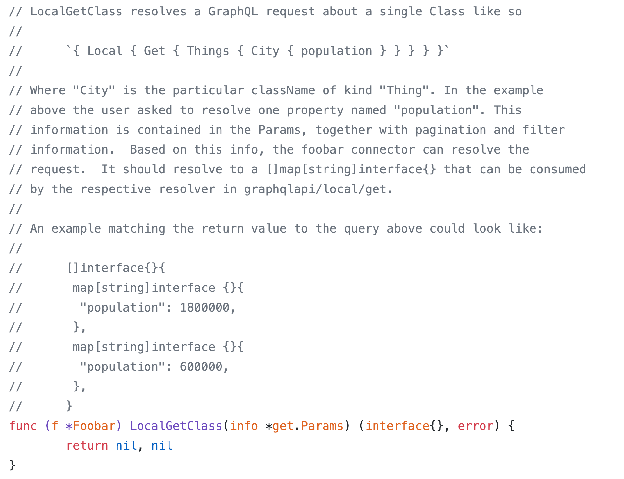
Focus on Modularity
Example: Database Connector
Anything that implements a DatabaseConnector interface is a database connector
The remainder of the app is database-agnostic
First connector we have built: Janusgraph (with C* and ES)
Get started with FooBar connector
https://github.com/creativesoftwarefdn/weaviate/blob/999fca94146dfba44803c3f862e3a25951a100dc/database/connectors/foobar/connector.go#L356-L379
Notes:
Before explaining what: WHY!!
CAP theorem
Scaling
Speed
Specific features
Anything that implements a DatabaseConnector interface is a database connector
The remainder of the app is database-agnostic
First connector we have built: Janusgraph (with C* and ES)
Get started with FooBar connector

Slide 13
Focus on Modularity
Example: Authentication and Authorization
Inspired by K8s
good separation between AuthN and AuthZ
AuthN highly pluggable
Basic Auth
OpenID Connect
… let’s see what our users use
anything that can decided between authenticated “yes/no” and provide a username and/or group to the AuthZ plugin
AuthZ
Role-based Access
(e.g. [“read”, “write”] on [“Things”, “*”])
full proposal available at https://github.com/creativesoftwarefdn/weaviate/issues/628

Slide 14
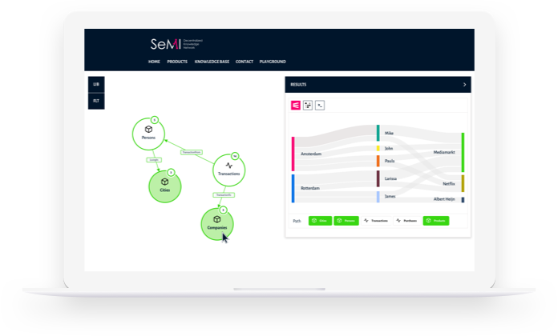
Who’s behind weaviate and what do they offer?
Enterprise support / Consulting
Advanced Networking abilities
Operate own weaviate with helpful datasets (e.g. Wikipedia-based, SMB directory)
Custom contextionaries (industry-specific)
“Playground” user interface

Slide 15
Roadmap
Completed
REST API
GraphQL API Local
Network Get/GetMeta
Contextionary
Janusgraph Connector
In Development
Network Fuzzy Requests
AuthN/AuthZ as proposed
In Research
Natural Language Interface on top of GraphQL
Notes:
Completed
REST API GraphQL API Local Network Get/GetMeta Contextionary Janusgraph Connector
In Development Network Fuzzy Requests AuthN/AuthZ as proposed In Research Natural Language Interface on top of GraphQL

Slide 16
Feedback and Contact Info
Feedback areas
General Feedback - How useful can weaviate be to you?
API design - Ease of use vs. Abilities?
Connectors - Abstraction vs. Specific features?
Contact SeMI semi.network Reach out to David or Micha
About me Etienne Dilocker Core Developer Weaviate dilocker.de GitHub/Twitter: etiennedi YouTube: kubucation

