Slide 1



Handling media - the RESTful approach
How we integrated media content in textual API
Notes:
Hi,
My name is Johnathan, architect in Kaltura Open Source Video Platform.
I want to share how we, in Kaltura, solved media related issues while using REST APIs and other network limitations.

Slide 2

What is media used for?
+2M
15%
25%
cat videos on YouTube alone
every year
of all internet traffic is connected to cats
(or so claimed by cat food companies)
of cat lovers pick George as their favorite Beatle
Notes:
Media has become the most significant content on the internet, in traffic, in interest, in cost.

Slide 3

The Challenge
World Domination
Cats always been trying to take over the world
2
Notes:
I could present you boring forecasts showing the future of media usage over the internet,
but it’s clear to all of us that every chart I might show will always end up with the same conclusion,
You can’t ignore media, not in your database, not in your storage, not in your network and not in your API.

Slide 4

Kaltura Manages Video From Any Source to Every Destination
Video Player
Personal Video Capture: Mobile or Desktop
Website Embed
Video Portal
Video Calls & Video Conferencing
SECURE
Social Media and Social Business
Classroom and Meeting Capture
ENRICH
DELIVER
Learning Management Systems
Webcasting and Live Events
Enterprise Content Management
VIDEO SOURCE
Human Capital Management
VIDEO DESTINATION
Big Video at Scale
INGEST
DISTRIBUTE
CRM and Marketing Automation
Live Linear
Content Management System
ANALYZE
SEARCH
Web, Mobile, and Tablets
VOD
ENGAGE
Set-top Boxes
TSTV and cDVR
Connected Devices
Game Consoles
Notes:
Kaltura aspire to do “everything video”, during the years we learned to manage media files for capturing, conferencing, transcoding, encrypting, streaming, ad-stitching, recording as well as playback, distribution and syndication.
We do all that using REST API.

Slide 5
REST is HTTP
REST is Textual
Request (no cats support)
HTTP supports media and cats
GET, DELETE – path and query string
POST, PUT – JSON or XML content
PUT – upload files
POST – send mixed content
GET – progressive download
HLS – VOD and Live streaming
Response (no cats support)
JSON or XML
Notes:
Although HTTP originally created for hyper-text, it’s supporting media files since its earliest versions.
It enables to upload files using PUT method, as multipart/form-data using POST method, download media files using GET method and in the last few years we all even stream VOD and live streams using HLS.
However,
The REST industry standard is textual, it accepts URL paths, query strings and even complex data structures using JSON and XML.
The response is also textual according to the industry best practice and supports complex JSON and XML.
But both the request and the response are fully textual, so unless you encode your binary data to base64, this standard is not enough.

Slide 6
Common approaches
PUT
Form data
Supports single file per request
Doesn’t support additional parameters (except for query-string)
Doesn’t support complex data structures like JSON and XML
2
Notes:
Different providers solved it using PUT method which enable uploading of a single file,
lacking the ability to send complex data structures with it.
Some providers use form-data that enable uploading multiple files in the same request,
but again, each field value is a single string value.

Slide 7


Further investigation
Java
Giga
Smart, Quick and Neurotic
Much like C
Fat, Slow and Furious
Much like C#
Notes:
So, as someone who aspire for professionalism, I decided to take home two specimens of these media providers.
After more than 10 year of investigation, they took over my bad, my sofa, my kitchen, and probably even my brain.

Slide 8

If you can’t beat them, at least you solve the mice problem
Serve
Upload
Download
2
Kaltura API defined serve actions to deliver media files
Kaltura API defined files as acceptable action argument
Just provide us the URL, we will do the rest
Expected returned type is file, instead of JSON / XML object.
POST body contains both files and JSON as form fields.
Async process to download the media in chunks, status could be tracked using API.
Notes:
So we started with few basic functionalities to deliver media files online.
Serve to download media from Kaltura server using API call.
Upload to Kaltura one file or more using API action.
Inform Kaltura of a file URL that should be downloaded to Kaltura server.

Slide 9
Serve Actions
File Upload
Thumbnail – crop and resize on the fly
Video – progressive download, clip and trim on the fly
Closed captions – SRT, DFXP, WebVTT, CAP
Related files – PDF, Text
Configuration files – JSON, XML, YAML
Thumbnails, Video, Closed Caption, etc.
Chunked upload support
Different DC – redirect
Different machines – shared disc
Chunks in wrong order – manage chunks info
Retroactive handling when the upload is done
Notes:
Since Kaltura REST API is not counting on HTTP method to define the action, for example POST, PUT and DELETE,
and since we define the action as part of the URL path, for example add, update, delete,
we just defined a new action type we call serve which instead of returning the object as JSON or XML,
it’s returning its related content, image, video or even SRT and PDF files.
As for upload, we needed our API actions to support more than one file, for example in case we want to upload XSD and its related XSL in the same call.
We also wanted to support complex data structures as JSON or XML, so we used form-data with POST action, while all the API parameters are sent as JSON as one form field and all files are sent as separate form fields.
For file upload we encountered few issues…

Slide 10
Common API call
File Upload call
POST http://www.kaltura.com/api_v3/service/uploadtoken/action/upload
Content-Type: multipart/form-data; boundary=---------------b3454fb3763c
---------------b3454fb3763c
Content-Disposition: form-data; name="json“
{"format":"1","ignoreNull":true,"clientTag":"php5:18-01-15","apiVersion":"3.6.287.27334","uploadTokenId":"FKdDf49c8s","ks":"djJ8MjAzfJ6icFKdDf49c8s2QiWj374Hgo1T","kalsig":"a61c44b19e883215d2093189e104744c"}
---------------b3454fb3763c
Content-Disposition: form-data; name="fileData"; filename="DemoImage.jpg“
Content-Type: image/jpeg
MEOW
POST http://www.kaltura.com/api_v3/service/uploadtoken/action/get
Content-Type: application/json
{
"apiVersion": "3.6.287.20750",
"clientTag": "dotnet:18-01-10",
"format": 2,
"kalsig": "eb574ceb54b8d2df26819ffb622cfba6",
"ks": "djJ8MjAzfJ6icFKdDf49c8s2QiWj374Hgo1T",
"uploadTokenId": "FKdDf49c8s“
}

Slide 11












Generated Client Libraries
File upload
Generated as method argument
Support different coding standards
  File paths
  File objects
  Streams
  Buffers
2
File Download
Client libraries will never perform the download,
Instead they generate the download URL.
URL built according to API parameters.
Notes:
If any of you ever tried to implement Webex API to download file, I’m sure you hate Webex now even more than you hated it before.
In Kaltura we wanted to simplify the process for developers as much as we can and therefore in each server build we also auto-generate a large variety of client libraries in different coding languages.
For each client library we generated each file argument to the data type that is most commonly used in that language.
For file download we assumed that the client library won’t be used to download media and binary data, but more for data model, so we used the client libraries just to generate the download URL, later the application can use that URL and image source or in order to download the file if needed.

Slide 12
File Upload (Sync)
File Download (Sync)
<?php
$filePath = './DemoImage.jpg';
$newUploadToken = new KalturaUploadToken();
$newUploadToken->fileSize = filesize($filePath);
$ceatedUploadToken = $client->uploadToken->add($newUploadToken);
$uploadedUploadToken = $client->uploadToken->upload($ceatedUploadToken->id, $filePath);
<?php
$thumbParams = new KalturaThumbParams();
$thumbParams->width = 300;
$thumbParams->height = 200;
$remoteUrl = $client->thumbAsset->serve($thumbAssetId, $thumbAssetVersion, $thumbParams);
file_put_contents($localFilePath, file_get_contents($remoteUrl));

Slide 13
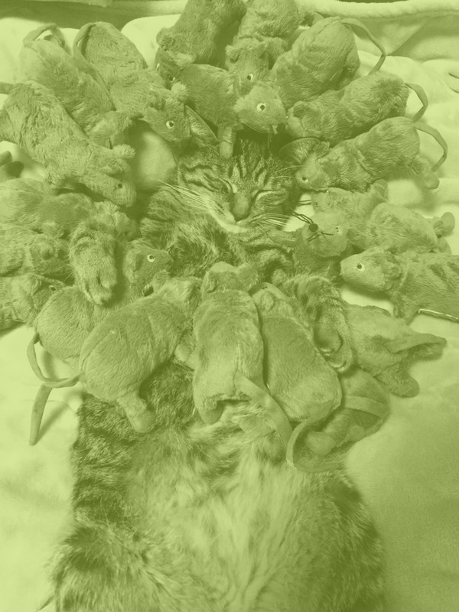
Bigger problems require a bigger cat
CSV Bulk
XML Bulk
Comma separated values, containing media name, URL and properties, status tracked via API.
Complex structures for automatic import from external systems models.
Drop Folder
Webex
Remote and Local
FTP
SFTP
S3
HTTP Feed
XML for complex model
Download media files using Webex API
Notes:
Very soon we learned that our customers need the ability to ingest large quantities of content to our platform.
Either because the needed to migrate from existing system, to create initial catalog or to integrate with content producing systems.

Slide 14
CSV
XML
Designed for simplicity, enable manual editing in Excel for list of media files with their basic properties.
ID (for update and delete actions)
Action (add, update or delete)
Name
URL
Thumbnail URL
Owner ID
Designed for machine to machine and enable complex models.
Media files URLs (multiple renditions per media-entry)
Basic and custom metadata
Related thumbnails URLs
Related closed caption URLs
Related files URLs
Time based data (cue-points)
Content distribution (to external systems)

Slide 15
Drop Folder
Drop Folder XML
Designed for simplicity
Each dropped file used as a new media-entry
File name used (with configured regex) to set media name
Designed for machine to machine
Enable everything as uploaded XML, with one addition, it may refer to files that dropped in the same drop folder.

Slide 16
Content resource
KalturaAssetResource
KalturaDropFolderFileResource
KalturaServerFileResource
KalturaUploadedFileResource
KalturaUploadedFileTokenResource
KalturaWebcamTokenResource
KalturaRemoteStorageResources
KalturaStringResource
KalturaUrlResource
<?php
$resource = new KalturaUrlResource();
$resource->url = ‘http://example.com/DemoImage.jpg';
$thumbAsset = $client->thumbAsset->setContent($thumbAssetId, $resource);

Slide 17

Content Distribution
Push
Push content using external API, upload files in necessary
Syndication
External systems pull content periodically based on MRSS
Notes:
As video platform, we wanted to enable our customers to publish their content to additional systems.
Either by pushing the content using external APIs, remote drop folders, FTP or SFTP,
Or by publishing the content as MRSS, enabling external systems to pull the content from Kaltura.

Slide 18























Industry standard is so important, so we have a few

Slide 19
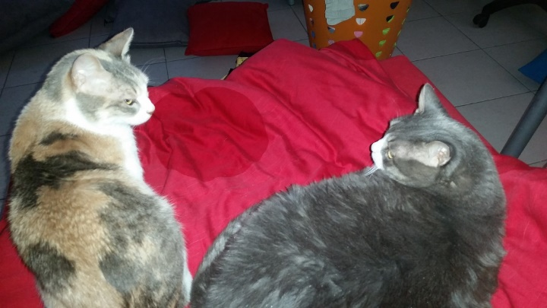
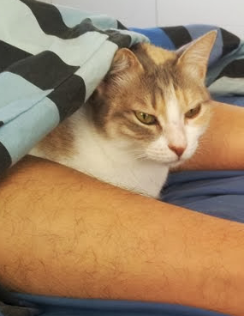
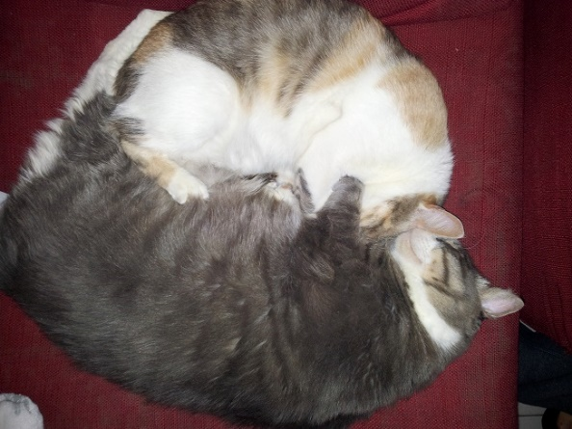

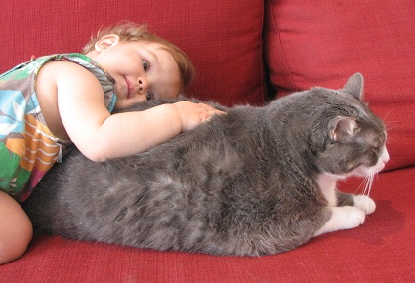
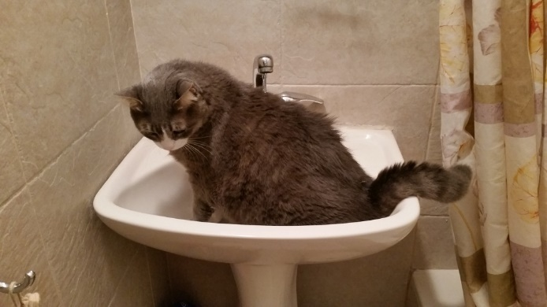

And few more pictures, just because I couldn’t resist

Slide 20
Thank you

