Slide 1
Scaling Graphite at Criteo
FOSDEM 2018 - “Not yet another talk about Prometheus”
Notes:
Hello everybody, welcome to “Scaling Graphite at Criteo”

Slide 2
Me
Corentin Chary
Twitter: @iksaif Mail: c.chary@criteo.com
Working on Graphite with the Observability team at Criteo
Worked on Bigtable/Colossus at Google
Notes:
First, let me introduce myself. My is is Corentin, I currently work at Criteo, in the Observability team. This team is in charge of metrics and logs at Criteo, and most of my worked is focused on Graphite.
Before that I worked on Bigtable and Colossus at Google, so I have a database/filesystem background.

Slide 3
Big
Graphite
Storing time series in Cassandra and querying them from Graphite
Notes:
Today we’re speaking about Graphite.
Well .. since it’s a BigData conference, we will be speaking about BigGraphite !
Just so I know, who has used Graphite here already ?
And Cassandra ?
Ok, cool.

Slide 4
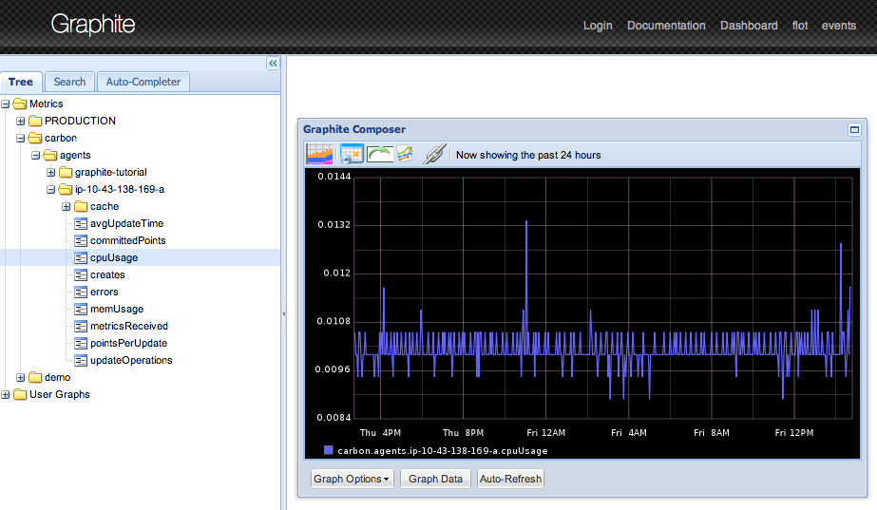
Graphite
Graphite does two things:
Store numeric time-series data
Render graphs of this data on demand
https://graphiteapp.org/
https://github.com/graphite-project
Notes:
So Graphite is an application that does to simple things:
It receives and stores points (metric name, timestamp, value)
It allows you to draw graphs with these

Slide 5
graphite-web
Django Web application
UI to browse metrics, display graph, build dashboard
Mostly deprecated by Grafana
API to list metrics and fetch points (and generate graphs)
/metrics/find?query=my.metrics.*
/render/?target=sum(my.metrics.*)&from=-10m
Notes:
You got three components in Graphite, the main one is graphite-web, the web application. It’s basically a UI and API to access to your data. Today the UI part is mostly superseded by Grafana.
The API is the most important thing for us, as it’s what allow us to interact with the data.
It allows you to do two things:
Find metrics matching a pattern
Evaluating expressions on metrics ( like a sum, or an average) and getting back the data (as a graph, or json)

Slide 6
Carbon
Receives metrics and relay them
carbon-relay: receives the metrics from the clients and relay them
carbon-aggregator: ‘aggregates’ metrics based on rules
Persist metrics to disk
carbon-cache: writes points to the storage layer
Default database: whisper, one file = one metric
host123.cpu0.user <timestamp> 100
carbon
disk
Notes:
The second component is carbon, it’s the tool responsible for receiving metrics sent by applications.
Simple: you send points on UDP and TCP etc.. and carbon receives them and persists them to disk.

Slide 7
Our usage
6 datacenters, 20k servers, 10k+ “applications”
We ingest and query >80M metrics
Read: ~20K metrics/s
Write: ~800K points/s
2000+ dashboards, 1000+ alerts (evaluated every 5min)
Notes:
So, that was a quick presentation of Graphite, here is how we use it at Criteo.
We have more than 5 datacenters, and thousands of machines and applications, all of them sending points to Graphite.
This translates to more than 50 million distinct metrics, 500k points per second written to disk.
All that read back by more than 1000 dashboards and 200 alerts that are periodically refreshed (5 minutes or), which means reading up to 10k metrics/s.

Slide 8
architecture overview
Applications
grafana
carbon-relay (dc local)
carbon-relay
(TCP)
carbon-cache
graphite
API + UI
in-memory
(UDP)
(UDP)
persisted
Notes:
So here is a quick schema of everything together: applications sending points to a carbon relay, which is local to a datacenter, then sending to the graphite cluster.
Carbon-cache stores the point on disk, which are read back by Grafana using the graphite-web API..

Slide 9
architecture overview (r=2)
Applications
carbon-relay
PAR
in-memory
(UDP)
AMS
(UDP)
Notes:
So we simply added a second Graphite cluster. Both store exactly the same data and can be used at the same time. If one goes down for any reason, or if points fail to reach one, we can just disable it and we still have a fully working cluster.

Slide 10
current tools are improvable
Graphite lacks true elasticity
… for storage and QPS
One file per metric is wasteful even with sparse files
Graphite’s clustering is naïve (slight better with 1.1.0)
Graphite-web clustering very fragile
Single query can bring down all the cluster
Huge fan-out of queries
Tooling
Whisper manipulation tools are brittle
Storage ‘repair’/’reconciliation’ is slow and inefficient (multiple days)
Scaling up is hard and error prone
Notes:
All these things, you can do with Graphite 1.0. The thing is that as you see, there is a strong correlation between Graphite-Web / carbon-cache and the disks. For various reasons, including how data is distributed, you can’t just add a machine (it takes us ~3 days if we want to do it, and we need to bring the cluster down).
Graphite clustering code is also quite naïve an fragile, queries have a huge fanout, and they tend to make the cluster explode. It’s also quite hard to tweak the clustering code to be resilient to the loss of one machine.
The whisper tooling also isn’t great, it’s hard and long to reconciliate both clusters, it can take more than a week.

Slide 11
solved problems?
Distributed database systems have already solved these problems
e.g. Cassandra, Riak, …
Fault tolerance through replication
Quorum queries and read-repair ensure consistency
Elasticity through consistent hashing
Replacing and adding nodes is fast and non-disruptive
Repairs are transparent, and usually fast
Almost-linear scalability
Notes:
The thing is that most of these issues are already solved in distributed databases like Cassandra, Riak and others .. So in order to make it easier for us to maintain the Graphite cluster, we decided to try to store points in a distributed database instead of using whisper on disk.

Slide 12
BigGraphite
Notes:
And that’s where big graphite comes !

Slide 13
decisions, decisions
OpenTSDB (HBase)
Too many moving parts
Only one HBase cluster at Criteo, hard/costly to spawn new ones
Cyanite (Cassandra/ES)
Originally depended on ES, manually ensures cross-database consistency…
Doesn’t behave exactly like Carbon/Graphite
KairosDB (Cassandra/ES)
Dependency on ES for Graphite compatibility
Relies on outdated libraries
[insert hyped/favorite time-series DBs]
Safest and easiest: build a Graphite plugin using only Cassandra
Notes:
First, we looked at various options, and none of them had perfect Graphite compatibility, which was a must for us, since we can’t convert these 1000 thousands dashboards and hundred of alerts.
Since we already have Cassandra internally, we decided to go with that.

Slide 14
Target architecture overview
grafana
graphite
API + UI
graphite
API + UI
Cassandra
Cassandra
Cassandra
metrics
carbon-relay
carbon-cache
carbon-cache
Notes:
The idea is that it would look like that in the end, and if you want to scale, you’ll just be able to add the kind of node that has become your bottleneck.

Slide 15
plug’n’play
Slightly more complicated than that…
Graphite has support for plug-ins since v1.0
carbon (carbon.py)
create(metric)
exists(metric)
update(metric, points)
update(uptime.nodeA, [now(), 42])
Graphite-Web (graphite.py)
find(glob)
fetch(metric, start, stop)
find(uptime.*) -> [uptime.nodeA]
fetch(uptime.nodeA, now()-60, now())
Notes:
The nice thing with Graphite 1.0 is that it comes with a plugin system for carbon and graphite-web.
carbon plugins have three functions to manipulate metrics: create(), exists() and update() which are pretty self-explainatory
graphite-web has one function to find metrics matching a pattern, and another one to fetch point for a given metric and time interval.
Plugins have to be written in Python but if you want you can just make it a dumb bridge to a REST API implemented in Go or whatever you want.

Slide 16
storing time series in Cassandra
Store points…
(metric, timestamp, value)
Multiple resolutions and TTLs (60s:8d, 1h:30d, 1d:1y)
Write => points
Read => series of points (usually to display a graph)
…and metadata !
Metrics hierarchy (like a filesystem, directories and metrics — like whisper)
Metric, resolution, [owner, …]
Write => new metrics
Read => list of metrics from globs (my.metric.*.foo.*)
Notes:
So .. to make it work we need to be able to store points in Cassandra
Which means storing tuples of (metric, timestamp, value), we also need to support various resolution.
The typical write operation will write a single point per metric, and the typical read operation will read a series of points (typically to display a graph)
We also need to think about metadata ! We need to be able to find metrics matching a glob and create new metrics.

Slide 17
<Cassandra>
Notes:
So .. how to do that with cassandra ?

Slide 18
storing data in Cassandra
Sparse matrix storage
Map< Row, Map< Column, Value > >
Row ⇔ Partition
Atomic storage unit (nodes hold full rows)
Data distributed according to Hash(rowKey)
Column Key
Atomic data unit inside a given partition
Unique per partition
Has a value
Stored in lexicographical order (supports range queries)
store( row, col, val )
H = hash( row )
Node = get_owner( H )
send( Node, (row, col, val) )
Notes:
Here is a quick introduction to Cassandra. You can see it as a table indexed by row and column.
The row (or partition key) is hashed in order to find the server that contains your data.
The column (or clustering key) is used to find your data on the machine.
The row always need to be fully qualified, and doesn’t support range queries. It also holds only up to 100 000 columns.
Columns support range queries and ar sorted, which allows you to select only a subset ofthe columns of a row.

Slide 19
naïve schema
CREATE TABLE points ( path text, -- Metric name time bigint, -- Value timestamp value double, -- Point value PRIMARY KEY ((path), time) ) WITH CLUSTERING ORDER BY (time DESC);
Boom! Timeseries.
(Boom! Your cluster explodes when your have many points on each metric.) (Boom! You spend your time compacting data and evicting expired points)
Notes:
So, knowing that, here is a first naive approach at storing timeseries in Cassandra.
In this example, the row key is the path of the metric, the time becomes the column, and the value is a double.
This matches perfectly the read(path, time_start, time_end) API !
This is also clearly not optimized for compactions, and will waste a lot of resources, but we won’t have time to speak about that today.
The issue with that, is that if you have more than 100 000 points per metrics, it breaks.

Slide 20
time sharding schema
CREATE TABLE IF NOT EXISTS %(table)s ( metric uuid, -- Metric UUID (actual name stored as metadata) time_start_ms bigint, -- Lower time bound for this row offset smallint, -- time_start_ms + offset * precision = timestamp value double, -- Value for the point. count int, -- If value is sum, divide by count to get the avg PRIMARY KEY ((metric, time_start_ms), offset) ) WITH CLUSTERING ORDER BY (offset DESC) AND default_time_to_live = %(default_time_to_live)d
table = datapoints_<resolution>
default_time_to_live = <resolution.duration>
(Number of points per partition limited to ~25K)
Notes:
Here is a better schema:
The first thing is that we create one table per resolution, so that all the data in a single table has the time TTL
We also add the upper part of the timestamp to the row key in order to shard metrics across multiple machines, and use the lower part as the column.
Something else that we do is that we store value *and* count in order to manage aggregations easier when you have multiple resolutions, we will speak about that later.
Using TimeWindowCompactionStrategy in Cassandra > 3.5

Slide 21
demo (sort of)
cqlsh> select * from biggraphite.datapoints_2880p_60s limit 5;
metric | time_start_ms | offset | count | value --------------------------------------+---------------+--------+-------+------- 7dfa0696-2d52-5d35-9cc9-114f5dccc1e4 | 1475040000000 | 1999 | 1 | 2019 7dfa0696-2d52-5d35-9cc9-114f5dccc1e4 | 1475040000000 | 1998 | 1 | 2035 7dfa0696-2d52-5d35-9cc9-114f5dccc1e4 | 1475040000000 | 1997 | 1 | 2031 7dfa0696-2d52-5d35-9cc9-114f5dccc1e4 | 1475040000000 | 1996 | 1 | 2028 7dfa0696-2d52-5d35-9cc9-114f5dccc1e4 | 1475040000000 | 1995 | 1 | 2028
(5 rows)
Partition key Clustering Key Value
Notes:
And in the end, it looks like that !
Questions ?

Slide 22
Finding nemo
How to find metrics matching fish.*.nemo* ?
Most people use ElasticSearch, and that’s fine, but we wanted a self-contained solution
Notes:
The other part was the metadata, we need to be able to find globs. A lot of people us ES for that, and that’s ok, but we wanted to minimize the number of depdencies, so we implemented that in Cassandra.

Slide 23
we’re feeling SASI
Recent Cassandra builds have secondary index facilities
SASI (SSTable-Attached Secondary Indexes)
Split metric path into components
criteo.cassandra.uptime ⇒ part0=criteo, part1=cassandra, part2=uptime, part3=$end$
criteo.* => part0=criteo,part2=$end$
Associate metric UUID to the metric name’s components
Add secondary indexes to path components
Retrieve metrics matching a pattern by querying the secondary indexes
See design.md and SASI Indexes for details
Notes:
Recent Cassandra now support SASI indexes. Which is exactly what we need. We decided to simply split the metric paths in multiple components.
When we do the select, we simply specify only the components that don’t contain a wildcard. For example for criteo.* we would do SELECT * FROM .. WHERE part0 = criteo AND part2 = $end$
You can see the design document to know more about this.

Slide 24
do you even query?
a.single.metric (equals)
Query: part0=a, part1=single, part2=metric, part3=$end$
Result: a.single.metric
a.few.metrics.* (wildcards)
Query: part0=a, part1=few, part2=metrics, part4=$end$
Result: a.few.metrics.a, a.few.metrics.b, a.few.metrics.c
match{ed_by,ing}.s[ao]me.regexp.?[0-9] (almost regexp, post-filtering)
^match(ed_by|ing)\.s[ao]me\.regexp\..[0-9]$
Query: similar to wildcards
Result: matched_by.same.regexp.b2, matched_by.some.regexp.a1, matching.same.regexp.w5, matching.some.regexp.z8
Notes:
Here are a few more example. Graphite supports a little more than wildcards, but the index do not, so we handle that by transforming all the pattern into wildcards, and then running post-filtering, which is usually efficient enough.
Questions ?

Slide 25
</Cassandra>

Slide 26
And then ?

Slide 27
BIGGEST GRAPHITE CLUSTER IN THE MULTIVERSE ! (or not)
800 TiB of capacity, 20 TiB in use currently (R=2)
Writes: 1M QPS
Reads: 10K QPS
24 bytes per point, 16 bytes with compression
But probably even better with double-delta encoding !
20 Cassandra nodes
6 Graphite Web, 10 Carbon Relays, 10 Carbon Cache
x3 ! 2 Replicated Datacenters, one isolated to canary changes.
Notes:
And .. that works !
It’s been in production for 10 months now, and it’s more stable that vanilla Graphite. We even replaced *all* the Cassandra servers with no downtime and no manual intervention.
We do 1M Qps replicated writes, and have 20TiB of capacity.

Slide 28
links of (potential) interest
Github project: github.com/criteo/biggraphite
Cassandra’s Design Doc: CASSANDRA_DESIGN.md
Announcement: BigGraphite-Announcement
You can just `pip install biggraphite` and voilà !
Notes:
Here are some links that you can look at later.

Slide 29
Roadmap ?
Add Prometheus Read/Write support (BigGraphite as long term storage for Prometheus).
Already kind of works with https://github.com/criteo/graphite-remote-adapter
Optimize writes: bottleneck on Cassandra is CPU, we could divide CPU usage by ~10 with proper batching
Optimize reads: better parallelization, better long term caching (points usually don’t change in the past)

Slide 30
More Slides

Slide 31
Monitoring your monitoring !
Graphite-Web availability (% of time on a moving window)
Graphite-Web performances (number of seconds to sum 500 metrics, at the 95pctl)
Point loss: sending 100 points per dc per seconds, checking how many arrive in less than 2 minutes
Point delay: setting the timestamp as the value, and diffing with now (~2-3 minutes)

Slide 32
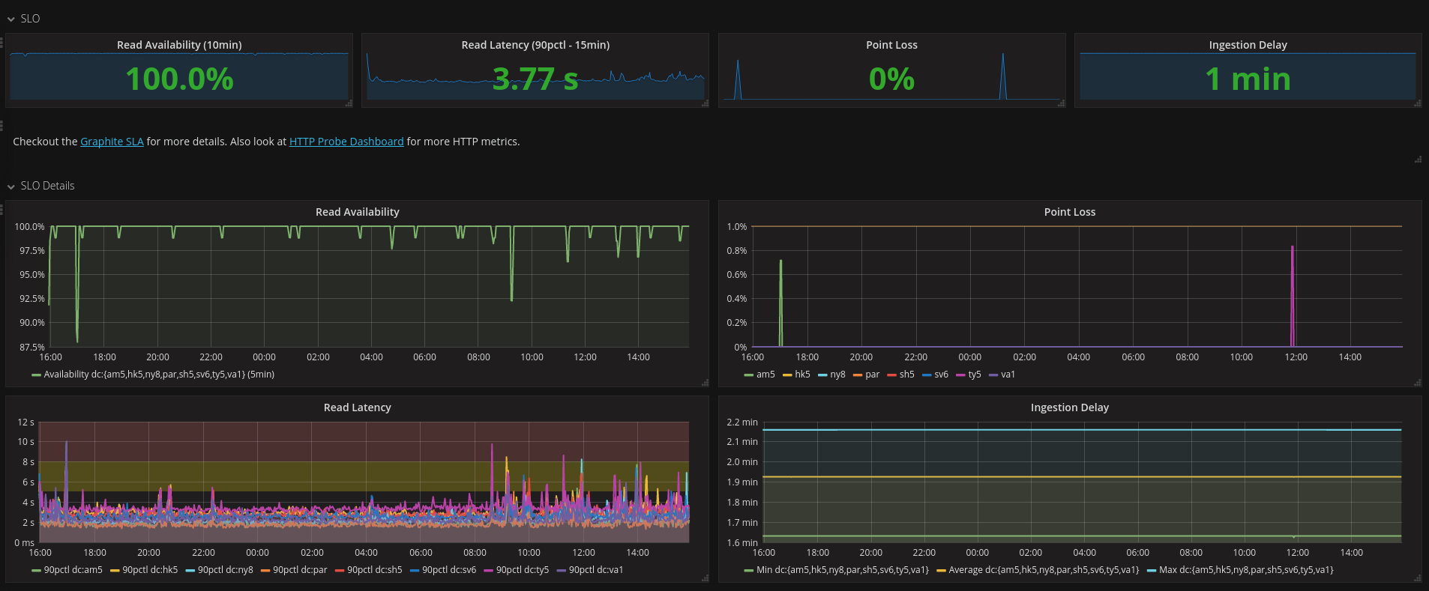

Slide 33
Aggregation Downsampling/Rollups/Resolutions/Retentions/...
Notes:
Another interesting part is how we handle aggregation and multiple resolutions.

Slide 34
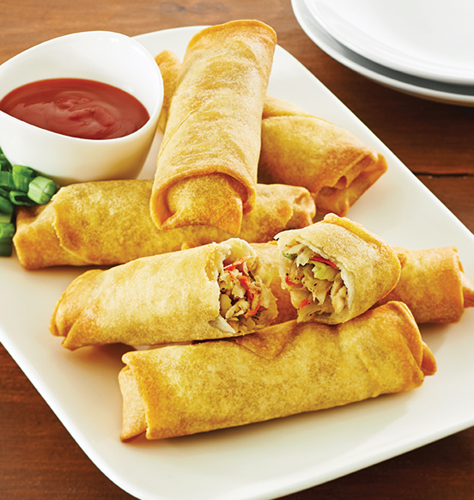
roll what? hmmm?
Retention policy: 60s:8d,1h:30d,1d:1y (combination of stages)
Stage: 60s:8d (resolution 60 seconds for 8d)
Aggregator functions: sum, min, max, avg
stage[N] = aggregator(stage[N-1])
60s:8d (stage0)
1h:30d
1d:1y
sum(points)
sum(points)
Notes:
If you remember, whisper supports multiple resolutions.
First you write to a stage with a very fine resolution, like every minute, and then points get aggregated to the next resolution. In this case 60 points will become one after 8 days.

Slide 35
Obviously this doesn’t work for average
avg(avg(1, 2), avg(3, 4)) ≠ avg(1, 2, 3, 4)
We have to store both ‘value’ and ‘count’!
(See downsampling.py for details)
Cheaper / simpler to do directly on the write path
Checkpointed every 5 minutes
But since processes can restart !
We use unique write ids (and replica ids when using replicated clusters)
(See design.md)
Notes:
There are various aggregators supported, and “average” is the tricky one, that’s why we keep both count and value in the database !
We also had two options to do that, either running a nighlty job that would read all the data and aggregated it back, or do it directly.
We decided that it was easier to just do everything on the write path. And we checkpoints values every 5 minutes, or before shutting down (which means that we can loose up to 5 minutes of data if there is crash). All that is defined by the table schema, so you can tweak it as you want. This makes the database a little bit more complicated that it would have been using batch jobs, because process can restart.
To solve that we associate points with a writer id, and a replica id, and we reconciliate everything on the read path.

Slide 36
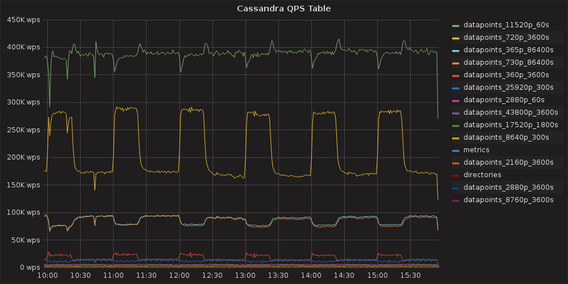
What about aggregation ?
We aggregate in the carbon plugins, before writing the points
Points for different level of resolution go to different tables for efficient compactions and TTL expiration
Reads go to a specific table depending on the time window
Notes:
If you remember, we have one table per resolution, and this graphs shows the number of QPS per table.
The green line is the first stage, which gets a lot of QPS, and the others are aggregated and have batched writes every 5 minutes.
When you read points you chose the table depending on the resolution you want.

