Slide 1

Open J9
The Next Free Java VM
Charlie Gracie, Eclipse OMR Co-Project Lead
IBM Advisory Software Developer
Notes:
Hi I am Charlie Gracie
Today I will be talking to you about OpenJ9
I have been a software developer at IBM for over 13 years working on the IBM J9 Java VM
I have worked on most areas of the VM but I have been focused on garbage collection for most of my career.
Currently I am the garbage collection architect and I am also the co-project lead on the Eclipse OMR project.

Slide 2
Important Disclaimers
THE INFORMATION CONTAINED IN THIS PRESENTATION IS PROVIDED FOR INFORMATIONAL PURPOSES ONLY.
WHILST EFFORTS WERE MADE TO VERIFY THE COMPLETENESS AND ACCURACY OF THE INFORMATION
CONTAINED IN THIS PRESENTATION, IT IS PROVIDED “AS IS”, WITHOUT WARRANTY OF ANY KIND,
EXPRESS OR IMPLIED.
ALL PERFORMANCE DATA INCLUDED IN THIS PRESENTATION HAVE BEEN GATHERED IN A CONTROLLED
ENVIRONMENT. YOUR OWN TEST RESULTS MAY VARY BASED ON HARDWARE, SOFTWARE OR
INFRASTRUCTURE DIFFERENCES.
ALL DATA INCLUDED IN THIS PRESENTATION ARE MEANT TO BE USED ONLY AS A GUIDE.
IN ADDITION, THE INFORMATION CONTAINED IN THIS PRESENTATION IS BASED ON IBM’S CURRENT
PRODUCT PLANS AND STRATEGY, WHICH ARE SUBJECT TO CHANGE BY IBM, WITHOUT NOTICE.
IBM AND ITS AFFILIATED COMPANIES SHALL NOT BE RESPONSIBLE FOR ANY DAMAGES ARISING OUT
OF THE USE OF, OR OTHERWISE RELATED TO, THIS PRESENTATION OR ANY OTHER DOCUMENTATION.
NOTHING CONTAINED IN THIS PRESENTATION IS INTENDED TO, OR SHALL HAVE THE EFFECT OF:
  CREATING ANY WARRANT OR REPRESENTATION FROM IBM, ITS AFFILIATED COMPANIES OR ITS
  OR THEIR SUPPLIERS AND/OR LICENSORS

Slide 3
This Talk
J9 Overview
Eclipse OMR
Open J9
Questions

Slide 4
IBM’s Java Virtual Machine
High performance
  High reliability
  Serviceability
User application
Middle ware
JVM
OS
Notes:
IBM provides the OS for our hardware: power and s390 / Z
IBM provides the middleware: be it websphere, liberty or others
It only makes sense for us to implement the pieces of the stack
That sit in the middle.
And we’ve done it in a way that provides a new, clean implementation
J9 is an independent implementation of the JVM.

Slide 5




J9 Scales
Notes:
Scales from cell phones (embedded platforms) to servers, and mainfraimes
Multiplatform: x86, ppc, zOS, arm
Big & little endian
32, 64 & compressedrefs

Slide 6
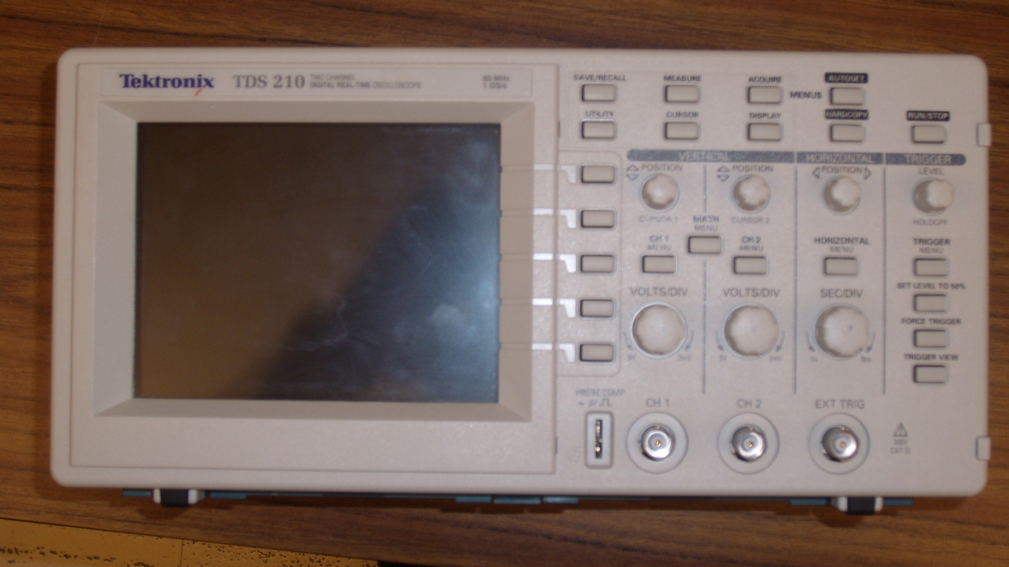
Virtual machines on oscilloscopes?
“Lots” of ROM, very little RAM
https://upload.wikimedia.org/wikipedia/commons/7/7e/Tektronix_TDS210_Oscilloscope.jpg
Notes:
https://upload.wikimedia.org/wikipedia/commons/7/7e/Tektronix_TDS210_Oscilloscope.jpg

Slide 7
J9 Architecture
Java calls
JNI
Uses 1 of many Java platform configurations
SE 7
Calls to
C
libraries
SE 6
Pluggable components that dynamically load into the virtual machine
CDC
MIDP
CLDC
Virtual machine
Native
applications
JVM Profiler
Class loader
VM Interface
JNI, INL, Fastcall
Debugger
Interpreter
TR JIT
Exception handler
Java VM Classes
JCL natives
Garbage collector
OS-specific calls
Thread model
Port Library (file IO, sockets, memory allocation)
Zip, fdlibm
Operating system
Notes:
This is an old slide, but the key idea it conveys is that J9
Has been developed as components
Pieces that can be added / removed at runtime where possible
Highly configurable with pluggable interfaces for alternative implementations of GC, JIT

Slide 8
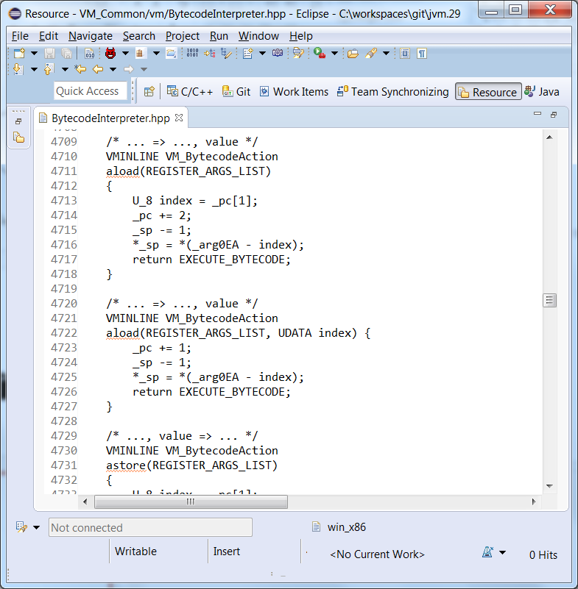
J9 Interpreter
Written in C++
Switch statement / computed goto
Executes:
  bytecodes
  INLs
  builds stack frames
Transition to the JIT
Notes:
Interpreter used to be written in assembly code that was generated from Smalltalk.
This was a big barrier to entry and made it hard for everyone to modify the critical parts of the code
In Java 7.0.1, we replaced it with the C++ code. This came at a slight performance hit, particularly to
Startup but we’ve recovered the loss through other improvements.
In Java 9, we will complete the removal of all Smalltalk generated assembly, preferring C/C++ and minimal amounts of handwritten assembly.

Slide 9
Garbage Collection
Throughput (Optthruput)
  Stop the world mark/sweep/compact (MSC) collector with all stages being parallel
Average Pause (Optavgpause)
  MSC with concurrent mark and sweep phases to reduce average pause times
Generational Collector (Gencon)
  Partial concurrent-mark for old-space and “semi-space” collected new area
    Parallel Copy, Tilted New Spaces, Dynamic New Space resizing
Multi-region Large Heap (Balanced)
  Region based collection supporting partial gc, high mobility, differentiated memory, goal based collections, with ROI heuristics
  Reduces maximum pause times in very large heaps
  Native memory aware reduces non-object heap consumption
Soft Realtime (Metronome)
  Realtime GC with max cpu utilization, max pause, max memory

Slide 10
Balanced GC
Heap
Heap Region
Differentiation
Object
“Points To”
Relationship
Gather objects with common properties
  Locality - sibling, child
  Usage frequency
  Lifetime, birthplace, resting place
“Results based” incremental operations
  productive GC every cycle
  localized garbage collect
Optimize based on memory characteristics
  Sharing status of mapped pages
  Regions grouped by memory speed
    NUMA, Tiered memory
  Flash, SSD, GPU exploitation
    Swapping, compression, LRU, custom formats
Notes:
Improved cache locality by placing related objects closer together
Allocation efficiency
Reduces working set size
Allows you to take more advantage of HW features like SSD, NUMA, etc
This can provide more scaling and sharing of memory
Can focus GC efforts on areas with high ROI

Slide 11
JIT Compilation
IL Generation
Profiler
Interpreter
Profile Info
Runtime
Environment/
Configuration
Optimizer
Profile
Manager
cold
warm
hot
very hot profiling
scorching
AOT
FSD
Sampling
Thread
Analyses and Optimizations
Options
Object Model
Memory
Threading
Tracing
Hardware
counters
Code Generators
ARM
Z
POWER
JIT
Profile Info
x86
RT Helpers
Runtime
Metadata
code
Notes:
A JIT is not *just* a compiler. It’s also a profile management, runtime assumptions and a high performance runtime collection system.

Slide 12
JIT Compilation
interpreter
Methods start out running bytecode form directly
After many invocations (or via sampling) code get compiled at ‘cold’ or ‘warm’ level
Low overhead sampling thread is used to identify hot methods
Methods may get recompiled at ‘hot’ or ‘scorching’ levels (for more optimizations)
Transition to ‘scorching’ goes through a temporary profiling step
cold
warm
hot
profiling
scorching
Notes:
Java's bytecodes are compiled as required, optimized based on runtime profiling
Dynamic compilation determines the target machine capabilities and app demands
Multiple phases, enable adaptive response to changing environment

Slide 13
Shared Classes
J9 JVMs use sharing to reduce memory and startup costs
  Ability to securely common Java class code across multiple JVM instances
  Reduces footprint due to sharing of read-only components (Java code)
  Reduces startup time by caching “ready to run” previously JITed code (Dynamic AOT)
  Dynamic AOT - reuse JIT code from multiple JVMs
  Reduce memory use by 20%, improve startup time 10-30 %

Slide 14
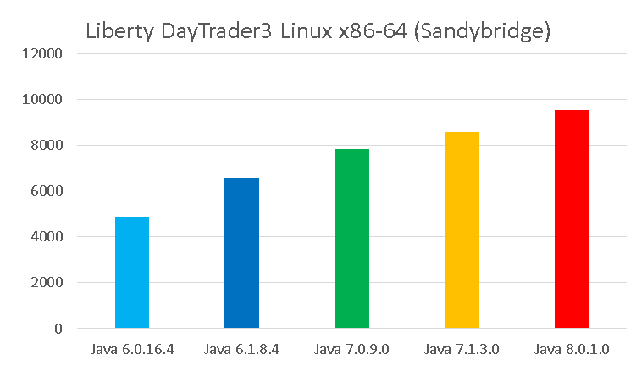
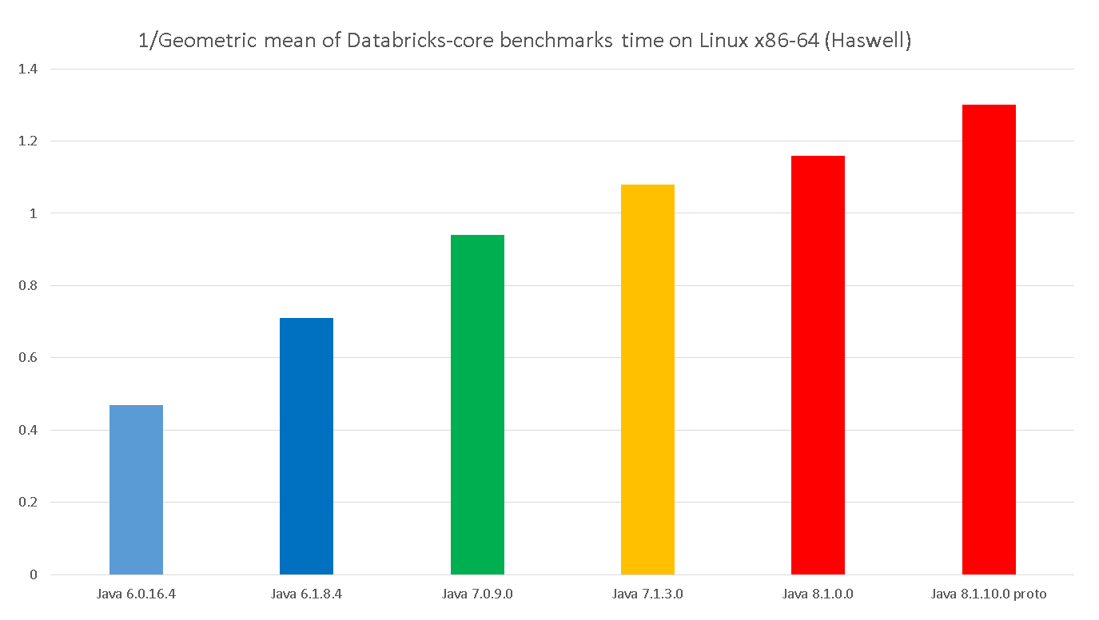
PERFORMANCE !
Java6
SR16 FP4
Java 6.1
SR8 FP4
Java 7
SR9
Java 7.1
SR3
Java 8
SR1
Apache Spark 1.4
Daytrader3 Linux Intel
Notes:
I have this slide here to show that performance continually improves from release to release on workloads that matter
Apache Spark and Daytrader for example
But this isn’t really the interesting part, let’s look at the details of J9.

Slide 15
http://www.eclipse.org/omr https://github.com/eclipse/omr https://developer.ibm.com/open/omr/
Dual License:
Eclipse Public License V1.0
Apache 2.0
Contributors very welcome https://github.com/eclipse/omr/blob/master/CONTRIBUTING.md
Eclipse OMR
Created March 2016

Slide 16
Eclipse OMR Mission
Build an open reusable language runtime foundation for cloud platforms
  To accelerate advancement and innovation
  In full cooperation with existing language communities
  Engaging a diverse community of people interested in language runtimes
    Professional developers
    Researchers
    Students
    Hobbyists

Slide 17
Eclipse OMR Components Currently Available
port platform abstraction (porting) library
thread cross platform pthread-like threading library
vm APIs to manage per-interpreter and per-thread contexts
gc garbage collection framework for managed heaps
compiler extensible compiler framework
jitbuilder WIP project to simplify bring up for a new JIT compiler
omrtrace library for publishing trace events for monitoring/diagnostics
fvtest language independent test framework built on the example glue so that components can be tested outside of a language runtime, uses Google Test 1.7 framework
+ a few others
~800KLOC at this point, more components coming!
Notes:
The next step for us is OpenJ9. Where we open up the rest of the J9 code base and build a fully open source JVM, continuing to leverage OpenJDK and OMR.

Slide 18
“We believe open ecosystems and partnerships are key to our future innovation.”
-- Ginni Rometty
(http://www.ibm.com/annualreport/2014/chairmans-letter.html)

Slide 19
Open J9 – Why?
Collaboration
Competition
Polyglot
Platforms
Collaboration
Competition
Polyglot
Platforms
Notes:
Collaboration:
Hard to collaborate when no one can see the source
Want to make it easy for everyone to work together on the code
Community members, customers, partners
Whether prototyping some new feature, have people try it, test out a new idea
Together we’re smarter than alone
Rapid innovation
One JVM good, multiple JVMs better
Competition makes runtimes better. It’s driven the perf improvements in Java for many years
Having two major ones enables more innovation & healthy competition.
Collaboration / Competition are the push-pull that drives rapid innovation
Absolutely necessary in the cloud age.
Polyglot
In IBM Runtimes, when we enable some feature for Java, say RDMA,
We’re immediately asked when Javascript, Swift, Go, Ruby will get it.
Flexible runtime components will benefit every language, including Java
And this gives rise to new functionality – better interop, portability, common debug / diagnostics
Platforms
Whether you run on X, or P, or Z, or ARM. This is good for you.
Cross platform capabilities makes your life easier as a dev when its
The same everywhere.
Enables HW producers – and not just cpus but gpus, fpga, etc
Two words: Rapid innovation.

Slide 20
Open J9 – Where?
Communities Beyond Java
Open JDK
IBM SDK for Java
Emulator
COBOL
Open JDK
PL/I
Open JDK
Open JDK
HotSpot
+
IBM
isms
Eclipse OMR
…
Open J9
Open J9
Ruby?
Python?
JS?
Swift?
OMR
OMR
OMR
OMR
OMR
OMR
Proven adaptable technology in the open for rapid innovation and collaboration across multiple language communities
Java community open innovation and collaboration, deep platform exploitation for X86 & IBM hardware platforms (OpenPOWER, Linux ONE)
Long term support, quick response for problems, and other forms of IBM customer specific engagement
Notes:
Our intentions are to work directly in the open source projects.
We feel that the best place would be to have the Open J9 project located at OpenJDK
This would give us the best opportunity to collaborate.
IBM already does JCL work at OpenJDK so it just makes sense to do our VM work there as well.

Slide 21
Open J9 – How?
hg clone <url>/jdk9/dev jdk9dev
cd jdk9dev
./get_source.sh
./configure
make all –with-openj9
Notes:
The goal is to have it be integrated seamlessly into OpenJDK.
get_source.sh could be modified to only pull OpenJ9 if you were going to use it by adding a –with-openj9 option
A first step would be just compiling OpenJ9 if it is asked for. In theory both HotSpot and OpenJ9 could be compiled and you could pick either one at runtime via a command line option but I am not sure this is something we want to pursue immediately

Slide 22
Open J9 – When?
Being developed concurrently with Java 9
Initial release being planned around Java9 release
Notes:
The development of getting ready for Open J9 is happening along side our Java 9 development
By doing it at the same time it keeps us honest and makes sure that everything works for both the open source project and for our internal JDK product
This means development is slower than we would like
We are hoping to have the initial drop ready around Java 9 GA.

Slide 23
Open Source
IBM is open sourcing its J9 JVM technology
  Includes Testarossa Just in Time (JIT) compiler
Eclipse OMR project is leading edge: github.com/eclipse/omr
  Project created March 7, 2016 : ~300KLOC
  Compiler contributed September 16, 2016 : ~500KLOC
Open J9 project is also coming
  We’re working on it at same time as Java 9 development

Slide 24
Questions?

