Slide 1
Containing Infrastructure
The Internet on Kubernetes
Brandon Philips
CTO & Co-Founder, CoreOS
@BrandonPhilips

Slide 2
3,424,000,000
Internet Users
Source: https://www.infoq.com/news/2014/01/IDC-software-developers
Notes:
https://www.infoq.com/news/2014/01/IDC-software-developers

Slide 3
29,000,000
Software Developers and IT Practioners
Source: http://www.internetlivestats.com/internet-users/
Notes:
https://www.infoq.com/news/2014/01/IDC-software-developers

Slide 4
We are Outnumbered!

Slide 5
238,975,082
New Internet Users in 2016
Source: http://www.internetlivestats.com/internet-users/

Slide 6
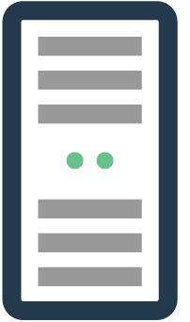
Notes:
http://www.gartner.com/newsroom/id/3441917
http://www.gartner.com/newsroom/id/3323017
3.5e8 * 4 * 2

Slide 7
Documents
Commerce
Communications
Notes:
http://www.gartner.com/newsroom/id/3441917
http://www.gartner.com/newsroom/id/3323017
3.5e8 * 4 * 2

Slide 8
~100,000,000
Servers Worldwide

Slide 9
3 Per Person
In the Software and IT Industry

Slide 10
100+ Per Person
At the Internet Giants

Slide 11
How do they do it?

Slide 12
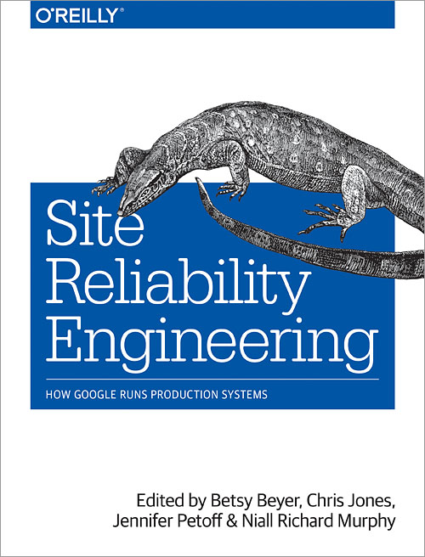
Software Systems:
Containers, Clustering, Monitoring
Enabling Teams To:
Organize, Specialize, Take Risks

Slide 13
you

Slide 14
you as a sw engineer

Slide 15
with Ada.Text_IO; procedure Hello_World is use Ada.Text_IO; begin Put_Line("Hello, world!"); end;
#include <stdio.h> int main() { printf("Hello, world!\n"); }
package main import "fmt" func main() { fmt.Println("Hello, world!") }
your

Slide 16
container
image
your

Slide 17
/bin/java
/opt/app.jar
/lib/libc
your

Slide 18
/bin/python
/opt/app.py
/lib/libc
your

Slide 19
quay.io/coreos/etcd
your

Slide 20
quay.io/coreos/etcd
your
sha256:d474e8c57737

Slide 21
Signed By: Alice
your
d474e8c57737625c

Slide 22
you as an ops engineer

Slide 23
your

Slide 24
quay.io/coreos/etcd
x3
your

Slide 25
quay.io/coreos/etcd
x3
your

Slide 26
quay.io/coreos/prometheus
x1
your

Slide 27
quay.io/coreos/dex
x2
your

Slide 28
Containers
Application Packaging

Slide 29
package main import "fmt" func main() { fmt.Println("Hello, world!") }

Slide 30
Building and Hosting
$ git clone git://github.com/coreos/etcd
$ docker build . -t quay.io/coreos/etcd:v3.1.0
$ docker push quay.io/coreos/etcd:v3.1.0

Slide 31
Dockerfile Build System
$ cat Dockerfile
FROM golang
ADD . /go/src/github.com/coreos/etcd
ADD cmd/vendor /go/src/github.com/coreos/e...
RUN go install github.com/coreos/etcd
EXPOSE 2379 2380
ENTRYPOINT ["etcd"]

Slide 32
container
image

Slide 33
/bin/etcd
/lib/libc

Slide 34
quay.io/philips/etcd

Slide 35
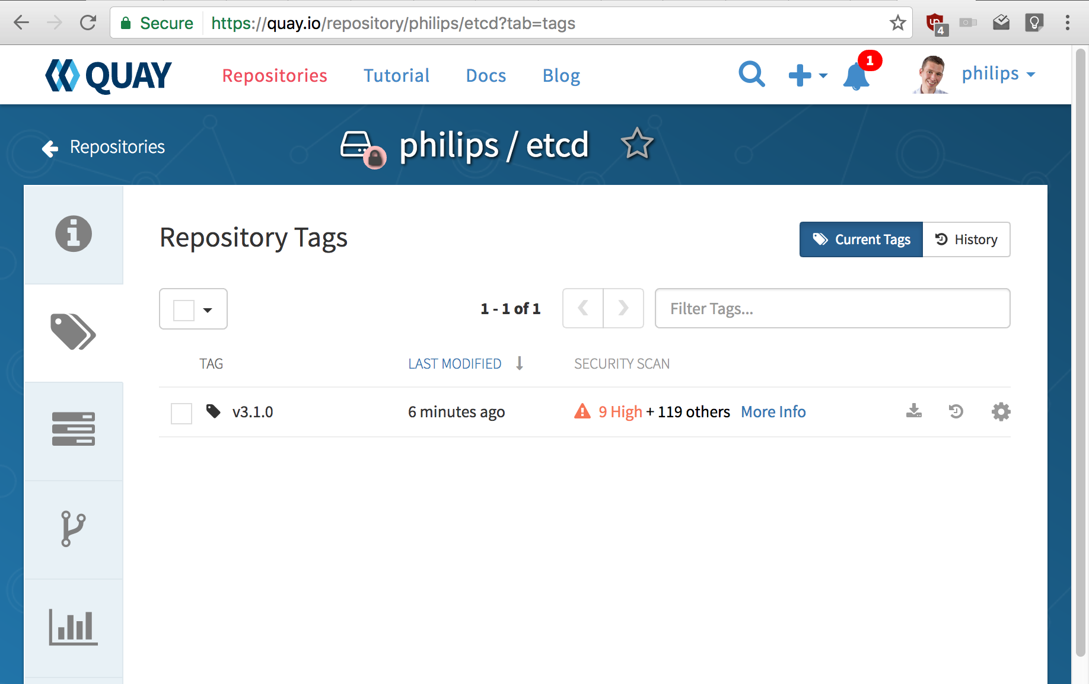

Slide 36
Running Containers
Application Packaging

Slide 37
Normal Linux Processes!
$ docker run -d quay.io/philips/etcd:v3.1.0 -d
$ pidof etcd
24725
$ cat /proc/24725/mounts | grep overlay
/ overlay workdir=/var/lib/docker/overlay/7134

Slide 38
Abstract away app from the OS
OS App

Slide 39
Traditional Linux

Slide 40
Containers
Required Software

Slide 41
Clustering

Slide 42
Clustering
Server Botnets!

Slide 43
100+ Per Person
At the Internet Giants

Slide 44
100+ Per Person
Too many for manual placement

Slide 45
100+ Per Person
Too many for manual placement

Slide 46
100+ Per Person
Too many for manual placement

Slide 47
$ while read host; ssh $host … < hosts
???

Slide 48
$ while read host; ssh $host … < hosts
???

Slide 49
$ while read host; ssh $host … < hosts
Problems: No monitoring, no state to recover

Slide 52
$ kubectl run --replicas=3 quay.io/coreos/dex

Slide 53
$ kubectl run --replicas=3 quay.io/coreos/dex
Solution: Monitoring, and state on computers

Slide 54
$ kubectl run --replicas=3 quay.io/coreos/dex

Slide 55
$ kubectl run --replicas=3 quay.io/coreos/dex

Slide 56
$ kubectl run --replicas=3 quay.io/coreos/dex

Slide 60
???

Slide 61
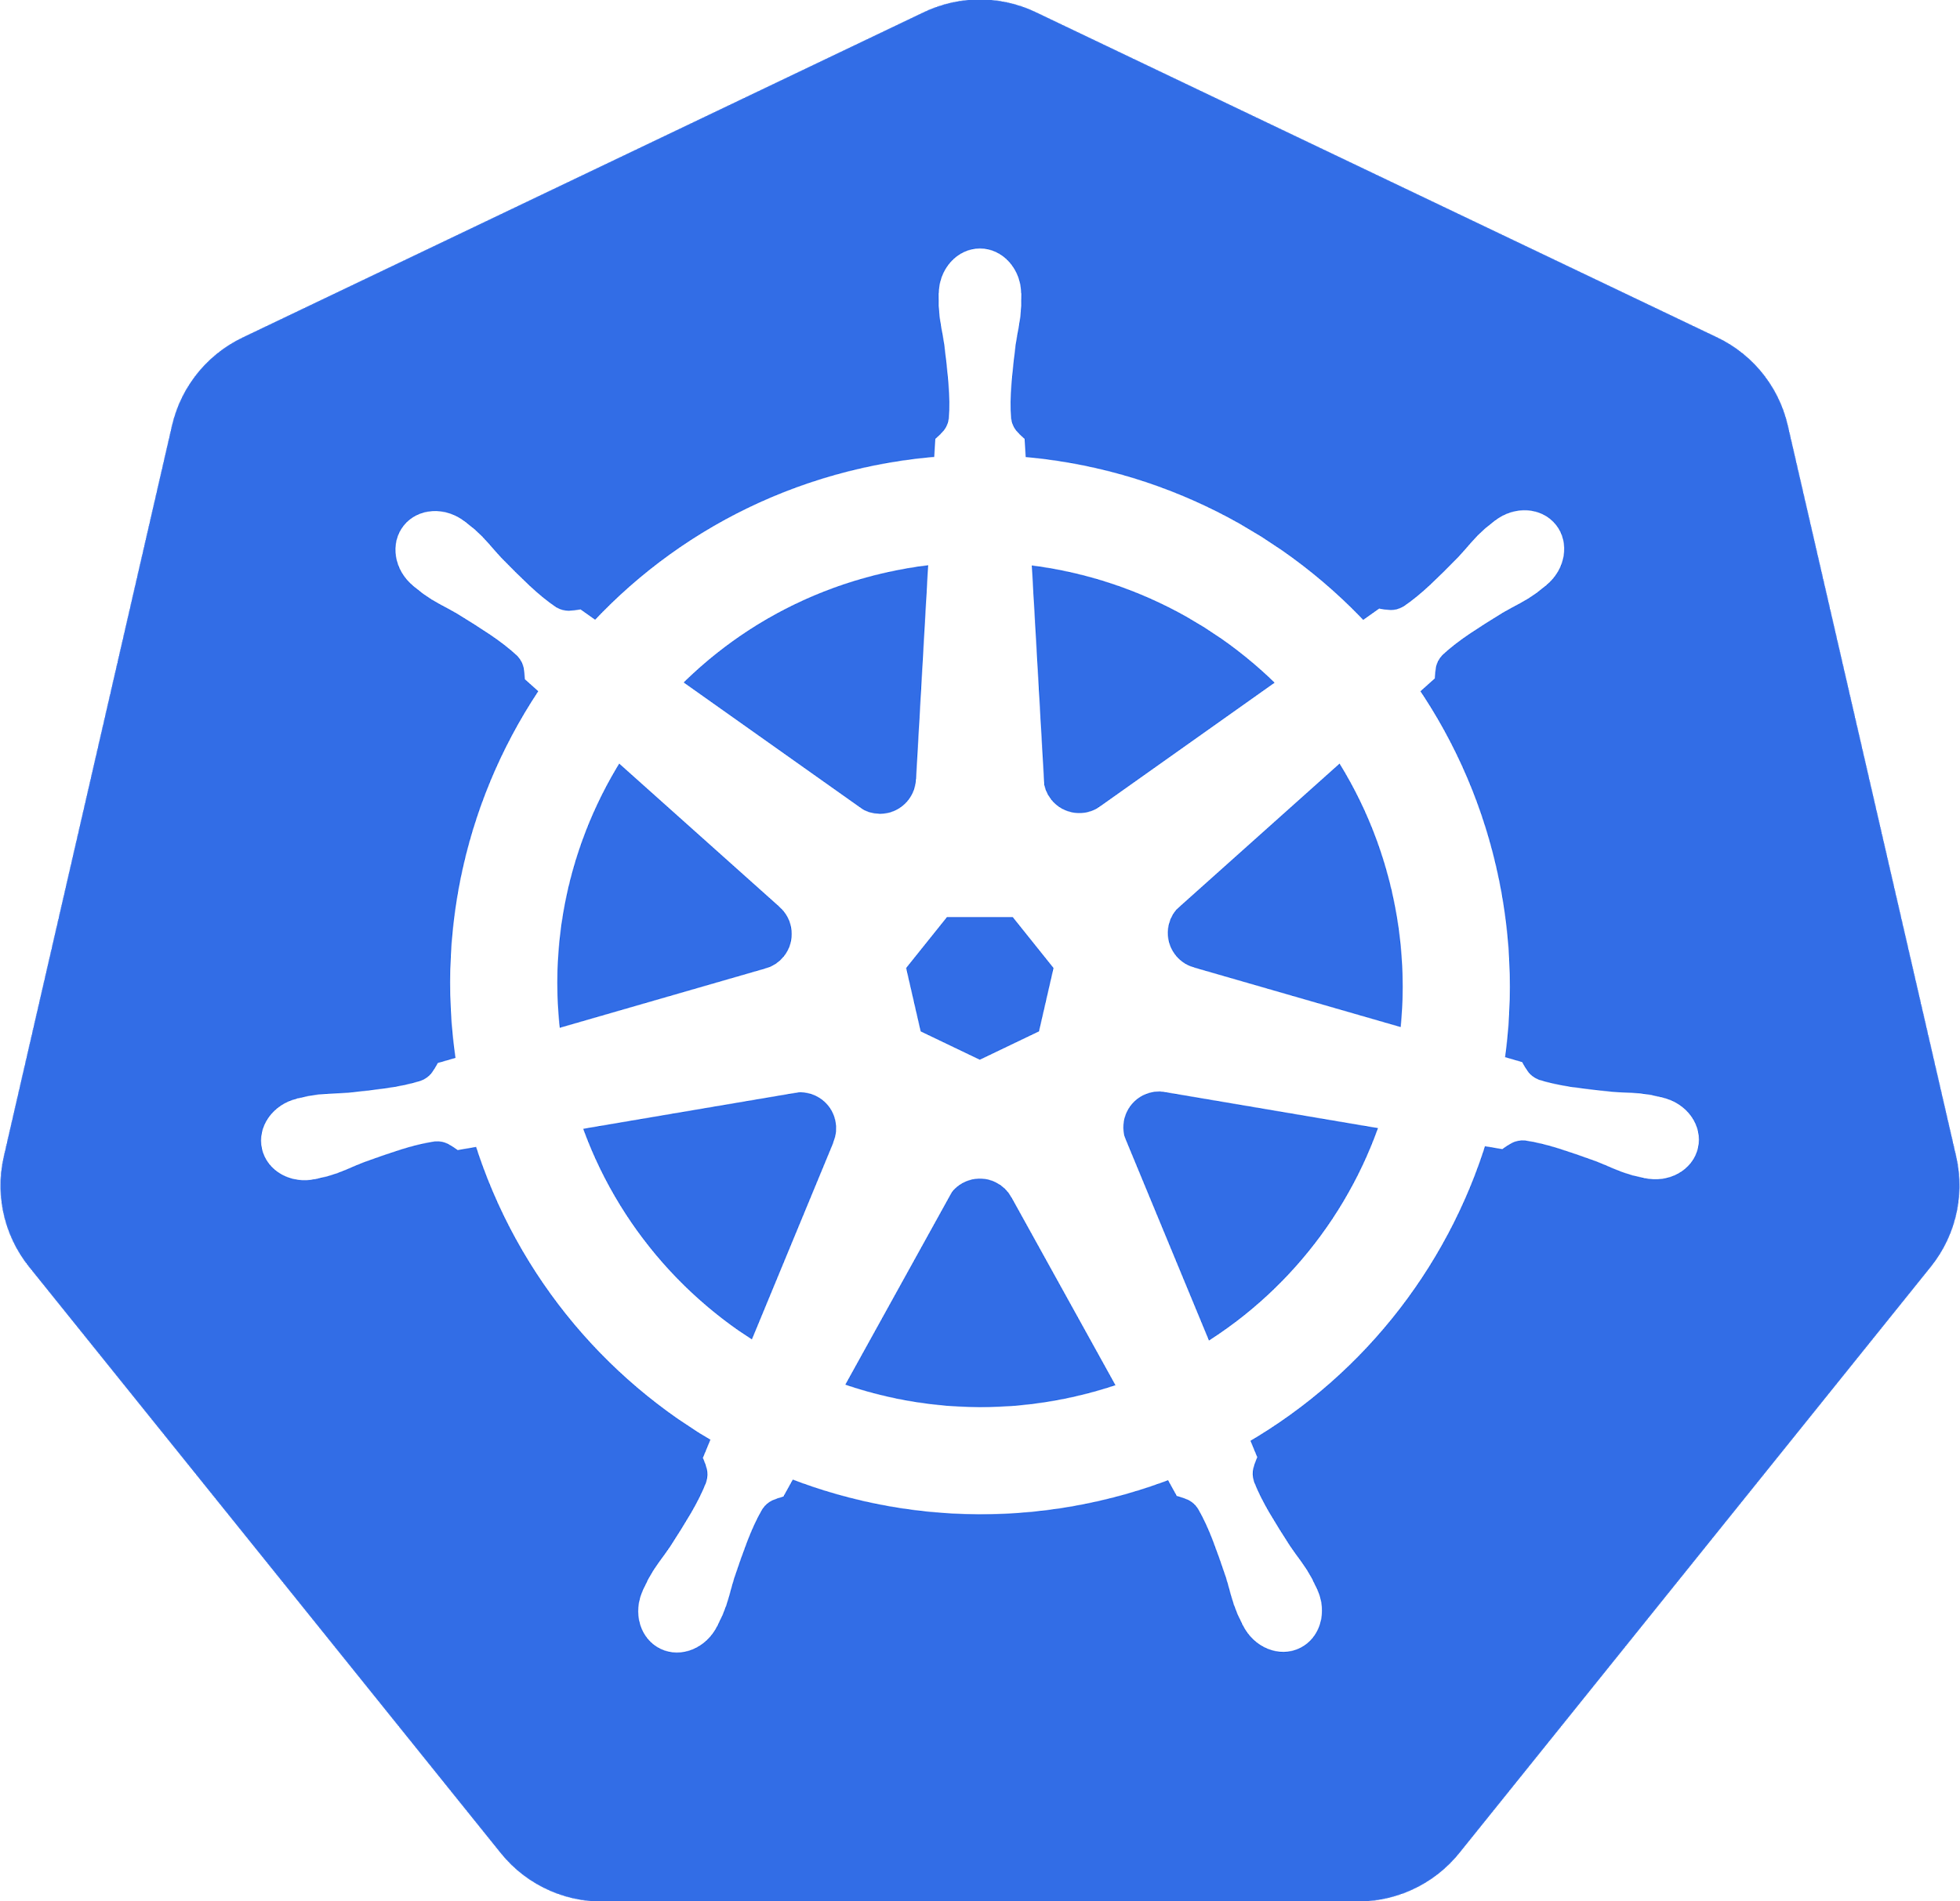
???

Slide 62
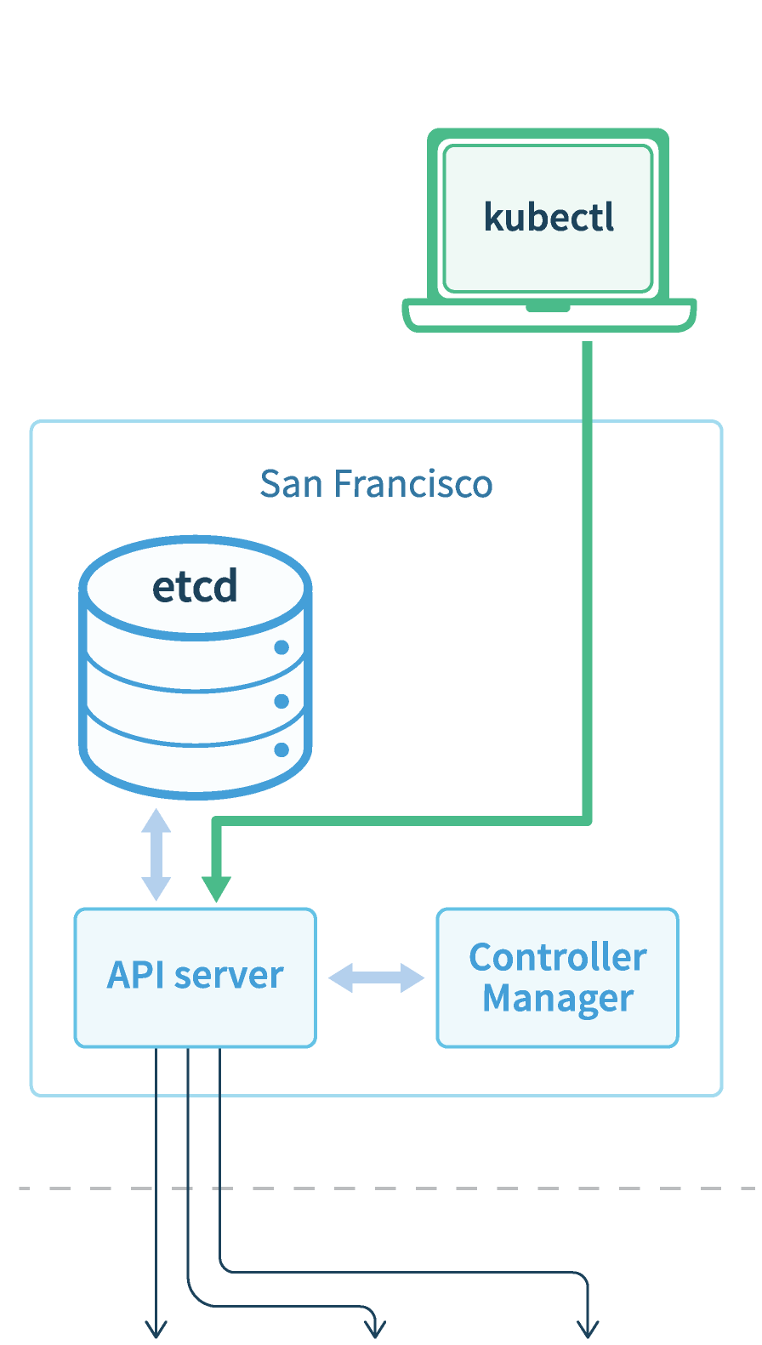
Simple cluster operations
Secure and Simple API
Friendly operational tools

Slide 63
Clustering
Facing Failure

Slide 64
Simple cluster operations
Secure and Simple API
Friendly operational tools

Slide 65
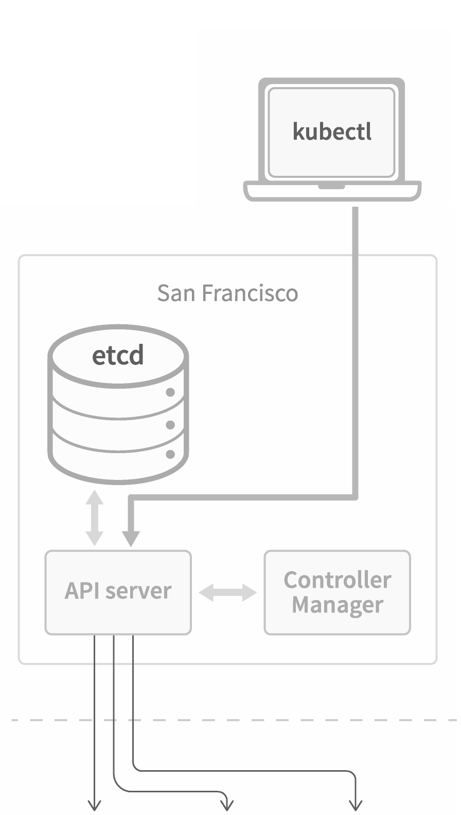
etcd Overview
Introduced in 2013 by CoreOS
Persistent database of Kubernetes
Auto-leader election for availability

Slide 66
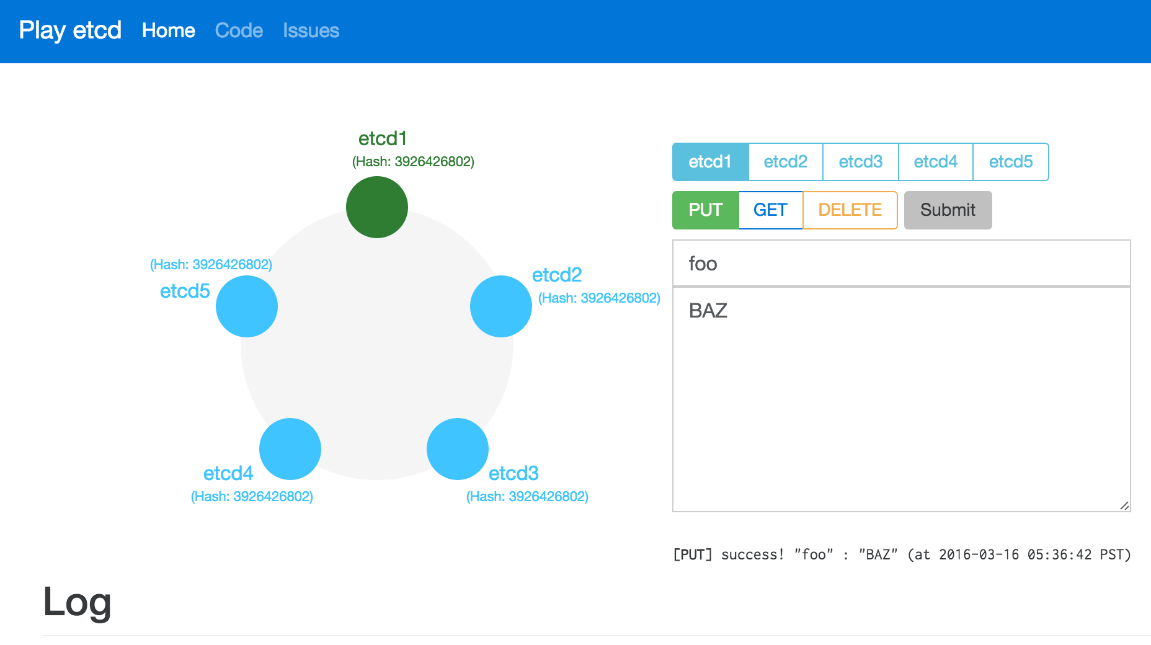

Slide 67
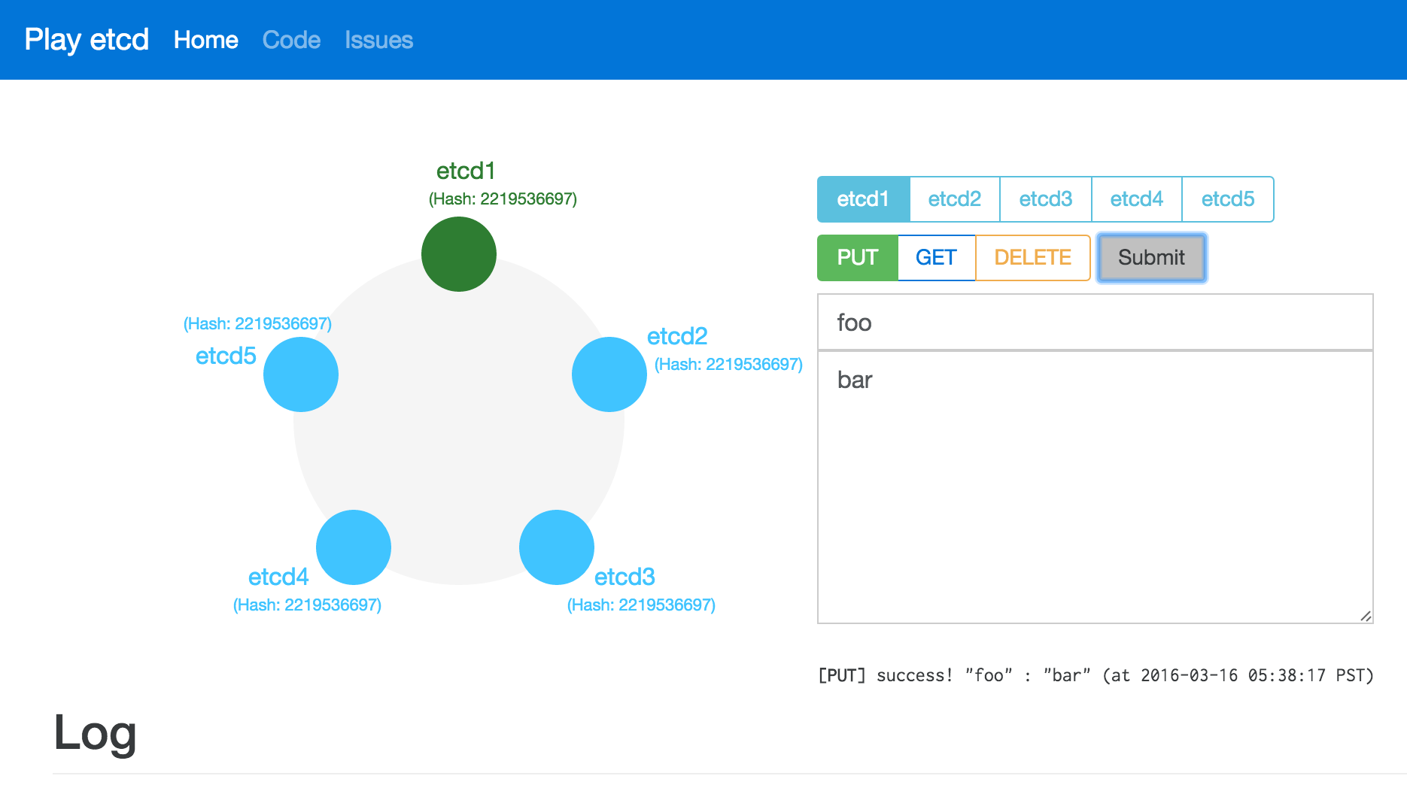

Slide 68
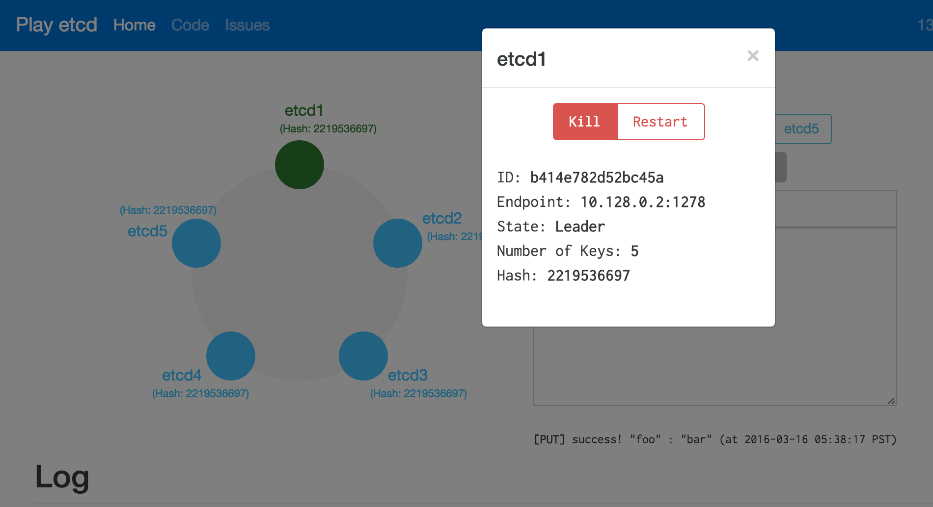

Slide 69
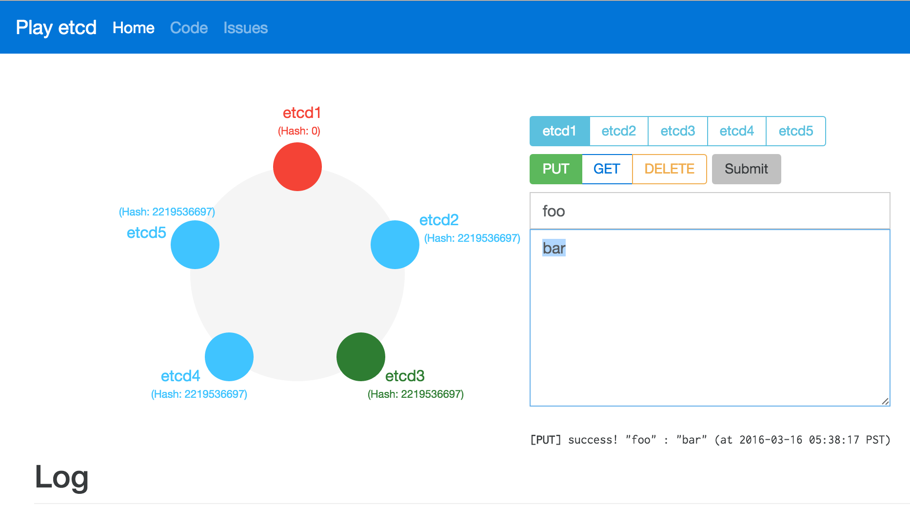

Slide 70
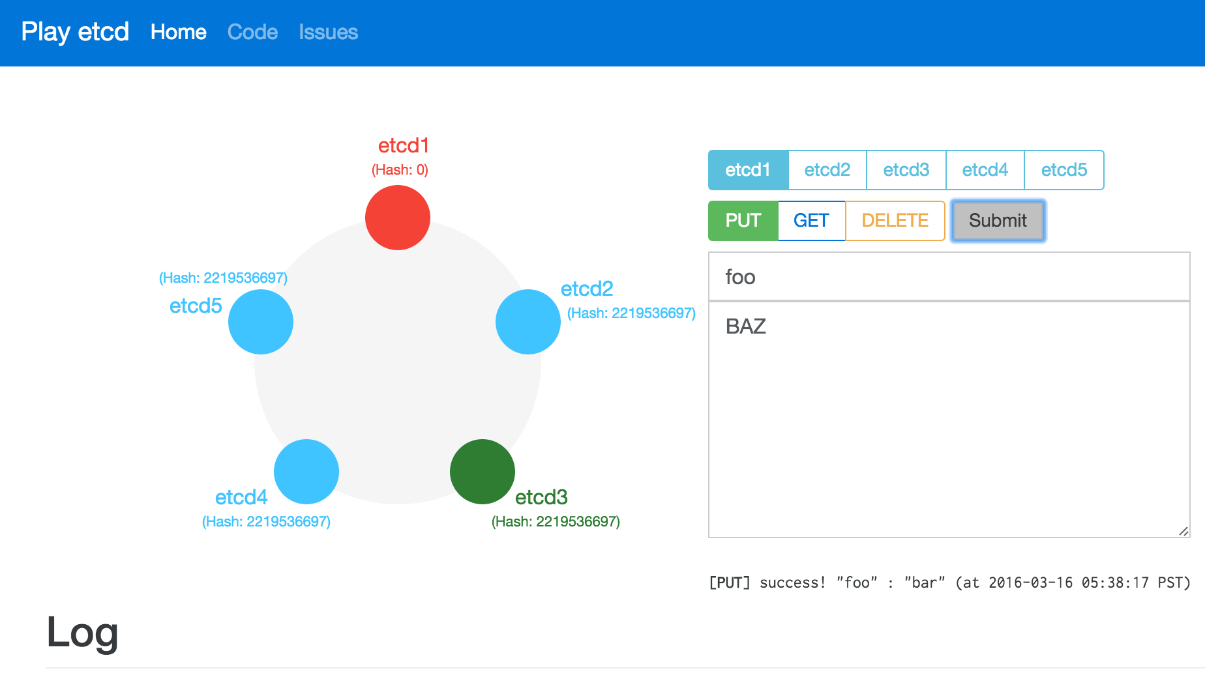

Slide 71
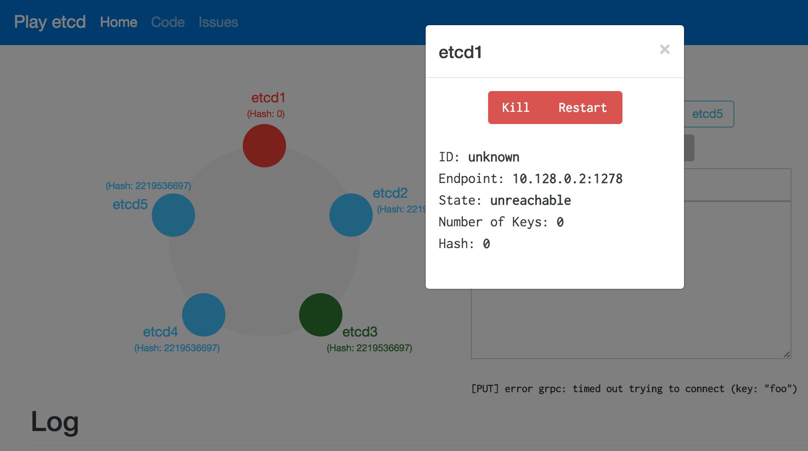

Slide 72
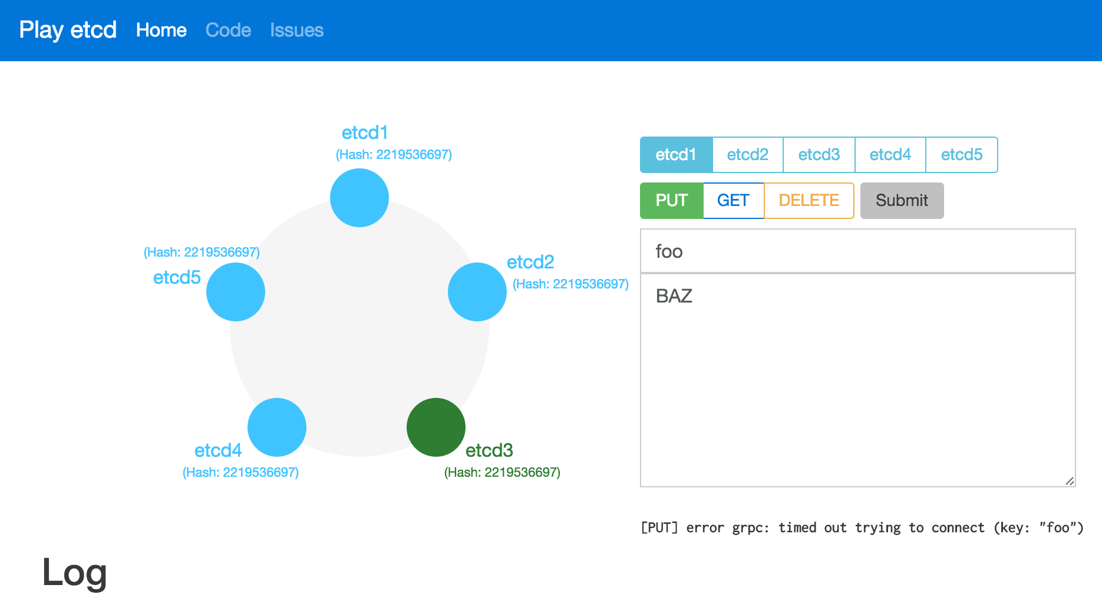

Slide 76
Kubernetes Everywhere
Consistent Infrastructure Everywhere

Slide 77
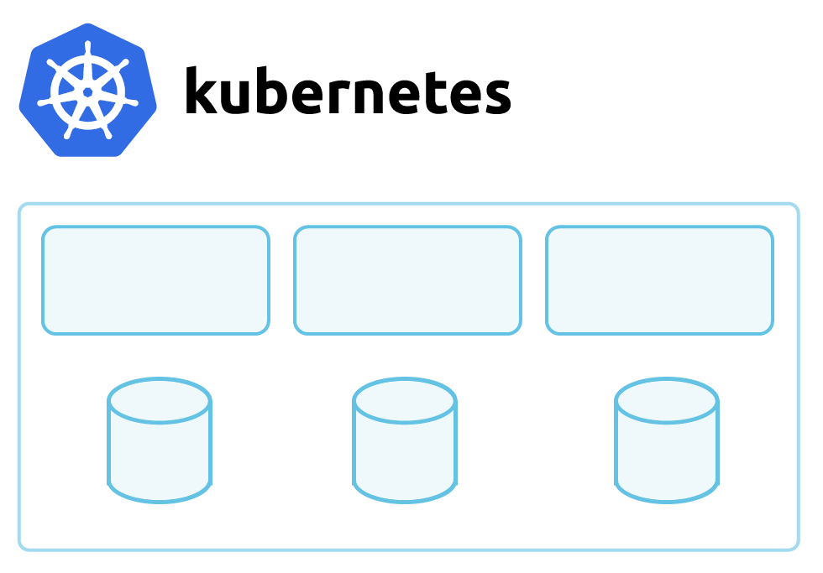
kubectl
v1.5.2
k8s API
EC2
EC2
EC2
AWS APIs
EBS
EBS
EBS
AWS VPC

Slide 78
kubectl
v1.5.2
k8s API
VM
VM
VM
Azure APIs
Disk
Disk
Disk
VirtualNet

Slide 79
kubectl
v1.5.2
k8s API
VM
VM
VM
Google APIs
PD
PD
PD
VirtualNet

Slide 80
kubectl
v1.5.2
k8s API
Droplet
Droplet
Droplet
Digitalocean APIs
Vol
Vol
Vol
VirtualNet

Slide 81
kubectl
v1.5.2
k8s API
Instance
Instance
Instance
OpenStack APIs
Vol
Vol
Vol
VirtualNet

Slide 82
kubectl
v1.5.2
k8s API
Bare Metal
Bare Metal
Bare Metal
SAN
SAN
SAN
Ethernet

Slide 83
Consistency on all major components
Compute: Physical, Virtual Machine, Cloud
Networking: VXLAN, BGP, IPIP, forwarding, etc
Storage: EBS, NFS, GlusterFS, Cinder, etc
Load Balancing: ELB, nginx, Cloud LB, etc

Slide 84
Federation
Handling Too Much Success

Slide 88
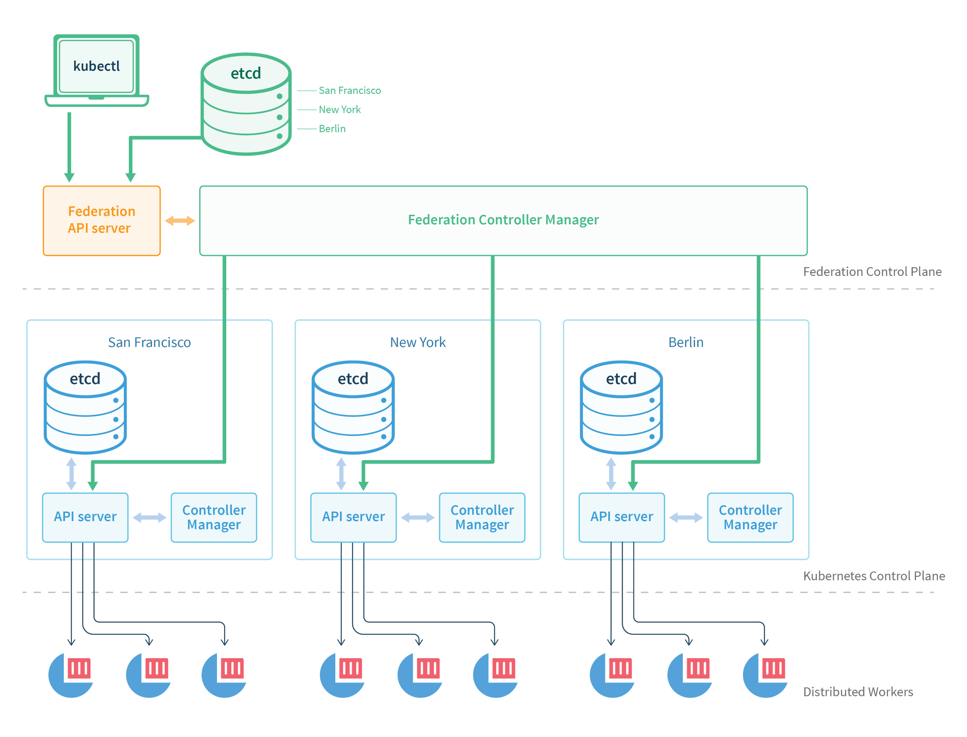

Slide 89
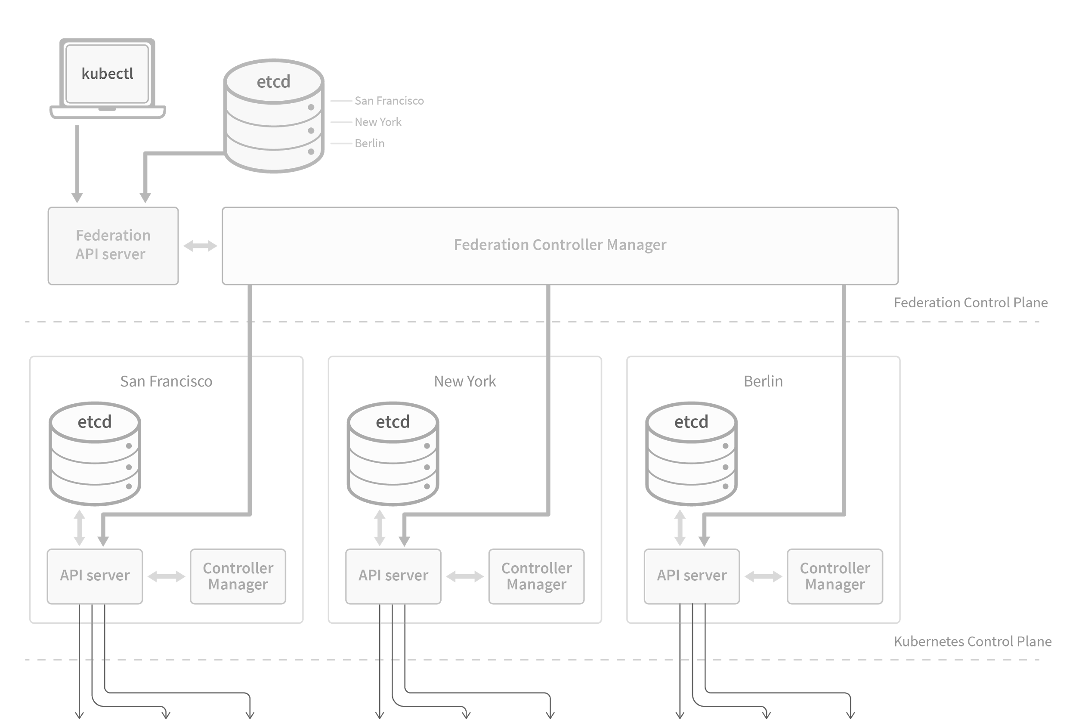

Slide 90
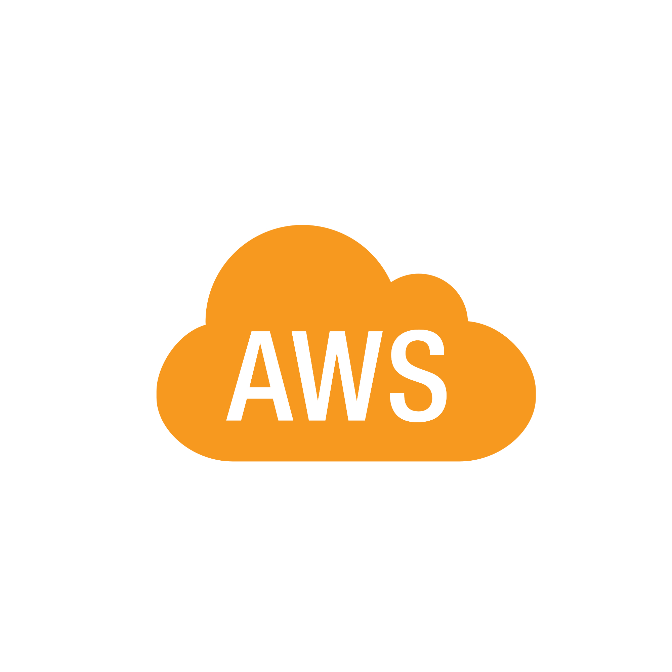
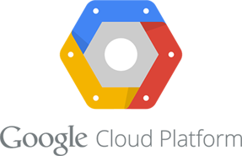

Slide 91
work-in-progress

Slide 92
Service Discovery
Labels, The Kubernetes Way

Slide 93
frontend
frontend
philips
rithu
prod
dev
backend
backend
rithu
philips
dev
prod

Slide 94
frontend
frontend
philips
rithu
prod
dev
backend
backend
rithu
philips
dev
prod

Slide 95
frontend
frontend
philips
rithu
prod
dev
backend
backend
rithu
philips
dev
prod

Slide 96
frontend
frontend
philips
rithu
dev
prod
backend
backend
rithu
philips
dev
prod

Slide 97
Scaling Applications
Reacting to Demand

Slide 98
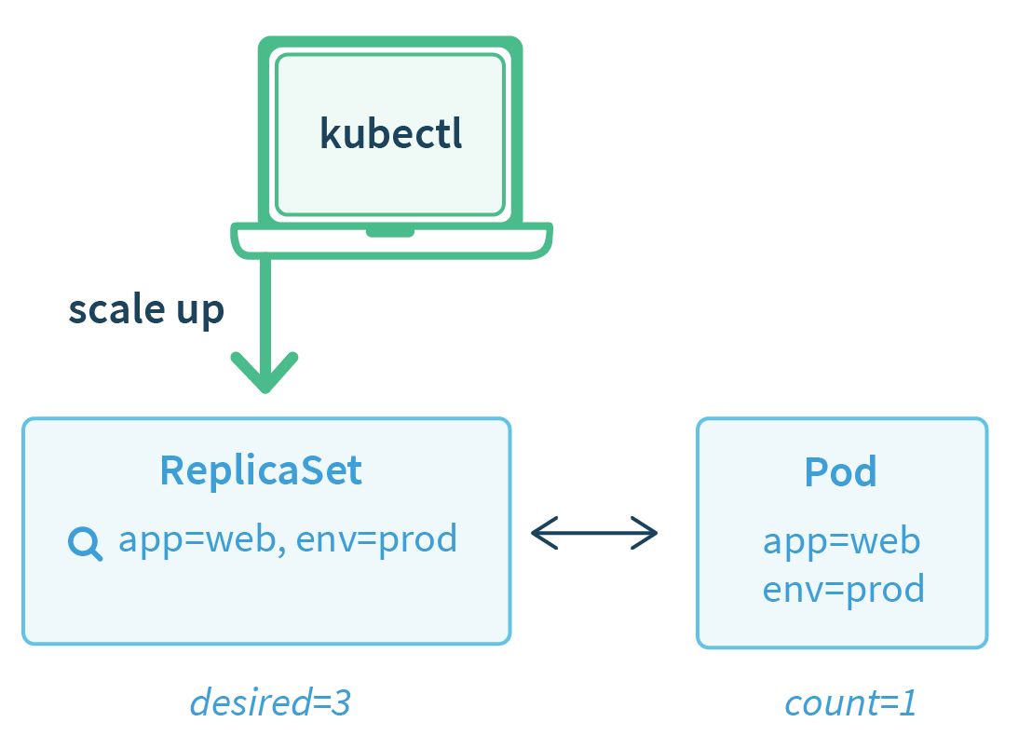
ReplicaSet

Slide 99
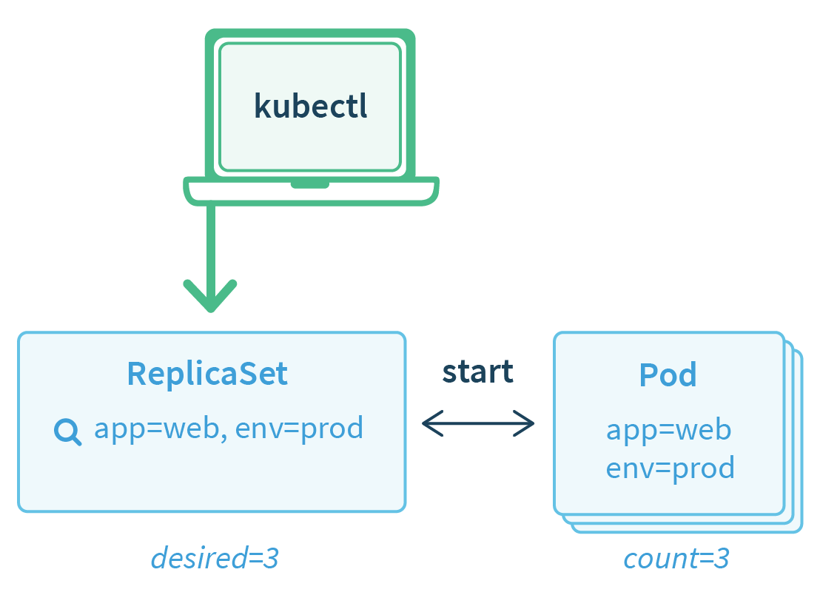
ReplicaSet

Slide 100
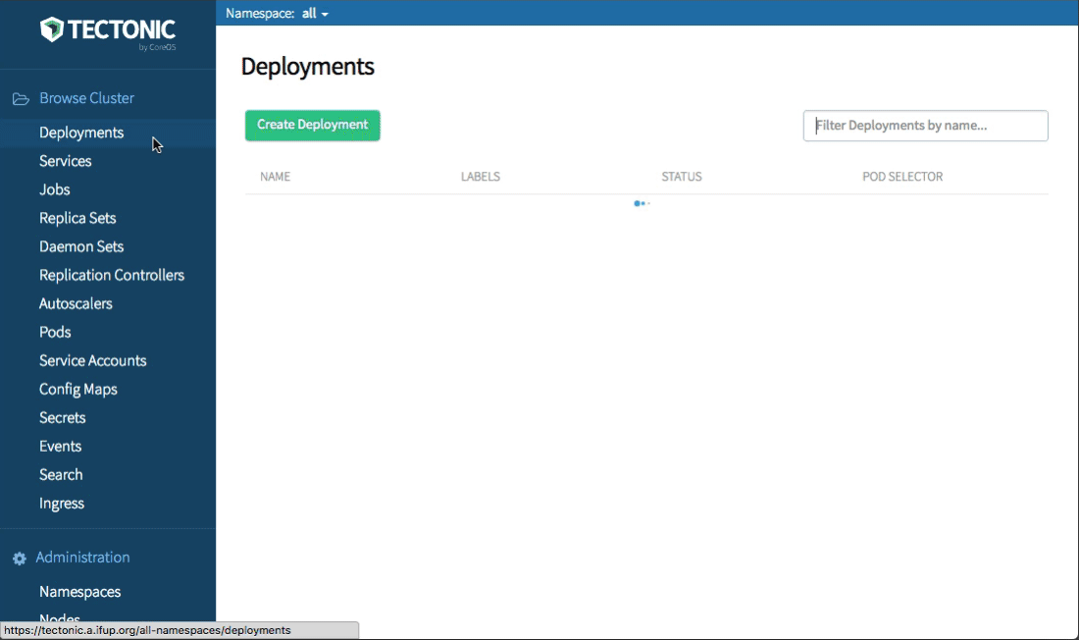

Slide 101
Overview
Scaling Complex Apps

Slide 102
Creating a Database is Easy on Kubernetes
$ kubectl run db --image=quay.io/my/db

Slide 103
Managing a Distributed Database is Harder
Resize/Upgrade - coordination for availability
Reconfigure - tedious generation / templating
Backup - requires coordination on instances
Healing - observe and act for recovery

Slide 104
Introducing
Operators

Slide 105
The Dream
$ cat my-db-cluster.yaml
spec:
clusterSize: 3
readReplicas: 2
version: v4.0.1

Slide 107
etcd Operator Resource
$ cat etcd-cluster.yaml
spec:
clusterSize: 3
version: v3.1.0

Slide 108
etcd Operator

Slide 109
Monitoring
Foundation of Production

Slide 110
Prometheus Operator
Operates Prometheus on k8s
Handles common tasks:
Create/Destroy
Monitor Configuration
Services Targets via Labels
Configured by resources

Slide 111
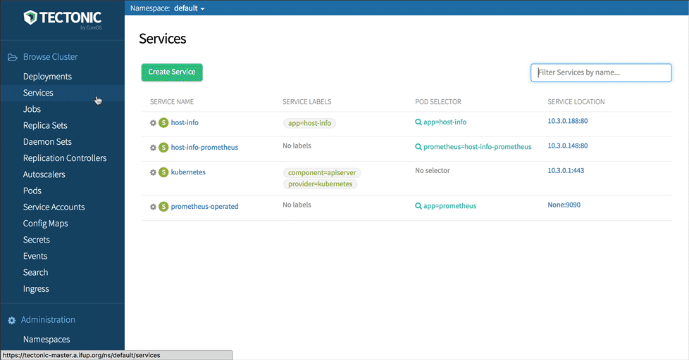

Slide 112
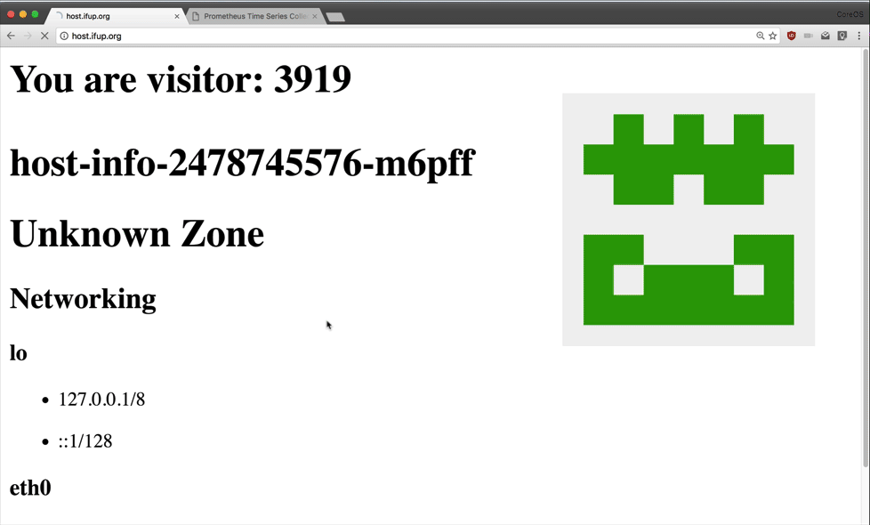

Slide 113
What's Next?
Kubernetes Next Steps

Slide 114
Kubernetes Next Steps
Healthy growth of the open source community
Better metrics and monitoring
Ever improving security defaults
Support for more cloud platforms
More pre-packaged applications
https://github.com/kubernetes/features

Slide 115
CoreOS Mission
Secure the Internet

Slide 116
Notes:
http://www.gartner.com/newsroom/id/3441917
http://www.gartner.com/newsroom/id/3323017
3.5e8 * 4 * 2

Slide 117
Documents
Commerce
Communications
Notes:
http://www.gartner.com/newsroom/id/3441917
http://www.gartner.com/newsroom/id/3323017
3.5e8 * 4 * 2

Slide 118
~100,000,000
Servers Worldwide

Slide 119
Self Driving Infrastructure

Slide 120
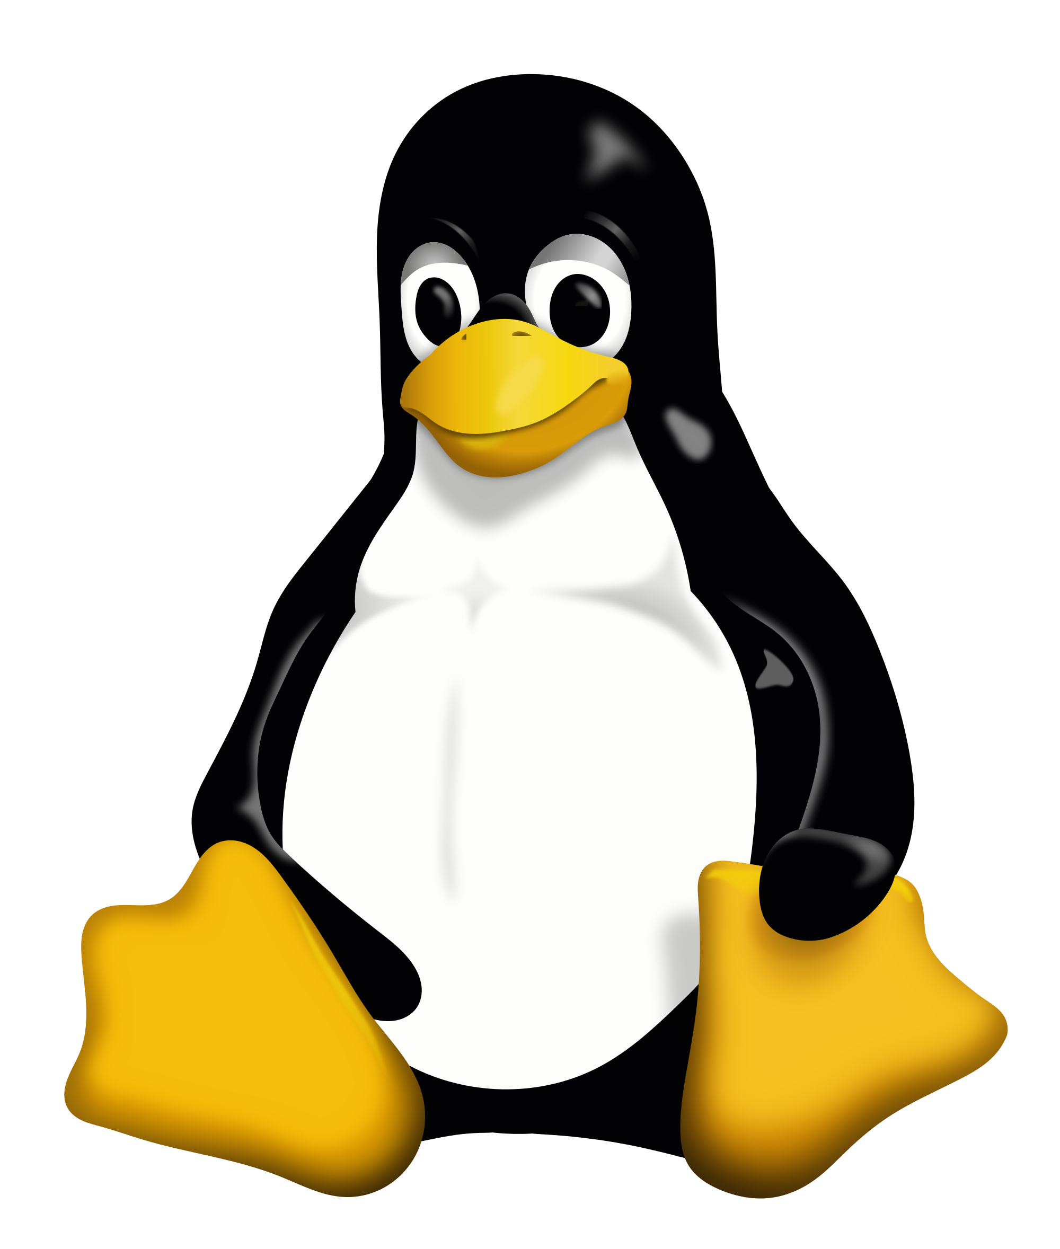
What is self-driving infrastructure
Applying updates to our infrastructure software much like the way updates are applied to our phones
1
1

Slide 121
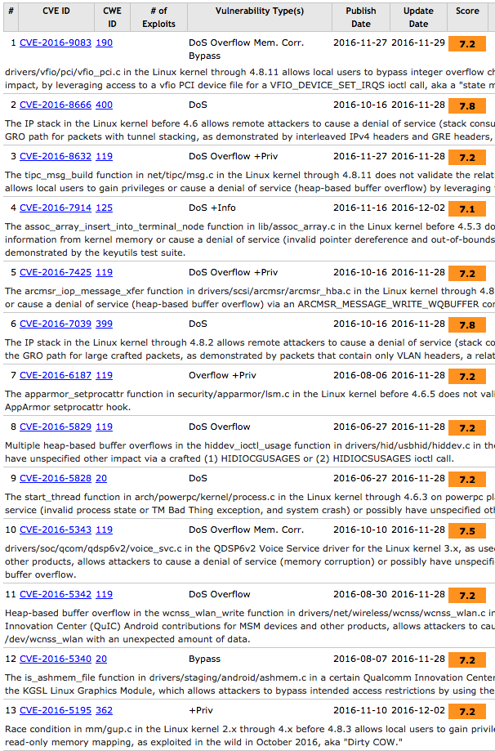
Why self driving infrastructure
Patching Software is important

Slide 122
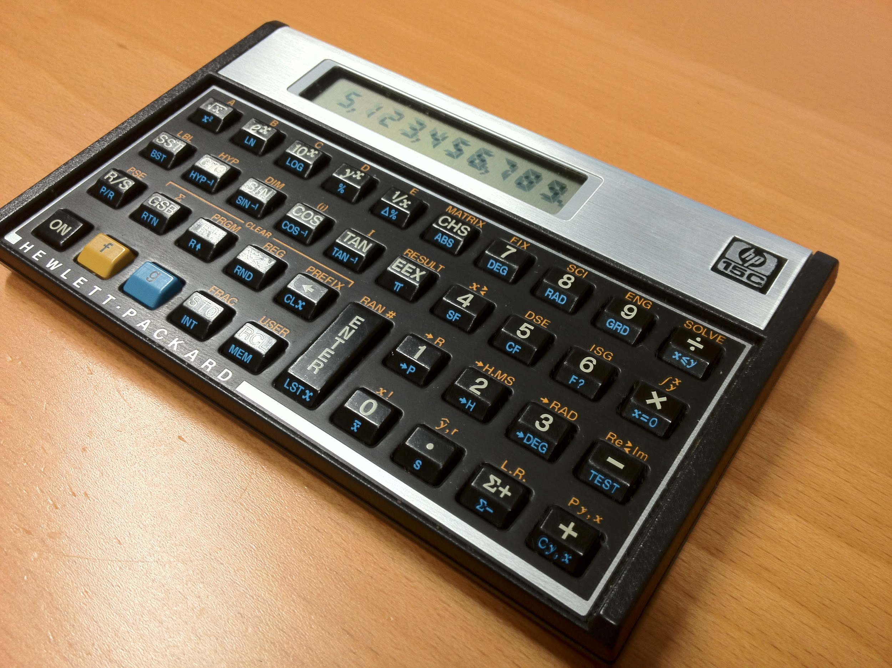

Slide 123
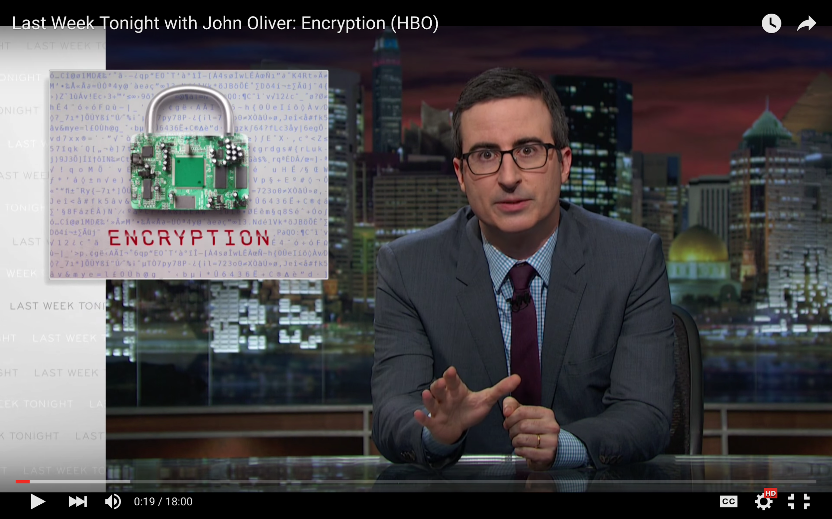

Slide 124
Notes:
Quote: "Best case we can keep attackers out of your stuff for about 6 months before it happens again"

Slide 125
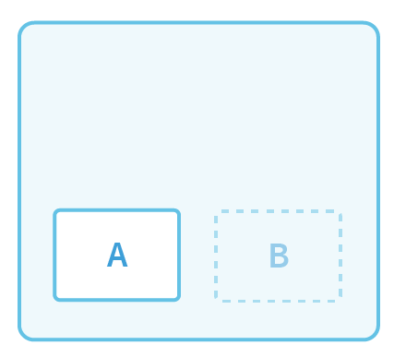
Updating Container Linux
Container Linux
OS
Update
VM / Bare Metal
Notes:
Note: global desired state with the updates. Spend some time talking about the system.

Slide 126
Updating Container Linux
Container Linux
OS
Update
VM / Bare Metal

Slide 127
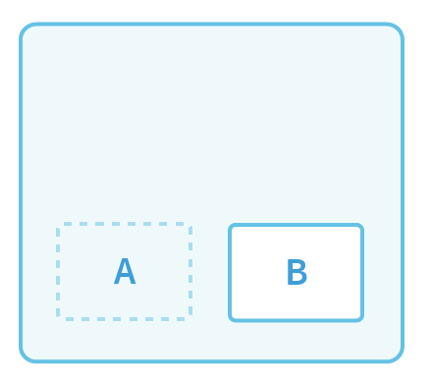
Updating Container Linux
Container Linux
VM / Bare Metal

Slide 128
Updating Kubernetes
Kubernetes
API Server
Container
Deployment

Slide 129
Updating Kubernetes
Kubernetes
API Server
Container
Deployment

Slide 130
Updating Kubernetes
Kubernetes
Deployment

Slide 131
kubectl
v1.5.1
k8s API
VM
VM
VM
Azure APIs
PD
PD
PD
VirtualNet

Slide 132
kubectl
v1.5.2
k8s API
VM
VM
VM
Azure APIs
PD
PD
PD
VirtualNet

Slide 133
Free Stuff
Get Kubernetes For Yourself

Slide 134
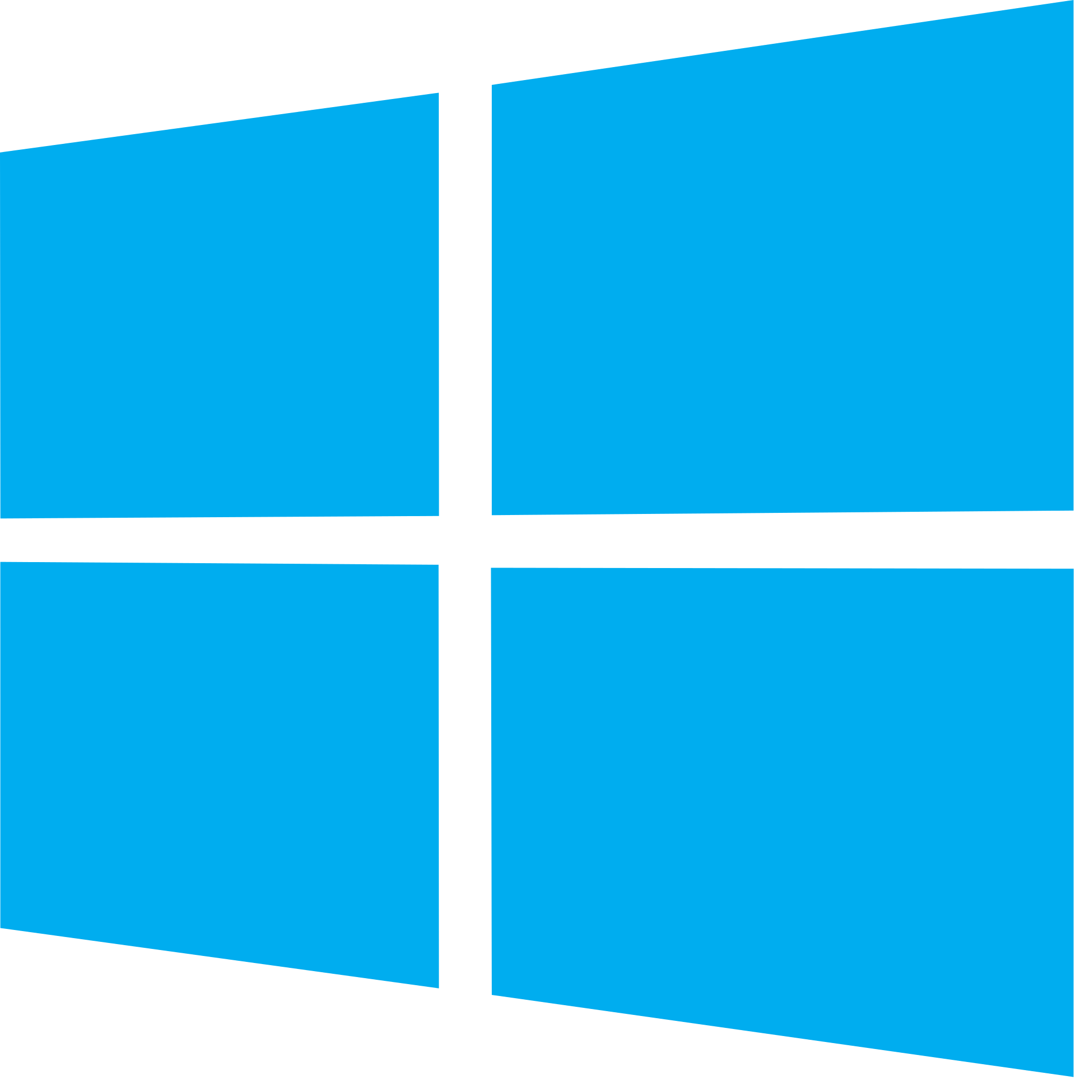
Minikube - Kubernetes on your laptop
All-in-one Virtual Machine
Single file download
Latest Kubernetes
github.com/kubernetes/minikube

Slide 135
Tectonic Free Tier
Pure upstream Kubernetes
Production configuration
Bare metal and AWS installer
(more coming soon)
coreos.com/tectonic

Slide 136
Join Us
Build great code

Slide 137
github.com/coreos
Hack on Operating Systems
Build distributed systems
Geek out on internet identity protocols
Container Focused Operating System
Clustered Database
Identity & Federation
10+ other major projects

Slide 138
github.com/kubernetes
Most active project on GitHub
Dozens of special interest groups
Not just code! Docs, PM, and more

Slide 139
Work WIth Us
Community is taking off

Slide 140
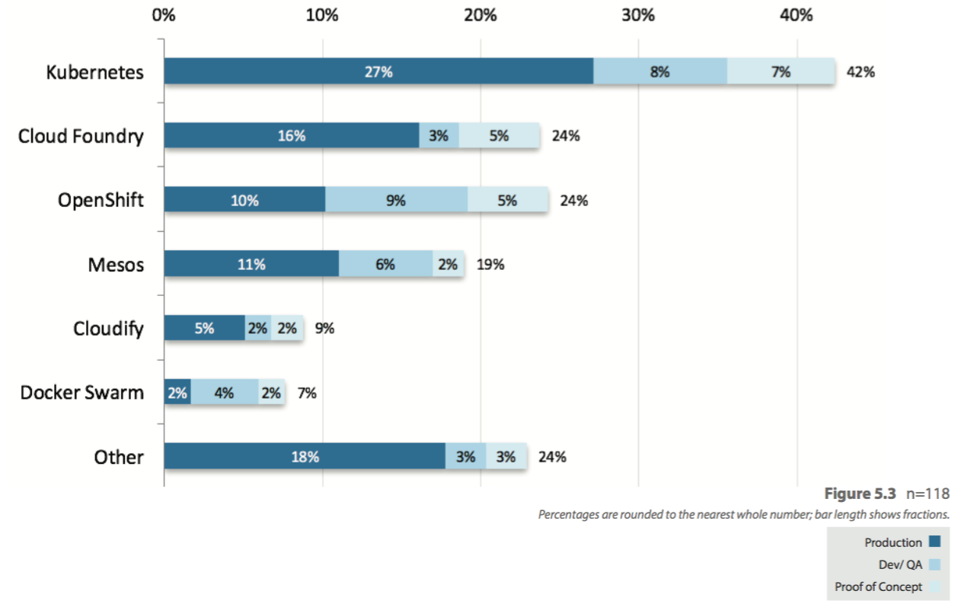
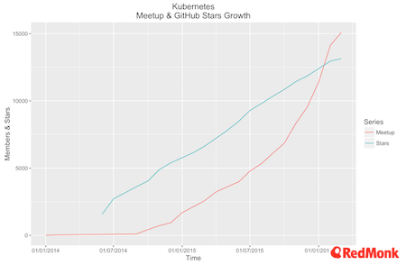
What container and PaaS tools are used to manage OpenStack applications?
Developer engagement
OpenStack User Survey, April 2016, openstack.org.
“The Further Evolution of Kubernetes,” March 2016.

Slide 141
CoreOS is running the world’s containers
We’re hiring: careers@coreos.com
OPEN SOURCE
ENTERPRISE
90+ Projects on GitHub, 1,000+ Contributors
Support plans, training and more
coreos.com
sales@coreos.com
Notes:
CoreOS provides the components needed to build distributed systems to support application containers.
#GIFEE

Slide 142
May 31 - June 1, 2017
San Francisco
coreos.com/fest
@coreosfest
Notes:
We invite you to the third annual CoreOS Fest. We'll gather 800+ developers, devops professionals and sysadmins to celebrate and explore Open Source Distributed Systems.
@ Pier 27 (The Embarcadero), San Francisco, CA 94111
Accepting speaking submissions until March 3, 2017.
Sponsorships available. Contact: fest@coreos.com
COST
$395 until February 15th
$495 until April 26th
$595 FULL PRICE

Slide 143
Thanks!
QUESTIONS?
LONGER CHAT?
brandon.philips@coreos.com
@BrandonPhilips
linkedin.com/in/brandonphilips
Let’s talk!
IRC
More events: coreos.com/community
We’re hiring: coreos.com/careers

Slide 144
Self-Driving Kubernetes
Preview

