Slide 1
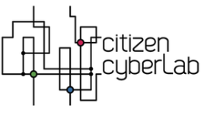
Team: Brogniart Benjamin, Collet Pierre, Goujet Raphael, Leflour Yann, Leung Armella, Shomar Helena
@dsynbio #fosdem to ask questions

Slide 2
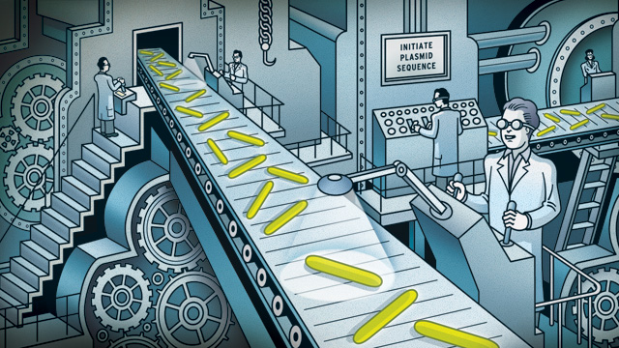
Synthetic Biology: THE XXIst century technology
World trend:
$1.1 billion in 2010;
$10.8 billion in 2016
86% of adults
don't know or know hardly anything about synthetic biology

Slide 3
Synthetic Biology: BioBricks, BioBricks everywhere
Apply engineering methods to biological systems
TO
Extend or modify the behaviour of living organisms, and program them to do useful, reliable and controlable tasks
‘Biobrick’

Slide 4
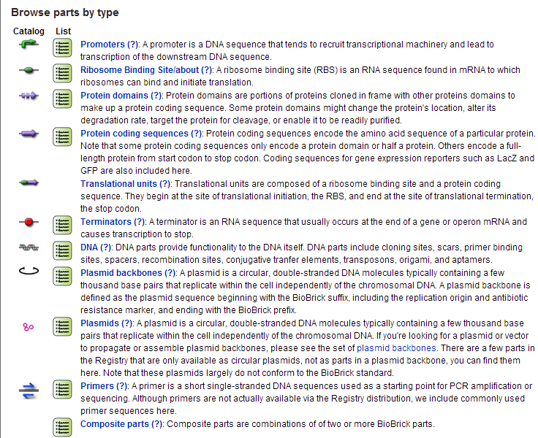
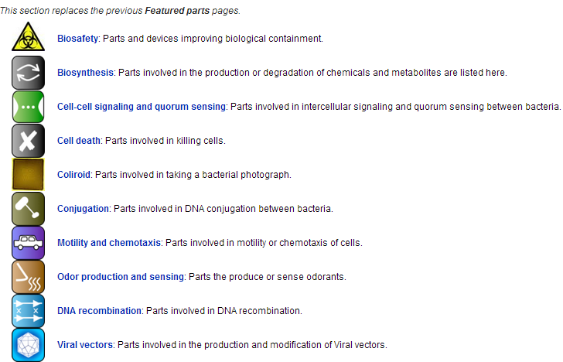

Slide 5
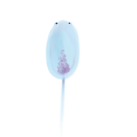
Synthetic Biology: Design
Cellular ability
Genetic device
4 types of ‘Briobricks’
WHEN?
HOW MUCH?
WHAT?
End
Promoter
RBS
Gene
Terminator
50%
GFP
25%

Slide 6
The simulator
Scientific realism
Concentration of X
Genetic expression
Enzyme activity
Allosteric interactions
Exchanges with the medium
- Diffusion
- Active transport
Degradation
Ability (S)

Slide 7
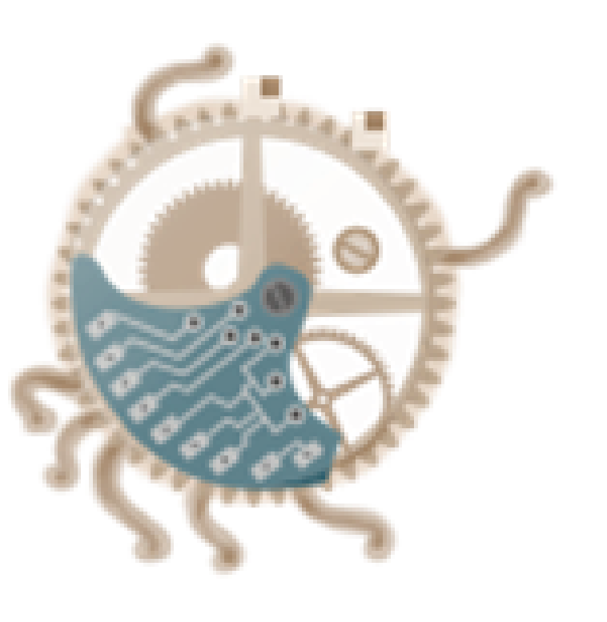
DEMO TIME

Slide 8
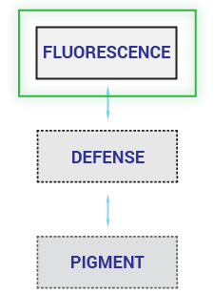
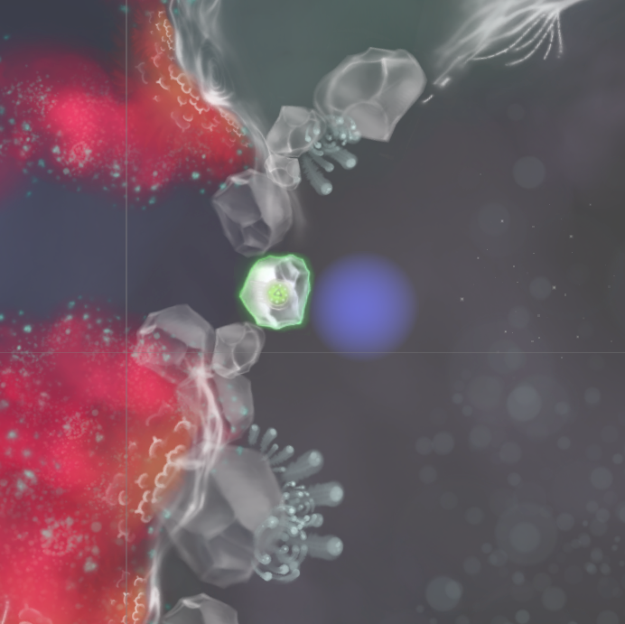
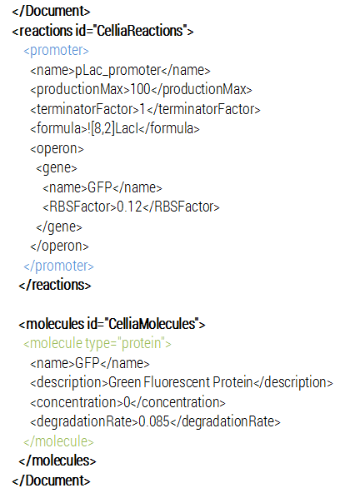
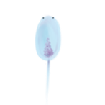
Gameplay loops
EASY
Play with ‘devices’

Slide 9
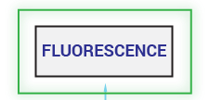
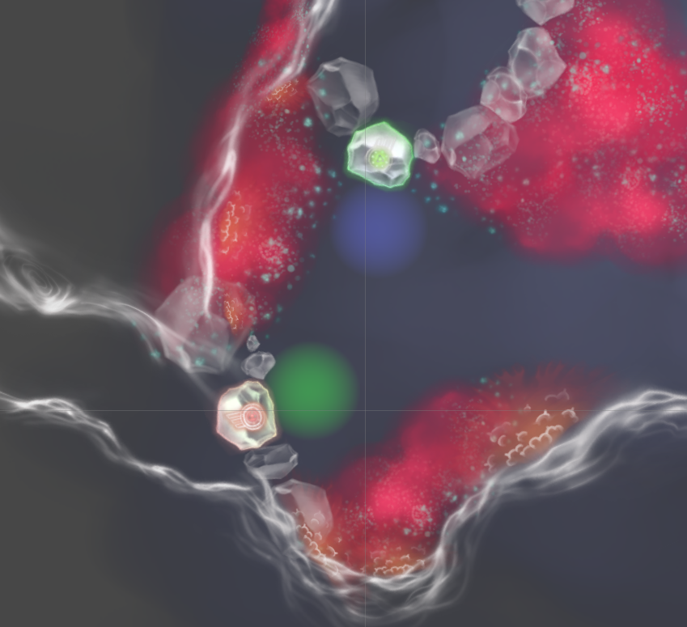
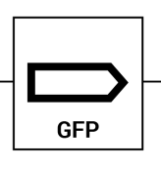
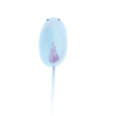
Gameplay loops
MEDIUM
Play with ‘BioBricks’
Craft new device
‘Biobrick’ picked up:
Gene to produce the Red Fluorescent Protein
RFP

Slide 10
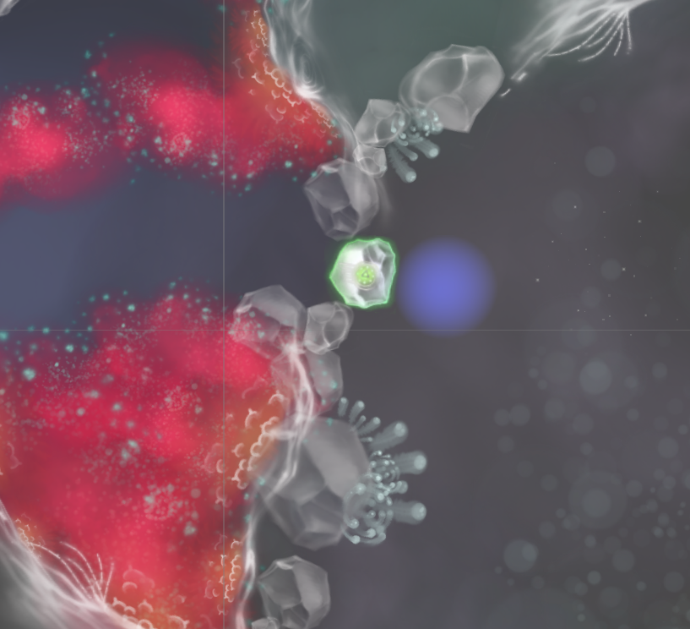
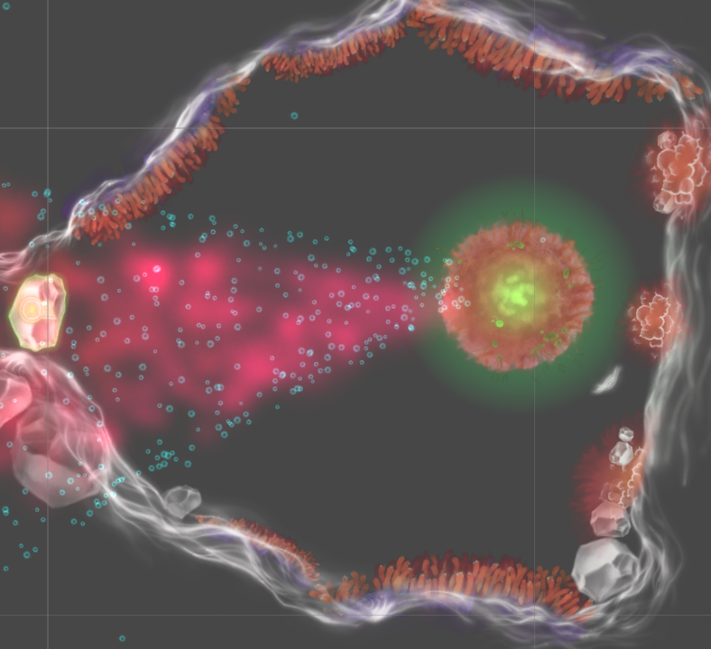
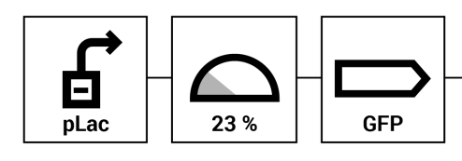
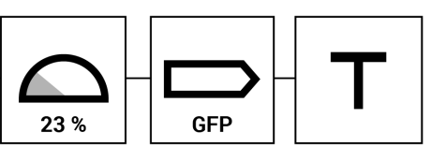
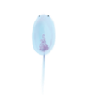
Gameplay loops
HARD
Create synergies between ‘devices’
Craft complex devices to create genetic networks
RFP
TetR
aTc
pTet
AmpR
LacI
Bi-stable switch between RFP and Ampicillin Resistance
IPTG

Slide 11
CONCLUSION

Slide 12
Ero.coli: results
IGAM4ER competition
'Best design' award
'Audience choice' award

Slide 13
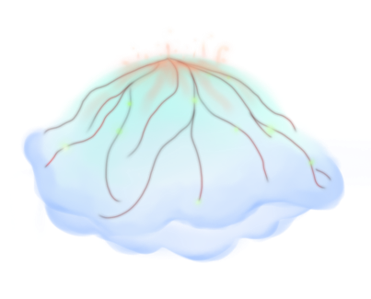
Ero.coli: prospects
Short term
‘Proof of concept’ demo
Polish
Test
Long haul
Crowd-sourcing
Real-Lab experiments
Multiplayer
Learning tool for MOOCS
Collaborations
Simulation tool

Slide 14
visit dsynbio.com
@dsynbio #fosdem to ask questions

